Slide 1
Introduction to Computational and Algorithmic Thinking
Lecture 5 – Iteration, Lists, and Algorithm design

Slide 2
Announcements
This lecture: Iteration, Lists, and Algorithm Design
Reading: Read Chapter 3 of Conery
Acknowledgement: Some of the lecture slides are based on CSE 101 lecture notes by Prof. Kevin McDonald at SBU and the textbook by John Conery.

Slide 3
The Sieve of Eratosthenes
As a motivating example of studying (i) iteration (code that repeats a list of steps), (ii) lists, and (iii) the thought process for designing algorithms, we will look at an ancient algorithm for finding prime numbers called the Sieve of Eratosthenes
A prime is a natural number greater than 1 that has no divisors other than 1 and itself
In modern times, prime numbers play an important role in encrypting data, including Internet traffic
Non-prime numbers are called composite numbers
Example primes: 5, 11, 73, 9967, . . .
Example composites: 10 (2x5), 99 (3x3x11)

Slide 4
The Sieve of Eratosthenes
The basic idea of the algorithm is simple. Below, it is briefly described in pseudocode:
make a list of numbers, starting with 2
repeat the following steps until done:
the first unmarked number in the list is prime
cross off multiples of the most recent prime
So, first we cross off multiples of 2.
Then, we cross off multiples of 3 that were not crossed off in the first round (e.g., 6 is a multiple of 2 and 3, so it was crossed off in the first round).
Next, we cross off multiples of 5 that were not crossed off in the first two rounds. Note that because 4 is a multiple of 2, all multiples of 4 were crossed off in the first round.

Slide 5
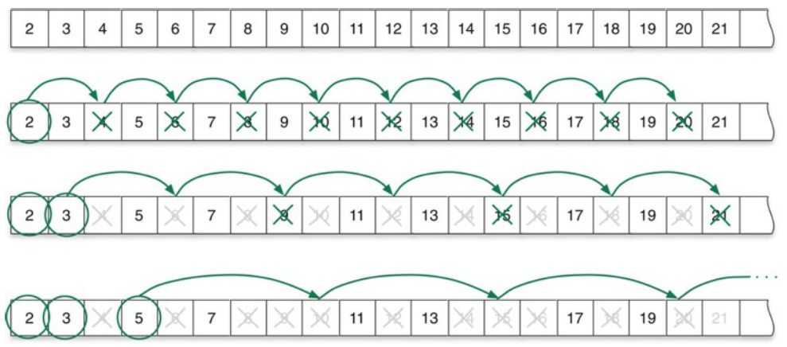
The Sieve of Eratosthenes
The algorithm continues in this fashion until there are no more numbers to cross off
We will explore the stopping condition in more detail later

Slide 6
Devising an algorithm
The method depicted in the previous slide works well for short lists
But what if you want to find prime numbers between 2 and 100? 1000?
It’s a tedious process to write out a list of 100 numbers
It takes a lot of paper to make a list of 1000 numbers
Chances are you will make a few arithmetic mistakes (this is a boring job!)
Can we turn this method into a computation?
Yes, but we need to be more precise about the steps

Slide 7
Devising an algorithm
A detailed specification of the starting condition is there in the pseudocode (e.g., “make a list”)
What about the other steps? “Cross off” and “next number” need to be clearly defined if we’re going to use Python
The stopping condition is not so clear just yet
When do we stop the process? Perhaps when all the numbers are crossed off?
As you’ve probably guessed by now, we will write a program to implement the Sieve of Eratosthenes algorithm
We will need to explore a few new ideas in Python first, however

Slide 8
Collections
In everyday life we often encounter collections of things
Course catalog: a collection of course descriptions
Parking lot: a collection of vehicles
Mathematicians also work with collections
Matrix (a table of numbers)
Sequence (e.g., 1, 1, 2, 3, 5, 8, ...)
In computer science we make a collection by defining a data structure that includes references to objects
The term object simply means generic piece of data
Objects include numbers, strings, dates, and others
Using programming terminology, a container is an object that contains other objects

Slide 9
Lists
The simplest kind of container in Python is called a list
One way to make a list is to enclose a set of objects in square brackets:
ages = [61, 32, 19, 37, 42, 39]
The above statement is an assignment statement, actually
Python allocates space in its object store, which is a fancy term for a particular section in the memory of the computer
Python creates an object to represent the list and associates the name ages with the new object
The len function tells us how many elements are in a list:
len(ages) # returns the value 6

Slide 10
Lists of strings
Any kind of object can be stored in a list
This statement defines a list with three strings:
breakfast = ['green eggs', 'ham', 'toast']
Note what happens when we ask Python how many objects are in this list:
len(breakfast) # returns the value 3
Python did not count the individual letters with a list
cf. len(‘apple’) returns 5 # with a string, it counts the individual letters
The list contains three string objects, so the return value of the call to len is 3

Slide 11
Empty lists
We can also make a list with no objects:
cars = []
The value on the right side of that expression is a valid list
An empty list is still a list, even though it contains no objects
A bag with nothing in it is still a bag, even though it contains nothing in it.
The length of an empty list is 0
len(cars) # returns the value 0
It may seem strange to create a list with nothing in it, but usually we do so because we need to wait until later to fill in the contents

Slide 12
Iteration
After building a container, we often want to do something with each item in it
The idea is to “step through” the container to “visit” each object
This type of operation is called iteration
From the Latin word iter, for “path” or “road”
For example, to find the largest item in an (unsorted) list, an algorithm would need to visit every item during its search
We’ll look at this algorithm a little later

Slide 13
for-loops
The simplest way to “visit” every item in a list is to use a for-loop
This example prints every item in the list cars :
for car in cars: # "for each car in cars"
print(car)
Note that the statements inside a for-loop – the body of the loop – must be indented
Python assigns car to be the first item in the list and then executes the indented statement(s)
Then it gets the next item, assigns it to car, and executes the indented statement(s) again
It repeats until all the items in list have been processed

Slide 14
for-loops
Suppose we had this code:
cars = ['Kia', 'Honda', 'Toyota', 'Ford']
for car in cars:
print(car + ' ' + str(len(car)))
The for-loop would output this:
Kia 3
Honda 5
Toyota 6
Ford 4
Note that len(car) gives the length of each car string in the list as we “visit” that car
len(cars) would give what?

Slide 15
Example: sum()
Consider a function that computes the sum of the numbers in a list
Such a function exists in Python (it’s called sum()), but let’s write our own so we can understand for-loops better
First, we’ll initialize a variable total to zero
Then, a for-loop will add each number in the list to total
The statement total += num means “add num to the value of total”
An alternative way of writing this would be
total = total + num
After all items have been added, the loop will terminate, and the function returns the final value of total

Slide 16
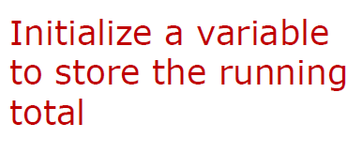
Example: sum()
def sum(nums):
total = 0
for num in nums:
total += num
return total
Example:
t = sum([3, 5, 1]) # t will equal 9
See sum_tests.py

Slide 17
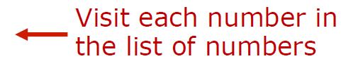
Example: sum()
def sum(nums):
total = 0
for num in nums:
total += num
return total
Example:
t = sum([3, 5, 1]) # t will equal 9

Slide 18

Example: sum()
def sum(nums):
total = 0
for num in nums:
total += num
return total
Example:
t = sum([3, 5, 1]) # t will equal 9

Slide 19
Example: sum()
def sum(nums):
total = 0
for num in nums:
total += num
return total
Example:
t = sum([3, 5, 1]) # t will equal 9

Slide 20
Example: sum()
Let’s trace the execution of this code to understand it better
A red arrow will indicate the current line of code we are executing
A table of values will show how the variables change value over time

Slide 21
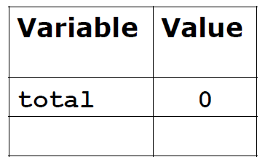

Trace execution: sum()
def sum(nums):
total = 0
for num in nums:
total += num
return total
Example:
t = sum([3, 5, 1]) # t will equal 9

Slide 22
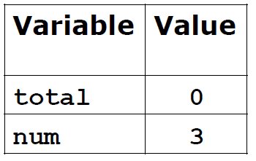

Trace execution: sum()
def sum(nums):
total = 0
for num in nums:
total += num
return total
Example:
t = sum([3, 5, 1]) # t will equal 9

Slide 23
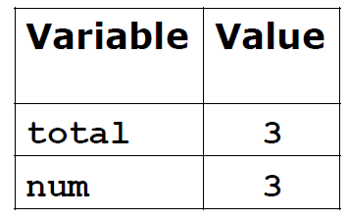

Trace execution: sum()
def sum(nums):
total = 0
for num in nums:
total += num
return total
Example:
t = sum([3, 5, 1]) # t will equal 9

Slide 24


Trace execution: sum()
def sum(nums):
total = 0
for num in nums:
total += num
return total
Example:
t = sum([3, 5, 1]) # t will equal 9

Slide 25

Trace execution: sum()
def sum(nums):
total = 0
for num in nums:
total += num
return total
Example:
t = sum([3, 5, 1]) # t will equal 9

Slide 26


Trace execution: sum()
def sum(nums):
total = 0
for num in nums:
total += num
return total
Example:
t = sum([3, 5, 1]) # t will equal 9

Slide 27


Trace execution: sum()
def sum(nums):
total = 0
for num in nums:
total += num
return total
Example:
t = sum([3, 5, 1]) # t will equal 9

Slide 28

Trace execution: sum()
def sum(nums):
total = 0
for num in nums:
total += num
return total
Example:
t = sum([3, 5, 1]) # t will equal 9

Slide 29
Trace execution in PyCharm
PyCharm features a powerful tool called a debugger which can help you trace the execution of your program
Usually we use a debugger to help find bugs
First we will set a breakpoint by clicking the mouse to the left of the line where we want the computer to pause execution
In sum_tests.py let’s put a breakpoint on line 11

Slide 30
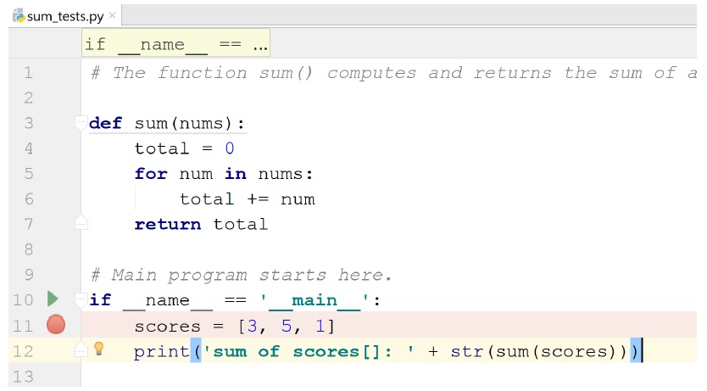
Trace execution in PyCharm
When we tell the computer to run the program, it will stop at that line and not execute it until we tell it to
When you first try the debugger, PyCharm may ask you to install some updates. Do them.

Slide 31
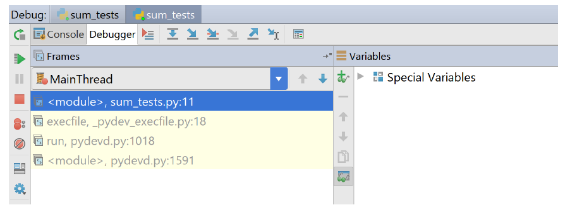
Trace execution in PyCharm
To begin execution, right-click on sum_tests.py and pick “Debug ‘sum_tests’”. The computer stops at line 11.
A “Debugger” panel opens
On the right we see a sub-panel named “Variables” that will show the values of variables as our program runs

Slide 32
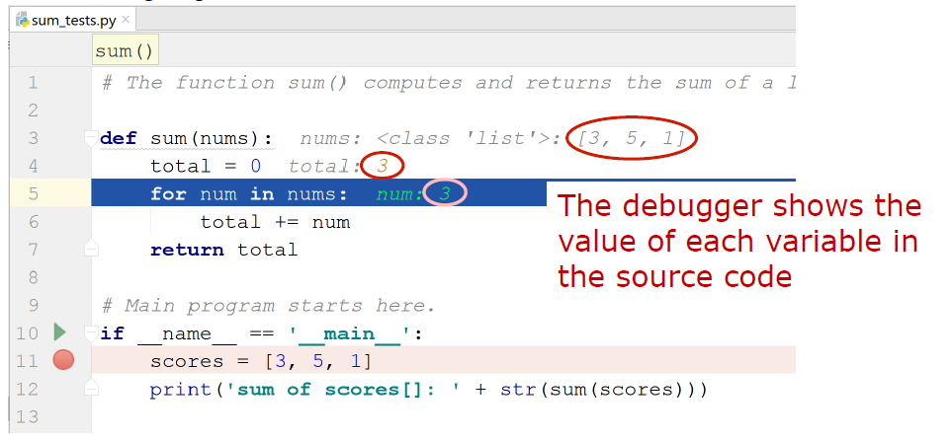
Trace execution in PyCharm
Every time we hit the green arrow (Resume Program button) PyCharm will execute another line of code
PyCharm highlights in blue what line it will execute next

Slide 33
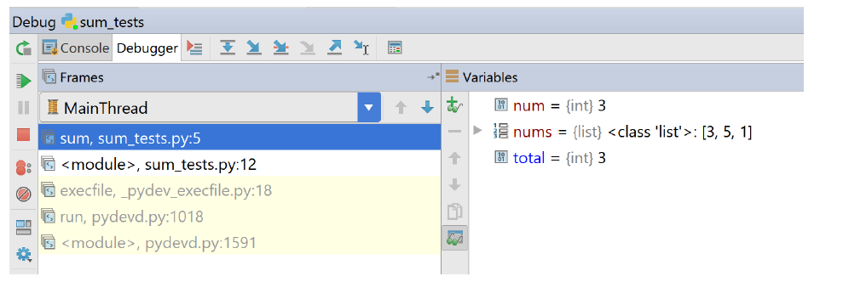
Trace execution in PyCharm
Here’s the state of the program after hitting the green arrow several
times:
. In lab you will practice using the debugger – getting familiar with this
tool will save you hours of headaches later on

Slide 34
List indexes
We often need an item in the middle of a list
If a list has n item, the locations in the list are numbered from 0 to n-1 (not 1 through n)
The notation a[i] stands for “the item at location I in list a”
a[i] is said aloud as “a sub I”
In programming, we use the word index to refer to the numerical position of an element in a list
Example: scores = [89, 78, 92, 63, 92]
scores[0] is 89
scores[2] is 92
scores[5] gives an “index out of range” error (why?)

Slide 35
List indexes
The index method will tell us the position of an element in a list
If the requested element is not in the list, the Python interpreter will generate an error
Example: scores = [89, 78, 92, 63, 92]
scores.index(92) is 2, the index of the first occurrence of 92 in the scores list
scores.index(99) generates this error: “ValueError: 99 is not in list”

Slide 36
List indexes
If your program needs the index of a value, and you’re not sure if the value is in the list, use an if-statement in conjunction with the in operator to first make sure the item is actually in the list
Example:
vowels = ['a', 'e', 'i', 'o', 'u']
letter = 'e'
if letter in vowels:
print('That letter is at index ‘ +
str(vowels.index(letter)) + '.')
else:
print('That letter is not in the list.')
Output for this example: That letter is at index 1.

Slide 37
Iteration using list indexes
A common programming “idiom” uses a for-loop based on a list index:
for i in range(n):
# do something with i
range(n) means “the sequence of integers starting from zero and ranging up to, but not including, n”
Python executes the body of the loop n times
i is set to every value between 0 and n-1 (i.e., n is not included)
For example, the partial_total function on the next slide computes and returns the sum of the first k values in a list (see sieve.py)

Slide 38
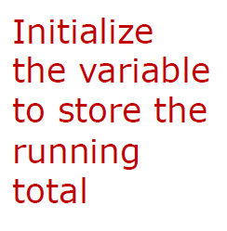
Iteration using list indexes
This function computes and returns the sum of the first k values in a
list
def partial_total(nums, k):
total = 0
for i in range(k):
total += nums[i]
return total
Example:
a = [4, 2, 8, 3, 1]
partial_total(a, 3) # returns the value 14
partial_total(a, 1) # returns the value 4
partial_total(a, 6) # error

Slide 39
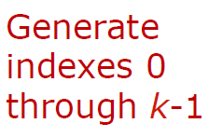

Iteration using list indexes
This function computes and returns the sum of the first k values in a
list
def partial_total(nums, k):
total = 0
for i in range(k):
total += nums[i]
return total
Example:
a = [4, 2, 8, 3, 1]
partial_total(a, 3) # returns the value 14
partial_total(a, 1) # returns the value 4
partial_total(a, 6) # error

Slide 40
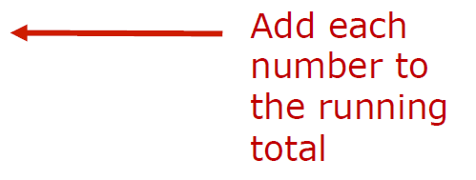
Iteration using list indexes
This function computes and returns the sum of the first k values in a
list
def partial_total(nums, k):
total = 0
for i in range(k):
total += nums[i]
return total
Example:
a = [4, 2, 8, 3, 1]
partial_total(a, 3) # returns the value 14
partial_total(a, 1) # returns the value 4
partial_total(a, 6) # error

Slide 41

Iteration using list indexes
This function computes and returns the sum of the first k values in a
list
def partial_total(nums, k):
total = 0
for i in range(k):
total += nums[i]
return total
Example:
a = [4, 2, 8, 3, 1]
partial_total(a, 3) # returns the value 14
partial_total(a, 1) # returns the value 4
partial_total(a, 6) # error

Slide 42

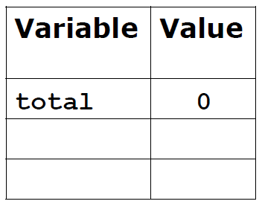
Iteration using list indexes
Let’s trace the execution of this function for one example
def partial_total(nums, k):
total = 0
for i in range(k):
total += nums[i]
return total
Example:
a = [4, 2, 8, 3, 1]
partial_total(a, 3) # returns the value 14

Slide 43
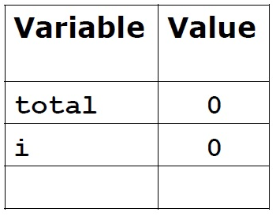
Iteration using list indexes
Let’s trace the execution of this function for one example
def partial_total(nums, k):
total = 0
for i in range(k):
total += nums[i]
return total
Example:
a = [4, 2, 8, 3, 1]
partial_total(a, 3) # returns the value 14

Slide 44


Iteration using list indexes
Let’s trace the execution of this function for one example
def partial_total(nums, k):
total = 0
for i in range(k):
total += nums[i]
return total
Example:
a = [4, 2, 8, 3, 1]
partial_total(a, 3) # returns the value 14

Slide 45

Iteration using list indexes
Let’s trace the execution of this function for one example
def partial_total(nums, k):
total = 0
for i in range(k):
total += nums[i]
return total
Example:
a = [4, 2, 8, 3, 1]
partial_total(a, 3) # returns the value 14

Slide 46

Iteration using list indexes
Let’s trace the execution of this function for one example
def partial_total(nums, k):
total = 0
for i in range(k):
total += nums[i]
return total
Example:
a = [4, 2, 8, 3, 1]
partial_total(a, 3) # returns the value 14

Slide 47

Iteration using list indexes
Let’s trace the execution of this function for one example
def partial_total(nums, k):
total = 0
for i in range(k):
total += nums[i]
return total
Example:
a = [4, 2, 8, 3, 1]
partial_total(a, 3) # returns the value 14

Slide 48

Iteration using list indexes
Let’s trace the execution of this function for one example
def partial_total(nums, k):
total = 0
for i in range(k):
total += nums[i]
return total
Example:
a = [4, 2, 8, 3, 1]
partial_total(a, 3) # returns the value 14

Slide 49
Iteration using list indexes
Let’s trace the execution of this function for one example
def partial_total(nums, k):
total = 0
for i in range(k):
total += nums[i]
return total
Example:
a = [4, 2, 8, 3, 1]
partial_total(a, 3) # returns the value 14

Slide 50
String indexes
Strings and lists have much in common, including indexing
Notation like name[i] would give us the character at index i of the string name, just as nums[i] gives us the element at index i of the list nums
Examples:
title = 'Lord of the Rings'
print(title[0]) # prints L
print(title[6]) # prints f
j = 10
print(title[j]) # prints e

Slide 51
Making lists of numbers
The range function can be used to make a list of integers
This example makes a list of the numbers from 0 to 9:
nums = list(range(10))
Note that list is the name of a class in Python
A class describes what kinds of data an object can store
In general, if we use a class name as a function, Python will create an object of that class
These functions are called constructors because they construct new objects
More on this topic later in the course

Slide 52
Back to the Sieve algorithm
We now have all the pieces we need to make a list of prime numbers
We will use a Python list object to represent a “worksheet” of numbers that we will progressively cross off
It will initially have all the integers from 2 to n (the upper limit)
We will use for-loops to iterate over the list to cross off composite numbers
If we pass two values to range, it uses one as the lower limit and the other as the upper limit (minus 1)
For example, to make a list of numbers between 2 and 99 we would type list(range(2, 100))

Slide 53
Back to the Sieve algorithm
The steps of the algorithm are easier to explain if we add two “placeholder” values at the front of the list to represent 0 and 1 (neither of which is a prime number)
Python has a special value called None that stands for “no object”
Since the expression a + b means “concatenate a and b” where a and b are lists, the statement below creates the initial worksheet:
worksheet = [None, None] + list(range(2,100))
With the two placeholders at the front, we now know any number I will be at worksheet[i]
For example, the number 5 will be at worksheet[5] instead of worksheet[3]

Slide 54
PythonLabs
PythonLabs is a set of Python modules developed for the course textbook
PythonLabs homepage: http://ix.cs.uoregon.edu/~conery/eic/python/index.html
Installation instructions: http://ix.cs.uoregon.edu/~conery/eic/python/installation.html

Slide 55
SieveLab
The module for the Sieve algorithm is named SieveLab
SieveLab has:
A complete implementation of a sieve function for finding prime numbers
Functions that use algorithm animation to generate graphical displays to show how the algorithm works
In PyCharm, right-click on the Examples folder and select the menu option “Mark Directory as” and choose “Sources Root”

Slide 56
SieveLab
Below you can see an example of how to use the SieveLab module
import PythonLabs.SieveLab
worksheet = [None, None] + list(range(2, 400))
PythonLabs.SieveLab.view_sieve(worksheet)
We can call a SieveLab function named mark_multiples to see how the algorithm removes multiples of a specified value
The two arguments to mark_multiples are a number k and the worksheet list
The screen will be updated to show that k is prime (indicated by a blue square)
Gray boxes will be drawn over all the multiples of k

Slide 57
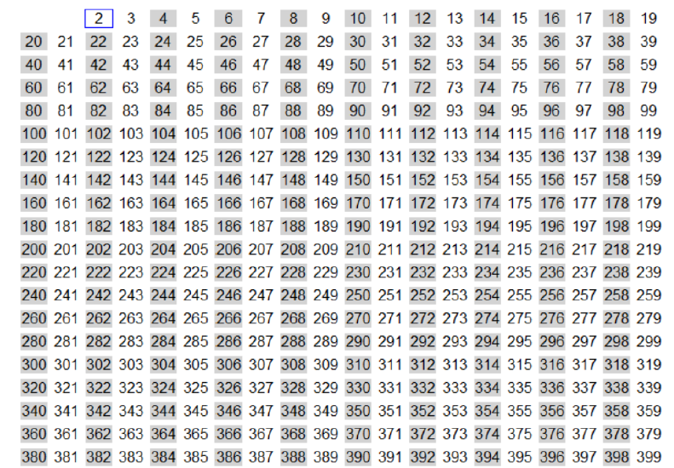
SieveLab
PythonLabs.SieveLab.mark_multiples(2, worksheet):

Slide 58
SieveLab
We can call SieveLab’s erase_multiples function to erase the marked numbers
Let’s erase the multiples of 2 using this function

Slide 59
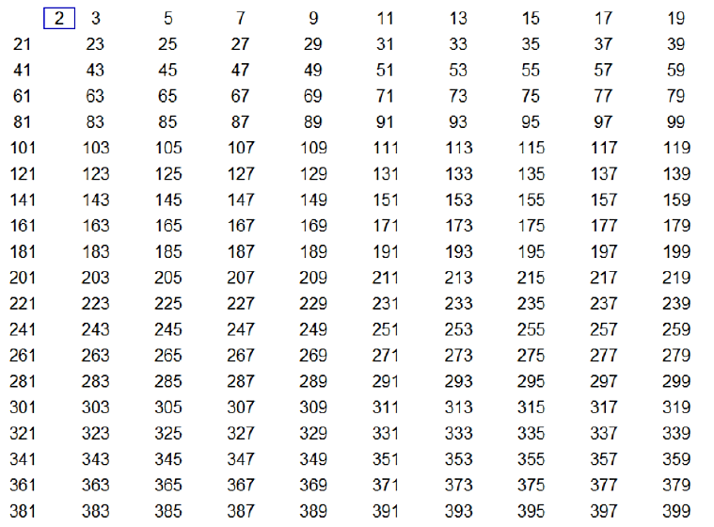
SieveLab
PythonLabs.SieveLab.erase_multiples(2, worksheet):

Slide 60
SieveLab
After erasing multiples of 2, the lowest unmarked number is 3, so on the next round we will remove multiples of 3
We repeat the “marking” and “erasing” steps until only prime numbers are left
Let’s see what this process looks like for marking and erasing multiples of 3, 5 and 7

Slide 61
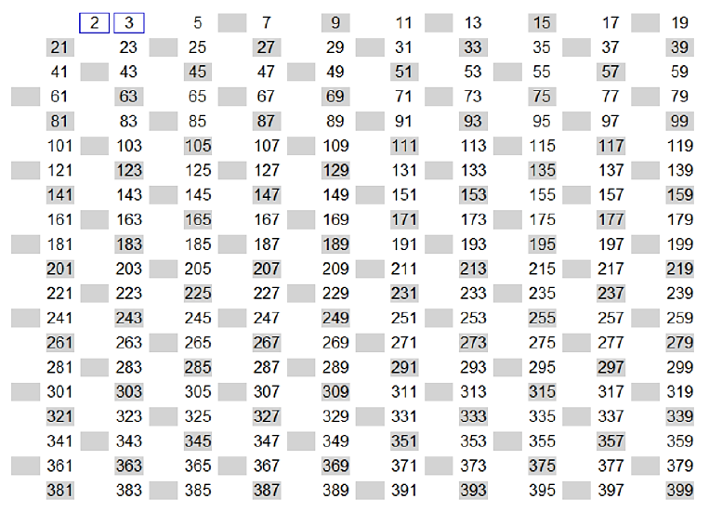
SieveLab
PythonLabs.SieveLab.mark_multiples(3, worksheet):

Slide 62
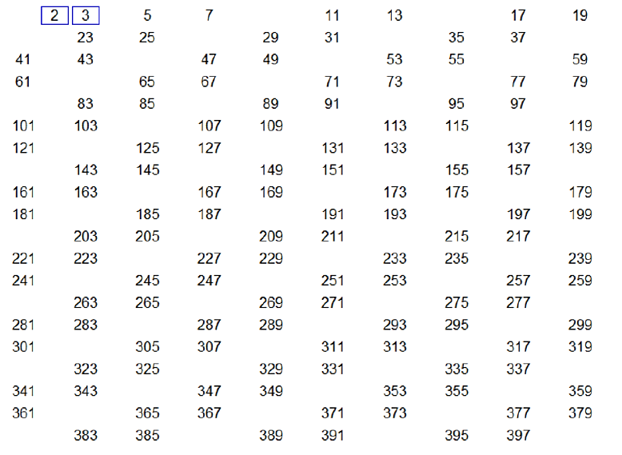
SieveLab
PythonLabs.SieveLab.erase_multiples(3, worksheet):

Slide 63
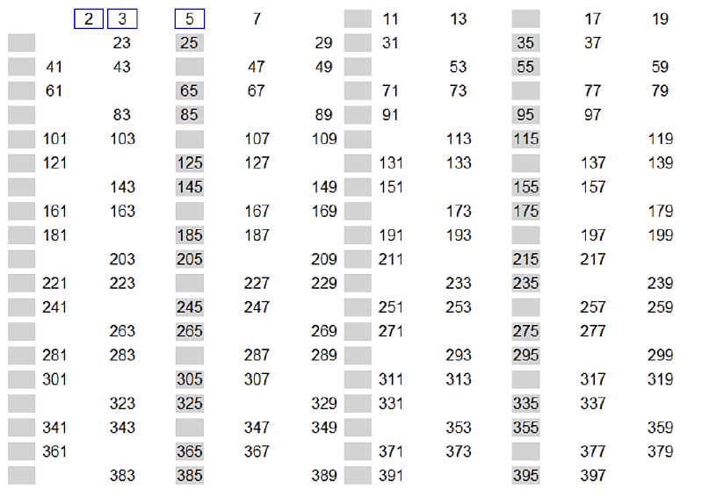
SieveLab
PythonLabs.SieveLab.mark_multiples(5, worksheet):

Slide 64
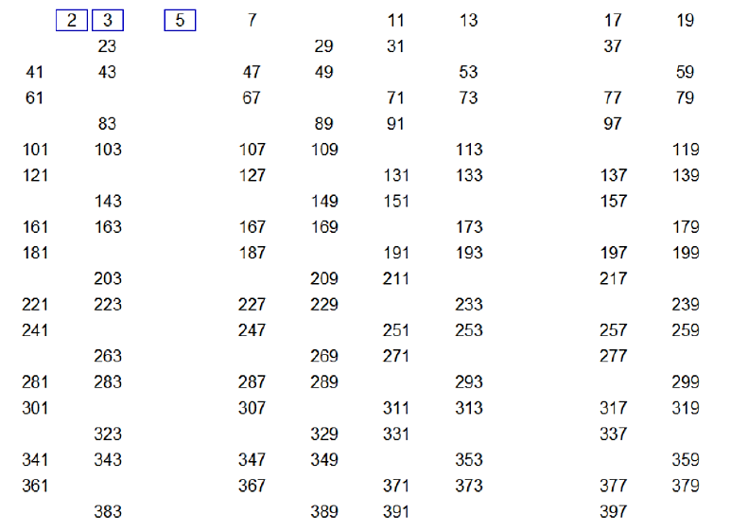
SieveLab
PythonLabs.SieveLab.erase_multiples(5, worksheet):

Slide 65
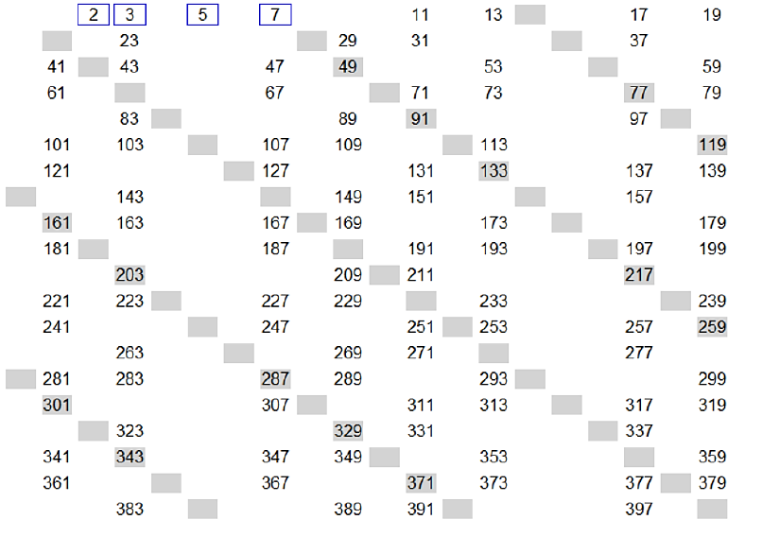
SieveLab
PythonLabs.SieveLab.mark_multiples(7, worksheet):

Slide 66
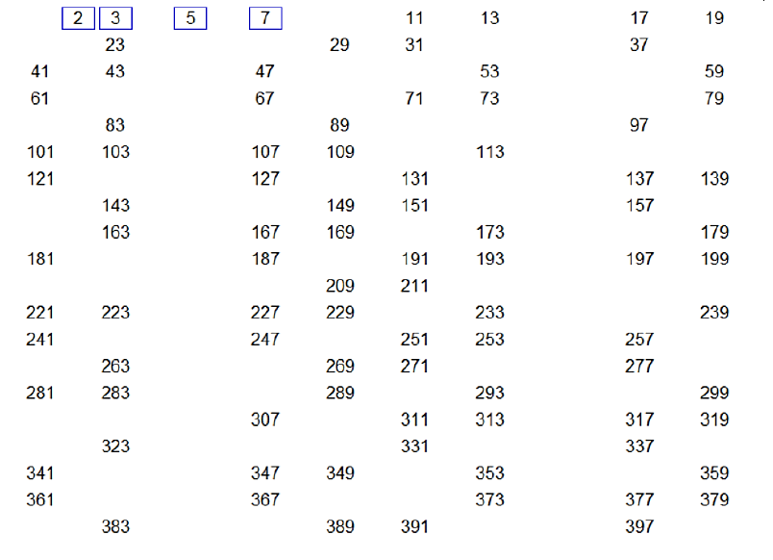
SieveLab
PythonLabs.SieveLab.erase_multiples(7, worksheet):

Slide 67
Sieve algorithm: a helper function
An important step toward implementing the Sieve algorithm is to write a function that solves a small part of the problem
The function sift will make a single pass through the worksheet
Pass it a number k, and sift will find and remove multiples of k
For example, to sift out multiples of 5 from the list called worksheet we would type this: sift(5, worksheet)
sift has a very specific purpose, and it is unlikely to be used except as part of an implementation of the Sieve algorithm
Programmers call special-purpose functions like this helper Functions

Slide 68
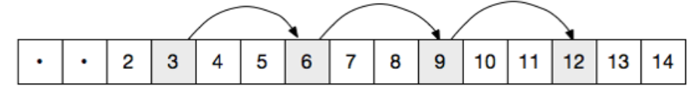
Stepping through the worksheet
On each call to sift we want to find multiples of k
The first one is 2xk
Notice that the remaining multiples (3xk, 4xk, etc) are all k steps apart:
We can use a for-loop with a range expression to walk through the list:
for i in range (2*k, len(a), k):
Note this range expression has three arguments: the starting point, the ending point, and the step size (k)

Slide 69
Stepping through the worksheet
If we want to remove a number from the worksheet, we could use the Python del statement, which deletes an item from a list
But this would shorten the list and make it harder to walk through on future iterations
Our solution: replace the items with placeholders (None objects)
The complete implementation of the sift function:
def sift(k, a):
for i in range(2*k, len(a), k):
a[i] = None

Slide 70
Stepping through the worksheet
def sift(k, a):
for i in range(2*k, len(a), k):
a[i] = None
An example of sift in action:
worksheet = [None, None] + list(range(2, 16))
worksheet is now:
[None, None, 2, 3, 4, 5, 6, 7, 8, 9, 10, 11, 12, 13, 14, 15]
Now call sift(2, worksheet)
worksheet becomes this:
[None, None, 2, 3, None, 5, None, 7, None, 9, None, 11, None, 13, None, 15]

Slide 71
The sieve() function
Now that we have a helper function to do the hard work, writing the sieve function is straightforward
When a program has helpers, a function like sieve (which is called to solve the complete problem) is known as a top-level function
We have to write a loop that starts by sifting multiples of 2 and keep calling sift until all composite numbers are removed
This loop can stop when the next number to send to sift is greater than the square root of n
The for-loop that controls the loop should set k to every value from 2 up to the square root (why?) of n:
for k in range(2, sqrt(n))

Slide 72
The sieve() function
for k in range(2, sqrt(n))
There is a problem with this code: we cannot pass a floating-point value to range
If we “round up” the square root, we’ll have what we want: an integer that is greater than the highest possible prime factor of n
A function named ceil in Python’s math library does this operation
ceil is short for “ceiling”
A corresponding function named floor rounds a floating-point value down to the nearest integer

Slide 73
sieve()’s main loop
One important detail: before sifting out multiples of a number, we make sure we haven’t already removed it
For example, we don’t sift multiples of 4 because 4 was already removed when sifting multiples of 2
sift would still work, but our program would be less efficient
The main loop looks like this:
for k in range(2, ceil(sqrt(n))):
if worksheet[k] is not None:
sift(k, worksheet)
Note that the expression x is not None is the preferred way of testing to see if x is a reference to the None object

Slide 74
Sieve: remove the placeholders
There is just one last step: to make the final list we have to remove the None objects from the worksheet
A new helper function called non_nulls returns a copy of the worksheet, but without any None objects
It makes an initial empty list named res (for “result”)
Then it uses a for loop to look at every item in the input list
If an item is not None, the item is appended to res using the append method for lists
When the iteration is complete, res is returned as the result of the
function call

Slide 75

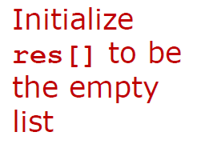
Sieve: remove the placeholders
def non_nulls(a):
res = []
for x in a:
if x is not None:
res.append(x)
return res
Example:
worksheet = [None, None, 2, 3, None, 5, None, 7, None, None,
None, 11, None, 13, None, None]
worksheet = non_nulls(worksheet)
worksheet is now: [2, 3, 5, 7, 11, 13]

Slide 76
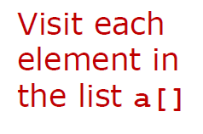

Sieve: remove the placeholders
def non_nulls(a):
res = []
for x in a:
if x is not None:
res.append(x)
return res
Example:
worksheet = [None, None, 2, 3, None, 5, None, 7, None, None,
None, 11, None, 13, None, None]
worksheet = non_nulls(worksheet)
worksheet is now: [2, 3, 5, 7, 11, 13]

Slide 77
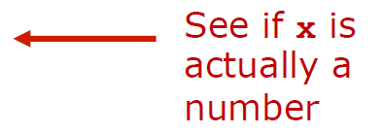
Sieve: remove the placeholders
def non_nulls(a):
res = []
for x in a:
if x is not None:
res.append(x)
return res
Example:
worksheet = [None, None, 2, 3, None, 5, None, 7, None, None,
None, 11, None, 13, None, None]
worksheet = non_nulls(worksheet)
worksheet is now: [2, 3, 5, 7, 11, 13]

Slide 78
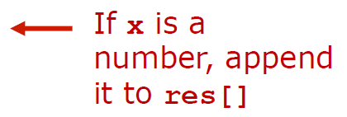
Sieve: remove the placeholders
def non_nulls(a):
res = []
for x in a:
if x is not None:
res.append(x)
return res
Example:
worksheet = [None, None, 2, 3, None, 5, None, 7, None, None,
None, 11, None, 13, None, None]
worksheet = non_nulls(worksheet)
worksheet is now: [2, 3, 5, 7, 11, 13]

Slide 79
Aside: appending to a List
+= can be used to concatenate one string to the end of another
This syntax can also be used to append one list to another
Example:
fruits = ['apple', 'orange’]
fruits += ['banana', 'mango', 'pear’]
fruits is now: ['apple', 'orange’,
'banana', 'mango', 'pear']
fruits += ['pineapple']
fruits is now: ['apple', 'orange’,
‘banana', 'mango', 'pear’,
'pineapple’]

Slide 80
The Sieve algorithm: completed!
We can now put all the pieces together
Import the math library to get access to sqrt and ceil
In the body of the sieve function we need to:
Create the worksheet with two initial None objects and all integers from 2 to n
Add the for-loop that calls sift
Call non_nulls to remove the None objects from the worksheet
See sieve.py and the next slide for the code
See PythonLabs/SieveLab.py: lines 12–28 for the textbook’s implementation of the sieve function
Run sieve_visualization.py to see it in action

Slide 81
Completed sieve() function
from math import
*
def sift(k, a):
... # see earlier slides
def non_nulls(a):
... # see earlier slides
def sieve(n):
worksheet = [None, None] + list(range(2, n))
for k in range(2, ceil(sqrt(n))):
if worksheet[k] is not None:
sift(k, worksheet)
return non_nulls(worksheet)
primes = sieve(100)
print(primes)
See sieve.py

Slide 82
Abstraction
Now that we have a function for making lists of prime numbers we can save it for later use
We can use it to answer questions about primes
How many primes are less than n?
What is the largest gap between successive primes?
What are some twin primes (two prime numbers that differ only by 2, like 17 and 19)?
Many other questions are possible.
This is a good example of abstraction: we have a nice, neat package that we can save and reuse
In the future, we don’t have to worry about the implementation details of sieve: we can just use it!
We (and people who use it) just need to know that sieve(n) makes a list of prime numbers from 2 to n

Slide 83
Additional examples
We’ll now take a look at some additional examples of how to use for-loops and lists to solve problems in Python

Slide 84
Example: find the maximum
Even though there already exists a function in Python that finds the maximum value in a list (it’s called max), we will write our own algorithm for performing this task
The basic idea is to iterate over the list and keep track of the largest value we have seen up to that point
We begin by taking the value at index 0 as the maximum
We continue with the remainder of the list, comparing the next value with the current maximum and updating the maximum if and when we find a value larger than the current maximum

Slide 85
Example: find_max.py
def find_max(nums):
maximum = nums[0]
for i in range(1, len(nums)):
if nums[i] > maximum:
maximum = nums[i]
return maximum
ages = [20, 16, 22, 30, 17, 24]
max_age = find_max(ages) # max_age will be 30
print('Maximum age: ' + str(max_age))

Slide 86
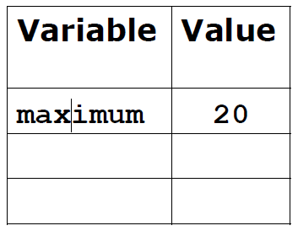

Trace execution: find_max.py
def find_max(nums):
maximum = nums[0]
for i in range(1, len(nums)):
if nums[i] > maximum:
maximum = nums[i]
return maximum
ages = [20, 16, 22, 30, 17, 24]
max_age = find_max(ages) # max_age will be 30
print('Maximum age: ' + str(max_age))

Slide 87
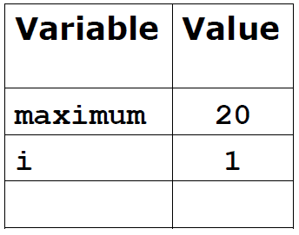
Trace execution: find_max.py
def find_max(nums):
maximum = nums[0]
for i in range(1, len(nums)):
if nums[i] > maximum:
maximum = nums[i]
return maximum
ages = [20, 16, 22, 30, 17, 24]
max_age = find_max(ages) # max_age will be 30
print('Maximum age: ' + str(max_age))

Slide 88
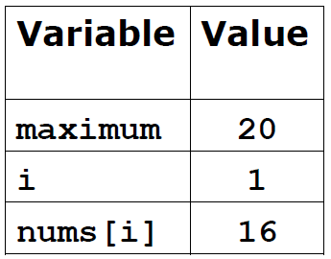
Trace execution: find_max.py
def find_max(nums):
maximum = nums[0]
for i in range(1, len(nums)):
if nums[i] > maximum:
maximum = nums[i]
return maximum
ages = [20, 16, 22, 30, 17, 24]
max_age = find_max(ages) # max_age will be 30
print('Maximum age: ' + str(max_age))

Slide 89
Trace execution: find_max.py
def find_max(nums):
maximum = nums[0]
for i in range(1, len(nums)):
if nums[i] > maximum: # False
maximum = nums[i]
return maximum
ages = [20, 16, 22, 30, 17, 24]
max_age = find_max(ages) # max_age will be 30
print('Maximum age: ' + str(max_age))

Slide 90
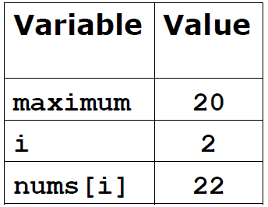
Trace execution: find_max.py
def find_max(nums):
maximum = nums[0]
for i in range(1, len(nums)):
if nums[i] > maximum:
maximum = nums[i]
return maximum
ages = [20, 16, 22, 30, 17, 24]
max_age = find_max(ages) # max_age will be 30
print('Maximum age: ' + str(max_age))

Slide 91
Trace execution: find_max.py
def find_max(nums):
maximum = nums[0]
for i in range(1, len(nums)):
if nums[i] > maximum:
maximum = nums[i]
return maximum
ages = [20, 16, 22, 30, 17, 24]
max_age = find_max(ages) # max_age will be 30
print('Maximum age: ' + str(max_age))

Slide 92
Trace execution: find_max.py
def find_max(nums):
maximum = nums[0]
for i in range(1, len(nums)):
if nums[i] > maximum: # True
maximum = nums[i]
return maximum
ages = [20, 16, 22, 30, 17, 24]
max_age = find_max(ages) # max_age will be 30
print('Maximum age: ' + str(max_age))

Slide 93
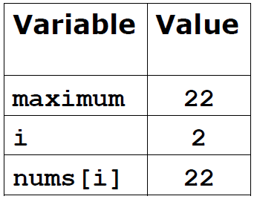
Trace execution: find_max.py
def find_max(nums):
maximum = nums[0]
for i in range(1, len(nums)):
if nums[i] > maximum:
maximum = nums[i]
return maximum
ages = [20, 16, 22, 30, 17, 24]
max_age = find_max(ages) # max_age will be 30
print('Maximum age: ' + str(max_age))

Slide 94
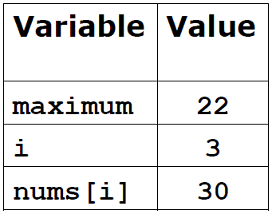
Trace execution: find_max.py
def find_max(nums):
maximum = nums[0]
for i in range(1, len(nums)):
if nums[i] > maximum:
maximum = nums[i]
return maximum
ages = [20, 16, 22, 30, 17, 24]
max_age = find_max(ages) # max_age will be 30
print('Maximum age: ' + str(max_age))

Slide 95
Trace execution: find_max.py
def find_max(nums):
maximum = nums[0]
for i in range(1, len(nums)):
if nums[i] > maximum:
maximum = nums[i]
return maximum
ages = [20, 16, 22, 30, 17, 24]
max_age = find_max(ages) # max_age will be 30
print('Maximum age: ' + str(max_age))

Slide 96
Trace execution: find_max.py
def find_max(nums):
maximum = nums[0]
for i in range(1, len(nums)):
if nums[i] > maximum: # True
maximum = nums[i]
return maximum
ages = [20, 16, 22, 30, 17, 24]
max_age = find_max(ages) # max_age will be 30
print('Maximum age: ' + str(max_age))

Slide 97
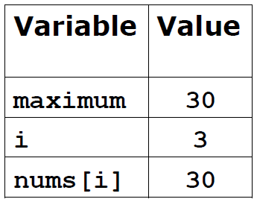
Trace execution: find_max.py
def find_max(nums):
maximum = nums[0]
for i in range(1, len(nums)):
if nums[i] > maximum:
maximum = nums[i]
return maximum
ages = [20, 16, 22, 30, 17, 24]
max_age = find_max(ages) # max_age will be 30
print('Maximum age: ' + str(max_age))

Slide 98
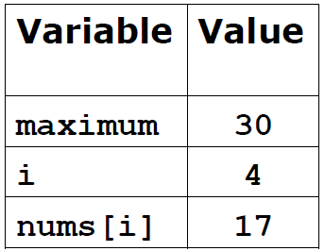
Trace execution: find_max.py
def find_max(nums):
maximum = nums[0]
for i in range(1, len(nums)):
if nums[i] > maximum:
maximum = nums[i]
return maximum
ages = [20, 16, 22, 30, 17, 24]
max_age = find_max(ages) # max_age will be 30
print('Maximum age: ' + str(max_age))

Slide 99
Trace execution: find_max.py
def find_max(nums):
maximum = nums[0]
for i in range(1, len(nums)):
if nums[i] > maximum:
maximum = nums[i]
return maximum
ages = [20, 16, 22, 30, 17, 24]
max_age = find_max(ages) # max_age will be 30
print('Maximum age: ' + str(max_age))

Slide 100
Trace execution: find_max.py
def find_max(nums):
maximum = nums[0]
for i in range(1, len(nums)):
if nums[i] > maximum: # False
maximum = nums[i]
return maximum
ages = [20, 16, 22, 30, 17, 24]
max_age = find_max(ages) # max_age will be 30
print('Maximum age: ' + str(max_age))

Slide 101
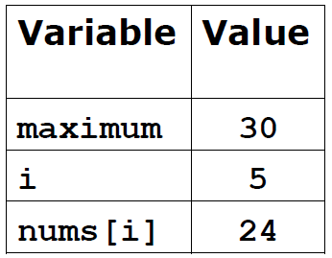
Trace execution: find_max.py
def find_max(nums):
maximum = nums[0]
for i in range(1, len(nums)):
if nums[i] > maximum:
maximum = nums[i]
return maximum
ages = [20, 16, 22, 30, 17, 24]
max_age = find_max(ages) # max_age will be 30
print('Maximum age: ' + str(max_age))

Slide 102
Trace execution: find_max.py
def find_max(nums):
maximum = nums[0]
for i in range(1, len(nums)):
if nums[i] > maximum:
maximum = nums[i]
return maximum
ages = [20, 16, 22, 30, 17, 24]
max_age = find_max(ages) # max_age will be 30
print('Maximum age: ' + str(max_age))

Slide 103
Trace execution: find_max.py
def find_max(nums):
maximum = nums[0]
for i in range(1, len(nums)):
if nums[i] > maximum: # False
maximum = nums[i]
return maximum
ages = [20, 16, 22, 30, 17, 24]
max_age = find_max(ages) # max_age will be 30
print('Maximum age: ' + str(max_age))

Slide 104
Trace execution: find_max.py
def find_max(nums):
maximum = nums[0]
for i in range(1, len(nums)):
if nums[i] > maximum:
maximum = nums[i]
return maximum
ages = [20, 16, 22, 30, 17, 24]
max_age = find_max(ages) # max_age will be 30
print('Maximum age: ' + str(max_age))

Slide 105
Example: count the vowels
A for-loop can be used to iterate over the characters of a string
To see how this works, let’s look a function called count_vowels that counts the number of vowels (lowercase or uppercase) in a word
To make this problem a little easier to solve, we will call the lower() method for strings, which makes a copy of a given string and changes all the uppercase letters to lowercase (upper() makes all letters uppercase)
Strings are immutable (unchangeable) quantities
If we want to convert a string into lowercase, all we can really do is make a lowercase copy of it and then replace the original string with the new one

Slide 106
Example: vowels.py
def count_vowels(word):
vowels = 'aeiou’
num_vowels = 0
for letter in word.lower(): # search through a
if letter in vowels: # lowercase copy of
num_vowels += 1 # the original word
return num_vowels
word = 'Cider'
print('The number of vowels in ' + word + ' is ' +
str(count_vowels(word))) # will print 2

Slide 107
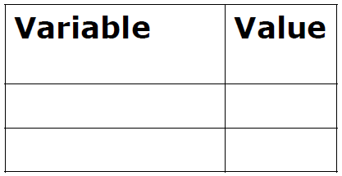
Example: vowels.py
def count_vowels(word):
vowels = 'aeiou’
num_vowels = 0
for letter in word.lower():
if letter in vowels:
num_vowels += 1
return num_vowels
word = 'Cider'
print('The number of vowels in ' + word + ' is ' +
str(count_vowels(word))) # will print 2

Slide 108
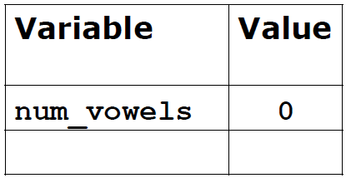
Example: vowels.py
def count_vowels(word):
vowels = 'aeiou’
num_vowels = 0
for letter in word.lower():
if letter in vowels:
num_vowels += 1
return num_vowels
word = 'Cider'
print('The number of vowels in ' + word + ' is ' +
str(count_vowels(word))) # will print 2

Slide 109
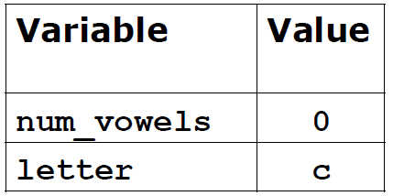
Example: vowels.py
def count_vowels(word):
vowels = 'aeiou’
num_vowels = 0
for letter in word.lower():
if letter in vowels:
num_vowels += 1
return num_vowels
word = 'Cider'
print('The number of vowels in ' + word + ' is ' +
str(count_vowels(word))) # will print 2

Slide 110
Example: vowels.py
def count_vowels(word):
vowels = 'aeiou’
num_vowels = 0
for letter in word.lower():
if letter in vowels:
num_vowels += 1
return num_vowels
word = 'Cider'
print('The number of vowels in ' + word + ' is ' +
str(count_vowels(word))) # will print 2

Slide 111
Example: vowels.py
def count_vowels(word):
vowels = 'aeiou’
num_vowels = 0
for letter in word.lower():
if letter in vowels: # False
num_vowels += 1
return num_vowels
word = 'Cider'
print('The number of vowels in ' + word + ' is ' +
str(count_vowels(word))) # will print 2

Slide 112
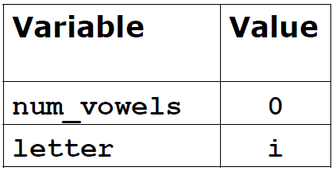
Example: vowels.py
def count_vowels(word):
vowels = 'aeiou’
num_vowels = 0
for letter in word.lower():
if letter in vowels:
num_vowels += 1
return num_vowels
word = 'Cider'
print('The number of vowels in ' + word + ' is ' +
str(count_vowels(word))) # will print 2

Slide 113
Example: vowels.py
def count_vowels(word):
vowels = 'aeiou’
num_vowels = 0
for letter in word.lower():
if letter in vowels:
num_vowels += 1
return num_vowels
word = 'Cider'
print('The number of vowels in ' + word + ' is ' +
str(count_vowels(word))) # will print 2

Slide 114
Example: vowels.py
def count_vowels(word):
vowels = 'aeiou’
num_vowels = 0
for letter in word.lower():
if letter in vowels: # True
num_vowels += 1
return num_vowels
word = 'Cider'
print('The number of vowels in ' + word + ' is ' +
str(count_vowels(word))) # will print 2

Slide 115
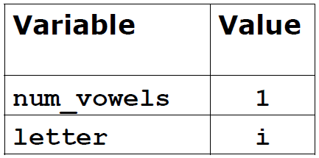
Example: vowels.py
def count_vowels(word):
vowels = 'aeiou’
num_vowels = 0
for letter in word.lower():
if letter in vowels:
num_vowels += 1
return num_vowels
word = 'Cider'
print('The number of vowels in ' + word + ' is ' +
str(count_vowels(word))) # will print 2

Slide 116
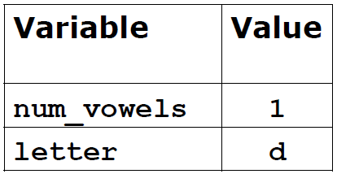
Example: vowels.py
def count_vowels(word):
vowels = 'aeiou’
num_vowels = 0
for letter in word.lower():
if letter in vowels:
num_vowels += 1
return num_vowels
word = 'Cider'
print('The number of vowels in ' + word + ' is ' +
str(count_vowels(word))) # will print 2

Slide 117
Example: vowels.py
def count_vowels(word):
vowels = 'aeiou’
num_vowels = 0
for letter in word.lower():
if letter in vowels:
num_vowels += 1
return num_vowels
word = 'Cider'
print('The number of vowels in ' + word + ' is ' +
str(count_vowels(word))) # will print 2

Slide 118
Example: vowels.py
def count_vowels(word):
vowels = 'aeiou’
num_vowels = 0
for letter in word.lower():
if letter in vowels: # False
num_vowels += 1
return num_vowels
word = 'Cider'
print('The number of vowels in ' + word + ' is ' +
str(count_vowels(word))) # will print 2

Slide 119
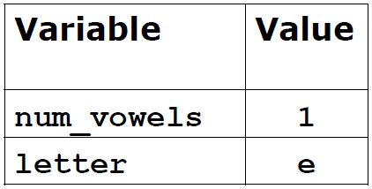
Example: vowels.py
def count_vowels(word):
vowels = 'aeiou’
num_vowels = 0
for letter in word.lower():
if letter in vowels:
num_vowels += 1
return num_vowels
word = 'Cider'
print('The number of vowels in ' + word + ' is ' +
str(count_vowels(word))) # will print 2

Slide 120
Example: vowels.py
def count_vowels(word):
vowels = 'aeiou’
num_vowels = 0
for letter in word.lower():
if letter in vowels:
num_vowels += 1
return num_vowels
word = 'Cider'
print('The number of vowels in ' + word + ' is ' +
str(count_vowels(word))) # will print 2

Slide 121
Example: vowels.py
def count_vowels(word):
vowels = 'aeiou’
num_vowels = 0
for letter in word.lower():
if letter in vowels: # True
num_vowels += 1
return num_vowels
word = 'Cider'
print('The number of vowels in ' + word + ' is ' +
str(count_vowels(word))) # will print 2

Slide 122
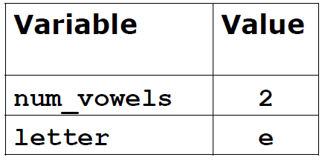
Example: vowels.py
def count_vowels(word):
vowels = 'aeiou’
num_vowels = 0
for letter in word.lower():
if letter in vowels:
num_vowels += 1
return num_vowels
word = 'Cider'
print('The number of vowels in ' + word + ' is ' +
str(count_vowels(word))) # will print 2

Slide 123
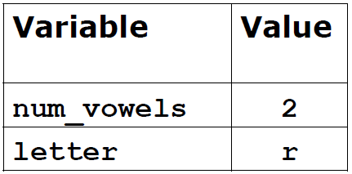
Example: vowels.py
def count_vowels(word):
vowels = 'aeiou’
num_vowels = 0
for letter in word.lower():
if letter in vowels:
num_vowels += 1
return num_vowels
word = 'Cider'
print('The number of vowels in ' + word + ' is ' +
str(count_vowels(word))) # will print 2

Slide 124
Example: vowels.py
def count_vowels(word):
vowels = 'aeiou’
num_vowels = 0
for letter in word.lower():
if letter in vowels:
num_vowels += 1
return num_vowels
word = 'Cider'
print('The number of vowels in ' + word + ' is ' +
str(count_vowels(word))) # will print 2

Slide 125
Example: vowels.py
def count_vowels(word):
vowels = 'aeiou’
num_vowels = 0
for letter in word.lower():
if letter in vowels: # False
num_vowels += 1
return num_vowels
word = 'Cider'
print('The number of vowels in ' + word + ' is ' +
str(count_vowels(word))) # will print 2

Slide 126
Example: vowels.py
def count_vowels(word):
vowels = 'aeiou’
num_vowels = 0
for letter in word.lower():
if letter in vowels:
num_vowels += 1
return num_vowels
word = 'Cider'
print('The number of vowels in ' + word + ' is ' +
str(count_vowels(word))) # will print 2

Slide 127
A list of lists
In Python, a list can contain objects of any type
A list is an object. Therefore, a list can contain other lists!
Imagine that we have a group of 4 students, and for each student we have 3 exam scores:
scores = [[89, 85, 90], [78, 85, 72],
[99, 86, 92], [82, 84, 79]]
To access a particular score, we need to give two indexes: first, which student we are interested in (0 through 3)
Second, which score of that student we are interested in (0 through 2)
Example: scores[3][1] is student 3’s score on exam 1 (which is 84)

Slide 128
Example: compute averages (v1)
Let’s write some code that will compute the average score the students earned on each exam
We will write more than one version of the program, but let’s start things off simply
In the first version we will “hard-code” several values (the number of students and the number of scores) in the program
Then we will generalize things a bit and use variables for these values

Slide 129
Example: averages_v1.py
scores = [[89, 85, 90], [78, 85, 72],
[99, 86, 92], [82, 84, 79]]
averages = [0, 0, 0]
for student in scores:
averages[0] += student[0]
averages[1] += student[1]
averages[2] += student[2]
for i in range(3):
averages[i] /= 4
print(averages)

Slide 130
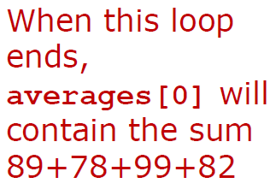
Example: averages_v1.py
scores = [[89, 85, 90], [78, 85, 72],
[99, 86, 92], [82, 84, 79]]
averages = [0, 0, 0]
for student in scores:
averages[0] += student[0]
averages[1] += student[1]
averages[2] += student[2]
for i in range(3):
averages[i] /= 4
print(averages)

Slide 131
Example: averages_v1.py
scores = [[89, 85, 90], [78, 85, 72],
[99, 86, 92], [82, 84, 79]]
averages = [0, 0, 0]
for student in scores:
averages[0] += student[0]
averages[1] += student[1]
averages[2] += student[2]
for i in range(3):
averages[i] /= 4
print(averages)

Slide 132
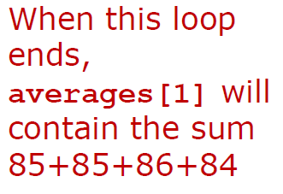
Example: averages_v1.py
scores = [[89, 85, 90], [78, 85, 72],
[99, 86, 92], [82, 84, 79]]
averages = [0, 0, 0]
for student in scores:
averages[0] += student[0]
averages[1] += student[1]
averages[2] += student[2]
for i in range(3):
averages[i] /= 4
print(averages)

Slide 133
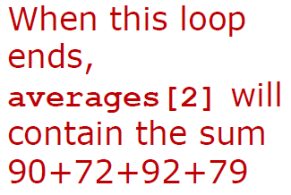
Example: averages_v1.py
scores = [[89, 85, 90], [78, 85, 72],
[99, 86, 92], [82, 84, 79]]
averages = [0, 0, 0]
for student in scores:
averages[0] += student[0]
averages[1] += student[1]
averages[2] += student[2]
for i in range(3):
averages[i] /= 4
print(averages)

Slide 134
Example: compute averages (v2)
The first version of our code has a major negative: the algorithm will work only for a class of four students who took three exams
Suppose we had a larger or smaller class? Or suppose the students took more or fewer exams?
We’ll develop a better (but more complicated) version of the algorithm that can adapt to larger/smaller class sizes and more/fewer exams
Our approach will rely on nested loops, which means we will have one loop inside of another
Nested loops will become increasingly important as we progress through the course

Slide 135
Example: averages_v2.py
One other thing before we look at the program
Recall that syntax like 'Hi'*3 will create a new string by repeating a given string a desired number of times
For instance, 'Hi'*3 equals 'HiHiHi'
In a similar manner, [0]*3 would create a list containing 3 zeroes, namely, [0, 0, 0]
As we can see, the * notation with strings and lists is essentially a form of concatenation

Slide 136
Example: averages_v2.py
scores = [[89, 85, 90], [78, 85, 72], [99, 86, 92],
[82, 84, 79]]
num_students = len(scores)
num_exams = len(scores[0]) # each student took the
averages = [0] * num_exams # same number of exams
for student in scores:
for i in range(0, num_exams): # nested loops
averages[i] += student[i]
for i in range(0, num_exams):
averages[i] /= num_students
print(averages)

Slide 137
Example: compute averages (v3)
In a third and final version of our exam average calculator, we will encapsulate (enclose or wrap) the computations inside of a function compute_averages(students)
The function will take the list of scores as its argument
After computing the exam averages, the function will return a list of the average scores
So we’ll now see that Python functions can return many values at once (via a list), not just a single number or string

Slide 138
Example: averages_v3.py
scores = [[89, 85, 90], [78, 85, 72], [99, 86, 92],
[82, 84, 79]]
def compute_averages(students):
num_students = len(students)
num_exams = len(students[0])
avgs = [0] * num_exams
for student in students:
for i in range(0, num_exams):
avgs[i] += student[i]
for i in range(0, num_exams):
avgs[i] /= num_students
return avgs
averages = compute_averages(scores)
print(averages)

Slide 139
Example: bottles of beer/milk
We’ll conclude the examples on a lighter note by looking at a program that prints the lyrics of the song “99 Bottles of Beer on the Wall”
In this song, the singer needs to count from 99 down to 0
The range command lets us count up, but it also can count down if we give a negative number for the step size
For example, range(10,-1,-1) will count down from 10 to 0 by 1s
So list(range(10,-1,-1)) would generate the list [10, 9, 8, 7, 6, 5, 4, 3, 2, 1, 0]
The code on the next slide asks the user for the starting number so that we can start from a value other than 99

Slide 140
Example: bottles.py
age = int(input('How old are you? ‘))
if age < 21:
drink_type = 'milk'
else:
drink_type = 'beer’;
num_bottles = int(input('How many bottles of ‘ +
drink_type + ' do you have? ‘))
for bottle in range(num_bottles, -1, -1):
if bottle > 1:
print(str(bottle) + ' bottles of ' + drink_type +
' on the wall!’)
elif bottle == 1:
print('1 bottle of ' + drink_type + ' on the wall!’)
else:
print('No bottles of ' + drink_type + ' on the wall!')

Slide 141
Questions?

