Slide 1

Spring 2019 CSE 216 : Programming Abstractions
TOPIC 3 – Data types and Type systems

Slide 2
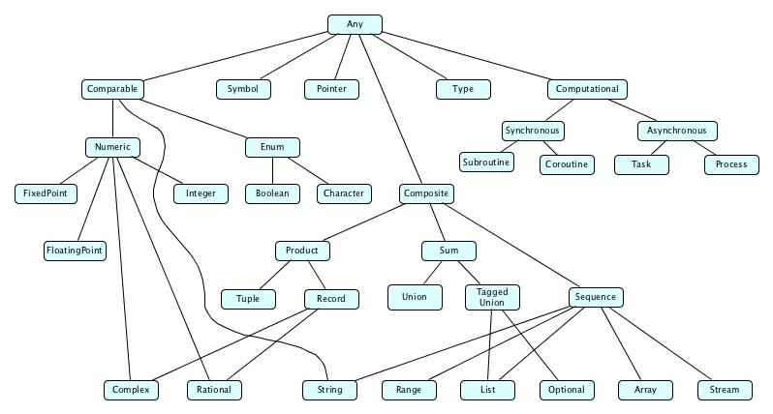
What is a type?
A type consists of set of values and a set of allowable operations.

Slide 3
Classification of Types
What has a type? – Things that have values
Constants, variables, fields, parameters, subroutines, objects
Classification of types:
Constructive: A type is built-in (e.g. Integer, Boolean) or composite (records, arrays).
Denotational: A type is a set or collection of values. (e.g. enum)
Abstraction-based: A type is defined by an interface, the set of operations it supports. (e.g. List)

Slide 4
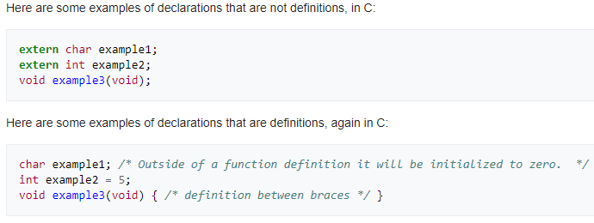
Definition of Types
Defining a type has two parts:
A type’s declaration introduces its name into the current scope.
A type’s definition describes the type (the simpler types it is composed of).

Slide 5
Type System
Mechanism for defining types and associating them with operations that can be performed on objects of each type:
Built-in types with built-in operations
Custom operations for built-in and custom types

Slide 6
Type System
A type system includes rules that specify
Type equivalence: Do two values have the same type? (Structural equivalence vs name equivalence)
Type compatibility: Can a value of a certain type be used in a certain context?
Type inference: How is the type of an expression computed from the types of its parts?

Slide 7
Type Errors
A type error is a program error that results from the incompatible use of differing data types in a program’s construct
int n = "n";
To prevent (or at least discourage) type errors, a programming language puts in rules for type safety.
Type safety contributes to a program’s correctness.
But keep in mind that it does not guarantee complete correctness.
Even if all operations in a program are type safe, there may still be bugs.
E.g., division of one number by another is type safe, but division by zero is unsafe unless the programmer explicitly handles that situation in some other manner.

Slide 8
Type Checking
Type checking is the process of verifying and enforcing the rules of type safety in a program.
This may be done at compile-time, called static typing (and the language is called a statically typed language).
Or, it may be done at runtime, which is known as dynamic typing (and the language is called a dynamically typed language).
Another way to distinguish between the type checking in a language is based on how strongly it enforces the conversion of one data type to another.
If a language generally only allows automatic type conversions that do not lose information, it is called a strongly typed language.
Otherwise, it is called weakly typed.

Slide 9
Common Kinds of Type Systems
Strongly typed
Prohibits the application of an operation to any object not supporting this operation.
Weakly typed
The type of a value depends on how it is used
Statically typed or typed
Strongly typed and type checking is performed at compile time (Pascal, C, Haskell, SML, …)
Dynamically typed or untyped
Strongly typed and type checking is performed at runtime (LISP, Smalltalk, Python, …)

Slide 10
Common Kinds of Type Systems
Programming languages are often classified according to some of the major programming paradigms – procedural, functional, and object oriented.
Within each paradigm, some languages are typed while others are untyped.
Within computer science, “untyped” really means dynamically typed.
That is, a variable or an expression is assigned the type of the corresponding data (i.e., the “value” denoted by the variable or the expression).
Similarly, “typed” typically means statically typed.

Slide 11
Type Systems: Examples
Java is strongly typed, with a non-trivial mix of things that can be checked statically and things that have to be checked dynamically (for instance, for dynamic binding):
String a = 1; //compile-time error
int i = 10.0; //compile-time error
Student s = (Student)(new Object());// runtime
Python is strong dynamic typed:
a = 1;
b = "2";
a + b run-time error
Perl is weak dynamic typed:
$a = 1
$b = "2"
$a + $b no error.

Slide 12
Static and Dynamic Binding in Java
Static binding happens at compile-time while dynamic binding happens at runtime.
Binding of private, static and final methods always happen at compile time since these methods cannot be overridden.
When the method overriding is actually happening and the reference of parent type is assigned to the object of child class type then such binding is resolved during runtime.
Illustrative example

Slide 13
Trade-offs
Strong static type checking (e.g. C)
+ type errors are caught early at compile time
− verbose code
Strong dynamic type checking (e.g. Python)
+ quick prototyping with lesser ‘amount’ of code
− type errors are caught only at runtime
• Weak dynamic type checking (e.g. Perl)
+ least verbose code writing
− type errors are often not caught even at runtime
− unintended program behavior may occur due to implicit type conversion at runtime

Slide 14
Advantages of Type Systems
Documentation/legibility – Typed languages are easier to read and understand since the code itself provides partial documentation of what a variable actually means.
Safety – Typed languages provide early (compile-time) detection of some programming errors, since a type system provides checks for type-incompatible operations.
Efficiency – Typed languages can precisely describe the memory layout of all variables, since every ‘instance’ of an ‘object’ of a certain type will occupy the same amount of space.
Except for dynamically resizing objects like a list.
But even then, we at least know how much memory each ‘cell’ of the list will occupy.
Abstraction – Typed languages force us to be more disciplined programmers. This is especially helpful in the context of large-scale software development.

Slide 15
Type System Rules
A type system has rules for:
type equivalence: when are the types of two values the same?
type compatibility: when can a value of type A be used in a context that expects type B?
type inference: what is the type of an expression, given the types of the operands?
a : int b : int
--------------------
a + b : int

Slide 16
Type Equivalence
The meaning of basic operations such as assignment (denoted by = in C) is specified in a language definition.
Consider the statement:
x = y;
Here the value of object y is copied into the memory locations for variable x.
However, before an operation such as an assignment can be accepted by the translator, usually the types of the two operands must be the same (or perhaps compatible in some other specified way).

Slide 17
Type Equivalence
When do two given expressions have equivalent types?
There are two possible approaches:
1. Name equivalence: two types are equal if and only if they have the same constructor expression (i.e., they are bound to the same name)
2. Structural equivalence: two types are equivalent if and only if they have the same “structure”.

Slide 18
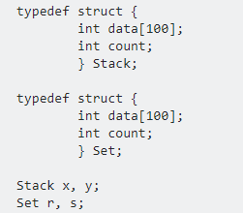
Name Equivalence
Two types are equal if, and only if, they have the same name.
In case of name equivalence, following are valid:
x = y;
r = s;
However, following is invalid:
x = r; 

Slide 19
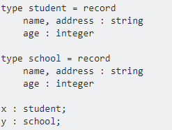
Structural Equivalence
Two types are equal if, and only if, they have the same "structure".
Check equivalence by expanding structures all the way down to basic types
x = y; is valid in structural equivalence
x = y, is not valid in name equivalence 

Slide 20
Structural equivalence
Most languages agree that the format of a declaration should not matter: struct { int b, a; } is the same as the type:
struct {
int a;
int b;
}

Slide 21
Type equivalence
Most modern languages use name equivalence because they assume that
If a programmer has gone through the trouble of repeatedly defining the same structure under different names,
Then s/he probably wants these names to represent different types.

Slide 22
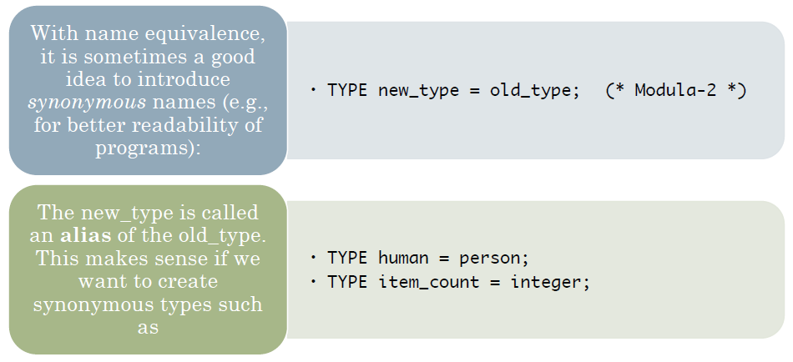
Alias Type

Slide 23
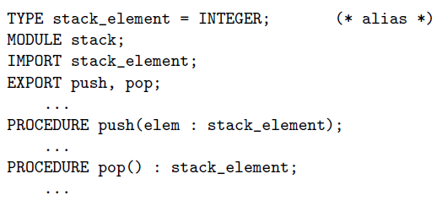
Alias Type
Stack is meant to serve as an abstraction that allows the programmer, to create a stack of any desired type (in this case INTEGER).
If alias types were not considered equivalent, a programmer would have to replace every occurrence of stack_element with INTEGER.

Slide 24
Extern in C
Extern refers to external variables – also known as global variables
Demo: http://tpcg.io/hyELzJ
Further reading: https://www.geeksforgeeks.org/understanding-extern-keyword-in-c/

Slide 25
Type Cast/Coercion
In statically typed languages, usually the values expected in a context must be of a certain type.
E.g., in the assignment statement x := expression, the right-hand side expression is expected to have a type that is equivalent to that of x.
var a : integer; b, c : real; ... c := a + b;
Type coercion refers to automatic, implicit conversion of one type to the expected type.
Type cast refers to explicit type conversion done by a programmer.

Slide 26
Type Coercion Example
Used when you are mixing data types. If you assign a value to a variable that is not the same type as the variable, C++ may do the conversion for you; this is coercion.
int i;
float f;
i = 5.6 // i will be 5
f = 10 // f will be 10.0
f = 5.3 / 2 + 1 // f will be 5.3/2.0 + 1.0
f = 5 / 2 + 4.5 // f will be 6.5
Coercion in JavaScript (Weak dynamically typed language): https://dorey.github.io/JavaScript-Equality-Table/

Slide 27
Type Casting Example
Used when the programmer wants to explicitly convert one data type to another. It shows the programmer's intention as being very clear.
int i;
float f;
i = 5.2 / f; // warning "loss of precision"
i = int(5.2 / f) // no warning but still loss
f = float(3 * i)

Slide 28
Various Data Types Scalar and Composite Types
At the very top, types can be divided into scalar and composite types.
A scalar type is a type whose values
occupy a fixed amount of memory, and
 are atomic, that is, a value is not subdivided further in any way.
 e.g., int in C, C++, and Java.
A composite type is a type whose values are composed of simpler component values. That is, it is an aggregation of other simpler types.
 Each component can be a scalar type, or itself be a composite type.
 e.g., int[ ] in C, C++, and Java.

Slide 29
Various Data Types Primitive Types
A primitive type is a type that is not defined in terms of any other type.
All languages have some fixed set of primitive types.
E.g., In Java: int, short, long, byte, char, float, double, boolean
Primitive types are the basic building blocks for other data types.
Some people consider “reference” or “pointer” to be a separate primitive type.
All languages have the primitive types ‘built-in’.
 Some languages also offer a few built-in composite data types (e.g., Tuple in ML and Python, List in Java and Python).
 We do not consider these built-in types to be primitive.

Slide 30
Various Data Types Discrete Types
Types can be discrete (countable/finite in implementation):
boolean:
in C, 0 or not 0
integer types:
different precisions (or even multiple precision)
different signedness
floating point numbers:
only numbers with denominators that are a power of 10 can be represented precisely
decimal types:
allow precise representation of decimals
useful for money: Visual Studio .NET:
decimal myMoney = 300.5m;

Slide 31
Various Data Types Character and String Types
In most languages, characters are internally represented as an integer type.
Each integer character code represented a particular char value.
Depending on the encoding (ASCII, Unicode, Latin-1, etc.), a char is represented by a 8, 16, or 32-bit integer.
Since text information is important in computation (e.g., a compiler), many languages provide String as a built-in data type, internally represented by a sequence of characters (i.e., it is not a scalar or a primitive).
Strings in C
A string is represented as a char[ ]
They can be of arbitrary length. The end of a string is denoted by NULL (which is ‘\0’).

Slide 32
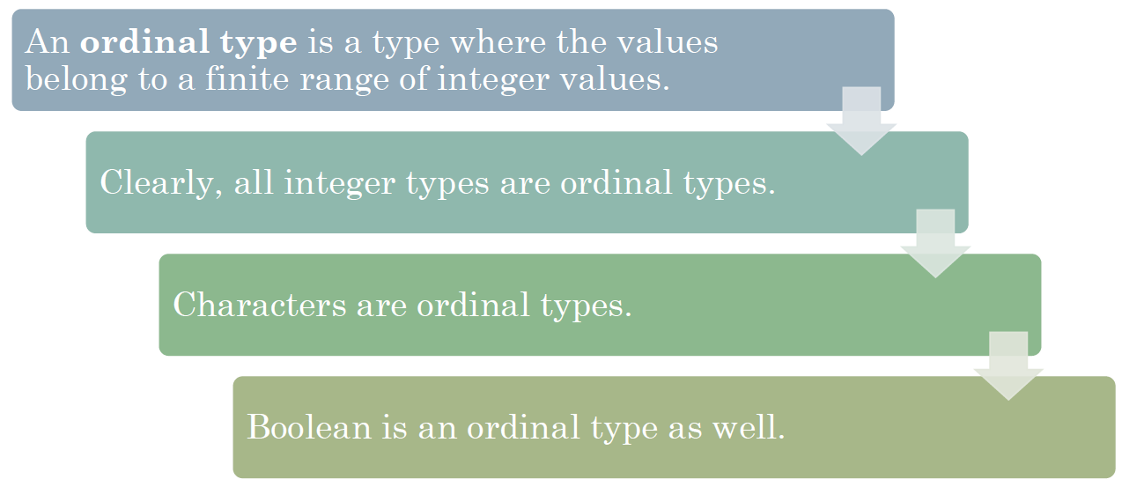
Various Data Types Ordinal Types

Slide 33
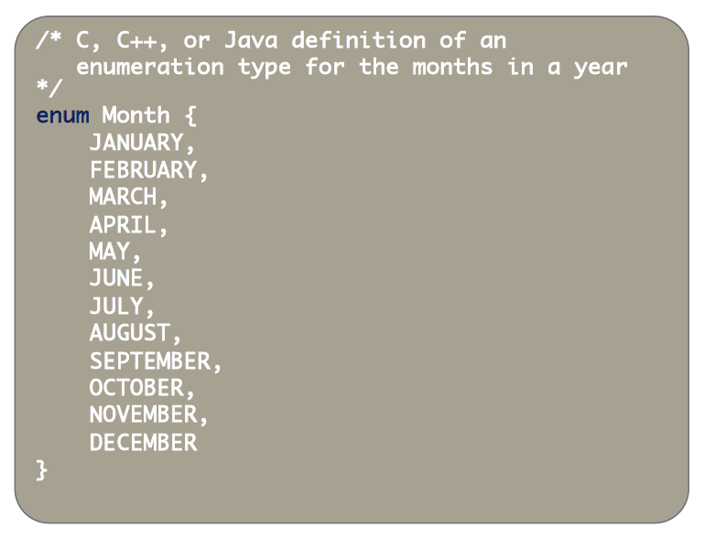
Various Data Types Enumeration Types
An enumeration type or enumerable type consists of a (typically small) finite set of values explicitly enumerated by the programmer.
Thus, an enumeration type is also an ordinal type. 

Slide 34
Various Data Types Subrange Type
The subrange type is a contiguous sequence of an ordinal type. E.g., we could define a subrange types as follows:
type teen = 13 . . 19;
type test_score = 0 . . 100;
type workday = MONDAY . . FRIDAY;
Subrange types are defined in PASCAL and all languages derived from it.
They are also defined in Python, and frequently used as a constraint to define a subset of a data type:
for x in range(1:10):

Slide 35
Various Data Types Composite Type
A composite data type or a compound data type is a type that can be constructed from the language’s primitive data types and other composite types.
Record (or union)
Array
Set
List
Map
Files

Slide 36
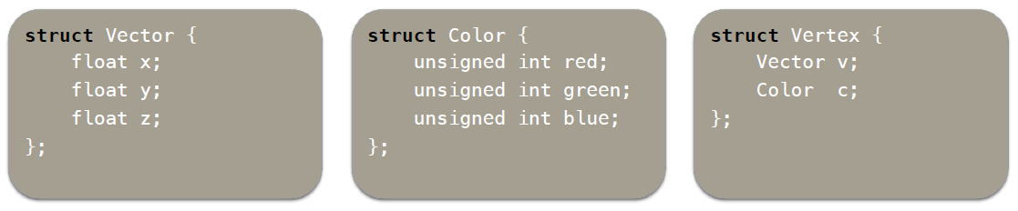
Various Data Types Records
A record consists of a number of fields:
In C it is implemented using struct keyword:
There is a way to access the field:
foo.bar; <- C, C++, Java style.
bar of foo <- Cobol/Algol style

Slide 37
Various Data Types Records
Nested record definition in Pascal:
type ore = record
name : short_string;
element_yielded : record
name : two_chars;
atomic_n : integers;
atomic_weight : real;
metallic : Boolean
end
end;
Accessing fields:
• ore.element_yielded.name
• name of element_yielded of ore

Slide 38
Various Data Types Sets
Set: contains distinct elements without order.
Pascal supports sets of any discrete type, and provides union, intersection, and difference operations:
var A, B, C : set of char;
D, E : set of weekday;
...
A := B + C;
(* union; A := {x | x is in B or x is in C} *)
A := B * C;
(* intersection; A := {x | x is in B and x is in C} *)
A := B - C;
(* difference; A := {x | x is in B and x is not in C}*)
A set can be implemented as a hash table, where the keys are the set elements, and there are no values associated with the keys.

Slide 39
Various Data Types Lists
A list is a discrete sequence of elements that allows duplicates.
Python lists: Array-lists are efficient for element extraction, doubling-resize

Slide 40
Various Data Types Arrays
Arrays are perhaps the most widely used composite data types.
Unlike records, which group related fields of disparate types, arrays are usually homogeneous.
Semantically, they can be thought of as a mapping from an index type to a component or element type.
Areas of memory of the same type.
Stored consecutively, so element access for any index is a constant-time operation.

Slide 41
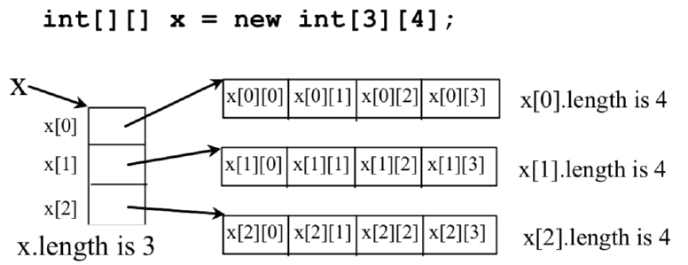
Various Data Types Multi-dimensional Arrays
Commonly, arrays are one-dimensional. But the data type of each array element can again be an array!
So we can have multi-dimensional arrays.

Slide 42
Various Data Types Memory Allocation of Arrays
If the shape of an array is known at compile time, and if the array can exist throughout the execution of the program, then the compiler can allocate space for the array in static global memory.
If the shape of the array is known at compile time, but the array should not exist throughout the execution of the program, then space can be allocated in the subroutine’s stack frame at run time, i.e., we have stack allocation.
Finally, if the shape is also not known at compile time, then the array is allocated memory in the heap, i.e., we have heap allocation.

Slide 43
Various Data Types Array Indexing
Most programming languages require array indices to be non-negative integers. That is, the “index” is implicitly the integer data type.
Some languages provide bound checking, and raise an exception when you try to access elements outside the bounds of the array (e.g. Java).
Other languages, like C, don’t perform such checks, so the responsibility lies with the programmer.

Slide 44
Various Data Types Array Indexing
Often, it is useful to get to a subsection of the array.
In some programming languages, this is verbose.
thers, like Python, offer easy slicing-and-dicing operations:
a[start:end] # items start through end-1
a[start:] # items start through the rest
# of the array
a[:end] # items from the beginning all
# the way to end-1

Slide 45
Questions?

