Slide 1

Spring 2019 CSE 216 : Programming Abstractions
TOPIC 1 – Programming paradigms

Slide 2
Machine Instructions
A machine instruction consists of several bytes in memory that tell the processor to perform one machine operation.
The processor looks at machine instructions in main memory one after another, and performs one machine operation for each machine instruction.
The collection of machine instructions in main memory is called a machine language program or (more commonly) an executable program.
Actual processors have many more machine instructions and the instructions are much more detailed.
A typical processor has a thousand or more different machine instructions.
https://chortle.ccsu.edu/java5/Notes/chap04/ch04_4.html

Slide 3
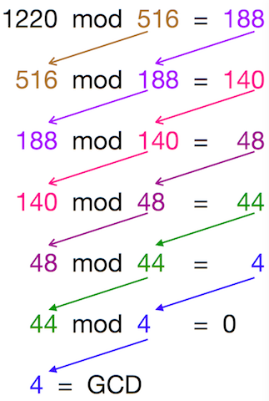
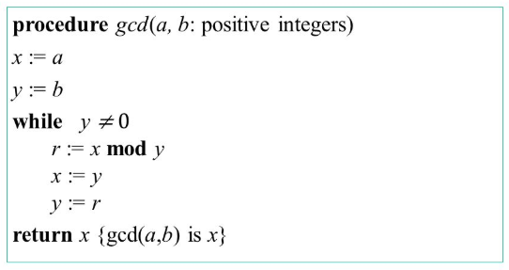
Euclid’s GCD algorithm
The Greatest Common Divisor (GCD) of two non-zero numbers is the largest positive integer that divides the number without a remainder.
Proposed by ancient Greek mathematician Euclid around 300 BC

Slide 4

GCD Program in x86
This program calculates GCD (Greatest Common Divider) of two integers using Euclid’s algorithm.
Written in machine language expressed as hexadecimal (base 16) numbers.
Instruction set used is x86.
It can be seen that writing larger programs quickly becomes error-prone.

Slide 5
Assembly Languages
Were invented to allow operations to be expressed with mnemonic abbreviations.
The assembly language is designed for a specific family of processors that represents various instructions in symbolic code and a more understandable form.
Assembly language is converted into executable machine code by a utility program referred to as an assembler.

Slide 6
Assembly Language Syntax
INC COUNT ; Increment the memory variable COUNT
MOV TOTAL, 48 ; Transfer the value 48 in the memory variable TOTAL
ADD AH, BH ; Add the content of the BH register into the AH register
AND MASK1, 128 ; Perform AND operation on the variable MASK1 and 128
ADD MARKS, 10 ; Add 10 to the variable MARKS
MOV AL, 10 ; Transfer the value 10 to the AL register
(c) P Pawar - SUNY Korea, R Banerjee - SBU - CSE 216, Elsevier

Slide 7
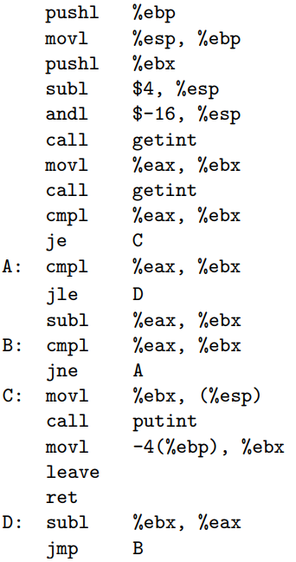
GCD program in Assembly Language
x86 assembly:
The $ prefix is for constants
The % prefix is for registers

Slide 8
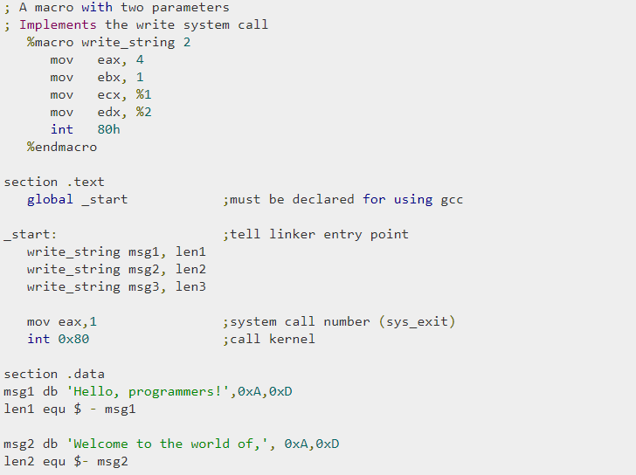
Macro Expansion in Assembly Language

Slide 9
Problems with Macro Expansion
Assemblers were eventually augmented with elaborate “macro expansion” facilities to permit programmers to define parameterized abbreviations for common sequences of instructions
Problem: each different kind of computer had to be programmed in its own assembly language
People began to wish for a machine-independent languages
These wishes led in the mid-1950s to the development of standard higher-level languages compiled for different architectures by compilers which translate high-level language code to assembly or machine level language.

Slide 10
Compilers
Compilers are more complicated than assemblers.
One-to-one correspondence between source and target languages does not exist with high-level languages.
Initial compilers (such as Fortran compilers) were slow as human programmers could also translate code with some efforts.
Over the time, performance gap narrowed and eventually reversed.
Better hardware and improvements in compiler technology generate code better and faster compared to a human being.

Slide 11
Why Programming Language?
Why do we have programming languages? What is a language for?
way of thinking -- way of expressing algorithms
languages from the user's point of view
abstraction of virtual machine -- way of specifying what you want
the hardware to do without getting down into the bits
languages from the implementor's point of view

Slide 12
Programming Languages
Today there are thousands of high-level programming languages, and new ones continue to emerge. Why are there so many?
Evolution
E.g. goto-based control flow to while loop, case-switch statements
Object orientation (C++, Java), rapid development (python)
Special Purposes
C is good for low level system programming
Personal Preference
Terseness of C (using few words), recursive vs. iteration, pointers vs. not using pointers

Slide 13
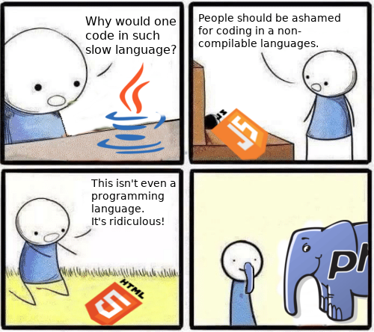

Slide 14
Factors behind Successful Programming Languages
What makes a language successful?
easy to learn (python, BASIC)
easy to express things (abstraction), ease of use (C, Java)
easy to implement (Javascript, BASIC)
Easily available (portable copies of Pascal sent to universities)
possible to compile to very good (fast/small) code (Fortran, C)
Open source compiler or interpreter

Slide 15
Factors behind Successful Programming Languages
What makes a language successful?
Standardization of language and libraries to ensure effective portability of code across platforms (C vs. Java)
backing of a powerful sponsor (Java – SUN/Oracle, Ada – US Defense)
wide dissemination at minimal cost (Java, Pascal, Turing, erlang)
Choosing optimal language is a tradeoff
Consider viewpoints of programmer and implementor
Cost of implementation

Slide 16
Why study programming languages?
Help you choose a language:
C vs. C++ for systems programming
Matlab vs. Python vs. R for numerical computations
Android vs. Java vs. Objective C vs. Javascript for embedded systems
Python vs. Ruby vs. Scheme vs. ML for symbolic data (not purely numerical) manipulation
Java RPC (JAX-RPC) vs. C/CORBA for networked PC programs

Slide 17
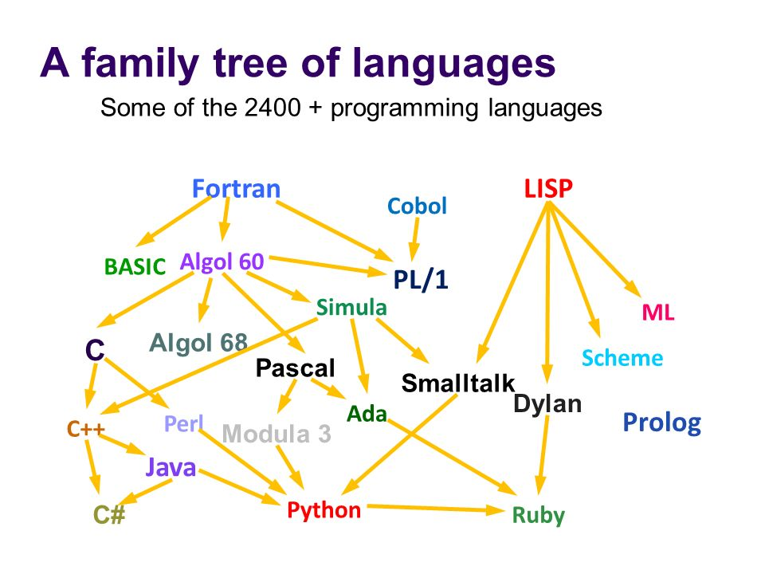
Why study programming languages?
Make it easier to learn new languages
some languages are similar: easy to walk down family tree

Slide 18
Why study programming languages?
Concepts have even more similarity; if you think in terms of iteration, recursion, abstraction (for example), you will find it easier to assimilate the syntax and semantic details of a new language.
Think of an analogy to human languages: good grasp of grammar makes it easier to pick up new languages (at least Indo-European – Albanian, Armenian, Balto-Slavic, Baltic, Slavic, Celtic, Germanic).
Help making better use of obscure features:
In C, help you understand unions, arrays & pointers, separate compilation, catch and throw

Slide 19
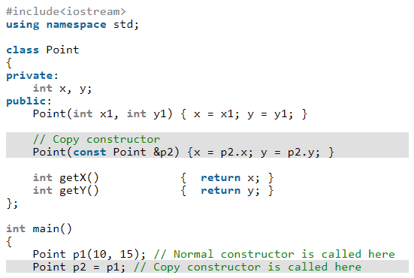
Why study programming languages?
understand implementation costs: choose between alternative ways of doing things, based on knowledge of what will be done underneath:
use simple arithmetic equal (use x*x instead of x**2)
Avoid unnecessary temporary variables and use copy constructors to minimize the cost of initialization

Slide 20
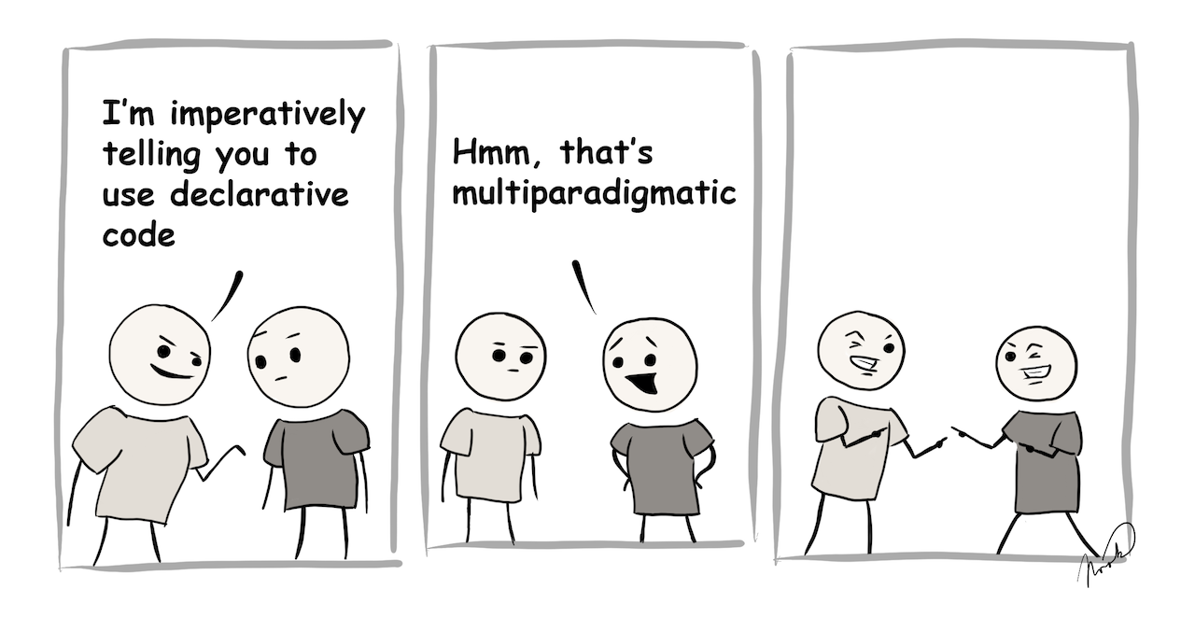
Imperative programming: Telling the “machine” how to do something, and as a result what you want to happen will happen. (e.g. Java code)
Declarative programming: Telling the “machine” what you would like to happen, and let the computer figure out how to do it. (e.g. HTML code, functional programming code)

Slide 21
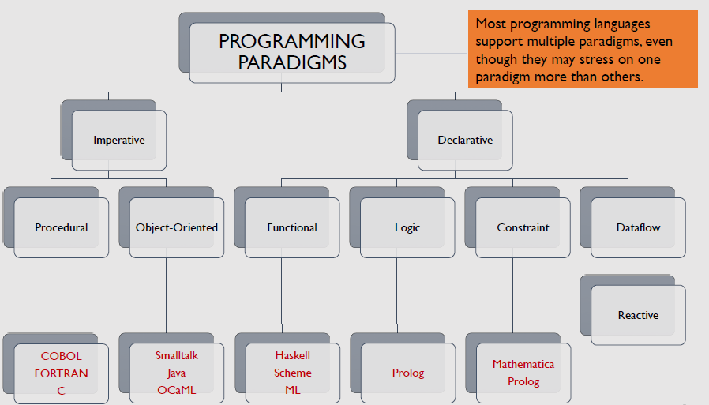

Slide 22
Imperative Programming
Imperative languages predominate the industry
Imperative programming describes “what” to do in terms of “how” to do it.
(Relatively) higher-level imperative languages like C are abstractions of assembly language, but they follow the same paradigm.
Tell the computer to perform step by step the procedure to get the final result.
Think of imperative programming as a “recipe”, where each step is an instruction about how to perform the next action, and the next action depends on the current “state” of your kitchen!

Slide 23
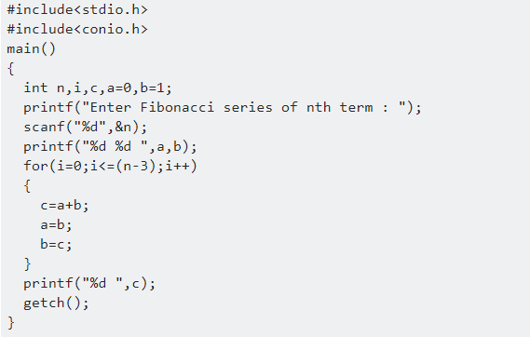
Imperative Programming
A statement is a syntactic unit of an imperative programming language that expresses some action to be carried out.
The program as a whole in such a language thus becomes a sequence of statements.

Slide 24
Procedural Programming
A type of imperative programming based on the concept of procedure calls (COBOL, Fortran, C, Pascal).
Procedures (a.k.a. routines, subroutines, or functions), simply contain a series of computational steps to be carried out.
That is, they define “how” to do what they are being asked to do. They explicitly refer to the underlying “state” (i.e., variables and their values), and are therefore within the scope of imperative programming.
Any procedure might be called at any point during a program’s execution. The call may come from other procedures or even itself.
(c) P Pawar - SUNY Korea, R Banerjee - SBU - CSE 216, Elsevier

Slide 25
Object Oriented Programming
A paradigm based on the concept of objects, which may contain:
Data in the form of fields, sometimes called attributes, and
Code, in the form of procedures, a.k.a. methods.
An object’s procedures can access and often modify the data of the object with which they are associated (using this or self).
In OOP, programs are designed by making them out of objects that interact with one another.
Most OOP languages are class-based, i.e., objects are instances of classes (usually, this determines their type).

Slide 26
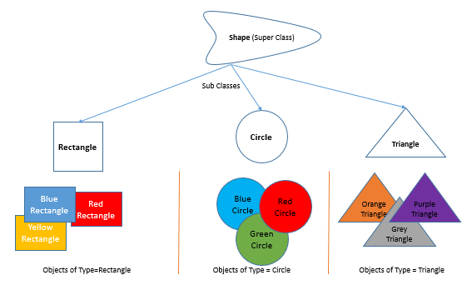
Object Oriented Programming

Slide 27
Declarative Programming
Declarative programming is about “what” to do, without specifying “how” to do it.
Just passes the input and expects the output without stating the procedure how it is done.
Of course, the computer needs to be told how to do something at some point!
But with declarative programming, those details are left to the language’s implementation.
There is a decoupling of ‘what’ and ‘how’, which makes life easier for the developer.

Slide 28
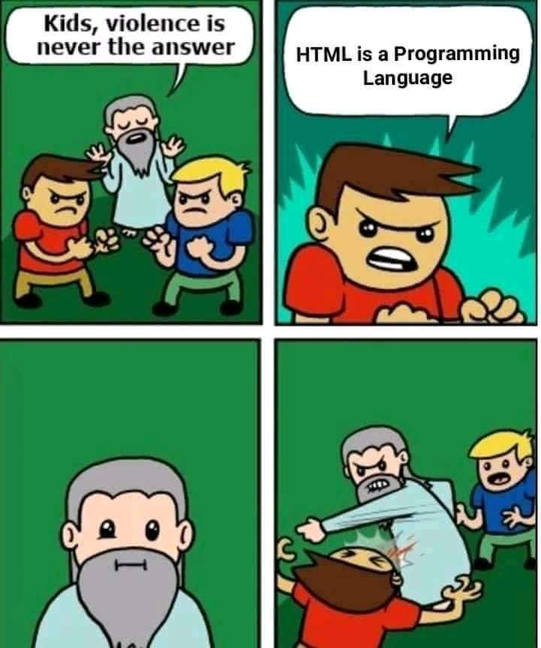

Slide 29

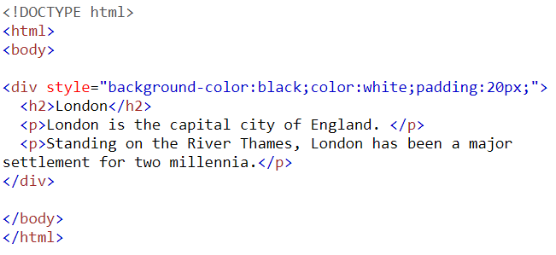
Declarative Programming
SQL example
HTML example

Slide 30
Imperative vs Declarative – Metaphoric Example
Imagine you walk into your favorite coffee place and that you like to order some coffee ☕.
The imperative approach:
Enter the coffee shop
Queue in the line and wait for the barista asking you for your order
Order
Yes, for takeaway, please
Pay
Present your loyalty card to collect points
Take your order and walk out
The declarative approach:
A large latte for takeaway, please

Slide 31
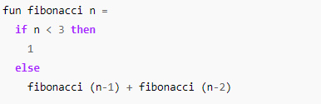
Functional Programming
Based on recursive definitions
They are inspired by a computational model called lambda calculus, developed by Alonzo Church in the 1930s.
A program is viewed as a mathematical function that transforms an input to an output. It is often defined in terms of simpler functions.
SML example – Fibonacci Series

Slide 32
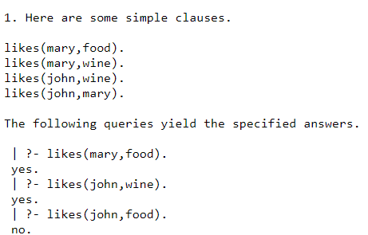
Logic/Constraint Based Programming
Based on predicate logic and an axiomatic way of finding solutions.
The goal is often to find specific relationships that are true, starting with basic
Relations that are always true. Such a basic truth is called an axiom.
Perhaps the best known logic programming language is Prolog.

Slide 33
Dataflow Programming
Computation is modeled as a ‘flow/stream of information’ – as a directed graph – between different operations.
Explicitly defined input and output connect the operations.
Each operation can be though of as a ‘black box’ function.
In that sense, dataflow programming shares some features of functional programming.
A common example is a spread sheet program which has columns of data that are affected by other columns of data.

Slide 34
Reactive Programming
A declarative, dataflow programming paradigm where it becomes very easy to propagate changes in data.
As an overly simplistic idea, consider a statement such as x = y + z
In traditional imperative programming, the x is assigned the sum of the values of y and z. If the value(s) of y and/or z changes, the value of x is not affected.
In reactive programming, the value of x is automatically updated whenever y and/or z change.
Reactive programming is extremely useful in interactive applications.

Slide 35
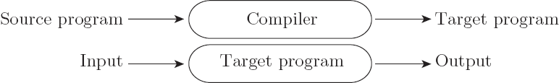
Compilation vs. Interpretation
Compilation vs. interpretation
not opposites
not a clear-cut distinction
Pure Compilation
The compiler translates the high-level source program into an equivalent target program (typically in machine language), and then goes away:

Slide 36

Pure Interpretation
Interpreter stays around for the execution of the program
Interpreter is the locus of control during execution

Slide 37
Compilation vs. Interpretation
Interpretation:
Greater flexibility
Better diagnostics (error messages)
Compilation
Better performance

Slide 38
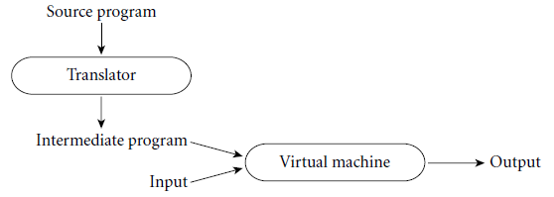
Compilation vs. Interpretation
Common case is compilation or simple pre-processing, followed by interpretation
Most language implementations include a mixture of both compilation and interpretation

Slide 39
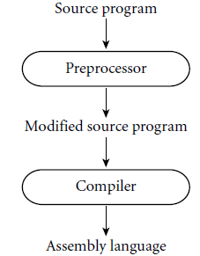
Preprocessor
Removes comments and white space
Groups characters into tokens (keywords, identifiers, numbers, symbols)
Expands abbreviations in the style of a macro assembler
Identifies higher-level syntactic structures (loops, subroutines)
A pre-processor will often let errors through. A compiler hides further steps; a pre-processor does not
C Preprocessor
Removes comments
Expands macros

Slide 40
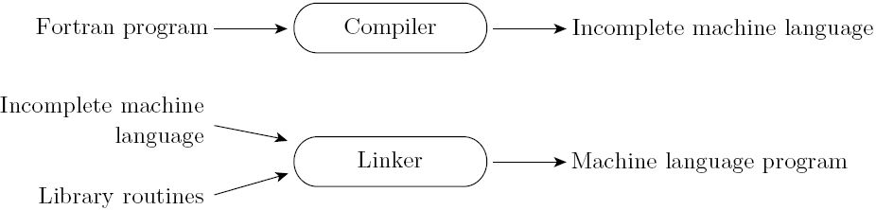
Linker
Compiler uses a linker program to merge the appropriate library of subroutines (e.g., math functions such as sin, cos, log, etc.) into the final program:

Slide 41
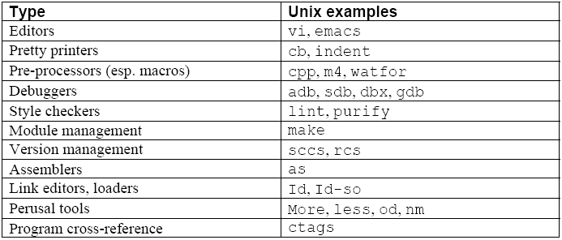
Programming Environment Tools

Slide 42
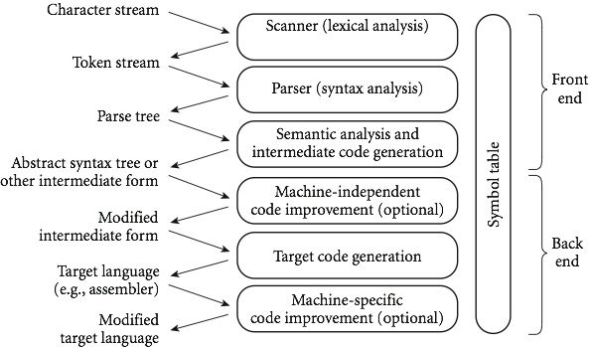
An Overview of Compilation
Phases of Compilation

Slide 43
GCD Program in C
int main() {
int i = getint(), j = getint();
while (i != j) {
if (i > j) i = i - j;
else j = j - i;
}
putint(i);
}

Slide 44
Scanning
divides the program into "tokens", which are the smallest meaningful units; this saves time, since character-by-character processing is slow
we can tune the scanner better if its job is simple; it also saves complexity (lots of it) for later stages
you can design a parser to take characters instead of tokens as input, but it isn't pretty
scanning is recognition of a regular language, e.g., via DFA

Slide 45
GCD Program Tokens
Scanning (lexical analysis) and parsing recognize t he structure of the program, groups characters into tokens, the smallest meaningful units of the program
int main ( ) {
int i = getint ( ) , j = getint ( ) ;
while ( i != j ) {
if ( i > j ) i = i - j ;
else j = j - i ;
}
putint ( i ) ;
}

Slide 46
Parsing
Parsing is recognition of a context-free language, e.g., via PDA
Parsing discovers the "context free" structure of the program
Informally, it finds the structure you can describe with syntax diagrams (the "circles and arrows" in a Pascal manual)

Slide 47
Example of Context-Free Grammar
Example (while loop in C)
iteration-statement → while ( expression ) statement
statement, in turn, is often a list enclosed in braces:
statement → compound-statement
compound-statement → { block-item-list opt }
where
block-item-list opt → block-item-list
or
block-item-list opt → ϵ
and
block-item-list → block-item
block-item-list → block-item-list block-item
block-item → declaration
block-item → statement

Slide 48
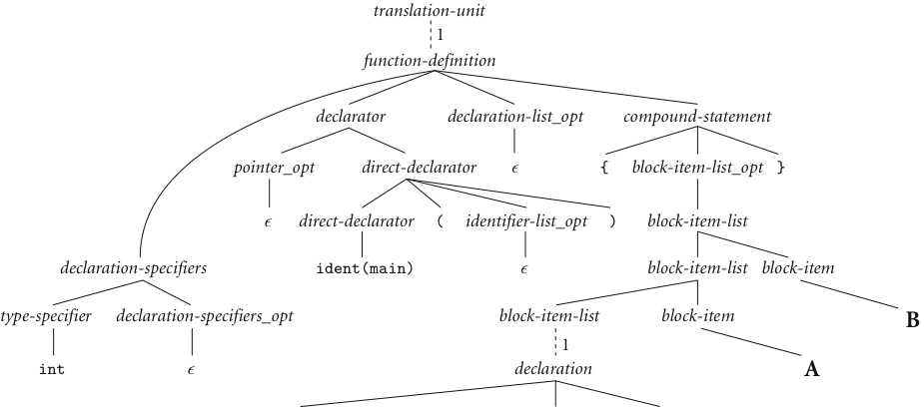
GCD Program Parse Tree

Slide 49
Semantic Analysis
Semantic analysis is the discovery of meaning in the program
The compiler actually does what is called STATIC semantic analysis. That's the meaning that can be figured out at compile time
Some things (e.g., array subscript out of bounds) can't be figured out until run time. Things like that are part of the program's DYNAMIC semantics

Slide 50
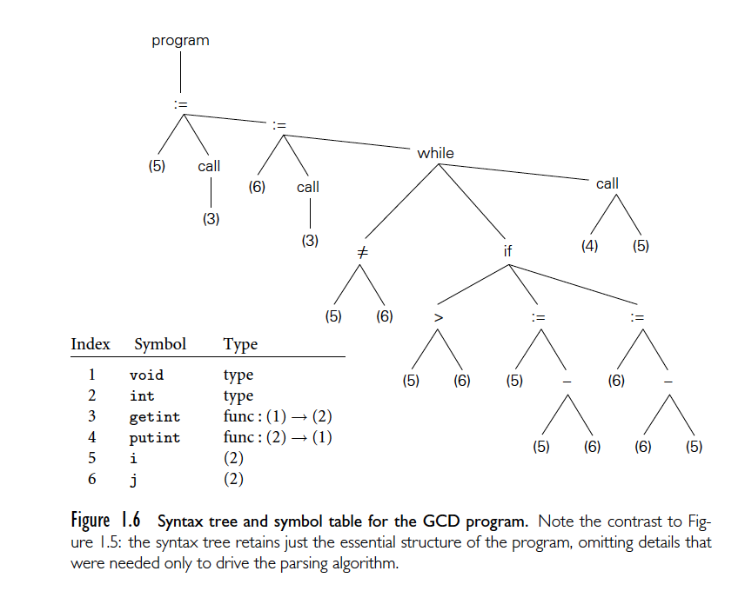
Syntax Tree and Symbol Table

Slide 51
Intermediate Form
Intermediate form (IF) done after semantic analysis (if the program passes all checks)
IFs are often chosen for machine independence, ease of optimization, or compactness (these are somewhat contradictory)
They often resemble machine code for some imaginary idealized machine; e.g. a stack machine, or a machine with arbitrarily many registers
Many compilers actually move the code through more than one IF

Slide 52
Optimization and Code Generation
Optimization takes an intermediate-code program and produces another one that does the same thing faster, or in less space
The term is a misnomer; we just improve code
The optimization phase is optional
Code generation phase produces assembly language or (sometime) relocatable machine language

Slide 53
Symbol Table
All phases rely on a symbol table that keeps track of all the identifiers in the program and what the compiler knows about them
This symbol table may be retained (in some form) for use by a debugger, even after compilation has completed

Slide 54
An Overview of Compilation
Lexical and Syntax Analysis
Context-Free Grammar and Parsing
Parsing organizes tokens into a parse tree that represents higher-level constructs in terms of their constituents
Potentially recursive rules known as context-free grammar define the ways in which these constituents combine

Slide 55
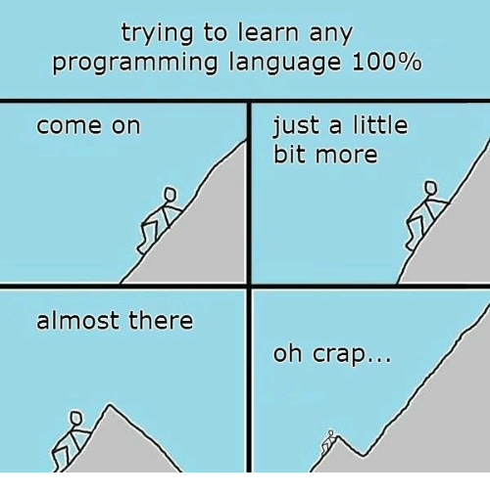
CSE 216

