Slide 1
Chapter 4: Introduction to CSS

Slide 2
CSS Defined:
Short for "Cascading Style Sheets".
Determines how the elements in our XHTML documents are displayed and formatted.
Designed to separate the content of a web page from the presentation of that content.
Enables us to make all pages of our website look similar and consistent (font, color, etc.).
Allows us to make site-wide formatting changes from a single location (rather than having to edit each page individually).
Initial few slides are taken from CSS slides uploaded by Grace Bautista Ursua on Scribd: https://www.scribd.com/user/413163374/Grace-Bautista-Ursua

Slide 3
Three Ways to Use CSS:
Inline Style - CSS is placed directly into the HTML element.
Internal Style Sheet - CSS is placed into a separate area within the <head> section of a web page.
External Style Sheet - CSS is placed into a separate computer file and "connected" to a web page.

Slide 4
CSS Format Conflicts:
It's possible for CSS formatting to be defined in all three locations at the same time.
For example, a paragraph element could contain an inline style (color:red) but the internal style sheet (color:blue) and the external style sheet (color:green) give conflicting instructions to the web browser.
Web browsers need a consistent way of "settling" this disagreement.
Within this cascade of style declarations, the closest rule wins.
An inline style overrules an internal style, which overrules an external style.

Slide 5
What is Meant by "Cascading"?
We use the term cascading because there is an established order of priority to resolve these formatting conflicts:
Inline style (highest priority)
Internal style sheet (second priority)
External style sheet (third priority)
Web browser default (only if not defined elsewhere)

Slide 6

Example: Inline Style
<h2 style="font-family:georgia; color:red;">
CAUTION: Stormy Weather!
</h2>
PREVIEW:
A semicolon must follow each style declaration.

Slide 7
Example: Internal Style Sheet
<head>
<style type="text/css">
h2 {font-family:georgia; color:red;}
</style>
</head>
For internal style sheets, all formatting declarations are placed inside the <style> element within the <head> section of the document.
An element is listed and all the styling information follows, surrounded by opening and closing curly brackets, { }.
A semicolon must still follow each style declaration.

Slide 8
Example: External Style Sheet
<head>
<link rel="stylesheet" type="text/css" href="style.css" />
</head>
style.css (separate file):
h2 {font-family:georgia; color:red;}
For external style sheets, a <link> tag is placed at the beginning of the <head> section of the document specifying the external style sheet (with a .css extension) to be used for formatting.
The external style sheet uses the same syntax as the internal style sheet when listing elements and their styling.
Styles declared in an external style sheet will affect all matching elements on all web pages that link to the stylesheet.
In this example, all <h2> elements on all pages using this style sheet will be displayed in Georgia font and in red color.

Slide 9
Internal vs. External Style Sheets
Internal style sheets are appropriate for very small sites, especially those that have just one page.
Internal style sheets might also make sense when each page of a site needs to have a completely different look.
External style sheets are better for multi-page websites that need to have a uniform look and feel to all pages.
External style sheets not only make for faster-loading sites (less redundant code) but also allow designers to make site-wide changes quickly and easily.

Slide 10
CSS Terminology and Syntax:
Correct syntax:
selector {property:value;}
p {color:red;}
Selector
Property
Value

Slide 11
Some Examples
Background Picture
body {
background-image:url('picture.gif');
background-repeat:repeat-x;
background-color:red;
}
Paragraph Properties
p {
color:red;
font-style:italic;
text-align:center;
}

Slide 12
CSS Text Properties:
The following properties can be specified for any element that contains text, such as <h1> thru <h6>, <p>, <ol>, <ul>, and <a>:
Property Some Possible Values
text-align: center, left, right, justify
text-decoration: underline, line-through, blink
color: blue, green, yellow, red, white, etc.
font-family: Arial, Verdana, "Times New Roman"
font-size: large, 120%, 20px (pixels)
font-weight: bold, normal
font-style: italic, normal

Slide 13
HTML + CSS = Webpage
A webpage consists of two basic parts: HTML5 code and CSS code.
A Webpage
CSS File
...
HTML File
CSS File

Slide 14
Listings of CSS properties are available on the Web.
Many properties can be associated with all HTML elements when appropriate. Some, such as text-align, apply only to block elements. Others, such as vertical-align, apply only to inline elements.
A few styles apply only to specific elements. For example, list-style-type is only for list items. CSS documents the applicability of each style property.
Browsers provide default presentation styles to all HTML elements. By associating your own style declarations, you can control the presentation style of an entire page and how any element in it is displayed.

Slide 15
Style Sheets
A set of style rules placed in a file (usually with the .css
suffix) become a style sheet.
In a style sheet, comments may be given between /* and */.
A style sheet may also contain at-rules for including other style sheets, indicating media targets, and so on.

Slide 16
Attaching a Style Sheet
HTML
File
<body>
. . .
<h2> . . . </h2>
. . .
<h2> . . .
. . .
. . .
h2 { font−size:
. . .
150% }
</h2>
Style Sheet
</body>

Slide 17
Whole-Page Styling
Because most style properties set for the body element apply to the entire page through inheritance, CSS makes whole-page styling easy to enforce.
body
{ font: small Verdana, Geneva, Arial, helvetica, sans-serif;
color: black;
background-color: white; border: 0px; padding: 0px; margin: 0px 0px 30px 0px;
/* top right bottom left */

Slide 18
The font Property
The font style property allows you to specify all font-related properties in one place in the general form:
font: style variant weight size / line-height family
Only the size and family are required.
Normally, line-height is 120% of font-size. To improve readability of textual materials on screen, we recommand
h1, h2, h3, p, li { line-height: 150% }
to set line spacing to 1.5 × font-size for these elements.

Slide 19
Centering
text-align: center
<h2 class="center">Topic of The Day</h2>
h2.center { text-align: center; color: #006600 }
h1.center, h2.center, h3.center, h4.center,
h5.center, h6.center
{ text-align: center; color: #006600 }
.center { text-align: center; color: #006600 }
<h1 class="center">Topic of The Day</h1>
<h3 class="center">Lunch Menu</h3>
<p class="center">Some text</p>

Slide 20
To center a block element with a fixed width or a table, use the style rules
margin-left: auto; margin-right: auto
Demo: Ex: CenterStyle

Slide 21
HTML Class Attribute
The class attribute specifies one or more classnames for an element.
The class attribute is mostly used to point to a class in a style sheet.
The general form of a class selector is
element . class
The rule matches element in that class. If element is omitted, then the selector matches all elements in that class.
https://www.w3schools.com/tags/att_class.asp

Slide 22
Indenting
p { text-indent: 3em }
p.abstract { margin-left: 5em;
margin-right: 5em }

Slide 23
Multicolumn Layout
body
{ margin: 50px; column-count: 2; column-gap: 2em;
column-rule: thin solid black; }
Within a multicolumn layout, child elements are flowed from one column to the next automatically. But, you can set the style column-span: all for a child element for it to span all columns.
h1 { column-span: all }
/* the only other value 1, the default */
Demo: Ex: TwoColumn

Slide 24
Universal selector
CSS Selectors
Type selector
A type selector is the simplest selector. It specifies an HTML element tag name and associates the rule with every instance of that element in the HTML document. For example, the rule
h3 { line-height: 140% }
The symbol * used as a selector selects every HTML element, thus making it simple to apply certain styles to all elements, all element in a class (*.class) or all child/descendant elements.

Slide 25
Class selector
The .className selector selects elements in the named class. An element is in class xyz if its class attribute contains the word xyz. For example,
.cap { text-transform: uppercase }
makes elements in the cap class ALL CAPS. And
.emphasis { font-style: italic; font-weight: bold }
makes the attribute class="emphasis" meaningful for many elements.

Slide 26
Id selector
The #idName selector associates the rule with the HTML element with the unique id attribute idName. Hence, the rule applies to at most one HTML element instance. For example,
#mileageChart{ font-family:Courier, monospace; color:red }
applies to <table id="mileageChart"> ... </table> only.

Slide 27
Concatenated (conjunction) selector
When a selector is the concatenation of two or more selectors, it selects elements satisfying each and every selector included. For example,
span.highlight nav.main.mobile mobile) table#mileageChart
(span elements in class highlight) (nav elements in class main and class
(table element with id mileageChart)

Slide 28
Selector Grouping
Selectors sharing the same properties can be grouped together in one rule to avoid repeating the same rule for different selectors. To group selectors, list them separated by commas. For example,
h1, h2, h3, h4, h5, h6 { color: blue }

Slide 29
Pseudo-class selectors
The pseudo-class is a way to permit selection based on conditions at run-time or on the hierarchical structure in the document.
The eight most widely used pseudo-classes are the selector suffixes:
:link (a valid link)
:visited (a visited link)
:hover (mouse over element)
:active (element being clicked)
:focus (UI element gained focus),
:enabled (UI element usable)
:disabled (UI element unusable)
:checked (element selected).
:target selects target of an in-page link action by the user. For example,
section:target { border: thin solid black }

Slide 30
CSS Selector Examples
body { background-color: white } |  | Element
*.fine or .fine { font-size: x-small | } | Universal + Class
h2.red { color: #933 } |  | Class
a.box:hover
{ border: #c91 1px solid; text-decoration: none; }
p, ul, nl { line-height: 150%; }
Pseudo-class in Class
Grouping

Slide 31
Link Styles
/* shaded blue for unvisited links */ a:link { color: #00c; }
/* dark red for visited links */ a:visited { color: #300; }
/* when link is clicked */ a:active
{ background-image: none;
color: #00c; font-weight: bold; }
/* when mouse is over link */ a:hover
{ background-color: #def; background-image: none; }

Slide 32
Sometimes it is useful to have different classes of links (e.g., external and internal links). In that case, you can use selectors in the form
a.external:link a.external:hover
a { text-decoration: none }
/* removing underline */

Slide 33
Webpage Layout with CSS
A critical task in developing a new website is creating a good visual design and page layout.
A layout grid is a set of invisible vertical and horizontal lines to guide content placement. It is the primary way designers organize elements in a two-dimensional space.
A grid aligns page elements vertically and horizontally, marks margins, and sets start and end points for element placement.
A consistent page layout also helps to create unity throughout the site.
A fixed-width (or ice) layout can be easier to implement but a fluid layout that adjusts to varying page width and screen resolution is more desirable.

Slide 34
Fluid Float Layout
An example that can be used as a template for a simple webpage.
We’ll look at the HTML page structure and the CSS styling for this example.

Slide 35
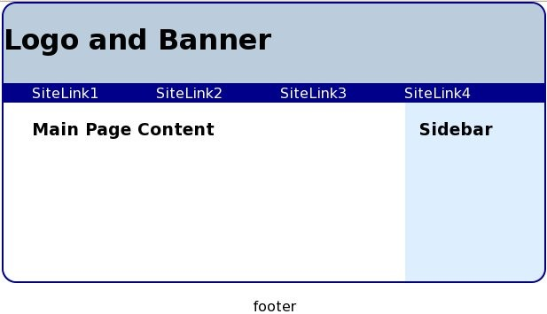
A Fluid Float Layout

Slide 36
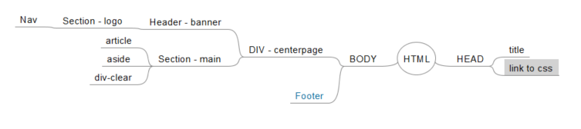
Structure
A header for top banner and navbar
A section containing an article (for the main content), an aside (for the sidebar), and an empty div.

Slide 37
Fluid Float Layout HTML & CSS
HTML
<body id="top">
<div id="centerpage">
<header class="banner">... </header>
<section id="main">
<article>... </article>
<aside>... </aside>
<div style="clear: both"></div>
</section>
</div>
<footer>
<p style="text-align: center">footer</p>
</footer>
CSS
div#centerpage
{/* centering */
margin-left:auto; margin-right:auto;
/* fluid page width */ width: 80%;
/* border */
border: 2px solid darkblue;
/* rounded corners */ border-radius: 16px; overflow: hidden;
}

Slide 38
Top Banner HTML and CSS
HTML
<header class="banner">
<section class="logo">Logo and Banner
</section>
<nav> <a href="#">SiteLink1</a>
<a href="#">SiteLink2</a>
<a href="#">SiteLink3</a>
<a href="#">SiteLink4</a></nav></header>
CSS
header.banner { background-color: #bcd; }
header.banner > section.logo
{ font-size: xx-large; font-weight: bold; height: 60px; padding-top: 30px;
}

Slide 39
Nav Bar HTML and CSS
CSS
header.banner nav
{ background-color:darkblue;/* color of navbar */
padding-left: 2em; /* lead spacing */
white-space: nowrap /* links on one line */ }
header.banner > nav a:link
{ text-decoration: none; /* no underline */
color: white; /* links in white */
margin-right: 60px; /* spacing the links */ }
header.banner > nav a:hover
{ /* mouseover effect */
text-decoration: underline; }
HTML
<header class="banner">
<section class="logo">Logo and Banner
</section>
<nav> <a href="#">SiteLink1</a>
<a href="#">SiteLink2</a>
<a href="#">SiteLink3</a>
<a href="#">SiteLink4</a></nav></header>

Slide 40
Main Content CSS
section#main
{ overflow: hidden; background-color: #def; }
section#main > article
{ width: 69%; float: left; background-color: white; padding-left: 2em; }
section#main > aside
{ float: left;
margin-left: 1em;top-margin: 2em; }
Demo: Ex: FloatLayout

Slide 41
Navbars
The two main questions from a user’s viewpoint are: Where am I in the site? How do I get where I need to go?
A good navigation system must clearly identify each page and provide consistent visual clues and feedback for links.
A navigation bar (navbar) or panel collects important links in a central place.
Visitors expect to find navigation constructs on the top and left sides of pages. Frequently, auxiliary navigation links are also placed on the right and bottom sides.
Links can appear “charged” or “armed” when the mouse cursor is positioned over them. This is the so-called rollover effect.
A consistent design of rollovers can help the user feel in control when visiting a site.

Slide 42
A Vertical Navbar – Left Side Navigation Panel
HTML
<div id="centerpage"> (centered table w border)
<section id="main"> (table row)
<nav class="leftnavbar">(1st table cell)
<span class="self">Main Page</span> (page id)
<a href="#">Products</a>
<a href="#">Services</a>
<a href="#">News</a>
<a href="#">Contact Us</a>
</nav>
<article id="content">... (2nd table cell)
</article>
</section></div>
CSS
div#centerpage { width: 80%; margin-left: auto; margin-right: auto; display: table;
border: 2px solid darkblue; }
section#main { display:table-row; width:100%; }
nav.leftnavbar { display: table-cell;
background-color: darkblue; color: white; font-family: Arial, Helvetica, sans-serif;
font-weight:bold; width:20%; text-align:right; padding-right: 1em; padding-left: 0.5em;
white-space: nowrap; }
nav.leftnavbar > span.self { display: block;
https://www.w3schools.com/cssref/pr_class_display.asp

Slide 43
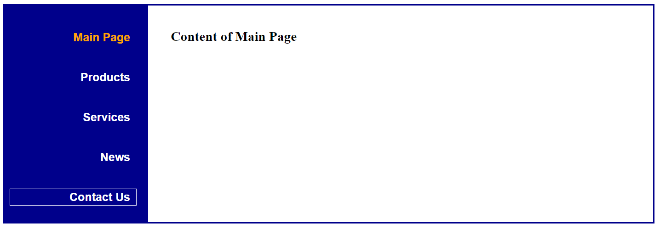
CSS-Defined Navigation Panel

Slide 44
Current-Page Links
When a link on the navbar happens to link to the page being viewed (the current page), this link must be modified to become inactive and look distinct. This brings two important advantages:
The user will not get confused by clicking a link that leads to the same page.
The distinct-looking link name helps identify the current page. Demo: Ex: NavPanel

Slide 45
More CSS examples

Slide 46
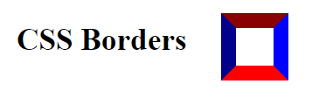
Four Borders
div#border
{ width:40px; height:40px; background-color: white; border-bottom: 15px solid red; border-right: 15px solid blue;
border-left: 15px solid darkblue; border-top: 15px solid darkred; display: inline-block;
vertical-align: middle; margin-left: 2em;
}
Demo: Ex: CSS Borders

Slide 47

An Elastic Banner
Demo: Ex: Elastic

Slide 48
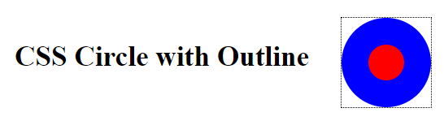
Circle Using Border Radius
div#circle
{ width:40px; height:40px; background-color: red; border: 30px solid blue;
border-radius: 50px; /* half of 40+30+30 */ outline: thin dotted black;
display: inline-block;
vertical-align: middle; margin-left: 2em;
}
Demo: Ex: Circle

Slide 49
Controlling Content Overflow
When a containing box is too small, the content inside overflows. It often happens when the browser window becomes too small. Content overflow destroys your page layout and must be avoided. The properties overflow-x and overflow-y specify how to handle width and height overflow, respectively. Possible values are:
visible—makes the overflowing content visible outside the box
hidden—makes the overflowing content invisible outside the box
scroll—adds a scroll bar to begin with
auto—adds a scroll bar only when overflow takes place
inherit—inherits the overflow setting from the parent element Demo: Ex: TextOverflow

Slide 50
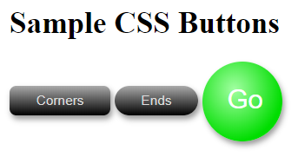
Sample CSS Buttons
Demo: Ex: Buttons

Slide 51

Inset Shadow Buttons
Demo: Ex: Inset
text-shadow adds drop shadows to texts
box-shadow adds drop shadows to block boxes
box-shadow: dx dy bl s color
a.out { box-shadow: -3px -3px 0 3px #888 inset; }
a.in { box-shadow: 3px 3px 0 3px #888 inset; }

Slide 52
Outline and 3D Effects
text-shadow:
dx dy bl color
span.outline /* Text Outline */
{ color: #aaa;
text-shadow: -1px 0 black, 0 1px black,
1px 0 black, 0 -1px black
}
span.threeD /* 3D Effect */
{ color: #aaa;
text-shadow: .5px -.5px #999, 1px -1px #888, 1.5px -1.5px #888, 2px -2px #777,
2.5px -2.5px #666, 3px -3px #555;
}

Slide 53
Embossing and Stamping Effects
span.light
{ color: #ccc; font-size: 25px; background-color: #d1d1d1;
}
span.emboss1
{text-shadow: -1px -1px white, 1px 1px #333 }
span.emboss0
{text-shadow: 1px 1px white, -1px -1px #444 }

Slide 54

Embossing Effects
span.light
{ color: #ccc; font-size: 25px; background-color: #d1d1d1;
}
span.emboss1
{text-shadow: -1px -1px white, 1px 1px #333 }
span.emboss0
{text-shadow: 1px 1px white, -1px -1px #444 }

Slide 55

Impress Effects
span.dark
{ background-color: #474747;
font-size: xx-large; letter-spacing: -2px;
font-family: Tahoma, Helvetica, Arial, Sans-Serif; }
span.press0
{ color: #666;
text-shadow: 0px 2px 3px #2a2a2a;
}
span.press0:hover { color: #777; }
span.press1
{ color: #222;
text-shadow: 0px 2px 3px #555;
}
Demo: Ex: TextShadow

Slide 56

Border Image Demo
div.redbutton
{ display: inline-block;
vertical-align: middle;
color: white; font-weight: bold; font-size: larger; width: 3.5em;
text-align: center; border-width: 8px 6px; border-image: url(redbutton.jpg) 20 18 stretch;
-moz-border-image: url(redbutton.jpg) 20 18 stretch;
-webkit-border-image:url(redbutton.jpg) 20 18 stretch;}
div img { vertical-align: middle; }
Demo: Ex: BorderImg

Slide 57
Background Colors and Images
The background of any HTML element, transparent by default, can be set to provide a desired backdrop for displaying the element content.
Use the background-color property to set a solid background color, which can be completely opaque or have degrees of transparency via an rgba color.
To set the background to that defined by an image, use the background-image style property. For example, to make myblue.gif the background image of a section child of an article, you may use:
article > section td.right
{ background-image: url(myblue.gif) }
The background-clip property clips the background and can be set to border-box (default), padding-box, or content-box. Demo: Ex: Bgclip

Slide 58

Background Patterns and Textures

Slide 59
Color Gradient
Instead of an image file, a background image can also be provided by a color gradient.
Basically, a color gradient image consists of a start color, a smooth transition, and a stop color along a gradient line.
A linear gradient varies color along a given direction, and a radial gradient varies color from a given center point circularly or elliptically outward in all directions.
Among many other uses, a gradient background can make buttons look three-dimensional, as we have seen in. And it can nicely bridge the background gaps upon window resizing.

Slide 60
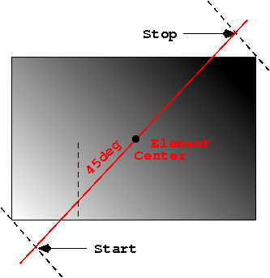
Gradient Concepts

Slide 61
Linear Gradients
background-image: linear-gradient(dir, start, stop)
dir—gives the gradient line direction: top (from top edge to bottom edge), bottom (bottom to top), left (left to right), right (right to left), top left (top left to bottom right diagonally), and so on. Alternatively, it can take on a degree (45deg, for example; 0deg is up and 90deg is right and so on.
start—the start color and an optional starting position.
stop—the stop color and an optional stopping position where to arrive at the stop color.
Demo: Ex: Gradient

Slide 62
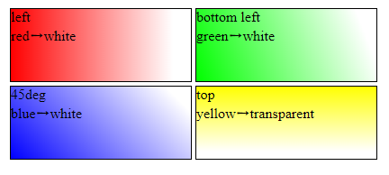
Color Gradients

Slide 63
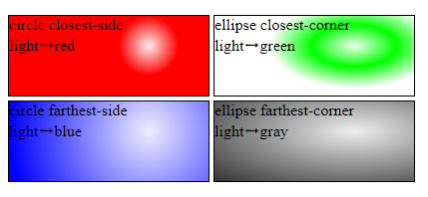
Radial Gradients
radial-gradient( pos, shape, start, stop, ... ) circle | ellipse size
Demo: Ex: Radial

Slide 64

A CSS Rainbow
Demo: Ex: Rainbow

Slide 65
Explicit Element Positioning
CSS uses three positioning schemes to place block and inline boxes for page layout:
Normal flow—This is the normal way inline and block boxes are flowed in the page layout.
Floating—A floating element is first laid out according to the normal flow and then shifted to the left or right as far as possible within its containing block. Content may flow along the side of a floating element.
Explicit positioning—Under explicit positioning, an element is removed from the normal flow entirely (as if it were not there) and assigned a position with respect to a containing block.

Slide 66
The position Style Property
Use the position property to explicitly position an element anywhere on the page layout with static, relative, absolute, and fixed positioning.
position:
static —The element follows the normal flow. This
is the default positioning scheme of elements.

Slide 67
Relative Positioning
position: relative —The element is laid out normally and then moved up, down, left, and/or right from its normal position. Elements around it stay in their normal position, ignoring the displacement of the element. For example
li.spacing
{ position:relative; left: 1em } /* move right 1em */
li.morespacing { position:relative; left: 3em }
moves the bullet items to the right in the list.
Demo: Ex: Relative

Slide 68
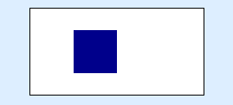
Absolute Positioning
position: absolute —This property applies only to block elements. The element is taken out of normal flow entirely and treated as an independent block box. Its position is given by the left, right, top, and bottom properties relative to the first explicitly positioned containing element (with a position other than static) or the html element.
Demo: Ex: Absolute
(C) Prof. Paul S. Wang, Kent State Univ., Pravin Pawar - SUNY Korea

Slide 69
Fixed Positioning
position: fixed—This property applies only to block elements. An element with fixed positioning is placed relative to a display medium rather than a point in the page. The medium is usually the screen viewport or a printed page. The familiar browser window is the on-screen viewport that can usually be resized and scrolled. A fixed element will be at the same position in the browser window and will not scroll with the page. A block fixed with respect to a printed page will show up at the same position on every page.
Demo: Ex: Fixed

Slide 70
Overlap, Stack Levels, and Visibility
With positioning, elements may overlap.
To manage overlapping elements, each element also has a
z-index property that designates its stack level on the z-axis.
The x- and y-directions are in the viewport plane, and the
z-direction is the depth perpendicular to the viewport plane.
An element with a larger stack level is in front of one with a smaller stack level. The element in front will obscure any elements behind it.
Because the initial value for background-color is transparent, the element behind may show through the background areas of the element in front.
The opacity property controls the transparency of the whole element, including its foreground and background. An opacity value of 0 gives total transparency and a value of 1 gives complete opacity.

Slide 71

CSS-Based Caption
Demo: Ex: Caption
Opacity Examples

Slide 72

CSS-Generated Content
The pseudo-elements ::before and ::after can insert
CSS-supplied content, with desired styles, before and after any given element.
For example, we can place a blue “An” before, and a red “for You” after the h1 head
<h1 id="target">Introduction</h1>
h1#target::before { content: ’An ’; color: blue } h1#target::after { content: " for You"; color: red }
Demo: Ex: Generated

Slide 73
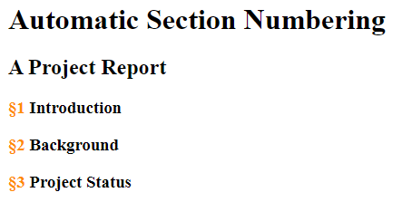
Generated Section Numbers
Demo: Ex: SecNum

Slide 74
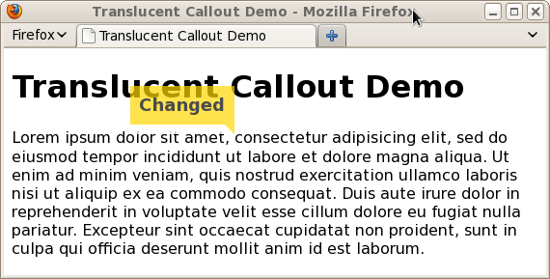
A Translucent Callout
Demo: Ex: Callout

Slide 75
Tutorial
Follow the CSS Overlay tutorial given at:
https://tympanus.net/codrops/2013/11/07/css-overlay-techniques/

