Slide 1
Introduction to Computational and Algorithmic Thinking
Lecture 8 – Random numbers and object oriented programming

Slide 2
Announcements
This lecture: Random Numbers and Object Oriented Programming
Reading: Read Chapter 7 of Conery
Acknowledgement: Some of this lecture slides are based on CSE 101 lecture notes by Prof. Kevin McDonald at SBU

Slide 3
Games of Chance
Many games involve chance of some kind:
Card games with drawing cards from a shuffled deck
Rolling dice to determine how many places we move a piece on a game board
Spinning a wheel to randomly determine an outcome
We expect these outcomes to be random or unbiased – in other words, unpredictable
Computers can be programmed to generate apparently “random” sequences of numbers and other quantities for such games and other applications

Slide 4
Games of Chance
In this lecture we will explore algorithms for generating values that are apparently random and unpredictable
We say “apparently” because we need to use mathematical formulas to generate sequences of numbers that at the very least appear to be random
Since we will use an algorithm to generate “random” values, we really can’t say the sequence of values is truly random
We say instead that a computer generates pseudorandom numbers

Slide 5
Pseudorandom Numbers
Randomness is a difficult property to quantify
Is the list [3, 7, 1, 4] more or less random than [4, 1, 7, 3]?
The algorithm that generates pseudorandom numbers is called pseudorandom number generator, or PRNG
The goal is for the algorithm to generate numbers without any kind of apparent predictability
Python has a built-in capability to generate random values through its random module
To generate a random integer in the range 1-10:
import random
num = random.randint(1,10) # 10, not 11!

Slide 6
Modular Arithmetic
The mod operator, denoted % in Python, will be a key part of generating pseudorandom numbers
Suppose we wanted to generate a seemingly random sequence of numbers, all in the range 0 through 11
Let’s start with the number 0 and store it in a new list named t:
t = [0]
One basic formula for generating numbers involves:
(1) adding a value to the previously-generated number and then
(2) performing a modulo operation

Slide 7
Modular Arithmetic
For our particular example, we could use 7 as our added value and then mod by 12
Conveniently, the Python language lets us write t[-1] to mean “retrieve the last element of list t”
We can write t[-2] to get the second-to-last element,
t[-3] to get the third-to-last element, and so on
So in general we can write t.append((t[-1]+7)%12) to generate and store the “next” pseudorandom number
If we put this code inside a loop, we can generate a series of random values and store them in the list

Slide 8
Modular Arithmetic
t = [0]
for i in range(15):
t.append((t[-1] + 7) % 12)
The above code will generate the list:
[0,7,2,9,4,11,6,1,8,3,10,5,0,7,2,9]
How “random” are these numbers?
They look pretty random, but we notice that eventually they start to repeat
Can we improve things?
Part of the issue is the divisor of 12, but the formula itself is a little too simplistic

Slide 9
Modular Arithmetic
A more general formula for generating pseudorandom numbers is x_{i+1}=(a*x_{i}+c) mod m
X_{i+1} is the “next” random number
X_{i} is the most recently generated random number
i is the position of the number in the list
a, c and m are constants called the multiplier, increment, and modulus, respectively
If the values a, c and m are chosen carefully, then every value from 0 through m-1 will appear in the list exactly once before the sequence repeats
The number of items in the repetitive part of the list is called the period of the list

Slide 10
Modular Arithmetic
We want the period to be as long as possible to make the numbers as unpredictable as possible
We will implement the above formula, but first we need to explore some new programming concepts

Slide 11
Numbers on Demand
One possibility for working with random numbers is to generate as many as we need and store them in a list
Often, however, in real applications we don’t know exactly how many random numbers we will ultimately need
Also, in practice we might not want to generate a very long list of random numbers and store them
Typically, we need only one or just a few random numbers at a time, so generating thousands or even millions of them at once is a waste of time and memory
Rather than building such a list, we can instead generate the numbers one at a time, on demand

Slide 12
Numbers on Demand
We will define a function rand() and a global variable x to store the most recently generated random number
A global variable is a variable defined outside functions and is available for use by any function in a .py file
The value of a global variable is preserved between function calls, unlike local variables, which disappear when a function returns
If we want a function to change the value of a global variable, we need to indicate this by using the global keyword in the function
If we are only reading the global variable, we do not need to use the global keyword

Slide 13
The rand() Function (v1)
Let’s consider a function for generating random numbers that uses the formula we saw earlier:
x = 0 # global variable
def rand(a, c, m):
global x
x = (a * x + c) % m
return x
Call the function several times with a=1, c=7, m=12:
rand(1, 7, 12) # returns 7 and updates x to 7
rand(1, 7, 12) # returns 2 and updates x to 2
rand(1, 7, 12) # returns 9 and updates x to 9
Let’s see why x is updated in this way

Slide 14



The rand() Function (v1)
The key line of code is x = (a * x + c) % m
Initially, x = 0
rand(1,7,12): x = (1 * 0 + 7) % 12 = 7
So, x becomes 7
rand(1,7,12): x = (1 * 7 + 7) % 12 = 2
So, x becomes 2
rand(1,7,12): x = (1 * 2 + 7) % 12 = 9
So, x becomes 9
The only reason this series of computations works correctly is because the value of x is preserved between function calls

Slide 15
Modules and Encapsulation
Suppose we wanted to use our new rand() function in several files. We have two options:
Copy and paste the function to each file (bad idea), or
Place the file in a .py by itself (or with other functions) to create a module that can be imported using an import statement (the right way)
We should place our function in a module, along with the global variable x
This global variable will be “hidden” inside the module so that there is no danger of a “name clash”, meaning that other modules could have their own global variables named x if they want to

Slide 16
Modules and Encapsulation
This idea of gathering functions and their related data values (variables) into a single package is called encapsulation
It’s an extension of the concept called abstraction we studied earlier in the course
We know that the math module has some useful functions and constants, like sqrt() and pi
A module like math is an example of a namespace, a collection of names that could be names of functions, objects or anything else in Python that has a name
A module/namespace is one way of implementing the concept of encapsulation in Python

Slide 17
Modules and Encapsulation
To create a new module, all we need to do is save the functions and variables of the module in a file ending in .py
For example, if we were to save the rand() function in the file prng.py, we could then import the rand() function in a new Python program by typing import prng at the top of the new program
Next slide shows a revised version of our rand() function that encapsulates the function in a module and stores the values of x, a, c and m as global variables
This means the user no longer needs to pass a, c, or m as arguments anymore
We will also add a new function reset() to reset the PRNG to its starting state

Slide 18
The rand() Function (v2)
x = 0
a = 81
c = 337
m = 1000
def rand():
global x
x = (a * x + c) % m
return x
def reset(mult, inc, mod):
global x, a, c, m
x = 0
a = mult
c = inc
m = mod

Slide 19
The rand() Function (v2)
x = 0
a = 81
c = 337
m = 1000
Examples:
rand(): (81 * 0 + 337) % 1000 = 337
rand(): (81 * 337 + 337) % 1000 = 634
rand(): (81 * 634 + 337) % 1000 = 691

Slide 20
The rand() Function (v2)
We can change the values of a, c, and m by calling the reset()
function. Example: reset(19, 4, 999), which also sets x = 0.
Now we will generate a different sequence of random numbers:
rand(): (19 * 0 + 4) % 999 = 4
rand(): (19 * 4 + 4) % 999 = 80
rand(): (19 * 80 + 4) % 999 = 525

Slide 21
Games with Random Numbers
Suppose we wanted to simulate the rolling of a six-sided die in a board game
We would want to generate integers in the range 1 through 6, inclusive
Our function rand() generates values outside this range, however
We can solve this problem using an expression like rand() % 6 + 1
The expression rand() % 6 gives us a value in the range 0 through 5, which we can then “shift up” by adding 1
Why not do rand() % 7 instead?

Slide 22
Games with Random Numbers
If we always initialize x, a, c, and m to the same values, then every program that uses the rand() function will get the same exactly sequence of pseudorandom values
Instead, we could allow someone using our code to set the starting value of x, which we call the seed of the pseudorandom number generator
Another option is we can have the computer pick the seed by using the system clock
The time module has a function called time() which returns the number of seconds since January 1, 1970
Fractions of a second are also included in the returned value

Slide 23
Games with Random Numbers
Our revised module shown on the right
uses time.time() to pick a random seed
See random_numbers.py
import time
a = 81
c = 337
m = 1000
x = int(time.time()) % m
def rand():
global x
x = (a * x + c) % m
return x

Slide 24
Random Numbers in a Range
In general, how can we generate random integers from an arbitrary range?
The formula is surprisingly simple:
rand() % (high – low + 1) + low
For example, suppose we wanted to generate a value in the range -1 through 10, inclusive
The formula indicates we should use this code:
rand() % (10 - (-5) + 1) + (-5)
Simplifying gives us: rand() % 16 – 5
See random_numbers.py

Slide 25
List Comprehensions
Python features a very compact syntax for generating a list called a list comprehension
We write a pair of square brackets and inside the brackets put an expression that describes each list item
For example, to make a list of numbers from 1 to 10 write [i for i in range(1,11)]
To make a list of the first 10 perfect squares we could write [i**2 for i in range(1,11)]
In general, we write an expression that describes each new item in the new list and a loop that describes a set of existing values to work from
A list of 10 random numbers:
[rand() for i in range(10)]

Slide 26
List Comprehensions
Suppose we wanted to take a list of words and capitalize them all:
names = ['bob', 'DANE', 'mikey', 'ToMmY']
names = [s.capitalize() for s in names]
names would become ['Bob', 'Dane', 'Mikey', 'Tommy’]
Or perhaps we wanted to extract the first initial of each person and capitalize it:
initials = [s[0].upper() for s in names]
initials would be ['B', 'D', 'M', 'T’]

Slide 27
Random Shuffles
Suppose we needed the ability to randomly permute (shuffle) a list of items, such as a deck of 52 playing cards
Let’s explore how we might write a function that does exactly this
The RandomLab module defines a class called Card
A class defines a new type of object in an object-oriented programming language like Python
We use a special method called the constructor to create (construct) new objects of the class
from PythonLabs.RandomLab import Card
card = Card()

Slide 28
The Card Class
A Card object has a separate rank and suit, which we can query using the rank() and suit() methods, respectively
The 2 through Ace are ranked 0 through 12
The suits are mapped to integers as follows:
Clubs: 0
Diamonds: 1
Hearts: 2
Spades: 3
For example, for a Card object representing the 9 of Spades, rank() would return 7 and suit() would return 3

Slide 29
The Card Class
The ranks and suits are numbered so that we can uniquely identify each card of a standard 52-card deck
When calling the constructor to create a Card object, we provide a number in the range 0 through 51 to identify which card we want
Examples:
Card(0) and Card(1) are the 2 and 3 of Clubs, respectively
Card(50) and Card(51) are the King and Ace of Spades, respectively
Card(46) is 9 of Spades
print(Card(51)) would output A♠ (yes, including that Spade symbol!)

Slide 30
The Card Class
We can use a list comprehension to generate all 52 cards and store them in a list:
deck = [Card(i) for i in range(0,52)]
With slicing we can take a look at just the first 5 by appending [:5] to the name of the variable
This notation means “slice out all the elements of the list up to (but not including) the element at index 5”
print(deck[:5])
Output: [2♣, 3♣, 4♣, 5♣, 6♣]

Slide 31
Shuffling Card Objects
The order of the cards generated by the list comprehension (i.e., sequential order) is only one particular ordering or permutation of the cards
We want to define a function that will let us permute a list to generate a more random ordering of the items in the list
A simple algorithm for permuting the items in a list is to iterate over the list and exchange each element with a random element to its right
This is most easily seen by example, as on the next slide

Slide 32
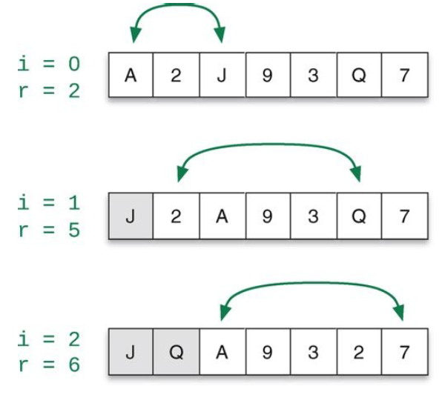
Shuffling Card Objects
Iterate over the entire list deck (with i as
the loop variable and index), swapping a
random item to the right of i with deck[i]

Slide 33
Shuffling Card Objects
This shuffling algorithm is very easy to implement with the help of a function that will choose a random item to the right of deck[i]
The function randint(low, high) from the random module generates a random integer in the range low through high (inclusive of both low and high)
The permute function will shuffle any list of items:
import random
def permute(a):
for i in range(0, len(a)-1):
r = random.randint(i, len(a)-1)
a[i], a[r] = a[r], a[i] # swap items

Slide 34
Shuffling Card Objects
import random
def permute(a):
for i in range(0, len(a)-1):
r = random.randint(i, len(a)-1)
a[i], a[r] = a[r], a[i] # swap items
r = random.randint(i, len(a)-1) picks the random index, r, that is to the right of i (or might choose i itself, meaning that a[i] doesn’t move)
a[i], a[r] = a[r], a[i] swaps a[i] with the randomly chosen item to its right
We would call this function with permute(deck) to shuffle our list of Card objects

Slide 35
Defining New Objects
The Card class we have been working with defines a new kind of object we can use in programs
In object-oriented programming, a class determines the data and operations associated with an object
For example, for a playing card object we need some way to store the rank and suit of a card; these are its data attributes
Operations for a playing card might include code that lets us print a playing card on the screen or retrieve the card’s rank and suit

Slide 36
Defining New Objects
The data values associated with a particular object are called instance variables
We say that an object is an instance of a class
For example, each of the 52 Card objects is an independent instance of the Card class
As such, each Card object has its own copies of the instance variable that store the object’s rank and suit
The operations associated with an object are called methods
So, a class defines the data properties and methods that an object of the class has

Slide 37
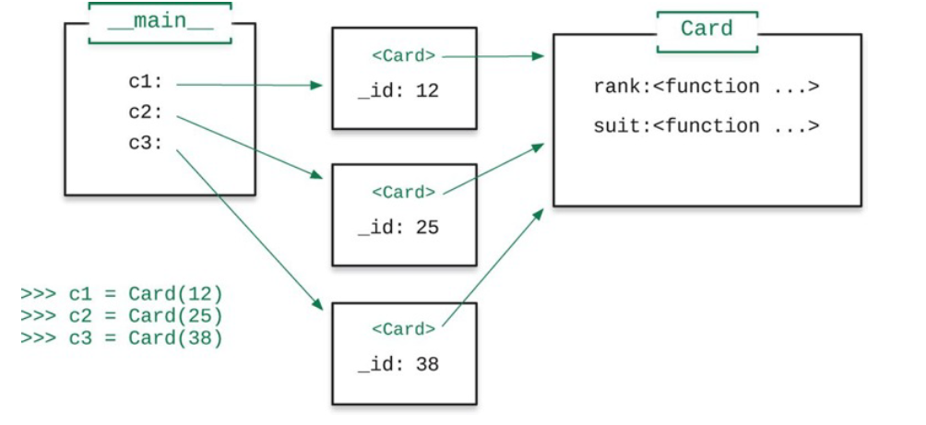
Defining New Objects
Let’s see an example where we create three distinct Card objects in a program:

Slide 38
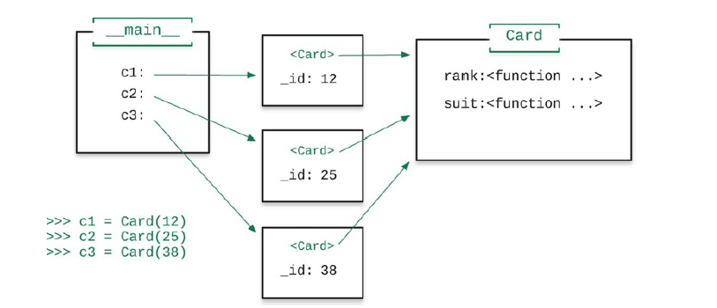
Defining New Objects
Three Card objects were constructed. They are referenced using the variables c1, c2 and c3 in main as shown on the left
The objects as they might exist in the computer memory are shown in the middle of the diagram
Rather than storing the rank and suit separately, they are combined into a single integer called _id

Slide 39
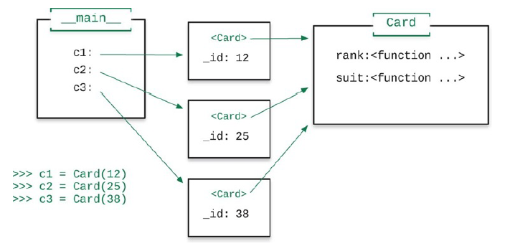
Defining New Objects
Prepending an underscore to a variable indicates that _id is an instance variable; this is a naming convention, not a strict rule
To retrieve the rank or suit, we need to call the methods rank() or suit(), as depicted on the right
Example call: c1.rank() since rank() is a method, not a function

Slide 40
Defining New Objects
To define a new class we usually include the following aspects:
One or more instance variables
One or more methods that perform some operation or execute some algorithm
A __init__ method, which initializes (gives starting values to) the instance variables
A __repr__ method, which defines a string representation of an object that is suitable for printing on the screen
Let’s step through building the Card class from the ground up

Slide 41
Building the Card Class
The code we build up in piecemeal fashion will all eventually be saved in a file named Card.py
We begin by writing a class statement:
class Card:
Next we write the __init__ method. The self keyword refers to the object itself.
def __init__(self, n):
self._id = n
The __init__ method is called the class’ constructor because it is used to construct new objects of the class

Slide 42
Building the Card Class
Now we can write the rank() and suit() methods
They translate the _id number into the rank and suit of a card
def suit(self):
return self._id // 13
def rank(self):
return self._id % 13
This encoding ensures that all 13 cards of a single suit are placed together in consecutive order
Now let’s write a simple __repr__ method
def __repr__(self):
return 'Card #' + str(self._id)

Slide 43
Building the Card Class
The Card class so far:
class Card:
“”” Instance variables: _id “””
def __init__(self, n):
self._id = n
def suit(self):
return self._id // 13
def rank(self):
return self._id % 13
def __repr__(self):
return 'Card #' + str(self._id)

Slide 44
Building the Card Class (next)
Suppose we created card #43: c1 = Card(43)
If we go ahead and print out c1, we will get output like this:
Card #43
That’s not very informative, so we’ll have to fix it later
We can write a function new_deck() that creates a list of 52 playing-card objects. This function is not part of the Card class itself. It is an example of use code of the Card class.
def new_deck():
return [Card(i) for i in range(52)]
An example call to this function:
deck = new_deck()

Slide 45
Building the Card Class
Another improvement we can make is to add special methods that allow us to compare Card objects
If we want to be able to sort Card objects, we must provide the __lt__() method, which tells us if one object is “less than” another:
def __lt__(self, other):
return self._id < other._id
__eq__() defines what it means for two Card objects to be “equal to” each other:
def __eq__(self, other):
return self._id == other._id

Slide 46
Building the Card Class
For example, consider the following objects:
c1 = Card(1)
c2 = Card(4)
The expression c1 < c2 would be True, but c1 == c2 would be False
Now that we can compare Card objects, we can sort them using the sorted function
sorted makes a copy of a list and then sorts the copy:
cards_sorted = sorted(cards)

Slide 47
Building the Card Class
The Card class defines an application program interface or API: a set of related methods that other programmers can use to build other software
Also, we are applying the concept of encapsulation by gathering all the code that defines a Card object in one place
On that topic, it can be useful to define class variables, values that pertain to a particular class but are not instance variables
For our Card class it would be useful if we could print symbols representing the suits: ♣ ♦ ♥ ♠
In Python we have access to many thousands of symbols
We can access them by giving the correct numeric codes
Let’s add two class variables: suit_sym and rank_sym to Card class

Slide 48
Building the Card Class
suit_sym = {0: '\u2663', 1: '\u2666’,
2: '\u2665', 3: '\u2660’}
If we were to print suit_sym, we would get this output:
{0: '♣', 1: '♦', 2: '♥', 3: '♠'}
The codes for various symbols can be found on the Internet by searching for “Unicode characters”
Likewise, we can define a dictionary for all the ranks:
rank_sym = {0: '2', 1: '3', 2: '4', 3: '5', 4:
'6', 5: '7', 6: '8', 7: '9', 8: '10', 9: 'J', 10:
'Q', 11: 'K', 12: 'A'}
Our goal now is to be able to print a Card object in a form like “2♣”.
Let’s see how to do that.

Slide 49
Building the Card Class
We will change our definition of the __repr__ method to this:
def __repr(self):
return Card.rank_sym[self.rank()] +
Card.suit_sym[self.suit()]
Now, when we print a Card object, we will get output like 2♣, A♦, 8♠, J♠, etc.

Slide 50
Exceptions and Exception-handling
What if another programmer using our class inadvertently gives a value outside the range 0 through 51 for n when constructing a Card object?
The __init__ method will accept the value, but it really shouldn’t
We can solve this problem by adding exception handling to our code
An exception is an unexpected event or error that has been detected
We say that the program has raised an exception
Let’s have the __init__ method raise an exception if an invalid value is given for n

Slide 51
Exceptions and Exception-handling
def __init__(self, n):
if n in range(0, 52):
self._id = n
else:
raise Exception('Card number must be in the range 0-51.’)
The new version of __init__ verifies that the argument n is valid
If not, it raises the exception and includes a diagnostic message of sorts

Slide 52
Exceptions and Exception-handling
Consider a function now that a programmer might use to make new cards that catches any exception that might be thrown by the __init__ method:
def make_card(n):
try:
return Card(n)
except Exception as e:
print('Invalid card: ' + str(e))
return None
If we call make_card(55), we get this output:
Invalid card: Card number must be in the range 0-51.

Slide 53
Exceptions and Exception-handling
This concludes our development of the Card class
See card.py for the completed Card class and use_card.py and use_card2.py for some tests
Note: To run, drag use_card.py into PyCharm and run it. Be sure that card.py is in the same folder where use_card.py is located

Slide 54
Example: Acronym Generator (v1)
Let’s explore a function that will create an acronym from the first letter of each “long” word in a list
Define a “long” word to be any word with more than two letters
After studying this first version, we will look at a second version that affords a little extra flexibility in creating acronyms

Slide 55
Example: acronym1.py
def acronym(phrase):
result = ‘’
words = phrase.split()
for w in words:
if len(w) >= 3: # keep only long words
result += w.upper()[0]
return result

Slide 56

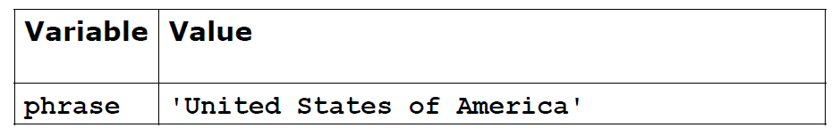
Trace: acronym() (version 1)
Let’s trace the execution of this function for one example:
acronym('United States of America’)
def acronym(phrase):
result = ‘’
words = phrase.split()
for w in words:
if len(w) > 3:
result += w.upper()[0]
return result

Slide 57
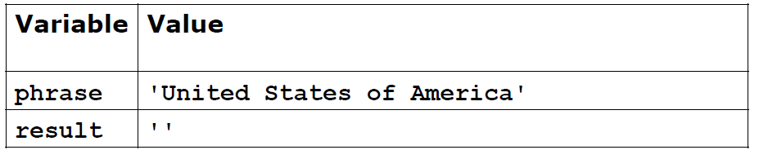
Trace: acronym() (version 1)
Let’s trace the execution of this function for one example:
acronym('United States of America’)
def acronym(phrase):
result = ‘’
words = phrase.split()
for w in words:
if len(w) > 3:
result += w.upper()[0]
return result

Slide 58
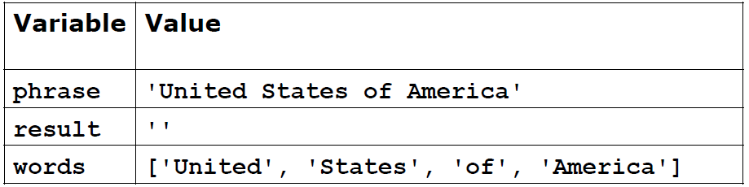
Trace: acronym() (version 1)
Let’s trace the execution of this function for one example:
acronym('United States of America’)
def acronym(phrase):
result = ‘’
words = phrase.split()
for w in words:
if len(w) > 3:
result += w.upper()[0]
return result

Slide 59
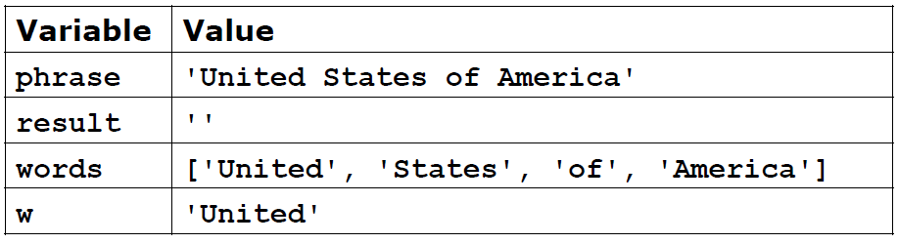
Trace: acronym() (version 1)
Let’s trace the execution of this function for one example:
acronym('United States of America’)
def acronym(phrase):
result = ‘’
words = phrase.split()
for w in words:
if len(w) > 3:
result += w.upper()[0]
return result

Slide 60
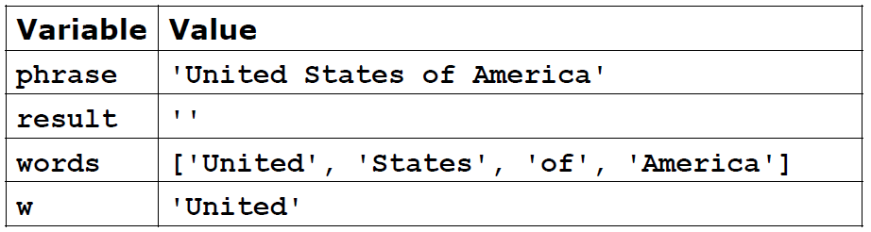
Trace: acronym() (version 1)
Let’s trace the execution of this function for one example:
acronym('United States of America’)
def acronym(phrase):
result = ‘’
words = phrase.split()
for w in words:
if len(w) > 3: # True
result += w.upper()[0]
return result

Slide 61
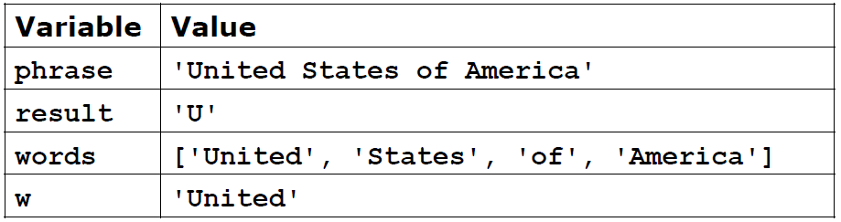
Trace: acronym() (version 1)
Let’s trace the execution of this function for one example:
acronym('United States of America’)
def acronym(phrase):
result = ‘’
words = phrase.split()
for w in words:
if len(w) > 3:
result += w.upper()[0]
return result

Slide 62
Trace: acronym() (version 1)
Let’s trace the execution of this function for one example:
acronym('United States of America’)
def acronym(phrase):
result = ‘’
words = phrase.split()
for w in words:
if len(w) > 3:
result += w.upper()[0]
return result

Slide 63
Trace: acronym() (version 1)
Let’s trace the execution of this function for one example:
acronym('United States of America’)
def acronym(phrase):
result = ‘’
words = phrase.split()
for w in words:
if len(w) > 3: # True
result += w.upper()[0]
return result

Slide 64
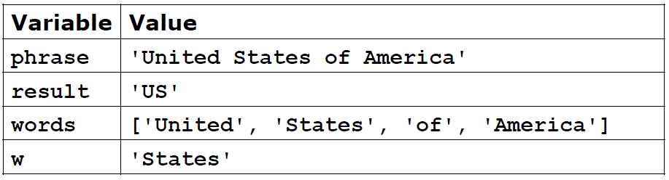
Trace: acronym() (version 1)
Let’s trace the execution of this function for one example:
acronym('United States of America’)
def acronym(phrase):
result = ‘’
words = phrase.split()
for w in words:
if len(w) > 3:
result += w.upper()[0]
return result

Slide 65
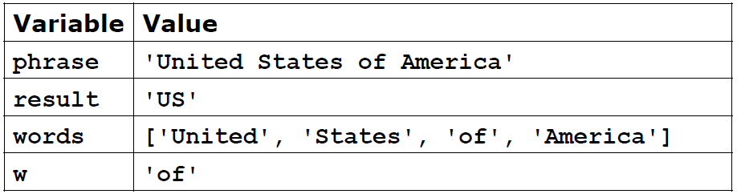
Trace: acronym() (version 1)
Let’s trace the execution of this function for one example:
acronym('United States of America’)
def acronym(phrase):
result = ‘’
words = phrase.split()
for w in words:
if len(w) > 3:
result += w.upper()[0]
return result

Slide 66
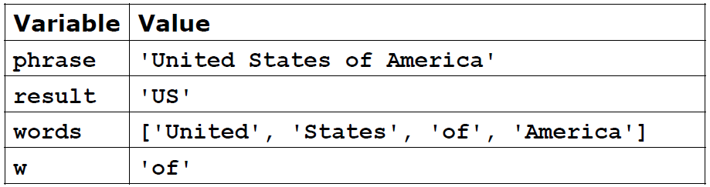
Trace: acronym() (version 1)
Let’s trace the execution of this function for one example:
acronym('United States of America’)
def acronym(phrase):
result = ‘’
words = phrase.split()
for w in words:
if len(w) > 3: # False
result += w.upper()[0]
return result

Slide 67
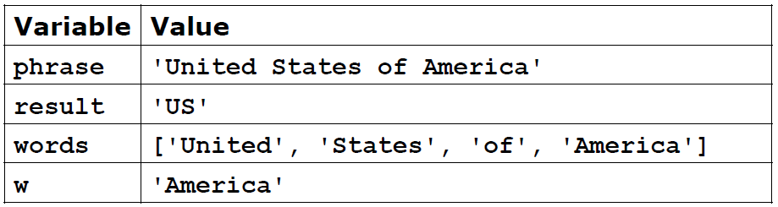
Trace: acronym() (version 1)
Let’s trace the execution of this function for one example:
acronym('United States of America’)
def acronym(phrase):
result = ‘’
words = phrase.split()
for w in words:
if len(w) > 3:
result += w.upper()[0]
return result

Slide 68
Trace: acronym() (version 1)
Let’s trace the execution of this function for one example:
acronym('United States of America’)
def acronym(phrase):
result = ‘’
words = phrase.split()
for w in words:
if len(w) > 3: # True
result += w.upper()[0]
return result

Slide 69
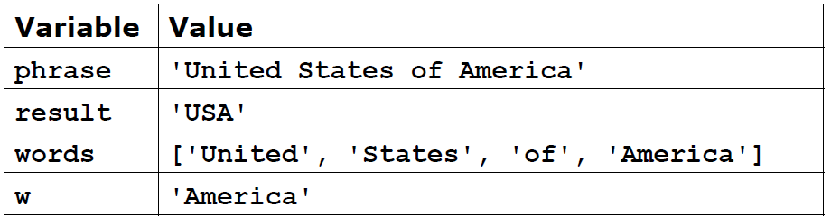
Trace: acronym() (version 1)
Let’s trace the execution of this function for one example:
acronym('United States of America’)
def acronym(phrase):
result = ‘’
words = phrase.split()
for w in words:
if len(w) > 3:
result += w.upper()[0]
return result

Slide 70
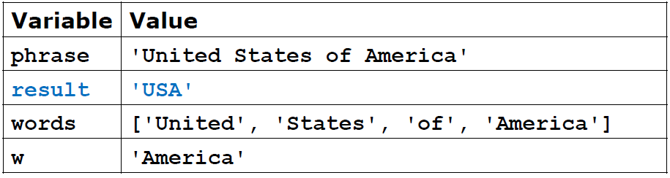
Trace: acronym() (version 1)
Let’s trace the execution of this function for one example:
acronym('United States of America’)
def acronym(phrase):
result = ‘’
words = phrase.split()
for w in words:
if len(w) > 3:
result += w.upper()[0]
return result

Slide 71
Example: Acronym Generator (v2)
Python allows function arguments to have default values
If the function is called without the argument, the argument gets its default value
Otherwise, the argument’s value is given in the normal way
We have seen a few examples of functions that have optional arguments
A good example is the round() function, which takes two arguments: the value to round and an optional argument that indicates how many digits after the decimal point we want
If the second argument is not provided, the number of digits defaults to 0, e.g.,
round(4.56324) = 5
round(4.56324, 2) = 4.56

Slide 72
Example: Acronym Generator (v2)
The second version of acronym takes an optional argument, include_shorts, that tells the function to include the first letter of all words (including short words), but short words will not be capitalized if they are included
The first version of acronym simply discarded all short words

Slide 73
Example: acronym2.py
def acronym(phrase, include_shorts=False):
result = ‘’
words = phrase.split()
for w in words:
if len(w) > 3:
result += w.upper()[0]
elif include_shorts:
result += w.lower()[0]
return result
By default, the optional argument is False, causing short words to be excluded
When the optional argument is True and w is a short word, the first letter of the word in lowercase is concatenated to result

Slide 74
Example: acronym() (v2)
Examples:
acronym(‘United States of America’) still returns ‘USA’
acronym(‘United States of America’, True) returns
‘USoA’

Slide 75
Optional Arguments
As another example, suppose we want to make a revised version of the bmi() function from earlier in the course:
def bmi(weight, height):
return (weight * 703) / (height ** 2)
This version of bmi() assumes weight is given in pounds and height in total inches
Suppose instead we want to give the programmer the option to use metric or standard (English) units
We can add a third, optional argument, units, that defaults to metric if the programmer doesn’t give a third argument
Let’s see the function on the next slide

Slide 76
Example: bmi_v4.py
def bmi(height, weight, units = 'metric’):
if units == 'metric’:
return weight / height**2
elif units == 'standard’:
return (weight * 703) / (height ** 2)
else:
return None
Examples: Return Value:
bmi(100, 150, ‘standard’) 10.545
bmi(100, 150) 0.015
bmi(100, 150, ‘metric’) 0.015
bmi(100, 150, ‘unknown’) None

Slide 77
Questions?

