Slide 1
Python
CSE 216 : Programming Abstractions
Department of Computer Science Stony Brook University Dr. Ritwik Banerjee

Slide 2

A Brief Background
Developed in the late 1980s, primarily by Guido Van Rossum.
Python 2.0 was released in 2000.
Python 3.0 was released in 2008.
Unlike Java, Python 3.x is not backward compatible.
  That is, if you write a program in a version 2.x., it may not work on modern Python interpreters.
  The official Python wiki says “Python 2.x is legacy, Python 3.x is the present and future of the language”. So, we will use Python 3.x in this course.
For additional help
  The standard Python documentation (https://docs.python.org/3/) contains a tutorial.
  The beginner’s guide to Python (https://wiki.python.org/moin/BeginnersGuide)
1

Slide 3
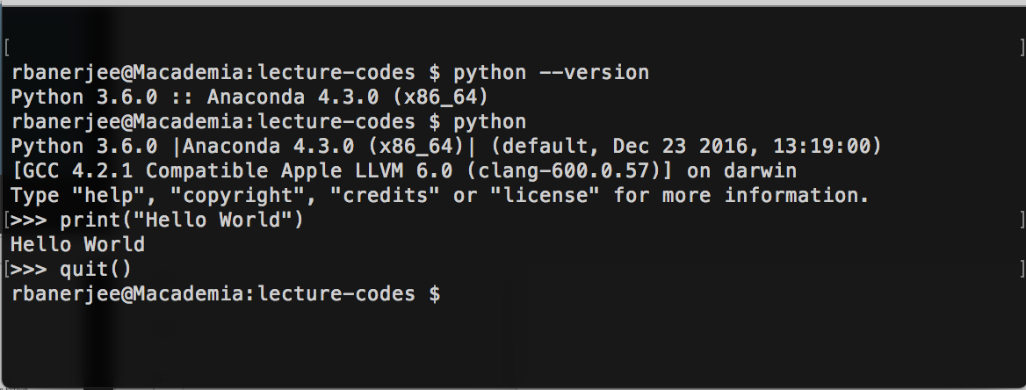
Coding Environment
Many computers come pre-installed with Python. If not, you can download and install it from https://www.python.org/downloads/.
The Python interpreter can be launched straight-away from the terminal. This is an interactive shell, and perhaps the best way to get started!
2

Slide 4

Coding Environment
The Python installation also usually comes with a GUI environment called IDLE, which contains a Python shell.
For more complex projects, you may want to use a IDE like PyCharm or PyDev+Eclipse.
3

Slide 5
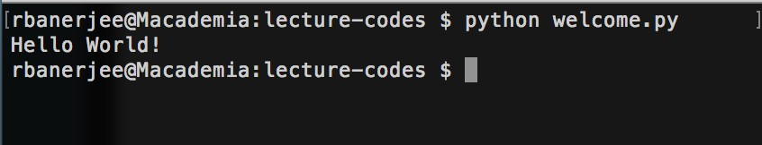
Running a simple program
# Welcome.py
# Display the one true message
# In case you haven’t figured it out yet,
# the hash marks a comment line. print(“Hello World!”)
# No semi-colon needed at the end of a statement
4

Slide 6
Syntax: blocks and indents
Instead of brackets, Python uses indented block structures.
So, instead of
if (x) {
if (y) {
a_subroutine();
}
another_subroutine();
}
Python looks like:
if x:
if y: a_subroutine()
another_subroutine()
The convention is to use 4 spaces (not tabs).
  This is not a formal requirement, but using anything other than 4 spaces will make your code incompatible with most other python codes.
5

Slide 7
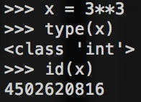
Objects
Python is an object-oriented language.
Everything – including numbers – is an object.
Every object has an id() and a type()
  The id remains unchanged from the creation until the destruction of the binding between the name and the object.
  In the C implementation, the id is address of the object in memory.
6

Slide 8



Built-in Types
Boolean Type
Numeric types
Sequence Types
Mappings
Classes
Instances
Exceptions
7

Slide 9
Boolean Type
An object is considered true by default, unless its class defines either a __bool__() method that returns False or a __len__() method that returns zero.
The common built-in objects that are equivalent to false are
  constants defined to be false: None and False.
  zero of any numeric type
  empty sequences and collections
The boolean operations are and, or, not.
With or, the second argument only gets evaluated if the first argument is true.
With or, the second argument only gets evaluated if the first argument is false.
In Python, Booleans are a subtype of integers.
  0 is false, everything else is true.
8

Slide 10
Numeric Types
Python has three numeric types (not considering Boolean):
  Integers
  Floating-point numbers
  Complex Numbers
An int has unlimited precision, which is why there is no separate data type called ‘long’ in Python.
A float are implemented as double in C.
A complex is a complex number (e.g., 5 + 3j), implemented as two floating- point numbers denoting the real and imaginary .parts respectively
9

Slide 11
Type Conversion
Python performs the following type conversions for numbers:
• int(4.2) | → | 4
float(4) | → | 4.0
• round(4.51) →
5
• round(4.5) → 4
• int(4.2) → 4
10

Slide 12

Built-in functions for numeric types
The following functions use the math module:
max(2,3,4) | # | 4
min(2,3,4) | # | 2
round(4.51) | # | 5
abs(-3.2) pow(3,2) | # # | 3.2 9 (same | as | 3**2)
11

Slide 13




Sequence Types
Lists
Tuples
Two additional sequence types:
String
Binary data
Ranges
12

Slide 14
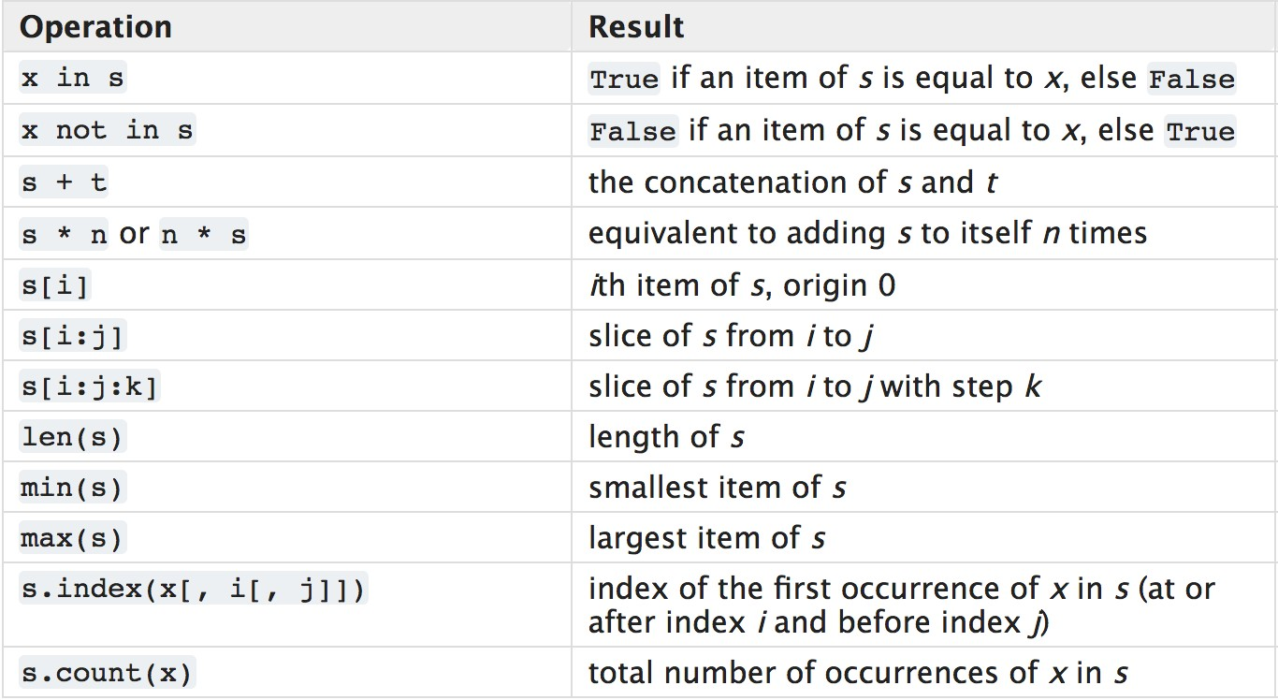

Common Sequence Operations
Source: https://docs.python.org/3/library/stdtypes.html#common-sequence-operations
13

Slide 15
Lists
A list is a mutable sequence.
It can be heterogeneous, but usually, programmers use homogeneous lists.
List construction:
1. | a_list | = | [] | # | create an empty list
2. | a_list | = | list() | # | same as line 1.
3. | a_list | = | [2,3,4] | # | create a list with these three | integers
a_list = ['red', 'green', 'blue'] # create a list with these
# three strings
a_list = list(‘red’) # create the list [‘r’, ‘e’, ‘d’]; this is
# possible because a string is a sequence
14

Slide 16

We are using the python syntax for method signature below, which is:
<method_name>(var_name: var_type, ...): return_type
append(x: object): | None
insert(index: int, remove(x: object): | x: object): None | None
index(x:
count(x:
sort():
object) int object): int
None
reverse():
extend(l:
None
list):
None

Slide 17
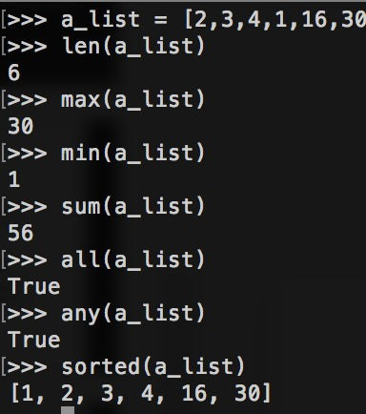
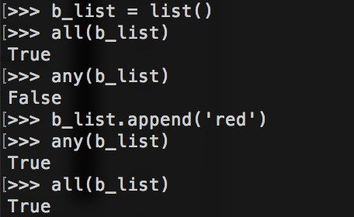

Built-in Functions with Lists
16

Slide 18
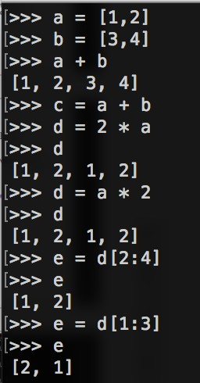
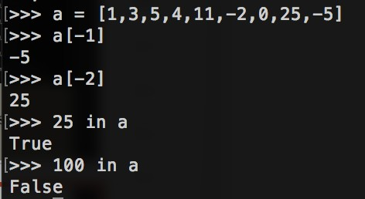
Operators on Lists
17

Slide 19
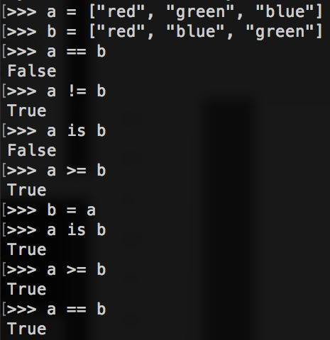
List Comparisons
18

Slide 20
Tuples
A tuple is an immutable sequences, typically used to store collections of
heterogeneous data.
  We can think of them as the “record” data type in Python.
Constructing a tuple
>>> a = (11, 22, 33, )
>>> | b | = | 'aa', | 'bb’
>>> | c | = | 123,
>>> | a
(11, 22, 33)
>>> b
('aa', 'bb')
>>> c (123,)
>>> type(c)
<type 'tuple'>
19

Slide 21
Heterogeneous Tuples
With heterogeneous tuples, it usually makes more sense to access the data using names instead of indices. To do this, use collections.namedtuple().
  This is not a built-in type.
>>> | from collections import namedtuple
>>> | Phone = namedtuple('Phone', ['owner', | 'number'])
>>> | p = Phone('John', '1231231231')
>>> | p
Phone(owner='John', number='1231231231')
>>> p[0]
'John’
>>> p.owner 'John'
>>> p.number '1231231231'
20

Slide 22
Heterogeneous Tuples
With heterogeneous tuples, it usually makes more sense to access the data using names instead of indices. To do this, use collections.namedtuple().
  This is not a built-in type.
>>> q = Phone('Jack', >>> q.number | 1231231231)
1231231231 >>> owner, number = q >>> owner 'Jack'
>>> number
1231231231
>>> tuple("apple")
('a', 'p', 'p', 'l', 'e')
21

Slide 23
Ranges
The range data type represented immutable sequences of numbers.
There are two ways of constructing a range:
  class range(stop)
>>> range(10) # ‘start’ has a default range(0, 10)
>>> list(range(10))
[0, 1, 2, 3, 4, 5, 6, 7, 8, 9]
2. class range(start, stop[, step])
value of 0
>>> [0, | list(range(0, 3, 6, 9] | 10, 3)) # ‘step’ has a default value of 1.
>>> [ ] | list(range(0, | 10, -2))
>>> | list(range(0, | -10, -2)) # count down with negative step
[0, -2, -4, -6, -8]
22

Slide 24
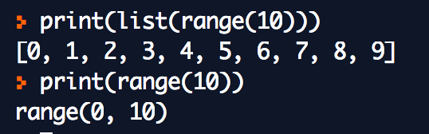
Ranges
The range data type represented immutable sequences of numbers.
What happens when you print a range?
In many ways the object returned by range() behaves like a list, but it isn’t.
It is an object that returns the successive items of the desired sequence when you iterate over it, but it doesn’t really keep the sequence pre- constructed.
  Saves space.
23

Slide 25
Text Sequences – Strings
A string in Python is an immutable sequence of characters.
  To be more precise, an immutable sequence of Unicode code points.
  Internally, it is implemented the same way as in C – a char array that is terminated by the NULL character ‘\0’.
s1 | = | ‘a string can be defined in single quotes’
s2 s3 | = = | “or double quotes” “““for multiline string,
three double quotes are required””” s4 = ‘‘‘three single quotes
work as well’’’
In the Python shell, you can type help(str) to see the documentation.
24

Slide 26
Text Sequences - Strings
Constructing strings
>>> >>> | s1 s2 | = = | str() str("this |  |  | is |  | a
string")
>>> | s3 | = | "this | is | a |  | string"
>>> | s1
''
>>> | s2
'this
is a string'
>>> s3
'this is
a string'
25

Slide 27
Sequence methods on strings
Text Sequences - Strings
s = "this is
>>> len(s) 16
>>>
't'
>>> ' '
a string"
max(s)
min(s)
>>> s + s
'this is string'
>>> 2*s
a stringthis is a
'this is string'
a stringthis is a
26

Slide 28
Text Sequences - Strings
Sequence methods on strings
s = "this is a
>>> s[2:6]
'is i'
>>> s[:1]
't'
>>>
's
>>>
'g'
>>>
string"
s[3:]
is a string'
s[-1]
'' in s
True
>>> 'balloon' in s False
27

Slide 29
String Methods
str.capitalize()
str.lower()
str.endswith(suffix)
str.find(substring)
  The find() method should be used only if you need to know the position of substring. Otherwise, in is sufficient.
For a complete (or mostly complete) list of methods to do string processing:
  https://docs.python.org/3/library/text.html#t extservices
28

Slide 30
Sets and Dictionaries
A set is an unordered collection of distinct elements*.
Two built-in set data types:
  set – mutable; we can add() and remove() elements
  frozenset – immutable
The mapping data type is called a dictionary, which maintains key- values pairs of arbitrary types*.
s = {"apple", "banana", "mango"} print(type(s))
a = dict(one=1, two=2, three=3)
b = {'one': 1, 'two': 2, 'three': 3}
c = dict(zip(['one', 'two', 'three'], [1, 2, 3]))
d = dict([('two', 2), ('one', 1), ('three', 3)])
e = dict({'three': 3, 'one': 1, 'two': 2}) print(a == b == c == d == e)
<class 'set'> True
* Technically, these elements are hashable objects, but we will look into that when we study the object-oriented data model of Python in detail.
29

Slide 31
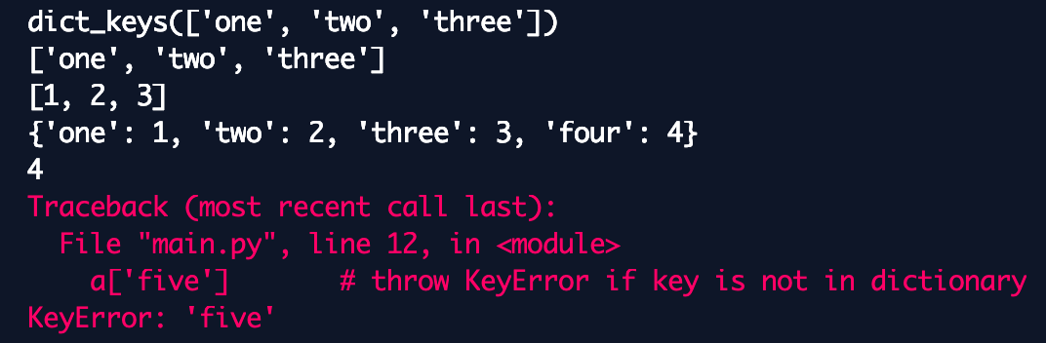
Dictionary operations
a = dict(one=1, two=2, three=3) print(a.keys())
print(list(a.keys()))
print(list(a.values()))
a['four'] | = | 4 | # | set key to value
a['four'] a['five'] |  |  | # # | return the value with this key throw KeyError if key is not in dictionary
30

Slide 32
Control Flow
from math import pi
if radius >= 0:
area = radius * radius * pi
print("The area of a circle with radius ", radius, "is ", area)
else:
print("I think that was an invalid in put")
31

Slide 33
Control Flow
if score >=
grade = else:
90.0:
'A'
if score >= 90.0: grade = 'A'
elif score >= 80.0: grade = 'B'
elif score >= 70.0: grade = 'C'
elif score >= 60.0: grade = 'D'
else:
grade = 'F'
if score >=
grade = else:
80.0:
'B'
if score >=
grade = else:
70.0:
'C'
if score >=
grade = else:
grade = 'F'
60.0:
'D'
32

Slide 34
Control Flow
words = ['cat', 'window',
'defenestrate']
for w in words: print(w, len(w))
for i in range(10): print(i**2)
a = ['Mary', 'had', 'a', 'little', 'lamb'] for i in range(len(a)):
print(i, a[i])
33

Slide 35
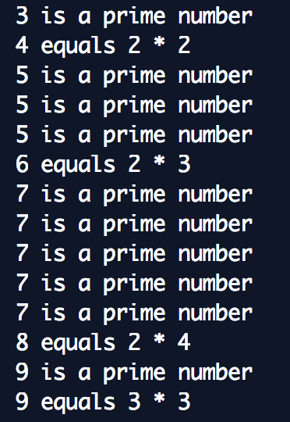
Control Flow
for n in range(2, 10): for x in range(2, n):
if n % x == 0:
print(n, 'equals', x, '*', n//x) break
else:
print(n, 'is a prime number')
34

Slide 36
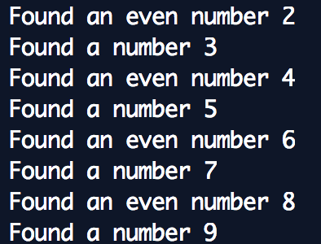
Control Flow
for num in range(2, 10): if num % 2 == 0:
print("Found an even number", num) continue
print("Found a number", num)
35

Slide 37
Control Flow
There is a special statement in Python called pass:
The pass statement does nothing, and can be used when a statement is required syntactically but the program requires no action.
Example:
while True: pass
36

Slide 38
Functions
The keyword def introduces a function definition.
Function name
List of formal parameters
The first statement can (optionally) be a string literal.
  Python’s way of providing the documentation string (docstring).
def fibseries(n):
"Print a Fibonacci series a, b = 0, 1
while a < n:
print(a, end = ' ') a, b = b, a + b
print()
up to n."
37

Slide 39

Functions
Multiple assignments:
The variables ‘a’ and ‘b’ simultaneously get the values 0 and 1.
In the last line of the loop, we use multiple assignments again.
❗ The expressions on the right-hand side are evaluated before any assignment takes place.
❗ The right-hand side expressions are evaluated left-to-right.
Keep in mind that the comma is implicitly a tuple-construction:
  b, a + b is the tuple (b, a + b)
def | fibseries(n):
 | "Print a Fibonacci series | up | to | n."
 | a, b = 0, 1
 | while a < n:
print(a, end = ' ') a, b = b, a + b
print()
38

Slide 40
Functions
What does the function
fibseries return?
def fib(n):
"Print the nth Fibonacci number." if n < 0:
Even functions without a return statement do return a value: None.
print("Fibonacci elif n == 0:
return 0 elif n == 1:
return 1 else:
return fib(n-1)
series begins
with
n = 0")
This is the null value in Python, much like void in Java. It is a reserved keyword.
+ fib(n-2)
As an example, here is a function that returns the integer type.
39

Slide 41
Variable number of parameters
Specify a default value for one or more arguments:
def confirmation(query,
max_attempts=3, reminder='Please
while True:
response = input(query) if response in ('y', 'Y',
return True
if response in ('n', 'N', return False
try again with a valid
input.'):
'yes', 'Yes', 'YES'):
'no', 'No', 'NO'):
max_attempts = max_attempts - 1 if max_attempts < 0:
raise ValueError('Too many invalid responses.') print(reminder)
40

Slide 42
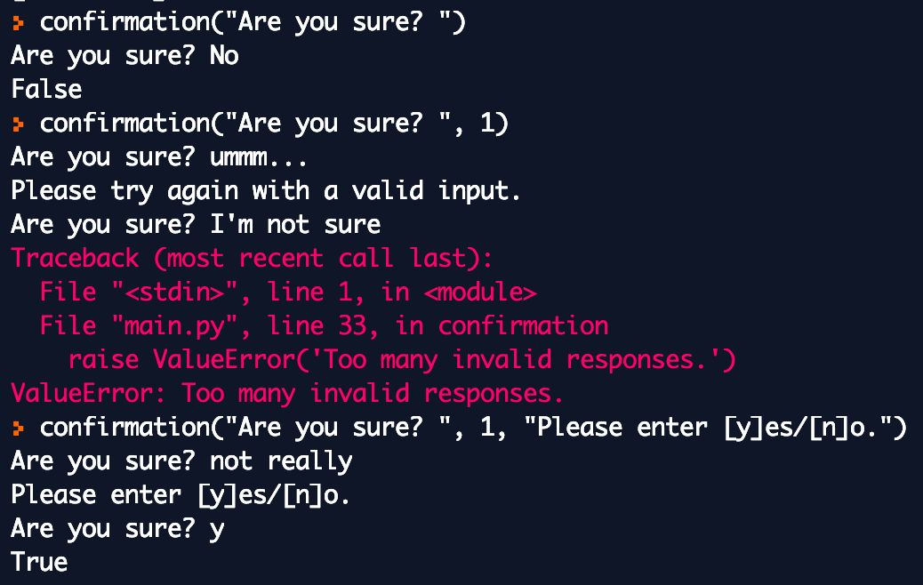
Variable number of parameters
Specify a default value for one or more arguments:
41

Slide 43
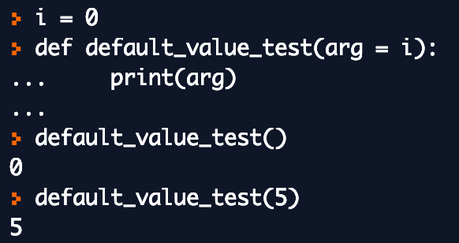
How are default values evaluated?
Default values are evaluated at the point of a function definition.
42

Slide 44
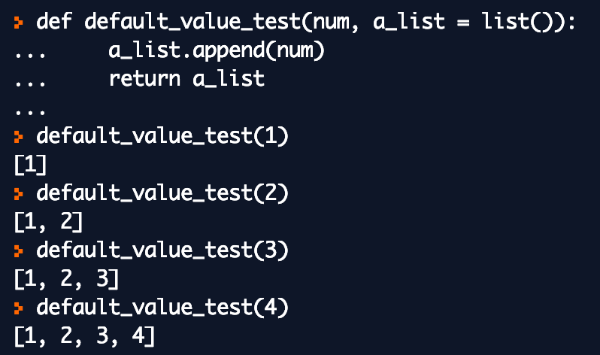
How are default values evaluated?
The default value is
evaluated only once.
This is very important for mutable objects like lists, dictionaries, etc.
43

Slide 45
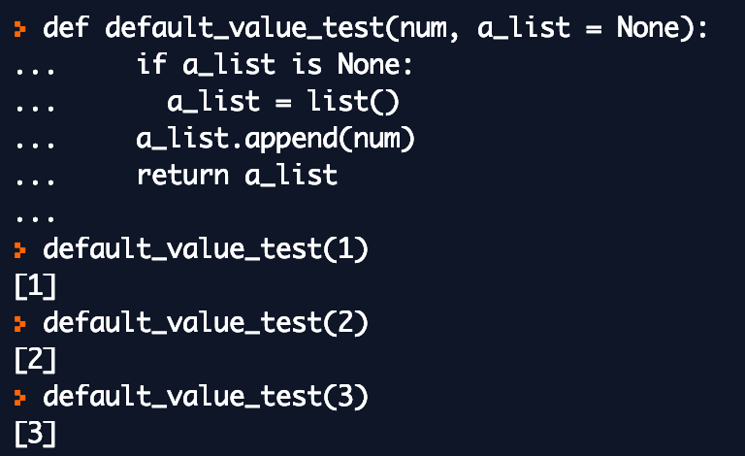
How are default values evaluated?
To avoid such sharing of the default value between subsequent function calls, rewrite the function like this.
44

Slide 46
Keyword and positional arguments
An argument is a value passed to a function when calling the function.
Python provides two kinds of arguments:
• A keyword argument (kwarg) is preceded by an identifier in a function call.
• E.g., construct a complex number by calling complex(real=3, imag=2).
• A positional argument is an argument that is not a keyword argument. These can appear at the beginning of an argument list.
• E.g., construct a complex number by calling complex(3, 2).
45

Slide 47
Variable number of parameters
Keyword Arguments
def confirmation(query,
max_attempts=3,
reminder='Please try again with a valid
input.')
This function can be called in any of the following ways:
confirmation(query=‘Are | you | sure? | ’)
confirmation(query=‘Are | you | sure? | ’, max_attempts=2)
confirmation(query=‘Are | you | sure? | ’,
max_attempts=2, reminder=‘Try again.’)
confirmation(query=‘Are you sure? ’, reminder=‘Try again.’)
46

Slide 48
Variable number of parameters
Keyword Arguments
def confirmation(query,
max_attempts=3,
reminder='Please try again with a valid input.')
But the following are invalid:
  confirmation() # required arg missing
  confirmation(query=‘Are you sure? ’, 2) # non-keyword arg after kw arg
47

Slide 49
Keyword arguments must follow positional arguments.
All the keyword arguments passed must match one of the arguments accepted by the function, and their order is not important.
Variable number of parameters
A required argument may also be provided with a keyword.
No argument may receive a value more than once.
48

Slide 50
Arbitrary number of arguments
A function can be called with an arbitrary number of arguments.
These arguments will be wrapped up in a tuple.
Normal arguments may occur before the variable number of arguments.
  They effectively “scoop up” all the remaining arguments passed to the function.
  Often called variadic arguments.
def write_multiple_items(file, separator, *args): file.write(separator.join(args))
  Any formal parameter after the *args must be keyword arguments.
def concat(*args, sep=' '): return sep.join(args)
49

Slide 51
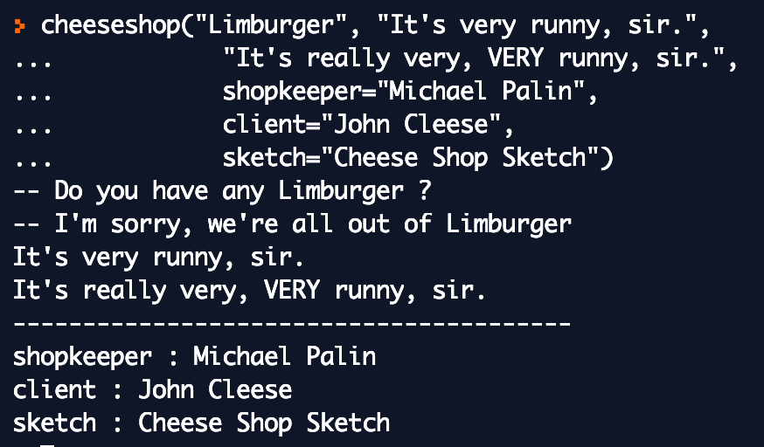
Arbitrary number of arguments
A dictionary can be passed as a formal parameter in the form **name.
def cheeseshop(kind, *arguments, **keywords): print("-- Do you have any", kind, "?") print("-- I'm sorry, we're all out of", kind) for arg in arguments:
print(arg) print("-" * 40) for kw in keywords:
print(kw, ":", keywords[kw])
50

Slide 52
Function Annotations
Even though Python is dynamically typed, it allows the programmer to include ‘type hints’ in the form of function annotations.
def sumtwo(a: int, b: int) -> int: return a + b
The annotations are stored in the __annotations__ attribute of the function as a dictionary and have no effect on any other part of the function.
51

Slide 53
PEPs and coding style
Python programming guidelines and conventions are defined in Python Enhancement Proposals, or PEPs.
PEP 8 has emerged as the nearly- universal style doctrine.
Fortunately, most modern IDEs (e.g., PyCharm) abide by PEP 8 and will warn the programmer of any violations.
For this course, we are not enforcing the style guide in its entirety, but we do require some minimal adherence, as described in this basic coding style guideline.
52

