Slide 1
Introduction to Computational and Algorithmic Thinking
Lecture 8 – Machine learning and String manipulation

Slide 2
Announcements
This lecture: Machine Learning and String Manipulation
Reading: Read Chapter 6 of Conery
Acknowledgement: Some of this lecture slides are based on CSE 101 lecture notes by Prof. Kevin McDonald at SBU

Slide 3
Machine Learning
Machine learning is a branch of computer science consisting of algorithms and techniques for “teaching” computers to recognize patterns, make predictions, detect trends, and the like.
One well-known application of machine learning is spam filtering
As a user flags emails as spam, over time the software learns how to identify spam itself, flagging spam emails automatically
We will develop a spam filter that uses word frequencies

Slide 4
Machine Learning
For example, if the word “diet” appears in 63 of 500 emails flagged by the user as spam, the probability of a spam email containing “diet” is 63/500 = 0.126 or 12.6%
Such frequencies will help the software learn how to detect spam and calculate a probability that a particular email is spam

Slide 5
Strings Revisited
Unlike lists, strings are immutable objects, which means you cannot change them
For example, if you try to execute the code given below:
fruit = ’apple’
fruit[0] = ‘A’
then you get the following error:
TypeError: 'str' object does not support item assignment
In other words, you can’t assign a new value to an existing string by changing the contents of the string
We can only replace an entire string

Slide 6
Strings Revisited
We need to use methods to create a new string based on an existing string
Some handy string methods include:
upper: changes all the characters to uppercase
lower: changes all the characters to lowercase
capitalize: capitalizes the word
For each of these methods, the method makes a copy of the string, leaving the original unchanged
name = ‘suny korea’
new_name = name.upper()
name will still be ‘suny korea’, but new_name will be ‘SUNY KOREA’

Slide 7
Strings Revisited
Another example:
name = ‘SUNY Korea’
new_name = name.lower()
new_name will be ‘suny korea’. The name variable remains unchanged.
One last example:
name = ‘suny korea’
new_name = name.capitalize()
new_name will be ‘Suny korea’. The name variable remains unchanged.

Slide 8
Splitting Strings
A very useful string method in Python is split()
The method splits a string into smaller substrings, using the space character to separate “words” (but the words could actually have any characters in them)
The substrings are placed inside of a list, which the split method returns back to us, the caller
Example:
school = 'Stony Brook Univ'
parts = school.split()
parts will be the list [‘Stony’, ‘Brook’, ‘Univ’]

Slide 9
Splitting Strings
In fact, the split method will use any whitespace characters to split a string into parts
Whitespace characters include spaces, tabs and newlines
In Python, a newline is denoted \n and a tab is \t
These are examples of escape sequences, which use a backslash to denote special characters
Example:
line = 'To be or not to be,\nthat is\tthe question.’
words = line.split()
words will be ['To', 'be', 'or', 'not', 'to', 'be,’, 'that', 'is', 'the', 'question.’]

Slide 10
Text Files
Files come in two general formats: plain text files and binary files
A (plain) text file is a simple file whose contents can be read by a basic text editor
.py and .txt files are examples of text files
Everything not a text file (images, videos, MP3s, compiled programs, etc.) is called a binary file because the file has a specific structure
In this course we will look at only how to work with text files

Slide 11
Text Files
Files give us a convenient way to provide input to a program so that we don’t have to type the input over and over
Programs that work with files need to perform three basic tasks:
Open the file
Read data from and/or write data to the file
Close the file so that other programs can access it
Let’s see how these tasks are handled in Python

Slide 12
Reading Files in Python
To open a file in Python we need to give its location on the disk
For example, suppose we have a file named “words.txt” in a folder named CSE101 and also that CSE101 is in a folder named Classes
Let’s further assume that our program (the .py file) is saved in the folder named Classes
Our program would refer to the file’s name as filename = "CSE101/words.txt"
The slash is called a separator and forms part of the path to the file on the disk
For example, assuming Classes is a folder within another folder (…), the following would be part of the path:
"…/Classes/CSE101/words.txt“

Slide 13
Reading Files in Python
Once we have a file’s path, we can open the file for reading using:
f = open(filename)
or whatever variable name we like instead of simply f
To read a single line of text at a time, we can repeatedly call the readline() function:
line = f.readline() # reads first line
line = f.readline() # reads second line
and so on...
When we are done with the file, we type f.close() to close it

Slide 14
Reading Files in Python
Usually in programming we need to process an entire file, not just part of it
For this reason Python has a simpler syntax we can use when we need to process an entire file
To read a file’s entire contents line-by-line, we can write this for-loop:
for li in open(filename):
. . .
The advantage of this syntax is that we don’t even need to make a separate variable (like f, from an earlier example) to point to the file and we don’t need to manually close it

Slide 15
Example: Getting File Size
The function below takes the name of a file as an argument and returns the number of characters in the file
def filesize(filename):
nchars = 0
for li in open(filename):
nchars += len(li)
return nchars
Example usage:
size = filesize(‘../PythonLabs/data/email/good.txt’)
See filesize.py

Slide 16
Counting Words in a File
The Unix/Linux family of operating systems has a command called wc, which gives a count of how many words are in a file
Consider a wc function in Python that performs the same task
Our wc function will return three values (in this order):
the number of lines in the file
the number of words in the file
the number of characters in the file
This means we need to count three quantities
Therefore, three counters (variables) will be needed, each initialized to zero

Slide 17
Counting Words in a File
Python provides a convenient means for initializing multiple variables to the same value via a multiple target assignment.
Instead of writing three separate assignment statements, we can collapse them into one
Example: nlines = nwords = nchars = 0
To return three values from our function we will actually return a tuple (pronounced “tupple”)
A tuple is like a list in that it contains several values
Unlike a list, a tuple is immutable (i.e., its contents cannot be changed, just as a string is immutable)

Slide 18
Example: wc() Function
def wc(filename):
nlines = nwords = nchars = 0
for li in open(filename):
nlines += 1
nwords += len(li.split())
nchars += len(li)
return nlines, nwords, nchars
We can perform a tuple assignment to save the multiple values returned by the wc function:
lines, words, chars = wc(‘../PythonLabs/data/email/good.txt’)
See wc.py

Slide 19
Dictionaries (next)
In Python, a dictionary is a type of collection where we can index (access) an element in the collection using a name instead of an integer index (as in a list)
We create a dictionary using curly braces, { }, but we still access the values using square brackets [ ]
To create an empty dictionary, we type this:
dictionary_name = {}
To insert or update a value stored in a dictionary, we give the key for the value and the value itself

Slide 20
Dictionaries
Suppose we want a distances dictionary to represent the number of feet in a single yard, fathom, furlong, or mile
We might initialize these values as follows:
distances['yard'] = 3
distances['fathom'] = 6
distances['furlong'] = 660
distances['mile'] = 5280
distances is now: {'fathom': 6, 'furlong': 660, 'mile': 5280, 'yard': 3}
The strings, ‘fathom’, ‘furlong’, ‘mile’ and ‘yard’ are the keys of the dictionary.
6, 660, 5280 and 3 are the values of the dictionary.

Slide 21
Dictionaries
We look up a value in the dictionary by giving its key:
distances[‘fathom’] has the value 6
Suppose we wanted to know how many feet are in 10 furlongs
The code 10 * distances['furlong'] would give us the answer (6,600)
Now how many miles is 10 furlongs?
(10 * distances['furlong']) / distances['mile’]

Slide 22
Dictionaries
In programming, a dictionary is considered an unordered collection
This means that the concept of sorting really doesn’t apply naturally to dictionaries (unlike a real dictionary, which is definitely sorted!)
Another important fact is that only immutable types can be used as the keys
So you can use integers, strings and floating-point numbers for keys
This makes dictionaries a little more flexible than lists in that regard
cf. lists can only use integers as index (key)

Slide 23
Dictionaries
Here is another example of a dictionary where we map Arabic numerals to Roman numerals:
roman = { 1: 'I', 5: 'V', 10: 'X’,
50: 'L', 100: 'C'}
Note that 1, 5, 10, etc. are not indexes as with a list, but are rather keys
If we try to use a key that is not in the dictionary, the program will crash
So, first we should use the in operator to check if the value is in the dictionary
An example is given on the next slide

Slide 24
Dictionaries
number = 10
if number in roman:
print(roman[number])
else:
print(‘Numeral not recognized.’)
Another option is to use the get method for dictionaries
If we don’t know if the provided key is in the dictionary, we can use the get method instead of [] to retrieve a value
We must provide an argument that says what should be used as the value if the key is not found. An example:
res = roman.get(number, ‘Numeral not recognized’)
print(res)

Slide 25
Word Frequencies for Spam Filtering
Getting back to our original problem, we want to build a program
that will do basic spam filtering
Part of the solution will include counting how many times each word appears in the input email message
We can define a dictionary called count to serve this purpose:
count = {}
To increment the count for a word, we can use the += 1 notation
Suppose the variable word has the string we want to increment the count of
We can write this: count[word] += 1

Slide 26
Word Frequencies for Spam Filtering
But what if we aren’t sure the string stored in word is already in the dictionary?
Code like count[word] += 1 will cause the program to crash if there is no value associated with word that we can add 1 to
We should first check using either the if-based approach we saw earlier, or use the setdefault method, which avoids the need to use an if-statement
Both of these techniques are most easily understood by example

Slide 27
Word Frequencies for Spam Filtering
Option 1: Use an if-statement:
if word not in count:
count[word] = 1
else:
count[word] += 1
Option 2: Use the setdefault method:
The setdefault method can take the place of the if-statement
We will set count[word] to 0 only if the string inside word is not a key in the dictionary yet
count.setdefault(word, 0)
count[word] += 1

Slide 28
Word Frequencies for Spam Filtering
Now we need to get the individual words from the input file so that we can use our count dictionary to count how many times each word appears in the file
We can use split method:
for line in open('../PythonLabs/data/text/quote1.txt’):
words = line.split()
quote1.txt contains this text:
If you have no confidence in self,
you are twice defeated in the race of life.
With confidence, you have won even before you have
started.
-- Marcus Tullius Cicero (106 BC -- 43 BC)

Slide 29
Word Frequencies for Spam Filtering
quote1.txt contains this text:
If you have no confidence in self,
you are twice defeated in the race of life.
With confidence, you have won even before you have
started.
-- Marcus Tullius Cicero (106 BC -- 43 BC)
Calling split on each line of the text yields these lists:
['If', 'you', 'have', 'no', 'confidence', 'in’,
'self,']
['you', 'are', 'twice', 'defeated', 'in', 'the’,
'race', 'of', 'life.']
['With', 'confidence,', 'you', 'have', 'won’,
'even', 'before', 'you', 'have', 'started.']
['--', 'Marcus', 'Tullius', 'Cicero', '(106’,
'BC', '--', '43', 'BC)']

Slide 30
Word Frequencies for Spam Filtering
So far this is looking pretty good. Let’s insert each word into a dictionary now and keep track of the counts:
count = {}
for line in open('../PythonLabs/data/text/quote1.txt’):
words = line.split()
for word in words:
count.setdefault(word, 0)
count[word] += 1
The count dictionary will now contain a count of every word in the file
The full dictionary is shown on the following slide

Slide 31
Word Frequencies for Spam Filtering
{'BC': 1, '--': 2, 'of': 1, 'Tullius': 1,
'confidence,': 1, '(106': 1, 'BC)': 1, 'Marcus': 1,
'are': 1, 'started.': 1, 'confidence': 1, 'race':
1, 'even': 1, 'twice': 1, 'With': 1, 'defeated': 1,
'won': 1, 'have': 3, 'Cicero': 1,
'self,': 1, '43': 1, 'no': 1, 'you': 4, 'life.': 1,
'If': 1, 'the': 1, 'in': 2, 'before': 1}
Do you see anything unfortunate about this?
Is there room for improvement in how we do the counting?

Slide 32
Word Frequencies for Spam Filtering
We have a few problems:
We might have the same word appearing in the text with different capitalization (not shown in this example)
Punctuation is causing us issues in this example: “confidence” and “confidence,” (with a comma) are treated as separate words
This means they are treated as different keys in the dictionary
To solve these two problems we will convert all words to lowercase, which is easy, and we will strip out all punctuation marks

Slide 33
Stripping Strings
The strip method in Python will let us delete from the beginning and end of a string any characters from the string that we don’t want
For example, s1.strip('0123456789') would strip out all numerals at the start or end of string s1
Here’s a concrete example:
s1 = '2/13/2193. Astronauts living on Mars base: 4,920'
s2 = s1.strip('0123456789')
s2 will contain '/13/2193. Astronauts living on
Mars base: 4,'
s1 will remain unchanged

Slide 34
Stripping Strings
Because stripping punctuation is a common operation in text processing, Python has it built-in through the string module:
import string
s1 = 'Good morning!'
s2 = s1.strip(string.punctuation)
s2 will contain 'Good morning'

Slide 35
Word Frequencies for Spam Filtering (next)
With these programming capabilities at hand, we can write a function wf that will create a dictionary of word frequencies for us
It will rely on a helper function tokenize that will split a string into a list of lowercase words with punctuation marks stripped from each lowercase string
In programming, the word tokenize means to process an input string, splitting or dividing it into its constituent parts (or substrings)
These substrings are the tokens
Let’s take a look at the tokenize function

Slide 36
Word Frequencies for Spam Filtering
def tokenize(s):
tokens = []
for x in s.split():
tokens.append(x.strip(string.punctuation).lower())
return tokens
Let’s break down this code:
s is a string, perhaps a line from the file
x is a word taken from the string (via split)
x is stripped of its punctuation, converted to lowercase, and then appended to the tokens list

Slide 37
Word Frequencies for Spam Filtering
Let’s see an example of tokenize:
res = tokenize('With confidence, you have won even before you have started.’)
res will contain the list ['with', 'confidence', 'you’, 'have', 'won', 'even', 'before', 'you', 'have’, 'started’]
Now we can look at the completed wf function, on the next slide
This function will not be explicitly used in implementing our spam filter, but looking at it will give us a sense of how to work with dictionaries in an effective manner

Slide 38
Word Frequencies for Spam Filtering
def wf(filename):
count = {}
for line in open(filename):
for word in tokenize(line):
count.setdefault(word, 0)
count[word] += 1
return count
Let’s break down this code on the next few slides

Slide 39
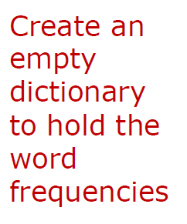
Word Frequencies for Spam Filtering
def wf(filename):
count = {}
for line in open(filename):
for word in tokenize(line):
count.setdefault(word, 0)
count[word] += 1
return count

Slide 40
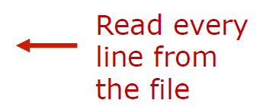
Word Frequencies for Spam Filtering
def wf(filename):
count = {}
for line in open(filename):
for word in tokenize(line):
count.setdefault(word, 0)
count[word] += 1
return count

Slide 41
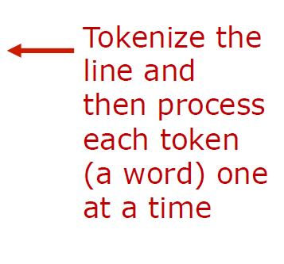
Word Frequencies for Spam Filtering
def wf(filename):
count = {}
for line in open(filename):
for word in tokenize(line):
count.setdefault(word, 0)
count[word] += 1
return count

Slide 42
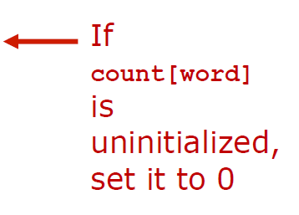
Word Frequencies for Spam Filtering
def wf(filename):
count = {}
for line in open(filename):
for word in tokenize(line):
count.setdefault(word, 0)
count[word] += 1
return count

Slide 43
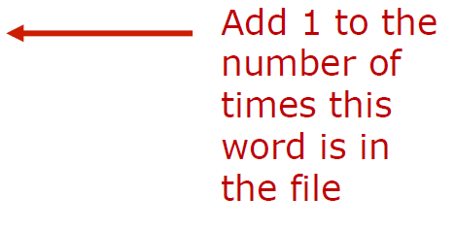
Word Frequencies for Spam Filtering
def wf(filename):
count = {}
for line in open(filename):
for word in tokenize(line):
count.setdefault(word, 0)
count[word] += 1
return count

Slide 44
Word Frequencies for Spam Filtering
Let’s see an example of wf for the quote1.txt file
res = wf(‘../quote1.txt')
res will contain:
{'': 2, '106': 1, '43': 1, 'are': 1, 'bc': 2,
'before': 1, 'cicero': 1, 'confidence': 2,
'defeated': 1, 'even': 1, 'have': 3, 'if': 1,
'in': 2, 'life': 1, 'marcus': 1, 'no': 1, 'of':
1, 'race': 1, 'self': 1, 'started': 1, 'the':
1, 'tullius': 1, 'twice': 1, 'with': 1, 'won':
1, 'you': 4}
Note that the problems we encountered before have been fixed (e.g., “confidence”)

Slide 45
Spamicity (aka Spaminess)
Now that we have a way of counting the number of occurrences of each word in a file, we can use it to help us calculate the probability that an email is spam
Suppose we know that the word “secret” appears in 252 out of 1000 spam messages
We might define the spam probability of “secret” as 252/1000 = 0.252
In other words, the probability of seeing the word “secret” in a piece of spam is 0.252
This idea of a probability of some event being based on some known fact is called conditional probability

Slide 46
Spamicity
The probability of seeing a particular word w in an email we know is spam will be denoted P(w/spam)
Read this as “the probability of seeing word w, given a spam email”
From the Internet we can download training data that gives us these probabilities for a large number of words.
The data is made available by people who design spam filtering algorithm.
Ultimately, we want to compute the “spamicity” of w, which is P(spam/w)
This is the probability that an email is spam, given that w appears in the email

Slide 47
Spamicity
The textbook’s SpamLab contains training data we can load using this code:
from PythonLabs.SpamLab import load_probabilities
pbad = load_probabilities('email/bad.txt')
pgood = load_probabilities('email/good.txt’)
pbad is a dictionary that tells us the probability of a word appearing in a spam message
Likewise, pgood is a dictionary that tells us the probability of a word appearing in a non-spam message

Slide 48
Spamicity
For example, pbad['money'] is 0.127 and pgood['money'] is 0.0164
We see that the probability of “money” appearing in a spam message is 0.127, and its probability of appearing in a non-spam message is 0.0164
What if we encounter a word that is not in either dictionary?
Then, we really don’t know anything about the word and can’t use it to help us identify spam messages

Slide 49
Spamicity
With pbad and pgood we can now define the “spamicity” of a word
The spamicity will be closer to 1 than to 0 when an word appears in more spam messages than good messages
The spamicity will be closer to 0 than to 1 when a word is found in more good messages than in spam messages
Define spamicity of a word w using this formula:
spamicity(w) = P(spam|w)
= P(w|spam) / (P(w|spam) + P(w|good))
This formula is based on a concept called Bayesian inference, which is explained a little in the textbook if you want to check it out

Slide 50
The spamicity() Function
The two conditional probabilities in the formula will come directly from the pbad and pgood dictionaries
We can now write a function to compute spamicity:
def spamicity(w, pbad, pgood):
if w in pbad and w in pgood:
return pbad[w] / (pbad[w] + pgood[w])
else:
return None
For example, spamicity(“money”) is 0.89, meaning that we predict 89% of incoming messages containing the word “money” are spam
If the word w is not in one or both dictionaries, the value None is returned

Slide 51
Identifying Junk Mail
Now we will use our spamicity function to help us classify entire emails as good or spam
Somehow we need to combine the spamicity values of the words in a message
The approach we will take is to consider “interesting” words – those words with high or low spamicity
Let’s define the “interestingness quotient” (IQ) of a word w as IQ(w)=|0.5-s|, where s is the spamicity of word w
The IQ of a word will range from 0.0 to 0.5, with 0.5 meaning a very interesting word
So a word with a high spamicity will have an IQ near 1.0, but so will a low-spamicity word

Slide 52
Identifying Junk Mail
Consider some examples:
If s=0.9, then |0.5-0.9|=0.4
If s=0.05, then |0.5-0.05|=0.45
A “boring” word would have s near 0.5. Consider s=0.47. Then, that word’s IQ is |0.5-0.47|=0.03, which is quite low
We will use a data structure called a priority queue , which lets us add and remove items from a collection, always putting the highest priority item at the front
The SpamLab contains a version of a priority queue we can use to keep track of the most interesting words in an email
It sorts words by their IQs

Slide 53
Identifying Junk Mail
As we add or remove words, the most interesting word will always be at the front
Here’s a short example of how we might use the queue
from PythonLabs.SpamLab import WordQueue
pq = WordQueue(10) # creates a queue to
# hold 10 words
s = spamicity('there', pbad, pgood)
pq.insert('there', s)
s = spamicity('book', pbad, pgood)
pq.insert('book', s)

Slide 54
Identifying Junk Mail
Now we can define the top-level function pspam, which will give us a probability that a particular message is spam
The input will come from a file
The function will depend on another function called combined_probability that uses some formulas from probability theory to combine all the word spamicity values into a single number
See junk_mail.py

Slide 55
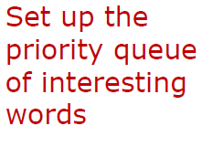

The pspam() Function
# import statements omitted to save space
def pspam(fn):
queue = WordQueue(15)
pbad = load_probabilities('email/bad.txt’)
pgood = load_probabilities('email/good.txt’)
with open(fn) as message:
for line in message:
for w in tokenize(line):
p = spamicity(w, pbad, pgood)
if p is not None:
queue.insert(w, p)
return combined_probability(queue)

Slide 56
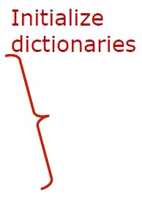
The pspam() Function
# import statements omitted to save space
def pspam(fn):
queue = WordQueue(15)
pbad = load_probabilities('email/bad.txt’)
pgood = load_probabilities('email/good.txt’)
with open(fn) as message:
for line in message:
for w in tokenize(line):
p = spamicity(w, pbad, pgood)
if p is not None:
queue.insert(w, p)
return combined_probability(queue)

Slide 57

The pspam() Function
# import statements omitted to save space
def pspam(fn):
queue = WordQueue(15)
pbad = load_probabilities('email/bad.txt’)
pgood = load_probabilities('email/good.txt’)
with open(fn) as message:
for line in message:
for w in tokenize(line):
p = spamicity(w, pbad, pgood)
if p is not None:
queue.insert(w, p)
return combined_probability(queue)

Slide 58

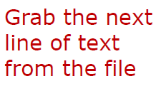
The pspam() Function
# import statements omitted to save space
def pspam(fn):
queue = WordQueue(15)
pbad = load_probabilities(
'email/bad.txt’)
pgood = load_probabilities(
'email/good.txt’)
with open(fn) as message:
for line in message:
for w in tokenize(line):
p = spamicity(w, pbad, pgood)
if p is not None:
queue.insert(w, p)
return combined_probability(queue)

Slide 59

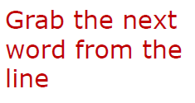
The pspam() Function
# import statements omitted to save space
def pspam(fn):
queue = WordQueue(15)
pbad = load_probabilities(
'email/bad.txt’)
pgood = load_probabilities(
'email/good.txt’)
with open(fn) as message:
for line in message:
for w in tokenize(line):
p = spamicity(w, pbad, pgood)
if p is not None:
queue.insert(w, p)
return combined_probability(queue)

Slide 60

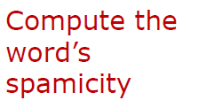
The pspam() Function
# import statements omitted to save space
def pspam(fn):
queue = WordQueue(15)
pbad = load_probabilities(
'email/bad.txt’)
pgood = load_probabilities(
'email/good.txt’)
with open(fn) as message:
for line in message:
for w in tokenize(line):
p = spamicity(w, pbad, pgood)
if p is not None:
queue.insert(w, p)
return combined_probability(queue)

Slide 61
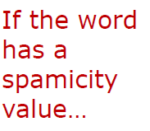

The pspam() Function
# import statements omitted to save space
def pspam(fn):
queue = WordQueue(15)
pbad = load_probabilities(
'email/bad.txt’)
pgood = load_probabilities(
'email/good.txt’)
with open(fn) as message:
for line in message:
for w in tokenize(line):
p = spamicity(w, pbad, pgood)
if p is not None:
queue.insert(w, p)
return combined_probability(queue)

Slide 62
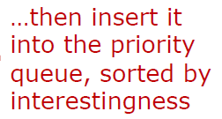

The pspam() Function
# import statements omitted to save space
def pspam(fn):
queue = WordQueue(15)
pbad = load_probabilities(
'email/bad.txt’)
pgood = load_probabilities(
'email/good.txt’)
with open(fn) as message:
for line in message:
for w in tokenize(line):
p = spamicity(w, pbad, pgood)
if p is not None:
queue.insert(w, p)
return combined_probability(queue)

Slide 63
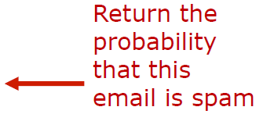
The pspam() Function
# import statements omitted to save space
def pspam(fn):
queue = WordQueue(15)
pbad = load_probabilities(
'email/bad.txt’)
pgood = load_probabilities(
'email/good.txt’)
with open(fn) as message:
for line in message:
for w in tokenize(line):
p = spamicity(w, pbad, pgood)
if p is not None:
queue.insert(w, p)
return combined_probability(queue)

Slide 64
pspam() Example #1
pspam('../PythonLabs/data/email/msg1.txt’)
Result: 0.92930483265 (high probability of spam)
File contents: (correctly identified as spam)
Hurting for funds right now?
It doesn't have to be that way. Here is 1,500 to ease
your pain: http://bulk.hideorganic.com/
171026390236329103248372180 Transfer immediately to the
account of your choice: http://bulk.hideorganic.com/
171026390236438808248372180 Take your time to pay off
this amazing loan. Small payment due in late September
or early October (and not all in one payment!).

Slide 65
pspam() Example #2
pspam('../PythonLabs/data/email/msg2.txt’)
Result: 4.400695206e-05 (practically a zero probability)
File contents: (correctly identified as non-spam)
Hi John:
Interesting that the key might be preventing ANY
crystals from being able to nucleate - which kicks off
a chain reaction and the whole thing goes to hell. Thus
the very clean pot and not allowing anything to splash
up onto the sides. Cooking really is chemistry! Thanks
for the links.
Susie
[... rest of message follows ...]

Slide 66
pspam() Example #3
pspam('../PythonLabs/data/email/msg3.txt')
Result: 0.05810198935 (low probability of spam)
File contents: (incorrectly identified as non-spam)
Guess what conery@cs.uoregon.edu!
AUTO CLEARANCE ENDS TONIGHT! : Price Drop On All
Vehicles
Want To Drive A Brand New Car Today For A Fraction Of
What You Thought You Would Pay?
Now You Can! Dealers Have Drastically Reduced MSRPs.
AVAILABLE ONLY UNTIL 10:00 PM TONIGHT! http://
server.beavercreekdistrict.com/
3813010413df842258012632451675
Click this link to unsubscribe: http://
server.beavercreekdistrict.com/
3813010413df528010632451675

Slide 67
pspam() Example #4
pspam('../PythonLabs/data/email/msg4.txt’)
Result: 3.758445e-15 (practically a zero probability)
File contents: (correctly marked as non-spam)
Hi John, I meant to ask you if you tried the revised
cat command. Were you able todo what you needed?
Regarding your lab meetings... sure, I could come and
give a brief description and answer any questions your
group members might have. My assistant, Erik, has just
put up more information from Chris' slides onto the
wiki that might be helpful. It would be helpful to me
if I knew in advance more specifically what kind of
questions to address before coming - perhaps you can
collect some at today's group meeting?
Cheers,Rob

Slide 68
Example: Date Decoder
Consider the task of converting a date from one format to another
A date of the form 8-MAR-85 includes the name of the month, which must be translated to a number
We can use a dictionary to map month names to numbers
Let’s consider a function date_decoder that uses string operations to split the date into its three parts
Then it translates the month to digits and corrects the year to include all four digits: 70-99 will be mapped to 1970-1999, and 00-69 will be mapped to 2000-2069
Finally, the function returns the tuple (y, m, d)
See date_decoder.py

Slide 69
Example: date_decoder.py
def date_decoder(date):
months = {'jan': 1, 'feb': 2, 'mar': 3, 'apr': 4,
'may': 5, 'jun': 6, 'jul': 7, 'aug': 8,
'sep': 9, 'oct': 10, 'nov': 11, 'dec': 12}
parts = date.lower().split('-’)
day = int(parts[0])
month = months[parts[1]]
year = 1900 + int(parts[2])
if int(parts[2]) <= 69:
year += 100
return year, month, day
print(date_decoder('8-MAR-85’))
print(date_decoder('17-Apr-25'))

Slide 70
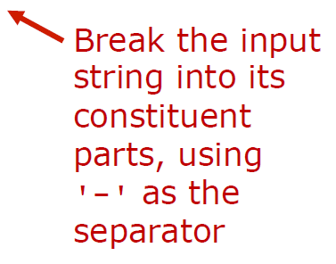
Example: date_decoder.py
def date_decoder(date):
months = {'jan': 1, 'feb': 2, 'mar': 3, 'apr': 4,
'may': 5, 'jun': 6, 'jul': 7, 'aug': 8,
'sep': 9, 'oct': 10, 'nov': 11, 'dec': 12}
parts = date.lower().split('-’)
day = int(parts[0])
month = months[parts[1]]
year = 1900 + int(parts[2])
if int(parts[2]) <= 69:
year += 100
return year, month, day
print(date_decoder('8-MAR-85’))
print(date_decoder('17-Apr-25'))

Slide 71

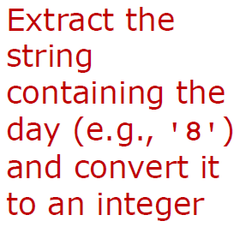
Example: date_decoder.py
def date_decoder(date):
months = {'jan': 1, 'feb': 2, 'mar': 3, 'apr': 4,
'may': 5, 'jun': 6, 'jul': 7, 'aug': 8,
'sep': 9, 'oct': 10, 'nov': 11, 'dec': 12}
parts = date.lower().split('-’)
day = int(parts[0])
month = months[parts[1]]
year = 1900 + int(parts[2])
if int(parts[2]) <= 69:
year += 100
return year, month, day
print(date_decoder('8-MAR-85’))
print(date_decoder('17-Apr-25'))

Slide 72

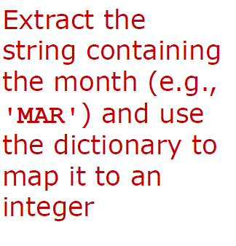
Example: date_decoder.py
def date_decoder(date):
months = {'jan': 1, 'feb': 2, 'mar': 3, 'apr': 4,
'may': 5, 'jun': 6, 'jul': 7, 'aug': 8,
'sep': 9, 'oct': 10, 'nov': 11, 'dec': 12}
parts = date.lower().split('-’)
day = int(parts[0])
month = months[parts[1]]
year = 1900 + int(parts[2])
if int(parts[2]) <= 69:
year += 100
return year, month, day
print(date_decoder('8-MAR-85’))
print(date_decoder('17-Apr-25'))

Slide 73
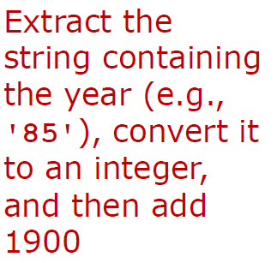
Example: date_decoder.py
def date_decoder(date):
months = {'jan': 1, 'feb': 2, 'mar': 3, 'apr': 4,
'may': 5, 'jun': 6, 'jul': 7, 'aug': 8,
'sep': 9, 'oct': 10, 'nov': 11, 'dec': 12}
parts = date.lower().split('-’)
day = int(parts[0])
month = months[parts[1]]
year = 1900 + int(parts[2])
if int(parts[2]) <= 69:
year += 100
return year, month, day
print(date_decoder('8-MAR-85’))
print(date_decoder('17-Apr-25'))

Slide 74
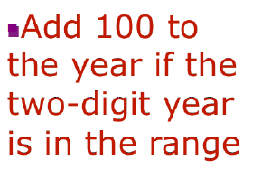
Example: date_decoder.py
def date_decoder(date):
months = {'jan': 1, 'feb': 2, 'mar': 3, 'apr': 4,
'may': 5, 'jun': 6, 'jul': 7, 'aug': 8,
'sep': 9, 'oct': 10, 'nov': 11, 'dec': 12}
parts = date.lower().split('-’)
day = int(parts[0])
month = months[parts[1]]
year = 1900 + int(parts[2])
if int(parts[2]) <= 69:
year += 100
return year, month, day
print(date_decoder('8-MAR-85’))
print(date_decoder('17-Apr-25'))

Slide 75
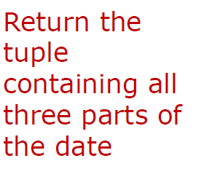
Example: date_decoder.py
def date_decoder(date):
months = {'jan': 1, 'feb': 2, 'mar': 3, 'apr': 4,
'may': 5, 'jun': 6, 'jul': 7, 'aug': 8,
'sep': 9, 'oct': 10, 'nov': 11, 'dec': 12}
parts = date.lower().split('-’)
day = int(parts[0])
month = months[parts[1]]
year = 1900 + int(parts[2])
if int(parts[2]) <= 69:
year += 100
return year, month, day
print(date_decoder('8-MAR-85’))
print(date_decoder('17-Apr-25'))

Slide 76
Example: date_decoder.py
def date_decoder(date):
months = {'jan': 1, 'feb': 2, 'mar': 3, 'apr': 4,
'may': 5, 'jun': 6, 'jul': 7, 'aug': 8,
'sep': 9, 'oct': 10, 'nov': 11, 'dec': 12}
parts = date.lower().split('-’)
day = int(parts[0])
month = months[parts[1]]
year = 1900 + int(parts[2])
if int(parts[2]) <= 69:
year += 100
return year, month, day
print(date_decoder('8-MAR-85’))
print(date_decoder('17-Apr-25'))

Slide 77

Example: date_decoder.py
def date_decoder(date):
months = {'jan': 1, 'feb': 2, 'mar': 3, 'apr': 4,
'may': 5, 'jun': 6, 'jul': 7, 'aug': 8,
'sep': 9, 'oct': 10, 'nov': 11, 'dec': 12}
parts = date.lower().split('-’)
day = int(parts[0])
month = months[parts[1]]
year = 1900 + int(parts[2])
if int(parts[2]) <= 69:
year += 100
return year, month, day
print(date_decoder('8-MAR-85’))
print(date_decoder('17-Apr-25'))

Slide 78
Example: Student Database
A dictionary can contain any data we like – this includes lists
Imagine we wanted to maintain lists of students organized by major
We could make a dictionary where the key is major (string) and the value for each key is the list of student names (a list of strings)
Consider a function add_stu that takes three arguments: a dictionary structured as described above, the name of a student, and the major for that student
The function adds the student to the database

Slide 79
Example: Student Database
def add_stu(majors, stu_name, stu_major):
majors.setdefault(stu_major, [])
majors[stu_major].append(stu_name)
The first line initializes the list of students in a major to be the empty list
This code is executed the first time a new major is encountered
The second line locates the list for a particular major
(majors[stu_major]) and then appends that student’s name to
the list with append(stu_name)

Slide 80
Example: Student Database
To see how this function works, first create an empty dictionary:
maj_dict = {}
Then we can call the function to add students one by one:
add_stu(maj_dict, 'Adam', 'CSE')
add_stu(maj_dict, 'Dave', 'CSE')
add_stu(maj_dict, 'Chris', 'ECO')
add_stu(maj_dict, 'Terry', 'AMS')
add_stu(maj_dict, 'Erin', 'CSE')
add_stu(maj_dict, 'Frank', 'ECO’)
major_dict = {‘CSE’: [‘Adam’, ‘Dave’, ‘Erin], ‘ECO’: [‘Chris’, ‘Frank’],
‘AMS’: [‘Terry’]}

Slide 81
Example: Student Database
We can answer several questions now:
Who is majoring in Computer Science?
cse_majors = maj_dict['CSE']
How many students are majoring in Economics?
num_econ = len(maj_dict['ECO'])
A dictionary does not support “reverse lookup”
Multiple keys could actually be mapped to the same value
For example, consider a dictionary where the keys are book titles and the values are authors
Since a single author might write several books, there is no way to reverse the title-to-author mapping and uniquely map authors to book titles

Slide 82
Example: Student Database
In the student example above, each student has exactly one major, so we could create a new dictionary that maps students to majors
To do this we will need to iterate over the keys of the maj_dict dictionary
Fortunately, there is a dictionary method that will help with this process:
keys()
stu_dict = {} # map: student -> major
# for each major:
for major in maj_dict.keys():
# for each student in that major:
for s in maj_dict[major]:
# record that student’s major
stu_dict[s] = major
stu_dict = {‘Adam’: ‘CSE’, ‘Dave’: ‘CSE’, ...}

Slide 83
Questions?

