Slide 1
Introduction to Programming Languages
CSE 307 – Principles of Programming Languages
SUNY Korea

Slide 2
Introduction
Computer users usually don't think about the billions of tiny electronic operations that go on each second.
The situation is (very roughly) similar to when you are driving your car. You think about the "big operations" it can perform, such as "accelerate", "turn left", "brake", and so on.
You don't think about tiny operations, such as the valves in your engine opening and closing 24,000 times per minute or the crankshaft spinning at 3000 revolutions per minute.
At the beginning there was only machine language: a sequence of bits that directly controls a processor, causing it to add, compare, move data from one place to another.

Slide 3
Machine Instructions
A machine instruction consists of several bytes in memory that tell the processor to perform one machine operation.
The processor looks at machine instructions in main memory one after another, and performs one machine operation for each machine instruction.
The collection of machine instructions in main memory is called a machine language program or (more commonly) an executable program.
Actual processors have many more machine instructions and the instructions are much more detailed. A typical processor has a thousand or more different machine instructions.
https://chortle.ccsu.edu/java5/Notes/chap04/ch04_4.html

Slide 4

GCD Program in x86
This program calculates GCD (Greatest Common Divider) of two integers using Euclid’s algorithm.
Written in machine language expressed as hexadecimal (base 16) numbers.
Instruction set used is x86.
It can be seen that writing larger programs quickly becomes error-prone.

Slide 5
Assembly Languages
Assembly languages were invented to allow operations to be expressed with mnemonic abbreviations.
The low-level assembly language is designed for a specific family of processors that represents various instructions in symbolic code and a more understandable form.
Assembly language is converted into executable machine code by a utility program referred to as an assembler like NASM, MASM, etc.

Slide 6
Assembly Language Syntax
INC COUNT ; Increment the memory variable COUNT
MOV TOTAL, 48 ; Transfer the value 48 in the
; memory variable TOTAL
ADD AH, BH ; Add the content of the
; BH register into the AH register
AND MASK1, 128 ; Perform AND operation on the
; variable MASK1 and 128
ADD MARKS, 10 ; Add 10 to the variable MARKS
MOV AL, 10 ; Transfer the value 10 to the AL register

Slide 7
Hello World in Assembly Language
section .text
global _start ;must be declared for linker (ld)
_start: ;tells linker entry point
mov edx,len ;message length
mov ecx,msg ;message to write
mov ebx,1 ;file descriptor (stdout)
mov eax,4 ;system call number (sys_write)
int 0x80 ;call kernel
mov eax,1 ;system call number (sys_exit)
int 0x80 ;call kernel
section .data
msg db 'Hello, world!', 0xa ;string to be printed
len equ $ - msg ;length of the string

Slide 8
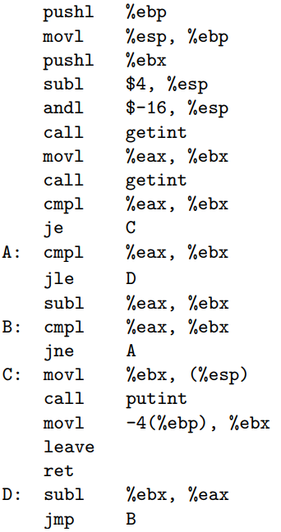
GCD program in Assembly Language

Slide 9
Introduction
Assemblers were eventually augmented with elaborate “macro expansion” facilities to permit programmers to define parameterized abbreviations for common sequences of instructions
Problem: each different kind of computer had to be programmed in its own assembly language
People began to wish for a machine-independent languages
These wishes led in the mid-1950s to the development of standard higher-level languages compiled for different architectures by compilers which translate high-level language code to assembly or machine level language.

Slide 10
Introduction
Compilers are more complicated than assemblers.
One-to-one correspondence between source and target languages does not exist with high-level languages.
Initial compilers (such as Fortran compilers) were slow as human programmers could also translate code with some efforts.
Over the time, performance gap narrowed and eventually reversed.
Better hardware and improvements in compiler technology generate code better and faster compared to a human being.

Slide 11
Introduction
Today there are thousands of high-level programming languages, and new ones continue to emerge. Why are there so many?
Evolution
E.g. goto-based control flow to while loop, case-switch statements
Object orientation (C++, Java), rapid development (python)
Special Purposes
Awk for string manipulation, C is good for low level system programming
Personal Preference
Terseness of C (using few words), recursive vs. iteration, pointers vs. not using pointers

Slide 12
Introduction
What makes a language successful?
easy to learn (python, BASIC, Pascal, LOGO, Scheme)
easy to express things (abstraction), easy use once fluent, "powerful” (C, Java, Common Lisp, APL, Algol-68, Perl)
easy to implement (Javascript, BASIC, Forth)
Easily available (portable copies of Pascal sent to universities)
possible to compile to very good (fast/small) code (Fortran, C)
Open source compiler or interpreter

Slide 13
Introduction
What makes a language successful?
Standardization of language and libraries to ensure effective portability of code across platforms (C vs. Java)
backing of a powerful sponsor (Java – SUN/Oracle, Visual Basic, COBOL , Ada – US Defense, PL/1 - IBM)
wide dissemination at minimal cost (Java, Pascal, Turing, erlang)
Choosing optimal language is a tradeoff
Consider viewpoints of programmer and implementor
Cost of implementation

Slide 14
Introduction
Why do we have programming languages? What is a language for?
way of thinking -- way of expressing algorithms
languages from the user's point of view
abstraction of virtual machine -- way of specifying what you want
the hardware to do without getting down into the bits
languages from the implementor's point of view

Slide 15
Why study programming languages?
Help you choose a language:
C vs. C++ for systems programming
Matlab vs. Python vs. R for numerical computations
Android vs. Java vs. ObjectiveC vs. Javascript for embedded systems
Python vs. Ruby vs. Common Lisp vs. Scheme vs. ML for symbolic data (not purely numerical) manipulation
Java RPC (JAX-RPC) vs. C/CORBA for networked PC programs

Slide 16
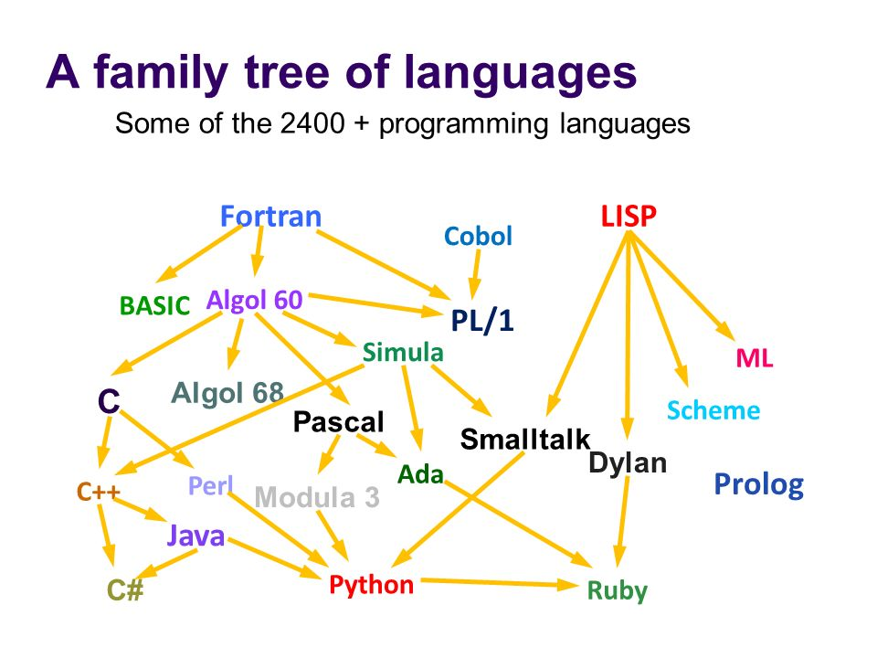
Why study programming languages?
Make it easier to learn new languages
some languages are similar: easy to walk down family tree

Slide 17
Why study programming languages?
concepts have even more similarity; if you think in terms of iteration, recursion, abstraction (for example), you will find it easier to assimilate the syntax and semantic details of a new language than if you try to pick it up in a vacuum.
Think of an analogy to human languages: good grasp of grammar makes it easier to pick up new languages (at least Indo-European – Albanian, Armenian, Balto-Slavic, Baltic, Slavic, Celtic, Germanic).

Slide 18
Why study programming languages?
Help you make better use of whatever language you use
understand obscure features:
In C, help you understand unions, arrays & pointers, separate compilation, catch and throw

Slide 19
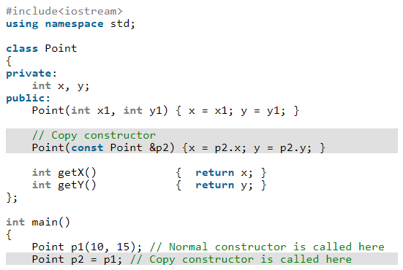
Why study programming languages?
understand implementation costs: choose between alternative ways of doing things, based on knowledge of what will be done underneath:
use simple arithmetic equal (use x*x instead of x**2)
Avoid unnecessary temporary variables and use copy constructors to minimize the cost of initialization

Slide 20
Why study programming languages?
figure out how to do things in languages that don't support them explicitly:
lack of recursion in Fortran, CSP, etc.
write a recursive algorithm then use mechanical recursion elimination (even for things that aren't quite tail recursive)
lack of suitable control structures in Fortran
use comments and programmer discipline for control structures
lack of named constants and enumerations in Fortran
use variables that are initialized once, then never changed

Slide 21
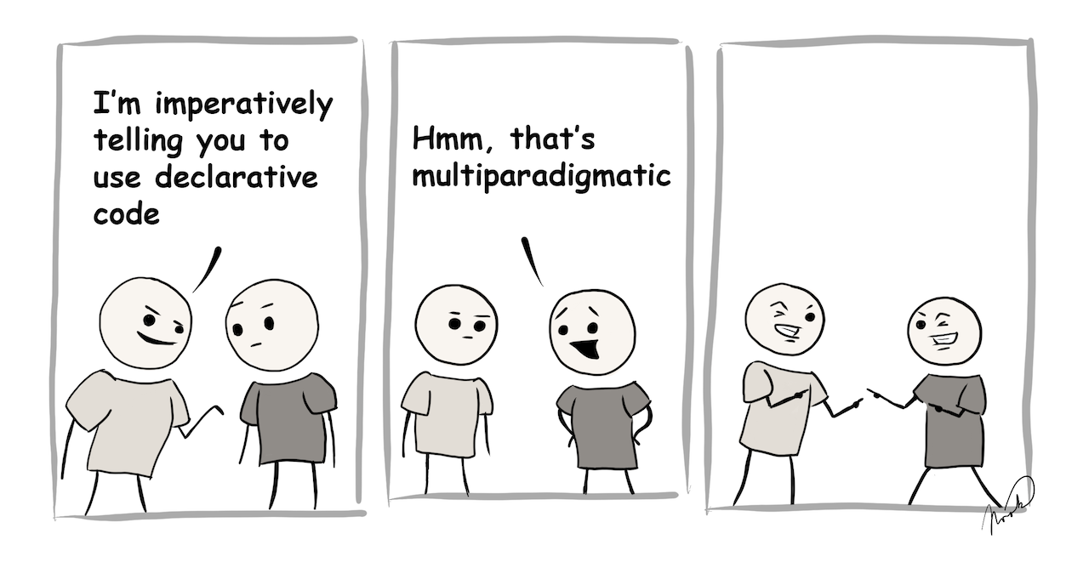
Imperative programming: Telling the “machine” how to do something, and as a result what you want to happen will happen. (e.g. Java code)
Declarative programming: Telling the “machine”1 what you would like to happen, and let the computer figure out how to do it. (e.g. HTML code, functional programming code)

Slide 22
Classifications
Many classifications group languages as:
imperative
von Neumann (Fortran, Pascal, Basic, C)
object-oriented (Smalltalk, Eiffel, C++?)
scripting languages (Perl, Python, JavaScript, PHP)
declarative
functional (Scheme, ML, pure Lisp, FP)
logic, constraint-based (Prolog, VisiCalc, RPG)
Markup languages (HTML)

Slide 23
Imperative languages
Imperative languages, particularly the von Neumann languages, predominate in industry

Slide 24
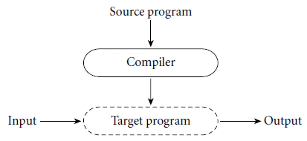
Compilation vs. Interpretation
Compilation vs. interpretation
not opposites
not a clear-cut distinction
Pure Compilation
The compiler translates the high-level source program into an equivalent target program (typically in machine language), and then goes away:

Slide 25

Compilation vs. Interpretation
Pure Interpretation
Interpreter stays around for the execution of the program
Interpreter is the locus of control during execution
Some language features are impossible without interpreter – e.g. in Lisp, program write new pieces of itself and execute on the fly

Slide 26
Compilation vs. Interpretation
Interpretation:
Greater flexibility and portability
Better diagnostics (debugging and error messages)
Compilation
Better performance!

Slide 27
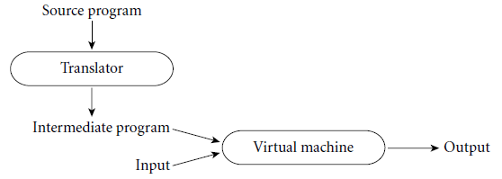
Compilation vs. Interpretation
Common case is compilation or simple pre-processing, followed by interpretation
Most modern language implementations include a mixture of both compilation and interpretation

Slide 28
Compilation vs. Interpretation
Note that compilation does NOT have to produce machine language for some sort of hardware
Compilation is translation from one language into another, with full analysis of the meaning of the input
Compilation entails semantic understanding of what is being processed; pre-processing does not
A pre-processor may do formatting, remove comments etc. but will often let errors through.

Slide 29
Compilation vs. Interpretation
Many compiled languages have interpreted pieces, e.g., formats in Fortran or C
Most compiled languages use “virtual instructions”
set operations in Pascal
string manipulation in Basic
Some compilers produce nothing but virtual instructions, e.g., Java bytecode, Pascal P-code, Microsoft COM+ (.net)

Slide 30
Compilation vs. Interpretation
Implementation strategies:
Preprocessor
Removes comments and white space
Groups characters into tokens (keywords, identifiers, numbers, symbols)
Expands abbreviations in the style of a macro assembler
Identifies higher-level syntactic structures (loops, subroutines)

Slide 31
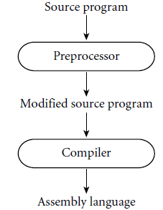
Compilation vs. Interpretation
Implementation strategies:
The C Preprocessor:
removes comments
expands macros

Slide 32
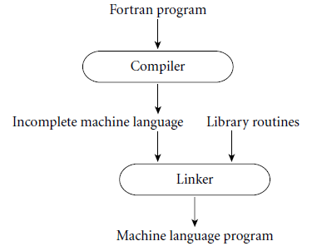
Compilation vs. Interpretation
Implementation strategies:
Library of Routines and Linking
Compiler uses a linker program to merge the appropriate library of subroutines (e.g., math functions such as sin, cos, log, etc.) into the final program:

Slide 33
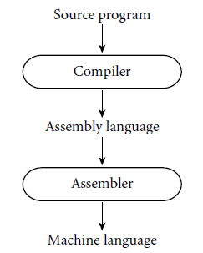
Compilation vs. Interpretation
Implementation strategies:
Post-compilation Assembly
Facilitates debugging (assembly language easier for people to read)
Isolates the compiler from changes in the format of machine language files (only assembler must be changed, is shared by many compilers)

Slide 34
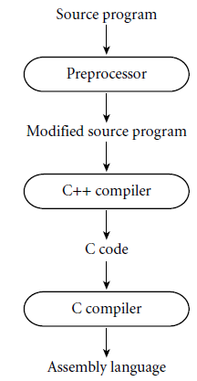
Compilation vs. Interpretation
Implementation strategies:
Source-to-Source Translation
C++ implementations based on the early AT&T compiler generated an intermediate program in C, instead of an assembly language

Slide 35
Compilation vs. Interpretation
Implementation strategies:
Bootstrapping: many compilers are self-hosting: they are written in the language they compile
How does one compile the compiler in the first place?
Response: one starts with a simple implementation—often an interpreter—and uses it to build progressively more sophisticated versions

Slide 36
Compilation vs. Interpretation
Implementation strategies:
Compilation of Interpreted Languages (e.g., Prolog, Lisp, Smalltalk, Java, C#):
Permit a lot of late binding
The compiler generates code that makes assumptions about decisions that won’t be finalized until runtime. If these assumptions are valid, the code runs very fast. If not, a dynamic check will revert to the interpreter.

Slide 37
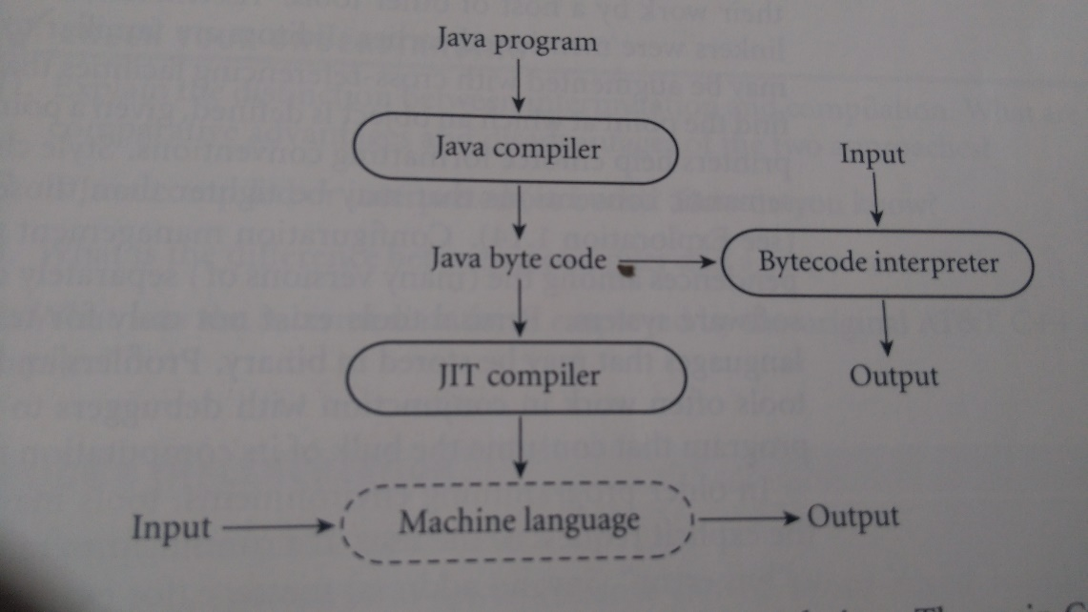
Compilation vs. Interpretation
Implementation strategies:
Dynamic and Just-in-Time Compilation
In some cases a programming system may deliberately delay compilation until the last possible moment. (Lisp, Prolog, java, C#)
The Java language definition defines a machine-independent intermediate form known as byte code. Bytecode is the standard format for distribution of Java programs that allows programs to be transferred easily over the Internet, and then run on any platform

Slide 38
Compilation vs. Interpretation
Implementation strategies:
Microcode
Assembly-level instruction set is not implemented in hardware; it runs on an interpreter.
The interpreter is written in low-level instructions (microcode or firmware), which are stored in read-only memory and executed by the hardware.

Slide 39
Compilation vs. Interpretation
Compilers exist for some interpreted languages, but they aren't pure:
selective compilation of compilable pieces and extra-sophisticated pre-processing of remaining source.
Interpretation is still necessary.
E.g., XSB Prolog is compiled into .wam (Warren Abstract Machine) files and then executed by the interpreter
Unconventional compilers:
text formatters: TEX and troff are actually compilers
silicon compilers: laser printers themselves incorporate interpreters for the Postscript page description language
query language processors for database systems are also compilers: translate languages like SQL into primitive operations (e.g., tuple relational calculus and domain relational calculus)

Slide 40
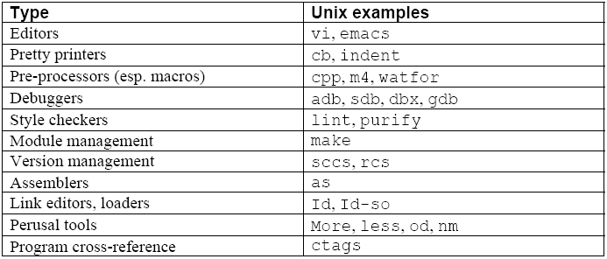
Programming Environment Tools
Tools/IDEs:
Compilers and interpreters do not exist in isolation
Programmers are assisted by tools and IDEs

Slide 41
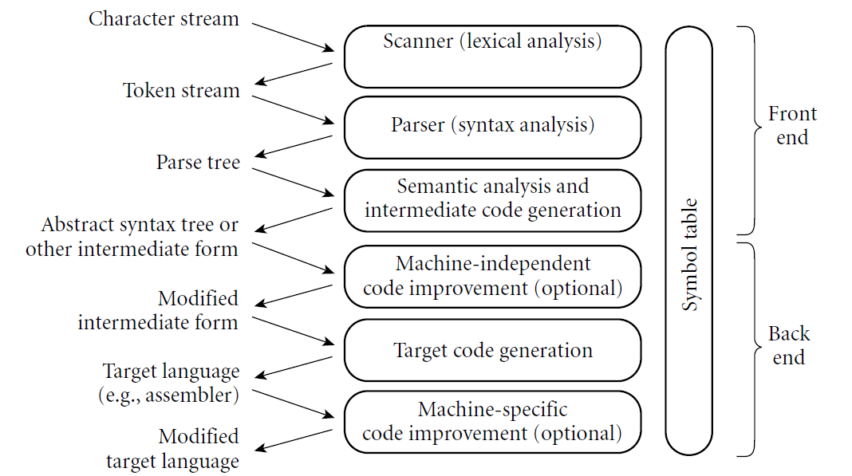
An Overview of Compilation
Phases of Compilation

Slide 42
An Overview of Compilation
Scanning:
divides the program into "tokens", which are the smallest meaningful units; this saves time, since character-by-character processing is slow
we can tune the scanner better if its job is simple; it also saves complexity (lots of it) for later stages
you can design a parser to take characters instead of tokens as input, but it isn't pretty
Scanning is recognition of a regular language, e.g., via DFA (Deterministic finite automaton)

Slide 43
An Overview of Compilation
Parsing is recognition of a context-free language, e.g., via PDA (Pushdown automaton)
Parsing discovers the "context free" structure of the program
Informally, it finds the structure you can describe with syntax diagrams (e.g., the "circles and arrows" in a language manual)

Slide 44
An Overview of Compilation
Semantic analysis is the discovery of meaning in the program
The compiler actually does what is called STATIC semantic analysis = that's the meaning that can be figured out at compile time
Some things (e.g., array subscript out of bounds) can't be figured out until run time. Things like that are part of the program's DYNAMIC semantics.

Slide 45
An Overview of Compilation
Intermediate Form (IF) is done after semantic analysis (if the program passes all checks)
IFs are often chosen for machine independence, ease of optimization, or compactness (these are somewhat contradictory)
They often resemble machine code for some imaginary idealized machine; e.g. a stack machine, or a machine with arbitrarily many registers
Many compilers actually move the code through more than one IF

Slide 46
An Overview of Compilation
Optimization takes an intermediate-code program and produces another one that does the same thing faster, or in less space
The term is a misnomer; we just improve code
The optimization phase is optional

Slide 47
An Overview of Compilation
Code generation phase produces assembly language or (sometime) relocatable machine language
Certain machine-specific optimizations (use of special instructions or addressing modes, etc.) may be performed during or after target code generation

Slide 48
An Overview of Compilation
Symbol table: all phases rely on a symbol table that keeps track of all the identifiers in the program and what the compiler knows about them
This symbol table may be retained (in some form) for use by a debugger, even after compilation has completed

Slide 49
An Overview of Compilation
Example, take the GCD Program (in C):
int main() {
int i = getint(), j = getint();
while (i != j) {
if (i > j) i = i - j;
else j = j - i;
}
putint(i);
}

Slide 50
An Overview of Compilation
Lexical and Syntax Analysis
GCD Program Tokens
Scanning (lexical analysis) and parsing recognize the structure of the program, groups characters into tokens, the smallest meaningful units of the program
int main ( ) {
int i = getint ( ) , j = getint ( ) ;
while ( i != j ) {
if ( i > j ) i = i - j ;
else j = j - i ;
}
putint ( i ) ;
}

Slide 51
An Overview of Compilation
Lexical and Syntax Analysis
Context-Free Grammar and Parsing
Parsing organizes tokens into a parse tree that represents higher-level constructs in terms of their constituents
Potentially recursive rules known as context-free grammar define the ways in which these constituents combine

Slide 52
An Overview of Compilation
Context-Free Grammar and Parsing
Grammar Example for while loops in C:
while-iteration-statement → while ( expression ) statement
statement, in turn, is often a list enclosed in braces:
statement → compound-statement
compound-statement → { block-item-list opt }
where
block-item-list opt → block-item-list
or
block-item-list opt → ϵ
and
block-item-list → block-item
block-item-list → block-item-list block-item
block-item → declaration
block-item → statement

Slide 53
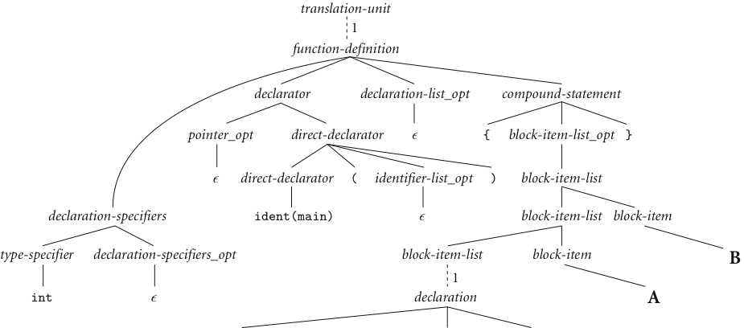
An Overview of Compilation
Context-Free Grammar and Parsing
GCD Program Parse Tree:
B
A
next slide

Slide 54
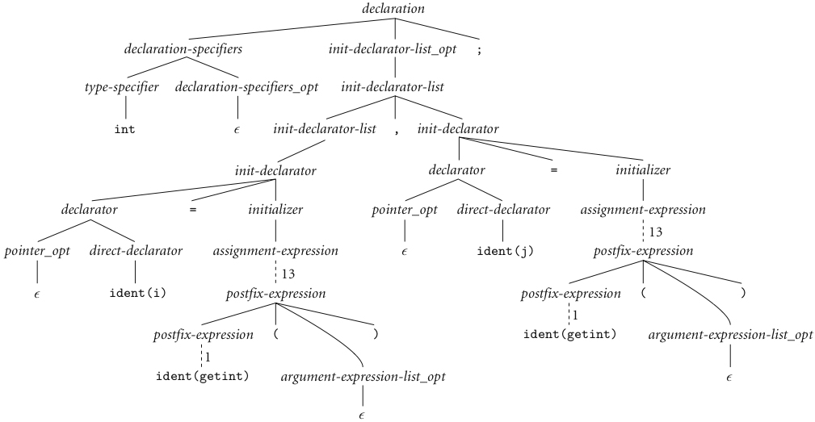
An Overview of Compilation
Context-Free Grammar and Parsing (continued)

Slide 55
An Overview of Compilation
Context-Free Grammar and Parsing (continued)
A
B

Slide 56
An Overview of Compilation
Semantic Analysis and Intermediate Code Generation
Semantic analysis is the discovery of meaning in a program
tracks the types of both identifiers and expressions
builds and maintains a symbol table data structure that maps each identifier to the information known about it
context checking
Every identifier is declared before it is used
No identifier is used in an inappropriate context (e.g., adding a string to an integer)
Subroutine calls provide the correct number and types of arguments.
Labels on the arms of a switch statement are distinct constants.
Any function with a non-void return type returns a value explicitly

Slide 57
An Overview of Compilation
Semantic analysis implementation
semantic action routines are invoked by the parser when it realizes that it has reached a particular point within a grammar rule.
Not all semantic rules can be checked at compile time: only the static semantics of the language
the dynamic semantics of the language must be checked at run time
Array subscript expressions lie within the bounds of the array
Arithmetic operations do not overflow

Slide 58
An Overview of Compilation
Semantic Analysis and Intermediate Code Generation
The parse tree is very verbose: once we know that a token sequence is valid, much of the information in the parse tree is irrelevant to further phases of compilation
The semantic analyzer typically transforms the parse tree into an abstract syntax tree (AST or simply a syntax tree) by removing most of the “artificial” nodes in the tree’s interior
The semantic analyzer also annotates the remaining nodes with useful information, such as pointers from identifiers to their symbol table entries
The annotations attached to a particular node are known as its attributes

Slide 59
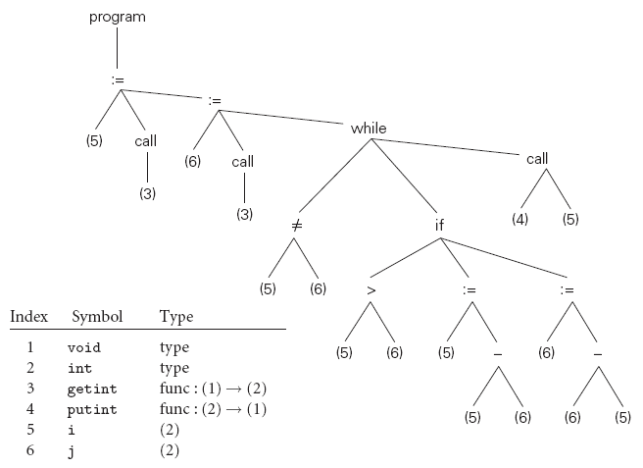
An Overview of Compilation
GCD Syntax Tree (AST)

Slide 60
An Overview of Compilation
In many compilers, the annotated syntax tree constitutes the intermediate form that is passed from the front end to the back end.
In other compilers, semantic analysis ends with a traversal of the tree that generates some other intermediate form
One common such form consists of a control flow graph whose nodes resemble fragments of assembly language for a simple idealized machine

Slide 61
An Overview of Compilation
Target Code Generation:
The code generation phase of a compiler translates the intermediate form into the target language
To generate assembly or machine language, the code generator traverses the symbol table to assign locations to variables, and then traverses the intermediate representation of the program, generating loads and stores for variable references, interspersed with appropriate arithmetic operations, tests, and branches

Slide 62
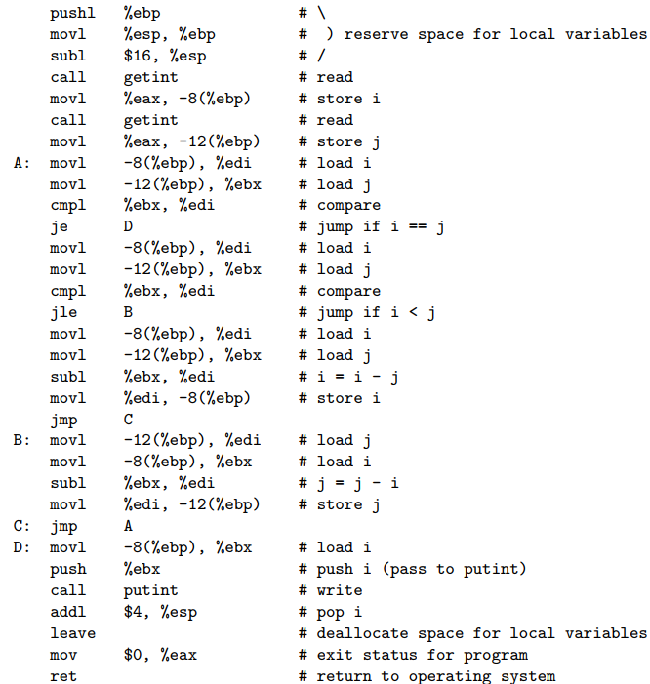
An Overview of Compilation
Target Code Generation:
Naive x86 assembly language for the GCD program

Slide 63
An Overview of Compilation
Some improvements are machine independent
Other improvements require an understanding of the target machine
Code improvement often appears as two phases of compilation, one immediately after semantic analysis and intermediate code generation, the other immediately after target code generation

Slide 64
HW1 (part of hw1)
Write and test the GCD Program in different languages, like C, Prolog, SML and Python:
In C:
int main() {
int i = getint(), j = getint();
while (i != j) {
if (i > j) i = i - j;
else j = j - i;
}
putint(i);
}
In XSB Prolog:
gcd(A,B,G) :- A = B, G = A.
gcd(A,B,G) :- A > B, C is A-B, gcd(C,B,G).
gcd(A,B,G) :- A < B, C is B-A, gcd(C,A,G).
In SML:
fun gcd(m,n):int = if m=n then n
= else if m>n then gcd(m-n,n)
= else gcd(m,n-m);
Due: on Blackboard.
In Python:
def gcd(a, b):
if a == b:
return a
else:
if a > b:
return gcd(a-b, b)
else:
return gcd(a, b-a)

