Slide 1

Spring 2019 CSE 308 : Software Engineering
Lecture 0 – Course Introduction

Slide 2
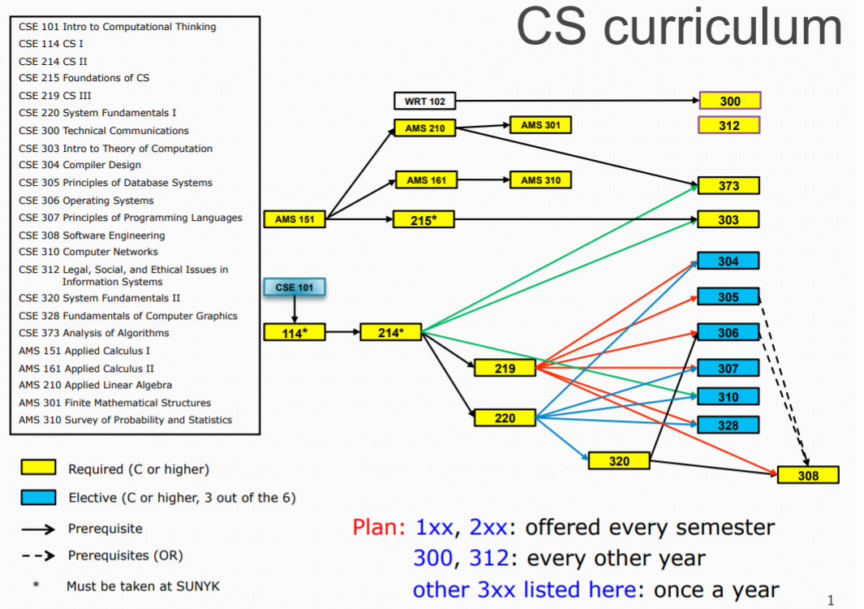

Slide 3
Course Information
CSE 308 : Software Engineering
Course webpage: https://ppawar.github.io/CSE308-S19/index.html
Meetings: Lecture: Mon/Wed 3:30-4:50 PM
Place: B206
Prerequisites: C or higher: CSE 219 or CSE 260; CSE 320; CE305 or CE306; CSE major.

Slide 4
Staff
Instructor
Pravin Pawar
Office: B424
Email: Pravin.pawar@sunykorea.ac.kr
Phone: +82-032-626-1227
Office Hours: Tue/Thu 10:30 AM - 12:00 PM, Wed 5:00 PM - 6:30 PM
Teaching Assistants
Undergraduate (tutoring TA):

Slide 5
Course Overview
Introduces the basic concepts and modern tools and techniques of software engineering. Emphasizes the development of reliable and maintainable software via system requirements and specifications, software design methodologies including object-oriented design, implementation, integration, and testing; software project management; life-cycle documentation; software maintenance; and consideration of human factor issues.
The students work in teams of about four people to produce a significant piece of software during the entire semester. Each team produces a Specification Document, a Design Document, and a Test Plan. Each team gives an oral presentation of a design review and a formal demonstration of their project at the end of the semester.

Slide 6
Major Course Topics
Agile software development methodology
Waterfall model, together with its variations and improvements
The UML (Universal Modeling Language)
Requirements Analysis
Use Case Modeling
Object Modeling
Functional Modeling
Dynamic Modeling using State Diagrams, Sequence Diagrams, and Activity Diagrams
Specification Documents
Design Documents
Testing -- Black Box, Glass Box and Test Plan Documents
Project Planning -- Pert Charts, Gantt Charts
Software Engineering tools
Oral and Written Communication

Slide 7

Textbook

Slide 8
The project
This semester the CSE308 project will be developing a mobile phone application of Commodity Ecology proposed by Dr. Mark D. Whitaker from the Department of Technology & Society at SUNY Korea. The United Nations acknowledged his leading work in understanding global commodity flows. See the following link for details:
https://academicimpact.un.org/content/commodity-ecology-initiative-facilitate-sustainable-development
The students will jointly work with Dr. Mark D. Whitaker (project customer) to understand the requirements of expected mobile application, approve the requirement specifications and develop this app to the level of satisfaction expected by him.
We will follow agile software development approach
Weekly scrum meetings

Slide 9
Project roles
For the group project, students will be divided into teams of four.
All students are expected to make contributions and the project benefits as a whole.
Note that all students are considered Software Engineers.
Additionally, students will be assigned the following roles:
Lead programmer
Project manager
Lead designer
Data designer

Slide 10
Lead Programmer
The lead programmer will be responsible for directing group decision-making regarding any technical aspects of the project, including design, implementation, and test decisions.
While not required, it would be helpful if this person has taken the Internet Commerce Programming and/or Principles of Database Systems courses.

Slide 11
Project Manager
A project manager drives the project, which means:
Working with the lead programmer to direct the meetings (i.e. make the meeting agenda, assign action items, follow up on action items, take meeting minutes)
Develop the Project Specifications
Help divide project responsibilities
Develop Gantt and Pert Charts for managing work measurement, forecasting, task breakdown, task assignment, and task dependencies
Makes sure the project is progressing at the proper rate while using available resources (i.e. team members) efficiently.
Will use project management software to organize the project.
Note that teams may decide to make this a floating position, rotating responsibility from one member to another.
At the end of the semester, full project management documentation must be provided specifying the full arc of the project.

Slide 12
Lead Designer
A lead designer is responsible for the look and feel, including interactivity, of the Web app.
This person should have a good taste.
Hopefully this person has some training in Web design or some knowledge of GUI Design Principles.
While not required, it would be helpful if this person has taken the Introduction to Web Design & Programming and/or User Interface Development courses.

Slide 13
Data Designer
This person is responsible for the data persisted to your site's database.
This means deciding what needs to be stored there and in what format to put it, and then making decisions regarding how to setup the database, how to update it, and how to make sure proper data is preserved and reset when necessary.
While not required, it would be helpful if this person has taken the Principles of Database Systems course.

Slide 14
Some Tips
Self-Learning is Key
While we'll touch upon some of the topics needed for building Web apps, much will be left for team members to discover on their own.
Early in the semester there will be an individual programming assignment that will introduce students to these technologies.
Becoming skilled at self-learning is not easy, but is one of the best way to avoid career obsolescence.
Well Defined Contributions
We will be using project management software this semester for managing all aspects of the development process.
It will involve carefully defining each student's responsibilities and contributions.
Students who fail to make expected contributions may receive a project grade lower than their teammates.
Team Programming

Slide 15
Late-work Policy
All assignments and milestones must be turned in by the due date and time.
Any part of an assignment that’s late means the entire assignment is late.
If your assignment is incomplete or not entirely working by the due date, turn in what you have to get some partial credit.
If you have an emergency situation, email me before the due date and I may be able to work something out
Bottom line: Plan ahead, start early!

Slide 16
Grading
Individual HW Assignment (10%):
An individual programming assignment that uses all the needed Web technologies.
6 March – 18 March.
Quizzes (10%, 3 quizzes given, lowest grade dropped)
Midterm Exam (20%)
Group Project (60% - divided over 4 milestones and final project presentation):
Software requirement specification along with wireframes (10%, due on 25 March)
Software design document and technology choices justification (10%, due on 10 April)
Alpha version and software test plan (10%, due on 29 April)
Beta version and test results (due on (10%, due on 15 May)
Final version along with deployment (20%, due on 5 June)
The final grade is based on the accumulated points from the individual HW assignment, mid-term exam and group project.

Slide 17
Re-Grading
To promote consistency of grading, questions and concerns about grading should be addressed first to the TA and then, if that does not resolve the issue, to the instructor.
You are welcome to contact the TA by email or come to his/her office hour. If you would like to speak with the TA in person, and have a schedule conflict with his/her office hour, you are welcome to make an appointment to meet the TA at another time.
For the assignments, quizzes and mid-term exams, request for re-grading must be made within one week from after the announcement of grades.

Slide 18
TA Assistance
TAs are available almost every day each week
Schedule is forthcoming (posted on course web)
In “CS Commons” (next to CSD office)
Come with specific questions and/or code with which you need help
TAs strive to spend time with everyone that comes to a session so be courteous and share the TA’s attention

Slide 19
Electronics in Class
Cell phones should be put away during class
Laptops may be used during periods where you are asked to work on an exercise during class
Lecture slides are available on the course website for study before class
Talk to me after class if there’s an issue with this policy

Slide 20
Disability
If you have a physical, psychological, medical or learning disability, please contact the Student Services and Career Team.
Location: Academic Building A208
Phone: 626-1190
The DSS will determine with you what accommodations, if any, are necessary and appropriate
All information and documentation of disability is confidential

Slide 21
How to Succeed in this Class
Attend class and be on time!
Not all information is in my lecture notes or in the book
I sometimes do in-class demos that emphasize non-obvious details
This is an introductory course, true, but we’re going to cover a lot of ground and move quickly starting from scratch
The assigned work will take a lot of your time, so practice good time management
Read the reading assignments and review the lecture notes and try out example code
Practice is the only way to become proficient at coding
Very often your first, second, or third attempt at solving a problem will not be successful. It is essential that you give yourself enough time to try different ideas, taking breaks along the way!
Those who write extra code for problems not assigned (“for fun”) generally do best in this class
Learning to code involves learning to read other people’s code
Ask questions right away if confused. Ask in class, ask a TA, come to my office hours or send email. Don’t stay confused and don’t get behind!
Welcome and I hope you enjoy the class!

