Slide 1

CSE353 – machine learning Environment setup
Pravin pawar, suny korea

Slide 2
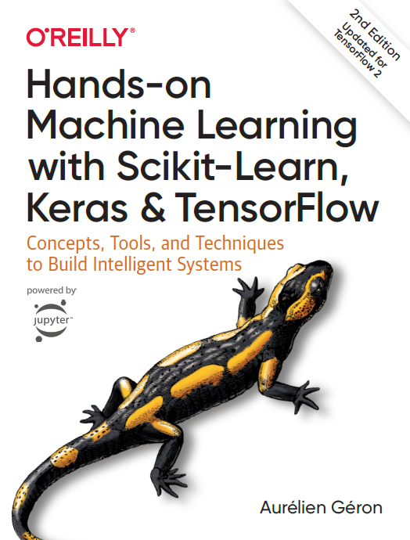
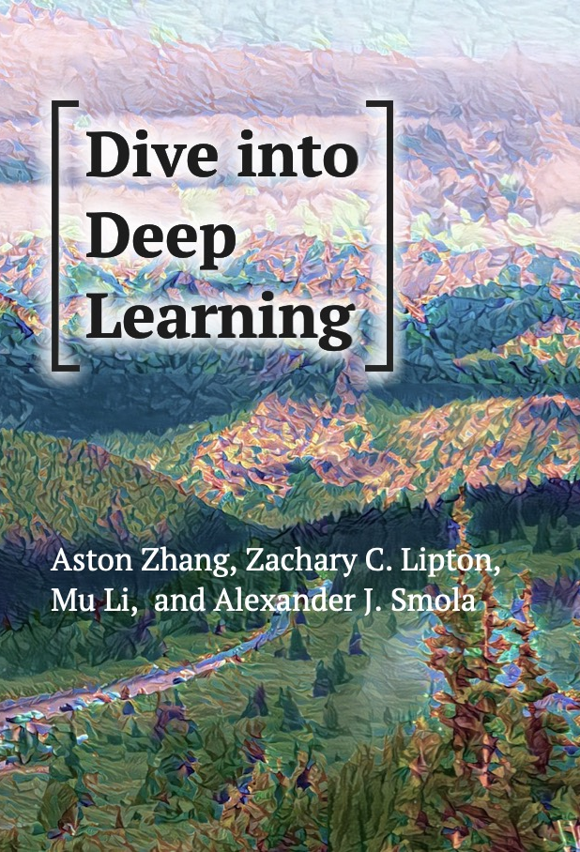
Programming Environment setup – as PER following textbooks

Slide 3
Machine learning with Python
Get Data
Data Pre-proc essing
Analysis And Modeling
Evaluate And Present
Beautiful Soup
LXML
Tweepy
Pandas
Pandas
NLTK
Scikit
Matplotlib
Numpy
Scipy
Sympy
Sklearn
Tensorflow
IPython
Bokeh
Flask

Slide 4
Anaconda/MINICONDA installation
Anaconda: Anaconda is a package manager, an environment manager, a Python/R data science distribution, and a collection of over 7,500+ open-source packages.
Anaconda installation instructions: https://docs.anaconda.com/anaconda/install/
Miniconda: Miniconda is a free minimal installer for conda. It is a small, bootstrap version of Anaconda that includes only conda, Python, the packages they depend on, and a small number of other useful packages, including pip, zlib and a few others.
Miniconda installation instructions: https://conda.io/projects/conda/en/latest/user-guide/install/index.html
Conda: Conda is an open source package management system and environment management system that runs on Windows, macOS and Linux.
Conda is able to create isolated environments that can contain different versions of Python and/or the packages.
Pip: Pip is a de facto standard package-management system used to install and manage software packages written in Python.
Pip installs Python packages whereas conda installs packages which may contain software written in any language. For details see: https://www.anaconda.com/blog/understanding-conda-and-pip

Slide 5
DIVE into deep learning – environment setup
Follow instructions given at: https://d2l.ai/chapter_installation/index.html
Install MXNET/PYTORCH/TENSORFLOW in the d2l environment you have created.
Add environment in IPythonKernel using: python -m ipykernel install --user --name=d2l
Open jupyter notebook, select d2l environment
Try to run ipynb files in chapter_preliminaries
There might be some issues in using PyTorch
https://github.com/pytorch/pytorch/issues/42078
Try downgrading torchversion to 0.4.0
pip uninstall torchvision
pip install torchvision==0.4.0 -f https://download.pytorch.org/whl/torch_stable.html
There might be issues with Tensorflow
Uninstall cloudpickle using pip uninstall cloudpickle
Install 1.3.0 version using pip install cloudpickle==1.3.0

Slide 6
Handson machine learning – environment setup
Open Github page: https://github.com/ageron/handson-ml2
Download Github repository
Follow installation procedure at https://github.com/ageron/handson-ml2/blob/master/INSTALL.md
Add environment in IPythonKernel using: python -m ipykernel install --user --name=tf2
Open jupyter notebook, select tf2 environment
Try to run 01_the_machine_learning_landscape.ipynb
In case of problems, change the name of environment to ml2 in file environment.yml or environment-windows.yml
Repeat installation procedure
Add environment in IPythonKernel using: python -m ipykernel install --user --name=ml2
Open jupyter notebook, select ml2 environment
Try to run 01_the_machine_learning_landscape.ipynb

Slide 7
Questions?

