Slide 1
Introduction to Computational and Algorithmic Thinking
Lecture 4 – SearchinG and Sorting algorithms. Scalability

Slide 2
Announcements
This lecture: Searching and Sorting Algorithms. Scalability
Reading: Read Chapter 4 of Conery
Acknowledgement: Some of the lecture slides are based on CSE 101 lecture notes by Prof. Kevin McDonald at SBU and the textbook by John Conery.

Slide 3
Searching and sorting
Searching is a common operation in many different situations:
Finding a file on your computer (e.g., Spotlight on MacOS, Search box in Windows Explorer)
Online dictionaries and catalogs
The “find” command in a word processor or text editor
Looking for a book, either on a bookshelf at home or in a library
Finding a name in a phone book or a word in a dictionary
Searching a file drawer to find customer information or student records

Slide 4
Searching and sorting
What these searching problems have in common:
We have a potentially large collection of items
We need to search the collection to find a single item that matches a certain condition (e.g., name of book/name of a person)
Sorting involves reorganizing information so it’s in a particular order
Sorting could help for faster searching
There are many algorithms available for both searching and sorting of data

Slide 5
Iterative algorithms
In this Unit we will look at one algorithm each for searching and sorting, and explore more later
Both algorithms are iterative and rely heavily on loops
Searching algorithm: linear search
Sorting algorithm: insertion sort
We will use the IterationLab module to help us explore these two algorithms

Slide 6
Linear search
Linear search is the simplest, most straightforward search strategy
As the name implies, the idea is to start at the beginning of a collection and compare items one after another
Also called sequential search because the elements of the collection are examined sequentially
Recall the index method for lists, which tells us the position of an element in a list
Example:
notes = ['do', 're', 'me', 'fa', 'sol', 'la', 'ti’]
notes.index('sol’) # will return the value 4
The index method is performing a search, in fact

Slide 7
Linear search
Also recall the in operator, which tells us if an element is present in a list
This operator is necessary because the index method will cause our program to crash if the element we want is missing
if 'sol' in notes:
print('Present in list...')
else:
print('Not present in list...’)

Slide 8
Linear search
The linear search function in IterationLab, isearch, is like Python’s index method
Pass it a list and an item to search for
If the item is in the list, the function returns the location where it was found
If the item is not in the list, the function returns None
Examples:
from PythonLabs.IterationLab import isearch
notes = ['do', 're', 'me', 'fa', 'sol', 'la', 'ti']
print(isearch(notes, 'ti')) # returns 6
print(isearch(notes, 'ba')) # returns None
See isearch_tests.py if you installed PythonLabs

Slide 9
PythonLabs: RandomList
For our experiments on searching and sorting algorithms we’re going to need some data to test our programs
The lab module defines a special type of list called a RandomList
We can make lists of integers or strings
The list will not contain any duplicates
When we do a searching experiment, we can use items we know are in the list (so the search succeeds) or not in the list (so the search fails)

Slide 10
RandomList examples
List of 10 random integers:
from PythonLabs.Tools import RandomList
rand_nums = PythonLabs.Tools.RandomList(10)
print(rand_nums)
Sample output:
[84, 62, 76, 24, 80, 42, 17, 54, 7, 14]
List of 5 random fish (!!!):
fish = PythonLabs.Tools.RandomList(5, 'fish’)
print(fish)
Sample output:
['black bass', 'halibut', 'herring’,
'flounder', 'mackerel’]

Slide 11
RandomList examples
After we make a RandomList object, we can ask it to give us a randomly chosen item from the list
First let’s search for a fish that is in the list:
success_fish = fish.random('success')
isearch(fish, success_fish) # returns 4
Now let’s request the name of a fish that is not in the list:
fail_fish = fish.random('fail’)
isearch(fish, fail_fish) # returns None
See isearch_tests.py

Slide 12
Visualizing isearch()
IterationLab supports visualization of isearch
Visualizing the action will help us design and implement the algorithm
First, make a list of random integers
Next, print the list in the terminal window
Then, pick a random number to search for
Next, display the list on the canvas (works only for integers)
Finally, call the isearch function on the list and display the result
The Python code for this algorithm is given on the next slide and in isearch_visualization.py

Slide 13

Visualizing isearch()
from PythonLabs.IterationLab import view_list, isearch
from PythonLabs.Tools import RandomList
nums = RandomList(20)
print('nums: ' + str(nums))
target = nums.random('success')
print('target: ' + str(target))
view_list(nums)
result = isearch(nums, target)
print('result: ' + str(result))

Slide 14
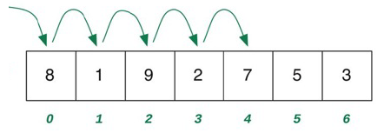
Implementing linear search
One way to write our own version of isearch is to use a for-loop with a range expression
def isearch(a, x):
for i in range(len(a)):
if a[i] == x:
return i
return None
Some explanation: the i variable acts as an index into a
We do this so that we can return the position (index) of the target element, x, in the list

Slide 15
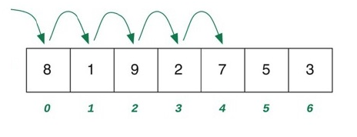
Implementing linear search
def isearch(a, x):
for i in range(len(a)):
if a[i] == x:
return i
return None
If the item is found, the first return statement tells Python to exit the loop and return before the iteration is done
If the item is not in the list, the loop terminates and the other return statement is executed returning None

Slide 16
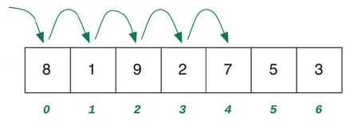
while-loops
Another way to write the function is shown below
def isearch(a, x):
i = 0
while i < len(a):
if a[i] == x:
return i
i = i + 1
return None
The while statement is another kind of loop available in Python that is just as important as the for statement

Slide 17
while-loops
def isearch(a, x):
i = 0
while i < len(a):
if a[i] == x:
return i
i = i + 1
return None
Python evaluates the Boolean expression next to the keyword while
If the expression is true, the statements in the body of
the loop are executed
Python then goes back to the top of the loop to
evaluate the Boolean expression again

Slide 18
while-loops
The loop terminates when the Boolean expression becomes false
Note that the index variable I must be initialized before the
while statement
The i variable is updated inside of the loop
If i never changes, the program will be caught in an infinite loop
def isearch(a, x):
i = 0
while i < len(a):
if a[i] == x:
return i
i = i + 1
return None

Slide 19
while-loops vs. for-loops
Why does Python give us two ways to write loops?
for-loops are convenient, but some algorithms need to look at items in a different order
for-loops are appropriate when you know or can calculate the number of times the loop’s body must be executed
Sometimes we can’t determine ahead of time the number of repetitions, so we use a while-loop instead
So, for-loops are perfect for visiting every element of a list, and while-loops are the better choice for most other situations

Slide 20
while-loops vs. for-loops
Advice: unless there is a good reason to use a while-loop, write your loops with for statements
Python takes care of initializing and updating the index variable
Programs will be shorter, simpler and less likely to contain errors
The single line of code for i in range(len(a)) would require three lines if written as a while-loop:
i = 0
while i < len(a):
...
i = i + 1

Slide 21
Linear search: performance
The linear search algorithm looks for an item in a list
Start at the beginning (a[0], or “the left”)
Compare each item, moving systematically to the right (i = i + 1)
How many comparisons will the linear search algorithm make as it searches through a list with n items?
Another way to phrase it: how many iterations will our Python function make in its while-loop?
Well, it depends on whether the search is successful or not, doesn’t it?!

Slide 22
Linear search: performance
For an unsuccessful search:
Visit every item before returning None
i.e., make n comparisons
For a successful search, anywhere from 1 and n interactions are required
Search may be lucky and find the item in the first location
At the other extreme, the item might be in the last location
Expect, on average, n/2 comparisons

Slide 23
Example: the Luhn Algorithm
The Luhn algorithm checks if an account number (such as a credit card number) is valid
It works like this:
1. Process each digit in turn, from right to left. The rightmost digit is treated as being in position #1.
Odd-positioned digits are added as-is to a running total.
Even-positioned digits are doubled. If that doubled value is less than 10, add it to the running total. Otherwise, add the two digits individually to the running total.
2. If the sum is a multiple of 10, the account number is valid. Otherwise it isn’t.

Slide 24
Example: the Luhn Algorithm
Here’s an example of this computation
Account number 79927398713
Odd-positioned values: 3, 7, 9, 7, 9, 7 (remember: indexes start from 1 for this algorithm)
Add them: 3+7+9+7+9+7=42
Even-positioned values: 1, 8, 3, 2, 9
Even-positioned values doubled: 2, 16, 6, 4, 18
16 and 18 are both > 10, so we will add 7 (1 + 6) and 9 (1 + 8) to the total
Add: 42+2+7+6+4+9=70
70 is divisible by 10, so the account number is valid

Slide 25
Example: the Luhn Algorithm
We know how to tell if a number is divisible by 10, right?
The remainder operator (%):
if num % 10 == 0: # say "num mod 10"
# stmts for when num is divisible by 10
else:
# stmts for when num is not div. by 10
We also know how to tell if a number is even or odd, right?

Slide 26
Example: the Luhn Algorithm
Sometimes it is useful (or necessary) to put one if-statement inside of another if-statement
These are known as nested if-statements as we saw in our last PS
We will find nested if-statements useful in implementing the Luhn algorithm
Python source code for the algorithm is given in a few slides, but see the file luhn.py itself for fully-commented code that explains every line of the source code

Slide 27
Example: the Luhn Algorithm
Some additional Python functionality that will be useful in implementing the Luhn algorithm:
We can write *= and //= to multiply or divide (respectively) one number by another
Example: salary *= 3 would triple the value stored in variable salary
To extract digits one-by-one from an integer, we can use repeated division by 10:
num % 10 would give us the rightmost digit of 10
num //= 10 would then remove that digit from num
Suppose num is 942. num % 10 would give us 2
Then num //= 10 would change num from 942 to 94

Slide 28
Example: luhn.py
def luhn(number):
total = 0
position = 1
while number > 0:
digit = number % 10
if position % 2 == 1:
total += digit
else:
digit *= 2
if digit >= 10:
total += 1 + (digit % 10)
else:
total += digit
number //= 10
position += 1
return total % 10 == 0

Slide 29
Sorting
The linear search algorithm is an example of an iterative algorithm
Start at the beginning of a collection
Systematically progress through the collection, all the way to the end, if necessary
A similar strategy can be used to sort the items in a list
We will now look at a simple, iterative sorting algorithm known as insertion sort
The basic idea is:
Pick up an item, find the place it belongs, insert it back into the list
Move to the next item and repeat

Slide 30
Insertion sort
The important property of the insertion sort algorithm: at any point in this algorithm, part of the list is already sorted
More specifically, the left-hand part of the list is the sorted part and the right-hand part is still unsorted
The initial item to work on is at index 1
Pick up the current item
Scan the left-hand part backwards from that index until we find an item lower than the current item or we arrive at the front of the list, whichever comes first
Insert the current item back into the list at this location
The next item to work on is to the right of the original location of the item
Go back to step 2

Slide 31
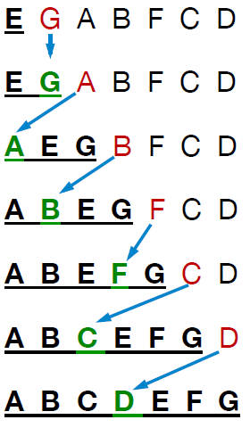
Insertion sort example
The example here illustrates the general idea
The underlined letters constitute the sorted part of the array
Initially, the leftmost item is considered to be in a sorted sub-list
by itself, and all the other items are in an adjoining unsorted sub-list
The leftmost item in the unsorted sub-list is selected and inserted into
its correct position in the sorted sub-list

Slide 32
Insertion sort in Python (almost)
def isort(a):
i = 1
while i < len(a):
x = a[i]
remove x from a
j = location for x
insert x at a[j+1]
We have a couple of obvious gaps in this pseudocode, but we’re on our way to writing a Python function that implements insertion sort

Slide 33
Insertion sort in Python (almost)
The figure on the next slide shows the core part of the algorithm:
Select the next item (step (a))
Remove the item from the list (step (b))
Determine at which index the item should go (step (b) also)
Insert the item at that index (step (c))
When we’re working on the item at index 3, the values to the left (indexes 0 through 2) have been sorted
The statements in the body of the while-loop find the new location for this item and insert it back into the list

Slide 34
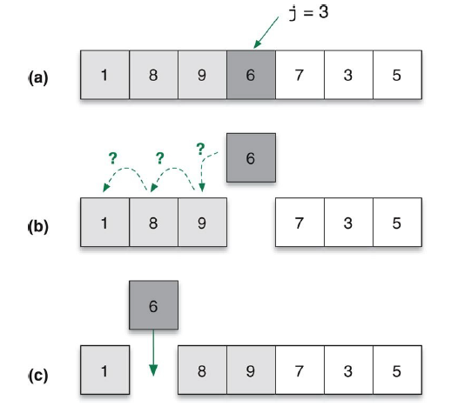
Insertion sort in Python (almost)

Slide 35

Visualizing inserting sort
Before delving any deeper yet into the code, it might be helpful to watch a visualization of insertion sort in action
See isort_visualization.py
Also see http://visualgo.net/en/sorting
from PythonLabs.IterationLab
import view_list, isort
from PythonLabs.Tools
import RandomList
nums = RandomList(20)
print('nums before sorting: ' + str(nums))
view_list(nums)
isort(nums)
print('nums after sorting: ' + str(nums))

Slide 36
Moving items in a list
In order to implement the steps in the body of the main loop we need to know:
How to remove an item from the middle of a list
How to insert an item into a list
Both operations are performed by methods of the list class
Call a.pop(i) to delete the item at location i in list a
The method returns the item that was deleted
Call a.insert(i, x) to insert item x into the list a at location i
Some examples of these methods are on the next slide

Slide 37
Moving items in a list
Suppose we had a random list of seven chemical elements (e.g., oxygen, hydrogen, etc.):
a = RandomList(7, 'elements’)
a: ['Co', 'Tm', 'U', 'Hs', 'F', 'Rn', 'Y']
Now let's remove the item at index 4 and save it in x:
x = a.pop(4) # x will contain 'F'
The list a will become:
['Co', 'Tm', 'U', 'Hs', 'Rn', 'Y']
Let’s insert the element at index 2:
a.insert(2, x)
The list a will become:
['Co', 'Tm', 'F', 'U', 'Hs', 'Rn', 'Y’]

Slide 38
Finding where an item belongs
During the insertion sort algorithm, after we pull an item out of the list, we have to find the location to re-insert it
We’ll use an index variable j to specify which locations we are checking
Subtracting 1 from j will tell Python to move “left” during its search
We can use a while-loop that keeps subtracting 1 from j until it finds the place where item x belongs
while a[j-1] > x: # preliminary version
j = j – 1 # of loop

Slide 39
Finding where an item belongs
There is a potential problem with this strategy: what if x is smaller than everything to its left?
The loop will reach a point where j = 0 and there is nothing remaining to compare
It will try to compare x to a[-1], which is an error (index out of bound)
The solution is to keep iterating only if j > 0 and the item to the left is greater than x
while j > 0 and a[j-1] > x: # final version
j = j – 1 # of loop

Slide 40
moveLeft()
We can now write a helper function named moveLeft that inserts an item where it needs to go
A call to moveLeft(a, j) will remove the item at a[j] and insert it back into a where it belongs
def moveLeft(a, j):
x = a.pop(j)
while j > 0 and a[j-1] > x:
j -= 1
a.insert(j, x)
Example: let a = [1, 3, 4, 6, 2, 7, 5]
After moveLeft(a, 4), a is [1, 2, 3, 4, 6, 7, 5]

Slide 41
Completed isort() function
With a helper function to move items, writing isort is easy
Use a for-loop where an index variable i marks the start of the unsorted region
Initially i will be 1 (the single item at a[0] is a sorted region of size 1)
In the body of the loop, just call moveLeft to move the item at location i to its proper position
isort is the top-level function called to solve the entire problem of sorting a list of numbers
def isort(a):
for i in range(1, len(a)):
moveLeft(a, i)

Slide 42
Completed isort() function
def isort(a):
for i in range(1, len(a)):
moveLeft(a, i)
An example of how to use the isort function:
nums = RandomList(10)
isort(a)
# a is now sorted
See also isort_visualization.py if you installed PythonLabs

Slide 43
Aside: Boolean operators
In the process of implementing the moveLeft function we used a new Python keyword: and
and, or and not are three of the Boolean operators that Python provides for writing Boolean conditions in if-statements and while-loops
p and q: True only when Boolean variables p and q are both True
p or q: True if either p or q (or both of them) is True
Note how this differs from the “or” used in everyday English
not p: True if p is False; and False if p is True

Slide 44
Aside: Boolean operators
Complex expressions can also have parentheses to form groups, as in p and not (q or r)
Python performs a kind of “lazy evaluation”, meaning it evaluates a Boolean expression according to the rules of precedence and stops as soon as it can determine if the entire expression will be True or False
For example, Python will evaluate the j > 0 part of while j > 0 and a[j-1] > x before the a[j-1] > x part
If it determines that j > 0 is False, there is no need to evaluate a[j-1] > x because False and "anything" is always False

Slide 45
Example: Is it a leap year?
Let’s look at an example of Boolean expressions
A year is a leap year if:
It is greater than 1582, and
It is divisible by 4, except centenary years not divisible by 400 (e.g., 1700, 1800, 1900, 2100, etc.)
Here is one way of expressing this definition in code:
if the year is divisible by 4 and not 100, then it is a leap year
else, if the year is divisible by 400, then it is a leap year
otherwise, the year is not a leap year
This logic is implemented in the code on the next slide, color-coded to map the algorithm to Python code

Slide 46
Example: leapyear.py
year = int(input('Enter a year: ‘))
if year < 1582:
print('You must enter a year >= 1582.')
else:
if ((year % 4 == 0) and (year % 100 != 0)) or
(year % 400 == 0):
print('That is a leap year.’)
else:
print('That is NOT a leap year.’)
Example leap years: 2012, 2000, 2400
Not leap years: 2003, 1900

Slide 47
Example: Crazy grading scheme
Let’s look at another example of Boolean expressions
Students in Prof. Smith’s math class take two regular exams and a final exam. The course grade is usually calculated as:
(25% * exam #1 score) + (25% * exam #2 score)
+ (50% * final exam score)
However, if a student scores less than a 60 on exam #1 or exam #2 (or both), he or she fails the course with a grade of 50, regardless of the other grades (Rule #1)
Or, if a student scores 90 or higher on both exam #1 and exam #2, the course grade is the average of these two scores, provided that the normal weighted course average is less than the average of those two scores (Rule #2)

Slide 48
Example: Crazy grading scheme
Here are some examples of how the rules apply
exam #1: 48 exam #2: 92 final exam: 89
Rule #1 applies: the grade is 50
exam #1: 92 exam #2: 91 final exam: 60
Rule #2 applies because the average of 92 and 91 is greater than the normal weighted grade
exam #1: 92 exam #2: 91 final exam: 100
Don’t apply Rule #2 because the normal weighted grade is higher than the average of 92 and 91
exam #1: 62 exam #2: 90 final exam: 75
Neither one of the special rules applies, so we just take the normal weighted grade

Slide 49
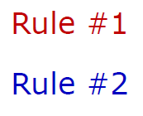
Example: grades.py
def compute_grade(exam1_score, exam2_score,
final_exam_score):
normal = 0.25 * exam1_score + 0.25 * exam2_score
+ 0.5 * final_exam_score
if exam1_score < 60 or exam2_score < 60:
grade = 50
elif exam1_score >= 90 and
exam2_score >= 90 and
exam1_score + exam2_score) / 2 > normal:
grade = (exam1_score + exam2_score) / 2
else:
grade = normal
return grade

Slide 50
isort: Algorithm performance
We saw earlier that for a list with n items we can expect, on average, to do n/2 comparisons during a linear search
Can we come up with a similar equation for insertion sort?
At first glance, it might seem that insertion sort is a “linear” algorithm like linear search
It has a for-loop that progresses through the list from left to right
But remember that moveLeft also contains a loop
The step that finds the proper location for the current item is also a loop
It scans left from location i, going all the way back to 0 if necessary

Slide 51
isort: Algorithm performance
If we write isort without the moveLeft helper function, we can
see that one loop is inside another
def isort(a):
for i in range(1, len(a)):
j = i
x = a.pop(j)
while j > 0 and a[j-1] > x:
j = j - 1
a.insert(j, x)

Slide 52
isort: Algorithm performance
The outer loop has the same structure as the iteration in
linear search
A list index i ranges from 1 up to n-1
At any time, the items to the left of i are sorted
The inner loop moves a[i] to its proper location in the sorted region
The size of the sorted region grows on each iteration
We need to understand nested loops a bit better to be able to analyze this code
def isort(a):
for i in range(1, len(a)):
j = i
x = a.pop(j)
while j > 0 and a[j-1] > x:
j = j - 1
a.insert(j, x)

Slide 53
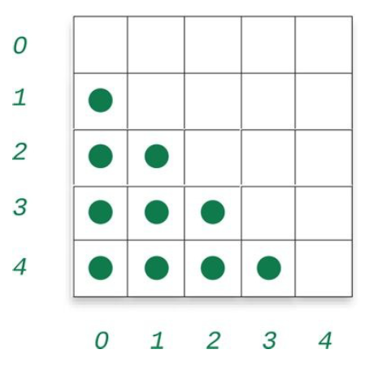
Nested loops
An algorithm like isort that has one loop inside another is said to have nested loops
In the figure below, a dot in a square indicates a potential comparison
The row number is i from the code on the previous slide
The column number is j
For any value of i, the inner loop might have to compare
values from a[i-1] all the way down to a[0]

Slide 54
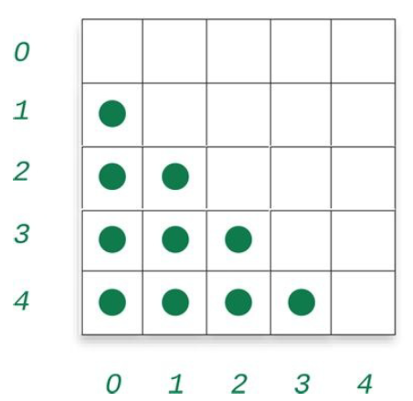
Nested loops
def isort(a):
for i in range(1, len(a)):
j = i
x = a.pop(j)
while j > 0 and a[j-1] > x:
j = j - 1
a.insert(j, x)
So, as i increases, the potential number of comparisons also increases
The label next to a row is the value of i passed to the moveLeft function

Slide 55
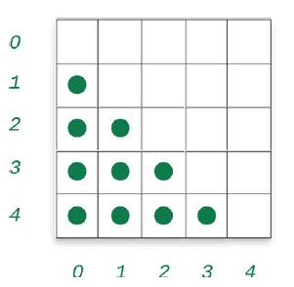
Nested loops
The diagram below is for a call to isort with a list of n=5 items
There are 4+3+2+1=10 dots total, signifying that there we be at most 10 comparisons necessary
In general, for a list with n items, the potential number of comparisons is n(n-2)/2 ≈ n²/2
We say that in the worst case, the sorting algorithm will make approximately n² / 2 comparisons

Slide 56
A question about isort
How many comparisons will be made when isort is passed a list that is already sorted, such as this list of 10 items?
a = [0, 1, 2, 3, 4, 5, 6, 7, 8, 9]
Consider the while loop’s condition:
while j > 0 and a[j-1] > x:
The part a[j-1] > x will never be true! Do you see why?
This means that the while-loop’s body will never execute
Therefore, the algorithm will compare a[j-1] > x exactly 9 times because the outer loop will repeat exactly 9 times for this particular list:
for i in range(1, len(a)):
len(a) == 10 here

Slide 57
A question about isort
In general, for a list of n items that is already sorted, how many comparisons will the program make?
The outer loop will repeat exactly n-1 times, and, for each of those iterations, perform the comparison a[j-1] > x exactly once
Therefore, the code will perform exactly n-1 of those a[j-1] > x comparisons
This is the kind of algorithm analysis that computer scientists frequently do, so let’s look at this topic in a little more detail

Slide 58
Estimating the # of comparisons
So, the formula for the worst case number of comparisons in isort is: n(n-1)/2 ≈ n² – n/2
For small lists, we can compute the exact answer: (5²-5)/2 = 20/2 = 10
For larger lists, the –n term doesn’t affect the result very much because n² will be much larger than –n
We say that the n² term dominates the expression
Therefore, we can get a good estimate by computing only n² / 2

Slide 59
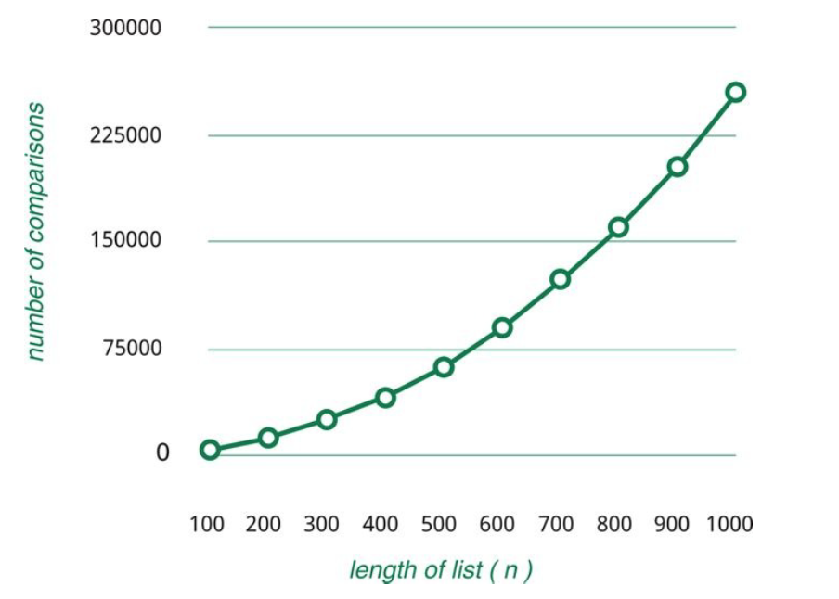
Length of list vs. # of comparisons
This graph gives a sense of how much “work” the insert sort algorithm does, based on the length of the input list

Slide 60
Big-Oh notation
Computer scientists use the notation O(n²) to mean “for large n, the number of comparisons will be roughly n²”
O(n²) is read aloud as “oh of n-squared”
Or sometimes “big oh of n-squared”
Or sometimes “order n-squared”
There is a precise definition of what it means for an algorithm to be O(n²), but for this course we’ll just use the notation informally
For isort, the notation means “on the order of n² comparisons”
Thus, insertion sort is a O(n²) algorithm

Slide 61
Big-Oh notation
What about linear search? How efficient is that algorithm?
Like insertion sort, linear search performs many comparisons
In the worst case, the linear search algorithm won’t find the desired item beause the item is not in the list
In that case, the algorithm will need to inspect every one of the n items in the list
Therefore, we say that linear search is an O(n) algorithm
“oh of n”
“big oh of n”
“ofrder n”
All equivalent ways of expressing the efficiency

Slide 62
Scalability
The fact that the number of comparisons grows as the square of the list size may not seem important
For small-to-moderate-sized lists it’s not a big deal
But execution time will start to be a factor for larger lists
The ability of an algorithm to solve increasingly larger problems is an attribute known as scalability
We say that an efficient algorithm scales well for larger inputs
We’ll revisit this idea after looking at more sophisticated sorting algorithms in a future lecture of the course

Slide 63
Selection sort
The selection sort algorithm is another O(n²) iteration-based algorithm for sorting a list of values:
Find the smallest value. Swap it (exchange it) with the first value in the list.
Find the second-smallest value. Swap it with the second value in the list.
Find the third-smallest value. Swap it with the third value in the list.
Repeat finding the next-smallest value and swapping it into the correct position until the list is sorted.
Let’s see some examples of how this algorithm works
Also, be sure to check out visualgo.net/en/sorting

Slide 64
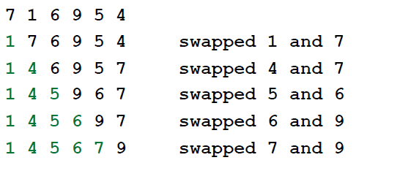
Selection sort: example #1
Eventually, only the largest value will remain
But, it will be in the rightmost position, so we don’t need to do anything with it

Slide 65
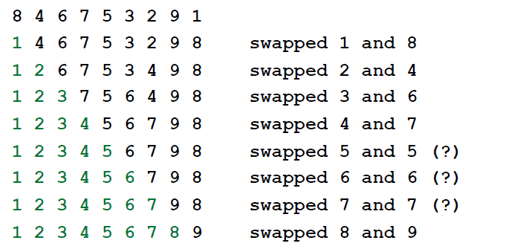
Selection sort: example #2
We note that sometimes the algorithm does no useful work, like “swapping” 5 with itself

Slide 66
Selection sort
Perhaps you noticed that during execution of the algorithm, the list is divided into two parts:
the sorted part (green)
the yet-to-be-sorted part (black)
Also you may have noticed that the largest element winds up in the rightmost spot without any additional work
Think about that for a moment. Suppose we have 10 elements in our list.
Once we have moved the 9 smallest elements into their final positions, the 10th (largest) value must be in the rightmost position
This has a small implication in the implementation

Slide 67
Selection sort
Python makes it very easy to swap (exchange) the values stored in two variables
To exchange the contents of two variables x and y, all we need to type is this: x, y = y, x
This swapping notation also works with elements of a list
Suppose i and j are valid indices of list a
We can type this to swap the contents of a[i] and a[j]:
a[i], a[j] = a[j], a[i]
With the pseudocode from earlier and this syntax for swapping list elements, we can implement selection sort

Slide 68
Example: selection_sort.py
def selection_sort(a):
for i in range(len(a)-1):
least_i = i
for k in range(i+1, len(a)):
if a[k] < a[least_i]:
least_i = k
a[least_i], a[i] = a[i], a[least_i]
See selection_sort.py for fully commented code and additional explanation

Slide 69
Example: Lucky numbers
Define a lucky number as a positive integer whose decimal (base 10) representation contains only the lucky digits 4 and 7
For example, numbers 47, 744, 4 are lucky, whereas 5, 73 and -3 are not
Consider a function is_lucky_number(num) that returns True if num is a lucky number and False, otherwise
We need to extract each digit one at a time and inspect it
If the digit is neither 4 nor 7, the number is not lucky
Otherwise, it is 4 or 7, so discard it and move to the next digit, stopping when we run out of digits

Slide 70
Example: lucky.py
def is_lucky_number(num):
if num <= 0:
return False
while num > 0:
if num % 10 == 4 or num % 10 == 7:
num //= 10 # discard the digit
else:
return False
return True
See lucky.py for fully commented code and additional explanation

Slide 71
Example: Almost-lucky numbers
Define an almost-lucky number as a positive integer that is divisible by a lucky number
For example, 611 is almost-lucky because it is divisible by the lucky number 47
Consider a function almost_lucky_divisor(num) that returns the largest lucky number that divides evenly into num if num is an almost-lucky number
The function returns None if num is not an almost-lucky number
Note that every lucky number is an almost-lucky number because every lucky number is divisible by itself

Slide 72
Example: almost_lucky_divisor.py
def almost_lucky_divisor(num):
for divisor in range(num, 0, -1):
if num % divisor == 0 and
is_lucky_number(divisor):
return divisor
return None

Slide 73
Questions?

