Slide 1
Webpage Markup with HTML5
(C) Pravin Pawar - SUNY Korea, Paul Wang - Kent State University, Ohio

Slide 2
Useful resources
https://www.w3schools.com/html/html5_intro.asp
https://developer.mozilla.org/en-US/docs/Web/HTML
http://codepen.io/pen/
HTML reference sheet: See the course webpage
Your favorite browser and its developer tools

Slide 3
HTML5 Page Structure
XML namespaces help contextualize elements an attributes, among other things. It also offers a precise identification for a particular element or attribute.
For instance, the <html> element can be defined by anyone and have any meaning. However, the <html> element within the http://www.w3.org/1999/xhtml namespace is unique and refers to the XHTML.
Tells the browser that this is a html page.
<!DOCTYPE html>
<html xmlns="http://www.w3.org/1999/xhtml" lang="en" xml:lang="en">
<head>
<meta charset="utf-8"/>
<title>Great Company: homepage</title>
<!-- other head elements as appropriate -->
</head>
<body> <!-- page content begin -->
Head section start
Head section end
Body section start
. . .
. . .
<!-- page content end -->
</body>
</html>
Body section end
This is a comment.

Slide 4
Creating a Webpage
<!DOCTYPE html>
<html xmlns="http://www.w3.org/1999/xhtml" lang="en" xml:lang="en">
<head>
<meta charset="utf-8"/>
<title>My Sample Webpage</title>
</head>
<body style="background-color: cyan; margin: 50px">
<h2>Hi everybody!</h2>
<p>My Name is (put your name here) and today is
<time>(put in the date yyyy-mm-dd)</time>.</p>
<p>HTML5 is cool.</p></body></html>
Demo: Ex: FirstPage

Slide 5
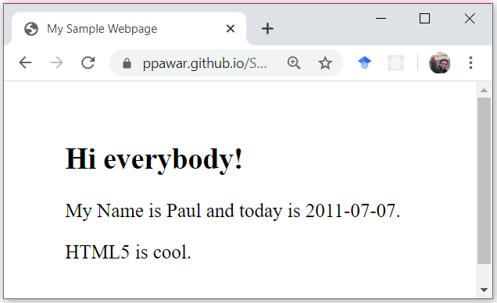
Sample Webpage
Page title is displayed in the title bar of the browser window
Used in making a bookmark for the page

Slide 6
HTML5 Elements
Therer are more than 100 different elements in HTML5.
Elements for meta information are placed in the head element.
Elements for page content are placed in the <body> element.
HTML5 distinguishes between two broad types of content elements:
flow elements that occupy their own vertical space in a page and phrasing elements that act like words and phrases.
Flow elements act like paragraphs, lists, and tables and can contain other flow elements, phrasing elements, and texts.
Phrasing elements can contain other phrasing elements and texts.

Slide 7
HTML5 Elements Classified
Top-level elements: html, head, and body.
Head elements: elements placed inside head, including title (page title), style (rendering style), link (related documents), meta (data about the document), base (URL of the document), and script (client-side scripting). These elements are not part of the page display.
Block-level elements:
Flow elements behaving like paragraphs, including article, h1–h6 (headings), header, footer, section, p (paragraph), figure, canvas (dynamic drawing area), pre (preformatted text), div (designated block), ul, ol, dl (lists), table (tabulation), form (user-input forms), and video (video).
A block element occupies 100% of the available width to it and will be stacked vertically with preceding and subsequent block elements.
A block-level (or simply block) element always starts on a new line, and any element immediately after the block element also begins on a new line.

Slide 8
HTML5 Elements Classified
Inline elements:
Phrasing elements behaving like words, characters, or phrases that flow horizontally to fill the available width before starting new lines.
Usually, inline elements are placed within block elements.
Inline elements include a (anchor or link), audio (sound), br (line break), code (computer code), img (picture or graphics), em (emphasis), nav (navigation), samp (sample output), span (designated inline scope), strong (strong emphasis), sub (subscript), sup (superscript), time (time/date), and var (variable name).

Slide 9
HTML5 Entities
In an HTML5 document, certain characters, such as < and &, are used for markup and must be escaped to appear literally. HTML provides entities (escape sequences) to introduce such characters into a webpage. For example, the entity &lt; gives
< and &amp; gives &.
Characters not on the regular keyboard can also be included directly or using HTML5-defined character references.
Use <html> <head> <meta charset="utf-8">
E.g. displaying Korean characters:
https://ofcourse.kr/html-course/%EC%9D%B8%EC%BD%94%EB%94%A9

Slide 10
Evolution of HTML
In 1989, Tim Berners-Lee defined a very simple version of HTML based on SGML. The first common standard for HTML was HTML 3.2 (1997).
HTML 4.01 became a W3C (the World-Wide Web Consortium) recommendation in December 1999.
HTML 4.01 begins to clearly separate the document structure and document presentation and specifies a clear relationship between HTML and client-side scripting (JavaScript).
In January 2000, W3C released XHTML 1.0 as an XML reformulation of HTML 4.01.
XHTML pages can be processed easily by any XML tool.

Slide 11
HTML5 combines the XHTML, HTML 4, and CSS3 standards, introduces new elements and APIs, as well as incorporates MathML (Mathematical Markup Language) and SVG (Scalable Vector Graphics) into HTML.
HTML5 can also easily be written in an XML compliant way.
The release of the HTML5 standard promises to bring significant advantages to Web developers and benefits to end users.
SVG example: https://www.w3schools.com/graphics/svg_examples.asp
MathML example: https://www.w3.org/Math/XSL/csmall2.xml (works with firefox)

Slide 12

HTML5 Integration
HTML 4
CSS3
XHTML New Elements APIs
MathML SVG

Slide 13
Webpage Syntax
All tags begin with < and end with >. The tag name is given immediately following the leading <. Make sure the tag is spelled correctly. Unrecognized tags are ignored by browsers. Any attributes are given following the tag name in the form:
<tag attribute₁ ="value" attribute₂ ="value" ... >
You may use single quotes (’), instead of double quotes ("), for the value part of any attribute. Be careful; forgetting to close a quote can result in a blank page display.
e.g. <a href="https://www.w3schools.com">This is a link</a>
Tag names and attributes are lowercase. Attributes are always given in either of the two forms:
attribute_name="value" attribute_name=’value’

Slide 14
For Boolean attributes, those that are either on or off, use either of these forms for “on”:
attribute_name ="attribute_name"
attribute_name=""
and omit the attribute for “off”.
Unrecognized tags and attributes are ignored by browsers.
Most elements involve start and end tags. Other elements, such as <br/> (line break) and <img .../> (image), do not have closing tags and are known as void elements.
Elements must be well-formed. This means no missing opening or closing tags and no improper element nesting. For example,
<p>Learning <strong>HTML5</p></strong>
overlaps the tags and is not properly nested. The correct nesting is
<p>Learning <strong>HTML5</strong></p>

Slide 15
Attributes can be required or optional and can be given in any order. If an attribute is not given, its initial (default) value, if any, is used.
Extra white space and line breaks are allowed between the tag name and attributes and around the = sign inside an attribute. Line breaks and white space within attribute values are also allowed but should be avoided because they may be treated inconsistently by browsers.

Slide 16
HTML5 Core Attributes
id—Uniquely identifies the element in a page. All ids in a document must be distinct. Among other uses, a URL ending in #some id can lead directly to an element inside a document.
style—Gives presentation styles for the individual element.
For example, the code
<body style="background-color: cyan">
gives the color value cyan to the style property
background-color for this element. Several style properties separated by semicolons can be given. The style attribute is a direct but inflexible way to specify presentation style. (css is used for improved styling)

Slide 17
class— Specifies a style class or a space separated list of style classes for the element. For example, class="fineprint" or class="footnote fineprint". Thus, you may place HTML elements in different classes and associate presentation styles to all elements belonging to the same class.
title—Provides a title for the element. This may be used for tool-tip displays by browsers.
hidden—Prevents the element from being displayed by a browser when set to true.

Slide 18
Webpage Architecture
A typical webpage is organized into the following parts inside the root element html.
The head element contains child elements: the page title (title), the page character encoding with a meta tag
<meta charset="UTF-8"/>
both are required by HTML5. Usually head contains additional elements for styling, scripting, and other meta info.
The body element provides the page content, often organized into a header part for the top banner and a horizontal navigation bar at the top of the page.
After the header, the page may also have a vertical navigation bar on the left side. The flow (block) element nav is used for navbars that organize links.

Slide 19
NAV EXAMPLE
<nav class="crumbs">
<ol>
<li class="crumb"><a href="bikes">Bikes</a></li>
<li class="crumb"><a href="bikes/bmx">BMX</a></li>
<li class="crumb">Jump Bike 3000</li>
</ol>
</nav>
<h1>Jump Bike 3000</h1>
<p>This BMX bike is a solid step into the pro world. It looks as legit as it rides and is built to polish your skills.</p>

Slide 20
Then, there are one or more articles (article) for the main content, followed by a footer at the end of the webpage.
An article may contain one or more sections (section) that consist of headings (h1 through h6), paragraphs (p), tables, figures, audio, and video.
A paragraph man contain text, pictures (img), audio, and video.
The footer often provides information on copyright, author, and links to terms of use, privacy policy, customer service, and so on.
An aside flow (block) element can set aside related information, such as links to references, outside resources, and advertisements, that are not the primary content of the page.

Slide 21
ARTICLE EXAMPLE
<!DOCTYPE html>
<html>
<body style="background-color:powderblue;">
<article class="film_review">
<header>
<h2>Jurassic Park</h2>
</header>
<section class="main_review">
<p>Dinos were great!</p>
</section>
<section class="user_reviews">
<article class="user_review">
<p>Way too scary for me.</p>
<footer>
<p>
Posted on
<time datetime="2015-05-16 19:00">May 16</time>
by Lisa.
</p>
</footer>
</article>
</body>
</html>

Slide 22
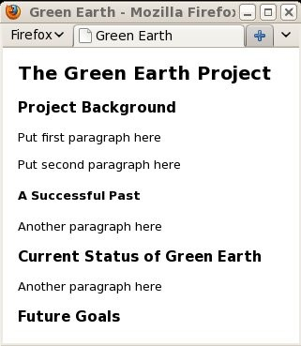
Sections and Paragraphs

Slide 23
<article>
<h1>The Green Earth Project</h1>
<section>
<h3>Project Background</h3> <!-- section 1-->
<p>Put first paragraph here</p>
<p>Put second paragraph here</p>
<h4>A Successful Past</h4><!-- subsection -->
<p>Another paragraph here</p>
</section><section>
<h3>Current Status of Green Earth</h3><!-- section 2-->
<p>Another paragraph here</p>
</section><section>
<h3>Future Goals</h3><!-- section 3-->
</section></article>
Demo: Ex: GreenEarth

Slide 24
Flowing Content
The p (a paragraph) is a flow (block) element which may contain texts and phrasing elements.
A flow element is typically displayed with a leading and a trailing blank line.
The element content will be formatted to fit the available width. Line breaks are inserted automatically (line wrapping) where needed to render the contents. Extraneous white spaces between words and lines within the source text of the content are normally ignored (white-space collapsing).

Slide 25
Flowing Content – line breaks
If you need a line break at a specific point in the content, you can use the <br /> tag to call for a line break. For a
long-running text without spaces, such as an email or Web address, you can insert the void element <wbr /> to indicate a
line break opportunity. The browser will do a line break indicated by wbr only if necessary. For example,
<p>Please visit
www.somelong.<wbr />andcomplicated.com.</p>
Inside a flow element, you can place other phrasing (inline) elements such as q, em, mark, strong, img, video, and audio.

Slide 26
<p>In his famous <em>I Have A Dream</em> speech, Martin Luther King said:</p>
<blockquote cite="http://www.mlkonline.net">
I have a dream that my four little children will one day live in a nation where they will not be judged by the color of their skin but by the content of their character.
</blockquote>
Demo: Ex: Quote
<p>Confucius: <q>Don’t employ a person due to words or dismiss words due to the person.</q></p>
Demo: Ex: InlineQuote

Slide 27
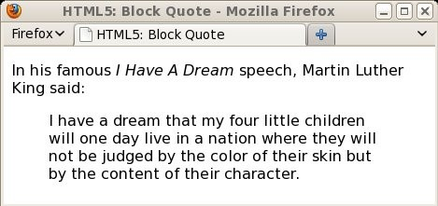
Block Quote

Slide 28
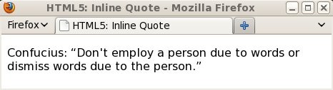
Inline Quote

Slide 29
<hr style="height: 4px; width: 50%;
margin-left: auto; margin-right: auto" />
Demo: Ex: Hrule

Slide 30
White Space and Line Wrapping
HTML uses white space separates text into words.
Words can be separated by one or more white-space characters but will only result in at most one rendered interword space.
Tags do not break words. For example,
<p>The HTML<strong>5</strong> standard.</p>

Slide 31
Preformatted Text
Text in a pre element is displayed in a fixed-width font, and it preserves both spaces and line breaks.
<figure style="width: 12em; background-color: cyan">
<pre>
North
West
East
South
</pre></figure>

Slide 32
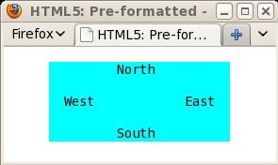
Preformatted Text
Demo: Ex: Pre

Slide 33
Phrasing Elements
a: a link
br: an explicit line break
cite: a citation
em: emphasis, usually displayed in italics
strong: strong emphasis, usually displayed in boldface
mark: stronger emphasis with highlighting
code: computer code, usually displayed in a monospaced font
del: deleted words displayed with a line through them
sub: subscript (e.g., x<sub>0</sub>)
sup: superscript (e.g., x<sup>2</sub>)
samp: sample computer output

Slide 34
span: a general phrasing element that can contain other phrasing (inline) elements, providing a simple way to attach presentation styles to enclosed elements; for example,
<span style="font-weight: bold; color: blue"> Important point</span>
var: a variable
kbd: keyboard text

Slide 35
Formatted Time
<time datetime="date time">text</time>
<p>Fireworks start at <time datetime="2011-07-04T19:00"> 7pm on Independence Day</time></p>
<p>The final NASA space shuttle Atlantis launched on
<time datetime="2011-07-08T11:29-04:00">the morning of Friday, 08 July 2011</time>
in Cape Canaveral, Florida USA.</p>

Slide 36
Publication Date
Put a time element as child of body or child of the desired
article.
Give datetime a date string with optional time string.
Add the attribute pubdate="pubdate"
Note: The time element does not render as anything special in any of the major browsers.
<body>
<time timedate="2012-07-07" pubdate="pubdate"></time>
...
</body>

Slide 37
Webpage Presentation Styles
Define the style attribute for an individual element.
<h1 style="color: darkgreen">The Green Earth Project</h1>

Slide 38
style Attribute
General form:
style="property₁:value₁; property₂:value₂; . . . "
Foreground and Background Colors:
color: some color
background-color: some color

Slide 39
Text Alignment
left—lines are left justified right—lines are right justified center—lines are centered justify—lines are justified left and right
text-align:
text-align:
text-align:
text-align:

Slide 40
Font Sizes
<footer style="font-size: x-small">
<p> ... </p>
...
<p> ... </p>
</footer>
Demo: Ex: FontSize

Slide 41
Indenting Content
To indent first line
<p style="text-indent: 3em"> ... </p>
To indent entire flow (block) element
margin-left: length
margin-right: length
<div style="margin-left: 5em; margin-right: 5em">
<p> ... </p>
</div>

Slide 42
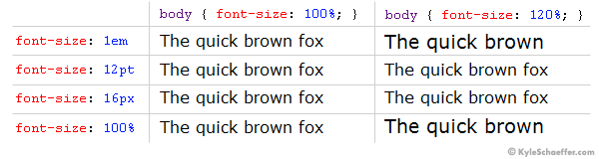
Style Length Units
em—the font-size of the current font
ex—the x-height of the current font
ch—the size of 0 (zero) of the current font
“Ems” (em): The “em” is a scalable unit that is used in web document media. An em is equal to the current font-size, for instance, if the font-size of the document is 12pt, 1em is equal to 12pt.

Slide 43
Colors
Color values in style properties can be a color name such as magenta or darkblue. Currently there are about 150 color names defined in CSS.
Color values can also be given in a number of standard notations, including RGB (red-green-blue) and HSL
(hue-saturation-lightness):
#rrggbb—where the first two, middle two, and last two of the six hexadecimal digits specify red, green, and blue values, respectively (e.g., #0ace9f). This is 24-bit color.
#rgb—shorthand for the above notation when the first two, middle two, and last two digits are the same (e.g., #03c stands for #0033cc).
rgb(r , g , b )—where base-10 integers between 0 and 255 inclusive are used (e.g., rgb(0,204,108)). This is the decimal equivalent of notation 1.
hsl(h , s %, l %)—where h (in 0–360 degrees) indicates the hue on the color wheel.
https://www.w3schools.com/colors/colors_rgb.asp
https://www.w3schools.com/colors/colors_hsl.asp

Slide 44
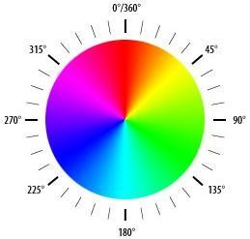
The Color Wheel

Slide 45
Font Styles
font-family font-style font-variant font-weight font-size
font-family: Times
font-family: Arial, Helvetica, sans-serif
Demo: Ex: FontFamily

Slide 46
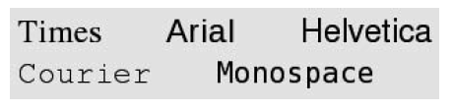
Some Fonts

Slide 47
Generic Font Families
serif—for example, Times
sans-serif—for example, Arial or Helvetica
cursive—for example, Zapf-Chancery
fantasy—for example, Western
monospace—for example, Courier
http://wavian.com/font-list.html
https://websitesetup.org/web-safe-fonts-html-css/

Slide 48
Font Weight
font-weight: normal font-weight: bold font-weight: bolder font-weight: lighter

Slide 49
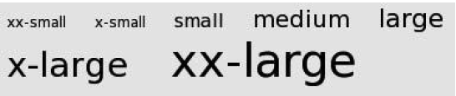
Relative Font Sizes
xx-small | x-small | small
medium | large | x-large | xx-large
Absolute Font Sizes
pt (points; 1 pt = 1/72 in.)
pc (picas; 1 pc = 12 pt)

Slide 50
Itemized Lists
Bullet list: The ul element provides an unordered list where the ordering of the items is unimportant. A ul is usually presented as a set of bulleted items.
Ordered list: The ol element offers a numbered list where the ordering of the items is important. An ol is typically displayed as a sequence of enumerated items.
Definition list: The dl element is handy for a definition list where each term (<dt>) is given a definition or description (<dd>).

Slide 51
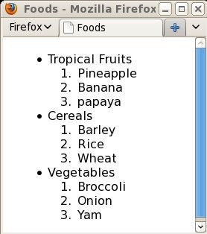
Lists

Slide 52
<ul>
<li>Tropical Fruits
<ol><li>Pineapple</li><li>Banana</li>
<li>papaya</li></ol>
</li>
<li>Cereals
<ol><li>Barley</li> <li>Rice</li> <li>Wheat</li></ol>
</li>
<li>Vegetables
<ol><li>Broccoli</li> <li>Onion</li> <li>Yam</li></ol>
</li></ul>
Demo: Ex: List

Slide 53
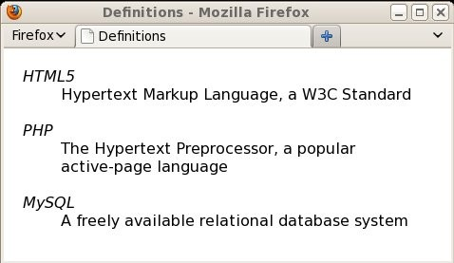
A Definition List

Slide 54
<dl>
<dt style="font-style: italic">HTML5</dt>
<dd>Hypertext Markup Language, a W3C Standard<br />
<br /></dd>
<dt style="font-style: italic">PHP</dt>
<dd>The Hypertext Preprocessor, a popular active-page language <br /><br /></dd>
<dt style="font-style: italic">MySQL</dt>
<dd>A freely available relational database system</dd>
</dl>
Demo: Ex: Defs

Slide 55
List Styles
<ul style="list-style-type: circle"> ... </ul>
<ol style="list-style-type: upper-alpha"> ... </ol>
<p>The following list has inside positioning</p>
<ul style="list-style-position:inside">
<li style="list-style-type: square; color: green">
<span style="color: black">First item in the list with a green square marker.</span></li>
<li style="list-style-type: square; color: red">
<span style="color: black">Second item in the list with a red square marker.</span></li>
<li style="list-style-type: square; color: blue">
<span style="color: black">Third item in the list with a blue square marker.</span></li>
</ul>
Demo: Ex: MarkerStyle

Slide 56
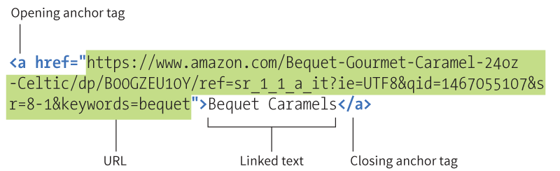
Links in Webpages
<a href="URL">
The URL of the link.
Possible values:
An absolute URL - points to another web site (like href="http://www.example.com/default.htm")
A relative URL - points to a file within a web site (like href="default.htm")
Link to an element with a specified id within the page (like href="#top")
Other protocols (like https://, ftp://, mailto:, file:, etc..)
A script (like href="javascript:alert('Hello');")

Slide 57
Links in Webpages
<a href="URL">anchor</a>
<a href="bio.html">Brief Bio</a>
<a href="http://www.w3.org/"> The W3C Consortium</a>
<a href="../pic/dragonfly.jpg" type="image/jpeg" title="dragonfly.jpg">Picture of Dragonfly</a>
<a href="sound/cthd.mp3" type="audio/mpeg"> Tan Dun, Yo Yo Ma - Crouching Tiger, Hidden Dragon - Theme</a>
https://www.w3schools.com/html/html_links.asp

Slide 58
In-page Links
<h3 id="products">Our Quality Products</h3>
<a href="#products"> ... </a>
<article>
<nav><ul>
<li><a href="#product">Products</a></li>
<li><a href="#service">Services</a></li>
<li><a href="#testimonial">Testimonials</a></li>
</ul></nav>
<section>
<h3 id="product">Our Quality Products</h3>
...
</section><section>
<h3 id="service">Responsive Services</h3>
...
</article>

Slide 59
Site Internal and External Links
Is clearly indicated as going off site.
Is displayed in a new browser window or tab so the visitor can come back by closing that new window or tab. A simple way is to use the attribute target=" blank" to cause the referenced page to display in a new window/tab:
<a href="http://www.w3.org/" target="_blank"> The W3C Consortium</a>

Slide 60
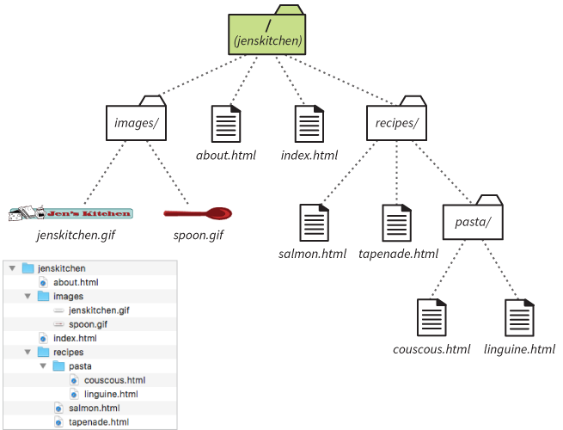
Example Server Directory Structure
The following relative pathname discussions are based on this site structure.
The root directory is called jenskitchen.
How it looks in the MacOS Finder
Slide no. 60 to 71 are courtesy of Jennifer Robbins – Author of Learning Web Design, O’Reilly

Slide 61
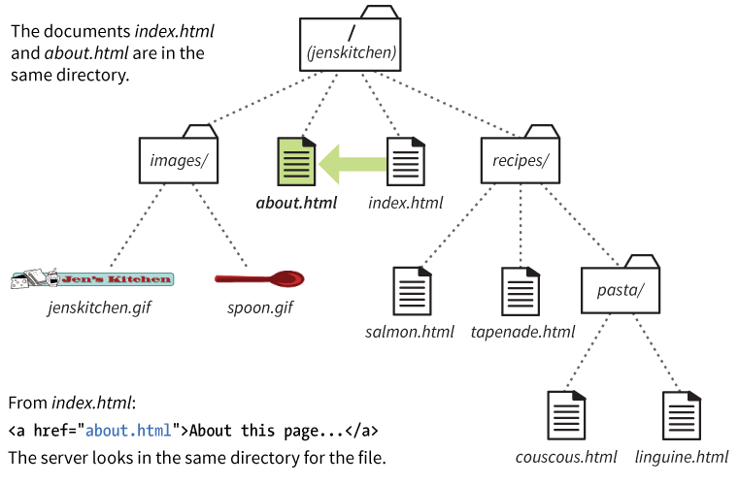
Linking in the Same Directory
When the linked document is in the same directory as the current document, just provide its filename:
href="about.html"

Slide 62
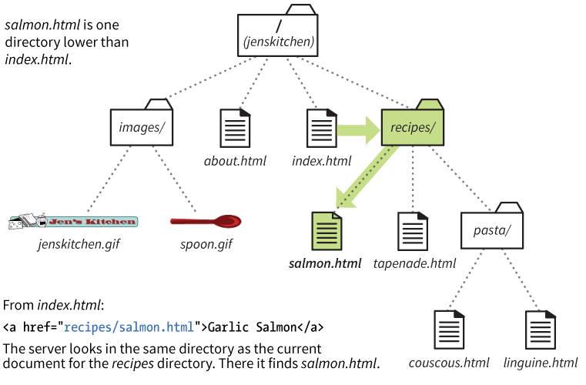
Linking in the Lower Directory
If the linked file is in a directory, include the directory name in the path.
href="recipes/salmon.html"

Slide 63
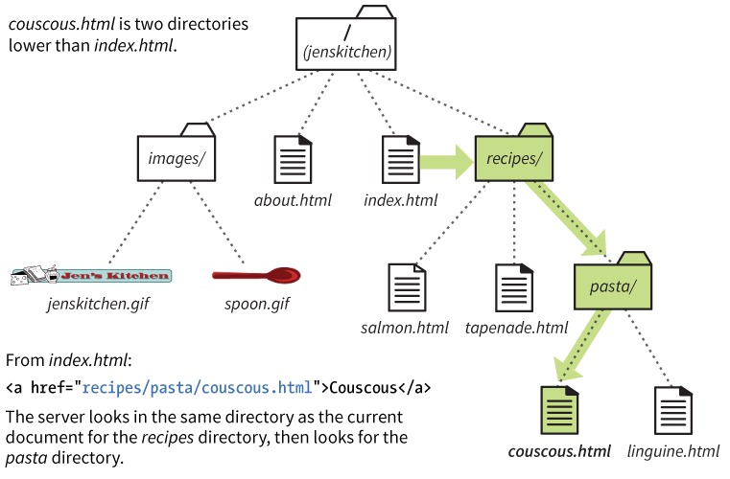
Linking into Two Directories
Include each subdirectory name in the path to the linked document:
href="recipes/pasta/couscous.html"

Slide 64
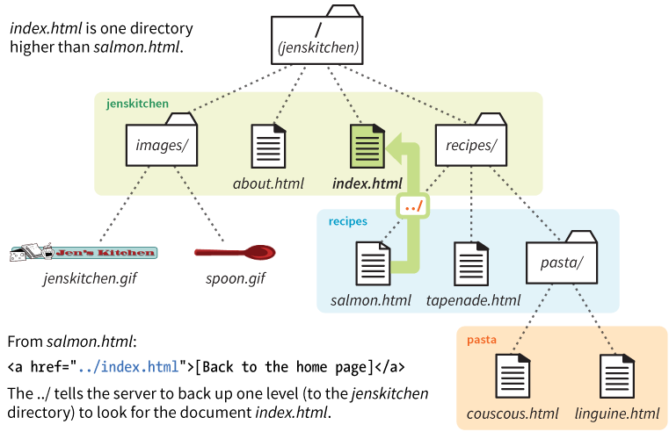
Linking to a Higher Directory
To back up a level, the ../ stands in for the name of the higher directory:
href="../index.html"

Slide 65
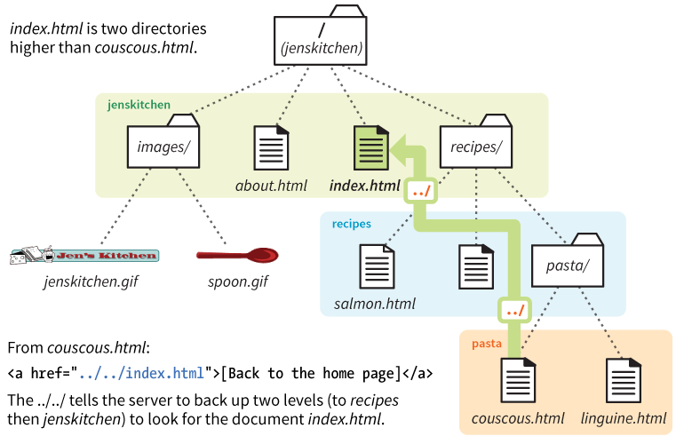
Linking up Two Directory Levels
Include a ../ for each level you need to back up to:
href="../../index.html"

Slide 66
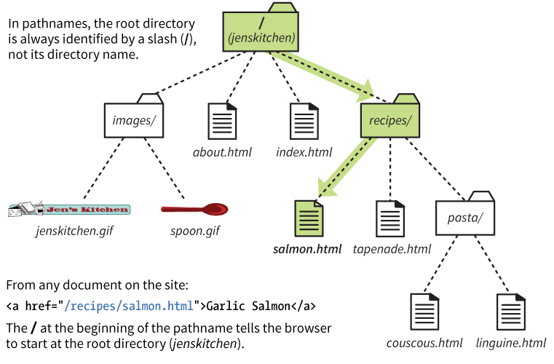
Site Root Relative Paths
Starting the path with a slash / means the pathname starts at the root directory. You don’t need to write the name of the directory.
href="/recipes/salmon.html”
NOTE: Site root relative URLs are more flexible because they work from any document on the site.
DOWNSIDE: They won’t work on your own computer because the / will be relative to your hard drive. You’ll need to test it on the actual web server.

Slide 67
Image src Pathnames
Relative pathnames are also commonly used to point to image files with the src attribute:
<img src="/images/icons/next.svg" alt="next">

Slide 68
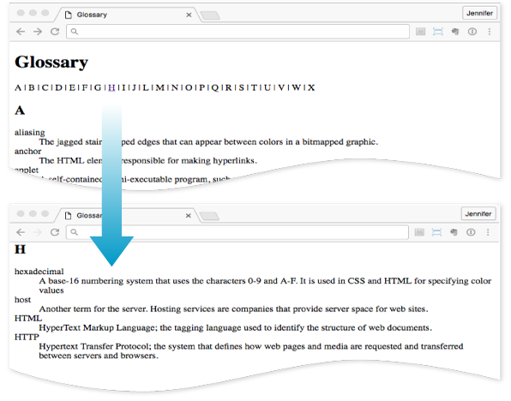
Linking Within a page (Fragments)
Linking to a specific point on a web page is called linking to a document fragment.
This is useful for providing links down to content from the top of a long document.

Slide 69
Linking to a Fragment
For example, to create a link from the letter H in a list at the top of the page to the “H” heading farther down in the document:
Step 1: Identify the target destination.
Use the id attribute to give the target element a unique name:
<h2 id="startH">H</h2>
Step 2: Link to the target (#).
The # symbol before the name indicates that the link goes to a fragment:
<p>… F | G | <a href="#startH">H</a> | I | … </p>

Slide 70
Targeting Browser Windows
The target attribute in the a tag tells the browser the name of the window in which you want the linked document to open:
<a href="recipes.html" target="_blank">Recipe book</a>
target="_blank"
Always opens a new browser window.
target="name"
Opens a new window with that name and then opens all subsequent targeted links with that name in the same window.
It may also open in an embedded frame (iframe) with that name.

Slide 71
Mail Links
Use the “mailto” protocol to make a linked email address open in a mail program:
<a href="mailto:wonderwoman@example.com">Email WonderWoman</a> (wonderwoman@example.com)
NOTE: Most browsers are configured to open the computer’s primary email program, but this may not work for some users. Be sure the email address is included on the page and use the mailto link as progressive enhancement.

Slide 72
Mail Links
For example,
<a href="mailto:wdpgroup-request@cs.kent.edu?
SUBJECT=join&BODY=subscribe">Joint web design and programming email listserv group</a>
provides an easy way to join a listserv.
Download links—A link in the form
<a href="ftp:host:port/path-to-file">
tells the browser to launch an FTP program to connect to the given host and to download the specified file by anonymous FTP. This is useful for downloading large files such as programs and compressed (ZIP or GZIP) files. If port is not given, then the standard port 21 for FTP is assumed. For example,
Download <a href="ftp://speedtest.tele2.net/1MB.zip">
<code>1MB.zip</code></a>
An FTP URL can also supply username, password, and file location information for file retrieval.

Slide 73
Telephone/SMS/Fax links—Links in these forms
<a href="tel:phone number">
<a href="sms:phone number">
<a href="fax:phone number">
are useful for mobile phone and tablet devices.
VOIP call links—A link in the form
<a href="callto:screen name or phone number">
TM
asks the browser to launch Skype or a similar program to
make voice-over-IP calls or to conduct voice/video conference.

Slide 74
Site Organization and Navigation
Organize the pages for a site into a hierarchy of files and directories (folders) stored on the hard disk of the server host. Avoid nonalphanumeric characters in file and directory names. Otherwise, the file name must be URL encoded before becoming part of a URL.
Place the site entry page (usually, index.html) in the server root directory.
Use subdirectories such as images/, videos/, css/ (for style sheets), js/ (for JavaScript code), products/, services/, contractors/, members/, and affiliates/ to organize the site. The index.html page within each subdirectory is usually the lead page for that part of the site.

Slide 75
Keep the organization simple and avoid using more than three levels of subdirectory nesting.
Design a navigation system that is clear, easy to use, and effective in getting visitors where they want to go in your site.
Use relative URLs exclusively for linking within the site and make sure the link is in one of these forms:
Relative to the host page itself (href="file" or
href="dir/file")
Relative to the server root (href="/path-to-file")

Slide 76
Content-Only Pages
In creating the content-only site, consider establishing pages with these parts:
Major navigation—Links to the main page, and first-level pages. If the top banner of a page includes a logo of the business or site, link the logo image to the site entry (main page).
Minor navigation—Links to subpages of this page and links to directly related sibling pages.
In-page navigation —Links to parts of this page when appropriate.
Draft page content—Includes text, pictures, and other media types.

Slide 77
Display Style for Links
Visual browsers pay special attention to the presentation of links. Usually, different display styles are used to indicate whether a textual link is not visited yet, under the mouse (hover), being clicked (active), or visited already (visited).
Browsers settings define default colors for links.
An image anchoring a link may by default be displayed with a distinct border.
The appearance of links can be controlled by style settings.
Web users are accustomed to seeing links underlined.
Therefore, avoid underlining regular text because it can cause confusion. Image links, on the other hand, are almost always presented without any border. Web users understand that clicking an image often leads to another page.

Slide 78
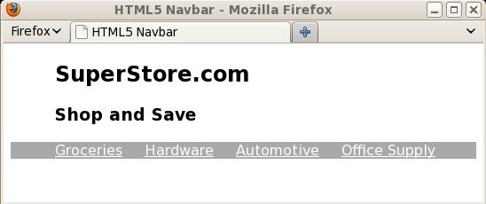
A Sample Navbar

Slide 79
<header>
<section style="margin-left: 50px">
<h1>SuperStore.com</h1>
<h3>Shop and Save</h3></section>
<nav style="background-color: darkgrey;
padding-left: 40px">
<a style="color:#fff; margin:10px" href="gr/"> Groceries</a>
<a style="color:#fff; margin:10px" href="hw/"> Hardware</a>
<a style="color:#fff; margin:10px" href="au/"> Automotive</a>
<a style="color:#fff; margin:10px" href="of/"> Office Supply</a></nav></header>
Demo: Ex: Navbar

Slide 80
Pictures and Images in Webpages
<img src="hat.jpg" alt="A nice hat" style="width:160px; height:200px" />
The src attribute
The value is the location (URL) of the image file.
Use the relative pathname conventions to point to the image on the server.

Slide 81
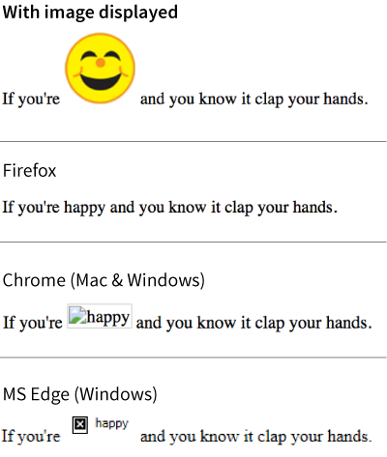
The alt Attribute
<p> If you're <img src="/images/smiley.png" alt="happy"> and you know it, clap your hands.</p>
The alt attribute provides alternative text for those who are not able to see it.
It is required for every img element in order for the HTML to be valid.
It is used by screen readers, search engines, and graphical browsers when the image fails to load.

Slide 82
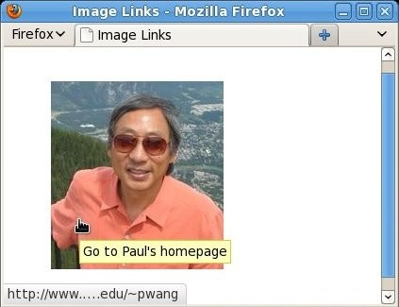
A Clickable Image
<a title="Go to Paul’s homepage" href="http://www.cs.kent.edu/~pwang">
<img src="http://www.cs.kent.edu/~pwang/paul.jpg" alt="photo of the author Paul S. Wang"/>
</a>
Demo: Ex: ImgLink

Slide 83
Text around Images
<p>For this green monkey, the new Chevy Volt is just
<img src="2012volt.jpg" alt="My dream 2012 Chevy Volt" height="110" style="float: left;
margin-right: 1em; margin-bottom: 8px; margin-top: 8px" />
the car I have been waiting for. ... </p>
<p>I love this car. On a recent trip to ... </p>
Demo: Ex: Float

Slide 84
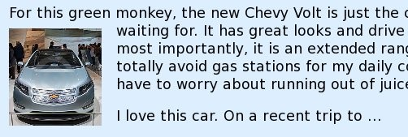
Text Around an Image

Slide 85
Image Alignment within A Line
Here is some text and an
image <img src="URL" style="vertical-align: baseline" />
vertical-align:
vertical-align:
baseline—Aligns baselines of image and text.
middle—Aligns middle of image with middle of
x character in preceding text.
vertical-align:
preceding text.
text-top—Aligns top of image with font top of
vertical-align:
text-bottom—Aligns bottom of image with font
bottom of preceding text.
vertical-align:
the text line height.
xx %—Raises the bottom of image xx percent of

Slide 86
vertical-align:
top—Aligns top of image to tallest
element on the line, which could be another image or some other tall element in the same line.
vertical-align:
bottom—Aligns bottom of image to lowest
element on the line, which could be another image or some other element in the same line.
Demo: Ex: ImgAlign

Slide 87
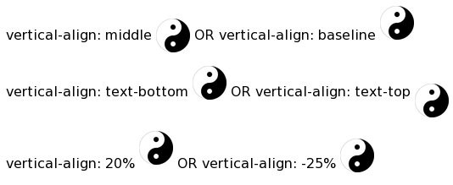
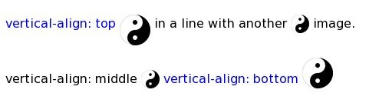
Inline Alignments with Preceding Text

Slide 88
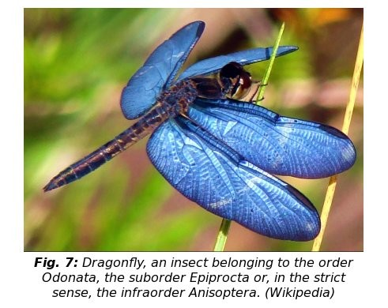
A Figure with Caption

Slide 89
<figure style="text-align: center; font-style: italic">
<img src="dragonfly.jpg" alt="a blue-winged dragonfly" />
<figcaption>
<strong>Fig. 7:</strong> Dragonfly, an insect belonging to the order Odonata, the suborder Epiprocta or, in the strict sense, the infraorder Anisoptera. (Wikipedia)
</figcaption>
</figure>
Demo: Ex: FigCap

Slide 90

Raster image
Raster images refer to a dot matrix data structure that represents a generally rectangular grid of pixels.
Raster images are stored in image files with varying formats.

Slide 91
Image Encoding Formats
Graphics Interchange Format (GIF)—A raster format suitable for icons, logos, cartoons, and line drawings. GIF images can have up to 256 colors (8-bit).
Joint Photographic Experts Group (JPEG) format—A raster format usable for color and black-and-white pictures with continuously changing color tones for display. JPEG images can store up to 16.8M colors (24-bit).
Portable Network Graphics (PNG) format—A format designed to replace GIF.

Slide 92
Colors in Raster Images
Monochrome—black and white
Gray scale—different levels of gray (up to 256 shades)
Indexed—Each pixel color is indicated by an index into a color palette. The palette may contain a set of up to 256 colors. The smaller the palette, the fewer bits needed for each index.
High color—thousands of colors, 15 to 16 bits per pixel
True color—16.8 million colors, 24 bits per pixel

Slide 93
Image Coordinates
(0,0)
x
(200,0)
Image
y
(0,150)

Slide 94
Image Maps
<map name="samplemap">
<area shape="rect" coords="0,0,100,150" href="some-url" alt="item 1" />
<area shape="poly" coords="0,0,10,32,98,200" href="some-url" alt="item 2" />
<area shape="circle" coords="0,0,100" href="some-url" alt="item 3" />
<area shape="default"
href="some-url" alt="item otherwise" />
</map>
<img src="img-url" usemap="#map-name" />

Slide 95
Image Map Example
<figure>
<img src="planets.jpg" usemap="#planets" alt="Planets image map" />
<map name="planets" id="planets">
<area shape="circle" coords="40,176,7"
href="mercury.html" alt="Mercury" title="Mercury"/>
<area shape="circle" coords="82,158,10"
href="venus.html" alt="Venus" title="Venus"/>
<area shape="circle" coords="127,132,11"
href="earth.html" alt="Earth" title="Earth"/>
<area shape="circle"

Slide 96
coords="157,103,10"
href="mars.html" alt="Mars" title="Mars"/>
<area shape="circle" coords="234,116,27"
href="jupiter.html" alt="Jupiter" title="Jupiter"/>
<area shape="poly" coords="254,53,327,54,373,102,300,107"
href="saturn.html" alt="Saturn" title="Saturn"/>
<area shape="default" href="solar.html"
alt="List of solar system planets" />
</map>
</figure>
Demo: Ex: Planets

Slide 97
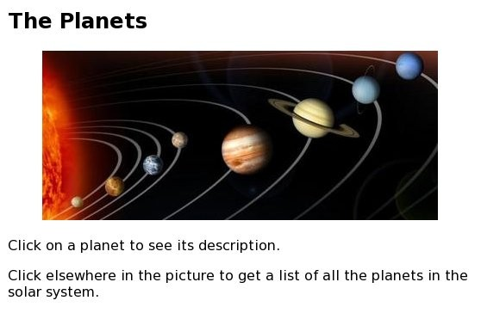
Planets Image Map

Slide 98
Adding SVG Images
SVG images are unique:
SVG is a vector format, made up of shapes and paths.
Those shapes and paths are described in a text file using the Scalable Vector Graphic markup language.
The elements in an SVG can be styled with CSS and scripted for interactivity.
Because they are vector, SVGs can resize with no loss of quality.

Slide 99

SVG Example
Compare the SVG source to the image. The svg element contains a rectangle (rect element) and a text element:
<svg xmlns="http://www.w3.org/2000/svg" viewBox="0 0 300 180">
<rect width="300" height="180" fill="purple" rx="20" ry="20"/>
<text x="40" y="114" fill="yellow" font-family="'Verdana-Bold'" font-size="72">
hello!
</text>
</svg>

Slide 100
Adding SVG to a Page
There are several ways to add an SVG image to a web page:
<img> element
<object> element
<svg> element directly in HTML (inline SVG)

Slide 101
Adding SVG with the img Element
You can add an .svg file to the page with the img element:
<img src="/images/circle.svg" alt="">
PROS:
Easy and familiar
Universally supported
CONS:
Can’t manipulate the SVG with scripts or styles.
The SVG can’t contain any external resources such as images or fonts.

Slide 102
Embedding SVGs with object
The content of the object element is a fallback text or image that displays if the SVG is not supported:
<object type="image/svg+xml" data="pizza.svg">
<img src="pizza.png" alt="pizza">
</object>
PROS:
SVG can be scripted and use external files (images and fonts).
CONS:
You can’t change styles with the same CSS used for the document.
May be buggy in some browsers.

Slide 103
Inline SVGs with the svg Element
You can paste the content of the SVG text file directly into the HTML source. This is called using the SVG inline.
PROS:
Can take full advantage of scripting and styling the SVG because the elements in the SVG are part of the DOM for the document.
CONS:
Code can get extremely long and unwieldy.
Harder to maintain images embedded in the source
Can’t take advantage of caching repeated images
Not universally supported

Slide 104
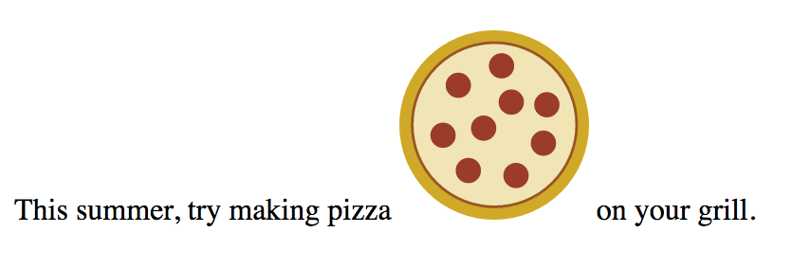
Example of an Inline SVG
<p>This summer, try making pizza
<svg xmlns="http://www.w3.org/2000/svg" viewBox="0 0 72 72" width="100" height="100">
<circle fill="#D4AB00" cx="36" cy="36" r="36"/>
<circle opacity=".7" fill="#FFF" stroke="#8A291C" cx="36.1" cy="35.9" r="31.2"/>
<circle fill="#A52C1B" cx="38.8" cy="13.5" r="4.8"/>
<circle fill="#A52C1B" cx="22.4" cy="20.9" r="4.8"/>
<circle fill="#A52C1B" cx="32" cy="37.2" r="4.8"/>
<circle fill="#A52C1B" cx="16.6" cy="39.9" r="4.8"/>
<circle fill="#A52C1B" cx="26.2" cy="53.3" r="4.8"/>
<circle fill="#A52C1B" cx="42.5" cy="27.3" r="4.8"/>
<circle fill="#A52C1B" cx="44.3" cy="55.2" r="4.8"/>
<circle fill="#A52C1B" cx="54.7" cy="42.9" r="4.8"/>
<circle fill="#A52C1B" cx="56" cy="28.3" r="4.8"/>
</svg>
on your grill.</p>

Slide 105
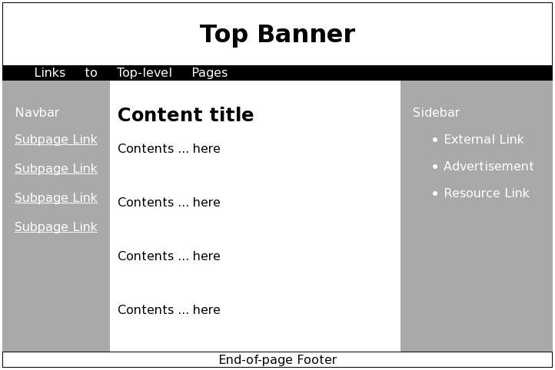
A Sample Page Layout

Slide 106
Webpage Layout
<header>
<h1 style="text-align: center">Top Banner</h1>
<nav style="background-color: black; color: white; padding-left: 40px">Links to Top-level Pages
</nav></header>
<div style="background-color: darkgrey">
<!-- three columns here -->
<section style="clear: both"></section>
</div>
<!-- page footer here -->
<nav style="float: left; padding: 1em; color: white">
<p>Navbar</p>
<a href="#">Subpage Link</a><br /><br />

Slide 107
</ul>
</nav>
<section style="float: left; padding: 10px; width:50%; background-color: white">
<h2>Content title</h2>
<article class="sectionArticle">
<p>Contents ... here</p><br />
</article>
</section>
<aside style="float: left; color: white;
padding: 1em">
<p>Sidebar</p>
<ul><li><p>External Link</p></li>
<li><p>Advertisement</p></li>
<li><p>Resource Link</p></li></ul>
</aside>
<footer style="border: thin solid black;
text-align: center">End-of-page Footer</footer>
Demo: Ex: Layout

Slide 108
Debugging and Validation
A spell checker can help you find typos and spelling errors.
Careful proofreading can catch grammar and other writing errors.
Test your webpage with different browsers under different operating systems. Even when a page looks OK, it may still contain coding errors. That is because Web browsers will ignore elements and attributes not recognized, as well as other problems in your HTML code.
Use Developer Tools for debugging the page.

Slide 109
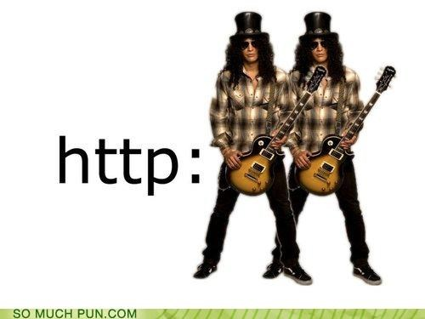
Questions?

