Slide 1
Python and PyCharm Installation

Slide 2
Announcements
This lecture: Python and PyCharm Installation

Slide 3
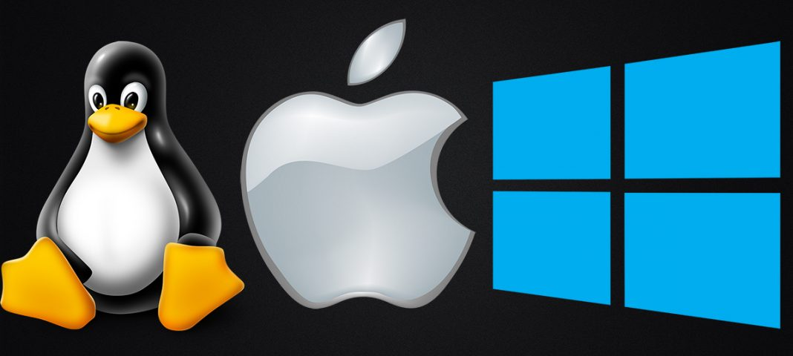
What is an Operating System?
Operating System is a program that manages computer hardware and software resources, and provide common services for computer applications.

Slide 4
What is Python?
Python is a computer programming language
Relatively simple syntax (set of rules programmers must follow when writing programs)
Python can be used to write simple programs that do basic calculations or very complicated ones
Can write basic games!
Python is popular with scientists because they can do complex data analysis by writing short programs
Python can be installed on a wide variety of computer types and operating systems

Slide 5
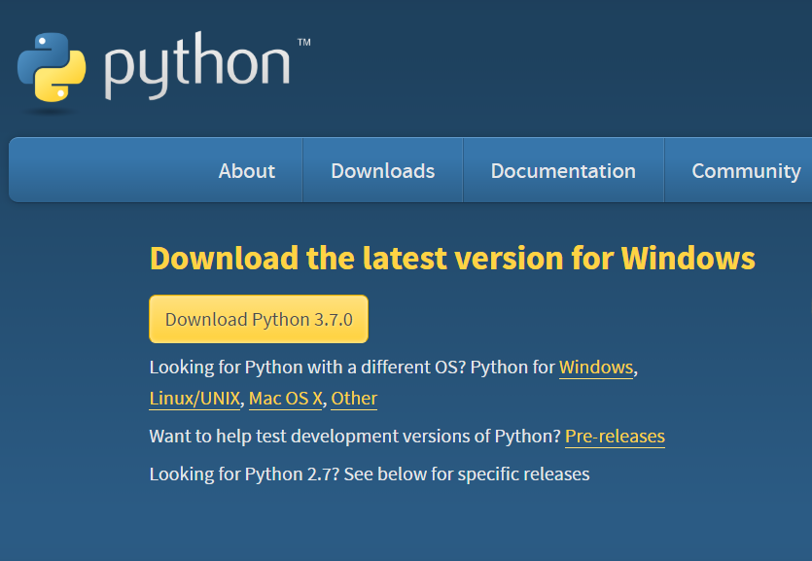
Python Installation on Windows
https://www.python.org/downloads/

Slide 6
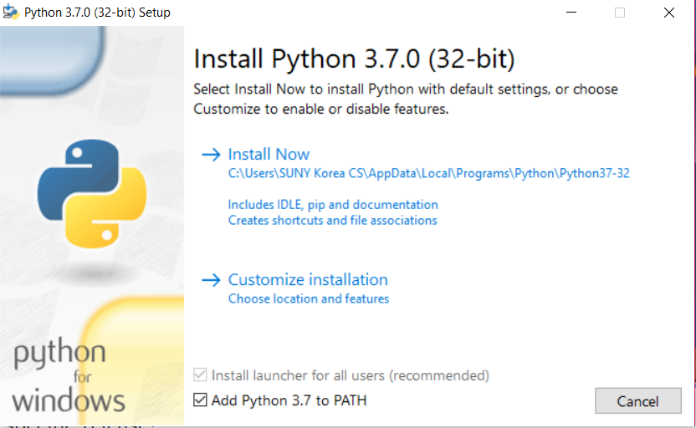
Python Installation on Windows
https://www.python.org/downloads/

Slide 7
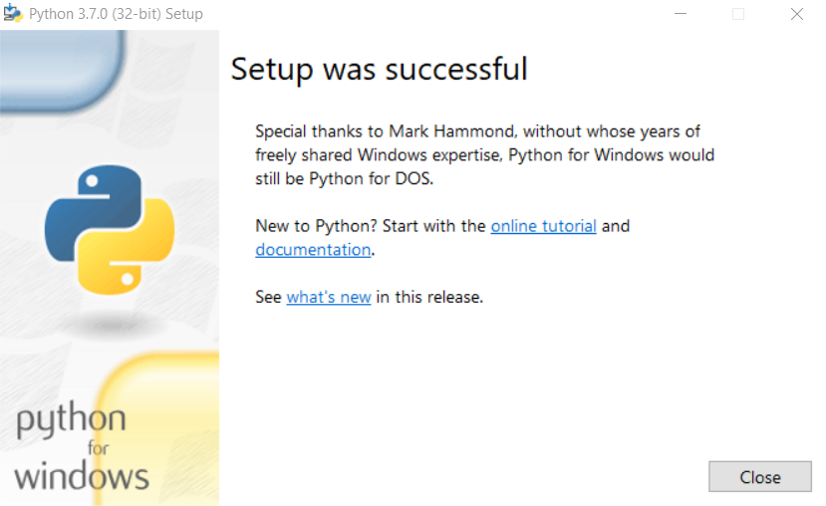
Python Installation on Windows

Slide 8
Python Installation on MacBook
https://www.youtube.com/watch?v=8BiYGIDCvvA

Slide 9
What is a computer program?
A computer program is a sequence of instructions the computer executes to solve a well-defined problem
The instructions or steps the programmer writes constitute the source code of the program
In Python, many of these instructions look like regular, everyday English with some extra punctuation thrown in
There are two basic ways to give commands written in Python to the computer:
Type individual instructions via a shell, an interactive program that executes the commands
Write a complete, stand-alone application that we can run over and over

Slide 10
Python console / interactive shell
The console (or interactive shell) is
a window where a single command or short set of commands can be typed to the computer
the computer tries to execute those command
Python interpreter
Reads Python instructions typed into the console by the user
The interpreter converts them into a form the computer’s hardware understands
The language that the hardware understands is called machine language
No matter what language is used, at some point the source code must be translated into machine code for the computer to execute it

Slide 11
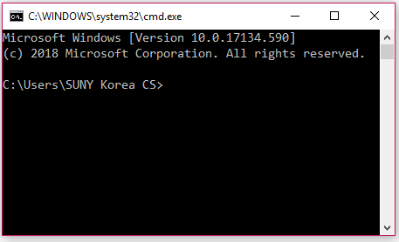
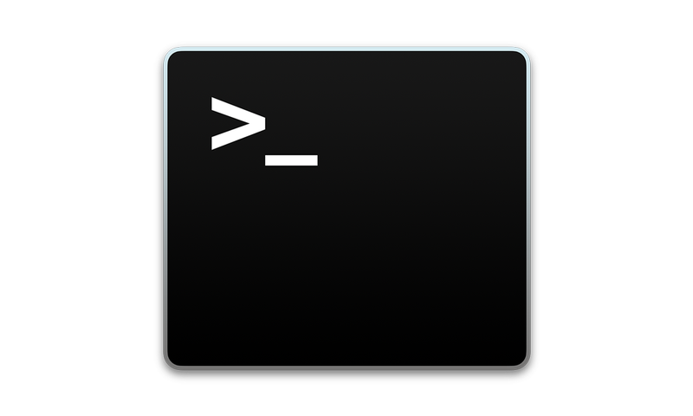
Opening a Terminal
Windows
Press "Win-R," type "cmd" and press "Enter" to open a Command Prompt session using just your keyboard.
Mac OS
Finder -> Applications -> Utilities -> Terminal

Slide 12
Some Python Statements
print (“helloworld”)
1 + 1
a = 1;
b = 2;
a + b
name = “SUNY”
country = “Korea”
print (name + country)
Pi = 22/7
print (type(name))
print (type(Pi))

Slide 13
The PyCharm IDE
In this course, an integrated development environment (IDE) called PyCharm will be used
PyCharm is industry-grade software used by professional software developers
still easy enough for novice programmers to use
First download and install Python from www.python.org
Go to www.jetbrains.com/pycharm to download and install the free Community Edition of PyCharm

Slide 14
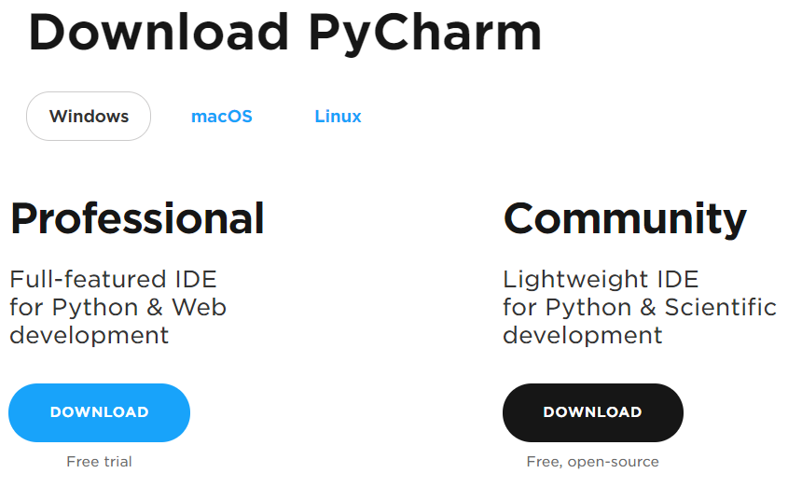
PyCharm Installation
https://www.jetbrains.com/pycharm/download/#section=windows

Slide 15
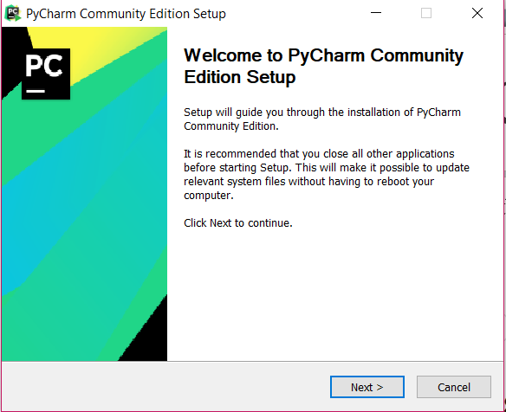
PyCharm Installation

Slide 16
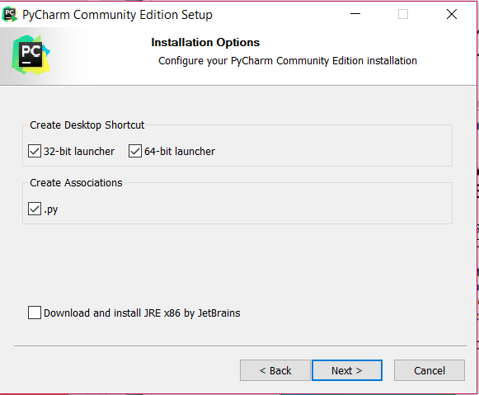
PyCharm Installation

Slide 17
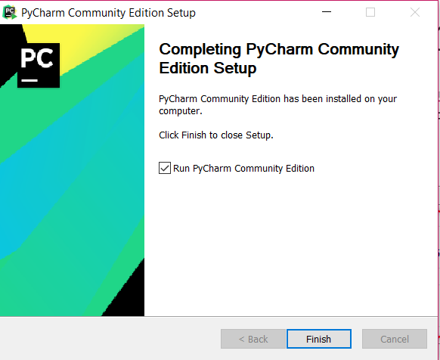
PyCharm Installation

Slide 18
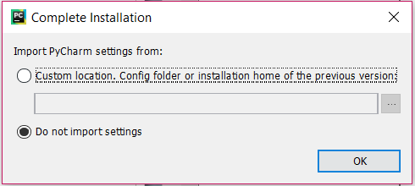
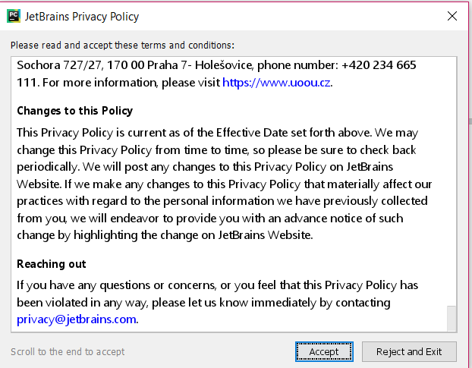
PyCharm Installation

Slide 19
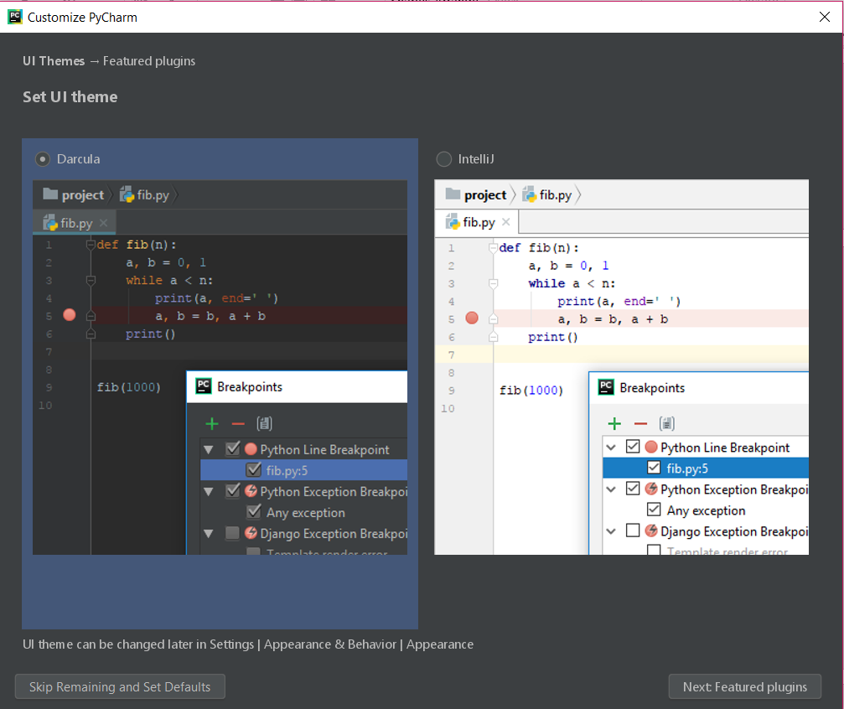
PyCharm Installation

Slide 20
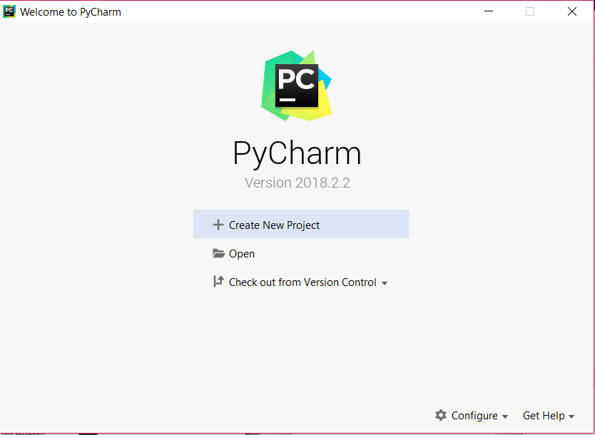
PyCharm Project

Slide 21
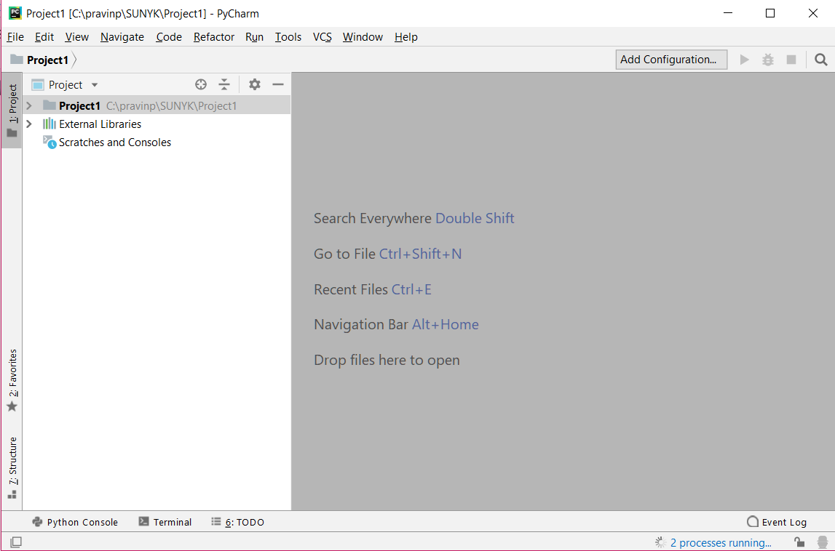
PyCharm IDE

Slide 22
PyCharm Installation on Mac
https://www.youtube.com/watch?v=wb4HNqQtIlI

Slide 23
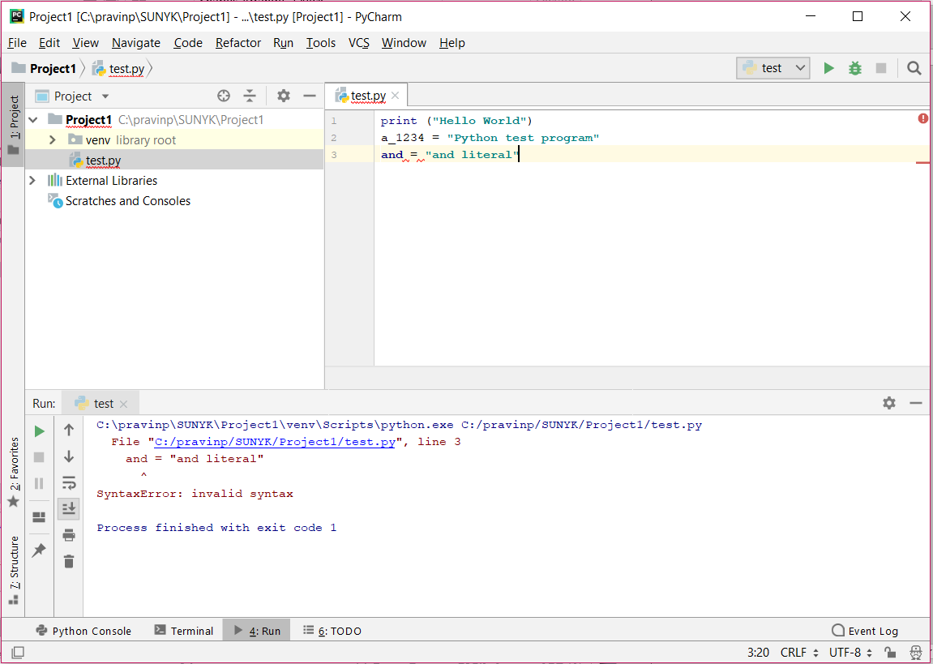
PyCharm IDE

Slide 24
Setting Default Python Interpreter in PyCharm
Step 1: Find out installation location of Python program:
Windows terminal command
where python
Mac terminal command
which python3
Note down the paths of python installation.

Slide 25
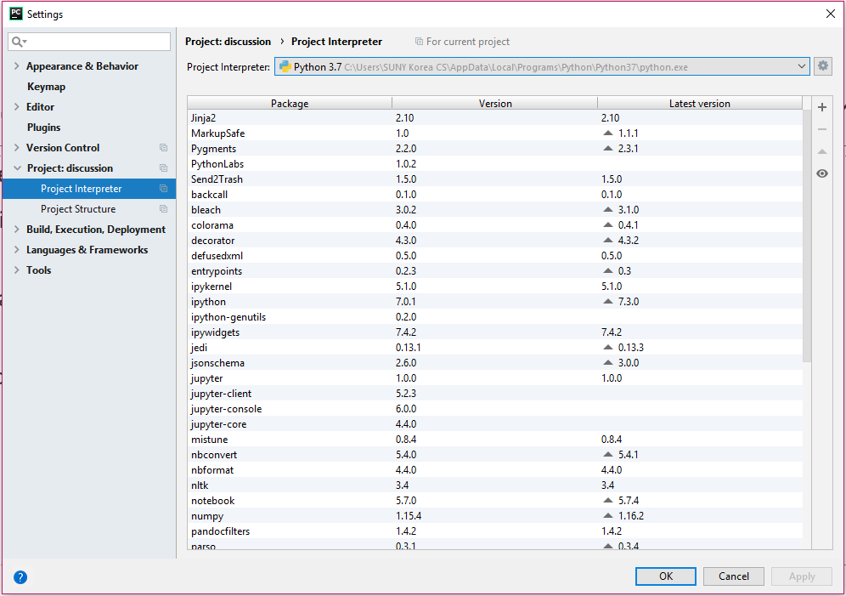
Setting Default Python Interpreter in PyCharm
Step 2: Change project settings (and New Project Settings) in PyCharm:

Slide 26
PyCharm basics
To create and run a stand-alone Python program:
Start PyCharm and press the “Create New Project” button.
Pick a “Location” and name for the Project (e.g., “CSE 101”).
Select File Menu > New > Python File and enter the name of the file for the source code.
Write the program and save the file.
After saving, go to Run Menu > Run.
Select the name of the program file to run it.
The next time the program is to be run:
Hit the green triangle in the lower-left corner of the screen.
Or, right-click the name of the file and choose Run.

Slide 27
Questions?

