Slide 1
Introduction to Computational and Algorithmic Thinking
Lecture 6 – Divide and conquer algorithms. Recursion

Slide 2
Announcements
This lecture: Divide and conquer algorithms. Recursion
Reading: Read Chapter 5 of Conery
Acknowledgement: Some of this lecture slides are based on CSE 101 lecture notes by Prof. Kevin McDonald at SBU

Slide 3
Divide and Conquer
The strategy for the linear search and insertion sort algorithms was the same: iterate over every location in the list and perform some operation
We will now look at a different strategy: divide and conquer
The idea: break a problem into smaller sub-problems and solve the smaller sub-problems
Sub-problems are chosen in such a way that their solutions can be combined to provide the solution to the original problem
It may not seem like that big a deal, but the improvement can be dramatic, as we will see

Slide 4
Example: Searching a Dictionary
To get a general sense of how the divide-and-conquer strategy improves search, consider how people find information in a (physical) phone book or dictionary
Suppose you want to find “janissary” in a dictionary
Open the book near the middle
The heading on the top left page is “kiwi”, so move back a small number of pages
Here you find “hypotenuse”, so move forward
Find “ichthyology”, move forward again
The number of pages you move gets smaller (or at least adjusts in response to the words you find)

Slide 5
Example: Searching a Dictionary
A more detailed specification of this process:
The goal is to search for a word w in a region of the book.
The initial region is the entire book.
At each step, pick a word x in the middle of the current region.
There are now two smaller regions: the part before x and the part after x.
If w comes before x, repeat the search on the region before x. Otherwise, search the region following x (go back to step 3).
Note: at first a “region” is a group of pages, but eventually a region is a set of words on a single page

Slide 6
A Note About Data Organization
An important note: an efficient search depends on having the data organized in some fashion
If books in a library are scattered all over the place we have to do an iterative search
Start at one end of the room and progress toward the other
If books are sorted or carefully cataloged we can try a more efficient method that exploits the sorted nature of the books

Slide 7
Binary Search: Overview
The binary search algorithm uses the divide-and-conquer strategy to search through a list
The list must be sorted for this algorithm to work properly
The “zeroing in” strategy for looking up a word in the dictionary won’t work if the words are not in alphabetical order
Similarly, binary search will not work for a list of values unless the list is sorted
To search a list of n items, first look at the item in location n/2
If this is the item we want, then the search has ended successfully
Otherwise, search either the region from 1 to (n/2)-1 or the region from (n/2)+1 to n

Slide 8
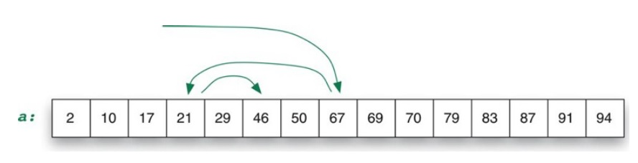
Binary Search: Example
Example: searching for 46 in a sorted list of 15 numbers:
Note how the search moves backward and forward, quickly finding the target element

Slide 9
Binary Search: the Details
The algorithm uses two variables to keep track of the boundaries of the region to search
lower: the index one position below the leftmost item in the region
upper: the index one position above the rightmost item in the region
Initial values when searching a list of n items:
lower = -1
upper = n

Slide 10
Binary Search: the Details
The algorithm is based on an iteration (loop) that keeps making the search region smaller and smaller
The initial region is the complete list
The next one is either the upper half or lower half
The one after that is one quarter, then one eighth, then…
The heart of the algorithm contains these operations:
Set mid to a location halfway between lower and upper:
mid = (lower + upper) // 2
If the item is at this location, then we’re done:
if a[mid] == x:
return mid

Slide 11
Binary Search: the Details
The heart of the algorithm (continued):
Otherwise, move one of the “brackets” to the current mid-point for the next iteration:
if x < mid:
upper = mid
else:
lower = mid

Slide 12
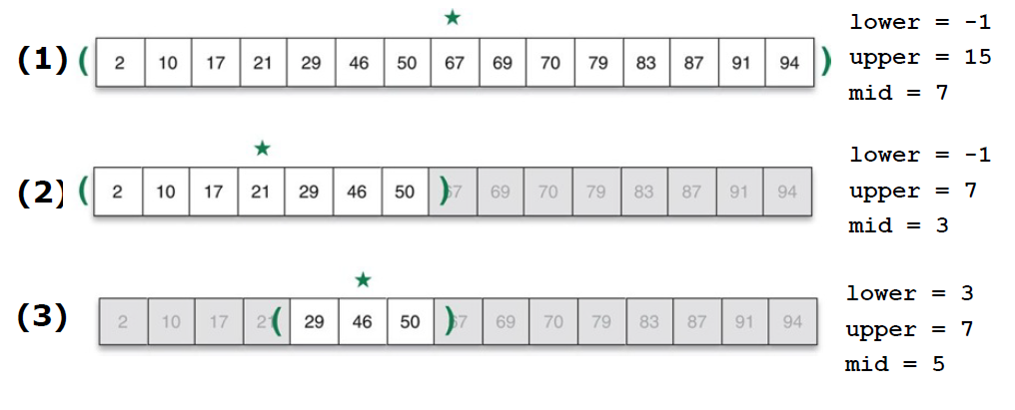
Binary Search: the Details
Let’s revisit our example from earlier. The star in the figure shows how the value of mid changes with each iteration

Slide 13
Binary Search: the Details
How do we handle the case when the target item is not in the list?
We have to add a condition that makes sure that lower is still to the left of upper
If the upper and lower pointers meet each other, this means that the search region has no elements in it – the search has failed
We can now write the complete bsearch function, which returns:
The index of the target item in the list, when the search is successful, or
None, if the target item is not in the list

Slide 14
Completed bsearch() Function
def bsearch(a, x):
lower = -1
upper = len(a)
while upper > lower + 1:
mid = (lower + upper) // 2
if a[mid] == x:
return mid
if x < a[mid]:
upper = mid
else:
lower = mid
return None
See bsearch_tests.py for fully commented code

Slide 15
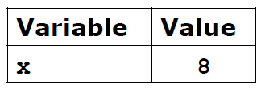

Trace Execution: bsearch()
a: [1, 2, 3, 5, 6, 8, 9, 11, 14, 17]
index: 0 1 2 3 4 5 6 7 8 9
def bsearch(a, x):
lower = -1
upper = len(a)
while upper > lower + 1:
mid = (lower + upper) // 2
if a[mid] == x:
return mid
if x < a[mid]:
upper = mid
else:
lower = mid
return None

Slide 16
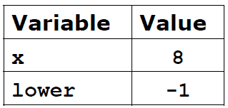
Trace Execution: bsearch()
a: [1, 2, 3, 5, 6, 8, 9, 11, 14, 17]
index: 0 1 2 3 4 5 6 7 8 9
def bsearch(a, x):
lower = -1
upper = len(a)
while upper > lower + 1:
mid = (lower + upper) // 2
if a[mid] == x:
return mid
if x < a[mid]:
upper = mid
else:
lower = mid
return None

Slide 17
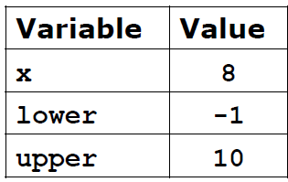
Trace Execution: bsearch()
a: [1, 2, 3, 5, 6, 8, 9, 11, 14, 17]
index: 0 1 2 3 4 5 6 7 8 9
def bsearch(a, x):
lower = -1
upper = len(a)
while upper > lower + 1:
mid = (lower + upper) // 2
if a[mid] == x:
return mid
if x < a[mid]:
upper = mid
else:
lower = mid
return None

Slide 18
Trace Execution: bsearch()
a: [1, 2, 3, 5, 6, 8, 9, 11, 14, 17]
index: 0 1 2 3 4 5 6 7 8 9
def bsearch(a, x):
lower = -1
upper = len(a)
while upper > lower + 1: # True
mid = (lower + upper) // 2
if a[mid] == x:
return mid
if x < a[mid]:
upper = mid
else:
lower = mid
return None

Slide 19
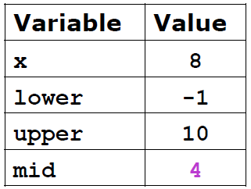
Trace Execution: bsearch()
a: [1, 2, 3, 5, 6, 8, 9, 11, 14, 17]
index: 0 1 2 3 4 5 6 7 8 9
def bsearch(a, x):
lower = -1
upper = len(a)
while upper > lower + 1:
mid = (lower + upper) // 2
if a[mid] == x:
return mid
if x < a[mid]:
upper = mid
else:
lower = mid
return None

Slide 20
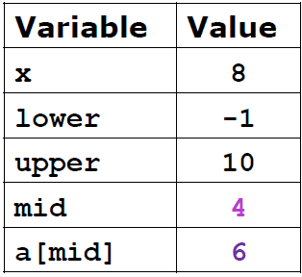
Trace Execution: bsearch()
a: [1, 2, 3, 5, 6, 8, 9, 11, 14, 17]
index: 0 1 2 3 4 5 6 7 8 9
def bsearch(a, x):
lower = -1
upper = len(a)
while upper > lower + 1:
mid = (lower + upper) // 2
if a[mid] == x: # False
return mid
if x < a[mid]:
upper = mid
else:
lower = mid
return None

Slide 21
Trace Execution: bsearch()
a: [1, 2, 3, 5, 6, 8, 9, 11, 14, 17]
index: 0 1 2 3 4 5 6 7 8 9
def bsearch(a, x):
lower = -1
upper = len(a)
while upper > lower + 1:
mid = (lower + upper) // 2
if a[mid] == x:
return mid
if x < a[mid]: # False
upper = mid
else:
lower = mid
return None

Slide 22
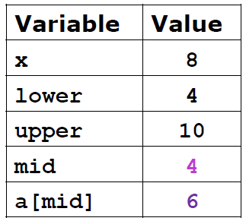
Trace Execution: bsearch()
a: 1, 2, 3, 5, [6, 8, 9, 11, 14, 17]
index: 0 1 2 3 4 5 6 7 8 9
def bsearch(a, x):
lower = -1
upper = len(a)
while upper > lower + 1:
mid = (lower + upper) // 2
if a[mid] == x:
return mid
if x < a[mid]:
upper = mid
else:
lower = mid
return None

Slide 23
Trace Execution: bsearch()
a: 1, 2, 3, 5, [6, 8, 9, 11, 14, 17]
index: 0 1 2 3 4 5 6 7 8 9
def bsearch(a, x):
lower = -1
upper = len(a)
while upper > lower + 1: # True
mid = (lower + upper) // 2
if a[mid] == x:
return mid
if x < a[mid]:
upper = mid
else:
lower = mid
return None

Slide 24
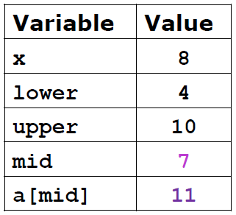
Trace Execution: bsearch()
a: 1, 2, 3, 5, [6, 8, 9, 11, 14, 17]
index: 0 1 2 3 4 5 6 7 8 9
def bsearch(a, x):
lower = -1
upper = len(a)
while upper > lower + 1:
mid = (lower + upper) // 2
if a[mid] == x:
return mid
if x < a[mid]:
upper = mid
else:
lower = mid
return None

Slide 25
Trace Execution: bsearch()
a: 1, 2, 3, 5, [6, 8, 9, 11, 14, 17]
index: 0 1 2 3 4 5 6 7 8 9
def bsearch(a, x):
lower = -1
upper = len(a)
while upper > lower + 1:
mid = (lower + upper) // 2
if a[mid] == x: # False
return mid
if x < a[mid]:
upper = mid
else:
lower = mid
return None

Slide 26
Trace Execution: bsearch()
a: 1, 2, 3, 5, [6, 8, 9, 11, 14, 17]
index: 0 1 2 3 4 5 6 7 8 9
def bsearch(a, x):
lower = -1
upper = len(a)
while upper > lower + 1:
mid = (lower + upper) // 2
if a[mid] == x:
return mid
if x < a[mid]: # True
upper = mid
else:
lower = mid
return None

Slide 27

Trace Execution: bsearch()
a: 1, 2, 3, 5, [6, 8, 9, 11], 14, 17]
index: 0 1 2 3 4 5 6 7 8 9
def bsearch(a, x):
lower = -1
upper = len(a)
while upper > lower + 1:
mid = (lower + upper) // 2
if a[mid] == x:
return mid
if x < a[mid]:
upper = mid
else:
lower = mid
return None

Slide 28
Trace Execution: bsearch()
a: 1, 2, 3, 5, [6, 8, 9, 11], 14, 17]
index: 0 1 2 3 4 5 6 7 8 9
def bsearch(a, x):
lower = -1
upper = len(a)
while upper > lower + 1: # True
mid = (lower + upper) // 2
if a[mid] == x:
return mid
if x < a[mid]:
upper = mid
else:
lower = mid
return None

Slide 29
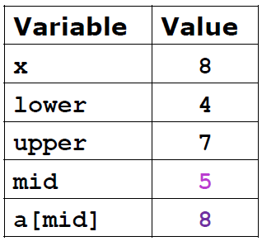
Trace Execution: bsearch()
a: 1, 2, 3, 5, [6, 8, 9, 11], 14, 17]
index: 0 1 2 3 4 5 6 7 8 9
def bsearch(a, x):
lower = -1
upper = len(a)
while upper > lower + 1:
mid = (lower + upper) // 2
if a[mid] == x:
return mid
if x < a[mid]:
upper = mid
else:
lower = mid
return None

Slide 30
Trace Execution: bsearch()
a: 1, 2, 3, 5, [6, 8, 9, 11], 14, 17]
index: 0 1 2 3 4 5 6 7 8 9
def bsearch(a, x):
lower = -1
upper = len(a)
while upper > lower + 1:
mid = (lower + upper) // 2
if a[mid] == x: # True
return mid
if x < a[mid]:
upper = mid
else:
lower = mid
return None

Slide 31
Trace Execution: bsearch()
a: 1, 2, 3, 5, [6, 8, 9, 11], 14, 17]
index: 0 1 2 3 4 5 6 7 8 9
def bsearch(a, x):
lower = -1
upper = len(a)
while upper > lower + 1:
mid = (lower + upper) // 2
if a[mid] == x:
return mid
if x < a[mid]:
upper = mid
else:
lower = mid
return None

Slide 32
Completed bsearch() Function
In the PythonLabs module called RecursionLab there is a function named print_bsearch_brackets that will let us visualize how the lower and upper pointers change as the search progresses
The call to this function goes near the top of the loop
See the code on the next slide

Slide 33
bsearch() with Print-outs
def bsearch(a, x):
lower = -1
upper = len(a)
while upper > lower + 1:
mid = (lower + upper) // 2
print_bsearch_brackets(a,lower,mid,upper)
if a[mid] == x:
return mid
if x < a[mid]:
upper = mid
else:
lower = mid
return None

Slide 34
bsearch() Example
list: [5, 12, 16, 40, 58, 62, 72, 84, 88, 90]
target element: 72
In the sample visualizations below, the brackets indicate the current
search region, and * indicates the middle element
[5 12 16 40 *58 62 72 84 88 90]
5 12 16 40 58 [62 72 *84 88 90]
5 12 16 40 58 *62 72] 84 88 90
5 12 16 40 58 62 [72] 84 88 90
Result: 6

Slide 35
bsearch() Example
list: [5, 12, 16, 40, 58, 62, 72, 84, 88, 90]
target element: 65 (not present in list)
In the sample visualizations below, the brackets indicate the current
search region, and * indicates the middle element
[5 12 16 40 *58 62 72 84 88 90]
5 12 16 40 58 [62 72 *84 88 90]
5 12 16 40 58 *62 72] 84 88 90
Result: None

Slide 36
Cutting the Problem Down to Size
It should be clear why we say that the binary search algorithm uses a divide-and-conquer strategy
The problem is to find an item within a given range
At each step, the problem is split into two equal sub-problems
Focus then turns to one sub-problem for the next step

Slide 37
Number of Comparisons
The number of iterations made by this algorithm when it searches a list containing n items is roughly log₂ n
To see why, consider the question from the other direction
Let’s start with a list containing 1 item. Suppose each step of an iteration doubles the size of the list
After n steps, we will have 2^{n} items in the list
By definition of logarithm, if x=2^{y}, then y=log₂ x
During searching we’re reducing a region of size n down to a region of size 1
A successful search might return after the first comparison
An unsuccessful search does all log₂ n + 1 comparisons
Exampe: 8->4->2->1, or 4 comparisons (note: log₂ 8 = 3)

Slide 38
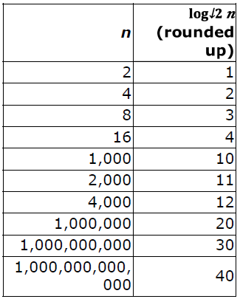
Searching Long Lists
Divide-and-conquer might seem like a lot of extra work for such a simple problem (searching)
For large lists, however, that work leads to a very efficient search
We would need at most 30 comparisons to find something in a list of 1 billion items
The worst case for linear search would be 1 billion comparisons!

Slide 39
Divide and Conquer Sorting
The divide-and-conquer strategy used to make a more efficient search algorithm can also be applied to sorting
Two well-known sorting algorithms:
Merge Sort: sort subgroups of size 2, merge them into sorted groups of size 4, merge those into sorted groups of size 8, and so on
Quicksort: divide a list into big values and small values, then sort each part
Let’s first explore merge sort and see how it can be implemented in Python

Slide 40
Merge Sort
The merge sort algorithm works from “the bottom up”
Start by solving the smallest pieces of the main problem
Keep combining their results into larger solutions
Eventually the original problem will be solved
Example: sorting playing cards
Divide the cards into groups of two
Sort each group, putting the smaller of the two on the top
Merge groups of two into groups of four
Merge groups of four into groups of eight
and so on ...

Slide 41
Merge Sort: Example
Let’s try an example of merge sort with 7 playing cards:
2 Q J 7 A 10 5 Original list
2 Q 7 J 10 A 5 Sorted pairs
2 7 J Q 5 10 A Merged pairs into sorted groups of 3 or 4
2 5 7 10 J Q A Merged smaller groups into 1 large sorted group

Slide 42
Merge Sort
What makes this method more effective than simple insertion sort?
Merging two piles is a very simple operation
Only need to look at the two cards currently on the top of each pile
No need to look deeper into either group
In our example, we had these two piles at one point:
[2 7 J Q] and [5 10 A]
Compare 2 with 5, pick up the 2
Compare 5 with 7, pick up the 5
Compare 7 with 10, pick up the 7
and so on ...

Slide 43
Merge Sort Visualization
See msort_visualization.py for an animation of merge sort
Also see visualgo.net/en/sorting
Watching a few animations of merge sort in action will give you a stronger sense of how the algorithm sorts a list of values

Slide 44
Implementing Merge Sort
We will now see how to implement merge sort as a function called msort
msort depends on two helper functions:
merge, which merges two sorted lists into one. This function is already implemented in the built-in heapq module in Python.
merge_groups, which calls merge and tells it exactly which sub-lists of the original list to merge

Slide 45
Implementing Merge Sort (next)
Let’s look at an example of the merge function so we understand how it works
import heapq
list1 = [1, 4, 6, 8]
list2 = [2, 5, 7, 9, 10, 13, 19]
merged_list = heapq.merge(list1, list2)
merged_list will be:
[1, 2, 4, 5, 6, 7, 8, 9, 10, 13, 19]

Slide 46
The merge_groups Function
A helper function which we will write ourselves is merge_groups
The merge_groups function takes two arguments: the list and the size of a group, group_size (e.g., 2, 4, 8, ...)
It takes adjacent groups of sorted values two at a time and merges them into single groups
For example, if the group size is 2, this means that merge_groups will merge adjacent pairs into quartets
The function depends on Python’s slicing notation, which works with lists and strings
Code like nums[i:j] means “create a new list containing elements I through j-1 of nums”

Slide 47
Slicing Examples
Example of slicing:
nums = [23, 6, 21, 45, 82, 4, 10]
0 1 2 3 4 5 6
print(nums[2:6])
Output: [21, 45, 82, 4]
Slicing notation can be used to change the contents of a list:
nums[1:3] = [11, 22, 33]
nums becomes:
[23, 11, 22, 33, 45, 82, 4, 10]
Note: 6 and 21 have been replaced with the numbers in red

Slide 48
Slicing Examples 2
Example of slicing:
names = ['Abe', 'Barbara', 'Chris’, 'Dave', 'Erin', 'Frank', 'Harry']
print(names[2:6])
Output: ['Chris', 'Dave', 'Erin', 'Frank']
Slicing notation can be used to change the contents of a list:
names[1:3] = ['Mike', 'Nathan', 'Opal']
names becomes:
['Abe', 'Mike', 'Nathan', 'Opal', 'Dave', 'Erin’, 'Frank', 'Harry']
Note: 'Barbara' and 'Chris' have been replaced with the words in red

Slide 49
The merge_groups Function
To understand how merge_groups needs to work, consider the task of merging two quartets into one octet (“quartets” means group_size = 4)
The two quartets are adjacent to each other in the list
Generally, there are several or many such pairs of quartets we need to merge together, and we have to merge all such pairs of quartets into octets
We need variables to tell us where each pair of quartets begins
Call these variables i and j
i is the starting index of the first quartet
j is the starting index of the second quartet

Slide 50
The merge_groups Function
After merging those quartets together, we need to move to the next two quartets
They can be found at indexes i+8 and j+8 since we need to skip over the octet we just created
Initially, i = 0 and j = 4
For the second iteration, i = 8 and j = 12
Note that j = i + 4 which means that j = i + group_size
Next, i = 16, j = 20 (again, j = i + group_size)
In general, after merging two groups together,
i will increase by 2 × group_size and
j will simply become j = i + group_size

Slide 51
The merge_groups Function
Now that we have worked out this logic, we can implement the merge_groups function:
def merge_groups(a, group_size):
for i in range(0, len(a), 2*group_size):
j = i + group_size
k = j + group_size
a[i:k] = list(heapq.merge(a[i:j], a[j:k]))
The for-loop doubles the group size until the list is just one large group
See merge_groups_tests.py for examples of this function in action

Slide 52
Trace Execution: merge_groups
def merge_groups(a, group_size):
for i in range(0, len(a), 2*group_size):
j = i + group_size
k = j + group_size
a[i:k] = list(heapq.merge(a[i:j], a[j:k]))
nums: [8, 6, 7, 5, 3, 1, 2, 4]
Function call: merge_groups(nums, 1)
a: [8, 6, 7, 5, 3, 1, 2, 4] group_size = 1
The loop will iterate as: i = 0, 2, 4, 6

Slide 53
Trace Execution: merge_groups
def merge_groups(a, group_size):
for i in range(0, len(a), 2*group_size):
j = i + group_size
k = j + group_size
a[i:k] = list(heapq.merge(a[i:j], a[j:k]))
nums: [8, 6, 7, 5, 3, 1, 2, 4]
Function call: merge_groups(nums, 1)
a: [8, 6, 7, 5, 3, 1, 2, 4] group_size = 1
i = 0
j = i + 1 = 1
k = j + 1 = 2
a[0:2] = merge(a[0:1], a[1:2])
a: [6, 8, 7, 5, 3, 1, 2, 4]

Slide 54
Trace Execution: merge_groups
def merge_groups(a, group_size):
for i in range(0, len(a), 2*group_size):
j = i + group_size
k = j + group_size
a[i:k] = list(heapq.merge(a[i:j], a[j:k]))
nums: [8, 6, 7, 5, 3, 1, 2, 4]
Function call: merge_groups(nums, 1)
a: [6, 8, 7, 5, 3, 1, 2, 4] group_size = 1
i = 2
j = i + 1 = 3
k = j + 1 = 4
a[2:4] = merge(a[2:3], a[3:4])
a: [6, 8, 5, 7, 3, 1, 2, 4]

Slide 55
Trace Execution: merge_groups
def merge_groups(a, group_size):
for i in range(0, len(a), 2*group_size):
j = i + group_size
k = j + group_size
a[i:k] = list(heapq.merge(a[i:j], a[j:k]))
nums: [8, 6, 7, 5, 3, 1, 2, 4]
Function call: merge_groups(nums, 1)
a: [6, 8, 5, 7, 3, 1, 2, 4] group_size = 1
i = 4
j = i + 1 = 5
k = j + 1 = 6
a[4:6] = merge(a[4:5], a[5:6])
a: [6, 8, 5, 7, 1, 3, 2, 4]

Slide 56
Trace Execution: merge_groups
def merge_groups(a, group_size):
for i in range(0, len(a), 2*group_size):
j = i + group_size
k = j + group_size
a[i:k] = list(heapq.merge(a[i:j], a[j:k]))
nums: [8, 6, 7, 5, 3, 1, 2, 4]
Function call: merge_groups(nums, 1)
a: [6, 8, 5, 7, 1, 3, 2, 4] group_size = 1
i = 6
j = i + 1 = 7
k = j + 1 = 8
a[6:8] = merge(a[6:7], a[7:8])
a: [6, 8, 5, 7, 1, 3, 2, 4]

Slide 57
Trace Execution: merge_groups
def merge_groups(a, group_size):
for i in range(0, len(a), 2*group_size):
j = i + group_size
k = j + group_size
a[i:k] = list(heapq.merge(a[i:j], a[j:k]))
nums: [8, 6, 7, 5, 3, 1, 2, 4]
Function call: merge_groups(nums, 2)
a: [6, 8, 5, 7, 1, 3, 2, 4] group_size = 2
The loop will iterate as: i = 0, 4

Slide 58
Trace Execution: merge_groups
def merge_groups(a, group_size):
for i in range(0, len(a), 2*group_size):
j = i + group_size
k = j + group_size
a[i:k] = list(heapq.merge(a[i:j], a[j:k]))
nums: [8, 6, 7, 5, 3, 1, 2, 4]
Function call: merge_groups(nums, 2)
a: [6, 8, 5, 7, 1, 3, 2, 4] group_size = 2
i = 0
j = i + 2 = 2
k = j + 2 = 4
a[0:4] = merge(a[0:2], a[2:4])
a: [5, 6, 7, 8, 1, 3, 2, 4]

Slide 59
Trace Execution: merge_groups
def merge_groups(a, group_size):
for i in range(0, len(a), 2*group_size):
j = i + group_size
k = j + group_size
a[i:k] = list(heapq.merge(a[i:j], a[j:k]))
nums: [8, 6, 7, 5, 3, 1, 2, 4]
Function call: merge_groups(nums, 2)
a: [5, 6, 7, 8, 1, 3, 2, 4] group_size = 2
i = 4
j = i + 2 = 6
k = j + 2 = 8
a[4:8] = merge(a[4:6], a[6:8])
a: [5, 6, 7, 8, 1, 2, 3, 4]

Slide 60
Trace Execution: merge_groups
def merge_groups(a, group_size):
for i in range(0, len(a), 2*group_size):
j = i + group_size
k = j + group_size
a[i:k] = list(heapq.merge(a[i:j], a[j:k]))
nums: [8, 6, 7, 5, 3, 1, 2, 4]
Function call: merge_groups(nums, 4)
a: [5, 6, 7, 8, 1, 2, 3, 4] group_size = 4
The loop will iterate as: i = 0, 8 (iterate once only)

Slide 61
Trace Execution: merge_groups
def merge_groups(a, group_size):
for i in range(0, len(a), 2*group_size):
j = i + group_size
k = j + group_size
a[i:k] = list(heapq.merge(a[i:j], a[j:k]))
nums: [8, 6, 7, 5, 3, 1, 2, 4]
Function call: merge_groups(nums, 4)
a: [5, 6, 7, 8, 1, 2, 3, 4] group_size = 4
i = 0
j = i + 4 = 4
k = j + 4 = 8
a[0:8] = merge(a[0:4], a[4:8])
a: [1, 2, 3, 4, 5, 6, 7, 8]

Slide 62
Exercise: write merge Function
Our merge_groups function uses merge from the heapq module
Let’s write our own merge function
It takes two parameters: list u and list v, both are sorted in increasing order
It returns a sorted list containing all the elements in u and v
Write a main function that tests merge that you write

Slide 63
Completed msort Function
All that remains now is to write msort, which will be straightforward with the help of merge_groups which in turn uses merge
The main thing that msort needs to do is tell merge_groups how large each group is. But that’s easy:
First, we take single elements and merge them into sorted pairs
Then, merge all the sorted pairs into sorted quartets
Next, merge all the sorted quartets into sorted octets
and so on ...
Two implementations of msort (make sure you study these two)
msort.py using heapq.merge
msort2.py using our own merge (see the previous slide)
If you want to visualize the progress of msort, you can call a function from RecursionLab called print_msort_brackets (continued on the next slides)

Slide 64
Completed msort Function
from PythonLabs.RecursionLab import
print_msort_brackets
def msort(a):
size = 1
while size < len(a):
print_msort_brackets(a, size) # optional
merge_groups(a, size)
size = size * 2
print_msort_brackets(a, len(a)) # optional
See msort_tests.py for a test run of the msort function

Slide 65
Completed msort Function
Example run of msort, with print_msort_brackets:
nums:
[33, 93, 7, 15, 50, 11, 65, 43]
[33] [93] [7] [15] [50] [11] [65] [43]
[33 93] [7 15] [11 50] [43 65]
[7 15 33 93] [11 43 50 65]
[7 11 15 33 43 50 65 93]

Slide 66
Comparisons in Merge Sort
To completely sort a list with n items requires log₂ n iterations
Why? The group size starts at 1 and doubles with each iteration. The group size equals or exceeds n after log₂ n rounds of doubling
During each iteration of msort there are at most n comparisons. Why?
Comparisons occur in the built-in merge method
It compares values at the front of each group
It may have to work all the way to the end of each group, but might stop early
So, the total number of comparisons is roughly n log₂ n

Slide 67
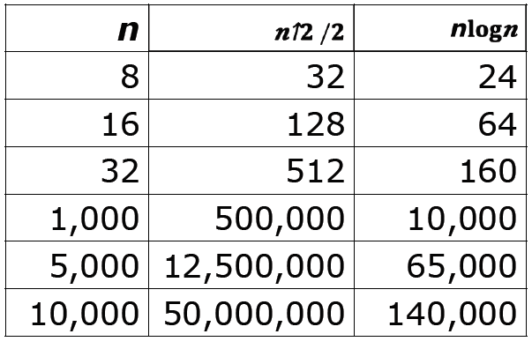
Scalability of Merge Sort
So, merge sort is a O(nlog₂ n) algorithm
Is the new formula that much better than the comparisons made by insertion sort?
Not that big of a difference for small lists
But as the length of the list increases, the
savings start to add up

Slide 68
Recursion
An algorithm that uses divide and conquer can be written using iteration or recursion
A recursive solution to a problem features “self-similarity”, meaning that a function that solves a problem calls itself
You actually already have familiarity with this concept
Consider the factorial operation in mathematics
n! = n x (n-1)! for integers n≥1, where 0! = 1
Note how factorial is defined in terms of itself (i.e., the ! Symbol appears on both sides of the equals sign)
This is a recursive definition of factorial
The simplest case of a recursive definition is called the base case

Slide 69

Recursion Example: Factorial
Writing a recursive Python function that implements factorial is very straightforward
We need to define both the recursive part (which is when the factorial function calls itself), and the base case
def factorial(n):
if n == 0: # base case
return 1
else:
return n * factorial(n-1)
See recursion_examples.py for code for many of the example recursive functions from these notes

Slide 70
Recursion
All recursive functions have the following characteristics:
One or more base cases (the simplest cases) are used to stop recursion
One or more a recursive calls that reduce the original problem in size, bringing it increasingly closer to a base case until it becomes that case
A recursive call can result in many more recursive calls, because the method keeps on dividing a sub-problem into new sub-problems that are of smaller size than the original
These sub-problems are of the same nature as the original
Please note: solutions can be recursive, not problems!

Slide 71
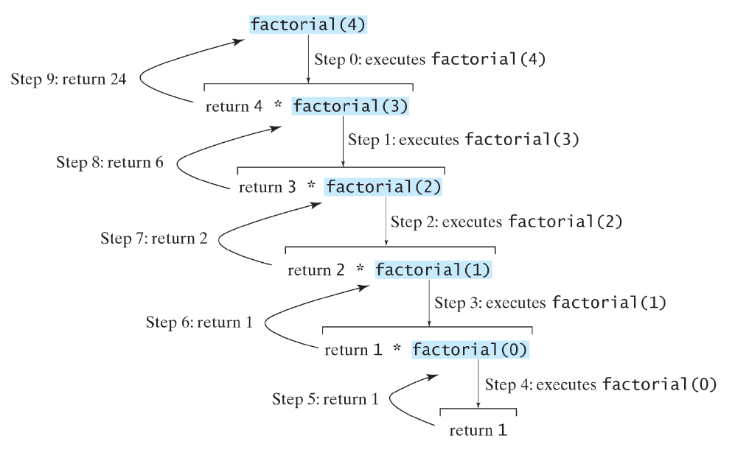
Trace: factorial(4)

Slide 72
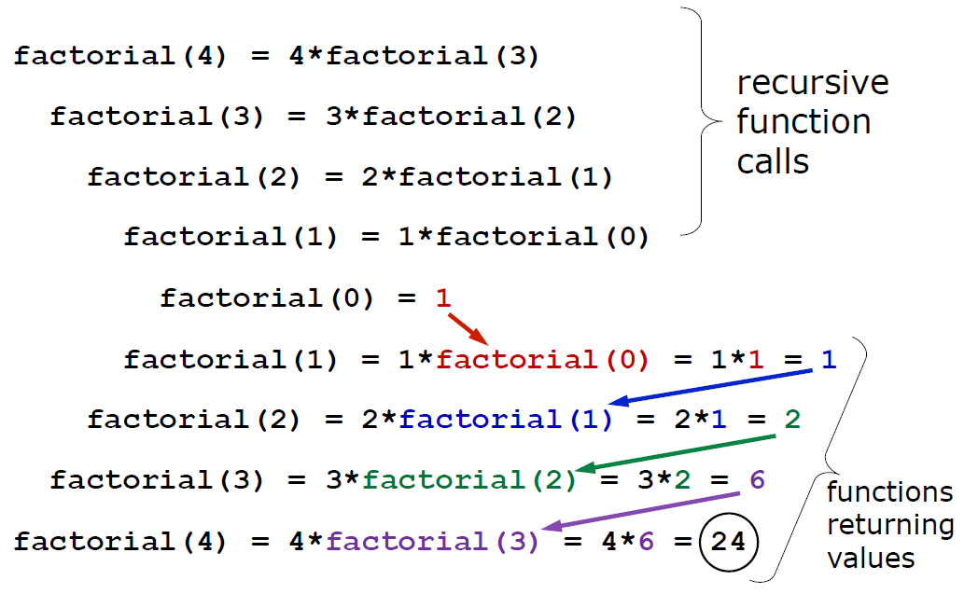
Trace: factorial(4)

Slide 73
A Disclaimer
The true benefit of recursive thinking is not realized until one starts trying to solve challenging problems that are more complicated than what we will explore in CSE 101
Some (but not all) of the problems described in these lecture notes would be better solved using iterative, non-recursive functions
One notable exception is sorting, which can be solved efficiently using recursive algorithms like merge sort or Quicksort
The purpose of these examples, therefore, is to help you understand how to think recursively when solving problems, not necessarily how to solve the stated problems in the most efficient manner

Slide 74
Example: Fibonacci Numbers
Suppose we have one pair of rabbits (male and female) at the beginning of a year
Rabbit pairs are not fertile during their first month of life but thereafter give birth to one new male and female pair at the end of every month
Also, these are immortal rabbits and never die

Slide 75
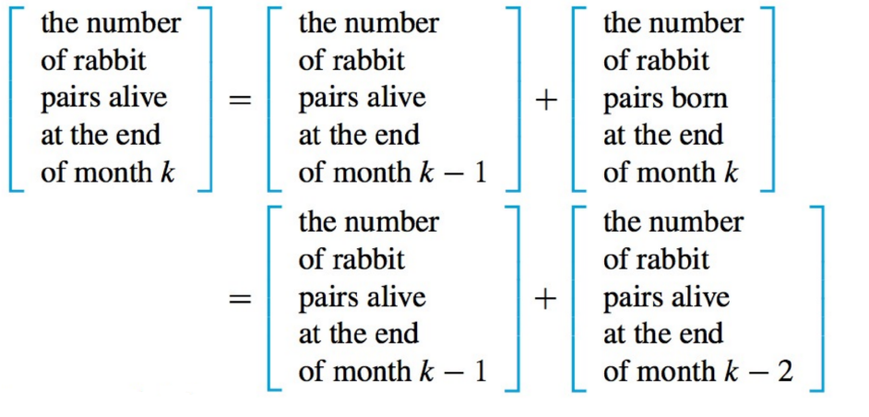
Example: Fibonacci Numbers
So we can now compute how many rabbit pairs will be alive at the end of month k:

Slide 76
Example: Fibonacci Numbers
At the start of the year (after 0 months), we have F₀ = 1 pair of rabbits
At the end of the first month we still have only F₁ = 1 pair of rabbits
At the end of k months there will be F_{k} = F_{k-1} + F_{k-2} pairs of rabbits
F_{k-1} is how many rabbits were alive the previous month
F_{k-2} is how many rabbits were alive two months ago, which equals how many rabbit will be born in month k
By now you have probably guessed that F is the Fibonacci sequence (1, 1, 2, 3, 5, 8, 13, 21,…)
Let’s see a function that returns the nth Fibonacci number

Slide 77
Example: Fibonacci Numbers
def fib(n):
if n == 0 or n == 1: # two base cases
return 1
return fib(n - 1) + fib(n - 2)
Examples:
fib(0) = 1
fib(1) = 1
fib(2) = fib(1) + fib(0) = 1 + 1 = 2
fib(3) = fib(2) + fib(1) = 2 + 1 = 3
fib(4) = fib(3) + fib(2) = 3 + 2 = 5
See recursion_examples.py

Slide 78
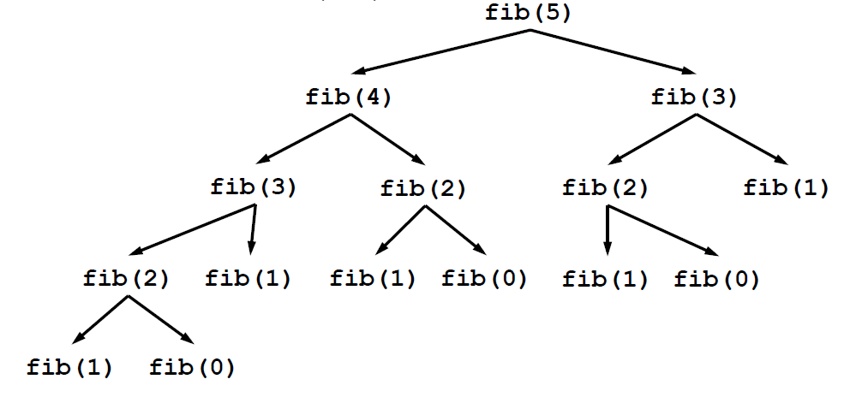
Trace: fib(5)
This call tree diagram illustrates how the initial call to fib(n) generates a large number of recursive calls, even for a small value for n

Slide 79
Recursive Binary Search
For recursive binary search (rsearch), the idea is basically the same as iterative binary search (bsearch, page 14)
But, the while-loop is replaced with a recursive call to the function
The algorithm checks the middle element to see if it equals the target
If not, the function calls itself on the first half or second half, depending on whether the middle element is greater than or less than the target (respectively)

Slide 80
Completed rsearch Function
def rsearch(a, x, lower, upper):
if upper == lower + 1:
return None
mid = (lower + upper) // 2
if a[mid] == x:
return mid
if x < a[mid]:
return rsearch(a, x, lower, mid)
else:
return rsearch(a, x, mid, upper)
See rsearch_tests.py

Slide 81
Binary Search Algorithms
Iterative version:
def bsearch(a, x):
lower = -1
upper = len(a)
while upper > lower + 1:
mid = (lower + upper) // 2
if a[mid] == x:
return mid
if x < a[mid]:
upper = mid
else:
lower = mid
return None
Recursive version:
def rsearch(a, x, lower, upper):
if upper == lower + 1:
return None
mid = (lower + upper) // 2
if a[mid] == x:
return mid
if x < a[mid]:
return rsearch(a, x, lower, mid)
else:
return rsearch(a, x, mid, upper)

Slide 82
Quicksort
Quicksort is a recursive sorting algorithm
Like merge sort, quicksort breaks a list into smaller sub-lists and sorts the smaller lists
It divides the list into sub-lists in a different manner, however
The first element in a region to be sorted is chosen as the pivot element
The region is then partitioned into two sub-regions with a helper function called partition

Slide 83
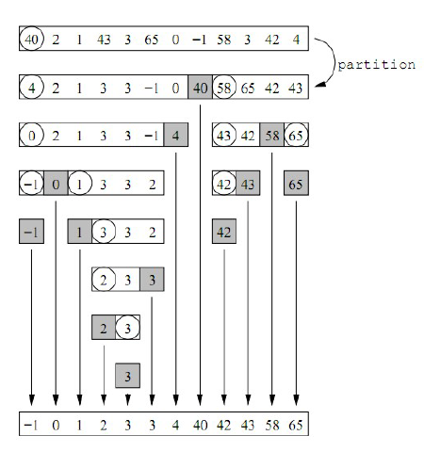
Quicksort Example
Note: Once an
element is picked as a
pivot, it is already in
its eventual place!

Slide 84
Quicksort
The partition function performs this work:
Elements less than the pivot element are put in the left sub-region
Elements greater than the pivot element are put in the right sub-region
The pivot element is placed between the two sub-regions
The pivot element is now in its final position
Quicksort works in a “top-down” approach by repeatedly splitting largest lists into smaller ones, whereas merge sort works in a “bottom-up” manner to recombine smaller lists into larger ones.
See visualgo.net/en/sorting for animations

Slide 85
Quicksort
The partition function partitions only a portion of a list
The function takes three arguments:
A list of numbers
The starting index of the region to partition
The ending index of the region to partition
For instance, partition(nums, 4, 15) means that nums[4] is the pivot element and that we want to partition elements in the range nums[4:16]
Example: nums = [62 88 6 85 39 19 82 23]
Function call: partition(nums, 0, 7)
Pivot element: 62 (element [0] is always the pivot element)
After partition: [23 6 39 19 62 85 82 88]

Slide 86
Completed partition Function
def partition(a, p, r):
x = a[p]
i = p
for j in range(p+1, r+1):
if a[j] <= x:
i += 1
a[i], a[j] = a[j], a[i]
a[p], a[i] = a[i], a[p]
return i
The function returns the index of where the pivot element eventually winds up in a[]. That number also happens to be the number of elements ≤ the pivot element.

Slide 87
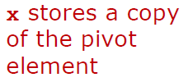
Completed partition Function
def partition(a, p, r):
x = a[p]
i = p
for j in range(p+1, r+1):
if a[j] <= x:
i += 1
a[i], a[j] = a[j], a[i]
a[p], a[i] = a[i], a[p]
return i

Slide 88
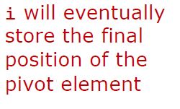

Completed partition Function
def partition(a, p, r):
x = a[p]
i = p
for j in range(p+1, r+1):
if a[j] <= x:
i += 1
a[i], a[j] = a[j], a[i]
a[p], a[i] = a[i], a[p]
return i

Slide 89
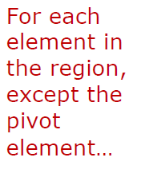

Completed partition Function
def partition(a, p, r):
x = a[p]
i = p
for j in range(p+1, r+1):
if a[j] <= x:
i += 1
a[i], a[j] = a[j], a[i]
a[p], a[i] = a[i], a[p]
return i

Slide 90
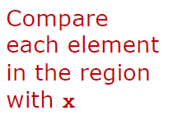

Completed partition Function
def partition(a, p, r):
x = a[p]
i = p
for j in range(p+1, r+1):
if a[j] <= x:
i += 1
a[i], a[j] = a[j], a[i]
a[p], a[i] = a[i], a[p]
return i

Slide 91
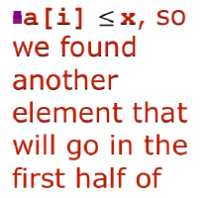

Completed partition Function
def partition(a, p, r):
x = a[p]
i = p
for j in range(p+1, r+1):
if a[j] <= x:
i += 1
a[i], a[j] = a[j], a[i]
a[p], a[i] = a[i], a[p]
return i

Slide 92
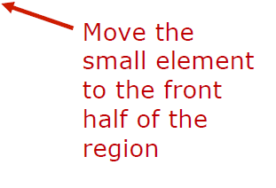
Completed partition Function
def partition(a, p, r):
x = a[p]
i = p
for j in range(p+1, r+1):
if a[j] <= x:
i += 1
a[i], a[j] = a[j], a[i]
a[p], a[i] = a[i], a[p]
return i

Slide 93
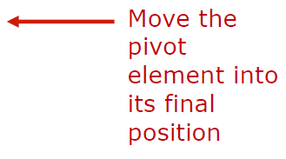
Completed partition Function
def partition(a, p, r):
x = a[p]
i = p
for j in range(p+1, r+1):
if a[j] <= x:
i += 1
a[i], a[j] = a[j], a[i]
a[p], a[i] = a[i], a[p]
return i

Slide 94
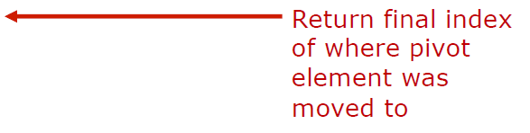
Completed partition Function
def partition(a, p, r):
x = a[p]
i = p
for j in range(p+1, r+1):
if a[j] <= x:
i += 1
a[i], a[j] = a[j], a[i]
a[p], a[i] = a[i], a[p]
return i

Slide 95
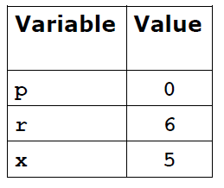

Trace Execution: partition()
a: [5, 8, 1, 6, 3, 7, 2]
index: 0 1 2 3 4 5 6
def partition(a, p, r):
x = a[p]
i = p
for j in range(p+1, r+1):
if a[j] <= x:
i += 1
a[i], a[j] = a[j], a[i]
a[p], a[i] = a[i], a[p]
return i

Slide 96
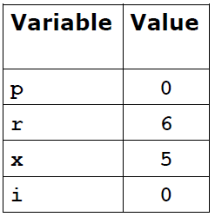
Trace Execution: partition()
a: [5, 8, 1, 6, 3, 7, 2]
index: 0 1 2 3 4 5 6
def partition(a, p, r):
x = a[p]
i = p
for j in range(p+1, r+1):
if a[j] <= x:
i += 1
a[i], a[j] = a[j], a[i]
a[p], a[i] = a[i], a[p]
return i

Slide 97
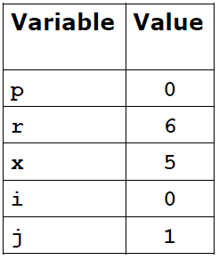
Trace Execution: partition()
a: [5, 8, 1, 6, 3, 7, 2]
index: 0 1 2 3 4 5 6
def partition(a, p, r):
x = a[p]
i = p
for j in range(p+1, r+1):
if a[j] <= x:
i += 1
a[i], a[j] = a[j], a[i]
a[p], a[i] = a[i], a[p]
return i

Slide 98
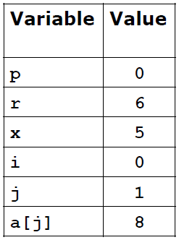
Trace Execution: partition()
a: [5, 8, 1, 6, 3, 7, 2]
index: 0 1 2 3 4 5 6
def partition(a, p, r):
x = a[p]
i = p
for j in range(p+1, r+1):
if a[j] <= x: # False
i += 1
a[i], a[j] = a[j], a[i]
a[p], a[i] = a[i], a[p]
return i

Slide 99
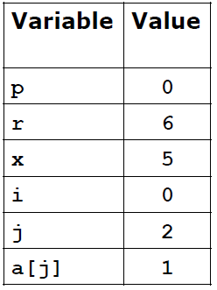
Trace Execution: partition()
a: [5, 8, 1, 6, 3, 7, 2]
index: 0 1 2 3 4 5 6
def partition(a, p, r):
x = a[p]
i = p
for j in range(p+1, r+1):
if a[j] <= x:
i += 1
a[i], a[j] = a[j], a[i]
a[p], a[i] = a[i], a[p]
return i

Slide 100
Trace Execution: partition()
a: [5, 8, 1, 6, 3, 7, 2]
index: 0 1 2 3 4 5 6
def partition(a, p, r):
x = a[p]
i = p
for j in range(p+1, r+1):
if a[j] <= x: # True
i += 1
a[i], a[j] = a[j], a[i]
a[p], a[i] = a[i], a[p]
return i

Slide 101
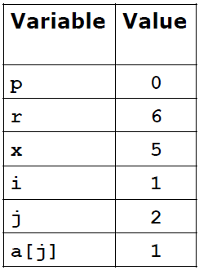
Trace Execution: partition()
a: [5, 8, 1, 6, 3, 7, 2]
index: 0 1 2 3 4 5 6
def partition(a, p, r):
x = a[p]
i = p
for j in range(p+1, r+1):
if a[j] <= x:
i += 1
a[i], a[j] = a[j], a[i]
a[p], a[i] = a[i], a[p]
return i

Slide 102
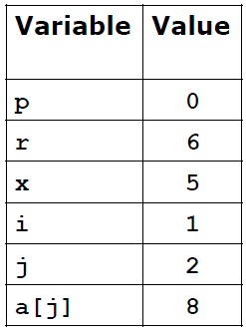
Trace Execution: partition()
a: [5, 1, 8, 6, 3, 7, 2]
index: 0 1 2 3 4 5 6
def partition(a, p, r):
x = a[p]
i = p
for j in range(p+1, r+1):
if a[j] <= x:
i += 1
a[i], a[j] = a[j], a[i]
a[p], a[i] = a[i], a[p]
return i

Slide 103
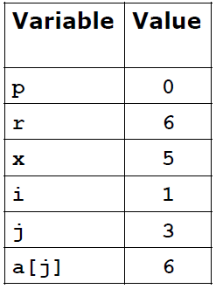
Trace Execution: partition()
a: [5, 1, 8, 6, 3, 7, 2]
index: 0 1 2 3 4 5 6
def partition(a, p, r):
x = a[p]
i = p
for j in range(p+1, r+1):
if a[j] <= x:
i += 1
a[i], a[j] = a[j], a[i]
a[p], a[i] = a[i], a[p]
return i

Slide 104
Trace Execution: partition()
a: [5, 1, 8, 6, 3, 7, 2]
index: 0 1 2 3 4 5 6
def partition(a, p, r):
x = a[p]
i = p
for j in range(p+1, r+1):
if a[j] <= x: # False
i += 1
a[i], a[j] = a[j], a[i]
a[p], a[i] = a[i], a[p]
return i

Slide 105
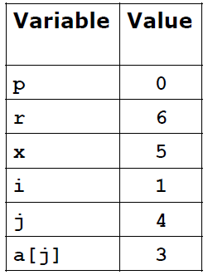
Trace Execution: partition()
a: [5, 1, 8, 6, 3, 7, 2]
index: 0 1 2 3 4 5 6
def partition(a, p, r):
x = a[p]
i = p
for j in range(p+1, r+1):
if a[j] <= x:
i += 1
a[i], a[j] = a[j], a[i]
a[p], a[i] = a[i], a[p]
return i

Slide 106
Trace Execution: partition()
a: [5, 1, 8, 6, 3, 7, 2]
index: 0 1 2 3 4 5 6
def partition(a, p, r):
x = a[p]
i = p
for j in range(p+1, r+1):
if a[j] <= x: # True
i += 1
a[i], a[j] = a[j], a[i]
a[p], a[i] = a[i], a[p]
return i

Slide 107
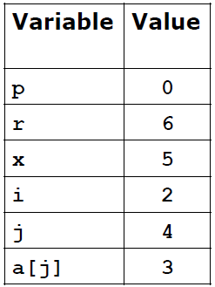
Trace Execution: partition()
a: [5, 1, 8, 6, 3, 7, 2]
index: 0 1 2 3 4 5 6
def partition(a, p, r):
x = a[p]
i = p
for j in range(p+1, r+1):
if a[j] <= x:
i += 1
a[i], a[j] = a[j], a[i]
a[p], a[i] = a[i], a[p]
return i

Slide 108
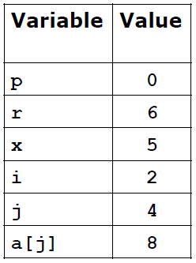
Trace Execution: partition()
a: [5, 1, 3, 6, 8, 7, 2]
index: 0 1 2 3 4 5 6
def partition(a, p, r):
x = a[p]
i = p
for j in range(p+1, r+1):
if a[j] <= x:
i += 1
a[i], a[j] = a[j], a[i]
a[p], a[i] = a[i], a[p]
return i

Slide 109
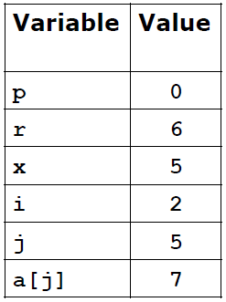
Trace Execution: partition()
a: [5, 1, 3, 6, 8, 7, 2]
index: 0 1 2 3 4 5 6
def partition(a, p, r):
x = a[p]
i = p
for j in range(p+1, r+1):
if a[j] <= x:
i += 1
a[i], a[j] = a[j], a[i]
a[p], a[i] = a[i], a[p]
return i

Slide 110
Trace Execution: partition()
a: [5, 1, 3, 6, 8, 7, 2]
index: 0 1 2 3 4 5 6
def partition(a, p, r):
x = a[p]
i = p
for j in range(p+1, r+1):
if a[j] <= x: # False
i += 1
a[i], a[j] = a[j], a[i]
a[p], a[i] = a[i], a[p]
return i

Slide 111
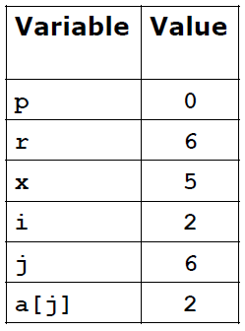
Trace Execution: partition()
a: [5, 1, 3, 6, 8, 7, 2]
index: 0 1 2 3 4 5 6
def partition(a, p, r):
x = a[p]
i = p
for j in range(p+1, r+1):
if a[j] <= x:
i += 1
a[i], a[j] = a[j], a[i]
a[p], a[i] = a[i], a[p]
return i

Slide 112
Trace Execution: partition()
a: [5, 1, 3, 6, 8, 7, 2]
index: 0 1 2 3 4 5 6
def partition(a, p, r):
x = a[p]
i = p
for j in range(p+1, r+1):
if a[j] <= x: # True
i += 1
a[i], a[j] = a[j], a[i]
a[p], a[i] = a[i], a[p]
return i

Slide 113
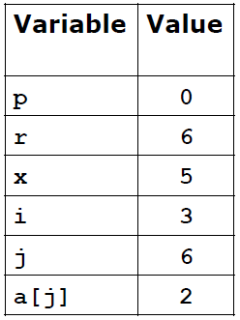
Trace Execution: partition()
a: [5, 1, 3, 6, 8, 7, 2]
index: 0 1 2 3 4 5 6
def partition(a, p, r):
x = a[p]
i = p
for j in range(p+1, r+1):
if a[j] <= x:
i += 1
a[i], a[j] = a[j], a[i]
a[p], a[i] = a[i], a[p]
return i

Slide 114
Trace Execution: partition()
a: [5, 1, 3, 2, 8, 7, 6]
index: 0 1 2 3 4 5 6
def partition(a, p, r):
x = a[p]
i = p
for j in range(p+1, r+1):
if a[j] <= x:
i += 1
a[i], a[j] = a[j], a[i]
a[p], a[i] = a[i], a[p]
return i

Slide 115
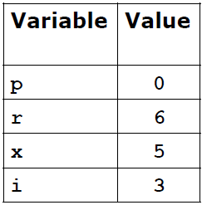
Trace Execution: partition()
a: [2, 1, 3, 5, 8, 7, 6]
index: 0 1 2 3 4 5 6
def partition(a, p, r):
x = a[p]
i = p
for j in range(p+1, r+1):
if a[j] <= x:
i += 1
a[i], a[j] = a[j], a[i]
a[p], a[i] = a[i], a[p]
return i

Slide 116
Trace Execution: partition()
a: [2, 1, 3, 5, 8, 7, 6]
index: 0 1 2 3 4 5 6
def partition(a, p, r):
x = a[p]
i = p
for j in range(p+1, r+1):
if a[j] <= x:
i += 1
a[i], a[j] = a[j], a[i]
a[p], a[i] = a[i], a[p]
return i

Slide 117
Quicksort
The partition function will do most of the work in the quicksort algorithm:
First, partition the entire list. The first pivot element will now be at its final position.
Take the first sub-region of the list and partition it, and likewise for the second sub-region
By now, 3 elements (the 3 pivot elements) are in their final positions and we have 4 small regions
We partition those 4 sub-regions, causing 4 more pivot elements to be finally positioned (7 total pivots)
This process continues until a region is so small that there is nothing to partition (zero elements in the region)

Slide 118
Completed qsort Function
The top-level function is qsort, which depends on a helper
function called qs, which in turn calls partition:
def qsort(a):
qs(a, 0, len(a)-1) # sort the entire list
def qs(a, p, r):
if p < r:
q = partition(a, p, r)
qs(a, p, q-1) # recursively sort first
qs(a, q+1, r) # and second sub-regions
regions: [... p p+1 ... q-1 q q+1 ... r r + 1 ...]

Slide 119
Trace Execution: qsort()
Input: [55, 46, 89, 64, 93, 45, 15, 96]
Red indicates a pivot element
Values in brackets are parts of sub-regions that are being partitioned
A red value outside brackets is a pivot element that was positioned during an earlier round of partitioning
[15, 46, 45, 55, 93, 89, 64, 96] 1st partition
[15, 46, 45] 55 [64, 89, 93, 96] 2nd partitions
15 [45, 46] 55 [64, 89] 93 [96] 3rd partitions
15 45 [46] 55 64 [89] 93 96 4th partitions
[15, 45, 46, 55, 64, 89, 93, 96] Done!

Slide 120
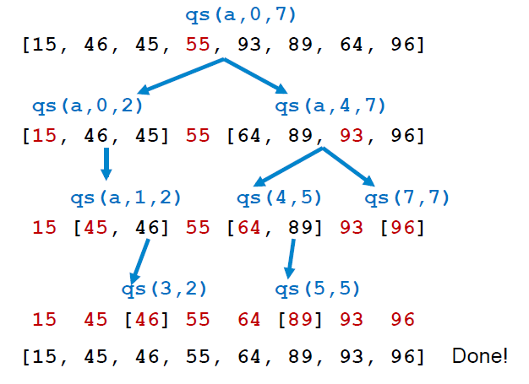
Trace Execution: qsort()

Slide 121
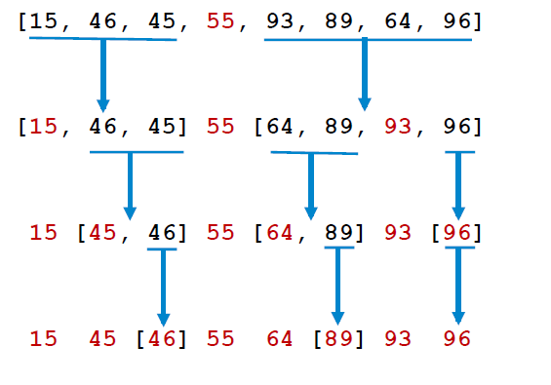
Trace Execution: qsort()
Another way to visualize the partitioning steps:

Slide 122
Additional Examples of
Recursive Solutions to
Problems

Slide 123
Example: Sum of Fractions
Although computing a sum is computed most efficiently with a loop, it is a simple problem to understand, which makes it a good candidate for solving with recursion.
Consider the problem of trying to compute the following sum, where n is a positive integer: 1 + 1/2 + 1/3 + … + 1/n
Let’s consider a function sum_fracs() that computes and returns this sum
The simplest case (base case) is where n = 1
For n>1 we can compute the sum as 1/n plus the sum of 1 + 1/2 + 1/3 + … + 1/n-1, which we will compute recursively

Slide 124
Example: Sum of Fractions
def sum_fracs(n):
if n == 1:
return 1
return 1/n + sum_fracs(n - 1)
See recursion_examples.py

Slide 125
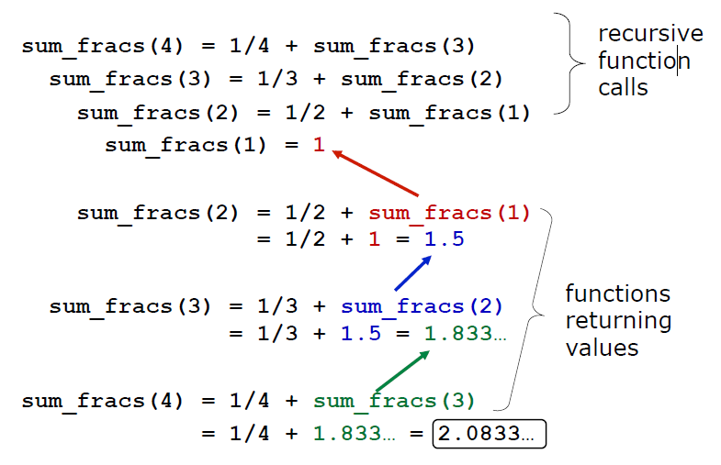
Trace: sum_fracs(4)

Slide 126
Example: Sum a List
Suppose we want to write a function rsum that computes the sum of the values in the list nums
If nums has just one item, then the sum is just the value of nums[0]
Otherwise, the sum is nums[0] plus the sum of the rest of the values, which is computed by a recursive call to the function

Slide 127
Example: Sum a List
def rsum(nums):
if len(nums) == 1:
return nums[0]
return nums[0] + rsum(nums[1:len(nums)])
Note the following two equivalent expressions:
nums[1:]
nums[1:len(nums)]
See recursion_examples.py

Slide 128
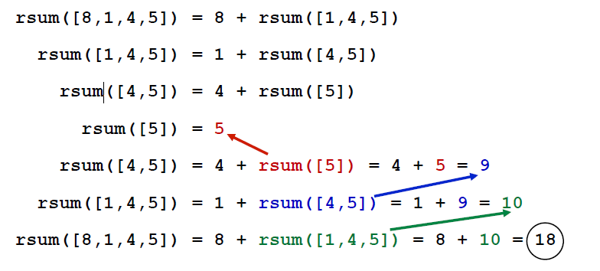
Trace: rsum([8,1,4,5])

Slide 129
Example: Exponentiation
One way to compute a^{n} for integer n is to multiply a by itself n times: a^{n} = a*a* … *a
This is easy to implement using a loop, but it I somewhat inefficient
A more efficient approach ues recursion
Example: suppose we want to compute 2⁸
From the laws of exponents we know 2⁸ = 2⁴ * 2⁴
If we compute the value of 2⁴ once, we can simply multiply the value of 24 by itself
Likewise, 2⁴ = 2² * 2²
In general, a^{n} = a^{n/2} * a^{n/2} when n is even and a^{n}=a^{(n-1)/2} * a^{(n-1)/2}*a when n is odd

Slide 130
Example: Exponentiation
Let’s use these formulas to write a function that recursively computes the nth power of any nonzero integer
For the base case we will use the fact that any non-zero value raised to the 0th power is 1

Slide 131
Example: Exponentiation
def power(base, exponent):
if exponent == 0:
return 1 # base case
elif exponent % 2 == 0: # even exponent
temp = power(base, exponent // 2)
return temp * temp
else: # odd exponent
temp = power(base, exponent // 2)
return temp * temp * base
See recursion_examples.py

Slide 132
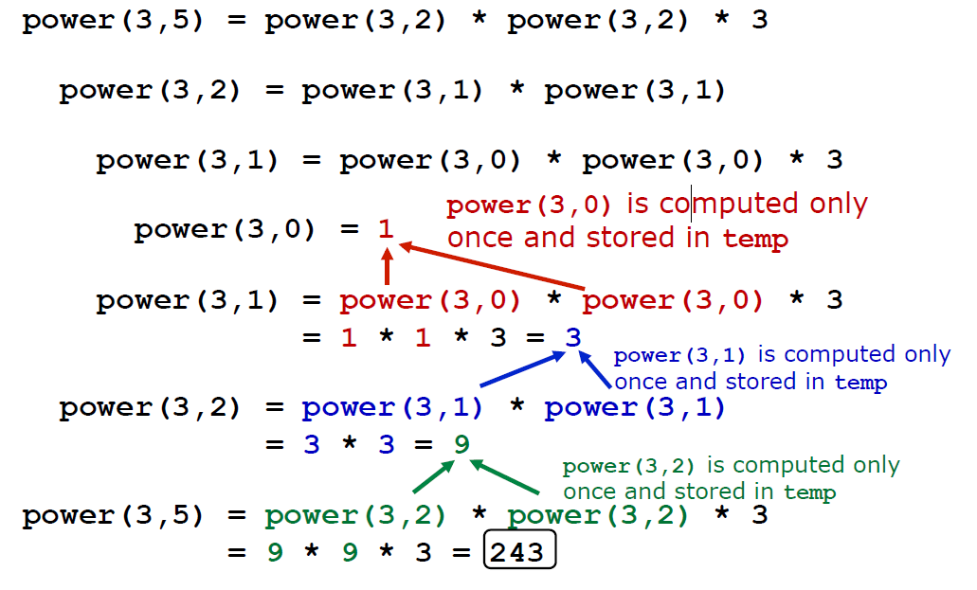
Trace: power(3,5)

Slide 133
Example: Reverse a String
Consider the problem of taking a string and reversing its characters
Example: convert ‘stony’ to ‘ytons’
Let’s explore a recursive function rev that solves this problem
Let n be the length of a string s
In the base case n=1, since s has only one character, just return s (“reversing” a single letter requires no work)
Otherwise, when n>1, return a string consisting of the last letter in s, followed by the reverse of the first n-1 characters
Doing this will require a recursive call to the rev function.

Slide 134
Example: Reverse a String
Some slicing notation that will help us:
s[-1] means “get the last character of string s”
s[:-1] means “get all but the last character of string s”
The same syntaxes can also be used to with lists
def rev(s):
if len(s) == 1:
return s
return s[-1] + rev(s[:-1])

Slide 135
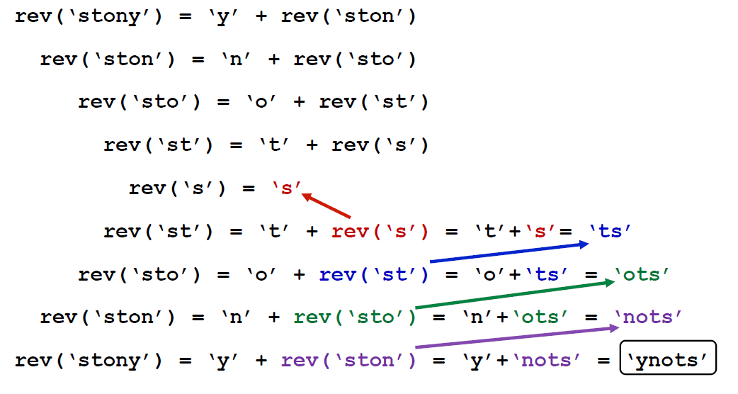
Trace: rev('stony')

Slide 136
Example: Count Occurrences
Python has a method named count(), which counts the number of times a target character appears in a string
For example, ‘stonybrook’.count(‘o’) is 3 because there are three lowercase o’s in ‘stonybrook’
How might we implement a recursive function that solves the same problem?
First, inspect the first character of the string
If the character matches the target, we need to add 1 to the number of matches in the remainder of the string
Otherwise, we simply continue by counting the number of matches in the remainder of the string

Slide 137
Example: Count Occurrences
But, how do we know how many times the target character appears in the remainder of the string?
We perform a recursive call to the function!
So here’s our algorithm:
If the string has at least one character in it then:
If the first character matches, then return
(1 + the # of matches of the target in the rest of the string)
Otherwise, return the # of matches in the rest of the string
Otherwise, return 0

Slide 138
Example: Count Occurrences
def count_occurrences(string, ch):
if len(string) > 0:
if string[0] == ch:
return 1 + count_occurrences(string[1:], ch)
return count_occurrences(string[1:], ch)
return 0
See recursion_examples.py

Slide 139
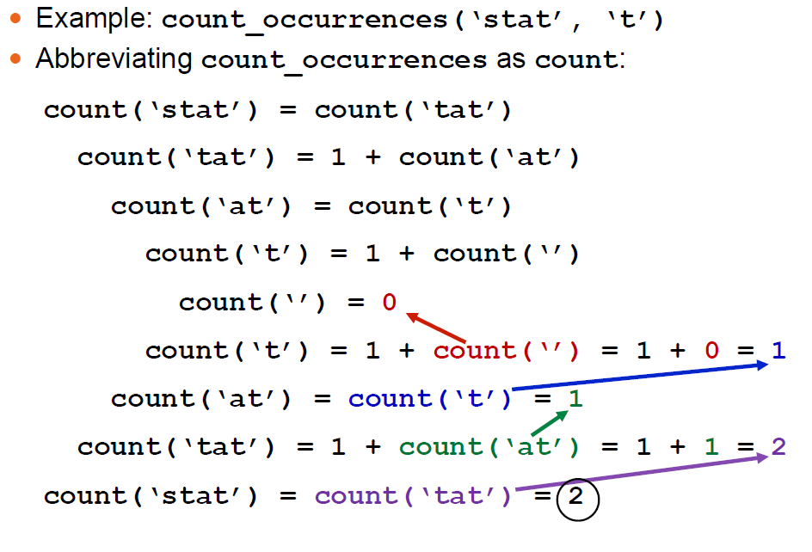
Trace: count_occurrences()

Slide 140
Example: Find Palindromes
A palindrome is a word or phrase that can be read backwards and forwards
Examples: radar, dad, toot, e
Let’s consider a function, is_palindrome, which returns True if its argument is a palindrome, and False if not
How could we formulate a recursive solution to this problem?
We need to consider the base case(s) and recursive step(s)

Slide 141
Example: Find Palindromes
The simplest case (base case) would be a string with exactly one character, which, by definition, would be a palindrome
For the more general case we have two sub-problems:
Verify that the first character and the last character of the string are equal
If they match, ignore the two end characters and check whether the rest of the substring is a palindrome
If the first and last characters don’t match, then the string (or sub-string) is not a palindrome
The notation to slice out the first and last elements of string s and keep the remaining characters is s[1:-1]

Slide 142
Example: Find Palindromes
def is_palindrome(s):
if len(s) <= 1: # a string of 0 or 1 characters
return True # is a palindrome
elif s[0] != s[-1]: # the first and last
return False # characters don't match
else:
return is_palindrome(s[1:-1])
See recursion_examples.py

Slide 143
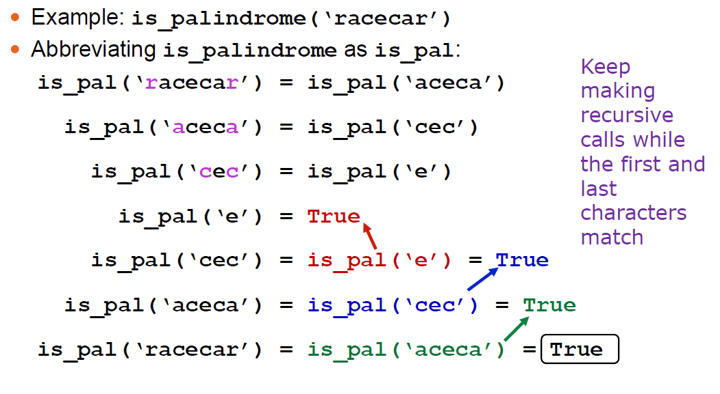
Trace: is_palindrome()

Slide 144
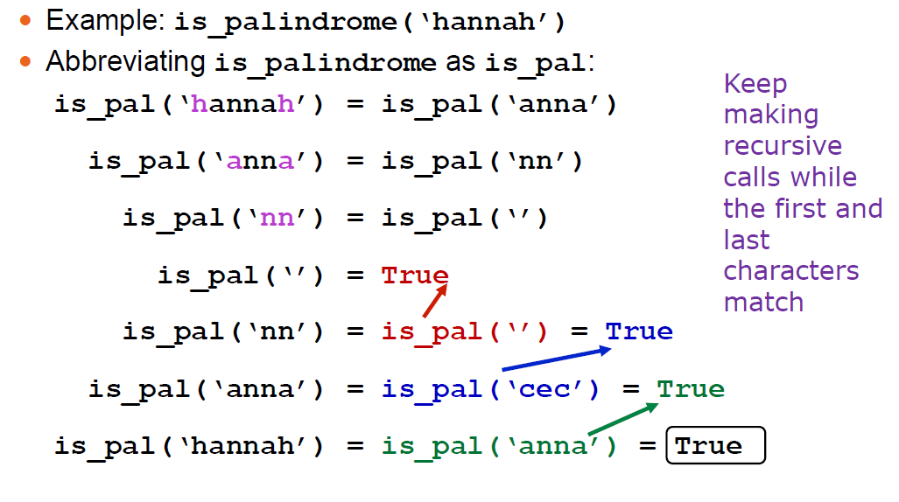
Trace: is_palindrome()

Slide 145
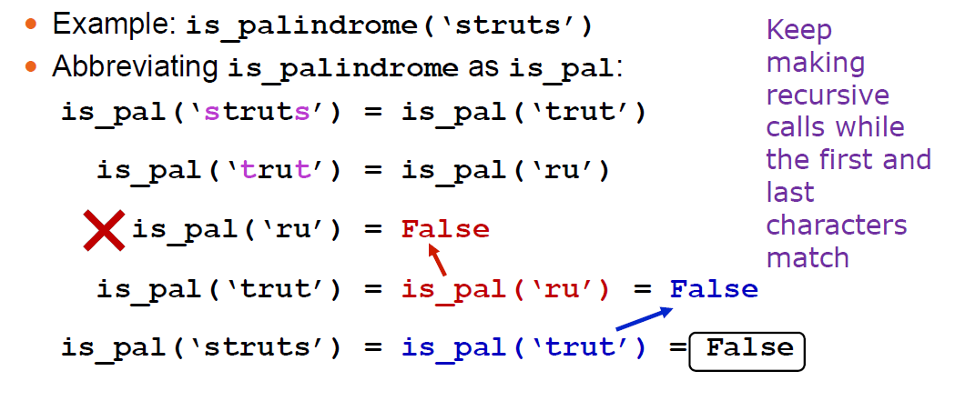
Trace: is_palindrome()

Slide 146
Example: Replace Multiples of 5
Consider a peculiar function named replace_mult5 that takes a list of numbers and replaces all multiples of 5 with a substitute number
The list and the substitute are passed as arguments
Here’s an example:
nums = [5,3,15,50,2,4,6,60]
replace_mult5(nums, 77)
nums becomes: [77,3,77,77,2,4,6,77]
Since this function does not return a value, it’s not entirely clear how to write it recursively
Consider: how do we keep track of what part of the list we have processed so far?

Slide 147
Example: Replace Multiples of 5
We can implement replace_mult5 more easily if we use a helper function
Recall the qs helper function that helped us implement the qsort function earlier in this Unit
Our helper function, replace_mult5_helper, will take the same two arguments as replace_mult5, plus a third argument that tracks what part of the list we have already processed:
def replace_mult5 (nums, sub)
def replace_mult5_helper(nums, sub, i)
In a certain sense, the helper function will simulate the behavior of a loop, as we can see in the implementation on the next slide

Slide 148
Example: Replace Multiples of 5
def replace_mult5(nums, sub):
replace_mult5_helper(nums, sub, 0)
def replace_mult5_helper(nums, sub, i):
if i == len(nums): # base case
return
if nums[i] % 5 == 0:
nums[i] = sub
replace_mult5_helper(nums, sub, i+1)

Slide 149
Example: Replace Multiples of 5
The recursive helper function could be written iteratively using the code below
def replace_mult5_helper(nums, sub, i):
for i in range(len(nums)):
if nums[i] % 5 == 0:
nums[i] = sub
Compare this code with the recursive version. Do you see how the recursive version is essentially simulating a for-loop?

Slide 150
Trace: replace_mult5_helper
Example: nums = [4,10,2,5]
replace_mult5_helper(nums, 8, 0)
Abbreviating replace_mult5_helper as rmh
rmh([4,10,2,5],8,0) ➔ rmh([4,10,2,5],8,1)
rmh([4,10,2,5],8,1) ➔ rmh([4,8,2,5],8,2)
rmh([4,8,2,5],8,2) ➔ rmh([4,8,2,5],8,3)
rmh([4,8,2,5],8,3) ➔ rmh([4,8,2,8],8,3)
rmh([4,8,2,8],8,3) ➔ do nothing & return
Since the recursive call is the last statement in the function, the four recursive calls now simply return to each other, in sequence, performing no additional work
The final contents of nums is [4,8,2,8]

Slide 151
Example: Find Index of Character
Python has a built-in string method called index that returns the index of the first occurrence of a character (or substring, actually) in a string
Example:
school = 'stony brook’
pos = school.index('o’) # pos will be 2
If the target character or substring does not appear in the string, the program crashes
Let’s consider a recursive solution to this problem and implement it in a function rindex
In cases where the target string is not found, the rindex function will simply return None instead of crashing the program

Slide 152
Example: Find Index of Character
One challenge we face is that somehow we need to keep track of what part of the string we have searched so far
We will write a helper function, rindex_helper, that will assist with this task
The helper function will ultimately solve the problem
All that rindex will need to do is call rindex_helper with the correct arguments

Slide 153
Example: Find Index of Char.
def rindex(string, target):
return rindex_helper(string, target, 0)
def rindex_helper(string, target, i):
if i >= len(string):
return None
elif string[i] == target:
return i
else:
return rindex_helper(string, target, i+1)

Slide 154

Trace: rindex_helper

Slide 155

Trace: rindex_helper

Slide 156
Recursive Helper Functions
The following material is based on notes by Jayesh Ranjan, a computer science major who served as a TA for CSE 101 many times during his studies at Stony Book University
The main focus on this guide is on understanding the relationship between iteration and recursion: both are forms of repetition, but each implements the repetition in a different way
Suppose you wanted to use a loop find the sum of all integers from 0 through n, inclusive
One possible solution is given on the next slide
A while-loop is used because it will match up more closely with the recursive version
See iter_to_rec.py

Slide 157
Recursive Helper Functions
def iter_sum(n):
i = 1
total = 1
while i <= n:
total += i
i += 1
return total
Somehow we need to map this iterative algorithm to a recursive implementation, specifically:
the i and total variables
the while-loop condition and body
the return statement

Slide 158
Recursive Helper Functions
Ultimately, we want a function rec_sum(n) we can call that will return the correct value
We will use a recursive helper function to keep track of the i variable by taking it as an argument to the helper
The total variable will be implemented as the return value of the helper function
The while-loop’s condition in the iterative solution will need to be replaced with a condition for an if-statement that will terminate the recursion
So, in both the iterative and recursive solutions we need a carefullywritten condition to stop the repetition
The recursive implementation is given on the next slide

Slide 159
Recursive Helper Functions
def rec_sum(n):
return rec_sum_helper(n, 1)
def rec_sum_helper(n, i):
if i == n:
return n
return i + rec_sum_helper(n, i+1)
Let’s try to understand now how this code matches up with the iterative solution

Slide 160
Recursive Helper Functions
Iterative version: Recursive version:
i = 1 rec_sum_helper(n, 1)
Initializing i to 1 in the iterative version is akin to calling the recursive helper function with an i argument of 1.

Slide 161
Recursive Helper Functions
Iterative version: Recursive version:
while i <= n if i == n
The while-loop will stop iterating (repeating) once i > n. Similarly, the recursive version will stop making function calls once i == n.
When i == n in the recursive version, we return n itself. This means that n will be added to the running total that the function is recursively computing.

Slide 162
Recursive Helper Functions
Iterative version: Recursive version:
total += I return i +
i += 1 rec_sum_helper(n, i+1)
The two += statements from the iterative version are captured in the single line from the recursive version.
Color is used to show the connection between versions. There is no total variable for the recursive function. Rather, the function’s return value serves this purpose.

Slide 163
Recursive Helper Functions
def iter_sum(n): def rec_sum(n):
i = 1 return rec_sum_helper(n, 1)
total = 0
while i <= n: def rec_sum_helper(n, i):
total += I if i == n:
i += 1 return n
return total return i +
rec_sum_helper(n, i+1)
It’s not really possible to make a perfect one-to-one matching between the code in both versions, but I’ve attempted to do so here using color

Slide 164
Questions?

