Slide 1
Functional Programming in Python
Recursion, iteraTORS, map, lambda expressions, reduce, filter, higher order functions, list comprehension

Slide 2
Recursion
A recursive solution to a problem features “self-similarity”, meaning that a function that solves a problem calls itself
You actually already have familiarity with this concept
Consider the factorial operation in mathematics
n! = n x (n-1)! for integers n≥1, where 0! = 1
Note how factorial is defined in terms of itself (i.e., the ! Symbol appears on both sides of the equals sign)
This is a recursive definition of factorial
The simplest case of a recursive definition is called the base case

Slide 3

Recursion Example: Factorial
Writing a recursive Python function that implements factorial is very straightforward
We need to define both the recursive part (which is when the factorial function calls itself), and the base case
def factorial(n):
if n == 0: # base case
return 1
else:
return n * factorial(n-1)
See recursion_examples.py for code for many of the example recursive functions from these notes

Slide 4
Recursion
All recursive functions have the following characteristics:
One or more base cases (the simplest cases) are used to stop recursion
One or more a recursive calls that reduce the original problem in size, bringing it increasingly closer to a base case until it becomes that case
A recursive call can result in many more recursive calls, because the method keeps on dividing a sub-problem into new sub-problems that are of smaller size than the original
These sub-problems are of the same nature as the original
Please note: solutions can be recursive, not problems!

Slide 5
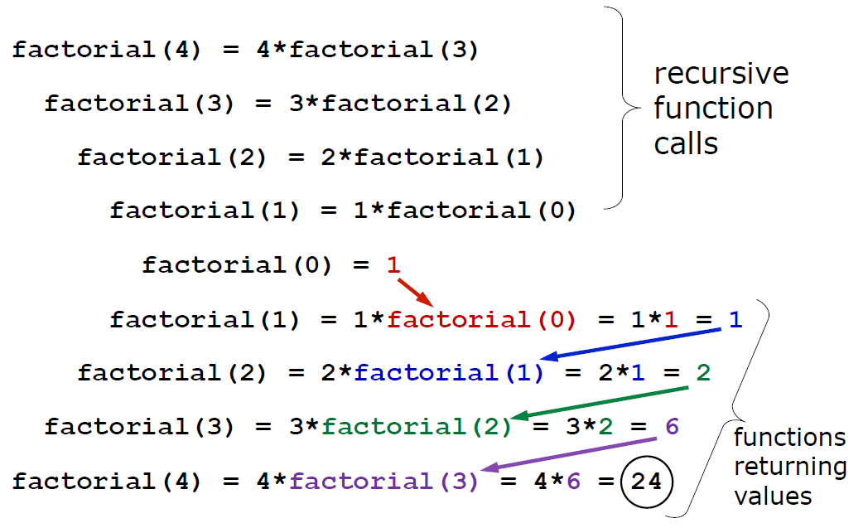
Trace: factorial(4)

Slide 6
Example: Fibonacci Numbers
def fib(n):
if n == 0 or n == 1: # two base cases
return 1
return fib(n - 1) + fib(n - 2)
Examples:
fib(0) = 1
fib(1) = 1
fib(2) = fib(1) + fib(0) = 1 + 1 = 2
fib(3) = fib(2) + fib(1) = 2 + 1 = 3
fib(4) = fib(3) + fib(2) = 3 + 2 = 5
See recursion_examples.py

Slide 7
Recursive Binary Search
For recursive binary search (rsearch), the idea is basically the same as iterative binary search (But, the while-loop is replaced with a recursive call to the function
The algorithm checks the middle element to see if it equals the target
If not, the function calls itself on the first half or second half, depending on whether the middle element is greater than or less than the target (respectively)

Slide 8
Completed rsearch Function
def rsearch(a, x, lower, upper):
if upper == lower + 1:
return None
mid = (lower + upper) // 2
if a[mid] == x:
return mid
if x < a[mid]:
return rsearch(a, x, lower, mid)
else:
return rsearch(a, x, mid, upper)

Slide 9
Additional recursion examples
See recursion_examples.py

Slide 10
Iterables
An iterable is anything you can iterate over.
List
>>> for i in [1, 2, 3, 4]:
... print i,
...
1
2
Dictionary keys
>>> for k in {"x": 1, "y": 2}:
... print k
...
y
x
Sets
>>> my_set = {1,2,3}
>>> for x in my_set:
... print(x)
...
1
2
3
Iter function – Takes an iterable object and returns an iterator
>>> x = iter([1, 2, 3])
>>> x
<listiterator object at 0x1004ca850>
>>> x.next()
1
>>> x.next()
2

Slide 11
Map function
The map function applies a function to every item in an iterable.
Takes two inputs – function to apply and iterable object
map(function, iterable)
Squaring a number
x = [1, 2, 3, 4, 5]
def square(num):
return num*num
print(list(map(square, x)))
Functional functions in Python are lazy.
If we didn’t include the “list()” the function would store the definition of the iterable, not the list itself.
We need to explicitly tell Python “turn this into a list” for us to use this.
Example:
X = range(100)
X = list(range(100))

Slide 12
Lambda expressions
Lambda expression is a one line function
Lambda expression which squares a given number
cube = lambda x: x * x * x
print(list(map(cube, x)))
In a lambda expression, arguments go on the left hand side and functionality goes on the right hand side
Simplifying square program in one line:
x = [1, 2, 3, 4, 5]
print(list(map(lambda num: num * num, x)))

Slide 13
Reduce function
The reduce function turns iterable into one thing.
reduce(function, iterable)
Lambda expression can be used as the function
Product of a list
from functools import reduce
lst = [1,2,3,4,5,6,7,8]
val = reduce((lambda x, y: x * y),lst)
print(val)

Slide 14
Filter function
The filter function takes an iterable and filters out all the things you don’t want in that iterable.
Normally filter takes a function and a list.
It applies the function to each item in the list and if that function returns True, it does nothing.
If it returns False, it removes that item from the list.
E.g.
x = range(-5, 5)
all_less_than_zero = list(filter(lambda num: num < 0, x))

Slide 15
Higher order functions
Higher order functions can take functions as parameters and return functions.
E.g.
def summation(nums):
return sum(nums)
def action(func, numbers):
return func(numbers)
print(action(summation, [1, 2, 3]))
# Output is 6
Return functions
E.g.
def rtnBrandon():
return "brandon"
def rtnJohn():
return "john"
def rtnPerson():
age = int(input("What's your age?"))
if age == 21:
return rtnBrandon()
else:
return rtnJohn()

Slide 16
List Comprehensions
As list comprehension returns list, they consists of brackets containing the expression which needs to be executed for each element along with the for loop to iterate over each element.
Basic syntax:
new_list = [expression for_loop_one_or_more conditions]
numbers = [1, 2, 3, 4]
squares = [n**2 for n in numbers]

Slide 17
Questions?

