Slide 1
Introduction to Computational and Algorithmic Thinking
Lecture 2b – Computer programming fundamentals II

Slide 2
Announcements
This lecture: Computer Programming Fundamentals
Reading: Read Chapter 2 of Conery
Acknowledgement: Some of the lecture slides are based on CSE 101 lecture notes by Prof. Kevin McDonald at SBU and the textbook by John Conery.

Slide 3
Functions
Recall that Python has a math module
The library has numbers (e, π , etc.)
It also has a variety of useful mathematical functions
In programming, a function is a name given to a set of statements that perform a well-defined task
For example, the input function performs a task (getting user input) and also returns the value entered by the user
print, int, float, and str are also functions
The next example introduces a new function, format, that lets the programmer format numerical output in a desired way

Slide 4
Example: BMI calculator
Once numbers are stored in variables, they can be used in calculations
The Body Mass Index (BMI) is a metric used to gauge a person’s general health
Given a person’s weight in pounds and total height in inches, a person’s BMI is calculated as:
BMI = (weight * 703) / height²
A BMI in the range of 18.5-24.9 is considered “healthy”
The next program being examined calculates and prints a person’s BMI based on entered values
The result is printed to 15 digits of accuracy, which is more digits than necessary

Slide 5
Example: BMI calculator
To print a number to a designed number of digits, use the format function
Suppose there is a variable total_due to be printed with two decimal places. Here is how to do it:
print("Total due: $" +
"{:.2f}".format(total_due))
If we wanted four digits, we would write {:.4f} instead
Note that when using the format method, do not also use str to print a number
In the code for this program, there are two print statements
one gives the BMI to the full accuracy
one rounds the result to three decimal places

Slide 6
Example: bmi_v1.py
weight = float(input('Enter weight in pounds: '))
feet = float(input('Enter feet portion of height: ‘))
inches = float(input('Enter inches portion of height: ‘))
total_inches = feet * 12 + inches
bmi = (weight * 703) / total_inches ** 2
print('Your BMI is ' + str(bmi))
print('Your BMI is ' + '{:.3f}'.format(bmi))
The blank lines are present to make the code more readable. They do not affect program execution in any way.
More about format function: https://www.python-course.eu/python3_formatted_output.php

Slide 7
Other functions in Python
Some examples:
Try these on a Python Console or as part of a program
type(45)
int(34.56)
float(45)
str(3421)
len(‘apple’)
round(2.32)
abs(-45)
pow(2, 3) # cf. 2**3
help(pow)
. . .
import math
math
math.log(10)
math.log10(10)
math.log10(1e6)
radians = 0.7
math.sin(radians)
math.sqrt(3)
...
import random
random.random()
random.randint(0,100)

Slide 8
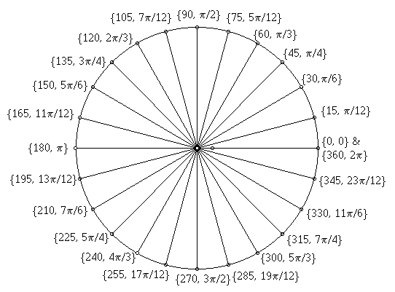
Function composition
Can compose functions as is done in mathematics, e.g., f(g(x,y))
import math
radians = 0.7
math.radians(math.degrees(radians))
radians = 0.3
math.acos(math.cos(radians))
pow(abs(-3), round(5.6))

Slide 9
Defining new functions
Functions in program have many benefits, including:
They make code easier to read and understand
➔ don’t need to know the details of how or why a function works
They allow code to be used more than once (code re-use)
To define a new function in Python we use a def statement
Consider writing a function that computes a person's Body Mass Index
Can then call this function as many times as desired
The alternative would be to copy and paste the code multiple times
First rule of programming: don’t repeat yourself!

Slide 10
Creating new functions
From mathematics: a 2 step process
Define a function, once
f(x, y) = x*y + 1
Apply/Use/Invoke/Call the function, as many times as desired
f(2,3) = 2*3 + 1 = 7
Do the same in programming: again a 2 step process
Define a function, once
def f(x, y):
return x * y + 1
Apply/Use/Invoke/Call the function, as many times as desired
f(2, 3)

Slide 11
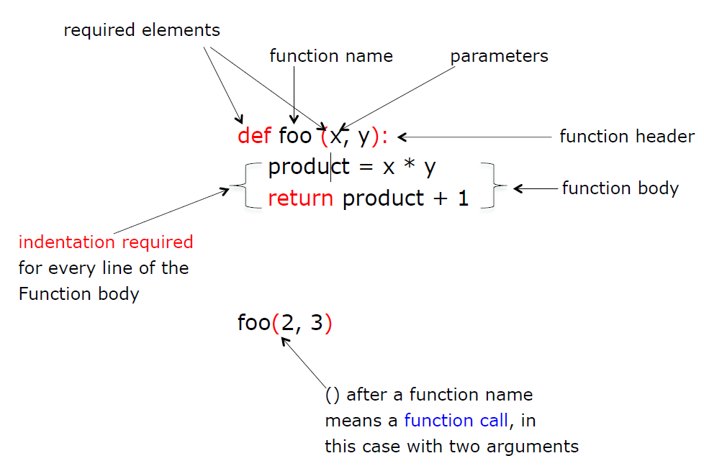
Mechanics of defining/calling a function

Slide 12
Parameters and arguments
Function can have zero or more parameters
Function may be defined with formal parameters
Then called with actual arguments
How many? As many as the function needs!
Example:
def multAdd(a, b, c):
return a * b + c
print(multAdd(1, 2, 3))
print(multAdd(2.1, 3.4, 4.3))
print(multAdd(abs(pow(2,3)), 3.2 + 2.3, 45.34))

Slide 13
Program: flow of execution
def message():
print(1)
message1()
print(2)
def message1():
print(‘a’)
message2()
print(‘b’)
def message2():
print(‘middle’)
message()
Note: three functions and a call
to message on the left is a program!
Output:
1
a
middle
b
2

Slide 14
Void functions vs. fruitful functions
announce below is an example of a void function
It does not return any useful value when it is called; it only prints a value
square is an example of a fruitful function
It returns a value when it is called
See what gets printed by the print statement in each case!
Don’t expect a void function to return any useful value.
The call announce(‘hello’) returns None to indicate that.
So the statement print(announce(‘hello!’)) will print None.
// void function
def announce(msg):
print(msg)
announce(‘hello!’)
// fruitful function
def square(n):
return n * n
print(square(3))

Slide 15
Example: bmi_v2.py
# Function definition
def bmi(w, h):
return (w * 703) / (h ** 2)
# main is to use the function defined above.
def main():
weight = float(input('Enter weight in pounds: ‘))
feet = float(input('Enter feet portion of height: ‘))
inches = float(input('Enter inches portion of height: ‘))
total_inches = feet * 12 + inches
my_bmi = bmi(weight, total_inches)
print('Your BMI is ' + '{:.3f}'.format(my_bmi))
# This sets up a call to the function main.
main()
Note how a program
is organized.

Slide 16
Why functions? Abstraction
One of the most important concepts in computer science is abstraction
Give a name to a group of statements and use it, e.g., bmi(…)
From the outside, the details are hidden
only care calling this function will do a desired computation
Functions thereby allow complex problems to be solved by subdividing it into smaller, more manageable sub-problems
This process is called problem decomposition (also functional decomposition)
Often programmers use functions to engage in top-down software design
They design the software as a series of steps
Each step corresponds to one or more functions

Slide 17
Example: bmi_v3.py
Here’s an alternative way of implementing the bmi function
It illustrates proper indentation and relies on two local variables, numerator and denominator
A local variable is a variable accessible only inside the function where it is created

Slide 18
Example: bmi_v3.py
def bmi(w, h):
numerator = w * 703
denominator = h ** 2
return numerator / denominator
def main():
weight = float(input('Enter weight in pounds: ‘))
feet = float(input('Enter feet portion of height: ‘))
inches = float(input('Enter inches portion of height: ‘))
total_inches = feet * 12 + inches
my_bmi = bmi(weight, total_inches)
print('Your BMI is ' + '{:.3f}'.format(my_bmi))
main()

Slide 19
Example: Distance calculator
Example: A distance traveled is provided in miles, yards, and feet (i.e. 3 miles, 68 yards, 16 feet)
Need this to be converted to total inches traveled and print the result
This requires some unit conversions
Recall the following equivalences:
1 foot = 12 inches
1 yard = 3 feet
1 mile = 5,280 feet
Finally, to print a comma every three digits we can use the formatting string '{:,}' when printing an integer

Slide 20
Example: distance.py
def distance(m, y, f):
return (m * 5280 * 12) + (y * 3 * 12) + (f * 12)
def main():
miles = int(input('Enter the number of miles: ‘))
yards = int(input('Enter the number of yards: ‘))
feet = int(input('Enter the number of feet: ‘))
inches = distance(miles, yards, feet)
print('Distance in inches: ' + '{:,}'.format(inches))
main()

Slide 21
Example: Mortgage calculator
The monthly payment on a fixed-rate mortgage can be calculated using this formula:
pmt = (r * P) / (1 – (1 + r)^{-n})
Where
P is the principal (the amount we borrowed)
r is the monthly interest rate as a decimal (i.e., the annual interest rate as a decimal divided by 12)
n is the number of months the loan will last
To include a comma every three digits, write the format string as `{:,.2f}’ for floats
Also, a format string can be saved in a variable if it’s needed to format several numbers in the same way:
fmt = `{:,.2f}’
Following is a function to compute pmt

Slide 22
Example: mortgage.py
def monthly_payment(borrow_amt, monthly_rate, num_months):
return (borrow_amt * monthly_rate) /
(1 - 1 / (1 + monthly_rate) ** num_months)
def main():
principal = float(input('Enter principal: ‘))
annual_rate = float(input('Enter annual interest rate as a percentage: ‘))
years = int(input('Enter term of mortgage in years: ‘))
payment = monthly_payment(principal, annual_rate / 12 / 100, years * 12)
totalPaid = payment * years * 12
totalInterest = totalPaid - principal
fmt = '{:,.2f}' # formatter string
print('Principal: $' + fmt.format(principal))
print('Annual interest rate: ' + fmt.format(annual_rate) + '%’)
print('Term of loan in years: ' + str(years))
print('Monthly payment: $' + fmt.format(payment))
print('Total money paid back: $' + fmt.format(totalPaid))
print('Total interest paid: $' + fmt.format(totalInterest))
main()

Slide 23
Conditional execution
Often an algorithm needs to make a decision
The steps which are executed next depend on the outcome of the decision
Example: a person’s income range determines the income taxation rate
If the income is above a certain minimum, use one tax rate; otherwise, use a lower rate
In Python, an if-statement allows testing conditions and executing different steps depending on the outcome

Slide 24
Example: Tuition calculator
Suppose part-time students (< 12 credits) at a fictional college pay $600 per credit and full-time students pay $5,000 per semester.
Use an if-statement to write a short program that implements this logic

Slide 25
Example: tuition.py
numCredits = int(input('Enter number of credits: ‘))
if numCredits < 12:
cost = numCredits*600
print('A student taking ' + str(numCredits) +
' credits is part-time and will pay $’ +
str(cost) + ' in tuition.')
else:
print('A student taking ' + str(numCredits) +
' credits is full-time and will pay
$5,000 in tuition.')

Slide 26
Conditional execution
if-statements can also appear in functions:
def tax_rate(income):
if income < 10000:
return 0.0
else:
return 5.0
Here, value returned by the function depends on value passed as an argument to the parameter
Things to note about the if statement:
The words if and else are keywords
There is a colon (:) at the end of the if and else clauses
The statements to be executed are indented

Slide 27
Multi-way if-statements
When an algorithm needs to choose among more than two alternatives, it can use elif clauses
elif is short for “else if”
This function distinguishes between three tax brackets:
def marginal_tax_rate(income):
if income < 10000:
return 0.0
elif income < 20000:
return 5.0
else:
return 7.0
Can use as many elif parts as needed

Slide 28
Boolean expressions
The expressions inside if and elif statements are special kinds of expressions
The result of these expressions is either True or False
An expression that evaluates to True or False is called a Boolean expression
Boolean expressions often involve relational operators:
equal to / not equal to
greater than / greater than or equal to
less than / less than or equal to

Slide 29
Boolean expressions
The notation >= means “greater than or equal to” and is one of six relational operators supported by Python:
Mathematical Operator | Python Equivalent | Meaning
= | == | is equal to
≠ | != | is not equal to
> | > | is greater than
≥ | >= | is greater than or equal to
< | < | is less than
≤ | <= | is less than or equal to

Slide 30
Example: Overtime calculator
Someone who works more than 40 hours a week is entitled to “time-and-a-half” overtime pay
How can the following be determined?
Whether or not an employee is entitled to overtime pay
If so, how much?
#1 is pretty simple: use an if-statement
For #2, a different calculation is required depending on whether employee will earn overtime pay or not
Regular pay formula: hourly wage × hours worked
The overtime formula has two parts:
The pay for first 40 hours
The pay for additional overtime hours

Slide 31
Example: paycheck.py
def compute_pay(hours, wage):
if hours <= 40:
paycheck = hours * wage
else:
paycheck = 40 * wage + (hours - 40) * 1.5 * wage
return paycheck
def main():
hours_worked = float(input('Enter # of hours worked: ‘))
hourly_wage = float(input('Enter hourly wage: ‘))
pay = compute_pay(hours_worked, hourly_wage)
print('Your pay is $' + '{:.2f}'.format(pay))
main()

Slide 32
Example: Hiring decisions
A hiring manager is trying to decide which candidates to hire
Each potential hire is evaluated based on GPA, interview performance, and an aptitude exam
A GPA of at least 3.3 is worth 1 point
An interview score of 7 or 8 (out of 10) is worth 1 point; a score of 9 or 10 is worth 2 points
An aptitude test score above 85 is worth 1 point
Hiring decisions are then based on point totals:
0, 1 or 2 total points: Not hired
3 total points: hired as a Junior Salesperson
4 points: hired as a Manager-in-Training

Slide 33
Example: Hiring decisions
Following is a function that takes these three values and returns the hiring decision as a string
The following Python capabilities/features will help with this task:
The += operator can be used to increment a variable by some amount
-=, *= and /= also exist and perform analogous operations
A variable can be used to maintain a tally or running total
An if-statement can contain elif clauses without a final else clause

Slide 34
Example: hiring.py
def decision(gpa, interview, test):
points = 0 # Point total accumulator
if gpa >= 3.3:
points += 1
if interview >= 9:
points += 2
elif interview >= 7:
points += 1 # note: no else clause
if test > 85:
points = points + 1
if points <= 2:
return 'Not hired’
elif points == 3:
return 'Junior Salesperson’
else:
return 'Manager-in-Training'

Slide 35
Ranges and relational operators
The relational operators can be used to express ranges of values
Examples:
An age in the range 1 through 25, inclusive:
0 <= age <= 25
A length in the range 15 (inclusive) through 27:
15 <= length < 27
A year in the range 1900 through 1972, exclusive of both:
1900 < year < 1972

Slide 36
More on strings
Python strings can begin and end with single quotes or double quotes
‘Stony Brook’ and “Stony Brook” are both valid ways of defining the same string
Recall that the plus symbol joins two strings into a single longer string (concatenation)
The asterisk repeats a string a specified number of times
Example: 'Hello' * 3 will evaluate to 'HelloHelloHello’

Slide 37
String functions
Strings are very fundamental to programming
most languages support many functions and other operations for strings
Python is no exception.
The Python function named len (short for “length”) counts the number of characters in a string
len counts every character in a string, including digits, spaces, and punctuation marks
Example:
school = 'Stony Brook University’
n = len(school) # n will equal 22

Slide 38
String methods
Many other functions on strings are called using a different syntax
Instead of writing func(s), they are written s.func()
The name of the string is written first, followed by a period, and then the function name
Functions called using this syntax are referred to as Methods

Slide 39
String methods
As an example of a string method, consider how to figure out how many words are in a sentence
If there is exactly one space between each word, just count the number of space characters
The method named count does exactly that:
sentence = 'It was a dark and stormy night.'
sentence.count(' ') + 1 # equals 7
Note the argument passed to count is a string containing exactly one character: a single space character.

Slide 40
String methods
Two other useful methods are startswith and endswith
These are both Boolean functions and return True or False depending on whether a string begins or ends with a specified value
Examples:
sentence = 'It was a dark and stormy night.'
sentence.startswith('It’) # True
sentence.startswith('it’) # False
sentence.startswith("It's") # False
sentence.endswith('?’) # False
sentence.endswith('.’) # True

Slide 41
String methods
Another example:
filename = input('Enter a filename: ')
if filename.endswith('.py’):
print('The file contains a Python program.')
else:
print('The file does not contain a Python program.')

Slide 42
Questions?

