Slide 1

Spring 2019 CSE 216 : Programming Abstractions
TOPIC 2 – names, scopes and bindings

Slide 2
NAMES, BINDING & SCOPES
Names:
Function names, variable names, type names refer to memory addresses at runtime or to abstract type structures at compile time.
Binding:
To clearly deﬁne the semantics of the program, we need to clearly identify this association between names and the objects they refer to.
E.g. Function name is bound to its definition.
The compiler/runtime system has to do this automatically.
Scopes:
What are the rules that determine which names are visible in which parts of the program?

Slide 3
NAMES & BINDINGS
Name
x, sin, f, prog1, null? are names.
1, 2, 3, "test" are not names.
• +, <=, … may be names if they are not built-in operations.
A mnemonic character string
representing something else (an identiﬁer from the parser’s point of view)
Binding
Name and memory location (for a variable)
Name and function
Name and type
An association between two
entities, typically between a name and the object it refers to

Slide 4
REFERENCING ENVIRONMENTS & SCOPES
Referencing environment
A complete set of bindings active at a certain point in a program
Scope of a binding
The region of a program or time interval(s) in the program’s execution during which the binding is active
Scope
A maximal region of the program where no bindings are destroyed (e.g., a function body)

Slide 5
QUESTIONS ABOUT BINDINGS
When is the binding established?
How long does the binding/the bound object exist?
Where does the bound object live?

Slide 6
BINDING TIMES
Language design time: the design of specific program constructs (syntax), primitive types, and meaning (semantics), etc. are decided when the language is designed.
Language implementation time: many issues are left to the implementer. These may include numeric precision (i.e., the number of bits), run time memory sizes, built-in run time exceptions, etc.
Program writing time: e.g., the choice of algorithms, data structures, names.

Slide 7
BINDING TIMES
Compile time (Early binding): compilers choose (i) how to map high-level constructs to machine code, and (ii) the memory layout for things used in the program.
Link time (Early binding): the time at which multiple object codes (machine code files) and libraries are combined into one executable. For complex programs, there may be names in one module that refer to things in another module. Such bindings are done at link time.
Load time (Early binding): the time at which the OS loads the executable into memory so that it can run.
Run time (late binding): many language-specific decisions may be taken during run time; the binding of values to variables may occur at run time.

Slide 8
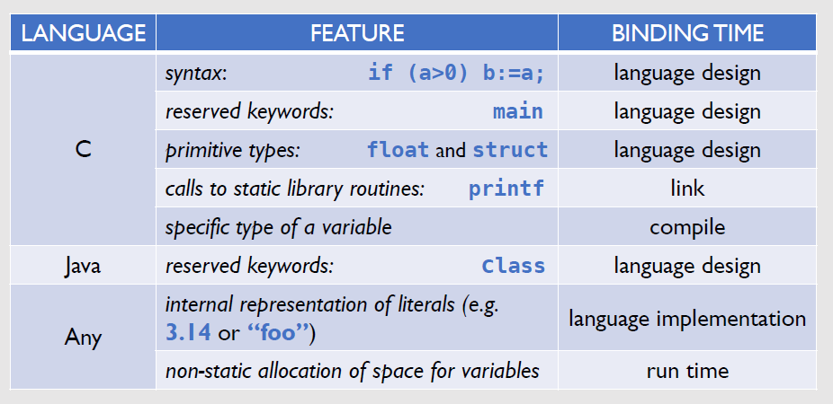
Examples

Slide 9
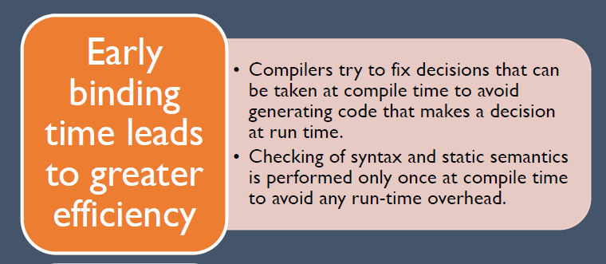
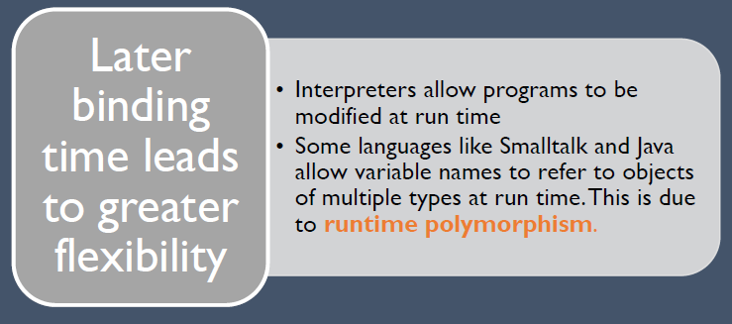
IMPORTANCE OF BINDING TIMES
Early binding (compile time, link time, load time):
Typical in compiled languages
Also called static binding
Late binding (run time):
Typical in interpreted languages
Also called dynamic binding

Slide 10
What is a run time?
Run time is a very broad term that covers the entire span from the beginning to the end of execution:
program start-up time
module entry time
elaboration time (point a which a declaration is first "seen")
procedure entry time
block entry time
statement execution time

Slide 11
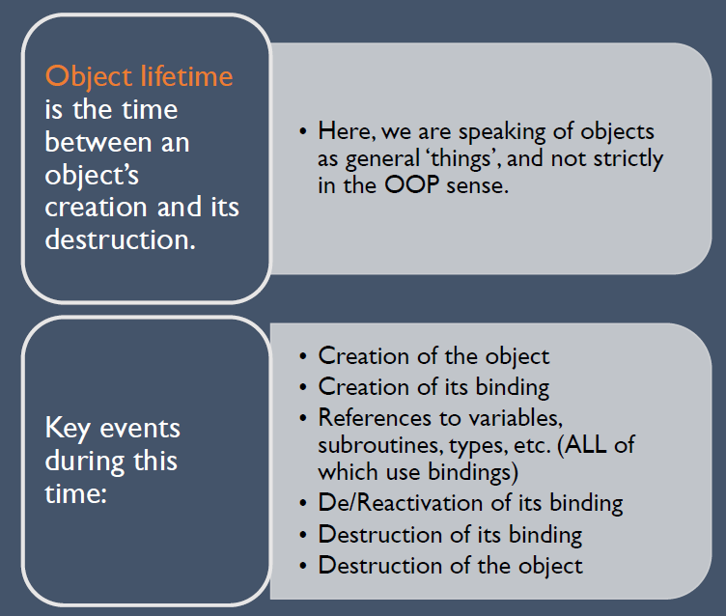
Object Lifetime
If object outlives binding it's garbage
If binding outlives object it's a dangling reference

Slide 12
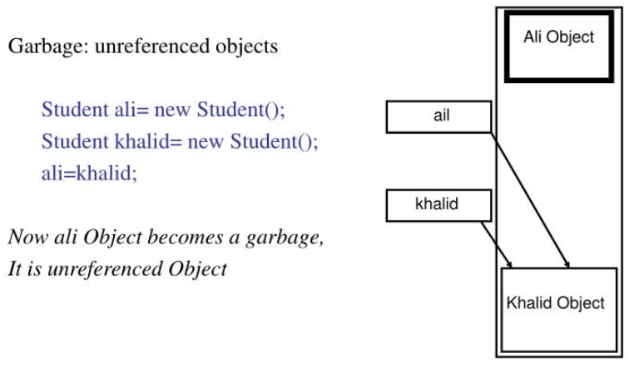
Garbage vs. Dangling Reference

Slide 13
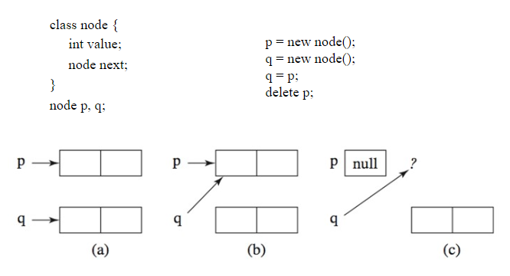
Another Example of Garbage

Slide 14
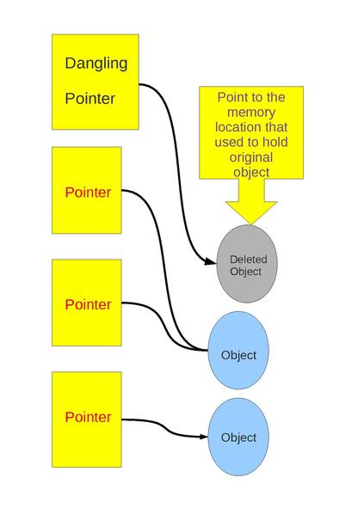
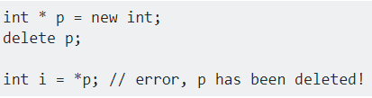
Garbage vs. Dangling Reference
Dangling Reference: Reference to a memory address that was originally allocated, but is now deallocated

Slide 15
Object Storage Management
Storage Allocation mechanisms are used to manage the object’s space during its lifetime:
Static objects are given an absolute address that is retained throughout the program’s execution
Global variables, subroutine code, class method code
Stack objects are allocated and deallocated in last-in, first-out order, usually in connection with subroutine calls and returns
Subroutine arguments, local variables
Heap: the objects may be allocated and deallocated at arbitrary times
Class instances in Java

Slide 16
Static Storage Allocation
Small constants - often stored within the instruction itself
Global variables
static or own variables
Explicit constants (including strings, sets, etc.), e.g., printf("hello, world\n")
Arguments and return values
Temporaries (intermediate values produced in complex calculations)

Slide 17
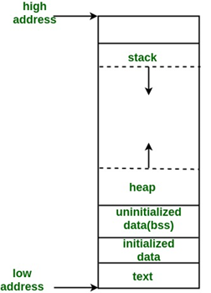
Memory Layout of C Program
Text segment: Contains executable instructions
Initialized data segment: Global variables and static variables initialized by the programmer
Unintialized data segment: Declared but not explicitly initialized variables
Stack: Starts from higher address and grows towards lower address. Saves information each time a function is called
Heap: Starts from lower address and grows towards higher address. Dynamic memory allocation takes place. Managed by malloc, realloc and free.

Slide 18
Stack Based Storage Management
Why a stack?
allocate space for recursive routines
the way subroutines call each other (or themselves) can be represented in a stack in a very natural way.
reuse space
Each instance of a subroutine at run time has its own frame (or activation record) for:
parameters
local variables
return address

Slide 19
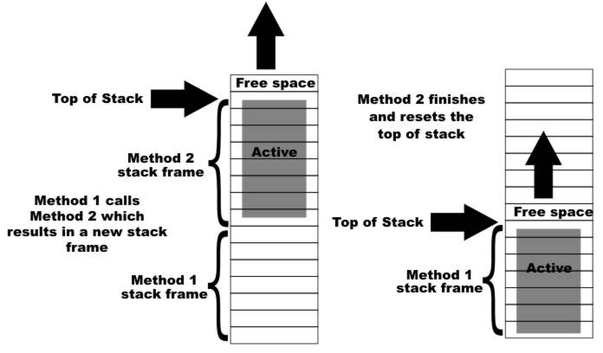
Stack Based Storage Management

Slide 20
Calling Methods Example in Java

Slide 21
Trace Call Stack
i is declared and initialized

Slide 22
Trace Call Stack
j is declared and initialized

Slide 23
Trace Call Stack
Declare k

Slide 24
Trace Call Stack
Invoke max(i, j)

Slide 25
Trace Call Stack
pass the values of i and j to num1 and num2

Slide 26
Trace Call Stack
pass the values of i and j to num1 and num2

Slide 27
Trace Call Stack
(num1 > num2) is true

Slide 28
Trace Call Stack
Assign num1 to result

Slide 29
Trace Call Stack
Return result and assign it to k

Slide 30
Trace Call Stack
Execute print statement

Slide 31
Stack Based Storage Management
Stack pointers:
The frame pointer (fp) register points to a known location within the frame of the current subroutine
The stack pointer (sp) register points to the first unused location on the stack (or the last used location on some machines)

Slide 32
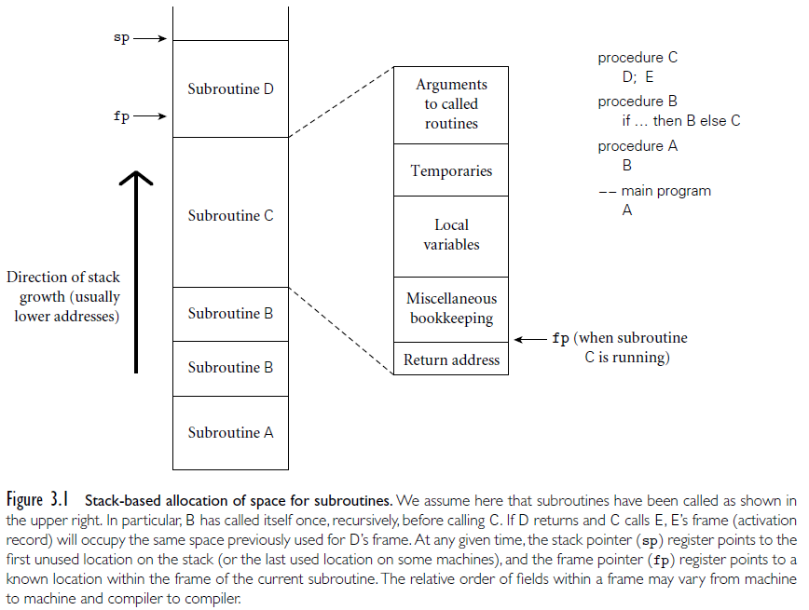
Stack based allocation of space

Slide 33
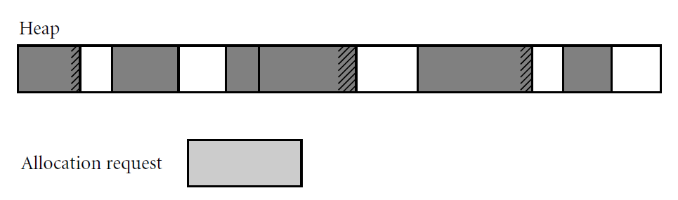
Heap-Based Storage Management
A heap is a region of storage in which sub-blocks can be allocated and deallocated at arbitrary times
Dynamically allocated pieces of data structures: objects, Strings, lists, and sets, whose size may change as a result of an assignment statement or other update operation
Two concerns with heap space management: Speed and Space

Slide 34
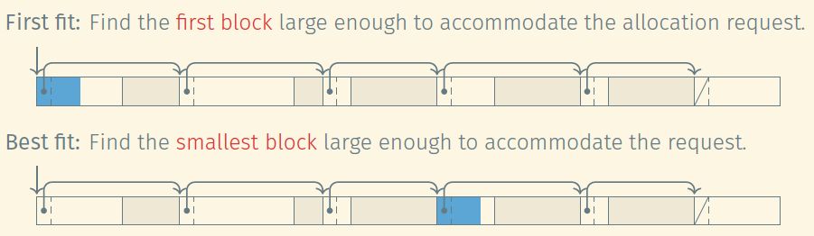
Heap Management
Free list: List of blocks of free memory
The allocation algorithm searches for a block of adequate size to accommodate the allocation request
Find a free block that is at least as big as the requested amount of memory
Mark requested number of bytes (plus padding) as allocated
Return rest of the free block to free list

Slide 35
Heap Fragmentation
Internal fragmentation occurs when a storage-management algorithm allocates a block that is larger than required to hold a given object
e.g. Boolean is stored in 1 bit/1 byte
External fragmentation occurs when the blocks that have been assigned to active objects are scattered through the heap in such a way that the remaining, unused space is composed of multiple blocks
There may be quite a lot of free space, but no one piece of it may be large enough to satisfy some request

Slide 36


Heap Compaction
To fight fragmentation, some memory management algorithms perform heap compaction once a while
Mark-Compact Algorithm
Mark reachable objects
Relocate the marked objects towards the beginning of the heap area

Slide 37
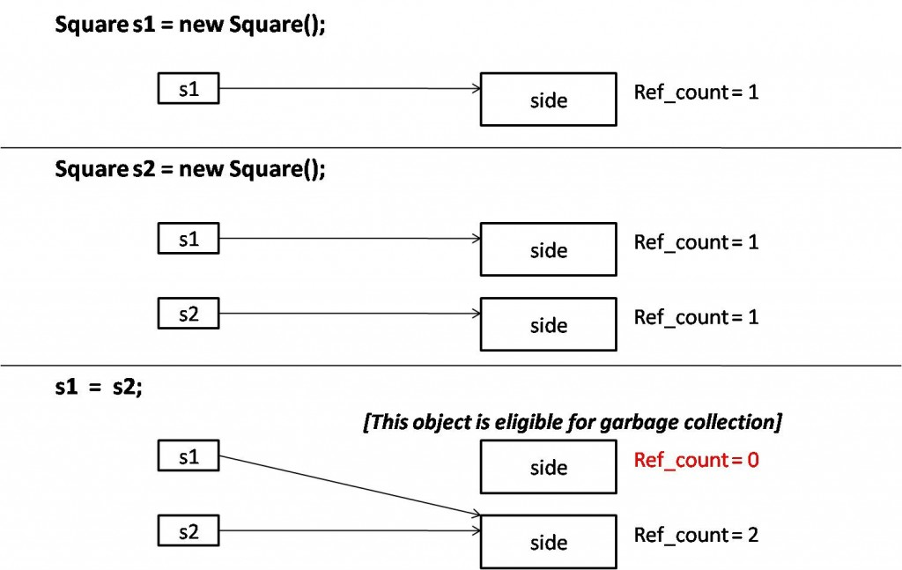
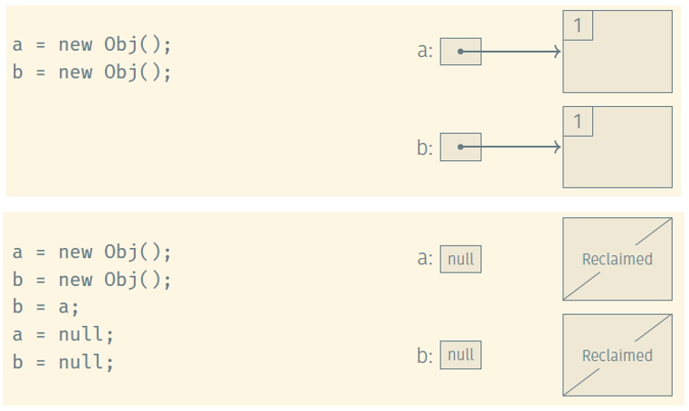
Garbage Collection
In languages that deallocation of objects is not explicit.
Manual deallocation errors are among the most common and costly bugs in real-world programs.
Objects are to be deallocated implicitly when it is no longer possible to reach them from any program variable.
Reference Counting Algorithm

Slide 38
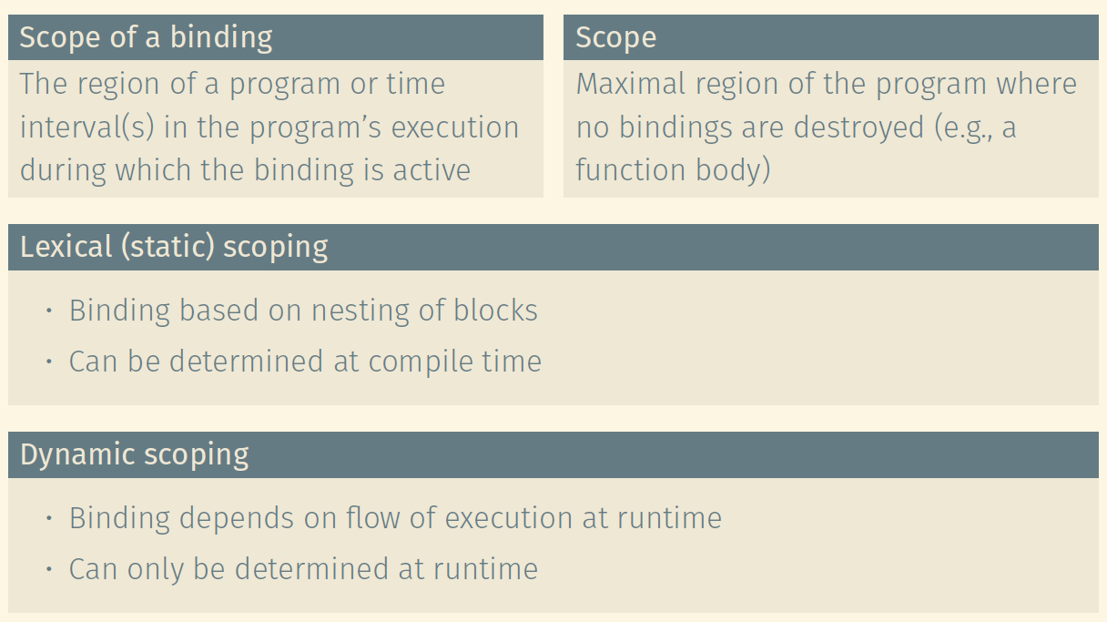
Scoping

Slide 39
Scope Rules
Scoping rule example:
Two uses of a given name
Do they refer to the same binding?
a = 1
...
def f():
a = 2
b = a
the scoping rules determine the scope

Slide 40
Python global
# Here, we're creating a variable 'x', in the __main__ scope.
x = 'None!'
def func_A():
# The below declaration lets the function know that we mean the global 'x' when we refer to that variable, not any local one
global x
x = 'A'
return x
def func_B():
# Here, we are somewhat mislead. We're actually involving two different
# variables named 'x'. One is local to func_B, the other is global.
# By calling func_A(), we do two things: we're reassigning the value
# of the GLOBAL x as part of func_A, and then taking that same value
# since it's returned by func_A, and assigning it to a LOCAL variable
# named 'x'.
x = func_A() # look at this as: x_local = func_A()
# Here, we're assigning the value of 'B' to the LOCAL x.
x = 'B' # look at this as: x_local = 'B'
return x # look at this as: return x_local

Slide 41
Static Scope Rules
In static scope rules, bindings are defined by the physical (lexical) structure of the program
Static scoping (also called lexical scoping) rule examples:
one big scope – one big segment of memory (old Basic),
scope of a function (variables live through a function execution - Java)
block scope (a local var. is available in the block in which is defined)
nested subroutines (have access to the variables defined in the parent)
if a variable is active in one or more scopes, then the closest nested scope rule applies
Lexical/static scoping is used in languages like C and Java

Slide 42
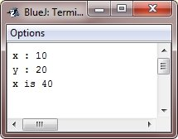
Java Example 1
/* Java Program Example - Java Variables Scope */
public class JavaProgram
{
public static void main(String args[])
{
int x; //known to all code within main
x = 10;
if(x == 10)
{
int y = 20; //known only to this block
/* x and y both known here */
System.out.println("x : " + x + "\ny : " + y);
x = y * 2;
}
// y = 100; //error! y not known here
/* x is still known here */
System.out.println("x is " +x);
}
}

Slide 43
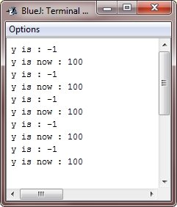
Java Example 2
/* Java Program Example - Demonstrate lifetime of a variable - Java Scope Rules */
public class JavaProgram
{
public static void main(String args[])
{
int x;
for(x=0; x<5; x++)
{
int y = -1; //y is initialized each time block is entered
System.out.println("y is : " +y); //this always prints -1
y = 100;
System.out.println("y is now : " +y);
}
}
}

Slide 44
Dynamic Scoping
Dynamic scope rules: bindings depend on the current state of program execution:
They cannot always be resolved by examining the program because they are dependent on calling sequences
The binding might depend on how a function is called
To resolve a reference, we use the most recent, active binding made at run time

Slide 45
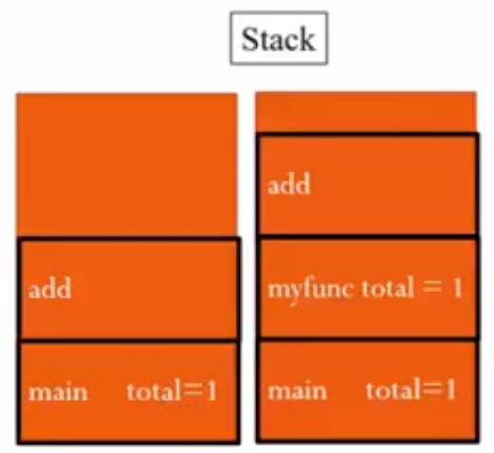
Dynamic Scoping of bindings
Example:
var total = 0
def add():
total += 1
def myfunc():
var total = 0
add()
add()
myfunc()
print total
prints 1 (add dynamically binds to total in myfunc)

Slide 46
Dynamic Scoping of bindings
Dynamic scope rules are usually encountered in interpreted languages
Lisp, Perl, Ruby
Such languages do not always have type checking of at compile time because type determination isn't always possible when dynamic scope rules are in effect
A common use of dynamic scope rules is to provide implicit parameters to subroutines

Slide 47
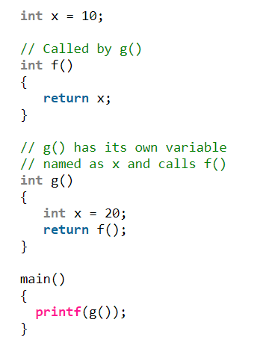
Example
Output with static scoping:
Output with dynamic scoping:

Slide 48
Overloading
Same name, more than one meaning
Some overloading happens in almost all languages
integer + vs. real + vs. String concatenation
Some languages get into overloading in a big way: Java, C++

Slide 49
Overloading & Ambiguous Invocation
public class AmbiguousOverloading {
public static void main(String[] args) {
System.out.println(max(1, 2));
}
public static double max(int num1, double num2){
if (num1 > num2)
return num1;
else
return num2;
}
public static double max(double num1, int num2){
if (num1 > num2)
return num1;
else
return num2;
}
}

Slide 50
