Slide 1

Spring 2019 CSE 216 : Programming Abstractions
Lecture 0 – Course Introduction

Slide 2
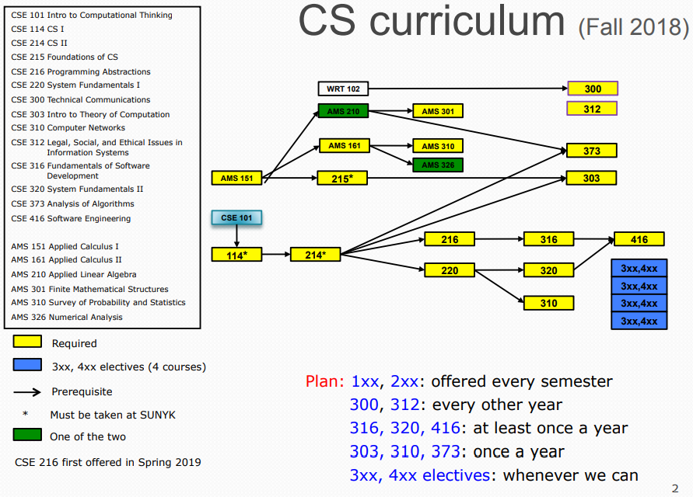

Slide 3
Course Information
CSE 216 : Programming Abstractions
Course webpage: https://ppawar.github.io/CSE216-S19/index.html
Meetings: Lecture: Tue/Thu 3:30-4:50 PM
Recitation: Mon: 12:30-1:50PM
place: B207
Prerequisites: C or higher in CSE214, CSE major

Slide 4
Staff
Instructor
Pravin Pawar
Office: B424
Email: Pravin.pawar@sunykorea.ac.kr
Phone: +82-032-626-1227
Office Hours: Tue/Thu 10:30 AM - 12:00 PM, Wed 5:00 PM - 6:30 PM
Teaching Assistants
Graduate (grading TA):
Undergraduate (tutoring TA):

Slide 5
Discussion Forum
As a technical discussion forum, we will be using Piazza on an experimental basis. Following is the signup link of CSE216 on Piazza:
http://piazza.com/sunykorea.ac.kr/spring2019/cse216
Piazza tutorial for students:
https://rutgers.instructure.com/courses/35/pages/piazza
Everyone is expected to:
Use this platform responsibly, and maintain social decorum at all times, and
Not use this platform for non-technical (especially non-course related) issues.

Slide 6
Course Overview
Course description:
Intermediate-level programming language concepts and paradigms, including functional programming, object-orientation, basics of type systems, event-driven programming, program and data abstractions, and modularity. Includes weekly recitations, which provide students with experience in the practice of programming in a variety of high-level languages such as Java, Scala, Haskell, Python or Javascript.
Course outcomes:
An understanding of programming paradigms and tradeoffs
An understanding of functional techniques to identify, formulate and solve problems
An ability to apply techniques of object-oriented programming in the context of large-scale software development
An ability to construct user interfaces using event-driven programming

Slide 7
Expectations
Ability to write programs of a few hundred lines of code in the Java programming language
Understanding of fundamental data structures, including lists, binary trees, hash tables, and graphs
Ability to construct simple command-based user interfaces, and to use basic I/O for input and output of data
A solid foundation of basic mathematical and geometric reasoning

Slide 8
Major Course Topics
Programming Paradigms [2 weeks]
Paradigms
Scope and bindings
Parameter passing
Type systems
Functional problem-solving using a high-level functional language [4 weeks]
Program and data abstractions
Language elements: data types, scope and binding, procedures and parameters
Recursion
Higher-order procedures
Streams and Lazy Evaluation
Modularity
Object-oriented design and programming [3 weeks]
Decomposition into objects carrying state and having behavior
Abstraction, Encapsulation and Information Hiding
Object-oriented Design and Implementation
Class-hierarchy for modeling data
Polymorphism and Inheritance
Dynamic method dispatch and interactions with types
OO design principles (is-a, has-a, etc.)
Cross-cutting concepts [2 weeks]
Unit testing and Integration testing
Multi-paradigm programming
Event-driven and reactive programming [3 weeks]
Graphical User Interface Programming
Multi-threading
Languages to be used
Java
SML
Python
Javascript

Slide 9

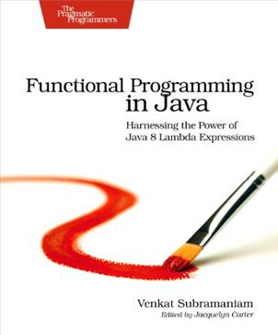
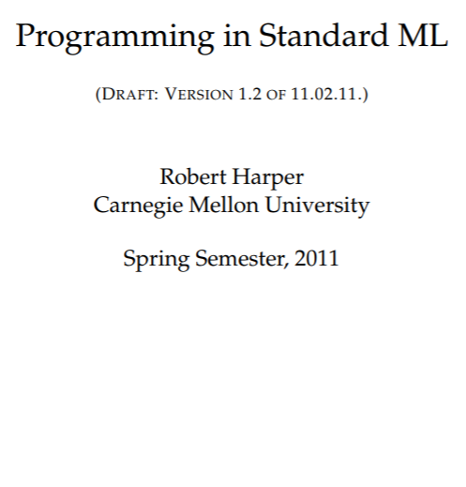
Textbook

Slide 10
Assignments
Over the course of the term you will be required to solve computational problems by writing software in Python
These homework assignments will reinforce concepts from class and have you explore new concepts, too
All work will due on fixed dates and times
All work will be completed on an individual basis (write your own code) unless otherwise instructed!
You will use Blackboard to submit your completed assignments
Please start early on the assignments!

Slide 11
Late-work Policy
Assignments must be turned in by the due date and time.
Any part of an assignment that’s late means the entire assignment is late.
If your assignment is incomplete or not entirely working by the due date, turn in what you have to get some partial credit.
If you have an emergency situation, email me before the due date and I may be able to work something out
Bottom line: Plan ahead, start early!

Slide 12
Cooperation vs. Copying
Cooperation (talking over problems) is a good way to learn and is encouraged
Do not copy code. Do not let others look at or copy your code.
Copying is not allowed on homework or exams no matter the source (written or verbal)
When you submit your homework or tests, you are pledging that the work is your own and you have not copied it.
You are also pledging that you have not allowed others to copy it.
DO NOT COPY! (Software tools catch it easily)

Slide 13
Examinations
Examination dates will be posted on the schedule page of the course website. Tentative dates are:
Midterm exam: Thu, 18 April
Final exam: June 13, 3:15 – 5:45 PM
Do not miss exams
Arrange your work and travel schedules as needed to be present for examinations
Makeup exams will only be given for verified, officially sanctioned university activities
All examinations will be closed-notes and closed-book, except one sheet of notes (A4 or 8.5x11), both sides, handwritten

Slide 14
Grading
Programming assignments (40%, 5 assignments given, lowest grade dropped) = 40% (200 points)
Quizzes (10%, 3 quizzes given, lowest grade dropped) = 10% (100 points)
Recitations (~10 recitations, 1% each) = (100 points)
Mid-term exam = 20% (100 points)
Final exam = 20% (100 points)
Policies:
Makeup exams will only be given for verified, officially sanctioned university activities
All makeup exams may be oral

Slide 15
Re-Grading
To promote consistency of grading, questions and concerns about grading should be addressed first to the TA and then, if that does not resolve the issue, to the instructor.
You are welcome to contact the TA by email or come to his/her office hour. If you would like to speak with the TA in person, and have a schedule conflict with his/her office hour, you are welcome to make an appointment to meet the TA at another time.
For the assignments, quizzes and mid-term exams, request for re-grading must be made within one week from after the announcement of grades.

Slide 16
TA Assistance
TAs are available almost every day each week
Schedule is forthcoming (posted on course web)
In “CS Commons” (next to CSD office)
Come with specific questions and/or code with which you need help
TAs strive to spend time with everyone that comes to a session so be courteous and share the TA’s attention

Slide 17
Electronics in Class
Cell phones should be put away during class
Laptops may be used during periods where you are asked to work on an exercise during class
Lecture slides are available on the course website for study before class
Talk to me after class if there’s an issue with this policy

Slide 18
Disability
If you have a physical, psychological, medical or learning disability, please contact the Student Services and Career Team.
Location: Academic Building A208
Phone: 626-1190
The DSS will determine with you what accommodations, if any, are necessary and appropriate
All information and documentation of disability is confidential

Slide 19
How to Succeed in this Class
Attend class and be on time!
Not all information is in my lecture notes or in the book
I sometimes do in-class demos that emphasize non-obvious details
This is an introductory course, true, but we’re going to cover a lot of ground and move quickly starting from scratch
The assigned work will take a lot of your time, so practice good time management
Read the reading assignments and review the lecture notes and try out example code
Practice is the only way to become proficient at coding
Very often your first, second, or third attempt at solving a problem will not be successful. It is essential that you give yourself enough time to try different ideas, taking breaks along the way!
Those who write extra code for problems not assigned (“for fun”) generally do best in this class
Learning to code involves learning to read other people’s code
Ask questions right away if confused. Ask in class, ask a TA, come to my office hours or send email. Don’t stay confused and don’t get behind!
Welcome and I hope you enjoy the class!

