Slide 1
Knative Upstream CI on Power
Note: If links in PPT are not accessible, please download the PPT and try accessing them.
Video session: https://ibm.box.com/s/jadfn2jsh4ans1pbp167g3ctbxn0sa0j

Slide 2
Motivation For Upstream CI On Power
Redhat Serverless product is based on open source Knative project.
For every release of RH Serverless, upstream Knative code is used with addition of Redhat features and compliances.
Enabling CI on Power for Knative components can help to catch and fix Power specific defects early in the entire lifecycle of RH Openshift Serverless release.
Helpful links
https://cloud.redhat.com/learn/topics/serverless
https://www.redhat.com/en/topics/microservices/why-choose-openshift-serverless

Slide 3
Knative CI
Knative community uses Prow as their CI tool.
Prow is a K8s based CI system maintained by Kubernetes community.
CI jobs(Prow jobs) are written in yaml files using Prow K8s CRDs.
All Knative CI jobs are maintained in knative/test-infra repo.
Helpful links
https://github.com/kubernetes/test-infra/tree/master/prow
https://github.com/kubernetes/test-infra/blob/master/prow/jobs.md
https://github.com/knative/test-infra
https://prow.knative.dev/
https://jazz06.rchland.ibm.com:12443/jazz/web/projects/Power%20Ecosystem#action=com.ibm.team.workitem.viewWorkItem&id=139046

Slide 4
Knative CI On S390x
4 Knative components are tested daily on s390x.
Eventing (main, 0.26, 1.0, 1.1, 1.2)
Client (main, 0.26, 1.0, 1.1, 1.2)
Operator (main, 0.26, 1.0, 1.1, 1.2)
Serving contour (main, 0.26, 1.0, 1.1, 1.2)
Serving kourier (main, 0.26, 1.0, 1.1, 1.2)
Z hardware is provisioned using IBM Cloud VPC.
Kind based Kubernetes cluster is used for testing.
Helpful links
https://prow.knative.dev/?job=*s390x*
https://github.com/knative/test-infra/pulls?q=s390x

Slide 5
S390x Knative CI Flow
Job is started at a particular time daily via cronjob on upstream server.
The job running on upstream server prepares remote s390x K8s cluster, makes s390x related changes in source code and runs e2e tests.
Example: https://github.com/knative/test-infra/pull/2812/files#diff-904a02b4d7580b96d059180f9309b3d141e0984da2d713deb776550bfcf63b50R6899-R6965
S390x Cluster details are provide to job via a GCP secret containing IP, ssh private key and other details.

Slide 6
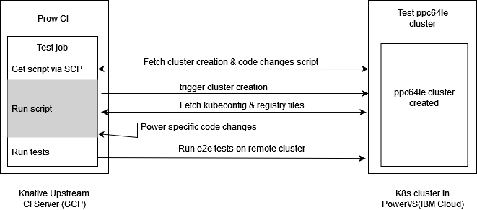
PPC64LE Knative CI Flow
https://github.com/knative/test-infra/issues/2842

Slide 7
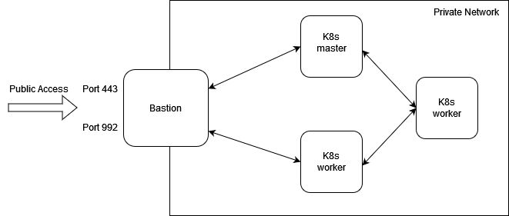
Test PPC64LE Cluster(K8s) Architecture
K8s cluster nodes are within private network with SNAT configured for internet.
Bastion node acts as a gateway for external traffic to the cluster.
Bastion runs private image registry, pull through cache registry(optional), nfs server & nginx proxy.
Port 443 & 992 are open for public access and proxies registry & k8s api server traffic respectively.

Slide 8
Progress So Far….
Started discussion with Knative community for Power CI.
Identified requirements: native K8s cluster, private image registry, GCP account for secret management.
Defined the test flow and completed a POC.
Configured GCP account to access secret-manager service.
Helpful links
Task 140140, Task 140142, Task 140143
https://github.com/knative/test-infra/issues/2842
https://cloud.google.com/run/docs/configuring/secrets
https://jazz06.rchland.ibm.com:12443/jazz/web/projects/Power%20Ecosystem#action=com.ibm.team.workitem.viewWorkItem&id=145663

Slide 9
Next Steps
Setup secrets in GCP account and configure upstream server access to created secrets. (take help from Hyounggyu Choi, if required)
https://github.com/knative/test-infra/issues/2760
https://github.ibm.com/zdocker/kind-knative/tree/master/prow#how-to-manipulate-the-secret-on-gcp
Setup prod test cluster.
Create test configurations, perform testing and raise PRs to enable Power CI jobs.
Order: eventing, client, operator, serving (main branch)
Setup slack notifications for job failures.
S390x: https://github.com/knative/test-infra/issues/2824

Slide 10
Contacts
Internal Slack Channel with Z: https://ibm-redhat-collab.slack.com/archives/C026T7XPW75
Knative Community Groups: https://github.com/knative/community/blob/main/working-groups/WORKING-GROUPS.md#working-groups (Use redhat id to join slack. Other ids require invitation.)

