Slide 1
JPEG / JPEG2000 coder-decoder with parameters adjustment
Piotr Ciesiołkiewicz
Michał Staroszczyk
Ismail Sahin
Krzysztof Rabsztyn
Wojciech Krzaczek

Slide 2
Business justification
Image

Slide 3
Goal
Our goal is to create library that will compress and decompress pictures using JPEG/JPEG2000 algorithm(ISO/IEC 10918-1 and ISO/IEC 15444-1) and save them using standarized file format.
Library will be used by GUI, which will allow to convert files from/to JPEG/JPEG2000 to/from other graphic formats and display them.

Slide 4
Primary features
- Loading images and compressing them using JPEG/JPEG2000 algorithm
- Decompressing JPEG/JPEG2000 coded files
- Covering most crucial parts of above algorithms, which will allow to
- Quality selection (compression level)
- Saving compressed pictures using JFIF (for JPEG) and JP2 (for JPEG2000) file formats
- GUI (including picture displaying)

Slide 5
Secondary features
- Covering optional parts of JPEG/JPEG2000 algorithms (e.g. Cb and Cr subsampling)
- Comparison of pictures + selecting which we like more (e.g. for different compression level, algorithm, displaying also resulting file size)
- Finding quality, which will fit to given file size
- Lossless JPEG2000 compression
- Automated finding best compression algorithm+level using some comparison criterion

Slide 6
State of art
JPEG and JPEG2000 algorithmss are described in ISO papers: respectively ISO/IEC 10918 and ISO/IEC 15444. There're also few standards describing structure of a JPEG file, where most popular are JFIF and EXIF. JPEG also introduced SPIFF file format and Lossless JPEG, but they are'nt popular. JPEG2000 introduced 5 file formats:
- JPEG 2000 codestream,
- JP2 (base still image format),
- JPX (extended still image format),
- JPM (compound image format),
- MJ2 (motion JPEG 2000).
Worth of saying is also, that another popular image file format TIFF can also use JPEG compression.

Slide 7





Tools
-Java
-Maven
-Git + github
-Redbooth

Slide 8
Milestones:
- Research finished
(20.10.2014)
- JPEG compression/decompression working
(20.11.2014)
- JPEG2000 compression/decompression working (01.12.2014)
- Core GUI completed
(13.10.2014)
- Documentation completed
(10.01.2015)

Slide 9
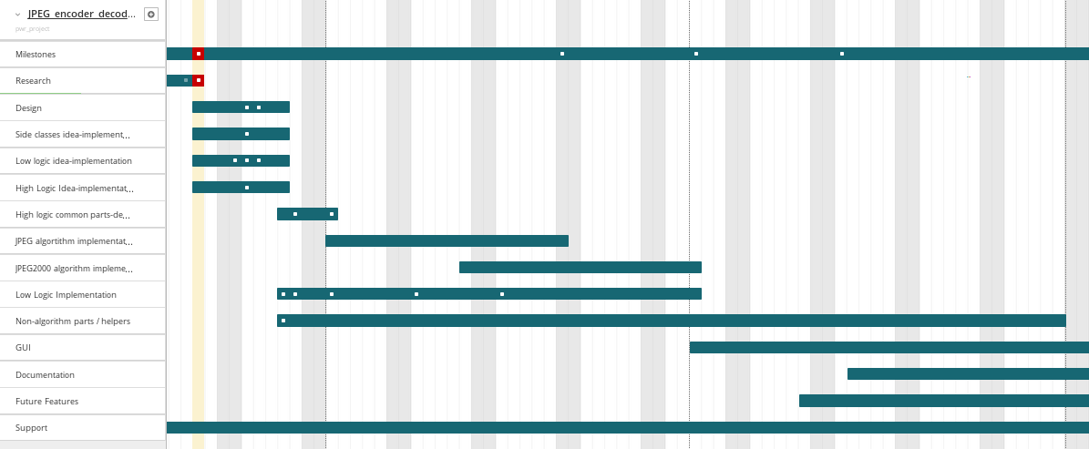
Gantt chart:

Slide 10
Thanks for attention

