Slide 1
JPEG / JPEG2000 coder-decoder with parameters adjustment
Piotr Ciesiołkiewicz
Michał Staroszczyk
Ismail Sahin
Krzysztof Rabsztyn
Wojciech Krzaczek

Slide 2
Business justification
---

Slide 3
Goal
Our goal is to create library that will compress and decompress pictures using JPEG algorithm according to ISO/IEC 10918-1 norm and save them using JFIF file format.
Library will be used by GUI, which will allow to convert files from/to JPEG/JPEG2000 to/from other graphic formats.

Slide 4
Primary features
- Loading images and compressing them using JPEG/JPEG2000 algorithm
- Decompressing JPEG/JPEG2000 coded files
- Quality selection (compression level)
- Saving pictures using standarized formats
- GUI (including picture displaying)

Slide 5
Secondary features
- Cb and Cr subsampling
- Alpha channel implementation
- Comparison of pictures + selecting which we like more (e.g. for different compression level, algorithm, displaying also resulting file size)
- Finding quality, which will fit to given file size
- Lossless JPEG2000 compression
- Automated finding best compression algorithm+level using some comparison criterion

Slide 6
State of art
----

Slide 7





Tools
-Java
-Maven
-Git + github
-Redbooth

Slide 8
Milestones:
- Research finished
(20.10.2014)
- JPEG compression/decompression working
(20.11.2014)
- JPEG2000 compression/decompression working (01.12.2014)
- Core GUI completed
(13.10.2014)
- Documentation completed
(10.01.2015)

Slide 9
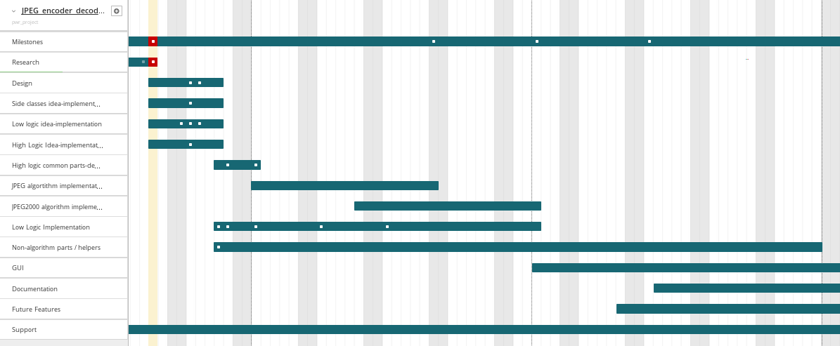
Gantt chart:

Slide 10
Thanks for attention

