Slide 1
Location-based game
Piotr Ciesiołkiewicz

Slide 2
Introduction
The main idea of the project is to create exciting Location-based game. Main goal will be to find and scan hidden QR codes.
Scanning them will give users points. Some special codes can give clues how to find better scored codes.
It is quite common to organize Location-based game. It can be a way of making form of such an events more interesting.

Slide 3


Introduction
It is highly possible that institutions, that organized such an events in the past will be interested in that application to introduce new level entertainment to their future games. We can point
ZOO Wrocław or Wrocław University of Economics, which are located in our city.

Slide 4
Primary Features
Feature | Managed to be done?
Android application - scanning codes, viewing user profile
Android application - displaying positions of QR codes on map
Admin panel – viewing and managing codes from database
Creating dedicated account

Slide 5
Secondary Features
Feature | Managed to be done?
Windows Phone application
Login via google+
Special codes (e.g. with clues to other better scored ones)
Random codes for users – every user starts with different codes and aren't able to scan the other codes
Story telling – every QR code add something new to the story
Generating QR codes bundle from admin panel

Slide 6








Tools and technologies
Quick Response codes,
Android,
Java,
Junit,
Javascript,
PHP,
Parse,
Apache Maven,
Project Libre,

Slide 7
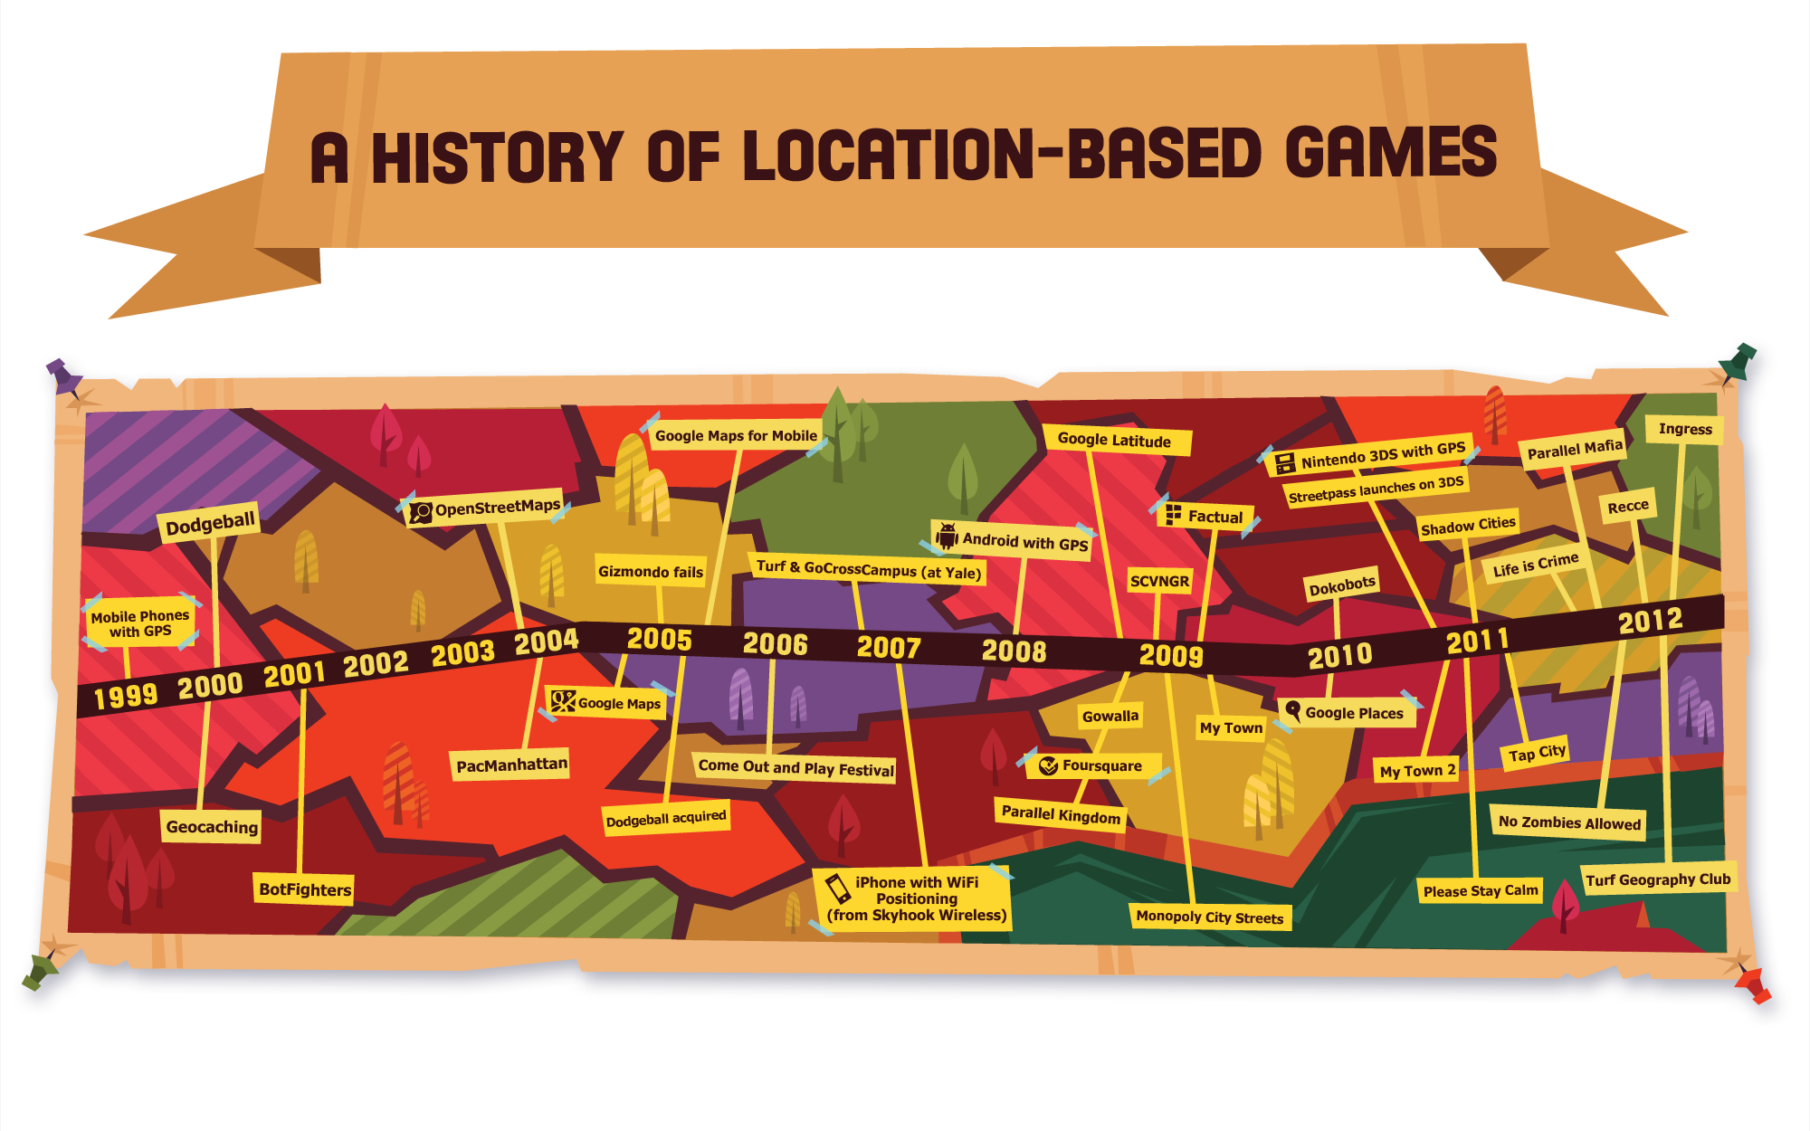
State of art

Slide 8
State of art
Actually on the market are quite a lot of location-based games which runs on smartphones. It is connected with availability of maps with convenient APIs. But most of them are standalone applications with hardcoded “story”. My application will allow to make configurable just for one event held by some organization.

Slide 9
Thanks for your attention, feel free to ask any questions!

