Slide 1
Lecture 1-1 Hardware/Software Interface Courtesy of A. Shrivastava (ASU) & Tack-Don Han (Yonsei)
Computer Architecture-Module1
Department of Computer Science
Kyoungwoo Lee

Slide 2
Agenda
Machine Language Program
Instruction Set Architecture

Slide 3
Machine Language Program
Hardware/Software Interface

Slide 4
What is This?
000000 00000 00101 00010 00010000000
000000 00100 00010 00010 00000100000
100011 00010 01111 00000 00000000000
100011 00010 10000 00000 00000000100
101011 00010 10000 00000 00000000000
101011 00010 01111 00000 00000000100
000000 11111 00000 00000 00000001000

Slide 5
Machine Language Program (for MIPS)
000000 00000 00101 00010 00010000000
000000 00100 00010 00010 00000100000
100011 00010 01111 00000 00000000000
100011 00010 10000 00000 00000000100
101011 00010 10000 00000 00000000000
101011 00010 01111 00000 00000000100
000000 11111 00000 00000 00000001000
Binary Digit or Bit
: One of the two
numbers in base 2
(0 or 1)
: Off / On Switch in electrical devices
Instruction
: A command that computer hardware understands & obeys

Slide 6
Assembly Language Program (for MIPS)
000000 00000 00101 00010 00010000000
000000 00100 00010 00010 00000100000
100011 00010 01111 00000 00000000000
100011 00010 10000 00000 00000000100
101011 00010 10000 00000 00000000000
101011 00010 01111 00000 00000000100
000000 11111 00000 00000 00000001000
swap: sll $2, $5, 2
add $2, $4, $2
lw $15, 0($2)
lw $16, 4($2)
sw $16, 0($2)
sw $15, 4($2)
jr $31
Machine Language
: A binary representation of machine instructions
Assembly language
: A symbolic representation of machine instructions

Slide 7
Assembly Language Program (for MIPS)
swap: sll $2, $5, 2
add $2, $4, $2
lw $15, 0($2)
lw $16, 4($2)
sw $16, 0($2)
sw $15, 4($2)
jr $31
Assembler
: A program translating assembly codes into machine codes
Program
: A set of instructions specifying operations/operands and sequence

Slide 8
High-level Language Program (in C)
void swap(int v[], int k) { int temp; temp = v[k]; v[k] = v[k+1]; v[k+1] = temp; }
Compiler
: A program translating high-level language codes into assembly codes
High-level Language
: A portable language consisting of words and algebraic notations (C, C++, Java) that humans understand

Slide 9
Machine Language Program (for MIPS)
High-level language program (in C)
void swap (int v[], int k)
. . .
Assembly language program (for MIPS)
swap: sll $2, $5, 2
add $2, $4, $2
lw $15, 0($2)
lw $16, 4($2)
sw $16, 0($2)
sw $15, 4($2)
jr $31
Machine (object) code (for MIPS)
000000 00000 00101 0001000010000000
000000 00100 00010 0001000000100000
100011 00010 01111 0000000000000000
100011 00010 10000 0000000000000100
101011 00010 10000 0000000000000000
101011 00010 01111 0000000000000100
000000 11111 00000 0000000000001000
C - Compiler
Assembler

Slide 10
Instruction Set Architecture
Hardware/Software Interface

Slide 11
Instruction Set Architecture (ISA)
Syntax and semantics of a list of instructions
Interface description separating the hardware and software
Many ISAs
X86/ia32, ia64, ARM, MIPS, PowerPC, etc.
RISC vs. CISC
Reduced Instruction-Set Computer
Complex Instruction-Set Computer
software
instruction set architecture
hardware

Slide 12
Main Concepts
Instructions are also data
Encoded in binary and stored in memory
Program Counter
Points to the location of the instruction to be executed
CPU
Memory
Address
Data
(Instruction)
Fetch instruction from
memory location pointed
to by the PC
A Stored Program Computer
: Memory holds program
: CPU executes instructions sequentially at a time
: Von Neumann Architecture
Execute the instruction
Update the PC

Slide 13
MIPS R4000 ISA
Instruction Categories
Arithmetic
Load/Store
Jump and Branch
Floating Point: coprocessor
Memory Management
Special
3 Instruction Formats: all 32 bits wide
Registers
3 Main Instruction Types
R0 - R31
PC
HI
LO
OP
rs
rt
rd
sa
funct
OP
rs
rt
immediate
OP
jump target

Slide 14
Below Your Program (Set of Instructions)
Application software
Written in high-level language
System software
Compiler: translates HLL code to machine code
Operating System: service code
Handling input/output
Managing memory and storage
Scheduling tasks & sharing resources
Hardware
Processor, memory, I/O controllers
Applications software
Systems software
Hardware

Slide 15
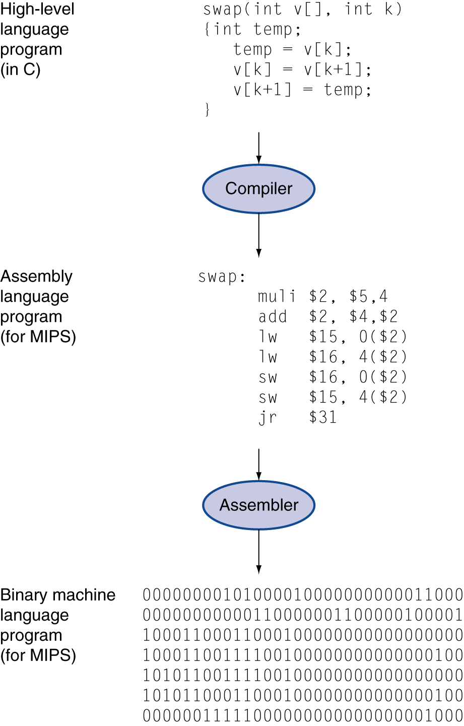
Levels of Program Code
High-level language
Level of abstraction closer to problem domain
Provides for productivity and portability
Assembly language
Textual representation of instructions
Hardware representation
Binary digits (bits)
Encoded instructions and data

Slide 16

Components of a Computer
The BIG Picture
Compiler
Same components for all kinds of computers
Desktop PC
Server
Embedded Computers
etc.
Interface
Computer
Input
Control
Datapath
Output
Processor
Memory

Slide 17
Summary
Machine Language Program, Assembly Language Program, High-level Language Program
Instruction Set Architecture = Computer Architecture
Computer = Processor (Datapath and Control) + Memory + Input/Output

