Slide 1
Lecture 7 Memory Hierarchy Courtesy of A. Shrivastava (ASU) & Tack-Don Han (Yonsei)
Computer Architecture-Module3
Department of Computer Science
Kyoungwoo Lee

Slide 2

Where are we and where to?
Compiler
Assembly Language
Simple Processor Design
Pipelined Processor
Bypasses
Branch Prediction
Out-of-order Scheduling
Memory Hierarchy
Direct-mapped Cache
Set-associative Cache
Virtual Memory
Inclusive Caches
Interface
Computer
Input
Control
Datapath
Output
Processor
Memory

Slide 3
Agenda
Memory Hierarchy
Caches

Slide 4
Memory Hierarchy
Memory

Slide 5
CPU-Memory Bottleneck
Ideally, as large as possible & as fast as possible
Performance of high-speed computers is usually limited by memory bandwidth & latency
Latency (time for a single access)
Memory access time >> Processor cycle time
(e.g.) approximately ~60 ns >> 1 ns at Intel Core i7 Xeon 5500 series
Bandwidth (number of accesses per unit time)
if fraction m of instructions access memory, ➔ 1+m memory references / instruction ➔ CPI = 1 requires 1+m memory refs / cycle
CPU
Memory

Slide 6
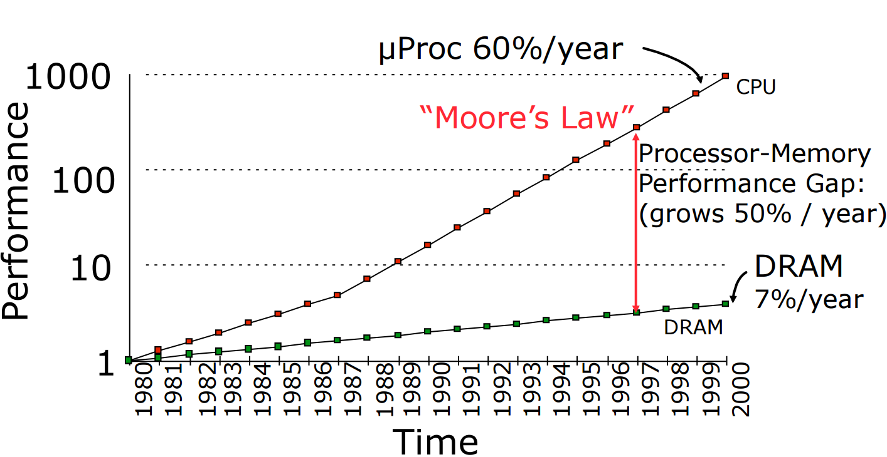
Processor – DRAM Gap (Latency)
Four-issue 2 GHz Superscalar accessing 100 ns DRAM could execute 800 instructions during time for one memory access!

Slide 7
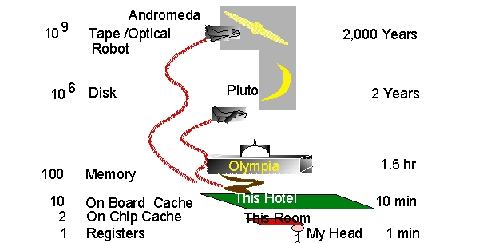
Storage Latency: How Far Away is the Data?
Jim Gray’s slides - http://loci.cs.utk.edu/dsi/netstore99/docs/presentations/keynote/sld023.htm

Slide 8
Why is bigger slower?
Physics slows us down
Racing the speed of light: (3.0x10^8m/s)
clock = 500MHz
how far can I go in a clock cycle?
(3.0x10^8 m/s) / (500x10^6 cycles/s) = 0.6m/cycle
For comparison: 21264 is about 17mm across
Capacitance:
long wires have more capacitance
either more powerful (bigger) transistors required, or slower
signal propagation speed proportional to capacitance
going “off chip” has an order of magnitude more capacitance

Slide 9
Memory Hierarchy
Consist of multiple levels of memory with different speeds and sizes
Take advantage of the principle of locality (temporal and spatial localities)
Make an illusion of memory as large and fast as possible
Current
Technology
Speed
Processor
Size
Cost ($/bit)
Fastest
Memory
Smallest
Highest
SRAM
Memory
DRAM
Memory
Slowest
Biggest
Lowest
Magnetic
Disk

Slide 10
Size-Speed-Cost Tradeoff
cache
virtual memory
CPU
Memory
Cache
8 B
16 B
4 KB
disk
Cache
regs
register
reference
L1-cache
reference
L2-cache
reference
memory
reference
disk memory
reference
size:
speed:
$/Mbyte:
block size:
608 B
1.4 ns
4 B
128KB
4.2 ns
4 B
512KB -- 4MB
16.8 ns
$90/MB
16 B
128 MB
112 ns
$2-6/MB
4-8 KB
27GB
9 ms
$0.01/MB
larger, slower, cheaper
(Numbers are for a 21264 at 700MHz)

Slide 11
Memory Hierarchy Analogy – Library (writing a report)
Memory Hierarchy | Latency
Registers | 1 ns
Caches | 4 ns
Main Memory | 112 ns
Hard Disk Drive | 9,000 ns
Library | Latency (Assumption)
Information in the book | 1 s
Books in the desk | 4 s
Books in the bookshelf | 112 s
Books in the central library | 9,000 s

Slide 12
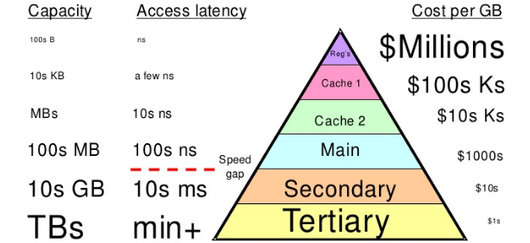
An Alternative View of Memory Hierarchy
From UCSB

Slide 13
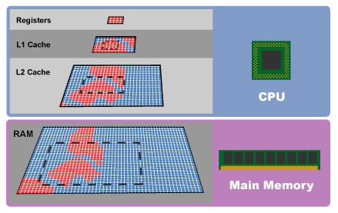

Another Alternative View of Memory Hierarchy
Level | Access Time | Size
Registers | 1-3 ns | 1 KB
L1 Cache | 2-8 ns | 8-128 KB
L2 Cache | 5-12 ns | 0.5-8 MB
MM | 10-60 ns | 64MB-1GB

Slide 14
Caches with Localities
Memory

Slide 15
Locality of Reference
Principle of Locality:
Programs tend to reuse data and instructions near those they have used recently
Temporal locality: recently referenced items are likely to be referenced in the near future
Spatial locality: items with nearby addresses tend to be referenced close together in time
Locality in Example:
Data
Reference array elements in succession (spatial)
Instructions
Reference instructions in sequence (spatial)
Cycle through loop repeatedly (temporal)
sum = 0;
for (i = 0; i < n; i++)
sum += a[i];
*v = sum;

Slide 16
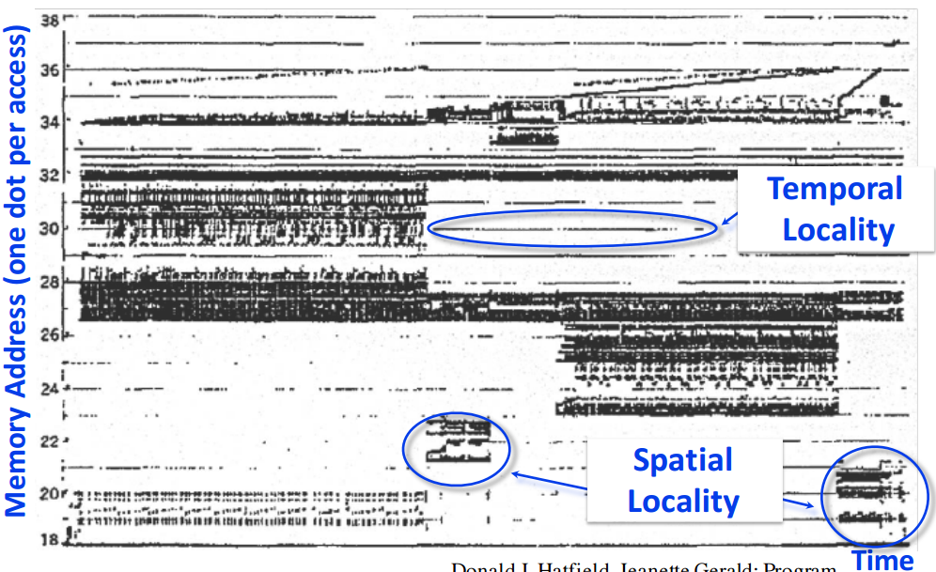
Real Memory Reference Patterns
Donald J. Hatfield, Jeanette Gerald: Program Restructuring for Virtual Memory. IBM Systems Journal 10(3): 168-192 (1971)

Slide 17
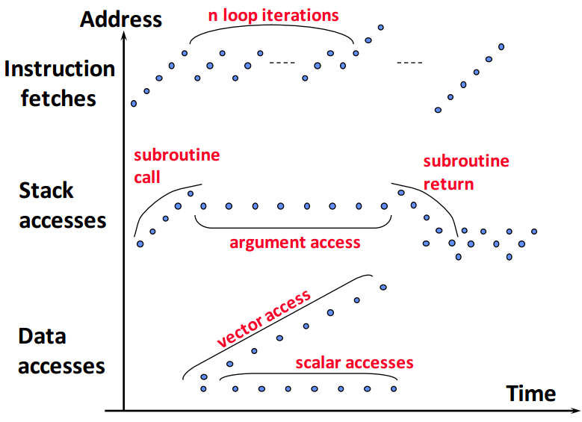
Typical Memory Reference Patterns
http://www-inst.eecs.berkeley.edu/~cs152/fa16/lectures/L06-Memory.pdf

Slide 18
Caching: The Basic Idea
Big, Slow Memory
Main Memory
Stores words
A–Z in example
Cache
Stores subset of the words
4 in example
Organized in lines
Multiple words
To exploit spatial locality
Access
Word must be in cache for processor to access
Small,
Fast Cache
A
A
Processor
B
B
C
G
•
•
•
H
Y
Z

Slide 19
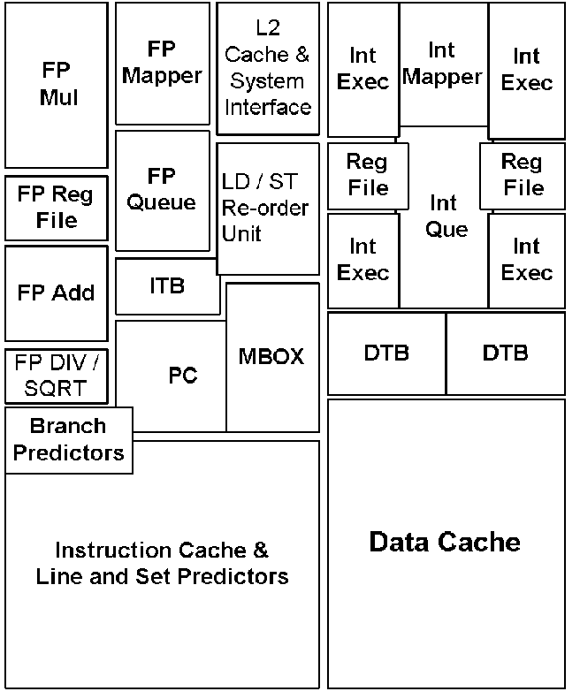
How important are caches?
21264 Floorplan
Register files in middle of execution units
64 KB instruction cache
64 KB data cache
Caches take up a large fraction of the die
(Figure from Jim Keller, Compaq Corp.)

Slide 20
Design Issues for Caches
Key Questions:
Where should a line be placed in the cache? (line placement)
How is a line found in the cache? (line identification)
Which line should be replaced on a miss? (line replacement)
What happens on a write? (write strategy)
Design Constraints:
Design must be very simple
Hardware realization
All decision making within nanosecond time scale
Want to optimize performance for “typical” programs
Do extensive benchmarking and simulations
Many subtle engineering tradeoffs

Slide 21
The Cache Architecture
MAIN MEMORY
Memory Address
Read/Write Data
Program
Decoder
Processor
Memory Bus
Cache Blocks
Notes:
1) If the cache had a total of 16 blocks, with 16 bytes each,
- What is the size of the memory address ?
- How will you access byte x in Block y ?
Ans: 5bits for the 16blocks,
5bits for the 16bytes in each block
Total memory address size = 8bits
When you double the memory size, which bit differs in the modulo of cache size ?
- This is the tag id that is used to identify if the memory block in the cache -- > valid status
Now, modulo (# cache blocks) is the mapping from main memory to the cache.
To identify which cache block contains the required data, if valid bit =1, use the next set of bits to identify the set associated with the memory address.
3)

Slide 22
Quiz / Assignments
What else can you see other than library as an analogy to memory hierarchy?
What makes CPU consider the memory as large as possible and as fast as possible (ideal memory)?

Slide 23
Summary
Memory Hierarchy – Size vs Cost, Locality, Ideal Memory
Caches and Design Issues
Next: Direct Mapped Caches

