Slide 1
Chap 1: Basic concepts
Computer Systems (CSI2107-02)
YONSEI UNIVERSITY
Spring 2015
(Courtesy of Prof. Shin-Dug Kim in YU
and Textbook Author)

Slide 2
Overview of the course
Intro. to computer system organization
Processor architecture and design
I/O organization
Chap 1: Basic Concepts
Chap 2: x86 Processor Architecture
Chap 3: Assembly Language Fundamentals
Chap 4: Data Transfers, Addressing, and Arithmetic
Chap 5: Procedures
Chap 6: Conditional Processing
Chap 7: Integer Arithmetic
Chap 8: Advanced Procedures
Chap 9: Strings and Arrays
Chap 10: Structures and Macros
Chap 11: MS-Windows Programming
Chap 12: Floating-Point Processing and Instruction Encoding
Chap 13: High-Level Language Interface
Computer System
Organization
Basic Assembly
Language
Advanced Assembly
Programming

Slide 3
Chapter Overview
Welcome to Assembly Language
Virtual Machine Concept
Data representation
Boolean Operations

Slide 4
Motivation
Why low level assembly language?
to design programs on embedded systems
to control directly computer hardware to communicate with OS
to optimize critical areas of application programs to speed up
to communicate with OS
Understand computer systems
interaction between CPU and programs
Instrs: a bridge between HW and SW
interaction between OS and application/assembly programs

Slide 5
What is Assembly Language?
Languages for computers
high level language (HLL): C, C++, PASCAL, COBOL, JAVA, etc.
assembly language
machine language: binary code executable by the CPU
HLL
Library
routines
Linker
Compiler
Executable code
Assembly code
Loader
Assembler
Memory
Object code

Slide 6
What is Assembly Language?
Assembly language
a machine-specific programming language
one-to-one correspondence
between assembly instructions and machine instructions
Assembler
a program converting assembly code into machine code
linker: combine individual files into a single executable program
debugger: trace and examine execution of a program
What is assembly language?
a symbolic form of machine language
allows alphabetic mnemonics for operation codes and storage locations

Slide 7
Why learn Assembly Language?
What is assembler?
translates a program written in assembly language (AL) to machine language (ML)
AL mnemonics: understandable by programmers
ML code: understandable by the CPU
Creates object module: machine language representation of any program
Why learn assembly language?
No language is perfect
strong points & corresponding week points
to understand the computer architecture and operating system
for its utilities that are not supported by high-level languages
Benefits of programming in AL: speed, versatility, flexibility, and compact

Slide 8
Why learn Assembly Language?
For real-time applications such as device drivers
programs in AL are fast (compact code)
routines include only code that programmers want to include
HLL: interpretive and compiled, but
too slow (too much redundant code)
no specific HW control mechanism
Versatility: anything that can be done with a computer can be done with AL
Flexibility
AL: multiple ways to accomplish one task
HLL: some languages have rigid coding restraint
Big programs in AL: harder and error prone
When to use ==> HLL cannot give necessary performance from HW

Slide 9
Machine Language
Instruction set
a set of machine instructions that a processor can execute
a processor interprets and translates machine instructions into HW signals
downward compatibility
EX: MOV AL,5
moves 5 into AL register
1011000000000101
operational code (OP-code)
Operand: data “5”

Slide 10
Chapter Overview
Welcome to Assembly Language
Virtual Machine Concept
Data representation
Boolean Operations

Slide 11
Virtual Machines
Tanenbaum: Virtual machine concept
Programming Language analogy:
Each computer has a native machine language (language L0) that runs directly on its hardware
A more human-friendly language is usually constructed above machine language, called Language L1
Programs written in L1 can run two different ways:
Interpretation – L0 program interprets and executes L1 instructions one by one
Translation – L1 program is completely translated into an L0 program, which then runs on the computer hardware

Slide 12
Translating Languages
English: Display the sum of A times B plus C.
C++: cout << (A * B + C);
Assembly Language:
mov eax,A
mul B
add eax,C
call WriteInt
Intel Machine Language:
A1 00000000
F7 25 00000004
03 05 00000008
E8 00500000

Slide 13
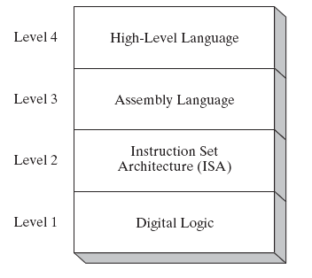
Specific Machine Levels

Slide 14
High-Level Language
Level 4
Application-oriented languages
C++, Java, Pascal, Visual Basic . . .
Programs compile into assembly language (Level 4)

Slide 15
Assembly Language
Level 3
Instruction mnemonics that have an one-to-one correspondence to machine language
Programs are translated into Instruction Set Architecture Level - machine language (Level 2)

Slide 16
Instruction Set Architecture (ISA)
Level 2
Also known as conventional machine language
Executed by Level 1 (Digital Logic)

Slide 17
Digital Logic
Level 1
CPU, constructed from digital logic gates
System bus
Memory
Implemented using bipolar transistors

Slide 18
Chapter Overview
Welcome to Assembly Language
Virtual Machine Concept
Data representation
Boolean Operations

Slide 19
Data Representation
Binary numbers
0/off/0v, 1/on/5v
Bits, bytes, words and D-words
word: 16-bits
double word: 32bits
quad word: 64bits
byte
byte
1 0 1 1 0 1 0 1 1 0 1 1 0 1 0 1
bits
word

Slide 20
Data Representation
Various number systems

Slide 21
Data Representation
Translating unsigned binary integers to decimal
Bin = D_{n-1}D_{n-2} …D₁D₀
(e.g.) 0 0 0 0 1 0 0 1 = D₇ D₆ D₅ D₄ D₃ D₂ D₁ D₀
Dec = (D_{n-1}X2^{n-1}) + (D_{n-2}X2^{n-2}) + …+(D₁X2¹) + (D₀X2⁰)
(e.g.) 0 0 0 0 1 0 0 1 = (1X2³) + (1X2⁰) = 9 D
Binary | Decimal | Hexadecimal
0001 | 1 | 1
0111 | 7 | 7
1010 | 10 | A
1111 | 15 | F

Slide 22
Data Representation
Translating unsigned decimal integers to binary
37D ➔100101B
Divide decimal by 2 repeatedly, save remainder as binary digit
Division | Quotient | Remainder
37/2 | 18 | 1
18/2 | 9 | 0
9/2 | 4 | 1
4/2 | 2 | 0
2/2 | 1 | 0
1/2 | 0 | 1

Slide 23
Data Representation
Binary addition
0 + 0 = 0, 0 + 1 = 1, 1 + 0 = 1, 1 + 1 = 10
Ranges of unsigned integers
0 0 0 0 0 1 0 0 (4)
0 0 0 0 0 1 1 1 (7)
+ --------------------------
0 0 0 0 1 0 1 1 (11)
Storage Type | Range (low – high) | Power of 2
Unsigned byte | 0 to 255 | 0 to (2⁸ – 1)
Unsigned word | 0 to 65,536 | 0 to (2¹⁶ -1)
Unsigned D-word | 0 to 4,294,967,295 | 0 to (2³² -1)
Unsigned Q-word | 0 to 18,446,744,073,709,551,615 | 0 to (2⁶⁴ -1)

Slide 24
Data Representation
Converting unsigned hexadecimal to decimal
4-digit Hexadecimal integer: D₃D₂D₁D₀
Dec = (D₃X16³) + (D₂X16²) +(D₁X16¹) + (D₀X16⁰)
N-digit hexadecimal
Dec = (D_{n-1}X16^{n-1}) + (D_{n-2}X16^{n-2}) + …+(D₁X16¹) + (D₀X16⁰)
EX: 3BA4
3 x 16³ = 12,288, 11 x 16² = 2816
10 x 16¹ = 160, 4 x 16⁰ = 4
3x16³ + 11x16² + 10x16¹ + 4x16⁰ = 15,268
Converting unsigned decimal to hexadecimal: 422 → Hex #
Division | Quotient | Remainder
422/16 | 26 | 6
26/16 | 1 | A
1/16 | 0 | 1
➔ 1A6 H

Slide 25
Data Representation
The highest bit indicates the sign: 1 = negative, 0 = positive

Slide 26
Data Representation
Signed numbers
sign bit: MSB
1 0 0 0 1 0 1 0 = - 10
0 0 0 0 1 0 1 0 = 10
Two’s complement number
way to represent negative number
toggle each bit value and add one
11110110 = -10
00001001 (toggle bits)
+ 1 (add 1)
--------------------------------
00001010 = + 10

Slide 27
Data Representation
Example
Storing numbers
“123” : 00110001 00110010 00110011
‘1’ ‘2’ ‘3’
123 : 01111011
Decimal | Binary(n) | NEG(n) | Decimal
+2 | 00000010 | 11111110 | -2
+16 | 00010000 | 11110000 | -16
+127 | 01111111 | 10000001 | -127

Slide 28
Sample Program
Sample program
AX content
Memory Content
1. MOV AX,5
05
011C
011E
2. ADD AX,10
15
35
0120
0122
0124
3. ADD AX,20
35
4. MOV[0120],AX
35
5. INT 20

Slide 29
Debug Program Usage
Commands
Command | Description
A | Starts assembling a program, placing each instruction in memory. EX: A100
G | Executes the program. EX: G, G100…
Q | Quits debugger
R | Display register contents or replace. EX: R, R AX, R BX, ..
T | Traces (executes) one instruction or more. EX: T, T3, Tn…

Slide 30
Chapter Overview
Welcome to Assembly Language
Virtual Machine Concept
Data representation
Boolean Operations

Slide 31
Boolean Operations
NOT
AND
OR
Operator Precedence
Truth Tables

Slide 32
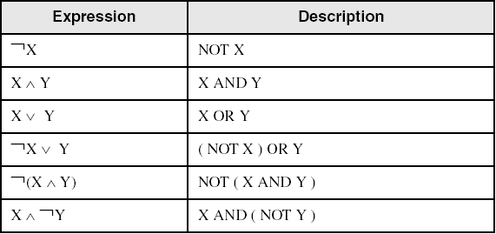
Boolean Algebra
Based on symbolic logic, designed by George Boole
Boolean expressions created from:
NOT, AND, OR

Slide 33
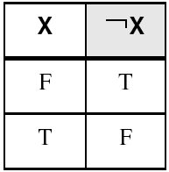
NOT
Inverts (reverses) a boolean value
Truth table for Boolean NOT operator:
Digital gate diagram for NOT:

Slide 34
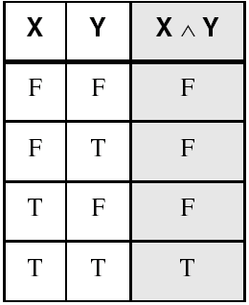
AND
Truth table for Boolean AND operator:
Digital gate diagram for AND:

Slide 35
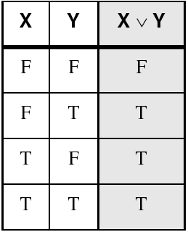
OR
Truth table for Boolean OR operator:
Digital gate diagram for OR:

Slide 36
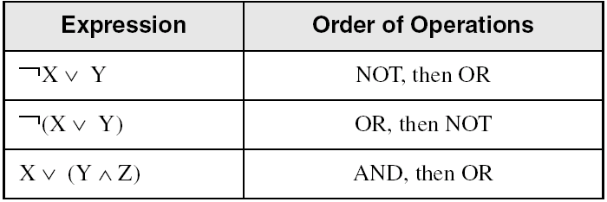
Operator Precedence
Examples showing the order of operations:

Slide 37
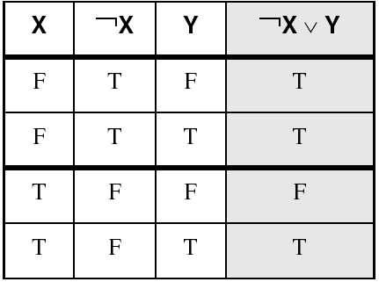
Truth Tables (1 of 3)
A Boolean function has one or more Boolean inputs, and returns a single Boolean output.
A truth table shows all the inputs and outputs of a Boolean function
Example: ¬X ∨ Y

Slide 38
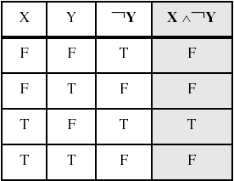
Truth Tables (2 of 3)
Example: X ∧ ¬Y

Slide 39
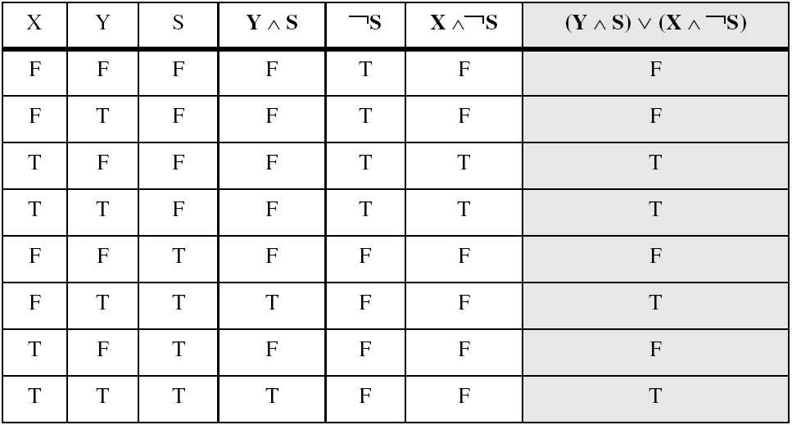
Truth Tables (3 of 3)
Example: (Y ∧ S) ∨ (X ∧ ¬S)
Two-input multiplexer

Slide 40
Summary
Assembly language helps you learn how software is constructed at the lowest levels
Assembly language has a one-to-one relationship with machine language
Each layer in a computer's architecture is an abstraction of a machine
layers can be hardware or software
Boolean expressions are essential to the design of computer hardware and software

