Slide 1
Chapter 2: x86 Processor Architecture
Computer Systems (CSI2107-02)
YONSEI UNIVERSITY
Spring 2015
(Courtesy of Prof. Shin-Dug Kim in YU
and Textbook Author)

Slide 2
Chapter Overview
General Concepts
IA-32 Processor Architecture
IA-32 Memory Management
Components of an IA-32 Microcomputer
Input/Output System

Slide 3
Basic Microcomputer Design
Why computer organization to ASL programming ?
need to understand memory addressing scheme by 8086 family
programming to access data items in memory
I/O programming (to know how components are interconnected)
features of ASL reflect the underlying computer organization
need to understand the differences among family of 8086
CPU: fetch, decode, & execute cycle

Slide 4
Basic Microcomputer Design
Memory
Data
Bus
ALU
Data Reg
Status
Reg
CU
Addrs Reg
Control Bus
CPU
Address
Bus

Slide 5
Another View of Microcomputer

Slide 6

Basic Microcomputer Design
Clock
every operation is synchronized by clock
Instruction execution cycle
Fetch
Decode
Operand fetch
Execute: ALU execution
Write back (store output operand)

Slide 7
Chapter Overview
General Concepts
IA-32 Processor Architecture
IA-32 Memory Management
Components of an IA-32 Microcomputer
Input-Output System

Slide 8
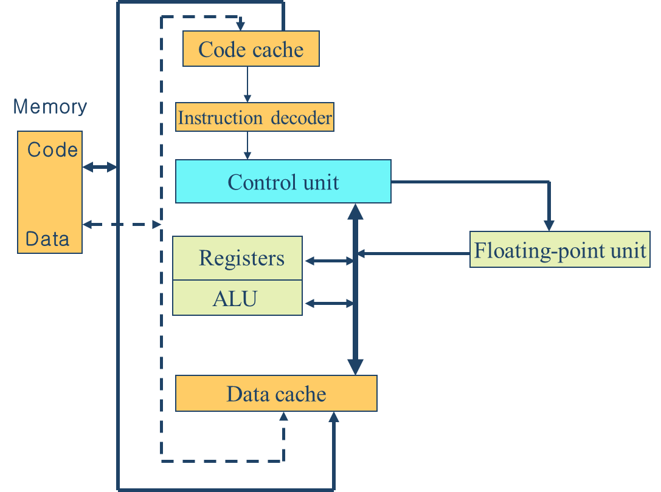
Pentium CPU Block Diagram
Multi-stage Pipeline

Slide 9
Basic Microcomputer Design
Multi-stage pipeline
Each step in instruction cycle takes one clock cycle
IA-32 processor: pipelined with 6-stage execution cycle
Bus interface unit (BIU): memory access & I/O access
Code fetch unit: get instructions from BIU & put into I-queue
Decode unit: decode instructions from I-queue & translate into micro-code
Execution unit: executes micro-code instructions
Segment unit: translate logical address into linear address
Paging unit: translate linear address into physical address

Slide 10
Pipelining: Its Natural!
Laundry Example
Ann, Brian, Cathy, Dave each have one load of clothes to wash, dry, and fold
Washer takes 30 minutes
Dryer takes 40 minutes
“Folder” takes 20 minutes
A
B
C
D

Slide 11
Sequential Laundry
6 PM
7
8
9
10
11
Midnight
Time
30
40
20
30
40
20
30
40
20
30
40
20
T
a
s
k
O
r
d
e
r
A
B
C
D
Sequential laundry takes 6 hours for 4 loads

Slide 12
Pipelined Laundry
6 PM
7
8
9
10
11
Midnight
Time
30
40
40
40
40
20
T
a
s
k
O
r
d
e
r
A
B
Note:
More time to do project
C
D
Pipelined laundry takes 3.5 hours for 4 loads

Slide 13
Applied to Computer Design
Clock Number
Inst. # | 1 | 2 | 3 | 4 | 5 | 6 | 7 | 8
Inst. i | IF | ID | EX | MEM | WB
Inst. i+1 |  | IF | ID | EX | MEM | WB
Inst. i+2 |  |  | IF | ID | EX | MEM | WB
Inst. i+3 |  |  |  | IF | ID | EX | MEM | WB
IM
Reg
ALU
DM
Reg
Time
IM
Reg
ALU
DM
Reg
Program execution order (in instructions)
IM
Reg
ALU
DM
Reg
IM
Reg
ALU
DM
Reg
Potential of n-times speedup. n = no of pipeline stages

Slide 14
6-stage non-pipelined processor
Stages
 | S1 | S2 | S3 | S4 | S5 | S6
1 | I-1
2 |  | I-1
3 |  |  | I-1
4 |  |  |  | I-1
5 |  |  |  |  | I-1
6 |  |  |  |  |  | I-1
7 | I-2
8 |  | I-2
9 |  |  | I-2
10 |  |  |  | I-2
11 |  |  |  |  | I-2
12 |  |  |  |  |  | I-2
Cycles
For k-stages, n-instructions take (n*k) cycles ➔ waste of CPU

Slide 15
6-stage pipelined processor
Stages
 | S1 | S2 | S3 | S4 | S5 | S6
1 | I-1
2 | I-2 | I-1
3 |  | I-2 | I-1
4 |  |  | I-2 | I-1
5 |  |  |  | I-2 | I-1
6 |  |  |  |  | I-2 | I-1
7 |  |  |  |  |  | I-2
Cycles
For k-stages, n-instructions take k +(n-1) cycles

Slide 16
Superscalar processor: 2 or more pipelines
Stages
 | S1 | S2 | S3 | S4 | S5 | S6
1 | I-1
2 | I-2 | I-1
3 | I-3 | I-2 | I-1
4 |  | I-3 | I-2 | I-1
5 |  |  | I-3 | I-1
6 |  |  |  | I-2 | I-1
7 |  |  |  | I-2 |  | I-1
8 |  |  |  | I-3 | I-2
9 |  |  |  | I-3 |  | I-3
10 |  |  |  |  | I-3
11 |  |  |  |  |  | I-3
12
EX
Cycles
Assume S4 needs 2 cycles
For k-stages, n-instructions take (k+2n-1) cycles

Slide 17
Superscalar processor: u-pipeline & v-pipeline
Stages
 | S1 | S2 | S3 | S4-u | S4-v | S5 | S6
1 | I-1 |  |  |  | EX
2 | I-2 | I-1
3 | I-3 | I-2 | I-1
4 |  | I-3 | I-2 | I-1
5 |  |  | I-3 | I-1 | I-2
6 |  |  |  | I-3 | I-2 | I-1
7 |  |  |  | I-3 | I-4 | I-2 | I-1
8 |  |  |  |  | I-4 | I-3 | I-2
9 |  |  |  |  |  | I-4 | I-3
10 |  |  |  |  |  |  | I-4
EX
Cycles
Assume S4 needs 2 cycles, odd numbered instruction→ u-pipe
even numbered instruction → v-pipe
For k-stages, n-instructions take (k+n) cycles

Slide 18
Reading from Memory
cycle1
cycle2
cycle3
cycle4
CLK
ADDR
RD
DATA
Cycle1: address bits of memory operand are placed on address bus
Cycle2: RD is set low
Cycle3: CPU waits one cycle to give memory time to respond
Cycle4: RD goes to one, signaling CPU to read data on data bus

Slide 19
Cache Memory
Cache memory
DRAMs are slower than CPU speed
Need high speed memory = cache memory
L-1 cache inside the CPU
L-2 cache outside CPU
Cache hit: when data to be read is already in cache memory
Cache miss: when data to be read is not in cache memory

Slide 20
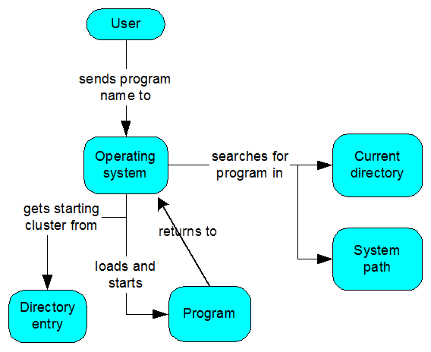
Program Execution
How a program runs
Type program name under OS control
OS search filename in current directory/paths
If found, retrieves file information (size, location, etc)
OS determines next available location in memory to load program file into memory
OS branch to the first instruction of the file → process (running program)
When finishes, remove file handle & memory space allocated

Slide 21
IA-32 Processor Architecture
Modes of operation
Protected mode: native state of processor (prevent programs from outside segment)
A program can access 4 GB memory (0 – 0FFFFFFFFH)
Virtual-8086 mode: while in protected mode, can execute real-address mode software (MS-DOS programs)
Real-address mode: Intel 8086 programming execution mode under MS-DOS

Slide 22
16-bit Intel Processor Architecture
Registers
8, 16, 32-bit storage locations in CPU
general-purpose, special purpose, & hidden
Data registers: arithmetic & data move
16-bit general-purpose: AX, BX, CX, & DX
8-bit: AH, AL, BH, BL, CH, CL, DH, DL
AX: Accumulator
BX: Base register (hold address of a procedure or variable)
CX: Counter register
DX: Data (special role in multiply/divide)
Segment registers
CS: code segment (base location of instruction code)
DS: data segment (base location for data)
SS: stack segment (base location for stack)
ES: extra segment (additional location for variables)

Slide 23
16-bit Intel Processor Architecture
Index registers (offsets of instructions and data)
BP: base pointer (offset from SS)
SP: stack pointer (offset of TOS in SS)
SI: source index (string movement)
DI: destination index (string movement)
Status and control registers
IP: instruction pointer (the offset of next instruction to be executed)
CS:IP form the complete address
Flags: control & status
Bit position
15
14
13
12
11
10
9
8
7
6
5
4
3
2
1
0
x
x
x
x
O
D
I
T
S
Z
x
A
X
P
x
C

Slide 24
16-bit Intel Processor Architecture
Flags (control & status)
DF: direction of data transfer (0: up, 1: down, MOVS, CMPS, STD, &CLD)
IF: interrupt control (1: EN, 0: DE by CLI & STI)
TF: halt after each instruction execution (1: on by INT 3)
CF: when the result of unsigned arithmetic is too big to fit: 1=carry, 0=no carry
OF: when the result of signed arithmetic is too big to fit
SF: 1=negative, 0=positive
ZF: when the result of arithmetic/logic operation: 1= zero, 0=nonzero
A: auxiliary carry showing a carry from bit 3 to bit 4
P: parity

Slide 25
16-bit Intel Processor Architecture
System bus (internal communication channel)
a set of electronic wires
address, data, & control signals
Instruction execution cycle
fetch instructions (6 byte instruction queue for prefetch)
decode instructions => pass to the execution unit
execute by execution unit
Intel family
8080, 8088: 8-bit
8086: 16-bit
80386: 32-bit
80486: 32-bit & 8K cache memory
Pentium: 64bit 2-way superscalar & separate I/D-caches

Slide 26
IA-32 Intel Processor Architecture
Improved execution cycle (386 – Pentium)
BIU (bus interface unit): access memory & I/O
code prefetch unit: get instructions from BIU and inserts in P-Q
instruction decode unit: decode instructions from prefetch queue
execution unit: execute instructions
segment unit: translate logical addresses to linear addresses
paging unit: translate virtual addresses into physical addresses
32-bit register set
General
Purpose
EAX
AX
Index: EBP, ESP, ESI, EDI
Segment: CS, SS, DS, ES,
FS, GS
Status & control: EFLAGS, EIP
EBX
BX
ECX
CX
EDX
DX

Slide 27
IA-32 Intel Processor Architecture
General purpose registers
32-bit | 16-bit | 8-bit(high) | 8-bit(low)
EAX | AX | AH | AL
EBX | BX | BH | BL
ECX | CX | CH | CL
EDX | DX | DH | DL
32-bit | 16-bit
ESI | SI
EDI | DI
EBP | BP
ESP | SP

Slide 28
Chapter Overview
General Concepts
IA-32 Processor Architecture
IA-32 Memory Management
Components of an IA-32 Microcomputer
Input-Output System

Slide 29
Memory Addressing: real addressing mode
Memory is divided into segments
each segment contains 2¹⁶ locations (64 KB long)
address formation in segmented memory (SM)
16 bit segment address
16 bit segment offset
ex) segment 2000H & offset 0BAFH
=> actual address 20000H
+ 0BAFH
------------
20BAFH
code and data can be in the same segment
code and data may not be in the same segment (separate segments)
code segment (64 KB long for program instructions)
data segment (64 KB long for data used)

Slide 30
Memory Addressing: real addressing mode
Memory is divided into segments
6000:FFFF
80000
70000
60000
50000
6000:0250
40000
250
30000
6000:000
SEG:Offset
20000
10000
00000

Slide 31
Memory Addressing
How to obtain real physical (linear) address?
notation : < seg addrs > : < offset addrs >
Ex) 020A:1BCD => offset 1BCDH in segment 020AH
step 1 : add a hex 0 to the right side of the seg addrs
step 2 : add the offset to that shifted seg addrs
ex) 020A:1BCD 020A0H
+ 1BCDH
--------------
03C6DH
Addresses and advanced 8086 family
8086 : 20 bit addrs (16 bit data)
80286 : 24 bit addrs (16 bit data)
80386/486 : 32 bit addrs (32 bit data)
all members support 20 bit segmented addressing

Slide 32
System Memory Map
Address | Mapping Info
00000 – 003FF | INT Vector Table
00400 - | DOS Data Area & SW BIOS
 | DOS kernel & command
 | User programs
0A0000 - 0AFFFF | Video Graphics Buffer
0B0000 – 0B7FFF | MDA Text Buffer
0B8000 – 0BFFFF | Color Text Buffer
0F0000 – 0FFFF0 | ROM BIOS
0FFFF0 | Reserved area for reset

Slide 33
Operating System & Memory
History of PC memory usage
8088 & 8086: 1MB using 20 bits (0000-FFFFFH)
RAM: 00000 - BFFFFH
ROM: C0000H – FFFFFH
Memory architecture
00000 - 003FFH: interrupt vector table of 32-bit addresses
00400H - : software BIOS
routines for managing KBD, display,
BIOS data area map: Table 1

Slide 34
Operating System & Memory
System startup
reset → initialization program in ROM BIOS
initial : bootstrap loader → loads the boot record → OS load → OS execution
Video display
memory-mapped video display
text mode: B0000H
graphics mode: B8000H
Serial communication ports
COM1: 0400:0000 03F8H
COM2: 0400:0002 02F8H
COM3: 0400:0004 0000H
COM4: 0400:0006 0000H
ROM: BIOS (0C0000H – 0FFFFFH)

Slide 35
Chapter Overview
General Concepts
IA-32 Processor Architecture
IA-32 Memory Management
Components of an IA-32 Microcomputer
Input-Output System

Slide 36
Components of an IA-32 Microcomputer
Motherboard
Video output
Memory
Input-output ports

Slide 37
Motherboard
CPU socket
External cache memory slots
Main memory slots
BIOS chips
Sound synthesizer chip (optional)
Video controller chip (optional)
IDE, parallel, serial, USB, video, keyboard, joystick, network, and mouse connectors
PCI bus connectors (expansion cards)

Slide 38
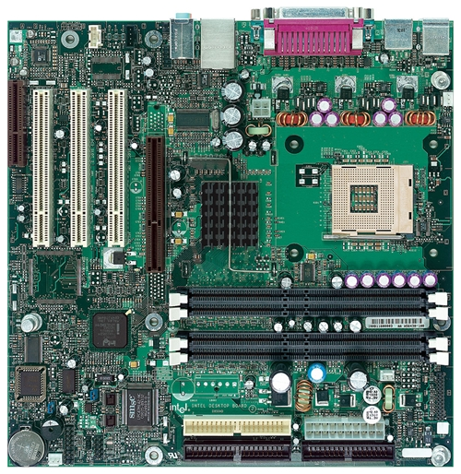
Intel D850MD Motherboard
mouse, keyboard, parallel, serial, and USB connectors
Video
Audio chip
PCI slots
memory controller hub
Pentium 4 socket
AGP slot
dynamic RAM
Firmware hub
I/O Controller
Speaker
Power connector
Battery
Diskette connector
Source: Intel® Desktop Board D850MD/D850MV Technical Product Specification
IDE drive connectors

Slide 39
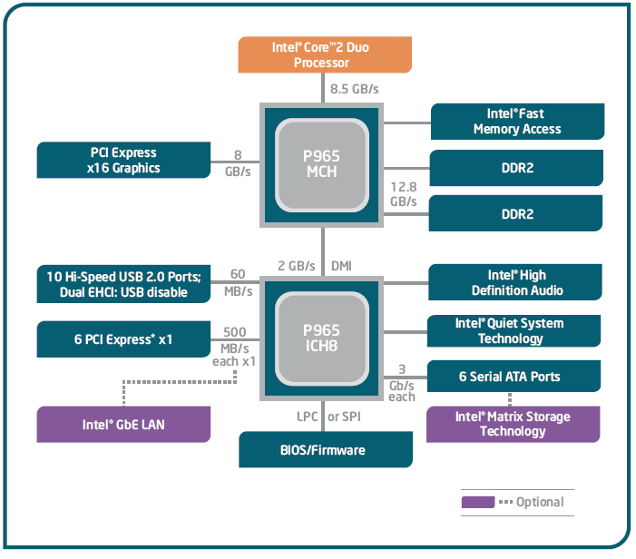
Intel 965 Express Chipset

Slide 40
Video Output
Video controller
on motherboard, or on expansion card
AGP (accelerated graphics port technology)*
Video memory (VRAM)
Video CRT Display
uses raster scanning
horizontal retrace
vertical retrace
Direct digital LCD monitors
no raster scanning required
* This link may change over time.

Slide 41
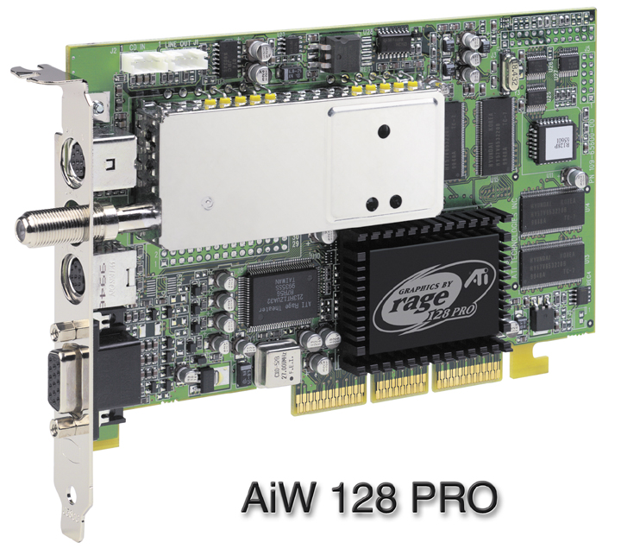
Sample Video Controller (ATI Corp.)
128-bit 3D graphics performance powered by RAGE™ 128 PRO
3D graphics performance
Intelligent TV-Tuner with Digital VCR
TV-ON-DEMAND™
Interactive Program Guide
Still image and MPEG-2 motion video capture
Video editing
Hardware DVD video playback
Video output to TV or VCR

Slide 42
Memory
ROM
read-only memory
EPROM
erasable programmable read-only memory
Dynamic RAM (DRAM)
inexpensive; must be refreshed constantly
Static RAM (SRAM)
expensive; used for cache memory; no refresh required
Video RAM (VRAM)
dual ported; optimized for constant video refresh
CMOS RAM
complimentary metal-oxide semiconductor
system setup information
See: Intel platform memory (Intel technology brief: link address may change)

Slide 43
Input-Output Ports
USB (universal serial bus)
intelligent high-speed connection to devices
up to 12 megabits/second
USB hub connects multiple devices
enumeration: computer queries devices
supports hot connections
Parallel
short cable, high speed
common for printers
bidirectional, parallel data transfer
Intel 8255 controller chip

Slide 44
Input-Output Ports (cont)
Serial
RS-232 serial port
one bit at a time
uses long cables and modems
16550 UART (universal asynchronous receiver transmitter)
programmable in assembly language

Slide 45
Device Interfaces
ATA host adapters
intelligent drive electronics (hard drive, CDROM)
SATA (Serial ATA)
inexpensive, fast, bidirectional
FireWire
high speed (800 MB/sec), many devices at once
Bluetooth
small amounts of data, short distances, low power usage
Wi-Fi (wireless Ethernet)
IEEE 802.11 standard, faster than Bluetooth

Slide 46
Chapter Overview
General Concepts
IA-32 Processor Architecture
IA-32 Memory Management
Components of an IA-32 Microcomputer
Input-Output System

Slide 47
Levels of Input-Output
Level 3: High-level language function
examples: C++, Java
portable, convenient, not always the fastest
Level 2: Operating system
Application Programming Interface (API)
extended capabilities, lots of details to master
Level 1: BIOS
drivers that communicate directly with devices
OS security may prevent application-level code from working at this level

Slide 48
Displaying a String of Characters
When a HLL program displays a string of characters, the following steps take place:

Slide 49
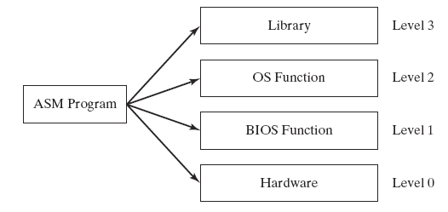
Programming levels
Assembly language programs can perform input-output at each of the following levels:

