Slide 1
Chap. 1 Introduction
Digital Logic (CSI2111-02)
Kyoungwoo Lee
(Courtesy of Textbook Authors)
© Copyright 2004, Gaetano Borriello and Randy H. Katz

Slide 2
zyBook
https://zybooks.zyante.com/ or http://www.zybooks.com
Digital Design
Students can get started immediately with the class zyBook by following these simple instructions.
Sign up at zyBooks.com
Enter zyBook code YonseiCSI2111Fall2015
Click Subscribe
Your students are receiving complimentary access to the material. The student subscriptions will be valid through01/02/16.

Slide 3
Course logistics and details
Course Web page -
http://yscec.yonsei.ac.kr
Lectures - Tue 4:00~4:50 pm, Thu 1:00~2:50 pm, Engineering Hall A019
Course Laboratories - machines on 3rd floor CS labs
CSI2111 Textbook :
Contemporary Logic Design
Randy H. Katz and Gaetano Borriello, Pearson
Other Reference
Digital Design with RTL Design, VHDL, and Verilog
Frank Vahid, Willey

Slide 4
Course logistics and details
Assignments
7 to 8 assignments in this semester
Summary: each team is required to submit the summary of what you’ve learned in the last week and to present it once
Test
Quiz – 3 quizzes in the class with one week notice
Midterm Exam – as per YU course catalog
Final Exam - as per YU course catalog
Course Project
No in this class
Yes, there will be project assignments through logic design lab

Slide 5
CSI2111-02 Grading Policy
Assignments - 20% of the final grade
Summary – 5%
Quiz – 10% of the final grade
Midterm Exam – 30% of the final grade
Final Exam - 40% of the final grade
Final assignment of grades will not be based on a curve
F grade if you miss 7 classes during the semester
3 late presence is considered one absence

Slide 6
Chapter Overview
Logic Design Introduction
A Brief History of Logic Design
Computation
Examples

Slide 7
Why study logic design?
Obvious reasons
this course is part of the CS/CompE requirements
it is the implementation basis for all modern computing devices
building large things from small components
provide a model of how a computer works
More important reasons
the inherent parallelism in hardware is often our first exposure to parallel computation
it offers an interesting counterpoint to software design and is therefore useful in furthering our understanding of computation, in general

Slide 8
What will we learn in this class?
The language of logic design
Boolean algebra, logic minimization, state, timing, CAD tools
The concept of state in digital systems
analogous to variables and program counters in software systems
How to specify/simulate/compile/realize our designs
hardware description languages
tools to simulate the workings of our designs
logic compilers to synthesize the hardware blocks of our designs
mapping onto programmable hardware
Contrast with software design
sequential and parallel implementations
specify algorithm as well as computing/storage resources it will use

Slide 9
Applications of logic design
Conventional computer design
CPUs, busses, peripherals
Networking and communications
phones, modems, routers
Embedded products
in cars, toys, appliances, entertainment devices
Scientific equipment
testing, sensing, reporting
The world of computing is much much bigger than just PCs!

Slide 10
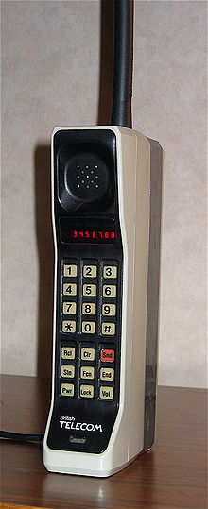


A DynaTAC 8000X
Courtesy of “Wall Street” (M. Douglas)
The Motorola DynaTAC 8000X commercial portable cellular phone, received approval from the U.S. FCC on September 21, 1983. ,^{[1]} and became the first cell phone to be offered commercially in 1984. It offered 30 minutes of talk time and 8 hours of standby, and a LED display for dialing or recall of one of 30 phone numbers. It was priced at $3,995 in 1983. DynaTAC was an abbreviation of Dynamic Adaptive Total Area Coverage.
Courtesy of Motorola and Wikipedia

Slide 11

1984 – The Nokia Mobira Talkman

Slide 12

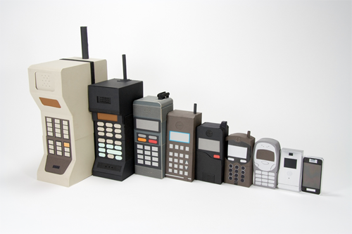
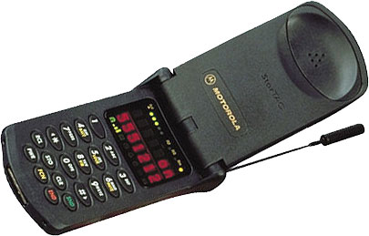
DynaTac, MicroTac, StarTac, …
Courtesy of Motorola and design-milk.com

Slide 13
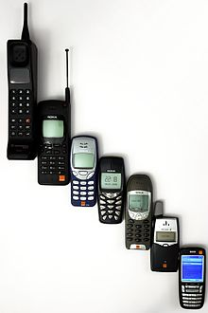
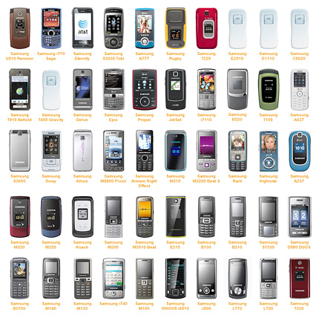
Nokia, Samsung, LG, Ericson, etc.

Slide 14

The iPhone

Slide 15

Smartphones

Slide 16
삼성 SST
삼성 SST(Samsung S/W Track)설명회를 진행합니다. 컴퓨터과학과 1,2,3학년 학생들의 많은 참여 바랍니다. 일시 : 9월 4일(목) 시간 : 오후 5시 30분 ~ 장소 : 제1공학관 A653 *간단한 다과(햄버거 및 음료) 진행 예정입니다. **행사 참여한 학생 전원에게 1만원 상품권지급 예정입니다.

Slide 17

SOSCON
http://www.soscon.net/

Slide 18
A quick history lesson
1850: George Boole invents Boolean algebra
maps logical propositions to symbols
permits manipulation of logic statements using mathematics
1938: Claude Shannon links Boolean algebra to switches
his Masters’ thesis
1945: John von Neumann develops the first stored program computer
its switching elements are vacuum tubes (a big advance from relays)
1946: ENIAC . . . The world’s first completely electronic computer
18,000 vacuum tubes
several hundred multiplications per minute
1947: Shockley, Brittain, and Bardeen invent the transistor
replaces vacuum tubes
enable integration of multiple devices into one package
gateway to modern electronics

Slide 19
What is logic design?
What is design?
given a specification of a problem, come up with a way of solving it choosing appropriately from a collection of available components
while meeting some criteria for size, cost, power, beauty, elegance, etc.
What is logic design?
determining the collection of digital logic components to perform a specified control and/or data manipulation and/or communication function and the interconnections between them
which logic components to choose? – there are many implementation technologies (e.g., off-the-shelf fixed-function components, programmable devices, transistors on a chip, etc.)
the design may need to be optimized and/or transformed to meet design constraints

Slide 20
What is digital hardware?
Collection of devices that sense and/or control wires that carry a digital value (i.e., a physical quantity that can be interpreted as a “0” or “1”)
example: digital logic where voltage < 0.8v is a “0” and > 2.0v is a “1”
example: pair of transmission wires where a “0” or “1” is distinguished by which wire has a higher voltage (differential)
example: orientation of magnetization signifies a “0” or a “1”
Primitive digital hardware devices
logic computation devices (sense and drive)
are two wires both “1” - make another be “1” (AND)
is at least one of two wires “1” - make another be “1” (OR)
is a wire “1” - then make another be “0” (NOT)
memory devices (store)
store a value
recall a previously stored value
sense
AND
drive
sense

Slide 21
What is happening now in digital design?
Important trends in how industry does hardware design
larger and larger designs
shorter and shorter time to market
cheaper and cheaper products
Scale
pervasive use of computer-aided design tools over hand methods
multiple levels of design representation
Time
emphasis on abstract design representations
programmable rather than fixed function components
automatic synthesis techniques
importance of sound design methodologies
Cost
higher levels of integration
use of simulation to debug designs
simulate and verify before you build

Slide 22
CSI2111: concepts/skills/abilities
Understanding the basics of logic design (concepts)
Understanding sound design methodologies (concepts)
Modern specification methods (concepts)
Familiarity with a full set of CAD tools (skills)
Realize digital designs in an implementation technology (skills)
Appreciation for the differences and similarities (abilities) in hardware and software design
New ability: to accomplish the logic design task with the aid of computer-aided design tools and map a problem description into an implementation with programmable logic devices after validation via simulation and understanding of the advantages/disadvantages as compared to a software implementation

Slide 23
Computation: abstract vs. implementation
Up to now, computation has been a mental exercise (paper, programs)
This class is about physically implementing computation using physical devices that use voltages to represent logical values
Basic units of computation are:
representation: "0", "1" on a wire set of wires (e.g., for binary ints)
assignment: x = y
data operations: x + y – 5
control: sequential statements: A; B; C conditionals: if x == 1 then y loops: for ( i = 1 ; i == 10, i++) procedures: A; proc(...); B;
We will study how each of these are implemented in hardware and composed into computational structures

Slide 24
Switches: basic element of physical implementations
Implementing a simple circuit (arrow shows action if wire changes to “1”):
A
Z
close switch (if A is “1” or asserted) and turn on light bulb (Z)
Z
A
open switch (if A is “0” or unasserted) and turn off light bulb (Z)
Z ≡ A

Slide 25
Switches (cont’d)
Compose switches into more complex ones (Boolean functions):
A
B
AND
Z ≡ A and B
A
OR
Z ≡ A or B
B

Slide 26
Switching networks
Switch settings
determine whether or not a conducting path exists to light the light bulb
To build larger computations
use a light bulb (output of the network) to set other switches (inputs to another network).
Connect together switching networks
to construct larger switching networks, i.e., there is a way to connect outputs of one network to the inputs of the next.

Slide 27
Relay networks
A simple way to convert between conducting paths and switch settings is to use (electro-mechanical) relays.
What is a relay? What determines the switching speed of a relay network?
conducting path composed of switches closes circuit
current flowing through coil magnetizes core and causes normally closed (nc) contact to be pulled open
when no current flows, the spring of the contact returns it to its normal position

Slide 28
Transistor networks
Relays aren't used much anymore
some traffic light controllers are still electro-mechanical
Modern digital systems are designed in CMOS technology
MOS stands for Metal-Oxide on Semiconductor
C is for complementary because there are both normally-open and normally-closed switches
MOS transistors act as voltage-controlled switches
similar, though easier to work with than relays.

Slide 29
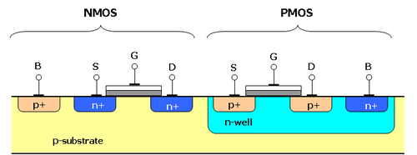
MOS transistors
MOS transistors have three terminals: drain, gate, and source
they act as switches in the following way: if the voltage on the gate terminal is (some amount) higher/lower than the source terminal then a conducting path will be established between the drain and source terminals
G
G
S
D
S
D
n-channel open when voltage at G is low closes when:
voltage(G) > voltage (S) + ε
p-channel closed when voltage at G is low opens when:
voltage(G) < voltage (S) – ε
Courtesy of Wikipedia

Slide 30
MOS networks
X
what is the relationship between x and y?
3v
x
y
Y
0 volts
3 volts
0v
3 volts
0 volts

Slide 31
Two input networks
X
Y
3v
what is the relationship between x, y and z?
Z₁
0v
x
y
z1 z2
X
Y
0 volts
0 volts
3 volts
3 volts
0 volts
3 volts
3 volts
0 volts
3v
3 volts
0 volts
3 volts
0 volts
Z₂
3 volts
3 volts
0 volts
0 volts
NAND
NOR
0v

Slide 32
Speed of MOS networks
What influences the speed of CMOS networks?
charging and discharging of voltages on wires and gates of transistors
Capacitors hold charge
capacitance is at gates of transistors and wire material
Resistors slow movement of electrons
resistance mostly due to transistors

Slide 33
Representation of digital designs
Physical devices (transistors, relays)
Switches
Truth tables
Boolean algebra
Gates
Waveforms
Finite state behavior
Register-transfer behavior
Concurrent abstract specifications
scope of CSI2111

Slide 34
Digital vs. analog
Convenient to think of digital systems as having only discrete, digital, input/output values
In reality, real electronic components exhibit continuous, analog, behavior
Why do we make the digital abstraction anyway?
switches operate this way
easier to think about a small number of discrete values
Why does it work?
does not propagate small errors in values
always resets to 0 or 1

Slide 35
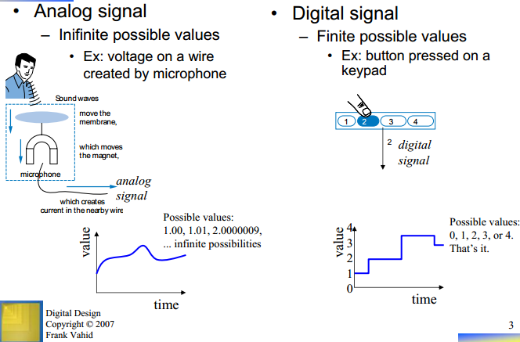
What does “Digital” mean?
Courtesy of Prof. Frank Vahid in UCR

Slide 36
Mapping from physical world to binary world
Technology State 0 State 1
Relay logic Circuit Open Circuit Closed CMOS logic 0.0-1.0 volts 2.0-3.0 volts Transistor transistor logic (TTL) 0.0-0.8 volts 2.0-5.0 volts Fiber Optics Light off Light on
Dynamic RAM Discharged capacitor Charged capacitor
Nonvolatile memory (erasable) Trapped electrons No trapped electrons
Programmable ROM Fuse blown Fuse intact
Bubble memory No magnetic bubble Bubble present
Magnetic disk No flux reversal Flux reversal
Compact disc No pit Pit

Slide 37
Combinational vs. sequential digital circuits
A simple model of a digital system is a unit with inputs and outputs:
Combinational means "memory-less"
a digital circuit is combinational if its output values only depend on its input values
inputs
system
outputs

Slide 38
Combinational logic symbols
Common combinational logic systems have standard symbols called logic gates
Buffer, NOT
AND, NAND
OR, NOR
A
Z
A
Z
easy to implement with CMOS transistors (the switches we have available and use most)
B
A
Z
B

Slide 39
Sequential logic
Sequential systems
exhibit behaviors (output values) that depend not only on the current input values, but also on previous input values
In reality, all real circuits are sequential
because the outputs do not change instantaneously after an input change
why not, and why is it then sequential?
A fundamental abstraction of digital design is to reason (mostly) about steady-state behaviors
look at the outputs only after sufficient time has elapsed for the system to make its required changes and settle down

Slide 40
Synchronous sequential digital systems
Outputs of a combinational circuit depend only on current inputs
after sufficient time has elapsed
Sequential circuits have memory
even after waiting for the transient activity to finish
The steady-state abstraction is so useful that most designers use a form of it when constructing sequential circuits:
the memory of a system is represented as its state
changes in system state are only allowed to occur at specific times controlled by an external periodic clock
the clock period is the time that elapses between state changes. it must be sufficiently long so that the system reaches a steady-state before the next state change at the end of the period

Slide 41
Example of combinational and sequential logic
Combinational:
input A, B
wait for clock edge
observe C
wait for another clock edge
observe C again: will stay the same
Sequential:
input A, B
wait for clock edge
observe C
wait for another clock edge
observe C again: may be different
A
C
B
Clock

Slide 42
Abstractions
Some we've seen already
digital interpretation of analog values
transistors as switches
switches as logic gates
use of a clock to realize a synchronous sequential circuit
Some others we will see
truth tables and Boolean algebra to represent combinational logic
encoding of signals with more than two logical values into binary form
state diagrams to represent sequential logic
hardware description languages to represent digital logic
waveforms to represent temporal behavior

Slide 43
An example
Calendar subsystem: number of days in a month (to control watch display)
used in controlling the display of a wrist-watch LCD screen
inputs: month, leap year flag
outputs: number of days

Slide 44
Implementation in software
integer number_of_days ( month, leap_year_flag) {
switch (month) {
case 1: return (31);
case 2: if (leap_year_flag == 1) then return (29) else return (28);
case 3: return (31);
...
case 12: return (31);
default: return (0);
}
}

Slide 45
Implementation as a combinational digital system
Encoding:
how many bits for each input/output?
binary number for month
four wires for 28, 29, 30, and 31
Behavior:
combinational
truth table specification
month leap d28 d29 d30 d31 0000 – – – – – 0001 – 0 0 0 1 0010 0 1 0 0 0 0010 1 0 1 0 0 0011 – 0 0 0 1 0100 – 0 0 1 0 0101 – 0 0 0 1 0110 – 0 0 1 0 0111 – 0 0 0 1 1000 – 0 0 0 1 1001 – 0 0 1 0 1010 – 0 0 0 1 1011 – 0 0 1 0 1100 – 0 0 0 1 1101 – – – – – 111– – – – – –
month
leap
d28
d29
d30
d31

Slide 46
Combinational example (cont’d)
Truth-table to logic to switches to gates
d28 = 1 when month=0010 and leap=0
d28 = m8'•m4'•m2•m1'•leap'
d31 = 1 when month=0001 or month=0011 or ... month=1100
d31 = (m8'•m4'•m2'•m1) + (m8'•m4'•m2•m1) + ... (m8•m4•m2'•m1')
d31 = can we simplify more?
symbol for not
month leap d28 d29 d30 d31 0001 – 0 0 0 1 0010 0 1 0 0 0 0010 1 0 1 0 0 0011 – 0 0 0 1 0100 – 0 0 1 0 ... 1100 – 0 0 0 1 1101 – – – – – 111– – – – – – 0000 – – – – –
symbol for and
symbol for or
m8
m4
m2
m1

Slide 47
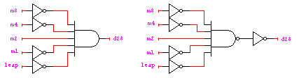
Combinational example (cont’d)
d28 = m8'•m4'•m2•m1'•leap’
d29 = m8'•m4'•m2•m1'•leap
d30 = (m8'•m4•m2'•m1') + (m8'•m4•m2•m1') + (m8•m4'•m2'•m1) + (m8•m4'•m2•m1) = (m8'•m4•m1') + (m8•m4'•m1)
d31 = (m8'•m4'•m2'•m1) + (m8'•m4'•m2•m1) + (m8'•m4•m2'•m1) + (m8'•m4•m2•m1) + (m8•m4'•m2'•m1') + (m8•m4'•m2•m1') + (m8•m4•m2'•m1')

Slide 48
Activity
How much can we simplify d31?
What if we started the months with 0 instead of 1? (i.e., January is 0000 and December is 1011)
d31 is true if: month is 7 or less and odd (1, 3, 5, 7), or month is 8 or more and even (8, 10, 12, and includes 14)
d31 is true if: m8 is 0 and m1 is 1, or m8 is 1 and m1 is 0 d31 = m8’m1 + m8m1’
More complex expression (0, 2, 4, 6, 7, 9, 11):
d31 = m8’m4’m2’m1’ + m8’m4’m2m1’ + m8’m4m2’m1’ + m8’m4m2m1’ + m8’m4m2m1 + m8m4’m2’m1 + m8m4’m2m1
d31 = m8’m1’ + m8’m4m2 + m8m1 (includes 13 and 15)
d31 = (d28 + d29 + d30)’

Slide 49
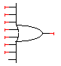
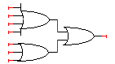
Combinational example (cont’d)
d28 = m8'•m4'•m2•m1'•leap’
d29 = m8'•m4'•m2•m1'•leap
d30 = (m8'•m4•m2'•m1') + (m8'•m4•m2•m1') + (m8•m4'•m2'•m1) + (m8•m4'•m2•m1)
d31 = (m8'•m4'•m2'•m1) + (m8'•m4'•m2•m1) + (m8'•m4•m2'•m1) + (m8'•m4•m2•m1) + (m8•m4'•m2'•m4') + (m8•m4'•m2•m1') + (m8•m4•m2'•m1')

Slide 50
Another example
Door combination lock:
punch in 3 values in sequence and the door opens; if there is an error the lock must be reset; once the door opens the lock must be reset
inputs: sequence of input values, reset
outputs: door open/close
memory: must remember combination or always have it available as an input

Slide 51
Implementation in software
integer combination_lock ( ) {
integer v1, v2, v3;
integer error = 0;
static integer c[3] = 3, 4, 2;
while (!new_value( ));
v1 = read_value( );
if (v1 != c[1]) then error = 1;
while (!new_value( ));
v2 = read_value( );
if (v2 != c[2]) then error = 1;
while (!new_value( ));
v3 = read_value( );
if (v2 != c[3]) then error = 1;
if (error == 1) then return(0); else return (1);
}

Slide 52
Implementation as a sequential digital system
Encoding:
how many bits per input value?
how many values in sequence?
how do we know a new input value is entered?
how do we represent the states of the system?
Behavior:
clock wire tells us when it’s ok to look at inputs (i.e., they have settled after change)
sequential: sequence of values must be entered
sequential: remember if an error occurred
finite-state specification
new
value
reset
state
clock
open/closed

Slide 53
Sequential example (cont’d): abstract control
Finite-state diagram
states: 5 states
represent point in execution of machine
each state has outputs
transitions: 6 from state to state, 5 self transitions, 1 global
changes of state occur when clock says it’s ok
based on value of inputs
inputs: reset, new, results of comparisons
output: open/closed
ERR
closed
C1!=value & new
C2!=value & new
C3!=value & new
S1
S2
S3
OPEN
reset
closed
closed
closed
open
C1=value & new
C2=value & new
C3=value & new
not new
not new
not new

Slide 54
Sequential example (cont’d): data-path vs. control
Internal structure
data-path
storage for combination
comparators
control
finite-state machine controller
control for data-path
state changes controlled by clock
new
equal
reset
value
C1
C2
C3
mux control
multiplexer
controller
clock
comparator
equal
open/closed

Slide 55
Sequential example (cont’d): finite-state machine
Finite-state machine
refine state diagram to include internal structure
ERR
closed
not equal & new
not equal & new
not equal & new
S1
S2
S3
OPEN
reset
closed
mux=C1
closed
mux=C2
closed
mux=C3
open
equal & new
equal & new
equal & new
not new
not new
not new

Slide 56
Sequential example (cont’d): finite-state machine
Finite-state machine
generate state table (much like a truth-table)
ERR
closed
not equal & new
not equal & new
not equal & new
S1
S2
S3
OPEN
reset
closed
mux=C1
equal & new
closed
mux=C2
equal & new
closed
mux=C3
equal & new
open
next
reset new equal state state mux open/closed 1 – – – S1 C1 closed 0 0 – S1 S1 C1 closed 0 1 0 S1 ERR – closed 0 1 1 S1 S2 C2 closed 0 0 – S2 S2 C2 closed 0 1 0 S2 ERR – closed 0 1 1 S2 S3 C3 closed 0 0 – S3 S3 C3 closed 0 1 0 S3 ERR – closed 0 1 1 S3 OPEN – open 0 – – OPEN OPEN – open 0 – – ERR ERR – closed
not new
not new
not new

Slide 57
Sequential example (cont’d): encoding
Encode state table
state can be: S1, S2, S3, OPEN, or ERR
needs at least 3 bits to encode: 000, 001, 010, 011, 100
and as many as 5: 00001, 00010, 00100, 01000, 10000
choose 4 bits: 0001, 0010, 0100, 1000, 0000
output mux can be: C1, C2, or C3
needs 2 to 3 bits to encode
choose 3 bits: 001, 010, 100
output open/closed can be: open or closed
needs 1 or 2 bits to encode
choose 1 bits: 1, 0

Slide 58
Sequential example (cont’d): encoding
Encode state table
state can be: S1, S2, S3, OPEN, or ERR
choose 4 bits: 0001, 0010, 0100, 1000, 0000
output mux can be: C1, C2, or C3
choose 3 bits: 001, 010, 100
output open/closed can be: open or closed
choose 1 bits: 1, 0
next
reset new equal state state mux open/closed 1 – – – 0001 001 0 0 0 – 0001 0001 001 0 0 1 0 0001 0000 – 0 0 1 1 0001 0010 010 0 0 0 – 0010 0010 010 0 0 1 0 0010 0000 – 0 0 1 1 0010 0100 100 0 0 0 – 0100 0100 100 0 0 1 0 0100 0000 – 0 0 1 1 0100 1000 – 1 0 – – 1000 1000 – 1 0 – – 0000 0000 – 0
good choice of encoding!
mux is identical to last 3 bits of state open/closed is identical to first bit of state

Slide 59
Activity
Have lock always wait for 3 key presses exactly before making a decision
remove reset
not new
not new
E2
E3
ERR
closed
new
new
closed
closed
not equal & new
not equal & new
not equal & new
S1
S2
S3
OPEN
closed
mux=C1
closed
mux=C2
closed
mux=C3
open
equal & new
equal & new
equal & new
not new
not new
not new

Slide 60
Sequential example (cont’d): controller implementation
Implementation of the controller
special circuit element, called a register, for remembering inputs
when told to by clock
new
equal
reset
mux control
controller
clock
new
equal
reset
open/closed
mux control
comb. logic
state
clock
open/closed

Slide 61
Design hierarchy
system
data-path
control
code registers
state registers
combinational logic
multiplexer
comparator
register
logic
switching networks

Slide 62
Summary
That was what the entire course is about
converting solutions to problems into combinational and sequential networks effectively organizing the design hierarchically
doing so with a modern set of design tools that lets us handle large designs effectively
taking advantage of optimization opportunities
Now lets do it again
this time we'll take 14 weeks instead of one

