Slide 1
21
Web Servers (IIS and Apache)

Slide 2
Stop abusing my verses, or publish some of your own.
Martial
There are three difficulties in authorship: to write anything worth the publishing, to find honest men to publish it, and to get sensible men to read it.
Charles Caleb Colton
When your Daemon is in charge, do not try to think consciously. Drift, wait and obey.
Rudyard Kipling

Slide 3
OBJECTIVES
In this chapter you will learn:
To understand a web server’s functionality.
To introduce Microsoft Internet Information Services (IIS) and Apache HTTP Server.
To set up virtual directories from which content can be served.
To test whether you set up the virtual directory properly.

Slide 4
21.1 Introduction
21.2 HTTP Transactions
21.3 Multitier Application Architecture
21.4 Client-Side Scripting versus Server-Side Scripting
21.5 Accessing Web Servers

Slide 5
21.1 Introduction
Web server
Responds to client requests by providing resources such as HTML documents
When entering a URL (Uniform Resource Locator) address into a browser
Requesting a specific document from a Web server
Web server and client communicate with the Hypertext Transfer Protocol (HTTP)
A protocol for transferring requests and files between Web servers and Web browsers
Two Web servers
Microsoft Internet Information Services (IIS)
Apache Web server

Slide 6
21.2 HTTP Transactions
The HTTP protocol allows clients and servers to interact and exchange information in a uniform and reliable manner.
HTTP uses URLs to identify data on the Internet.
A URL contains information that directs a browser to the resource that the user wishes to access.
http:// indicates that the resource is to be obtained using the HTTP protocol.

Slide 7
21.2 HTTP Transactions (Cont.)
A hostname (the name of the server ) is translated into an IP address
A unique numerical value which identifies the server much as a telephone number uniquely defines a particular phone line
Translation is performed by a domain name system (DNS) server—a computer that maintains a database of hostnames and their corresponding IP addresses
The process is called a DNS lookup

Slide 8
21.2 HTTP Transactions (Cont.)
The remainder of the URL after the hostname specifies both the name of the requested resource and its path, or location, on the Web server
For security reasons the path normally specifies the location of a virtual directory.
The server translates the virtual directory into a real location on the server (or on another computer on the server’s network), thus hiding the true location of the resource
Some resources are created dynamically and do not reside anywhere on the server

Slide 9
21.2 HTTP Transactions (Cont.)
When given a URL, a web browser performs a simple HTTP transaction to retrieve and display the web page found at that address.
HTTP method get indicates that the client wishes to obtain a resource from the server.
Any server that understands HTTP can receive a get request and respond appropriately.
HTTP status code 200 indicates success. Status code 404 informs the client that the web server could not locate the requested resource.
A complete list of numeric codes indicating the status of an HTTP transaction can be found at www.w3.org/Protocols/rfc2616/rfc2616-sec10.html

Slide 10
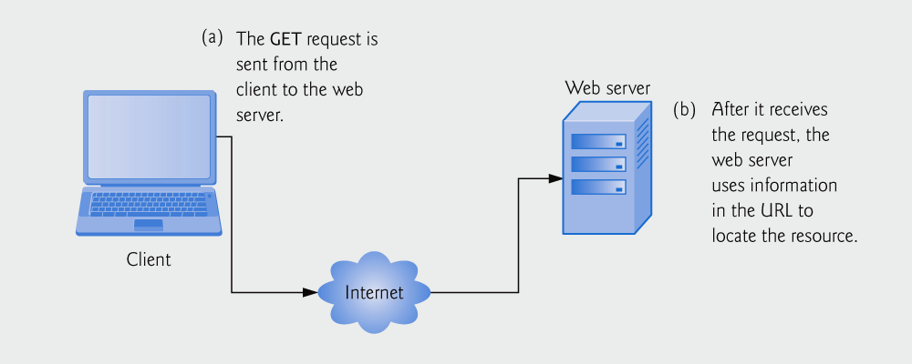
Fig. 21.1 | Client interacting with web server. Step 1: The GET request.

Slide 11
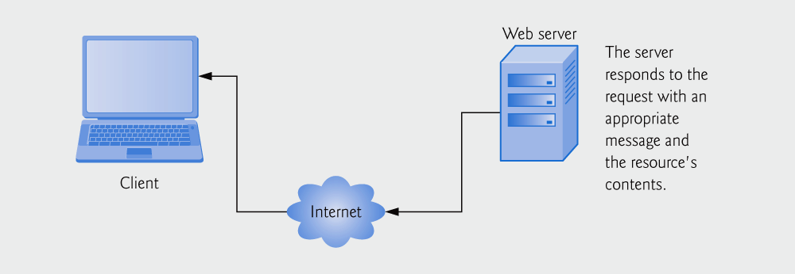
Fig. 21.2 | Client interacting with web server. Step 2: The HTTP response.

Slide 12
21.2 HTTP Request Types
Two most common HTTP request types (or methods)
get request
Typically gets (or retrieves) information from a server.
Common uses of get requests are to retrieve an HTML document or an image, or to fetch search results based on a user-submitted search term.
post request
Typically posts (or sends) data to a server.
Common uses of post requests are to send information to a server, such as authentication information or data from a form that gathers user input.

Slide 13
21.2 HTTP Request Types
Both requests can be used to send form data to a Web server, but differently
Get
Sends information to the server as part of the URL
www.search-engine.com/search?name=value
?: separates the query string from the rest of the URL
search: Name of a server-side form handler
name: Name of a variable in an XHTML form
value: Value assigned to that variable
If more than one name/value pair is submitted, each pair is separated by &
Initiated by submitting a form whose method attribute is set to “get”

Slide 14
21.2 HTTP Request Types
Post
Specified in an HTML form by the method “post”
Sends form data as an HTTP message, not a part of the URL
It is often necessary to send large information using the post method
Because get request limits the query string to 2048 characters
Microsoft Internet Explorer has a maximum URL length of 2083 characters. also has a maximum path length of 2048 characters
Hides the submitted data from the user by embedding it into an HTTP message

Slide 15
21.2 HTTP Request Types
Browsers often cache (save on disk) Web pages, so they can quickly reload the pages
If there are no changes between the last version stored in the cache and the current version on the Web server, this helps speed up the browsing
First ask the server if the document has changed since the last download
If not, load the document from the local cache
Minimize the amount of data that must be downloaded

Slide 16
21.2 HTTP Request Types
However, browsers typically do not cache the server’s response to a post request
Because the next post might not return the same result
E.g., in a survey (many users visit the same Web page and respond to a question. The survey results could be displayed for the user)
Each new response changes the overall results of the survey

Slide 17
Software Engineering Observation 21.1
The data sent in a post request is not part of the URL and the user can’t see the data by default. However there are tools available that expose this data, so you should not assume that the data is secure just because a post request is used.

Slide 18
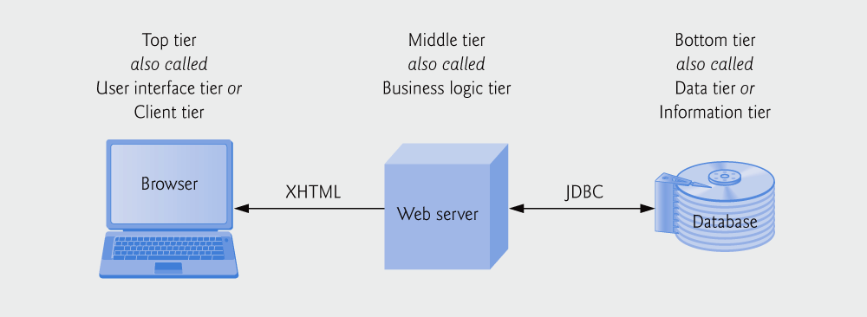
21.3 Multitier Application Architecture
Web-based applications are multitier applications (n-tier application) that divide functionality into separate tiers.
Although tiers can be located on the same computer, the tiers of web-based applications typically reside on separate computers.
Fig. 21.3 | Three-tier architecture.

Slide 19
21.3 Multitier Application Architecture
The bottom tier (also called the data tier or the information tier) maintains the application’s data.
Typically stores data in a relational database management system (RDBMS).
The middle tier implements business logic, controller logic and presentation logic to control interactions between the application’s clients and its data.
Business logic enforces business rules and ensures that data is reliable before the server application updates the database, or presents the data to users.
Business rules dictate how clients can and cannot access application data, and how applications process data.

Slide 20
21.3 Multitier Application Architecture
The top tier (or client tier) is the application’s user interface.
Typically a Web browser
In response to user actions, the client tier interacts with the middle tier to make requests and to retrieve data from the information tier.
The client tier then displays the data retrieved
The client tier never directly interacts with the information tier.

Slide 21
21.4 Client-Side Scripting versus Server-Side Scripting
Client-side scripting can be used
to validate user input, to access the browser, to enhance web pages by manipulating the DOM of a page, and to add Ajax functionality.
Client-side scripting does have limitations, such as browser dependency
The browser must support the scripting language
Client-side scripts can be viewed by the client by using the browser’s source-viewing capability.
Sensitive information, such as passwords or other personally identifiable data, should not be stored or validated on the client

Slide 22
21.4 Client-Side Scripting versus Server-Side Scripting (Cont.)
Server-side scripting languages have a wider range of programmatic capabilities than their client-side equivalents
For example, server-side scripts often can access the server’s file directory structure, whereas client-side scripts cannot access the client’s directories.
Properly configured server-side scripts are not visible to the client
Only HTML and any client-side scripts are visible to the client.

Slide 23
Software Engineering Observation 21.2
Properly configured server-side script source code is not visible to the client; only HTML and any client-side scripts are visible to the client.

Slide 24
21.5 Accessing Web Servers
To request documents from web servers, users must know the hostnames on which the web server software resides.
Users can request documents from local web servers or remote web servers.
Local web servers can be accessed through your computer’s name or through the name localhost
Translates to the IP address 127.0.0.1 (also known as the loopback address).
Remote Web server
Domain name (e.g., yahoo) or Internet Protocol (IP) address

Slide 25
21.5 Accessing Web Servers
Each fully qualified host name (e.g., www.yonsei.ac.kr)
Is assigned to an IP address
Domain name server (DNS)
Maintains a database of host names and their corresponding IP addresses
Translates a fully qualified host name to an IP address
Referred to as DNS lookup
IP address 127.0.0.1
Refers to the local Web server, that is, localhost

