Slide 1
Chapter 26 - PHP
Outline
26.1 Introduction
26.2 PHP
26.3 String Processing and Regular Expressions
26.4 Viewing Client/Server Environment Variables
26.5 Form Processing and Business Logic
26.6 Verifying a Username and Password
26.7 Connecting to a Database
26.8 Cookies
26.9 Dynamic Content in PHP
26.10 Operator Precedence
26.11 Web Resources

Slide 2
Objectives
In this chapter, you will learn:
To understand PHP data types, operators, arrays and control structures.
To understand string processing and regular expressions in PHP.
To construct programs that process form data.
To be able to read and write client data using cookies.
To construct programs that interact with MySQL databases.

Slide 3
26.1 Introduction
PHP
PHP: Hypertext Preprocessor
Originally called “Personal Home Page Tools”
Popular server-side scripting technology
Open-source
Anyone may view, modify and redistribute source code
Supported freely by community
Platform independent

Slide 4
26.2 PHP
Basic application
Scripting delimiters
<? php ?>
Must enclose all script code
Variables preceded by $ symbol
Case-sensitive
End statements with semicolon
Comments
// for single line
/* */ for multiline
Filenames end with .php by convention

Slide 5
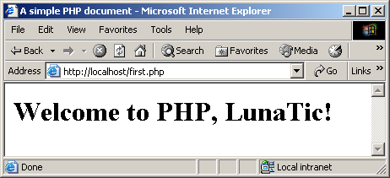
first.php (1 of 1)
Scripting delimiters
Declare variable $name
Single-line comment
Function print outputs the value of variable $name

Slide 6
26.2 PHP
Variables
Can have different types at different times
Variable names inside strings replaced by their value
Type conversions
settype function
Type casting
Concatenation operator
. (period)
Combine strings

Slide 7
26.2 PHP

Slide 8
data.php (1 of 3)
Assign a string to variable $testString
Assign a double to variable $testDouble
Assign an integer to variable $testInteger

Slide 9
data.php (2 of 3)
Print each variable’s value
Call function settype to convert the data type of variable $testString to a double.
Call function settype to convert the data type of variable $testString to an integer.
Convert variable $testString back to a string

Slide 10
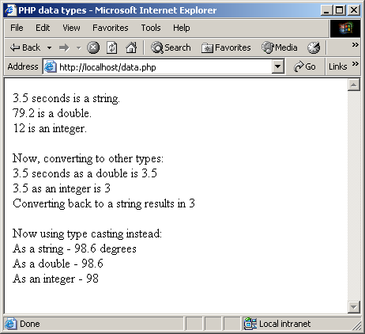
data.php (3 of 3)
Use type casting to cast variable $data to different types

Slide 11
operators.php (1 of 3)
Creates a named constant; Takes two arguments, the name and value of the constant
An optional third argument accepts a boolean value that specifies whether the constant is case insensitive. Constants are case sensitive by default
Add constant VALUE to variable $a.

Slide 12
operators.php (2 of 3)
Multiply variable $a by two using the multiplication assignment operator *=.
Test whether variable $a is less than 50
Add 40 to variable $a using the addition assignment operator +=.

Slide 13
operators.php (3 of 3)
Print an uninitialized variable ($nothing).
Add constant VALUE to an uninitialized variable.
Add a string to an integer.

Slide 14
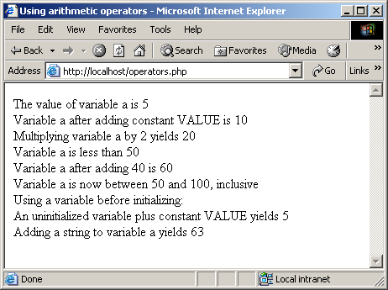
26.2 PHP
Fig. 26.4 Using PHP’s arithmetic operators.

Slide 15
26.2 PHP
Keywords
Reserved for language features
if…elseif…else
Arrays
Group of related data
Elements
Name plus braces and index
Indices start at zero
count function
array function

Slide 16
26.2 PHP
Arrays, cont.
Built-in iterators
Maintain pointer to element currently referenced
reset
key
next
foreach loops

Slide 17
26.2 PHP

Slide 18
arrays.php (1 of 3)
This script demonstrates initializing and manipulating arrays
Create the array $first by assigning a value to an array element.
Assign a value to the array, omitting the index. Appends a new element to the end of the array.
Use a for loop to print out each element’s index and value. Function count returns the total number of elements in the array.
Returns the total number of elements in the array

Slide 19
arrays.php (2 of 3)
Call function array to create an array that contains the arguments passed to it. Store the array in variable $second.
Assign values to non-numerical indices in array $third.
Function reset sets the internal pointer to the first element of the array.
Function key returns the index of the element which the internal pointer references.
Function next moves the internal pointer to the next element.

Slide 20
arrays.php (3 of 3)
Operator => is used in function array to assign each element a string index. The value to the left of the operator is the array index, and the value to the right is the element’s value.

Slide 21
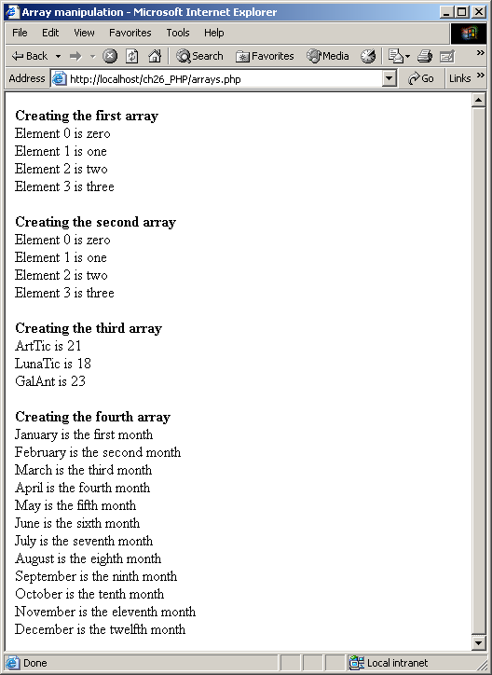
26.2 PHP
Fig. 26.6 Array manipulation.

Slide 22
26.3 String Processing and Regular Expressions
PHP provides several string functions
strcmp function
Returns –1 if string 1 < string 2
Returns 0 if string 1 = string 2
Returns 1 if string 1 > string 2
Relational operators

Slide 23
compare.php (1 of 2)
Use a for loop to iterate through each array element.
Function strcmp compares two strings. If the first string alphabetically precedes the second, then –1 is returned. If the strings are equal, 0 is returned. If the first string alphabetically follows the second, then 1 is returned.

Slide 24
compare.php (2 of 2)
Use relational operators to compare each array element to string “apple”.

Slide 25
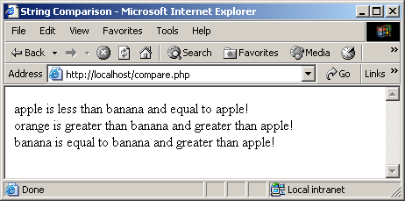
26.3 String Processing and Regular Expressions
Fig. 26.7 Using the string comparison operators.

Slide 26
26.3 String Processing and Regular Expressions
Pattern matching using regular expressions
ereg and preg_match
Use regular expressions to search a string for a specified pattern
ereg
bool ereg ( string pattern, string string [, array regs])
Searches a string for matches to the regular expression given in pattern in a case-sensitive way
Uses POSIX (portable operating system interface) regular expressions

Slide 27
26.3 String Processing and Regular Expressions
ereg (continued)
If matches are found for parenthesized substrings of pattern and the function is called with the third argument regs
the matches will be stored in the elements of the array regs.
$regs[0]: contain a copy of the complete string matched
$regs[1]: contain the substring which starts at the first left parenthesis
$regs[2]: contain the substring starting at the second
Returns the length of the matched string if a match for pattern was found in string, or FALSE otherwise

Slide 28
26.3 String Processing and Regular Expressions
preg_match
Uses Perl regular expressions
More widely used than POSIX regular expressions.
Make it easy migration from Perl to PHP
Often a faster alternative to ereg

Slide 29
expression.php (1 of 3)
This script demonstrates some of PHP’s regular expression capabilities by using function ereg.
Function ereg searches for the literal characters Now inside variable $search.

Slide 30
expression.php (2 of 3)
The caret special character (^) matches the beginning of a string. Function ereg searches the beginning of the string for pattern Now
The dollar sign special character ($) search for the pattern Now at the end of the string.
Search for the first word ending with the letters ow
The special bracket expressions [[:<:]] and [[:>:]] match the beginning and end of a word, respectively
Placing a pattern in parentheses stores the matched string in the array that is specified in the third argument to function ereg.
The pattern used in this example, [[:<:]](t[[:alpha:]]+)[[:>:]], matches any word beginning with the character t followed by one or more characters.
Character class [[:alpha:]] recognizes any alphabetic character. This character class is equivalent to the [a-zA-Z] bracket expression
Function eregi is used to specify case insensitive pattern matches.

Slide 31
expression.php (3 of 3)
After printing a match of a word beginning with t, function ereg_replace is called to remove the word from the string.
This is necessary because, to find multiple instances of a given pattern, the first matched instance must be removed.
Function ereg_replace takes three arguments: the pattern to match, a string to replace the matched string, and the string to search. The modified string is returned

Slide 32
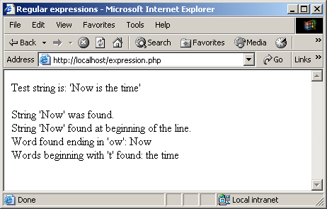
26.3 String Processing and Regular Expressions
Fig. 26.8 Regular expressions in PHP.

Slide 33
26.3 String Processing and Regular Expressions

Slide 34
26.3 String Processing and Regular Expressions

Slide 35
26.4 Viewing Client/Server Environment Variables
Environment variables
Provide information about a script’s environment
Type of Web browser
Type of server
Details of HTTP connection
E.g., PHP stores the client’s environment variables in the $_ENV array

Slide 36
26.4 Viewing Client/Server Environment Variables
Superglobals
$_GET
Variables provided to the script via HTTP GET. Analogous to the old $HTTP_GET_VARS array (still available, but deprecated).
$_POST
Variables provided to the script via HTTP POST. Analogous to the old $HTTP_POST_VARS array (still available, but deprecated).
$_COOKIE
Variables provided to the script via HTTP cookies. Analogous to the old $HTTP_COOKIE_VARS array (still available, but deprecated)
Even though both the superglobal and HTTP_*_VARS can exist at the same time, they are not identical, so modifying one will not change the other

Slide 37
env.php (1 of 1)
This script generates an XHTML document that displays the values of the client’s environment variables in a table
The foreach loop is used to print out the keys and values for each element in the $_ENV array.
PHP stores environment variables and their values in the $_ENV array.

Slide 38
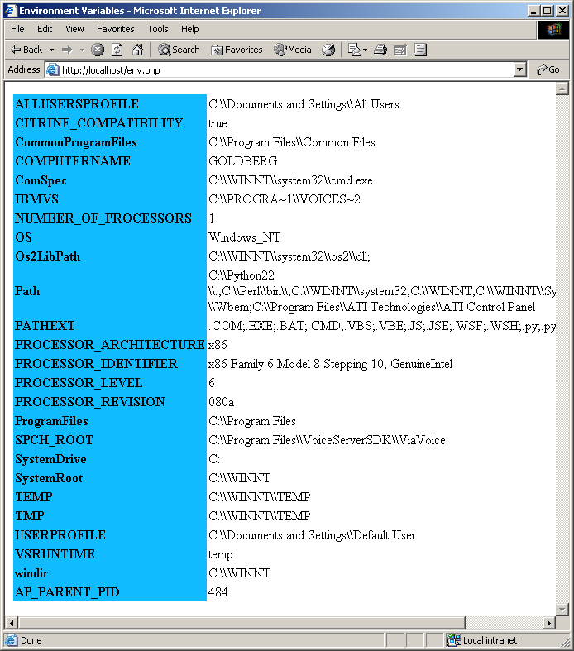
26.4 Viewing Client/Server Environment Variables
Fig. 26.12 Displaying environment variables.

Slide 39
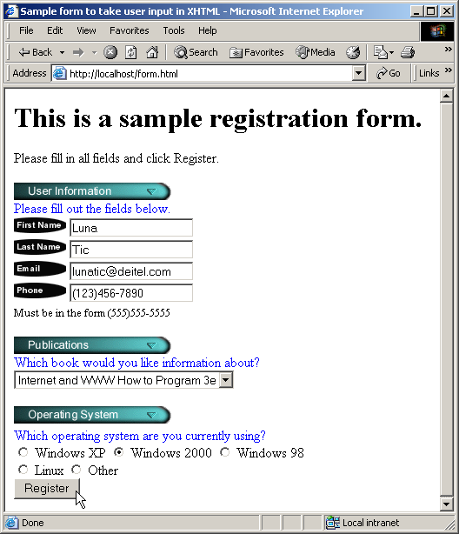
26.5 Form Processing and Business Logic
This document uses an XHTML form to collect information about users for the purpose of adding them to a mailing list
The action attribute of the form element indicates that when the user clicks Register, the form data will be posted to form.php.

Slide 40
form.html (2 of 4)
A unique name (e.g., email) is assigned to each of the form’s input fields. When Register is clicked, each field’s name and value are sent to the Web server.

Slide 41
form.html (3 of 4)

Slide 42
form.html (4 of 4)

Slide 43
26.5 Form Processing and Business Logic
Fig. 26.13 XHTML form for gathering user input.

Slide 44
form.php (1 of 4)
This script implements the business logic (confirms that valid information was entered)
Creates variables corresponding to each key-value pair in array $_POST
Function ereg is called to determine whether the phone number entered by the user is valid.
The expression \( matches the opening parentheses of a phone number. The parentheses in the expression must be followed by three digits ([0-9]{3}), a closing parenthesis, three digits, a literal hyphen and four additional digits.
After having called function extract, we can access the field’s value directly by using variable $phone

Slide 45
form.php (2 of 4)
Function die terminates script execution

Slide 46
form.php (3 of 4)

Slide 47
form.php (4 of 4)

Slide 48
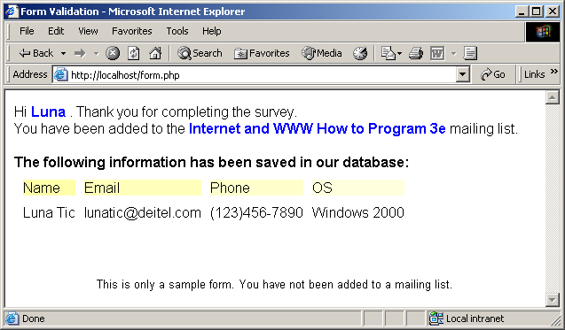
26.5 Form Processing and Business Logic
Fig. 26.14 Obtaining user input through forms.

Slide 49
26.6 Verifying a Username and Password
This XHTML document contains a form that queries the user for a username and a password

Slide 50
password.html (2 of 4)
Posts the fields username and password to the PHP script password.php upon submission of the form

Slide 51
password.html (3 of 4)

Slide 52
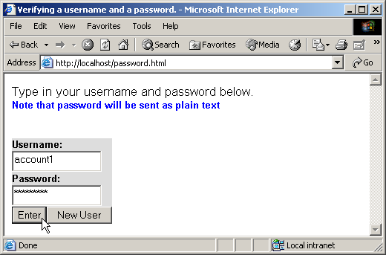
password.html (4 of 4)
Fig. 26.15 XHTML form for obtaining a username and password.

Slide 53
password.php (1 of 7)
The script is responsible for verifying the username and password of the client by crosschecking against values from a simple text file named password.txt
Variable names, when preceded by the logical negation operator (!), return true if they are empty or set to 0. This checks if a user has submitted a form without specifying a username or password.
Function fieldsBlank is called if the user has submitted an incomplete form to notify the user that all form fields must be completed.
Function isset tests whether the user has pressed the New User button, indicating that a new user must be added.
To add a new user, we open the file password.txt in append mode and assign the file handle that is returned to variable $file.

Slide 54
password.php (2 of 7)
Print an error message and terminate script execution if the file cannot be opened.
Function fputs writes the name and password to the text file..
password.txt
Function userAdded is called to print a message to the user to indicate that the username and password were added to the file.

Slide 55
password.php (3 of 7)
Before entering the while loop, variable $userVerified is set to 0.
The while loop executes as long as the there are more lines in the file to read and variable $userVerified is still 0 or empty.
Function fgets reads a line from the text file. The result is assigned to variable $line.
Function chop removes the newline character from the end of the line.
Function split is called to separate the string at the specified delimiter (in this case, a comma). The resulting array is stored in array $field.
The username entered by the user is tested against the one returned in the text file (stored in the first element of the array). If they match, variable $userVerified is set to 1.
Function checkPassword is called to verify the user’s password. Variable $PASSWORD and array $field are passed to the function.
If function checkPassword returns true, function accessGranted is called to notify the client that permission has been granted. Otherwise, function wrongPassword is called.

Slide 56
password.php (4 of 7)
After the while loop has executed, function fclose is called to close the file.
If variable $userVerified has not been set to a value other than 0, function accessDenied is called to notify the client that access has been denied.
Function checkPassword compares the user’s password to the password in the file. If they match, true is returned, whereas false is returned if they do not.

Slide 57
password.php (5 of 7)
Function userAdded prints a message to the client indicating that the user has been added.
Function accessGranted prints a message to the client indicating that permission has been granted.

Slide 58
password.php (6 of 7)
Function wrongPassword prints a message to the client indicating that the password is invalid.
Function accessDenied prints a message to the client indicating that access has been denied.

Slide 59
password.php (7 of 7)
Function fieldsBlank prints a message to the client indicating that all form fields have not been completed.

Slide 60
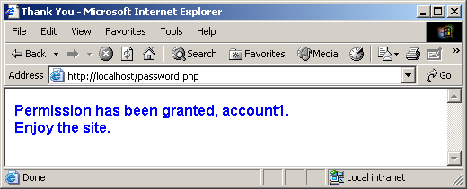
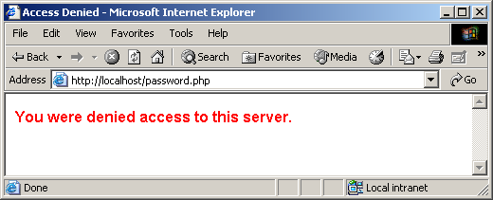
26.6 Verifying a Username and Password
Fig. 26.16 Verifying a username and password.

Slide 61
26.7 Connecting to a Database
PHP offers built-in supports for many databases.
Several useful functions to interact with MySQL databases
mysql_connect
Establishes a connection to a MySQL server
mysql_select_db
Sets the current active database on the server
mysql_query
Sends a query to the currently active database on the server
mysql_error
Returns the error text from the last MySQL function
mysql_fetch_row
Fetches one row of data from the result
mysql_close
Closes the connection to the MySQL server

Slide 62
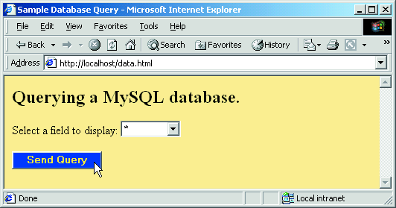
data.html (1 of 2)
In this example, the client selects a database field name that is sent to PHP script database.php.
Fig. 26.18 Form to query a MySQL database.

Slide 63
data.html (2 of 2)
Add a select box to the form, set the name of the select box to select, and set its default selection to *.
This value specifies that all rows are to be retrieved from the database

Slide 64
database.php (1 of 3)
This script is responsible for building an SQL query with the specified field name, querying the database, and sending result sets to the client
Concatenates the posted field name to a SELECT query
Calls function mysql_connect to connect to the MySQL database.
Takes three arguments - the server’s host name, a username and a password
Returns a database handle which represents PHP’s connection to a database.
If this connection is not made, function die is called to terminate script execution

Slide 65
database.php (2 of 3)
Calls function mysql_select_db to specify the database to be queried
To query the database, we call function mysql_query that specifies the query string and the database to query.
This function returns an object that contains the result of the query. This function can also be used to execute SQL statements, such as INSERT or DELETE, that do not return results.
The for loop iterates through each record in the result set while constructing an XHTML table from the results. Variable $counter is incremented by one for each row retrieved.
Function mysql_fetch_row returns an array containing the elements of each row in the result set of our query ($result).

Slide 66
database.php (3 of 3)
The foreach loop iterates through the array containing the elements of each row and prints out each element in an individual table cell.
After all the rows in the results have been displayed, the database is closed

Slide 67
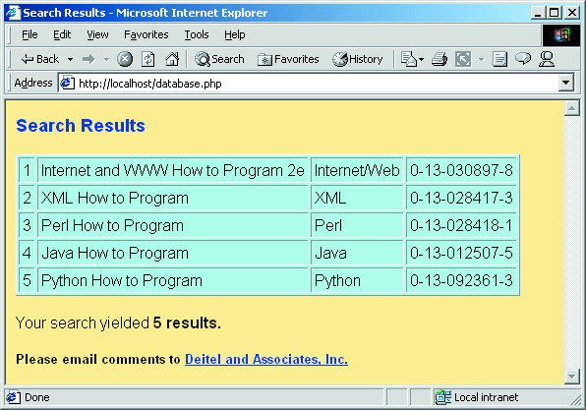
26.7 Connecting to a Database
Fig. 26.19 Querying a database and displaying the results.

Slide 68
26.8 Cookies
Cookie
A text file that a Web site stores on a client’s computer to maintain information about the client
By using cookies
Can record user preferences and other information that we can retrieve during the client’s subsequent visits.

Slide 69
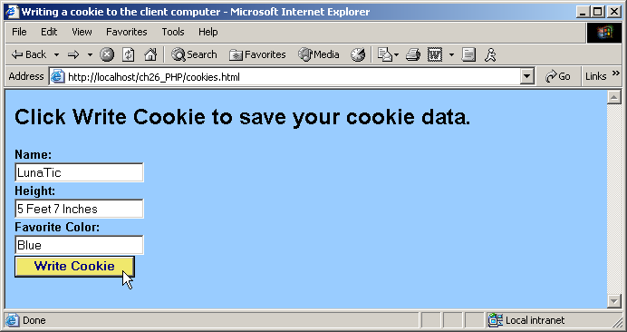
cookies.html (1 of 2)
This example uses a script to write a cookie to the client’s machine
This document displays a form that allows a user to enter a name, height, and favorite color. When the user clicks the Write Cookie button, the script cookies.php executes

Slide 70
cookies.html (2 of 2)

Slide 71
cookies.php (1 of 2)
This script writes cookies to the client
Function setcookie is called to set the cookies to the values passed from the client
Function setcookie takes the name of the cookie to be set as the first argument, followed by the value to be stored in the cookie.
The optional third argument specifies the expiration date of the cookie.

Slide 72
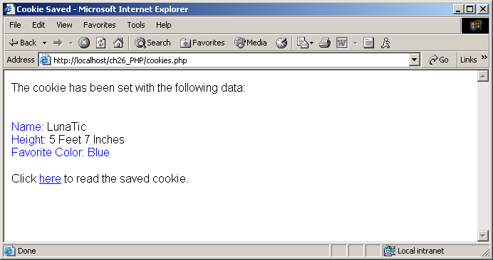
cookies.php (2 of 2)
Each form field’s value is printed to confirm the data that has been set as a cookie with the user.
Hyperlink to readCookies.php.

Slide 73
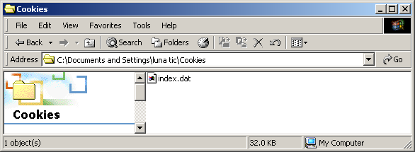
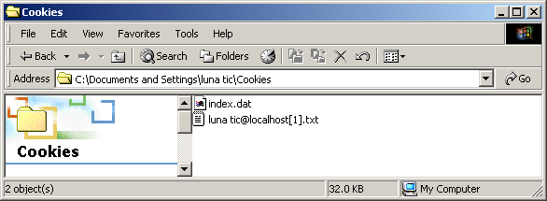
26.8 Cookies
Fig. 26.22 Cookies directory before a cookie is written.
Fig. 26.23 Cookies directory after a cookie is written.

Slide 74
readCookies.php (1 of 2)
This script reads the cookie written by the preceding script by using the superglobal array $_COOKIE that contains all the cookies.

Slide 75
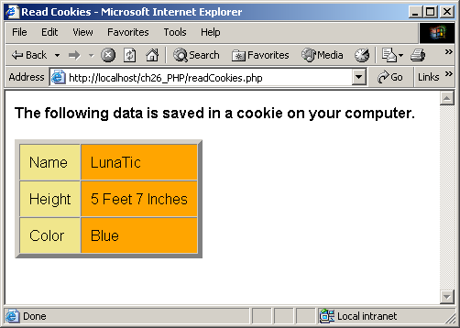
readCookies.php (2 of 2)
The foreach loop iterates through the $_COOKIE array and prints the name and value of each cookie in an XHTML table.
PHP creates array $_COOKIE which contains all cookie values indexed by their names.

Slide 76
26.9 Dynamic Content in PHP
In this section, we build on the example presented in Section 26.5 (Form Processing and Business Logic), combining the XHTML form of Fig. 26.13 and the PHP script of Fig. 26.14 into one dynamic PHP document
Build array of options for the form.

Slide 77
dynamicForm.php (2 of 9)
If the page is being loaded as a result of a form submission, do error checking and then retrieve information from the database.
Check for errors or omissions in form field input.

Slide 78
dynamicForm.php (3 of 9)
If there were no errors, query the MySQL database.
Function quotemeta inserts a backslash before any special characters in the passed string.
In this case, we must use this function so that MySQL does not interpret the parentheses in the phone number as having a special meaning aside from being part of a value to insert into the database

Slide 79
dynamicForm.php (4 of 9)

Slide 80
dynamicForm.php (5 of 9)
Halt the script so the form-generation code does not execute.

Slide 81
dynamicForm.php (6 of 9)
In line 142, we encounter the $$variable notation for specifying variable variables.
PHP permits the use of variable variables to allow developers to reference variables dynamically.
The expression could also be written as ${$variable}.
We can use this expression to obtain the value of the variable whose name is equal to the value of $variable.
For example, if $inputname contains the value “email”, the entire expression evaluates to the value of the variable $email.
If the form input contained errors, place a red asterisk (*) next to the text field.

Slide 82
dynamicForm.php (7 of 9)
Make sure the correct book is selected in the dropdown box.

Slide 83
dynamicForm.php (8 of 9)
Make sure the correct OS is checked in the checkbox.

Slide 84
dynamicForm.php (9 of 9)

Slide 85
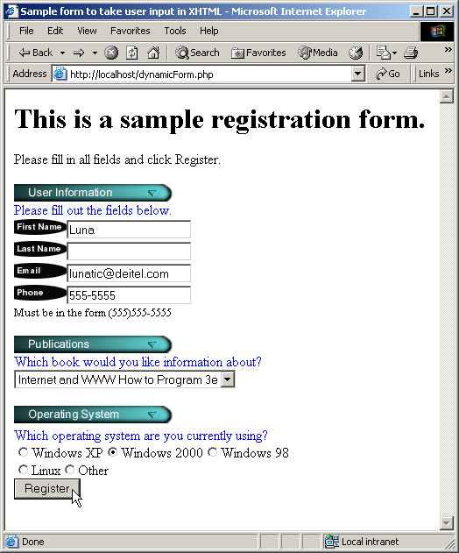
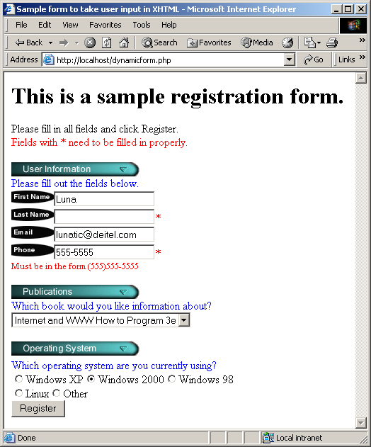
26.9 Dynamic Content in PHP
Fig. 26.25 Dynamic form using PHP.

Slide 86
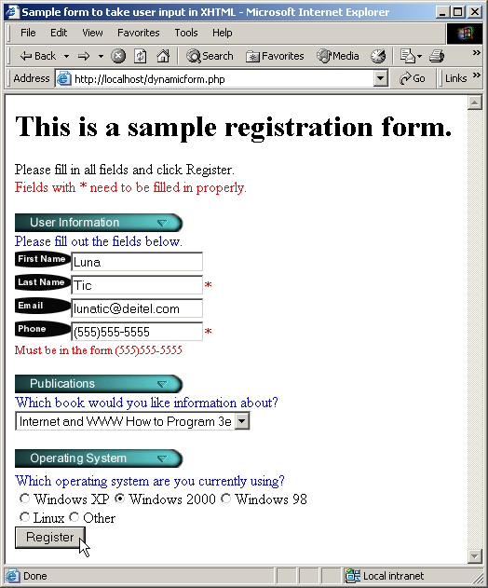
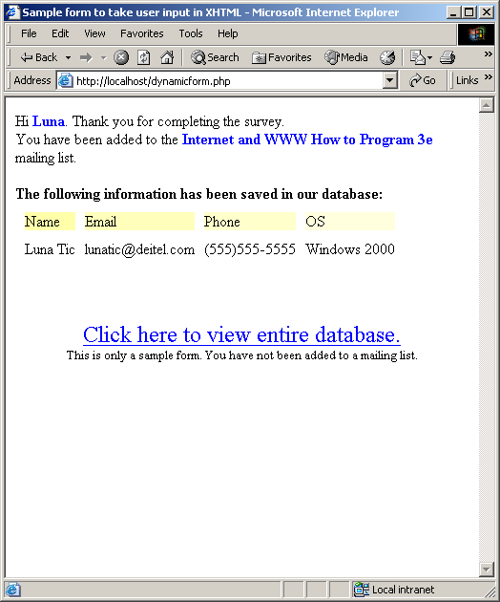
26.9 Dynamic Content in PHP
Fig. 26.25 Dynamic form using PHP.

Slide 87
formDatabase.php (1 of 3)
This script displays the contents of the MailingList database
Build the query string.

Slide 88
formDatabase.php (2 of 3)

Slide 89
formDatabase.php (3 of 3)
Retrieve each mailing list member record from the database.
Dynamically create a table containing each mailing list member.

Slide 90
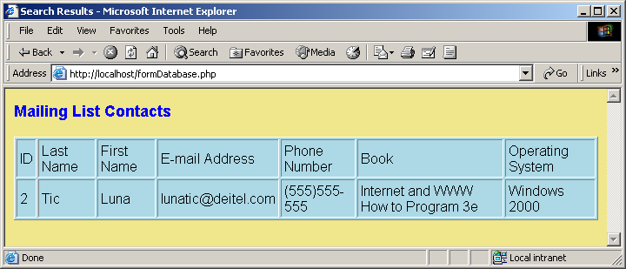
26.9 Dynamic Content in PHP
Fig. 26.26 Displaying the MailingList database.

Slide 91
26.10 Operator Precedence

Slide 92
26.10 Operator Precedence

