Slide 1
12.1 Origins and Uses of PHP
- Origins
- Rasmus Lerdorf - 1994
- Developed to track visitors to his Web site
- PHP is an open-source product
  http://www.php.net/
- PHP is an acronym for Personal Home Page, or
PHP: Hypertext Preprocessor
- PHP is used for form handling, file processing,
and database access

Slide 2
12.2 Overview of PHP
- PHP is a server-side scripting language whose
scripts are embedded in HTML documents
- .php, .php3, .phtml
- Similar to JavaScript, but on the server side
- PHP is an alternative to
- CGI, Active Server Pages (ASP), and JSP
- The PHP processor has two modes of operation:
- copy mode
: copy HTML and client-side scripts to output file
- interpret mode
: interpret PHP script and send the result to output file
- PHP syntax is similar to JavaScript and Perl
- PHP is dynamically typed

Slide 3
12.3 General Syntactic Characteristics
- PHP code can be specified in HTML document
internally or externally:
Internally: <?php ... ?>
Externally: include ‘myScript.inc’
- File can have both PHP and HTML
- copied into the document where the call appears
- If the file has PHP, the PHP must be in
<?php .. ?>, even if the include is already in
<?php .. ?>
http://www.w3schools.com/php/php_includes.asp
- All variable names begin with $
- Variable names are case sensitive
- neither reserved words nor function names are
- Comments - three different kinds (Java and Perl)
- single line: // , #
- multiple line: /* ... */
- Statements are terminated with semicolons
- Compound statements are formed with braces

Slide 4
12.4 Primitives, Operations, and
Expressions
- Eight primitive types:
- Four scalar types: Boolean, integer, double, and
string
- Two compound types: array and object
- Two special types:
- resource (a reference to an external resource
such as opened files & database connections)
- NULL
- Variables
- There are no type declarations
- Unassigned (unbound) variable has the
value, NULL
- The unset function sets a variable to NULL
- The IsSet function is used to determine
whether a variable is NULL
- IsSet ($fruit) returns TRUE if it has non-NULL

Slide 5
12.4 Primitives, Operations, and
Expressions (continued)
- Integer & double are typical
- correspond to long & double types of C
- Strings
- Single character: a string of length one
- String literals use single or double quotes
- Single-quoted string literals
- Embedded variables are NOT interpolated
- Embedded escape sequences are NOT recognized
- Double-quoted string literals
- Embedded variables ARE interpolated
- If there is a variable name in a double-
quoted string but you don’t want it
interpolated, it must be backslashed
- Embedded escape sequences ARE recognized
- For both single- and double-quoted literal strings,
embedded delimiters must be backslashed

Slide 6
12.4 Primitives, Operations, and
Expressions (continued)
- Boolean - values are true and false (case
insensitive)
- 0 and "" and "0" are false; others are true
- Arithmetic Operators and Expressions
- If the result of integer division is not an integer,
a double is returned
- Any integer operation that results in integer overflow
produces a double
- The modulus operator (%) coerces its operands to
integer.

Slide 7
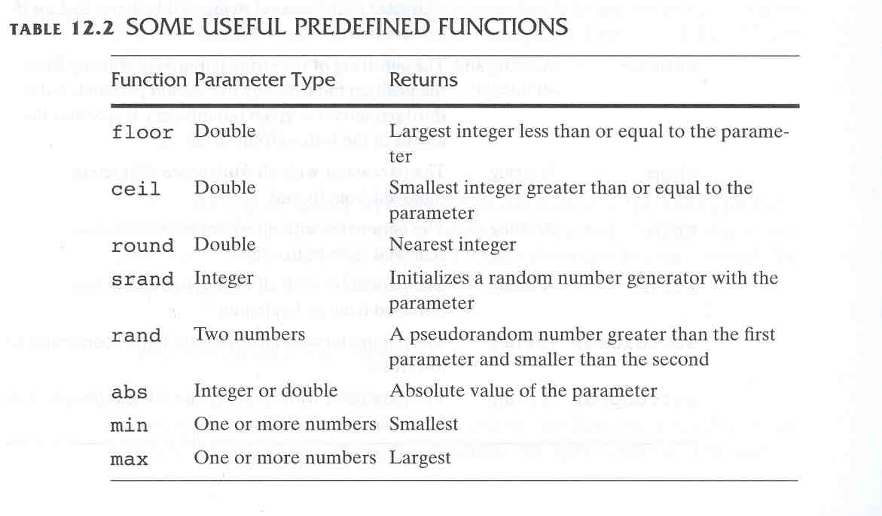
12.4 Primitives, Operations, and
Expressions (continued)

Slide 8
12.4 Primitives, Operations, and
Expressions (continued)
- String Operations and Functions
- The only operator is period (.), for catenation
- Indexing : braces
- $str = “apple”, $str{3} is the fourth character, “l”

Slide 9
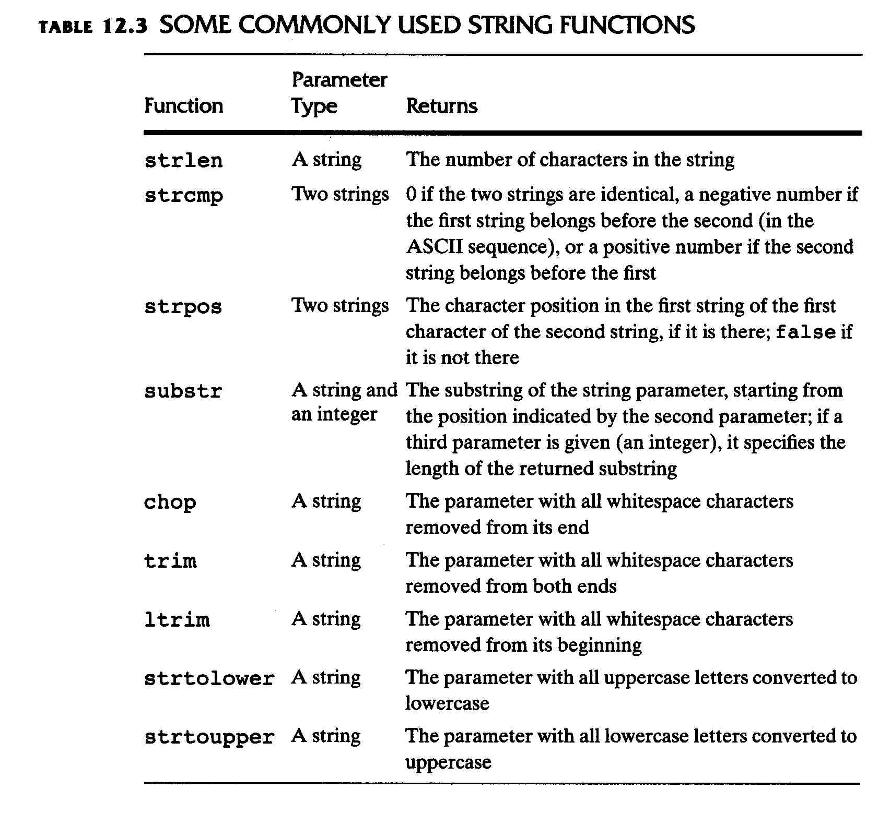
12.4 Primitives, Operations, and
Expressions (continued)

Slide 10
12.4 Primitives, Operations, and
Expressions (continued)
- Scalar Type Conversions
- String to numeric – coercions
- If the string contains a period, e, or E,
- converted to double; otherwise to integer
- If the string does not begin with a sign or a
digit
- zero is used
- Explicit conversions – casts
- e.g., (int)$total or intval($total) or
settype($total, "integer")
- The type of a variable can be determined with
gettype or is_type (is_int, is_integer, is_long)
gettype($total) - it may return a string or "unknown"
is_integer($total) – return Boolean value

Slide 11
12.5 Output
- Output from a PHP script: HTML
- HTML is sent to the browser through standard output
- Three ways to produce output:
- echo, print, printf
- echo : with or without parentheses
- if parentheses, only a single string parameter
echo “whatever <br />”, “Apples <br />”; # legal
echo(“first <br />”, “Apples <br />”) # illeal
- print take one parameter
print "Welcome to my site!";
- printf is exactly like its counterpart in C

Slide 12
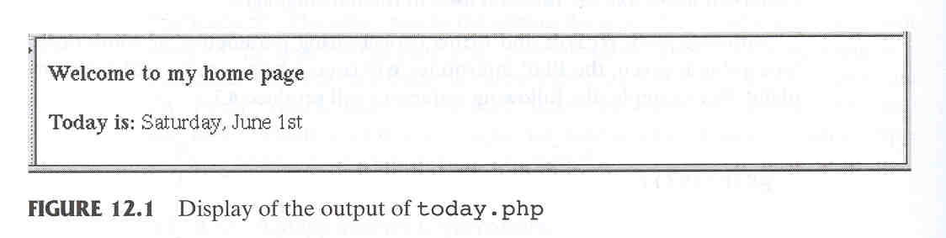
12.5 Output (continued)
- A PHP code block can be placed anywhere
in the HTML document
- An Example: today.php
<html>
<head><title> Trivial php example </title>
</head>
<body>
<?php
print “<b>Welcome to my Web site<br /> <br />”;
print “Today is: <b/>”;
print date(“l, F jS”);
# l (day of the week), F(month), j(day)S(suffix for the day)
print “<br />”;
?>
</body>
</html>

Slide 13
12.6 Control Statements
- Control Expressions
- Relational operators - same as JavaScript,
(including === [same value AND same type]
and !==)
- Boolean operators - same as Perl (two sets, &&
and and, etc.)
- Selection statements
- if, if-else, elseif
- switch - as in C
- The switch expression type must be integer,
double, or string
- while - just like C
- do-while - just like C
- for - just like C
- foreach - discussed later

Slide 14
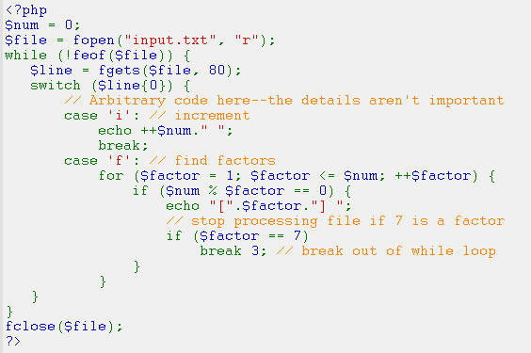
12.6 Control Statements (continued)
- break - in any for, foreach, while, do-while, or
switch
  break n: break out of n enclosing blocks
- continue - in any loop
continue n: tells how many levels of enclosing loops
it should skip to the end of

Slide 15
12.6 Control Statements (continued)
- Alternative compound delimiters – more readability
- endif, endswitch, endfor, endwhile
if(...):
...
endif;
- HTML can be intermingled with PHP script
<?php
$a = 7;
$b = 7;
if ($a == $b) {
$a = 3 * $a;
?>
<br /> At this point, $a and $b are equal <br />
So, we change $a to three times $a
<?php
}
?>

Slide 16
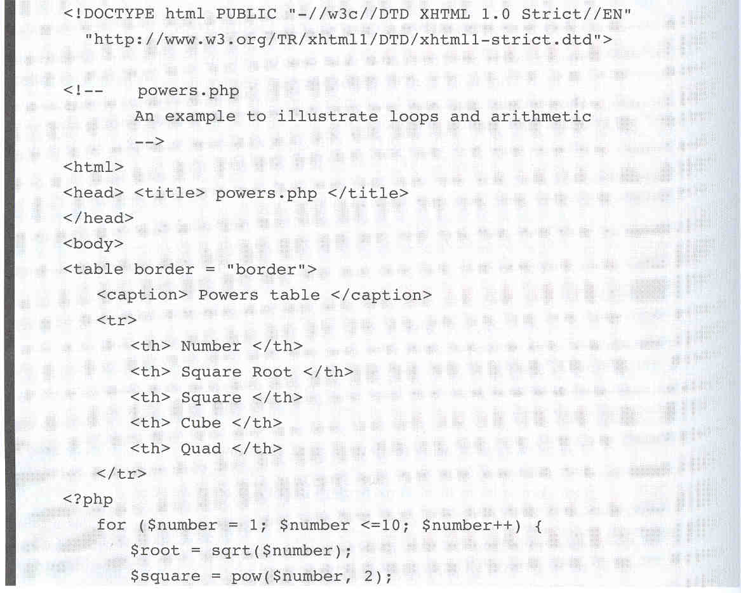
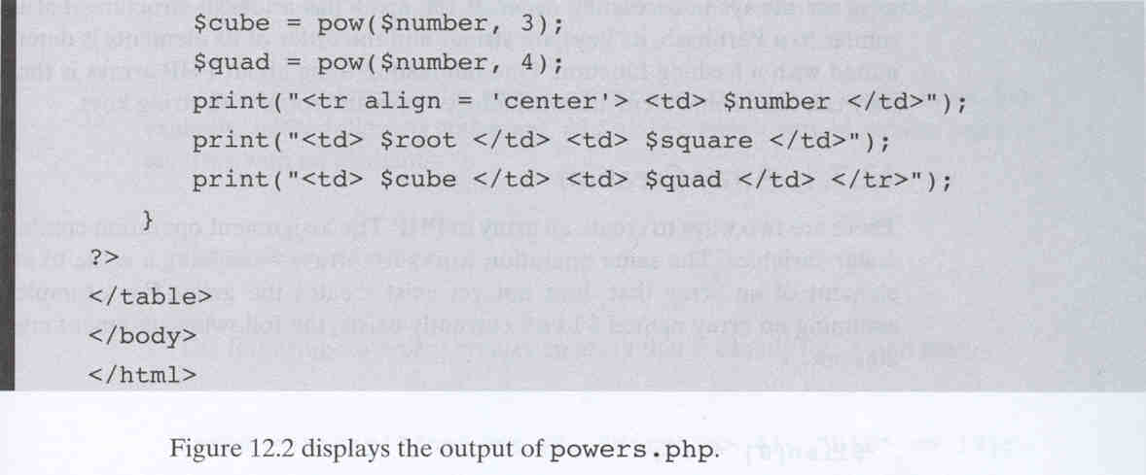
12.6 Control Statements (continued)

Slide 17
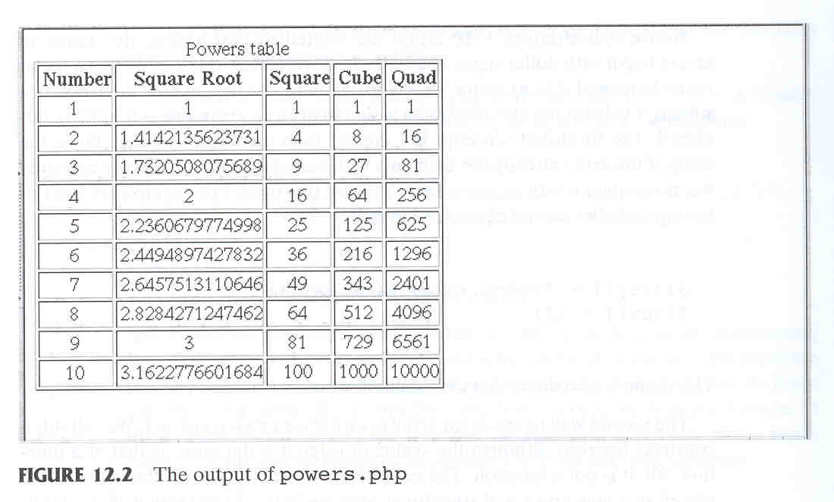
12.6 Control Statements (continued)

Slide 18
12.7 Arrays
- Not like JavaScript
- PHP array is
- array of typical language + hash of Perl
- element: key & value
- keys can be numbers (to get a
traditional array) or strings (to get a hash)

Slide 19
12.7 Arrays
- Array creation: two ways
1. Assignment operation
$list[0] = 17;
- If a key is omitted and there have been integer
keys, the default key will be the largest
current key + 1
$list[1] = “Today”;
$list[] = 42; # key will be 2
- If a key is omitted and there have been no
integer keys, 0 is the default key

Slide 20
12.7 Arrays
- Array creation: two ways (continued)
2. Use the array() construct
- key => value pairs or values as parameters
$list = array(1, 3, 5, 7, 9);
# same as $list = array(0=>1, 1=>3, 2=>5,3=>7, 4=>9);
- keys: non-negative integer or string literals
- values can be anything
e.g., $list = array(0 => "apples",
1 => "oranges",
2 => "grapes")
- This is a “regular” array of strings

Slide 21
12.7 Arrays (continued)
- Arrays can have mixed kinds of elements
- e.g.,
$list = array("make" => "Cessna",
"model" => "C210",
"year" => 1960,
3 => "sold");
$list = array(5, 3 => 7, 5 => 10,
"month" => "May");

Slide 22
12.7 Arrays (continued)
- Accessing array elements – use brackets
$list[4] = 7;
$list["day"] = "Tuesday";
$list[] = 17;
- If an element with the specified key does not
exist, it is created
- If the array does not exist, the array is created
- The keys or values can be extracted from an array
$highs = array("Mon" => 74, "Tue" => 70,
"Wed" => 67, "Thu" => 62,
"Fri" => 65);
$days = array_keys($highs);
$temps = array_values($highs);
- Dealing with Arrays
- An array can be deleted with unset
unset($list);
unset($list[4]); # No index 4 element now

Slide 23
12.7 Arrays (continued)
- Dealing with Arrays (continued)
- is_array($list) returns true if $list is a
array
- in_array — checks if a value exists in an array
e.g., in_array(17, $list) returns true if 17 is an
element of $list
- Conversion between strings and arrays
  - explode(" ", $str) explodes a string into substrings
  and returns them in array
  $str = “April in Paris, Texas is nice”;
  $words = explode(" ", $str)
  - implode(" ", $list)
  $words = array(“April”,“in”, “Paris”);
  $str = implode(" ", $words)
  - creates a string of the elements from $words,
  separated by a space

Slide 24
12.7 Arrays (continued)
- Sequential access to array elements
- current and next
- current pointer is initialized to reference the first
element of the array at the time the array is created
$colors = array(“blue", "red", "green", "yellow");
$color = current($colors);
print("$color <br />"); # blue
while ($color = next($colors))
print ("$color <br />");
- This does not always work – for example, if the
value in the array happens to be FALSE
- Alternative: each, instead of next
while ($element = each($colors)) {
$name = $element[“key”];
$color = $element[“value”];
print ("$color <br />");
}

Slide 25
12.7 Arrays (continued)
- The prev function moves current backwards
  - FALSE if there are no more elements
- reset: set the current pointer to the first element
- array_push and array_pop
- Used to implement stacks in arrays
- Push one or more elements onto the end of array
- Pop the element off the end of array
- array_unshift and array_shift
- Prepend passed elements to the front of the array
- Shift the first value of the array off and returns it
- All numerical keys will be modified to start
counting from zero while literal keys won't be touched

Slide 26
12.7 Arrays (continued)
- foreach (array_name as scalar_variable) { ... }
foreach ($colors as $color) {
print "Is $color your favorite?<br /> ";
}
Is blue your favorite color?
Is red your favorite color?
Is green your favorite color?
Is yellow your favorite color?
- foreach can iterate through both keys and values:
- foreach (array_name as key=>value) { ... }
$lows = array(“Mon”=>23, “Tue” =>18, “Wed”=>27);
foreach ($lows as $day=>$temp) {
print “The low temperature on $day was $temp<br /> ";
}

Slide 27
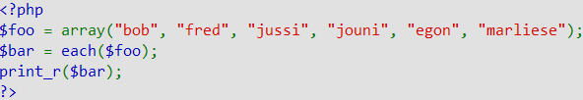
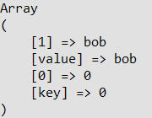
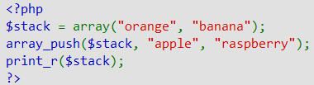
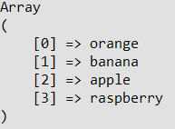
12.7 Arrays (continued)
- Example: each()
$bar now contains the following key/value pairs:
- Example: array_push()
The above example will output:

Slide 28
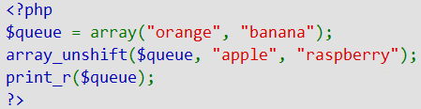
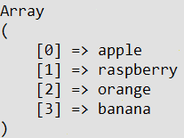
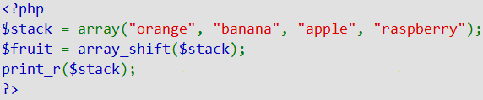
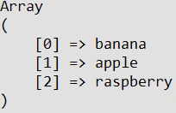
12.7 Arrays (continued)
- Example: array_unshift()
The above example will output:
- Example: array_shift()
The above example will output:

Slide 29
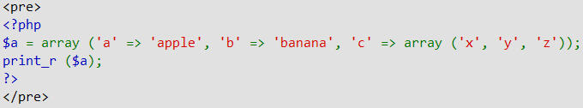
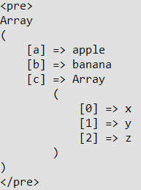
12.7 Arrays (continued)
- print_r ()
- prints human-readable information about a variable
- the above example will output:

Slide 30
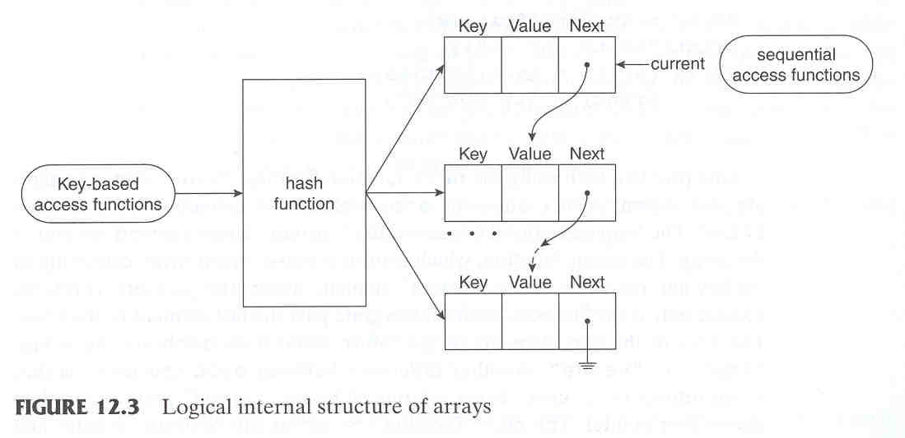
12.7 Arrays (continued)

Slide 31
12.7 Arrays (continued)
- sort
- sorts the values, replacing the keys (0,1,2,..)
- strings migrate to the beginning in alphabetical order
numbers follow in ascending order
e.g., sort($list);
- Works for both strings and numbers, even
mixed strings and numbers
$list = ('h', 100, 'c', 20, 'a');
sort($list);
// Produces ('a', 'c', 'h’, 20, 100)
- After PHP 4, the sort function can take a second
parameter, which specifies a particular kind of
sort
sort($list, SORT_NUMERIC);
- sort numeric values without sorting strings,
but string values are moved to the beginning

Slide 32
12.6 Arrays (continued)
- rsort: sort the values of an array in reverse order
- asort
- keep the original key/value relationships
- intended for hashes (associative array)
$fruits = array("d" => "lemon", "a" => "orange",
"b" => "banana", "c" => "apple");
asort($fruits);
foreach ($fruits as $key => $val) {echo "$key = $val ";}
➔ c = apple b = banana d = lemon a = orange
- arsort: reverse version of asort
- ksort: sort the elements of an array by the keys,
maintaining the key/value relationships (mainly for
associative arrays )
$list("Fred" => 17, "Mary" => 21,"Bob" => 49, "Jill" =>28);
ksort($list);
// $list is now ("Bob" => 49,"Fred" => 17,
// "Jill" => 28, "Mary" => 21)
- krsort
- To sort the elements of an array by the keys
into reverse order

Slide 33
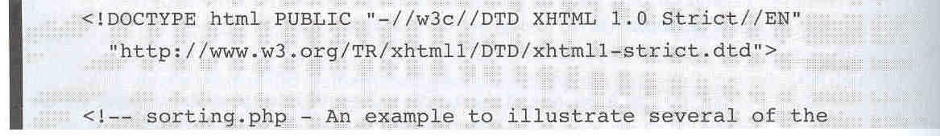
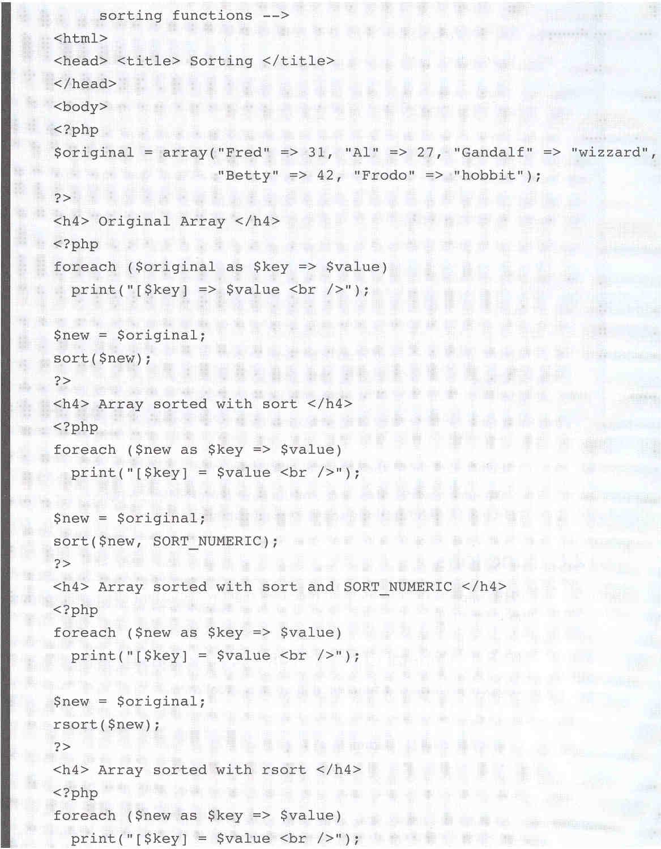

Slide 34
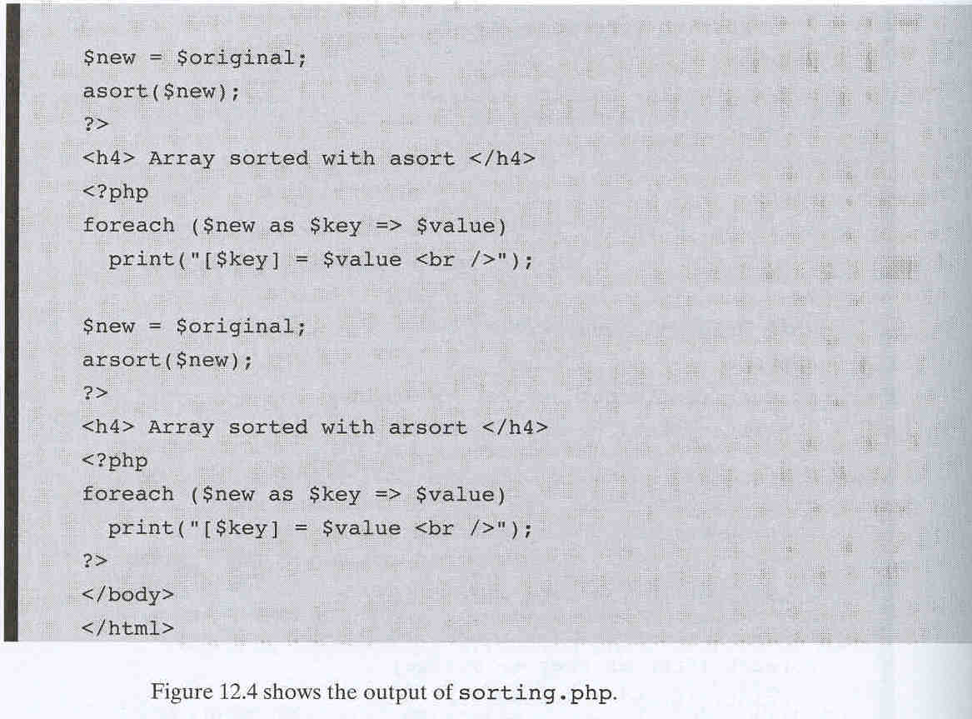

Slide 35
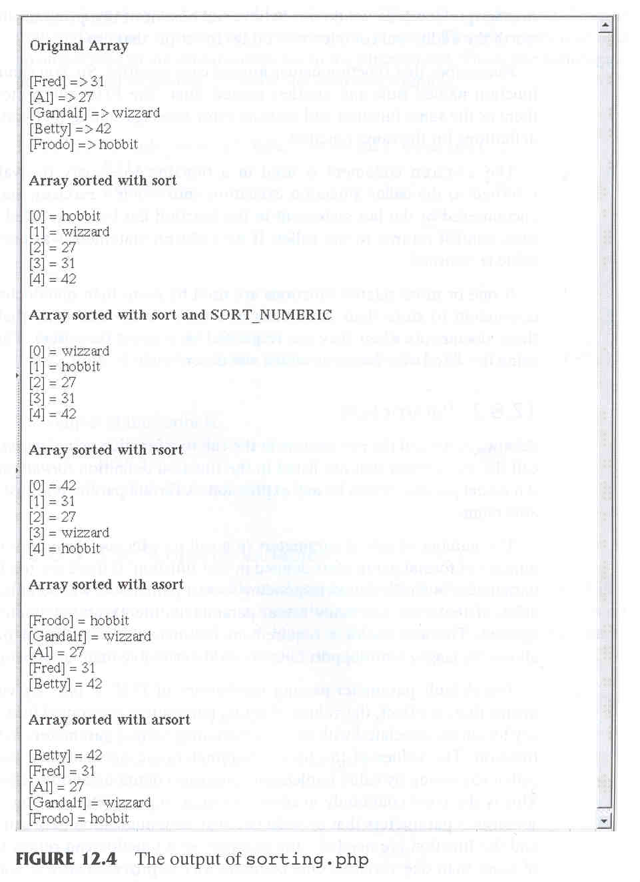

Slide 36
12.8 User-Defined Functions
- Syntactic form:
function function_name(formal_parameters) {
…
}
- General Characteristics
- Functions need not be defined before
they are called (in PHP 3, they must)
- Function overloading is not supported
- If you try to redefine a function, it is an error
- Function definitions can be nested
- Function names are NOT case sensitive
- The return function is used to return a value;
If there is no return, there is no returned value

Slide 37
12.8 User-Defined Functions (continued)
- Parameters
- number of actual parameters,
- too few actual parameters: unbound variables
- too many actual parameters: ignored
- default parameter passing method is
- pass by value (one-way communication)
- To specify pass-by-reference, prepend an
ampersand to the formal parameter
function addOne(&$param) {
$param++;
}
$it = 16;
addOne($it); // $it is now 17
- If the function does not specify its parameter to be
pass by reference, you can prepend an ampersand
to the actual parameter and still get pass-by-
reference semantics
function subOne($param) { $param--; }
$it = 16;
subOne(&$it); // $it is now 15

Slide 38
12.8 User-Defined Functions (continued)
- Scope of Variables
- Default scope of a variable used in a function: local
- In PHP global variables must be declared global
inside a function if they are going to be used in
that function
<?php
$a = 1; /* global scope */
function test()
{ echo $a; /* reference to local scope variable */}
test();
?>
➔ This script will not produce any output
(different from C in that global variables in C are
automatically available to functions unless specifically
overridden by a local definition)
- To access a nonlocal variable, it must be declared
to be global, as in
$a = 1; /* global scope */
function test()
{ global $a;
…

Slide 39
12.8 User-Defined Functions (continued)
- Lifetime of Variables
- Normally, the lifetime of a variable in a function is
from its first appearance to the end of the
function’s execution
- To support history sensitivity, static local variable
- end when the script execution ends
(when the browser leaves the document)
static sum = 0; # sum is a static variable

Slide 40
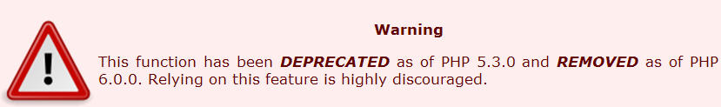
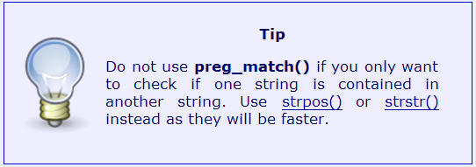
12.9 Pattern Matching
- PHP has two kinds of string pattern matching:
- POSIX regular expression: ereg (교과서)
- Perl regular expression: preg_match
preg_match(regex, str [,array])
- The optional array is where to put the matches
- Note: preg_match() uses a Perl-compatible regular
expression syntax, is often a faster alternative to ereg()
if (preg_match(“/^PHP/”, $str)
print (“\$str begins with PHP <br />”);
else
print (“\$str does not begins with PHP <br />”);

Slide 41
12.9 Pattern Matching
- Metacharacters:
\ | ( ) [ ] { } ^ $ * + ? .
- Metacharacters can match themselves if they are
backslashed
- Meta-characters outside square brackets
\ escape character
^ assert start of line
$ assert end of line
. match any character except newline
/a.b/ matches "aab", "abb", "acb", ...
[ start character class
] end character class
| start of alternative branch
( start subpattern
) end subpattern
? extends the meaning of (, also 0 or 1 quantifier
* 0 or more quantifier
+ 1 or more quantifier
{ start min/max quantifier
} end min/max quantifier
- Meta-characters inside square brackets (character class)
\ escape character
^ negate the class, but only if the first character
- indicates character range

Slide 42
12.9 Pattern Matching (continued)
- A character class is a string in brackets
[abc] means a | b | c
- A dash can be used to specify a range of
characters
[A-Za-z]
- If a character class begins with a circumflex,
it means the opposite
[^A-Z] matches any character except an
uppercase letter
- Predefined character classes:
Name Equivalent Pattern Matches
\d [0-9] a digit
\D [^0-9] not a digit
\w [A-Za-z_0-9] a word character
\W [^A-Za-z_0-9] not a word character
\s [ \r\t\n\f] a whitespace character
\S [^ \r\t\n\f] not a whitespace character

Slide 43
12.9 Pattern Matching (continued)
- Pattern Quantifiers (Repetition)
- pattern{n} means repeat the pattern n times
/a{5}bc{5}/
- pattern* means repeat the pattern zero or more
times
/a*bc*/
- pattern+ means repeat the pattern 1 or more
times
- pattern? means zero or one match
/\d*b?c+/

Slide 44
12.9 Pattern Matching (continued)
- Subpatterns are delimited by parentheses
- localizes a set of alternatives
cat(aract|erpillar|) matches "cat", "cataract", or "caterpillar”
Without the parentheses, matches "cataract", "erpillar"
or the empty string
- if the string "the red king" is matched against the pattern
((red|white) (king|queen)),
the captured substrings are "red king", "red", and "king
- If an opening parenthesis is followed by "?:",
the subpattern does not do any capturing
if "the white queen" is matched against
((?:red|white) (king|queen)), the captured substrings are
"white queen" and "queen”

Slide 45
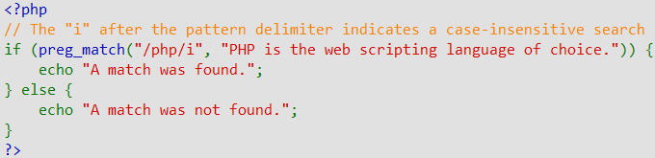
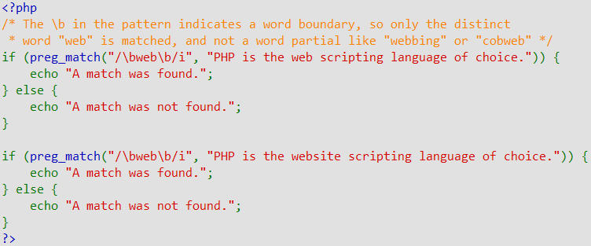
12.9 Pattern Matching
- Example: find the string of text "php“
- Example: find the word "web"

Slide 46
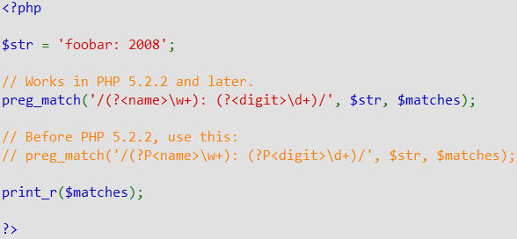
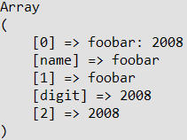
12.9 Pattern Matching
- Example: using named subpattern
- The above example will output:

Slide 47
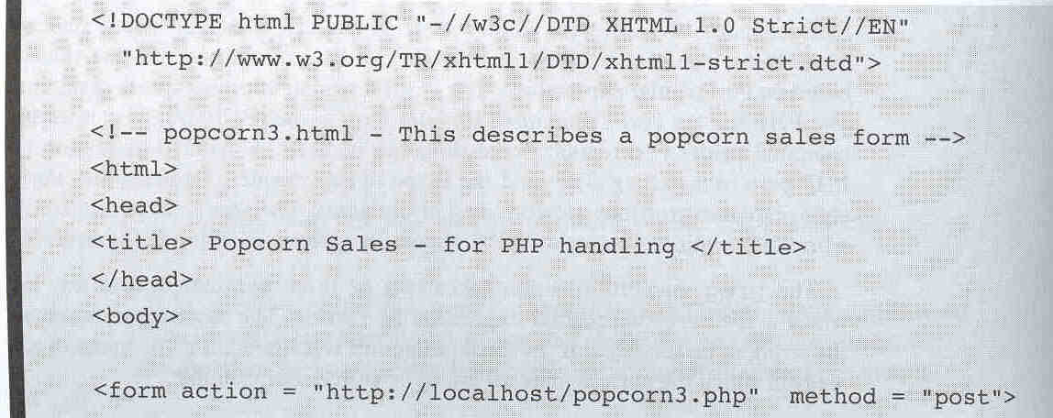
12.10 Form Handling
- Simpler than either CGI or servlets
- PHP particulars:
- It does not matter whether GET or POST method
is used to transmit the form data
- PHP builds a variable for each form element with
the same name as the element
  register_globals (PHP.ini): REMOVED as of PHP 5.4.0.
  if a form has a text element whose name is phone,
  the value is implicitly placed in a variable $phone

Slide 48
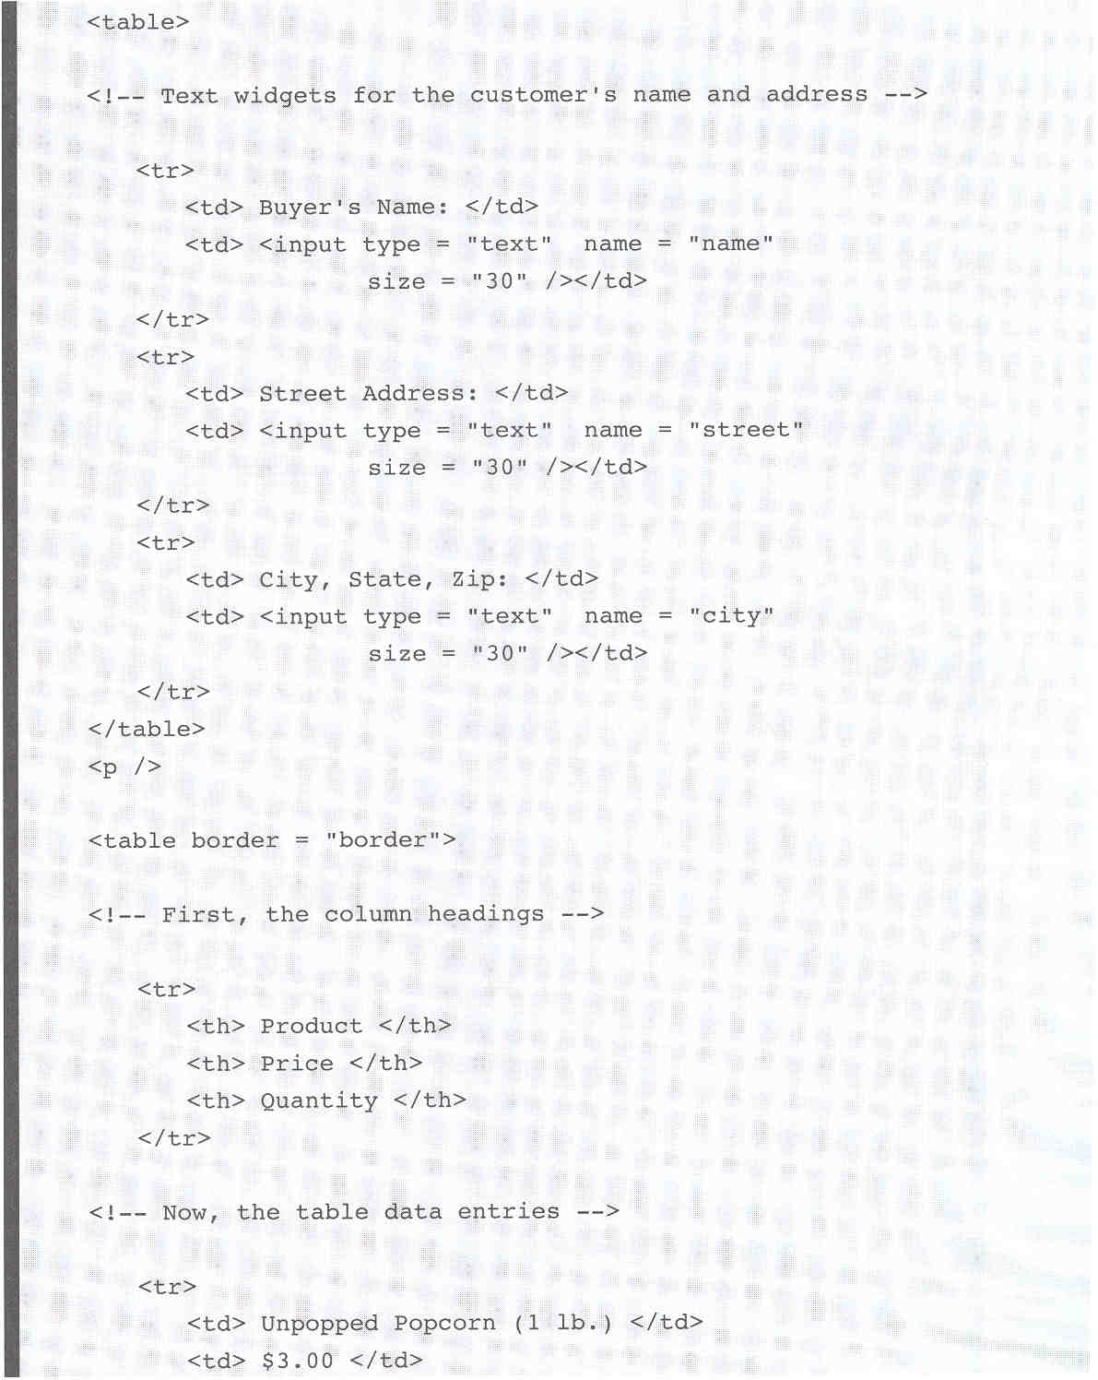

Slide 49
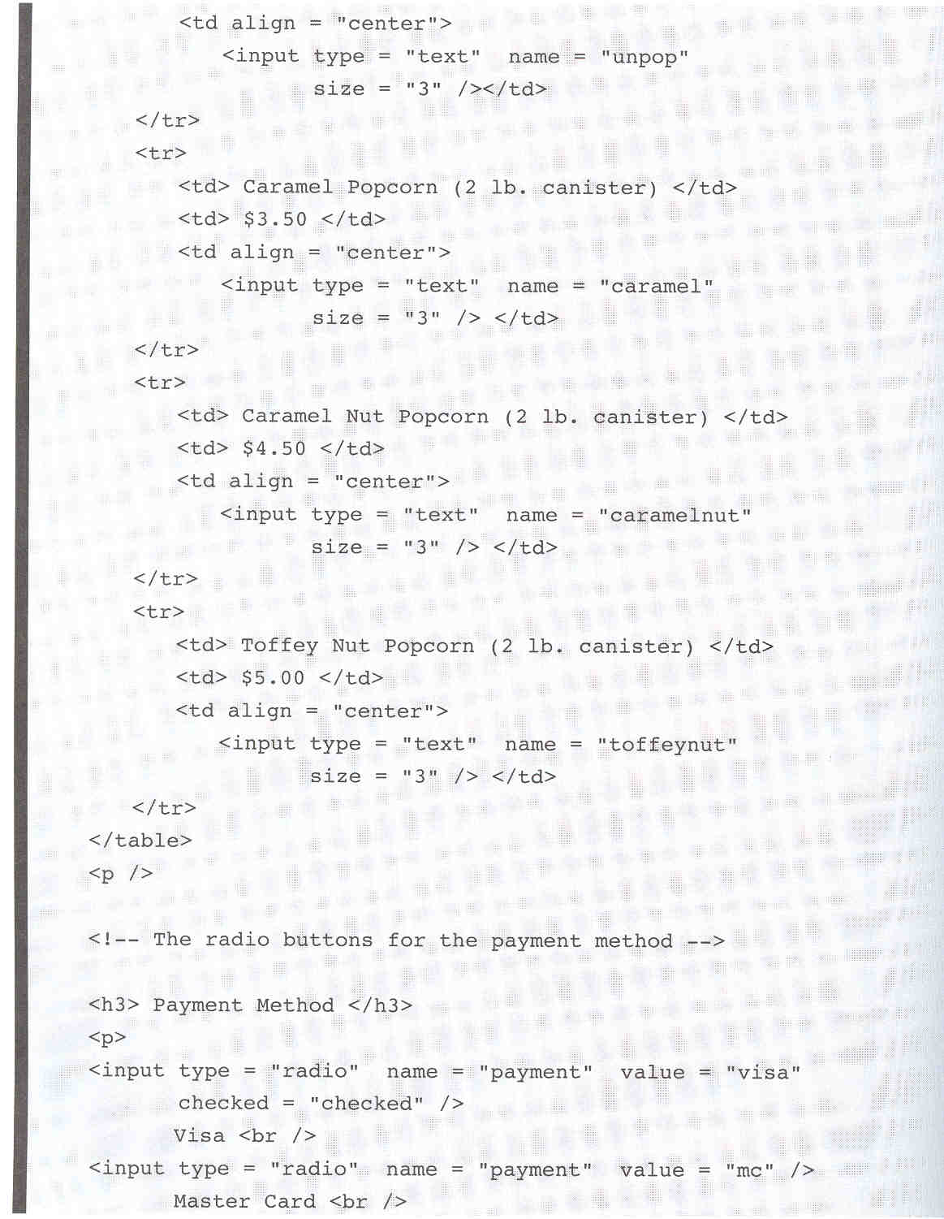

Slide 50
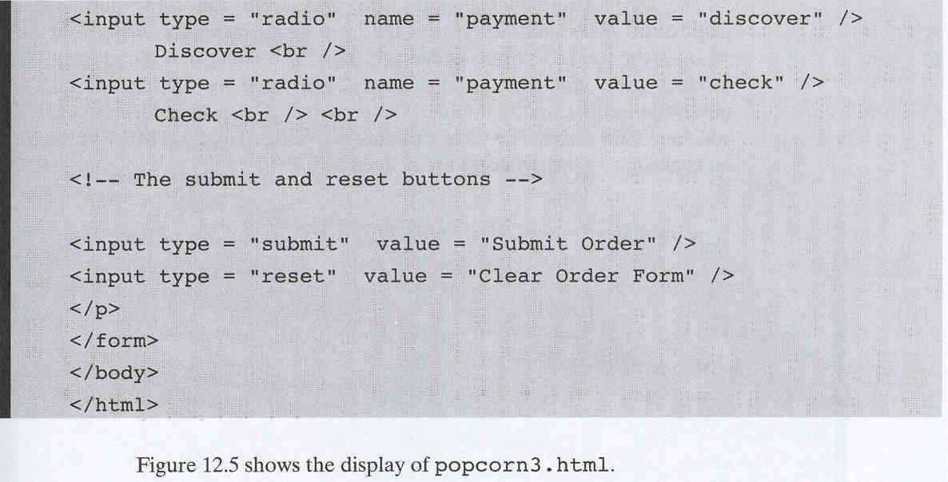
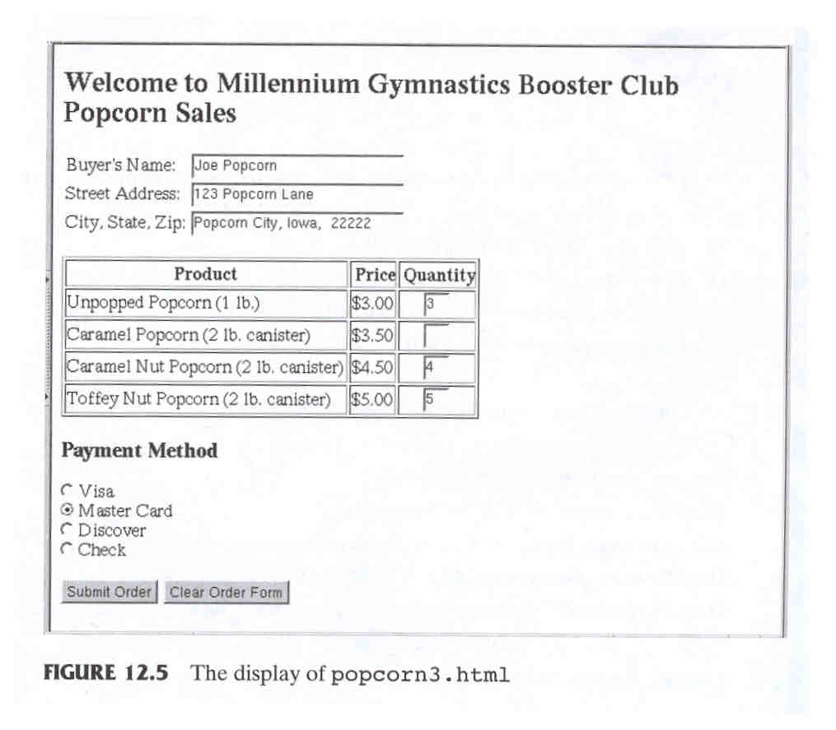

Slide 51
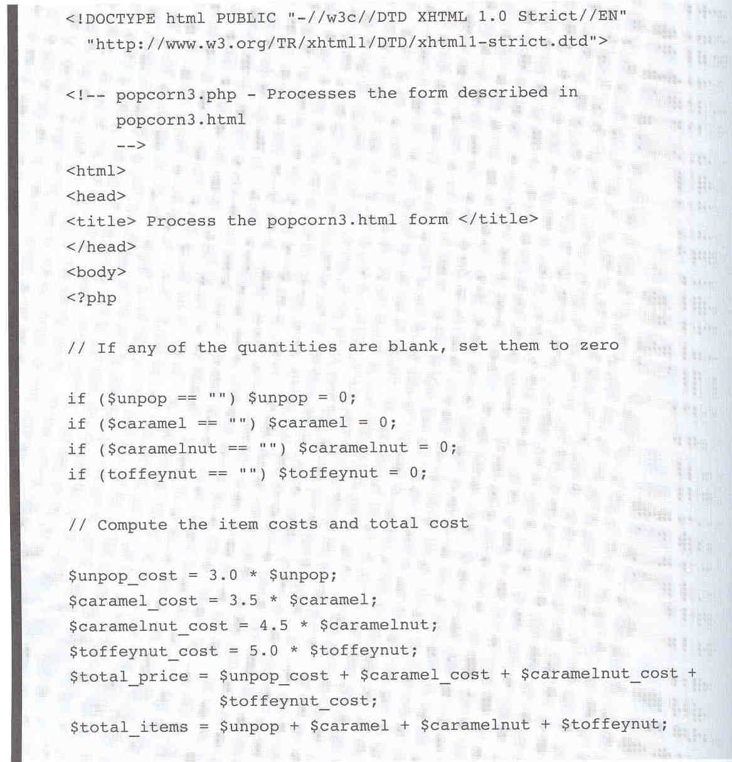

Slide 52
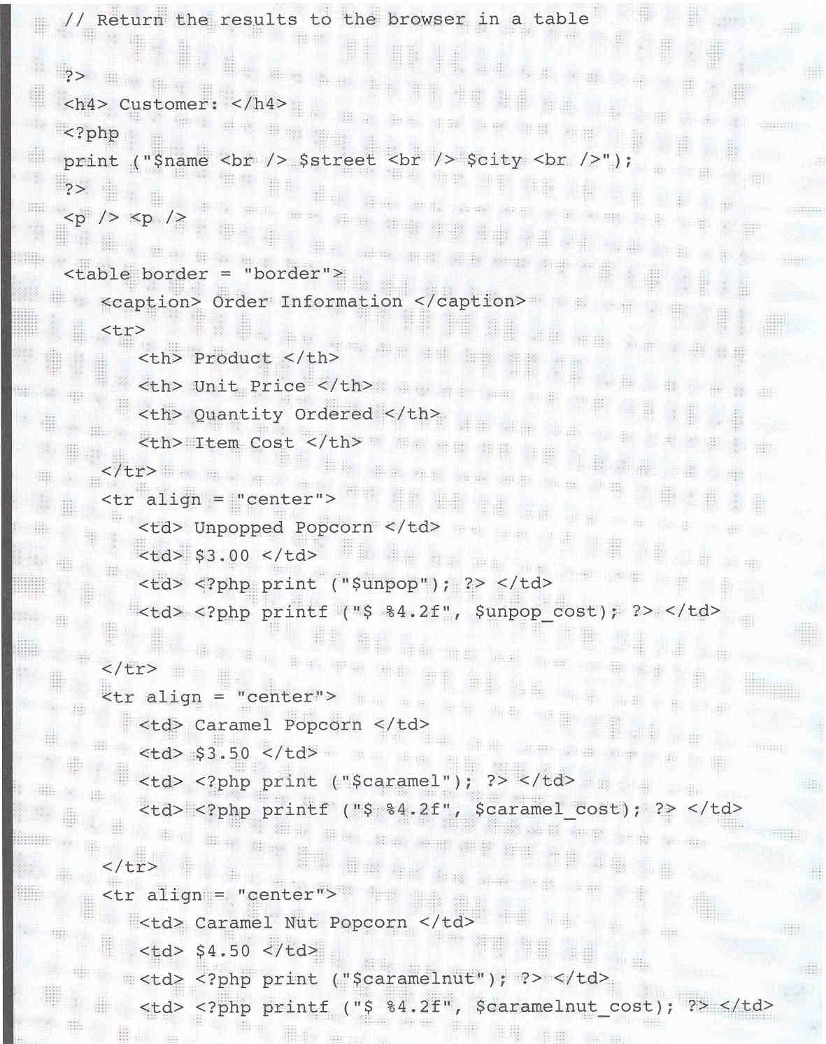

Slide 53
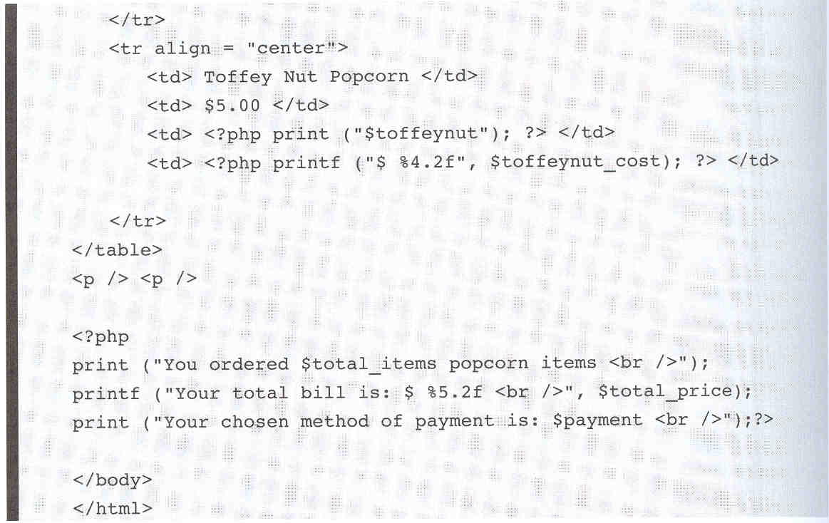
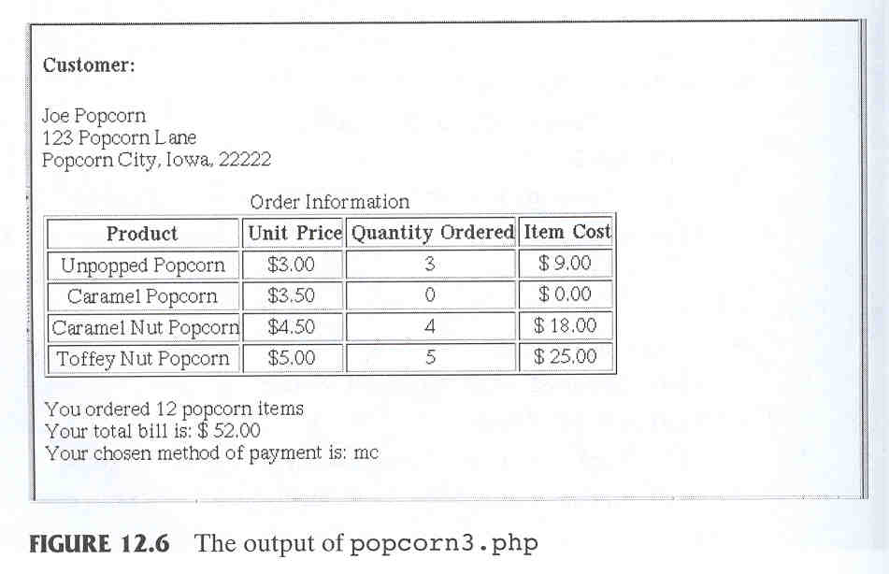

Slide 54
12.11 Files
- PHP can:
- Deal with any files on the server
- Deal with any files on the Internet, using either
http or ftp
- PHP associates a variable with a file,
called the file variable
$file_var = fopen(filename, use_indicator)
- every open file has a file pointer (where to read or write)
- Use indicators:
r read only, from the beginning
r+ read and write, from the beginning
w write only, from the beginning
(also creates the file, if necessary)
w+ read and write, from the beginning
(also creates the file, if necessary)
a write only, at the end, if it exists
(creates the file, if necessary)
a+ read and write, read at the beginning, write
at the end
- Because fopen could fail, use it with die
$file_var = fopen(“test.dat”, “r”) or
die (“Error – test.dat cannot be opened”);

Slide 55
12.11 Files (continued)
- Use file_exists(filename) to determine
whether file exists before trying to open it
- Use fclose(file_var) to close a file
- Reading files
1. Read all or part of the file into a string variable
$str = fread($file_var, # of bytes);
- To read the whole file, use filesize(file_name)
as the second parameter
$str = fread($file_var, filesize(“test.dat”));
2. Read array of all the lines of the file
$file_lines = file(file_name)
ex) $file_lines = file(“test.dat”)
- Need not open or close the file
3. Read a single line from the file
$line = fgets(file_var, #bytes)
- Reads characters until eoln, eof, or #bytes
characters have been read
$line = fgets($file_var, 100)

Slide 56
12.11 Files (continued)
- Reading files (continued)
4. Read one character at a time
$ch = fgetc(file_var)
- eof detection using feof
- TRUE for eof; FALSE otherwise
while(!feof($file_var)) {
$ch = fgetc($file_var);
}
- Writing to files
$bytes_written = fwrite(file_var, string)
- fwrite returns the number of bytes it wrote
- Files can be locked (to avoid interference from
concurrent accesses) with flock (just like Perl)
- two parameters:
- file_variable
- integer that specifies the needed operation
- LOCK_SH(1): specifies that file can be read by
others while the lock is set
- LOCK_EX(2): allows no other access
- LOCK_UN(3): unlock the file

Slide 57
12.12 Cookies
- Create a cookie with setcookie
setcookie(cookie_name, cookie_value, lifetime)
e.g.,
setcookie("voted", "true", time() + 86400);
/* expire in 1 day */
- Cookies must be created before any other HTML
is created by the script
- Cookies are obtained in a script the same way
form values are gotten
- There could be conflicts between GET, POST, and
cookie variables
- PHP puts all POST form variables in their own
array (hash) $_POST
- $HTTP_POST_VARS: deprecated
- Ditto for GET form variables ($_GET)
- all cookies in $_COOKIE

Slide 58
12.13 Session Tracking
- Session support in PHP consists of a way to preserve
certain data across subsequent accesses
- session id: internal value that identifies a session
- Create the id with a call to session_start with no
parameters
- To create a session variable, use
session_register
- The only parameter is a string literal of the
name of the session variable (without the
dollar sign)
- Example: count number of pages visited
- Put the following code in all documents
session_start();
if (!IsSet($page_number))
$page_number = 1;
print("You have now visited $page_number");
print(" of pages <br />");
$page_number++;
session_register("page_number");

Slide 59
12.14 Database Access with PHP and MySQL
- Potential problems with special characters
1. special characters in a DB (>, <, “, &)
- PHP htmlspecialchars to replace them with entities
$str = “Apples & grapes < raisins, too>”;
$str = htmlspecialchars($str);
- $str is “Apples &amp; grapes &lt; raisins, too&gt;”
2. occur with PHP scripts that accept values
from HTML forms
- switch magic_quotes_gpc in PHP.ini
- On (default), the value from the form has backslashes
inserted in front of all single quotes, double quotes,
backslashes.
- if the value from a form is placed in $name and its
value is “O”Reilly”.
$query = “SELECT * FROM Names
WHERE Name = $name”;
- “O\”Reilly” ➔ interpolation of $name into
the string literal is legal.

Slide 60
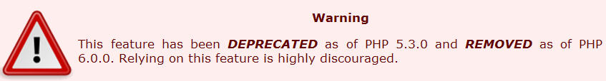
12.14 Database Access with PHP and MySQL
- magic_quotes_gpc
3. problematic when the form value is a complete SQL
command, in which field values must be single quoted
SELECT * FROM States
WHERE States.State = ‘Colorado’
- if the name of the form element is query, $query is
SELECT * FROM States
WHERE States.State = /‘Colorado/’
- this string is not a legal SQL command
- magic_quotes_gpc in PHP.ini must be set to Off
- alternative is to remove the extra slashes using the
predefined function stripslashes (≠addslashes)
$query = stripslashes($query);

Slide 61
12.14 Database Access with PHP and MySQL
- Connecting to MySQL and selecting a DB
- mysql_connect : connects a script to a MySQL server
- 3 parameters (optional):
- host (that is running MySQL), default is localhost
- user name for MySQL
- password, default is blank
- mysql_close : terminate the connection
- not necessary (connection will be terminated
when the script terminates)
- mysql_select_db : select a DB as the current DB
mysql_select_db(“cars”);

Slide 62
12.14 Database Access with PHP and MySQL
- Requesting MySQL operations
- mysql_query : request MySQL operations
$query = “SELECT * FROM Corvettes”;
$result = mysql_query($query );
- mysql_num_rows : determine the number of rows
$num_rows = mysql_ num_rows ($result );
- mysql_fetch_array : returns a hash of the next row
$num_rows = mysql_ num_rows ($result);
for ($row_num = 0; $row_num < $num_rows; $row_num++) {
$row = mysql_fetch_array($result);
print “<p> Result row number” . ($row_num + 1) .
“.State_id:”;
print htmlspecialchars($row[“State_id”]);
print “ State: “;
print htmlspecialchars($row[“State”]);
print “</p>“;
}

Slide 63
12.14 Database Access with PHP and MySQL
- A PHP/MySQL examples
- situation in which the column names are not known
- the row of the result of a query are PHP arrays
- has double sets of elements
- one with numeric keys
- one with string keys
- if a query gets a row with the field values (1, Alabama)
((0, 1), (State_id, 1), (1, Alabama), (State, Alabama))
- to display all of the values
$num_fields = sizeof($row);
for ($field_num =0; $field_num < $num_fields / 2;
$field_num++)
print $row[$field_num];

Slide 64
12.14 Database Access with PHP and MySQL
- column labels: keys of the odd-numbered elements
- extract the column labels
- use a loop that iterates
through the hash using each function
while ($next_element = each ($row)) {
$next_element = each ($row);
$next_key = $next_element[‘key’];
print $next_key . “ “;
}

Slide 65
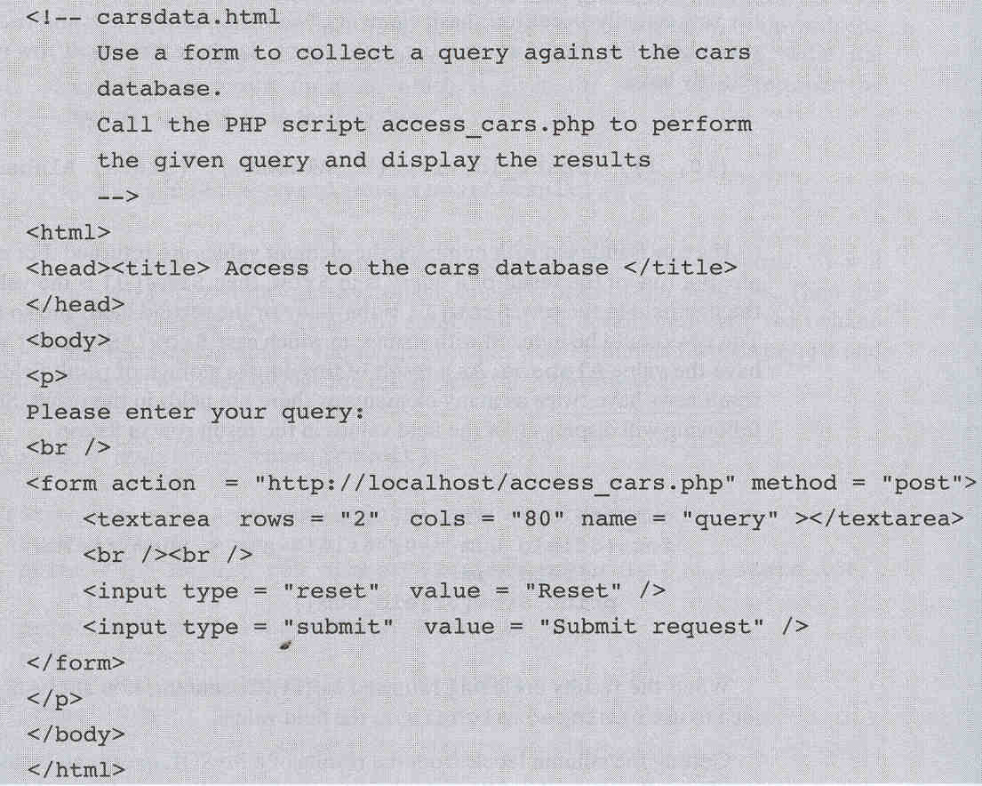


Slide 66
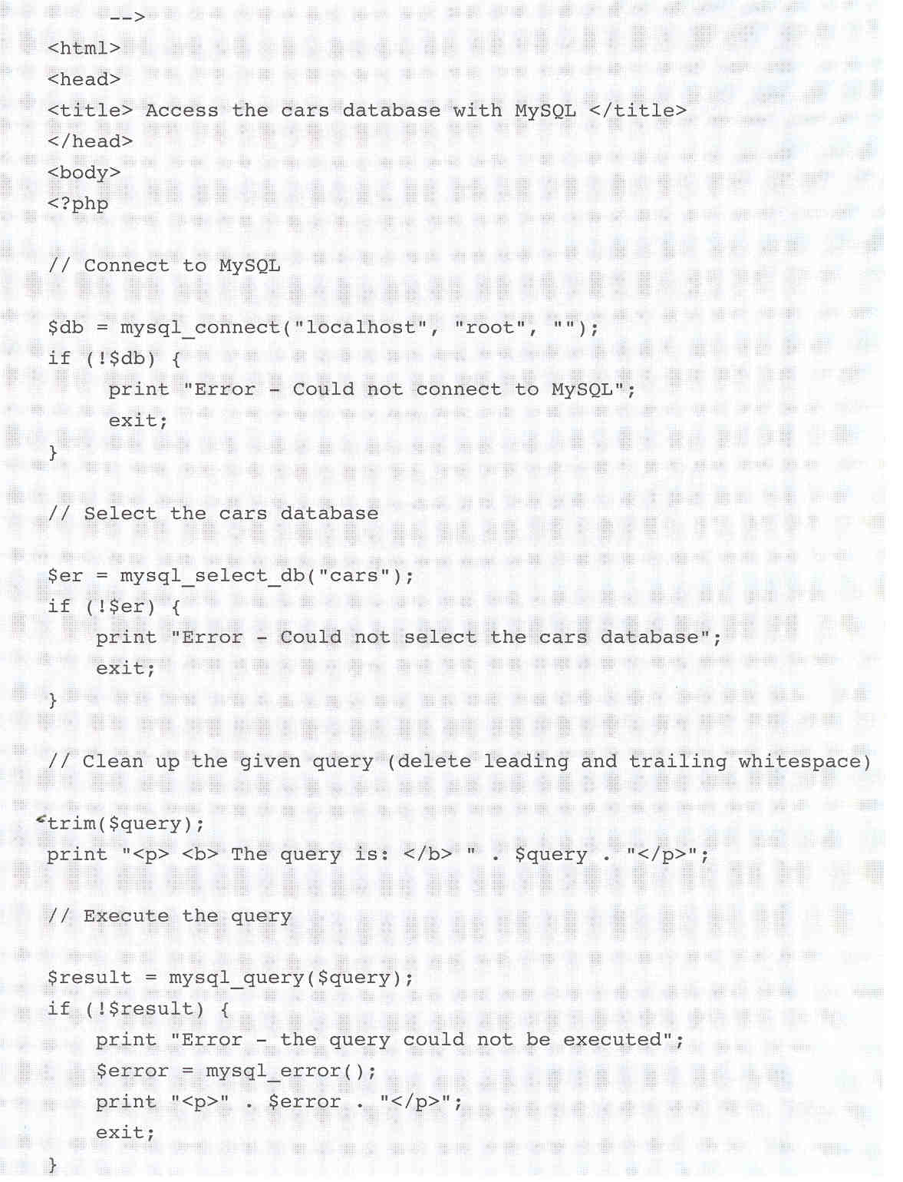

Slide 67
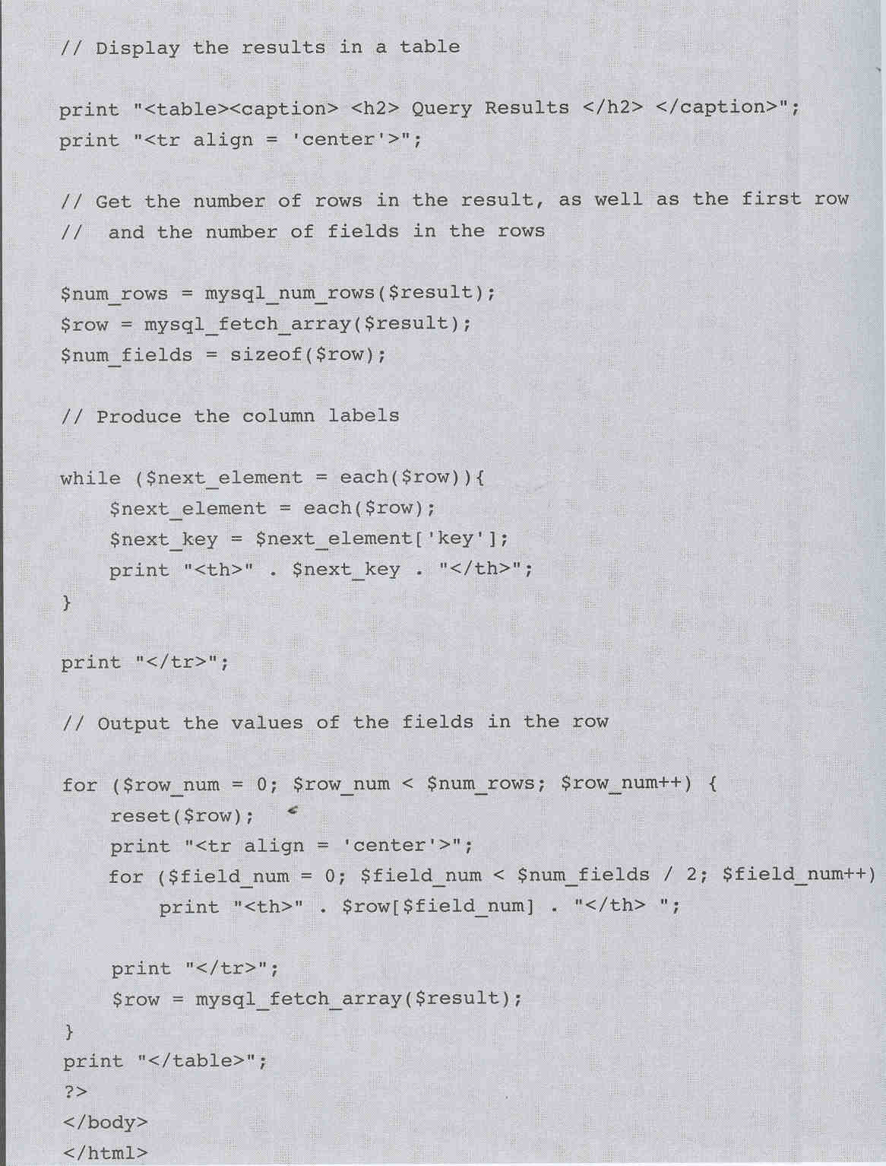

Slide 68
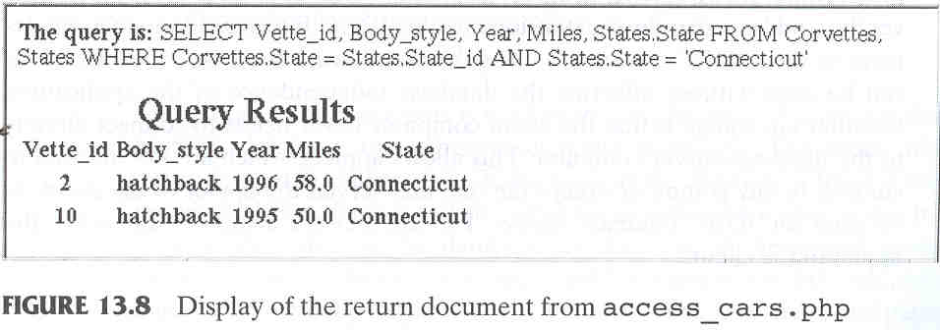



Slide 69
참고자료
PHP 매뉴얼
  http://kr.php.net/manual/kr/index.php

