Slide 1
DIGIWIZARD
A Modular Multi-Dev Tablet

Slide 2
Table of contents
01
02
03
04
Literature review
Research methodology
You can describe the topic of the section here
You can describe the topic of the section here
Theoretical framework
Data presentation
You can describe the topic of the section here
You can describe the topic of the section here

Slide 3
Introduction

Slide 4
About our prototype
This project develops a Raspberry Pi-based tablet providing an Android-like user experience while maintaining the flexibility of Linux. Using Raspberry Pi OS, the system ensures compatibility with hardware and supports advanced customization. The tablet also includes IR and RFID/NFC detection, expanding its use for signal analysis, smart home monitoring, and IoT prototyping. Its modular design allows for future upgrades, while the open-source environment supports customization for various applications. This project presents a versatile, cost-effective, and multi-purpose platform for modern technology.

Slide 5
01
Literature Review

Slide 6
Existing Solutions
Raspberry Pi Solutions
Other ARM Solutions
Commercial Solutions
Focuses primarily on basic computing and media consumption.
Limited to pre-designed hardware.
Locked GPIO pins.
E.g.: CutiePi, PiPad
Mostly open-source but lack of customization.
Incompatibility towards the raspberry tools.
Limited functionalities when compared to Raspberry Pi Solution.
E.g.: Ubuntu Touch Mobile, etc.
More powerful and easy to obtain.
Limited to the hardware capability.
Limited customization and no support for modules.
E.g.: Android Tablets, Apple iPad.

Slide 7
Problems in Existing Solutions
Lack of Unified Solution
Limited Customization
Versatility Gap
Current solutions either focus on functionality or tablet experience—not both.
No open-source device combines tablet functionality with usage of modules in GPIO.
Commercial products restrict hardware and software modification.

Slide 8
Methodological innovations
Innovations from multiple papers have been used and improvised such as:
Use of Raspberry Pi 5 over Pi 4 & Pi 3.
Use of IR and RFID/NFC using GPIO instead of direct soldering.
Usage of VS1838b instead of TSPO38238 due to operational capability.
Usage of PN532 instead of MRFC522 for better RFID performance.
Retention of raspi-config.
Signal detection with room for future upgrade in both software as well as hardware upgrade.
Room for multiple modules with GPIO instead of only IR & RFID/NFC.
Usage of Debian flavours instead of other distributions like Arch, Fedora, openSUSE.

Slide 9
Interdisciplinary research in literature
Embedded System:
Hardware integration using Raspberry Pi and multiple modules.
Wireless Communication:
Detection and analysis of signals like IR and RFID/NFC signals.
Human-Computer Interaction:
Integration of simple UI along with the advanced system settings as well as complex scripts.

Slide 10
02
Research methodology

Slide 11
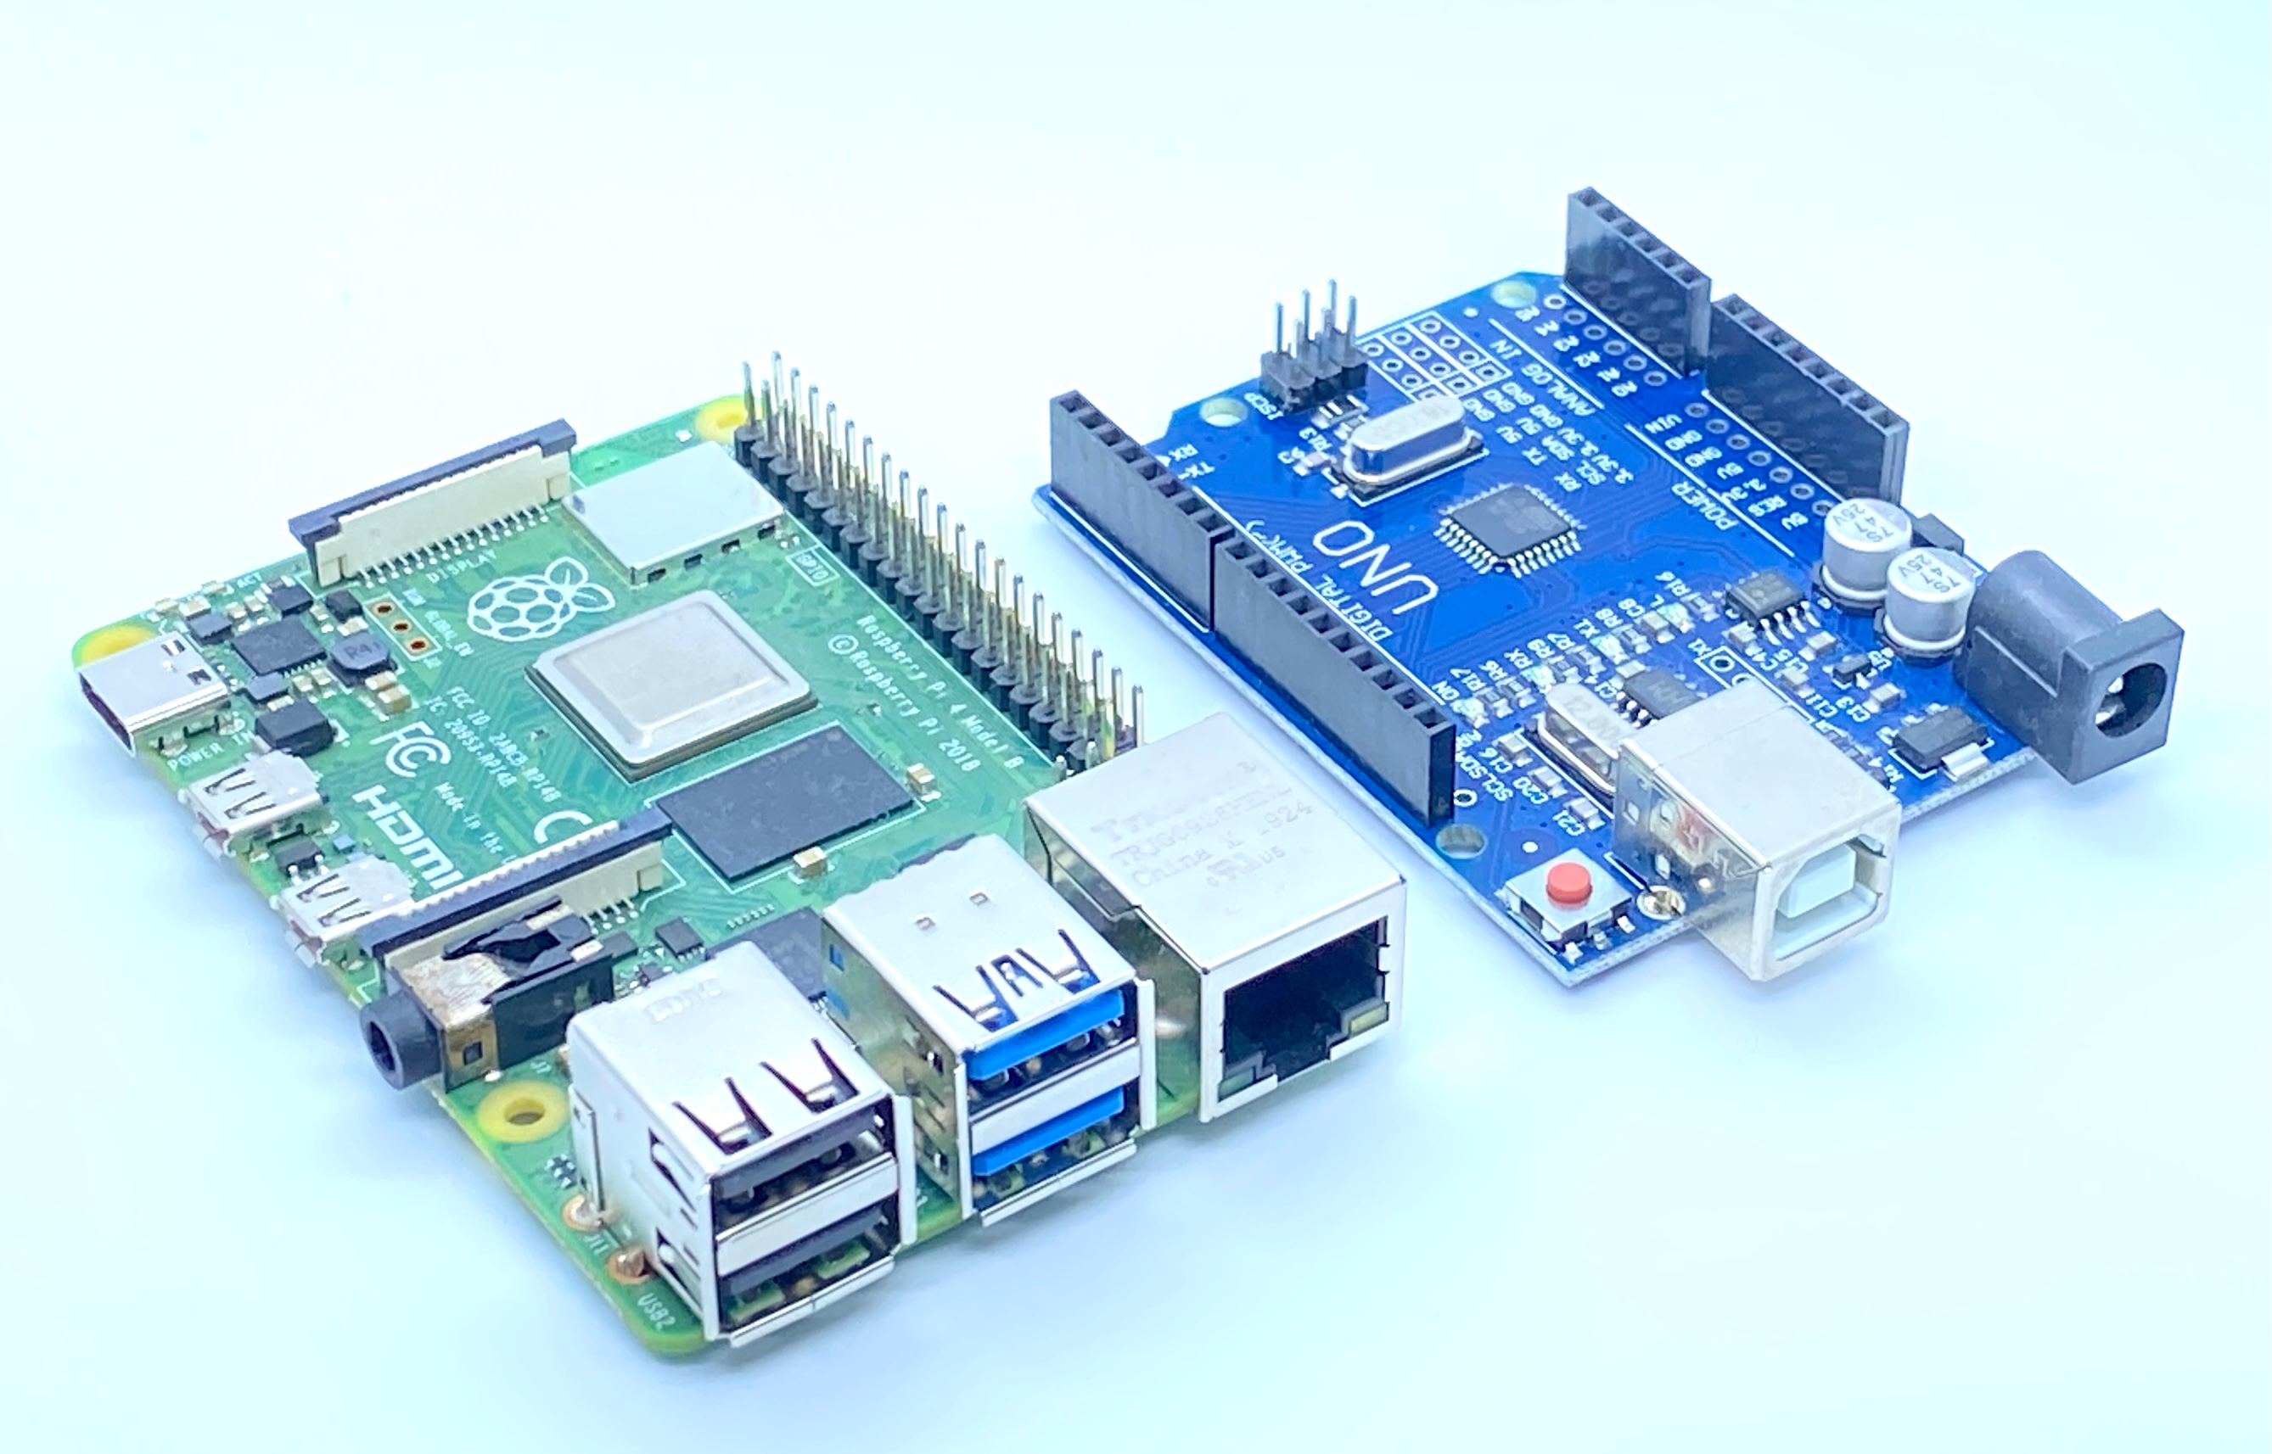
Experimental Setup
Selected hardware components based on availability, ease of integration, and performance.
Hardware Used:
SBC (Arduino Uno replaced by Pi 5)
IR (TSOP38238 replaced by VS1838b)
RFID (RC522 replaced by PN532)
GPIO replaced by 40 pin GPIO extender

Slide 12
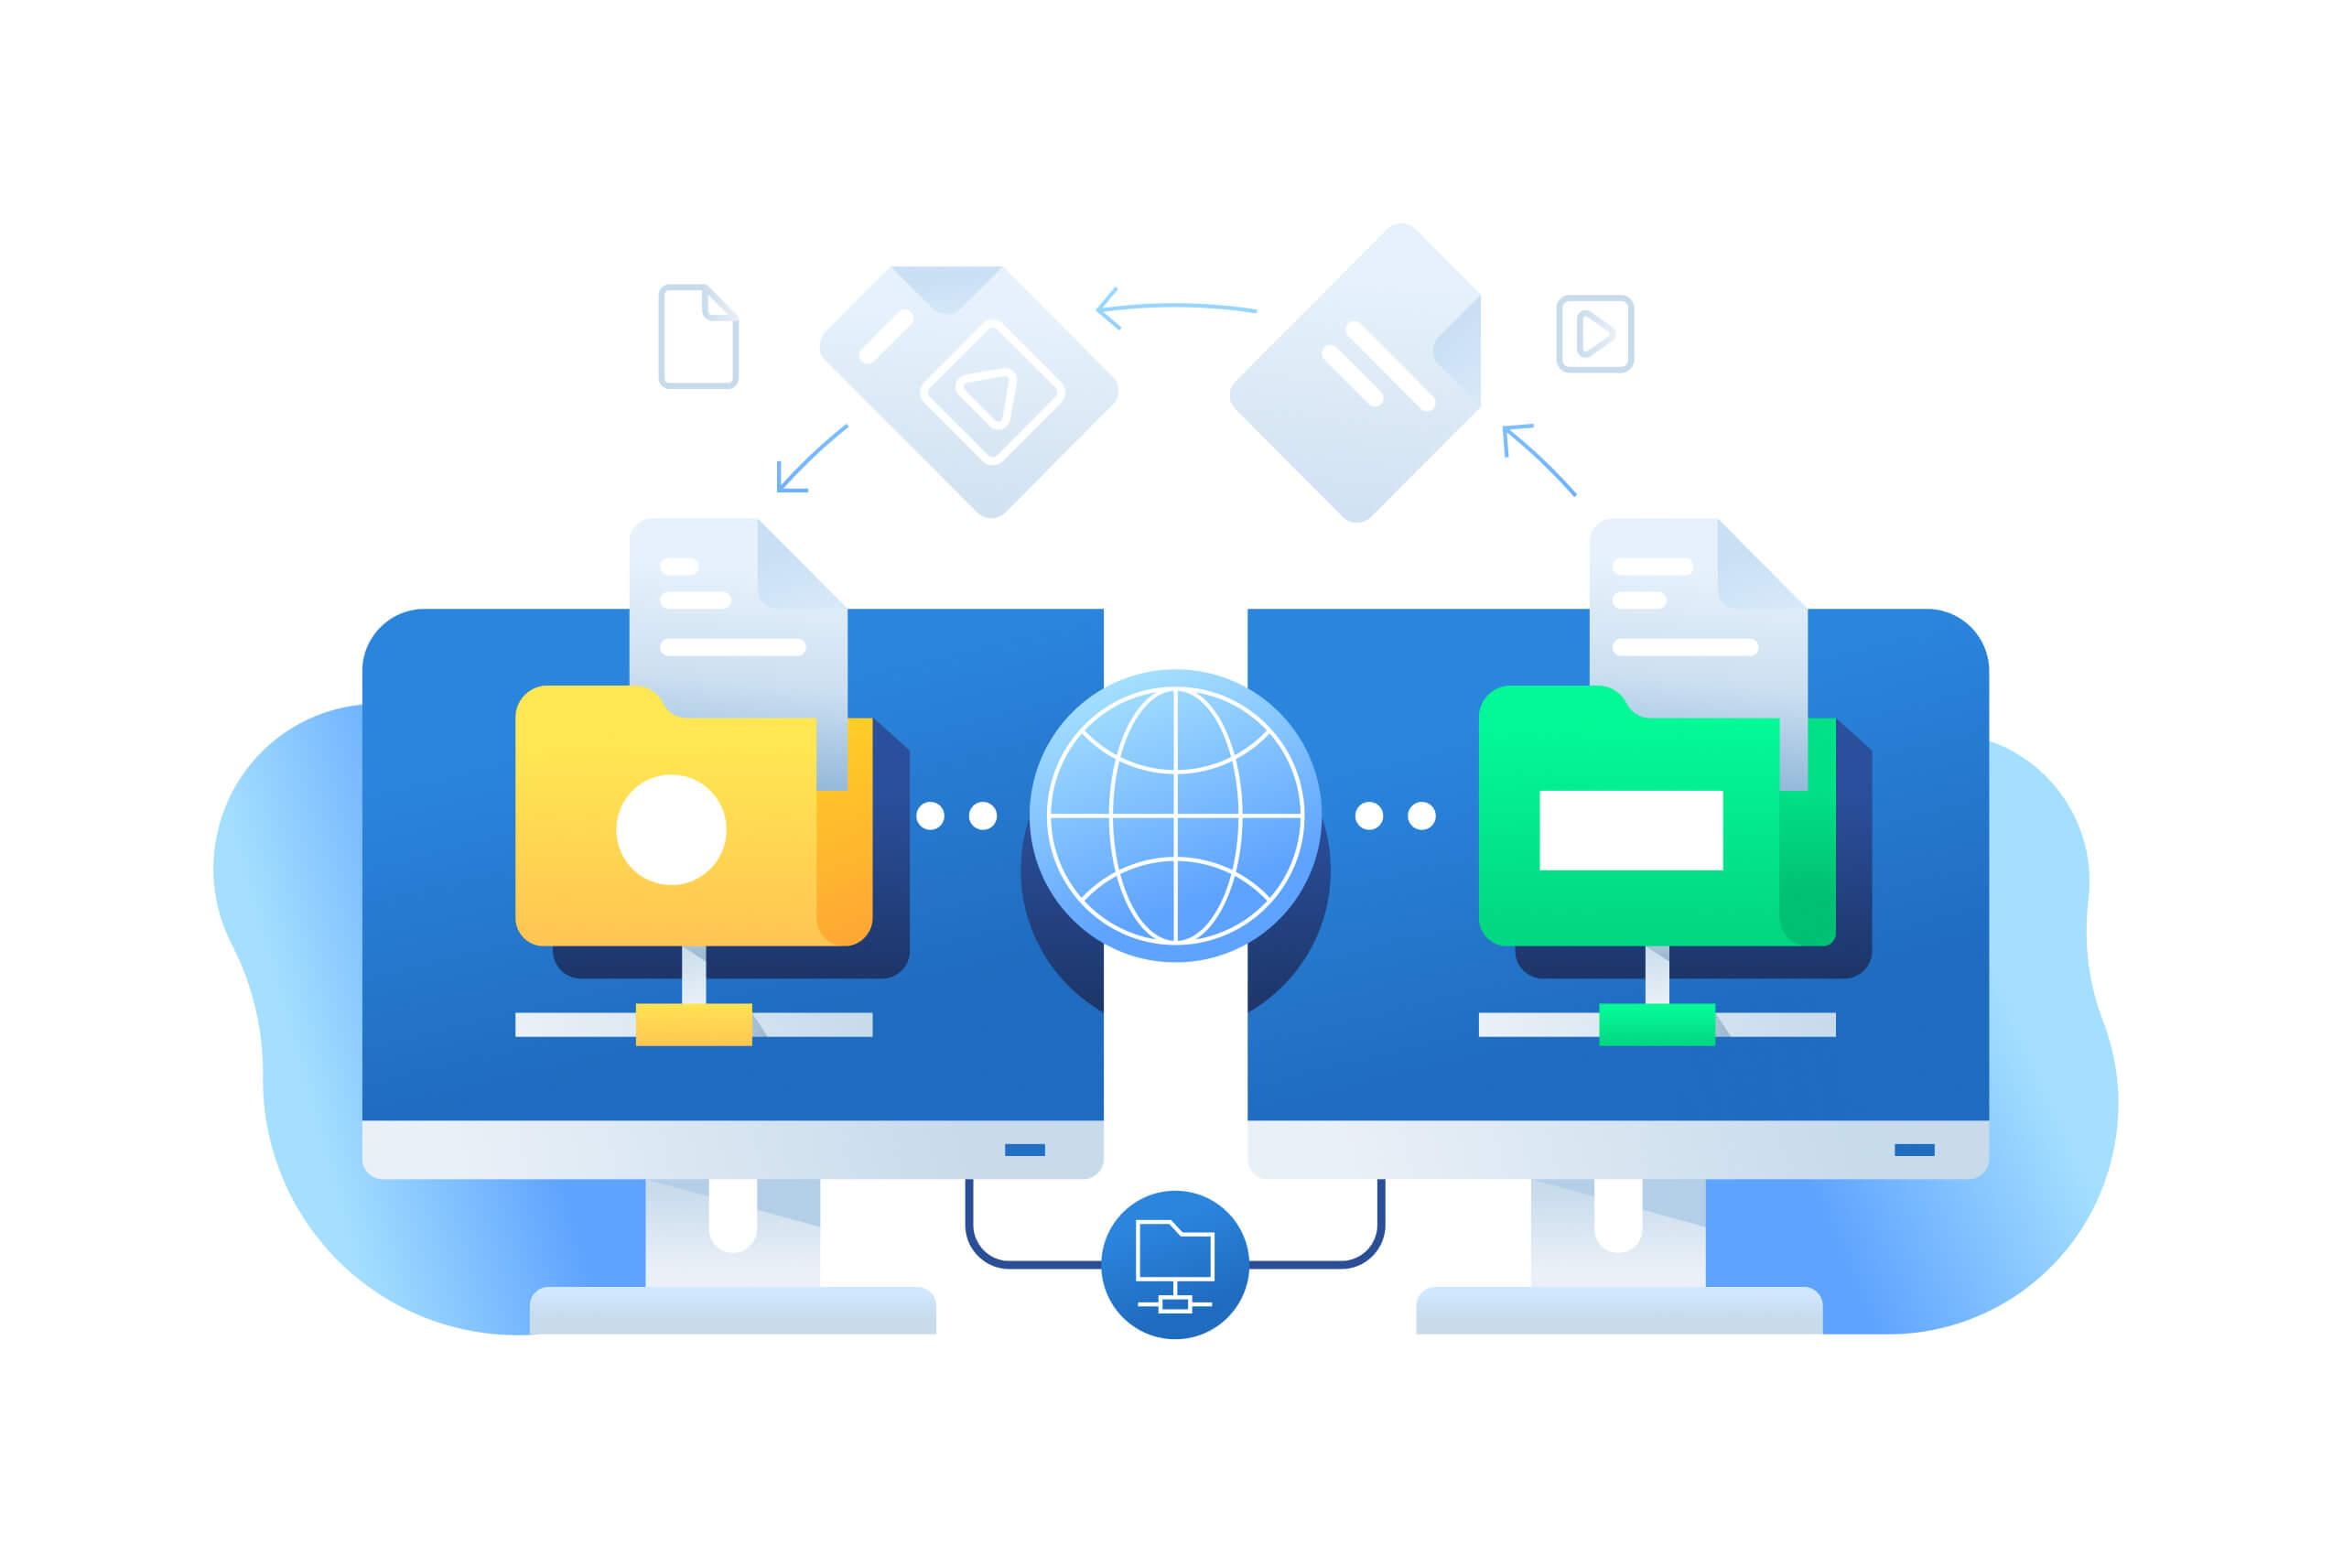
Iterative Prototyping
Initially used LIRC for IR signals later replaced by ir-keytable and ir-remote.
Initially used python scripts for RFID i.e. SimpleMFRC522 library later replaced by APT package libnfctools-bin
Transition to python scripts from bash scripts
Transition to KDE from LXDE

Slide 13
Software Development
Made ir-keytable to work alongside with LIRC commands
Integrated libnfctools-bin for better use of PN532.
Used KDE (tablet-based UI) instead of a proper desktop environment.
Developed custom python script for:
  IR Communication
  RFID Communication
  Installation of required packages
  Installation and updating scripts.

Slide 14

Testing and Validation
Verified individual components like IR receivers, RFID readers, and GPIO extensions.
Debugged latency issues in IR signal processing and NFC authentication.
Simulated real-world conditions to test system reliability.
Simulated real-world conditions to test system reliability.
Ensured smooth interaction between IR, RFID/NFC, and user interface.

Slide 15
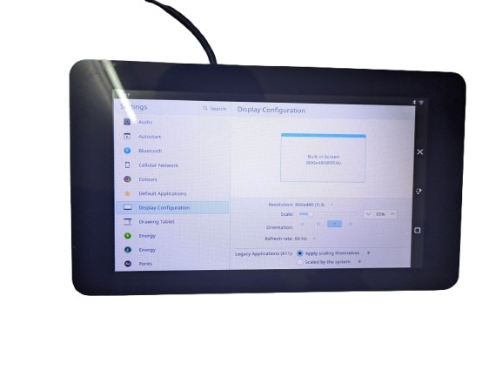
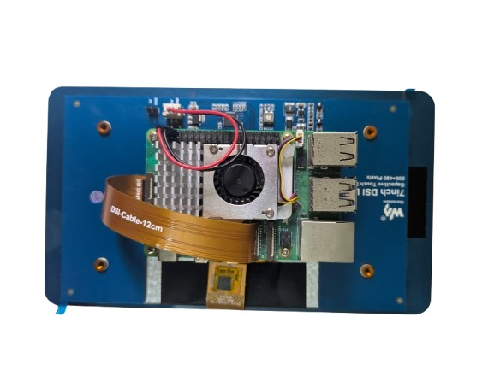
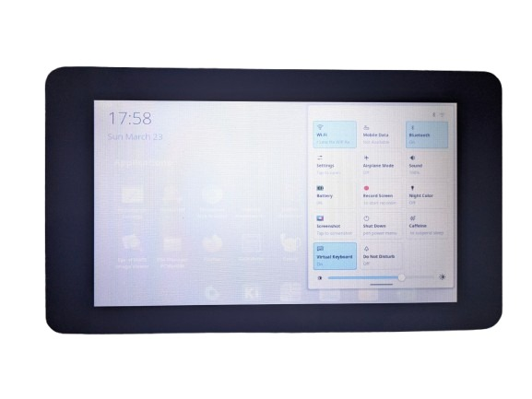
Tablet mockup
Tested and verified all the results of the tablet along with the working and proper working of modules without any surge or shortcircuit in the system.

Slide 16
03
Theoretical framework

Slide 17
Methodology
Agile Development Methodology
Chosen due to flexible and adaptive changes.
Easy changes can be done during development stage.
Integrating multiple modules at any point of time.
Small development iterations for continuous feedback.
Rapid prototyping due to small iterations.
User-centric design rather than conventional functionality provision.
Open source and open-to-collaboration .

Slide 18
System Design
Hardware Components
Software Components
Raspberry Pi 5
7” Touchscreen DSI Display
VS1838b IR Sensor
PN532 RFID/NFC Module
5V 5.1A Adapter
40 pin GPIO
Raspberry Pi OS (LTS)
KDE Plasma Mobile
LIRC
libnfctools-bin
ir-keytable
Custom Scripts for installation & usage.

Slide 19
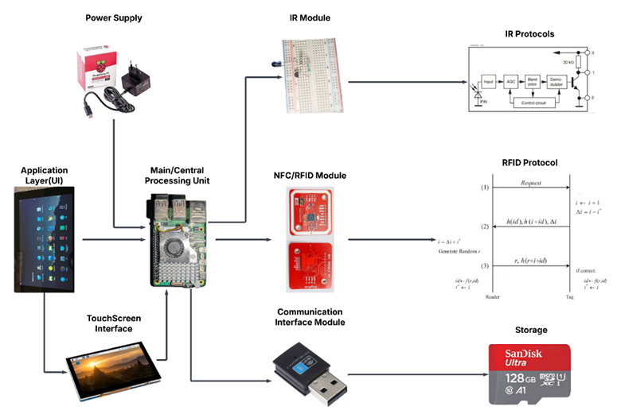
System Workflow
Architecture Diagram

Slide 20
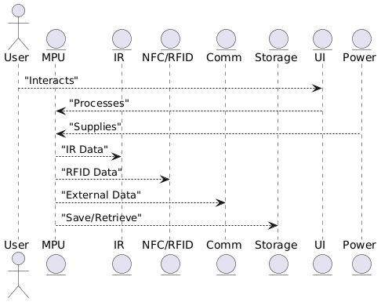
System Workflow
Class Diagram

Slide 21


Our team
Priyadharshan P
Monish Anand J

Slide 22
Thanks!
Does anyone have any questions?
priyadharshansharma@gmail.com
yourwebsite.com
Please keep this slide as attribution

