Slide 1
Unit Testing
Tutorial

Slide 2
Shopping List
What Unit Tests Are
Why they are Useful
How to write a Unit Test
Test Suites
Test Doubles
Q&A

Slide 3
Unit Testing
What is it?
“A unit test is an automated piece of code that invokes a unit of work in the system and then checks a single assumption about the behavior of that unit of work.” – The art of unit testing

Slide 4
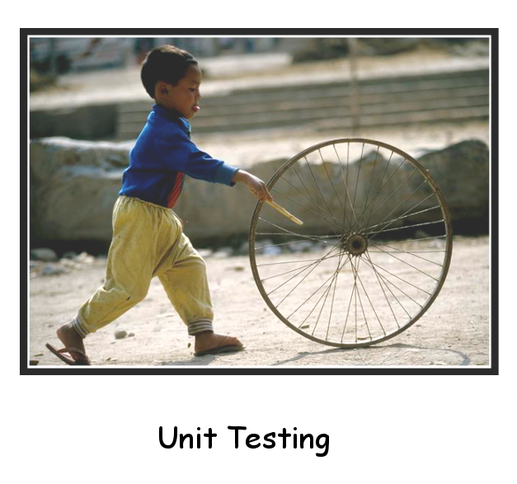
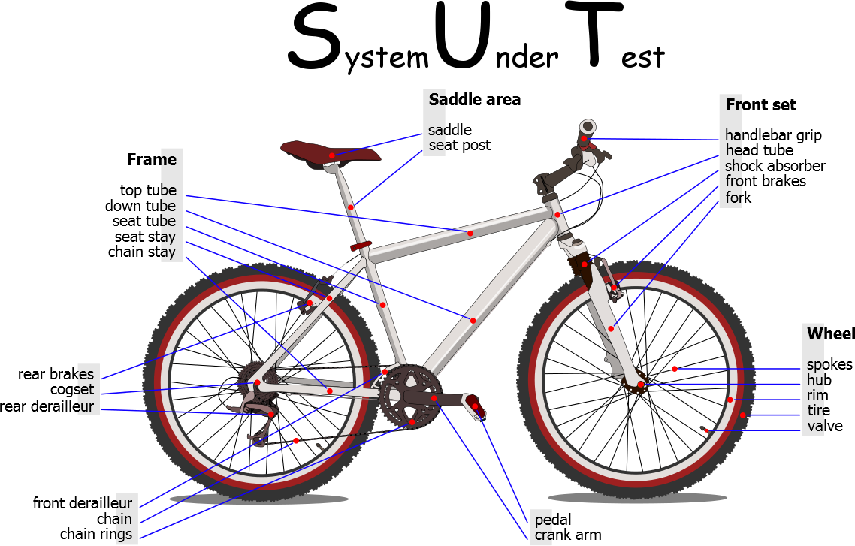
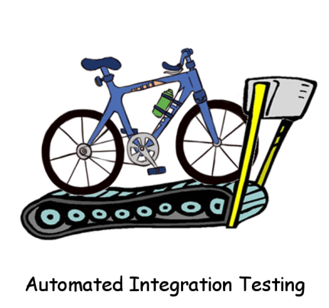
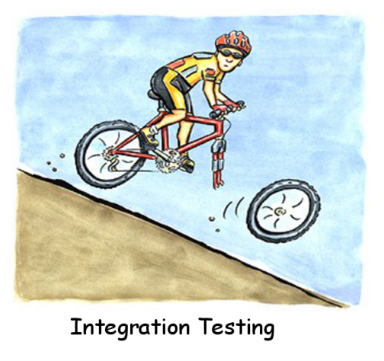

Slide 5
Unit Tests
How to spot one
Automated - no manual setup needed to run
Repeatable - can be run any amount of times
Consistent - will always expect the same results
Fast - less than a second fast
Tests a single logical concept - Can be described in words without using 'and'
Isolated - Can run independently from any other test
Doesn't require specific system configuration

Slide 6
Unit Tests
Why use them?
Improves quality of product (fewer bugs)
Promotes better design
Protects against regressions
Reduces debugging time
Simplifies debugging process
Enables faster evolution of software (agile)
Acts as documentation

Slide 7
Unit Tests
What do they actually test?
Procedural / Functional Languages
C, Lisp etc
Procedures / Functions
Object Oriented Languages
C++, Java etc
Methods
Great so can I start writing unit tests for my code?
Could I unit test this? :
Code needs to be written (or refactored) with unit tests in mind.

Slide 8
How to write a unit test
Poor man's solution – Write a program that runs the test
Implementation
Test

Slide 9
How to write a unit test
How the cool kids do it – Use a Unit Testing Framework
Each test can run and fail separately.
Easier to understand what each test is targeting.
No need to write fail messages for each test.
Seamlessly automated into the build process
Notes:
Show build example

Slide 10
Naming Tests
As important as the test code itself
Useful information:
Method Name or unit of work
State Under Test
Input Arguments
Current state of an object
Expected Behaviour
Result of a method
Subsequent state of the object
Format: <method>_<stateUnderTest>_<expectedBehaviour>()
Rule of thumb:
Can I understand what went wrong without reading the actual test code?

Slide 11
Test Suites
or Fixtures
A grouping of similar tests
Object Oriented
contains tests pertaining to a specific class.
can be named MyClassTests.
Procedural:
contains tests for a specific function or a group of closely related functions.
Allows easy access to the full set of tests related to a specific component without having to run all the tests.
But more importantly…

Slide 12
Setup and Teardown
How to avoid copy pasting stuff
Setup and Tear down code can be specified per Test Suite
Two types
Code that runs before and after every individual test run.
Code that runs before and after running all the tests as a group.
Suite setup
Test setup
Test run
Test teardown
Suite Teardown

Slide 13


Test Doubles
Who is afraid of dependencies?
Most software components depend on other components.
A direct usage of a dependency means we are also testing the dependency's implementation in our tests.
Solution: Use test doubles.
Code used in place of a dependency that contain no or very little implementation.
We can even create doubles for 3rd party libraries we don't have the source code to.
Known species:
Dummy, Fake, Stub, Mock, Spy.
Using interfaces is crucial.

Slide 14
How to use a Dependency
So you can test without it
The gist of it:
We want our cars to be able to carry humans as well as crash dummies!
Not Unit Testable
Unit Testable

Slide 15
Test Doubles
Test Implementations vs Mocking Frameworks
DIY
stubbing
Mocking Framework
stubbing

Slide 16
Useful Practices
Tip of the day
No if, for, while and switch in unit test code.
When a bug is found, add a unit test for it!
Use modern IDEs to reduce test overhead on changes.
Unit testing and vi don’t mix too well.
Don’t add print code in your tests.
If you feel the need to then you are probably writing an integration test.
Take advantage of the unit test harness
To tryout things (e.g. third party libraries)
Create quick prototypes
Without having to write a test program.
Don’t write tests where no logic exists (e.g. simple getters and setters)

Slide 17
Q&A

