Slide 1
Grundlagen
ASP.NET

Slide 2
Was ist ASP.NET?
So much liberty so much wow
Unabhängig von Programmiersprache
Unabhängig vom Browser
Mono
…by the Way
Objektorientiertes Programmieren
Serverseitige Events
Sites |  |  |  | Services
Web Forms | Web Pages | Single Page Apps | MVC | Web API | SignalR | ASMX
ASP.NET
Notes:
2
Module 7: Troubleshooting Microsoft® ASP.NET Web Applications
Course 10267A

Slide 3
Was ist .NET?
Installiertes Framework
1.1,2, 3.x, 4.x
CLR, BCL, CTS
Verschiedenen Programmiersprachen
Zwischensprache IL
Laufzeitkompilierung JIT
Exe
DLL Assembly
Garbage Collector
Managed Objects

Slide 4
On Top
Winforms
WPF
ADO.NET
Entity Framework
WCF
ASP.NET
Web API
Webforms
MVC
Razor

Slide 5
Basic Server Controls
Button, Label, Textbox
Postback
ispostback
Viewstate
Status Wiederherstellen

Slide 6
Inline Code
<script runat=server
<%= Response.Write
<%: Response.write+ HttpUtility.HtmlEncode
<%# Databinding
<%@ Page Page Deklaration
Imports

Slide 7
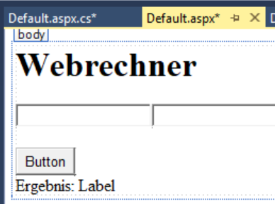
Visual Studio Designer
<form id="form1" runat="server">
<h1>Webrechner</h1>
<asp:TextBox ID="TextBox1" runat="server"></asp:TextBox>
<asp:TextBox ID="TextBox2" runat="server"></asp:TextBox>
<br />
<br />
<asp:Button ID="Button1" runat="server" Text="Button" />
<br />
Ergebnis:
<asp:Label ID="Label1" runat="server" Text="Label"></asp:Label>
</form>

Slide 8
Visual Studio Code Editor
public partial class _01Modul_Default : System.Web.UI.Page
{
protected void Page_Load(object sender, EventArgs e)
{
}
protected void Button1_Click(object sender, EventArgs e)
{
}

Slide 9
Events
Event Methode
Signatur
Page_load
Werte Properties zuweisen
Text

Slide 10
Page Attribute
Titel
Page
Metatag
Runat=Server
Codebehind vs Codefile
EnableViewstate

Slide 11
Hosting
IIS
Hostheader pro Website
IISExpress
Localhost +Port
Selfhosted
http.sys
app_offline.htm

Slide 12
Taschenrechner

