Slide 1
Webforms
ASP.NET

Slide 2
Troubleshooting
Debugging in Visual Studios
Fehlertypen
Definition
Debug Class
Tracing
TraceContext Class
Tracing a Web Application

Slide 3
Types of Errors
Syntax Errors
zB Schreibfehlder, Strukturen, etc und werden als Compile-Time Errors noch während des Schreibens entdeckt
?
Runtime Errors
Treten während der Laufzeit auf und sind bekannt als Exeptions. Zum Beispiel bei Datenbankzugriffen.
Semantic Errors
Sind am schwersten zu finden, weil die Anwendung einwandfrei läuft und man keine Fehlermeldungen auftreten
Notes:
Discuss various types of errors. State examples, and ask students how they would categorize them. Ask them about any errors they have come across recently.
There are three kinds of errors that you need to handle when you develop applications—syntax errors, runtime errors, and semantic errors.
Syntax Errors
The syntax of an application must be correct for a compiler to be able to compile the code, and for the application to run. Syntax refers to the application structure, and the rules associated with the structure. For example, this could be braces that surround a block of code in Microsoft Visual C#® (for example, if (!this.IsPostBack) { Block of Code }) or the matching Begin and End statements in Microsoft Visual Basic®, (for example, Sub SubName() ... End Sub). If you leave out one of the matching braces in Visual C#, or the End Sub statement in Visual Basic, a syntax error occurs.
Syntax errors are part of what is referred to as compile-time errors. Visual Studio 2010 warns you of potential errors at design time. Syntax notifications—or squiggles—underline code that will not compile or that might cause an error . You can identify syntax errors and resolve them when you compile the application.
Runtime Errors
Runtime errors occur when the application is running. Runtime errors are also known as exceptions. For example, an application may rely on a file to be available at run-time. However, if the file is not available when the application tries to access it, an exception is thrown, unless your application can handle the exception. Briefly cover exception handling, but refer the students to the link in the Additional Reading section for more information.
Semantic Errors
Semantic errors are the hardest to locate and fix because your application will run successfully, and you will not see any error messages. However, your application may not perform as intended, or may perform differently from what you want it to do. For example, a user performs a calculation, and the correct result displays on the user interface. If the calculation and related operations are not stored in the data storage when the next user logs on, the second user will view the same data viewed by the first user. This means that the semantics of the application is wrong. Identifying this type of error can be very tricky and confusing, because it requires you to follow the input, output, and the flow of the application to locate the bug.
Module 7: Troubleshooting Microsoft® ASP.NET Web Applications
Course 10267A
3

Slide 4
Definition
Debugging ist der Prozess technische oder logische Fehler in der Webanwendung zu finden und zu beheben.
Soll der Bug beseitigt werden?
Webfroms Application
Den Bug lokalisieren
Den Bug beseitigen
Notes:
4
Ensure that the students are familiar with the concept of debugging.
Explain the process of debugging: Determine whether the bug should be fixed, locate the bug, and fix the bug.
Point out that unlike spoken languages such as English and German, where a syntax error can be overlooked, a compiler error will not pass, because software like Visual Studio 2010 will not fix a syntax error.
Mention about debugging on the client—for example, how to debug a commercial Web application on a client computer by using Microsoft Visual Studio® 2010—and stepping through client-side code.
Potentially show the Options dialog box for enabling client-side debugging, and the JavaScript debugger method.
Point out though, that client-side debugging is not being discussed in this module.
Question: How will you ensure that your program or code is without any errors?
Answer: When you write a computer program, errors can and will occur. You might make a typographical error, your program might not perform as expected, or it might not run at all. When there is an error in your program, you need to find it and fix it. Finding and fixing errors is called debugging.
Module 7: Troubleshooting Microsoft® ASP.NET Web Applications
Course 10267A

Slide 5
Debug Class
Die System.Diagnostics.Debug class hilft dir deine Code zu debuggen indem Infos in der Console ausgegeben werden
Checkliste
Methoden einfügen
evtl Breakpoints setzen
Methoden
Debug.Write bzw Debug.WriteLine
Debug.WriteIf bzw Debug.Assert
Debug.Print
using System.Diagnostics;
protected void Page_Load(object sender) {
Debug.WriteLine("Entering Main");
Debug.Write ("Exiting Main");
}
Notes:
5
Explain what a Debug class is, and explain its methods.
The listeners are explained in the next topic, so defer any discussion.
For information on the methods and its overloads, refer to the Course Handbook and Additional Reading section.
Module 7: Troubleshooting Microsoft® ASP.NET Web Applications
Course 10267A

Slide 6
Definition
Bei Tracing erhält man Infos über die Ausführung der Web Applikation zur Laufzeit
Debug Statements können direkt in den Code geschrieben werden
Den Pfad der Ausführung wird Schritt für Schritt aufgezeichnet
Notes:
Explain what tracing is.
Explain the functionality of tracing.
Question: What is the purpose of using tracing functionality?
Answer: You can use tracing to view diagnostic information about a single request for an ASP.NET page simply by enabling it for your page or application. Tracing also allows you to write debug statements directly in your code without having to remove them from your application when you deploy it to production servers.
Module 7: Troubleshooting Microsoft® ASP.NET Web Applications
Course 10267A
6

Slide 7
Tracing verwenden
Checkliste
Tracing freigeben
TraceContext Class für eigene Ausgaben verweden
http://servername/webapp/trace.axd aufrufen
Seitenweise Freigabe für Tracing
<%@ Page Language="C#" Trace="true" %>
Allgemeine Freigabe für Tracing
<configuration>
<system.web>
<trace enabled="true" />
</system.web>
</configuration>
Notes:
Focus this conversation on enabling tracing, and how to view trace messages.
You can use the solution code for this module to view application-level tracing, and point out the information mentioned in the Trace Categories table.
Ensure that you discuss the following background on tracing. In classic application service providers (ASPs), tracing and debugging facilities were not available Therefore, developers used the ‘got here’ debugging in the form of Response.Write statements. This resulted in an HTML page with informal trace statements announcing to the programmer that the program ‘got here’ and ‘got there’ with each new line executed. This kind of intrusive tracing was very inconvenient to clean up. So, many developers created their own informal trace libraries to circumvent these limitations.
Emphasize that the students must use the Trace and Debug classes for tracing and debugging, rather than Response.Write statements.
Mention to the students that there are multiple things named Trace in the Microsoft .NET Framework. There is a class called System.Diagnostics.Trace, and there is also a public property on System.Web.UI.Page that is known as Trace. The Trace property on the Page class gives you access to the System.Web.TraceContext and the ASP.NET–specific tracing mechanism.
The TraceContext class collects all the details and timing of a Web request. It contains a number of methods, but the students will mostly use the Write method. It also includes the Warn method, which simply calls the Write() function, and ensures that the output generated by Warn is colored in red.
Avoid a discussion on state, because this is covered in Module 13.
Question: How will you view trace information?
Answer: You can view trace information at the bottom of each page. Alternatively, you can also use the trace viewer or Trace.axd to view trace information that is collected and cached by ASP.NET, when tracing is enabled.
Module 7: Troubleshooting Microsoft® ASP.NET Web Applications
Course 10267A
7

Slide 8
TraceContext Class
Die TraceContext class wird verwendet um Ausgaben auf der Webseite selbst oder im Trace Log im Speicher
Trace.Write Schreibt Nachrichten ins Log bzw Webseite | Trace.Warn Änlich wie Write, nur die Nachrichen sind rot
try {
} catch (ArgumentException ae) {
Trace.Warn("Exception Handling", "Warning:Method Page_Load.", ae);
} catch (InvalidOperationException ioe) {
Trace.Write("Exception Handling", "Exception: Method Page_Load.", ioe);
}
Notes:
8
Point out the difference between the Warn and Write methods of the TraceContext. They are similar, with the exception of the red font for the Warn method.
Tell the students that the Trace and TraceContext classes can be combined.
Refer to the Additional Reading section for more information.
Question: When will you use the TraceContext class?
Answer: You can use the TraceContext class to append messages to specific trace categories, and to obtain a set of trace records at the end of request execution.
Module 7: Troubleshooting Microsoft® ASP.NET Web Applications
Course 10267A

Slide 9
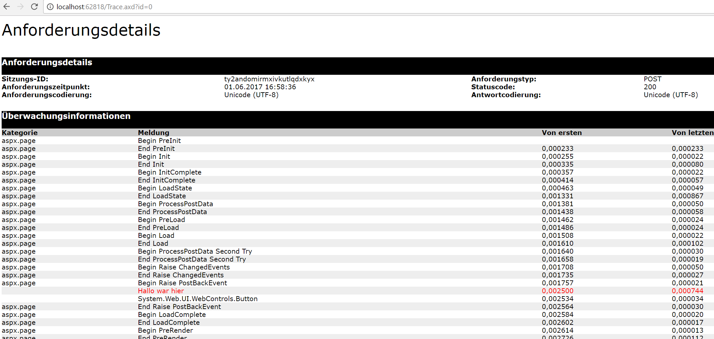

Slide 10
Logfiles
W3C IIS Setting
Logparser
iis failed request tracing

Slide 11
Tests
HTTP Status Codes
200
Lasttest

