Slide 1
Secure
ASP.NET

Slide 2
Secure your WebForms
ASP.NET Security
Authentifikation vs Authorisation
Authentifizierungs Methoden
Form-Basierte Authentifikation
Wichtige Dateien sichern
Programmieren von Authentication & Authorization
Login-Controls
Log-In hinzufügen
Deklaratives Authentifizieren & Authorisieren
Forms-Based Authentication

Slide 3
Verbindung verschlüsseln (Admin)
Zertifikat kaufen
Muss zur endgültigen Domain passen
www.ppedv.de <> ppedv.de
Wildcard Zertifikat *.ppedv.de
Self signed zum probieren
Im IIS Importieren
Protokoll Binding im IIS auf https hinzufügen
Website abrufen https://ppedv.de
Browser Zertifikat begutachten

Slide 4
Config-Dateien verschlüsseln
Bei Dateien mit sensiblen Informationen über die Konfiguration der Webanwendung zB wie web.config macht es Sinn diese zu verschlüsseln
Zusätzlicher Schutz des Projektes
Connection Strings werde nicht im Klartext angezeigt
Notes:
Briefly describe about using protected configuration.
Refer to the Course Handbook and provide examples to show how the connection string values are stored in a configuration file.
Question: What information can you encrypt in a Web application configuration file?
Answer: You can encrypt information such as user names and passwords, database connection strings, and encryption keys in a Web configuration file.
Module 15: Securing a Microsoft® ASP.NET Web Application
Course 10267A
4

Slide 5
Zugreifen auf gesicherte Dateien
Entschlüsseln mit…
Aspnet_regiis.exe mit –pd Option
ASP.NET entschlüsselt automatisch beim Verarbeiten der Datei
Notes:
Briefly describe about using protected configuration.
Refer to the Course Handbook and provide examples to show how the connection string values are stored in a configuration file.
Question: What information can you encrypt in a Web application configuration file?
Answer: You can encrypt information such as user names and passwords, database connection strings, and encryption keys in a Web configuration file.
Module 15: Securing a Microsoft® ASP.NET Web Application
Course 10267A
5

Slide 6
Authentifikation vs Authorisation
Authentifikation Erhalten einer Identität, welche dann bestätigt werden muss
Authorisation Dem authentifizierten Client werden Rechte gegeben oder verweigert.
Notes:
Discuss various types of errors. State examples, and ask students how they would categorize them. Ask them about any errors they have come across recently.
There are three kinds of errors that you need to handle when you develop applications—syntax errors, runtime errors, and semantic errors.
Syntax Errors
The syntax of an application must be correct for a compiler to be able to compile the code, and for the application to run. Syntax refers to the application structure, and the rules associated with the structure. For example, this could be braces that surround a block of code in Microsoft Visual C#® (for example, if (!this.IsPostBack) { Block of Code }) or the matching Begin and End statements in Microsoft Visual Basic®, (for example, Sub SubName() ... End Sub). If you leave out one of the matching braces in Visual C#, or the End Sub statement in Visual Basic, a syntax error occurs.
Syntax errors are part of what is referred to as compile-time errors. Visual Studio 2010 warns you of potential errors at design time. Syntax notifications—or squiggles—underline code that will not compile or that might cause an error . You can identify syntax errors and resolve them when you compile the application.
Runtime Errors
Runtime errors occur when the application is running. Runtime errors are also known as exceptions. For example, an application may rely on a file to be available at run-time. However, if the file is not available when the application tries to access it, an exception is thrown, unless your application can handle the exception. Briefly cover exception handling, but refer the students to the link in the Additional Reading section for more information.
Semantic Errors
Semantic errors are the hardest to locate and fix because your application will run successfully, and you will not see any error messages. However, your application may not perform as intended, or may perform differently from what you want it to do. For example, a user performs a calculation, and the correct result displays on the user interface. If the calculation and related operations are not stored in the data storage when the next user logs on, the second user will view the same data viewed by the first user. This means that the semantics of the application is wrong. Identifying this type of error can be very tricky and confusing, because it requires you to follow the input, output, and the flow of the application to locate the bug.
Module 7: Troubleshooting Microsoft® ASP.NET Web Applications
Course 10267A
6

Slide 7
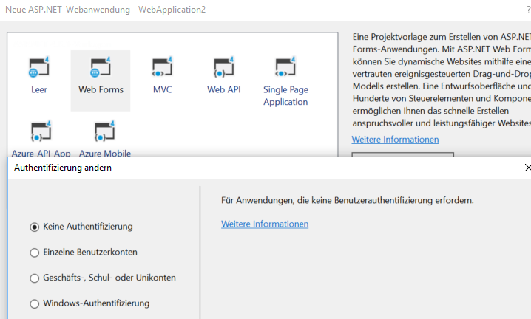

Slide 8
Authentifizierungs Methoden
Windows-based authentication | Forms-based authentication
Authentifizieren mit dem Nutzer des Betriebsystems | Authentifizieren mit einem Nutzer aus der eigenen Userdatenbank
Geeignet für das Intranet | Geeignet für das Internet Aufsetzen einer eigenen Benutzerregistrierung
Notes:
Briefly describe the two methods of authentication.
Distinguish between the two methods of authentication, and explain the key process of each method.
Question: Which authentication method uses Internet Information Services (IIS) authentication?
Answer: Windows-based authentication uses IIS authentication.
Module 15: Securing a Microsoft® ASP.NET Web Application
Course 10267A
8

Slide 9
Recht verwalten web.config
<location path="Modul13">
<system.web>
<authorization>
<deny users="?"/>
</authorization>
</system.web>
</location>
<system.web>
<authentication mode="Forms" >
<forms loginUrl="login.aspx">
</forms>
</authentication>
<authorization>
<deny roles="Guest"/>
</authorization>

Slide 10
User Objekt
Identity
Name
IsAuthenticated

Slide 11
Form
Login.aspx
Einfaches Eingabeformular
Mail
Passwort
E-mail address <asp:TextBox ID="UserEmail" runat="server" />
Password <asp:TextBox ID="UserPass" TextMode="Password" runat="server" />
Remember me? <asp:CheckBox ID="Persist" runat="server" />
<asp:Button OnClick="Logon_Click“ runat="server" />
Notes:
Explain that the animation shows how Forms-based authentication works with a nonauthenticated client, and with an authenticated client.
Question: When using Forms-based authentication, how are authentication credentials saved after a successful logon?
Answer: Authentication credentials are saved to the client by using a cookie, if not cookies have not been explicitly disabled on the client.
Module 15: Securing a Microsoft® ASP.NET Web Application
Course 10267A
11

Slide 12
Windows Authentifikation
web.config
<system.web>
<!--Modus Windows und Formauthentifikation erlauben-->
<authentication mode="Windows"/>
</system.web>
Notes:
Explain that the animation shows how Forms-based authentication works with a nonauthenticated client, and with an authenticated client.
Question: When using Forms-based authentication, how are authentication credentials saved after a successful logon?
Answer: Authentication credentials are saved to the client by using a cookie, if not cookies have not been explicitly disabled on the client.
Module 15: Securing a Microsoft® ASP.NET Web Application
Course 10267A
12

Slide 13
Windows Authentifikation
HttpClientHandler handler = new HttpClientHandler() {
UseDefaultCredentials = true
};
HttpClient client = new HttpClient(handler);
Notes:
Explain that the animation shows how Forms-based authentication works with a nonauthenticated client, and with an authenticated client.
Question: When using Forms-based authentication, how are authentication credentials saved after a successful logon?
Answer: Authentication credentials are saved to the client by using a cookie, if not cookies have not been explicitly disabled on the client.
Module 15: Securing a Microsoft® ASP.NET Web Application
Course 10267A
13

Slide 14
Form Authentifikation
web.config
<system.web>
<!--Modus Forms und Formauthentifikation erlauben-->
<authentication mode="Forms"/>
</system.web>
Notes:
Explain that the animation shows how Forms-based authentication works with a nonauthenticated client, and with an authenticated client.
Question: When using Forms-based authentication, how are authentication credentials saved after a successful logon?
Answer: Authentication credentials are saved to the client by using a cookie, if not cookies have not been explicitly disabled on the client.
Module 15: Securing a Microsoft® ASP.NET Web Application
Course 10267A
14

Slide 15
Form Authentifikation
void Logon_Click(object sender, EventArgs e)
{
if ((UserEmail.Text == "jchen@contoso.com") && (UserPass.Text == "37Yj*99Ps"))
{
Authentication.RedirectFromLoginPage(UserEmail.Value, Persist.Checked);
}
else
{
//Errormessage
}
}
Notes:
Explain that the animation shows how Forms-based authentication works with a nonauthenticated client, and with an authenticated client.
Question: When using Forms-based authentication, how are authentication credentials saved after a successful logon?
Answer: Authentication credentials are saved to the client by using a cookie, if not cookies have not been explicitly disabled on the client.
Module 15: Securing a Microsoft® ASP.NET Web Application
Course 10267A
15

Slide 16
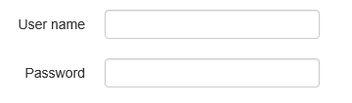
Login Controls
ChangePassword
CreateUserWizard
Login
LoginName
LoginStatus
LoginView
PasswordRecovery
Checkliste: eigener Login
Login Webform
Login-Tag hinzufügen <asp:Login ID = "Login1" runat = "server" OnAuthenticate= "UserMethod"></asp:Login>
Methode für das Anmelden UserMethod
Methode für das Abmelden
Timeout festlegen
Notes:
Briefly describe about using protected configuration.
Refer to the Course Handbook and provide examples to show how the connection string values are stored in a configuration file.
Question: What information can you encrypt in a Web application configuration file?
Answer: You can encrypt information such as user names and passwords, database connection strings, and encryption keys in a Web configuration file.
Module 15: Securing a Microsoft® ASP.NET Web Application
Course 10267A
16

Slide 17
Accessing User Identity
Nach dem Authentifizierungsprozess kannst du mit folgenden Code auf die User Identität zugreifen
UserLabel.Text = User.Identity.Name;
UserTypeLabel.Text = User.Identity.AuthenticationType;
UserAuthenticatedLabel.Text = User.Identity.IsAuthenticated.ToString();
Notes:
Briefly explain the code required to read user information.
Mention that User.Identity is not limited to Windows-based authentication.
Question: Which User.Identity object properties can you use to ascertain the user identity, the IIS authentication mechanism, and user authentication?
Answer: The User.Identity object properties AuthenticationType, Name, and IsAuthenticated, can be used to ascertain the user identity, the IIS authentication mechanism, and user authentication.
Module 15: Securing a Microsoft® ASP.NET Web Application
Course 10267A
17

Slide 18
ASP.NET Identity
https://docs.microsoft.com/en-us/aspnet/identity/overview/getting-started/adding-aspnet-identity-to-an-empty-or-existing-web-forms-project

