Slide 1
Webforms
ASP.NET

Slide 2
Creating Webforms
Webforms erstellen
Webform
Form Element
Server Controls

Slide 3
Webform
Web Form Default.aspx
<%@ Page Title="" Language="C#" Inherits="Default" %>
<html>
<body>
<form id="form1" runat="server">
</form>
</body>
</html>
Page directive and attributes
Form element and attributes
Notes:
3
Ensure that the students are familiar with the concept of debugging.
Explain the process of debugging: Determine whether the bug should be fixed, locate the bug, and fix the bug.
Point out that unlike spoken languages such as English and German, where a syntax error can be overlooked, a compiler error will not pass, because software like Visual Studio 2010 will not fix a syntax error.
Mention about debugging on the client—for example, how to debug a commercial Web application on a client computer by using Microsoft Visual Studio® 2010—and stepping through client-side code.
Potentially show the Options dialog box for enabling client-side debugging, and the JavaScript debugger method.
Point out though, that client-side debugging is not being discussed in this module.
Question: How will you ensure that your program or code is without any errors?
Answer: When you write a computer program, errors can and will occur. You might make a typographical error, your program might not perform as expected, or it might not run at all. When there is an error in your program, you need to find it and fix it. Finding and fixing errors is called debugging.
Module 7: Troubleshooting Microsoft® ASP.NET Web Applications
Course 10267A

Slide 4
Page Typen
<%@ Page Language="vb" AutoEventWireup="false" %>
Inline
Page
Projekt
<%@ Page Language="vb" AutoEventWireup="false" Codefile="WebForm2.aspx.vb" Inherits="WebForm2" %>
<%@ Page Language="vb" AutoEventWireup="false" CodeBehind="WebForm1.aspx.vb" Inherits="WebApplication1.WebForm1" %>

Slide 5
Attribute rendern
ID ->Name
ClientIDMode
Enabled, Width, Height
CSSClass -> Class
Runat=Server

Slide 6
Page Direktive
MaintainScrollpositionOnPostback
EnableViewstate
AutoEventWireUp
Culture UICulture

Slide 7
Server Controls
Serverseitige Event Handler werden verwendet, wenn das Event von einem Control ausgelöst wird.
Die Anfrage vom Client wird serverseitig verarbeitet und dann wird das Event auf dem Server gestartet
<asp:Button ID="Button1" runat="server" Text="Submit"/>
...renders as...
<input id="Button1" type="submit“ value="Submit" />
Brauchen runat="server" Attribut
Speichen den Zustand der Elemente
Beinhalten bereits Logikbausteine
Html ist danach browsersprezifisch
Notes:
7
Ensure that the students are familiar with the concept of debugging.
Explain the process of debugging: Determine whether the bug should be fixed, locate the bug, and fix the bug.
Point out that unlike spoken languages such as English and German, where a syntax error can be overlooked, a compiler error will not pass, because software like Visual Studio 2010 will not fix a syntax error.
Mention about debugging on the client—for example, how to debug a commercial Web application on a client computer by using Microsoft Visual Studio® 2010—and stepping through client-side code.
Potentially show the Options dialog box for enabling client-side debugging, and the JavaScript debugger method.
Point out though, that client-side debugging is not being discussed in this module.
Question: How will you ensure that your program or code is without any errors?
Answer: When you write a computer program, errors can and will occur. You might make a typographical error, your program might not perform as expected, or it might not run at all. When there is an error in your program, you need to find it and fix it. Finding and fixing errors is called debugging.
Module 7: Troubleshooting Microsoft® ASP.NET Web Applications
Course 10267A

Slide 8
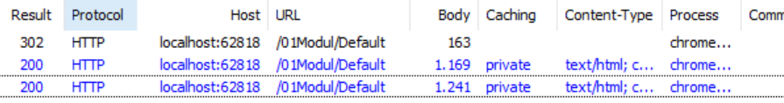
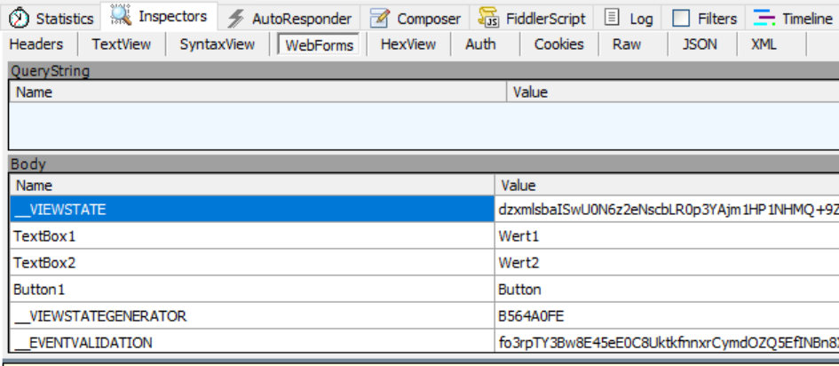
Was passiert
Get default.aspx
Post default.aspx
Default Post
Form Method = Get

Slide 9
Controls schachteln
Panel
<asp:Panel ID="Panel1" runat="server">
<asp:Button ID="Button1" runat="server" Text="Button" />
<asp:TextBox ID="TextBox1" runat="server"></asp:TextBox>

Slide 10
Control Typen
Html Server Control
Eins-zu-eins Mappen mit dem Html-Element
Web Server Control
Werden erst herunter gebrochen auf Html-Elemente
<asp:RadioButtonList runat="server" id="rblist">
<asp:ListItem>2</asp:ListItem>
<asp:ListItem>3</asp:ListItem>
</asp:RadioButtonList>
<div runat="server" id="ErrorAlert">
...
</div>
<div id="MainContent_ErrorAlert">
...
</div>
<input type="radio" value="2" name="group"/>
<input type="radio" value="3" name="group"/>
Notes:
10
Client-side event handlers are useful for events to which a Web Form must respond immediately, such as validation events. ASP.NET supports client script in either JavaScript or Microsoft Visual Basic Scripting Edition (VBScript) . Point out that VBScript is only supported in Windows® Internet Explorer®.
Take some time to discuss how event handlers can be created, assigned, or attached programmatically or explicitly.
Point out that you can get a reference to the ClientScriptManager class from the ClientScript property of the Page object, which is shown in the code samples as Me.ClientScript and this.ClientScript.
Note: Make sure that you do not get started on a discussion on ASP.NET Asynchronous JavaScript and XML (AJAX) at this point.
Module 7: Troubleshooting Microsoft® ASP.NET Web Applications
Course 10267A

Slide 11
Events
OnClick
OnPreRender
OnInit
OnLoad
SelectedIndexChanged

Slide 12
Controls
<img src="~/images/vespa.jpg" runat="server"/>
Placeholder
Hyperlink
Image
Radiobutton
Checkbox
Hiddenfield
Textbox mode

Slide 13
Zweifelhafte Controls
Treeview
Menu
Calendar
Adrotator
WebParts
Timer

