Slide 1
Kontrollfluss
ASP.NET

Slide 2
Adding Functionality
Mit C# Code arbeiten
Code plazieren
Code Behind Files
Handling Events
Allgemein
Serverseitg vs Clientseitig

Slide 3
Lebenszyklus der Seite
1. Page initialization
2. Load
3. Validation
4. Postback event handling
5. Rendering
6. Page unloading
Notes:
3
Ensure that the students are familiar with the concept of debugging.
Explain the process of debugging: Determine whether the bug should be fixed, locate the bug, and fix the bug.
Point out that unlike spoken languages such as English and German, where a syntax error can be overlooked, a compiler error will not pass, because software like Visual Studio 2010 will not fix a syntax error.
Mention about debugging on the client—for example, how to debug a commercial Web application on a client computer by using Microsoft Visual Studio® 2010—and stepping through client-side code.
Potentially show the Options dialog box for enabling client-side debugging, and the JavaScript debugger method.
Point out though, that client-side debugging is not being discussed in this module.
Question: How will you ensure that your program or code is without any errors?
Answer: When you write a computer program, errors can and will occur. You might make a typographical error, your program might not perform as expected, or it might not run at all. When there is an error in your program, you need to find it and fix it. Finding and fixing errors is called debugging.
Module 7: Troubleshooting Microsoft® ASP.NET Web Applications
Course 10267A

Slide 4
Code-Behind Files
Checkliste
Hinzufügen eines neuen Webforms
CodeFile- oder CodeBehindattribut
Inheritsattribut
Klassen & Methoden
Klasse hat den Namen des Webforms
Page_Load wird automatisch eingefügt
.aspx.cs
.aspx
<%@ Page Language="C#" CodeFile= "Webform1.aspx.cs" Inherits=„Webform1" %>
public partial class Webforms1 : System.Web.UI.Page {
protected void Page_Load(object sender, EventArgs e) {
}
}
Notes:
4
Ensure that the students are familiar with the concept of debugging.
Explain the process of debugging: Determine whether the bug should be fixed, locate the bug, and fix the bug.
Point out that unlike spoken languages such as English and German, where a syntax error can be overlooked, a compiler error will not pass, because software like Visual Studio 2010 will not fix a syntax error.
Mention about debugging on the client—for example, how to debug a commercial Web application on a client computer by using Microsoft Visual Studio® 2010—and stepping through client-side code.
Potentially show the Options dialog box for enabling client-side debugging, and the JavaScript debugger method.
Point out though, that client-side debugging is not being discussed in this module.
Question: How will you ensure that your program or code is without any errors?
Answer: When you write a computer program, errors can and will occur. You might make a typographical error, your program might not perform as expected, or it might not run at all. When there is an error in your program, you need to find it and fix it. Finding and fixing errors is called debugging.
Module 7: Troubleshooting Microsoft® ASP.NET Web Applications
Course 10267A

Slide 5
Event Handlers
Event Handler sind Methoden, die ausgeführt werden durch ein generiertes Event zB gedrückter Butten
!
Events werden meist vom Client ausgelöst
0001
1011
0111
Event Handler
Das Event kann sowohl serverseitig als auch clientseitig behandelt werden
Notes:
5
Ensure that the students are familiar with the concept of debugging.
Explain the process of debugging: Determine whether the bug should be fixed, locate the bug, and fix the bug.
Point out that unlike spoken languages such as English and German, where a syntax error can be overlooked, a compiler error will not pass, because software like Visual Studio 2010 will not fix a syntax error.
Mention about debugging on the client—for example, how to debug a commercial Web application on a client computer by using Microsoft Visual Studio® 2010—and stepping through client-side code.
Potentially show the Options dialog box for enabling client-side debugging, and the JavaScript debugger method.
Point out though, that client-side debugging is not being discussed in this module.
Question: How will you ensure that your program or code is without any errors?
Answer: When you write a computer program, errors can and will occur. You might make a typographical error, your program might not perform as expected, or it might not run at all. When there is an error in your program, you need to find it and fix it. Finding and fixing errors is called debugging.
Module 7: Troubleshooting Microsoft® ASP.NET Web Applications
Course 10267A

Slide 6

Clientside Event Handlers
Clientseitige Event Handler werden auf dem Client ausgelöst und verarbeitet.
Braucht keine Server ressourcen
Interface
!
0001
1011
0111
Notes:
6
Client-side event handlers are useful for events to which a Web Form must respond immediately, such as validation events. ASP.NET supports client script in either JavaScript or Microsoft Visual Basic Scripting Edition (VBScript) . Point out that VBScript is only supported in Windows® Internet Explorer®.
Take some time to discuss how event handlers can be created, assigned, or attached programmatically or explicitly.
Point out that you can get a reference to the ClientScriptManager class from the ClientScript property of the Page object, which is shown in the code samples as Me.ClientScript and this.ClientScript.
Note: Make sure that you do not get started on a discussion on ASP.NET Asynchronous JavaScript and XML (AJAX) at this point.
Module 7: Troubleshooting Microsoft® ASP.NET Web Applications
Course 10267A

Slide 7
Serverside Event Handlers
Response
Serverseitige Event Handler werden verwendet, wenn das Event von einem Control ausgelöst wird.
Die Anfrage vom Client wird serverseitig verarbeitet und dann wir das Event auf dem Server gestartet
Request
!
0001
1011
0111
Notes:
7
Ensure that the students are familiar with the concept of debugging.
Explain the process of debugging: Determine whether the bug should be fixed, locate the bug, and fix the bug.
Point out that unlike spoken languages such as English and German, where a syntax error can be overlooked, a compiler error will not pass, because software like Visual Studio 2010 will not fix a syntax error.
Mention about debugging on the client—for example, how to debug a commercial Web application on a client computer by using Microsoft Visual Studio® 2010—and stepping through client-side code.
Potentially show the Options dialog box for enabling client-side debugging, and the JavaScript debugger method.
Point out though, that client-side debugging is not being discussed in this module.
Question: How will you ensure that your program or code is without any errors?
Answer: When you write a computer program, errors can and will occur. You might make a typographical error, your program might not perform as expected, or it might not run at all. When there is an error in your program, you need to find it and fix it. Finding and fixing errors is called debugging.
Module 7: Troubleshooting Microsoft® ASP.NET Web Applications
Course 10267A

Slide 8
Wirklich löschen
OnClientClick="return confirm('wirklich');"

Slide 9
Handling Postbacks
protected void Page_Load(object sender, EventArgs e)
{
if (! IsPostBack) {
}
}
!
0001
1011
0111
Notes:
9
Ensure that the students are familiar with the concept of debugging.
Explain the process of debugging: Determine whether the bug should be fixed, locate the bug, and fix the bug.
Point out that unlike spoken languages such as English and German, where a syntax error can be overlooked, a compiler error will not pass, because software like Visual Studio 2010 will not fix a syntax error.
Mention about debugging on the client—for example, how to debug a commercial Web application on a client computer by using Microsoft Visual Studio® 2010—and stepping through client-side code.
Potentially show the Options dialog box for enabling client-side debugging, and the JavaScript debugger method.
Point out though, that client-side debugging is not being discussed in this module.
Question: How will you ensure that your program or code is without any errors?
Answer: When you write a computer program, errors can and will occur. You might make a typographical error, your program might not perform as expected, or it might not run at all. When there is an error in your program, you need to find it and fix it. Finding and fixing errors is called debugging.
Module 7: Troubleshooting Microsoft® ASP.NET Web Applications
Course 10267A

Slide 10
Programmablauf steuern
Web ist nicht Desktop
Statuslos Server
URI ist Status
Globalen Variable
Events
Button Click, Selection Changed
Page wird geladen
Status

Slide 11
Response Objekt
Server sendet an Client
Response.StatusCode = 404;
Response.redirect
302 Umleitung neue Seite
Response.Write

Slide 12
Request Objekt
Client zum Server
Request.Form["text1"]; HTML Input <input type="text" name="text1" />
Querystring, Form, Cookie
Request.LogonUserIdentity

Slide 13
Get the Data
Request.QueryString
Request.GetFriendlyUrlSegments
Index

Slide 14
Server Objekt
Server.Mappath
Transfer
Scripttimeout
UrlDecode UrlEncode
HTMLDecode, HTMLEncode
HttpUtility.UrlDecode
<%=Server.HtmlEncode("Hannes&Preishuber-Pflügl") %>
<%=Server.UrlEncode("http://www.ppedv.de?id=Hannes Preishuber-Pflügl") %>

Slide 15
Application Variable bzw Events
Globale Liste von Variablen
Key/Index-Value
Anwendungsfall User Counter
Global.asax
Application_start
Session_start
Session_end
Application["users"].ToString();

Slide 16
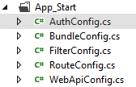
App_start
Auch ohne global.asax

Slide 17
Session Variable
Eher nein
User Liste von Variablen
Key/Index-Value
Anwendungsfall Warenkorb
Session.Abandon
Diskussion vs Cookie

Slide 18
Web.config & Session Management
<sessionState mode="InProc" cookieless="UseUri" customProvider="DefaultSessionProvider">
<providers>
<add name="DefaultSessionProvider" type="System.Web.Providers.DefaultSessionStateProvider, System.Web.Providers, Version=2.0.0.0, Culture=neutral, PublicKeyToken=31bf3856ad364e35" connectionStringName="DefaultConnection" />
</providers>
</sessionState>

Slide 19
Programmfluss durch Querystring ? steuern
Request.Querystring
ID oder Key
HyperLink ala Kunden.aspx?id=1&name=Hannes
URL ab ?
Variable=Wert
Mehrere Paare mit &

Slide 20
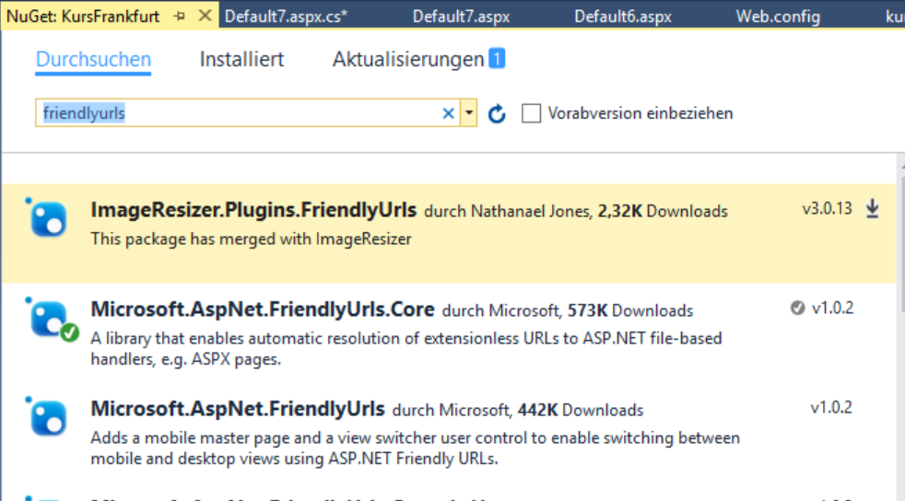
FriendlyUrls
Hyperlink als Pfad
kunden/id/1/name/Hannes
Paket Installieren
Global.asax
Routeconfig
Aktivieren
Imports oder using
<%@ Import Namespace="Microsoft.AspNet.FriendlyUrls" %>

Slide 21
Cookies
Variable Wert
Kann auch Objekt sein
Lebensdauer
Negative Zeit löscht den Cookie
Cookie ohne Zeit beim Schliessen des Browsers
ASP.NET
Response.Cookies
Request.Cookies

Slide 22
JavaScript Cookies
Document.Cookie
document.cookie = "username=John; expires=Thu, 18 Dec 2018 12:00:00 UTC";
a = document.cookie;
cookiename = a.substr(0,a.search('='));
cookiewert = a.substr(a.search('=')+1,a.search(';'));

