Slide 1
Webforms
ASP.NET

Slide 2
Reuse und Struktur
Master Page
Master Page erstellen
Content Pages
User Controls
Allgemein
Erstellen und verwenden

Slide 3
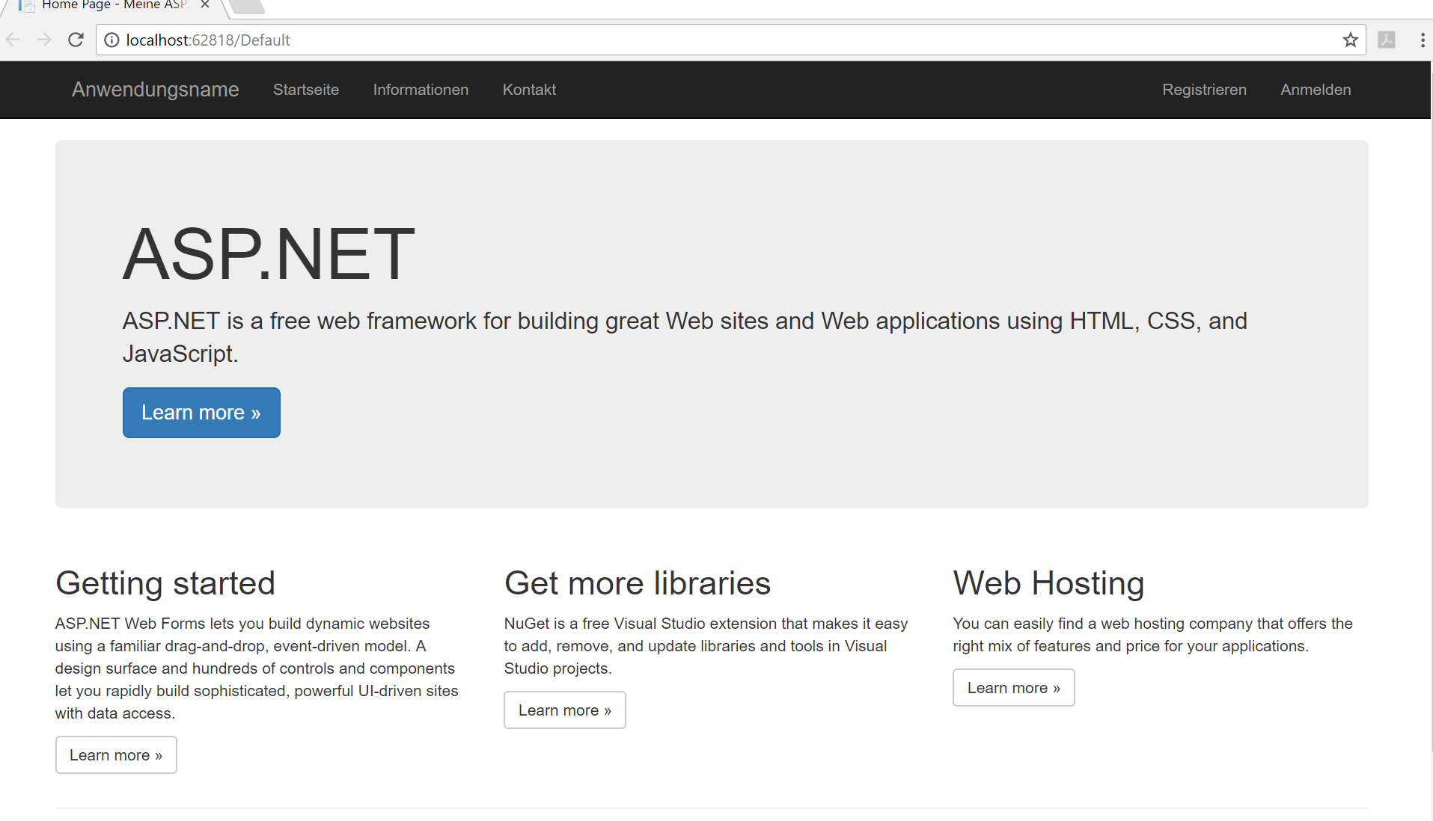
Menü in Masterpage
Row
Bootstrap Button
Bootstrap 12 Spalten Layout

Slide 4
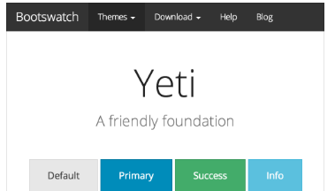
Master Page
Body & Head (mit Scripte und Styles)
Header & Footer
Vorsicht: In der Masterpage ist auch ein Form enthalten, diese sind in Webforms nicht schachtelbar
Seitenspezifischer Inhalt <asp:ContentPlaceHolder ID="MainContent" runat="server">
Nur spezifischen Seitenabschnitte werden ausgetauscht
.master Endung
Wiederverwendbar für alle Seite
Notes:
Focus this conversation on enabling tracing, and how to view trace messages.
You can use the solution code for this module to view application-level tracing, and point out the information mentioned in the Trace Categories table.
Ensure that you discuss the following background on tracing. In classic application service providers (ASPs), tracing and debugging facilities were not available Therefore, developers used the ‘got here’ debugging in the form of Response.Write statements. This resulted in an HTML page with informal trace statements announcing to the programmer that the program ‘got here’ and ‘got there’ with each new line executed. This kind of intrusive tracing was very inconvenient to clean up. So, many developers created their own informal trace libraries to circumvent these limitations.
Emphasize that the students must use the Trace and Debug classes for tracing and debugging, rather than Response.Write statements.
Mention to the students that there are multiple things named Trace in the Microsoft .NET Framework. There is a class called System.Diagnostics.Trace, and there is also a public property on System.Web.UI.Page that is known as Trace. The Trace property on the Page class gives you access to the System.Web.TraceContext and the ASP.NET–specific tracing mechanism.
The TraceContext class collects all the details and timing of a Web request. It contains a number of methods, but the students will mostly use the Write method. It also includes the Warn method, which simply calls the Write() function, and ensures that the output generated by Warn is colored in red.
Avoid a discussion on state, because this is covered in Module 13.
Question: How will you view trace information?
Answer: You can view trace information at the bottom of each page. Alternatively, you can also use the trace viewer or Trace.axd to view trace information that is collected and cached by ASP.NET, when tracing is enabled.
Module 7: Troubleshooting Microsoft® ASP.NET Web Applications
Course 10267A
4

Slide 5
MasterPage
Contentbereich per ContentPlaceholder Control
Mehrere möglich
Auch Head
Verschiedene Masterpage
Hierarchisch Schachtelbar
Tipp Webopt: bundlreference hindert intellisense am Css Klassen erkennen
Per drag Drop die bootstrap css reinziehen

Slide 6
Tipp Struktur
Head
ContentMain
ClientScripts

Slide 7
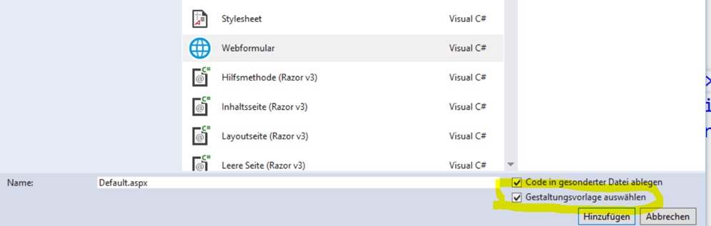
ContentPage
Head fehlt
Body fehlt
Samt Form Element
1+x Content Control
Nachträglich änderbar MasterpageFile
Hinweis gerenderte ID‘s

Slide 8
Content Pages
Content Pages sind Webforms, die Layout der Masterpage anwenden
Contentpage
Rechtsklick auf Solution Explorer
Neues Item hinzufügen
Wertform auswählen
Den Hacken bei „Use Masterpage“ setzten
Your Page Content
<%@ Page Language="C#" MasterPageFile="~/Master.master" CodeFile="Default.aspx.cs" Inherits="Default"%>
<asp:Content ContentPlaceHolderID=“MainContent" runat="Server"> Your Page Content </asp:Content>
Der Inhalt innerhalb des <asp:Content> wird in den ContentPaceHoder eingesetzt
Notes:
Focus this conversation on enabling tracing, and how to view trace messages.
You can use the solution code for this module to view application-level tracing, and point out the information mentioned in the Trace Categories table.
Ensure that you discuss the following background on tracing. In classic application service providers (ASPs), tracing and debugging facilities were not available Therefore, developers used the ‘got here’ debugging in the form of Response.Write statements. This resulted in an HTML page with informal trace statements announcing to the programmer that the program ‘got here’ and ‘got there’ with each new line executed. This kind of intrusive tracing was very inconvenient to clean up. So, many developers created their own informal trace libraries to circumvent these limitations.
Emphasize that the students must use the Trace and Debug classes for tracing and debugging, rather than Response.Write statements.
Mention to the students that there are multiple things named Trace in the Microsoft .NET Framework. There is a class called System.Diagnostics.Trace, and there is also a public property on System.Web.UI.Page that is known as Trace. The Trace property on the Page class gives you access to the System.Web.TraceContext and the ASP.NET–specific tracing mechanism.
The TraceContext class collects all the details and timing of a Web request. It contains a number of methods, but the students will mostly use the Write method. It also includes the Warn method, which simply calls the Write() function, and ensures that the output generated by Warn is colored in red.
Avoid a discussion on state, because this is covered in Module 13.
Question: How will you view trace information?
Answer: You can view trace information at the bottom of each page. Alternatively, you can also use the trace viewer or Trace.axd to view trace information that is collected and cached by ASP.NET, when tracing is enabled.
Module 7: Troubleshooting Microsoft® ASP.NET Web Applications
Course 10267A
8

Slide 9
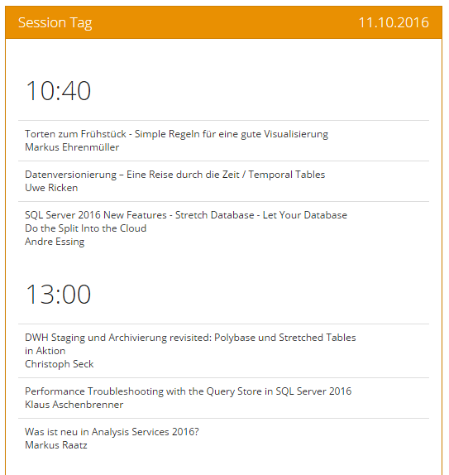
UserControl=neues Control
zB eine Randleiste mit Terminen
Vereinfacht das Wiederverwenden von UI und Code
Dürfen keine TopLevel-Html-Elemente enthalten zB Body oder Form
Behandelt seine Events selbst
Können statisches Markup und Server Controls enthalten
Selbstständig und unabhängig der gewählten Programmiersprache
Notes:
9
Ensure that the students are familiar with the concept of debugging.
Explain the process of debugging: Determine whether the bug should be fixed, locate the bug, and fix the bug.
Point out that unlike spoken languages such as English and German, where a syntax error can be overlooked, a compiler error will not pass, because software like Visual Studio 2010 will not fix a syntax error.
Mention about debugging on the client—for example, how to debug a commercial Web application on a client computer by using Microsoft Visual Studio® 2010—and stepping through client-side code.
Potentially show the Options dialog box for enabling client-side debugging, and the JavaScript debugger method.
Point out though, that client-side debugging is not being discussed in this module.
Question: How will you ensure that your program or code is without any errors?
Answer: When you write a computer program, errors can and will occur. You might make a typographical error, your program might not perform as expected, or it might not run at all. When there is an error in your program, you need to find it and fix it. Finding and fixing errors is called debugging.
Module 7: Troubleshooting Microsoft® ASP.NET Web Applications
Course 10267A

Slide 10
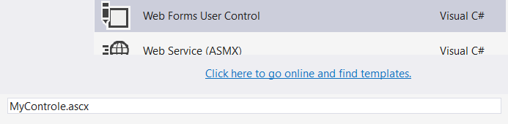
101
Klasse
Propertys
Statt Page Control
Server Controls zusammenfassen
Aus Projekt per Dra& Drop reinziehen
Propertys dienen als Schnittstelle nach aussen
<%@ Register Src="~/MyControl.ascx" TagPrefix="uc1" TagName="MyControl" %>
<uc1:MyControle runat="server" ID=" MyControl" TopOrders="6"/>

Slide 11
Custom Control
Ohne UI Deklaration
Klasse
Erbt von
Rendering Custom

Slide 12
Übung

