Slide 2
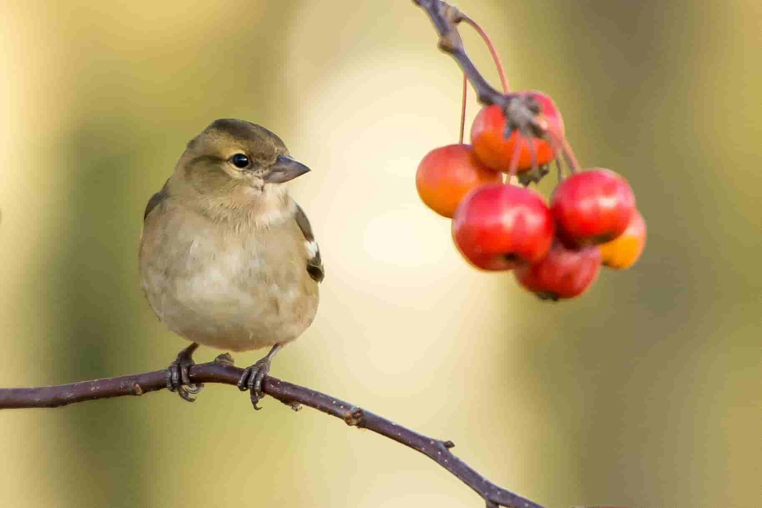
“Therefore I tell you, do not worry about your life, what you will eat or drink; or about your body, what you will wear.”
Matthew 6:25

Slide 3
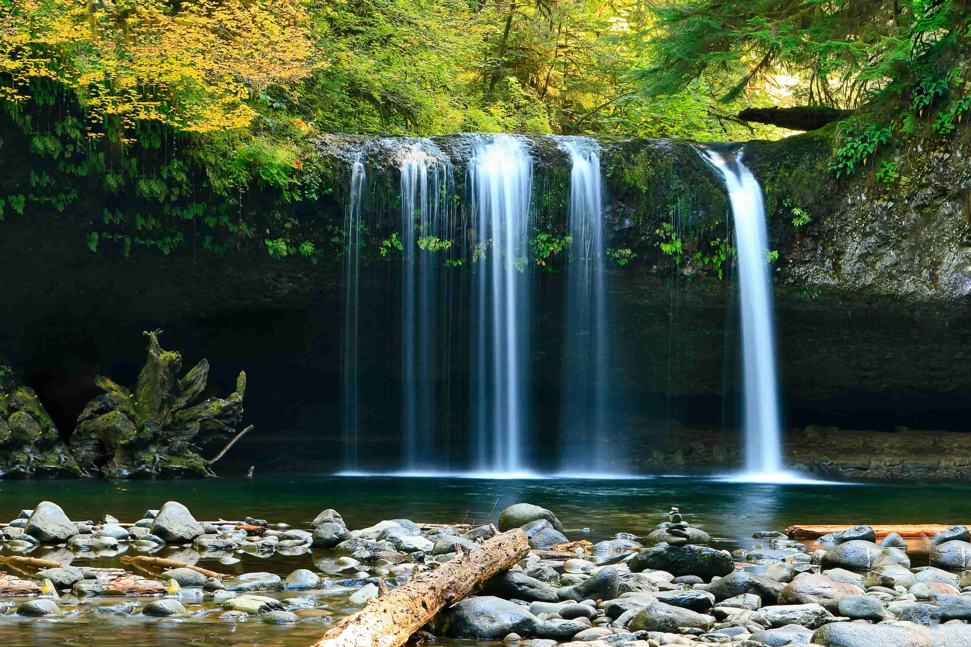
Whoever believes in me, as Scripture has said, “rivers of living water will flow from within them.”
John 7:38

Slide 4
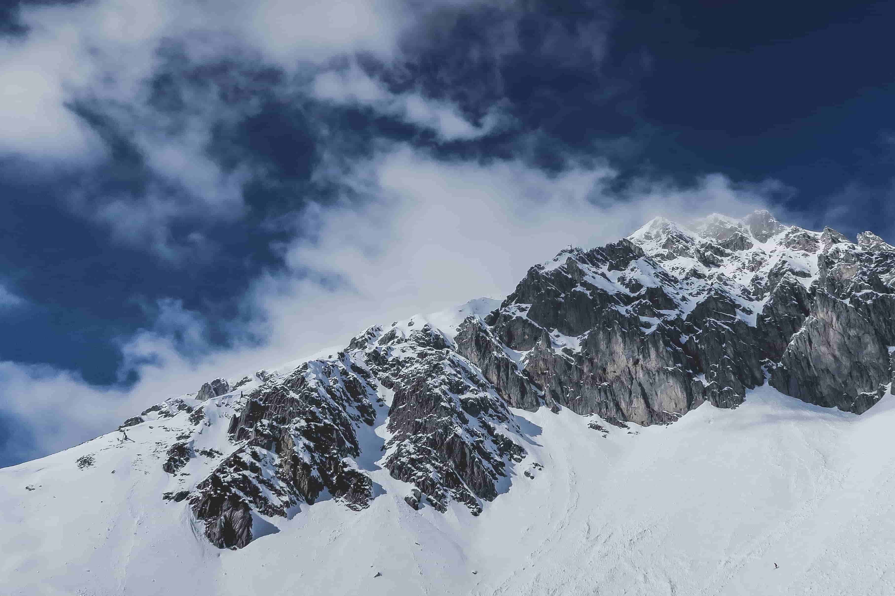
I lift up my eyes to the mountains - where does my help come from?
My help comes from the Lord, the Maker of heaven and earth.
Psalm 121:1-2

Slide 5
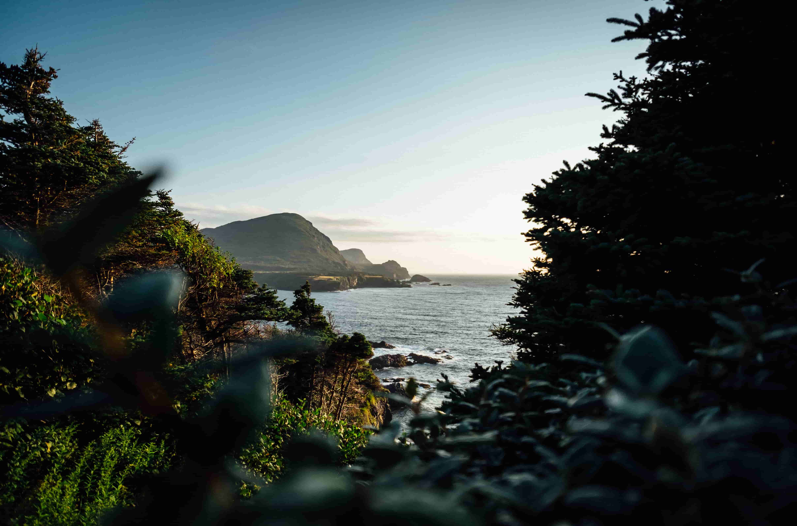
That person is like a tree planted by streams of water, which yields its fruit in season and whose leaf does not wither - whatever they do prospers.
Psalm 1:3

