Slide 1
Activity Recognition in a home
Patrick, Dong, Stephen

Slide 2
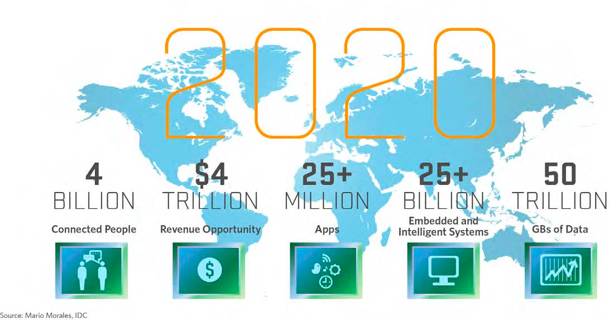
Internet of Things
Network of physical ‘things’ to collect and exchange data

Slide 3
Activity Recognition
Recognizing human activities e.g. sleeping, cooking, bathing

Slide 4
Problem definition

Slide 5
Related work

Slide 6
Experimental Design
Naïve Bayes
SVM
HMM
CRF
Structured SVM

Slide 7
Evaluation
Dataset

Slide 8
Summary

