Slide 1
Activity Recognition in a home
Patrick, Dong, Stephen

Slide 2
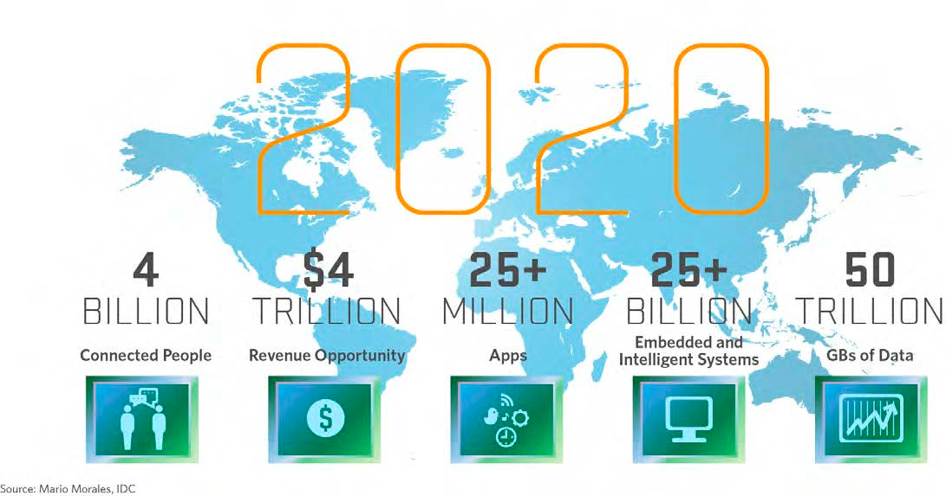
Internet of Things
Network of physical ‘things’ to collect and exchange data

Slide 3
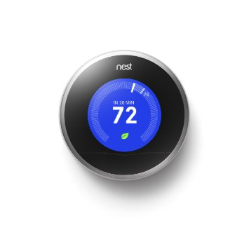
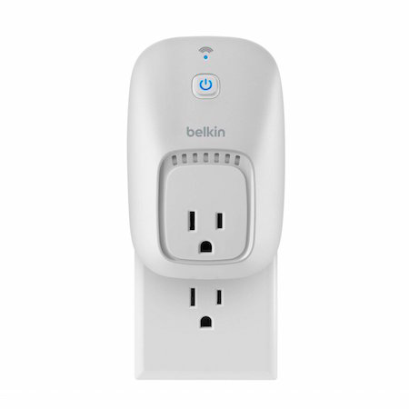
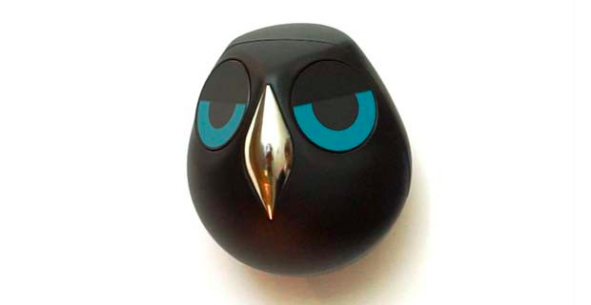
Activity Recognition
Recognizing human activities e.g. home occupancy, sleeping, cooking, bathing
Nest
Ulo
Belkin Smart Switch

Slide 4

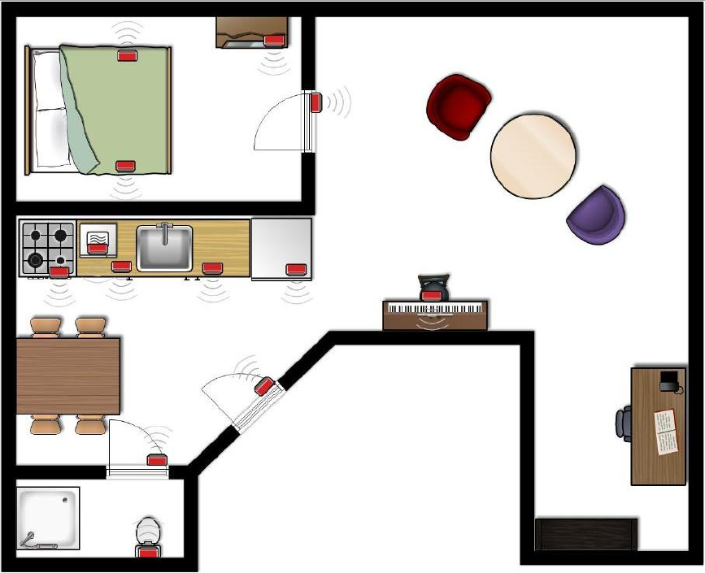
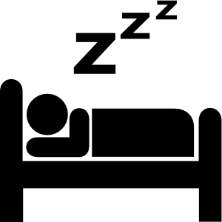

Problem definition
Infer occupant activities using sensors home deployed sensors

Slide 5
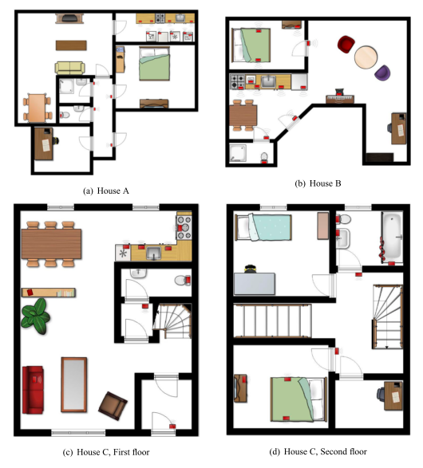
Evaluation
2 apartments 1 home
Each single occupant
Duration 14 – 25 days

Slide 6
Dataset
Binary sensor data:
Reed switches : doors or cupboards open or closed
Pressure mats : lying on bed or couch
Passive infrared: Detect motion in specific area
Float sensors: toilet being flushed
Labels:
Handwritten diary
Bluetooth diary

Slide 7
Related work
Van Kasteren, T. L. M., Gwenn Englebienne, and Ben JA Kröse. "Human activity recognition from wireless sensor network data: Benchmark and software." Activity recognition in pervasive intelligent environments. Atlantis Press, 2011. 165-186
Tapia, Emmanuel Munguia, Stephen S. Intille, and Kent Larson. Activity recognition in the home using simple and ubiquitous sensors. Springer Berlin Heidelberg, 2004.

Slide 8
Methods
Naïve Bayes
SVM
HMM
Generative probabilistic model
CRF
Discriminative probabilistic model
Structured SVM
Allows training of a classifier for general structured output labels

Slide 9
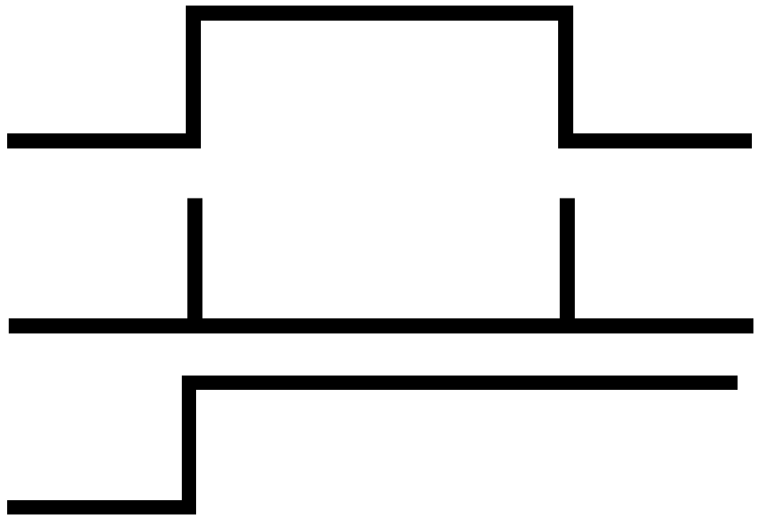
Evaluation Design
Feature representations
Raw
Change
Last
5 fold – cross validation
Divide the dataset into smaller subsequences of ~2 hours

Slide 10
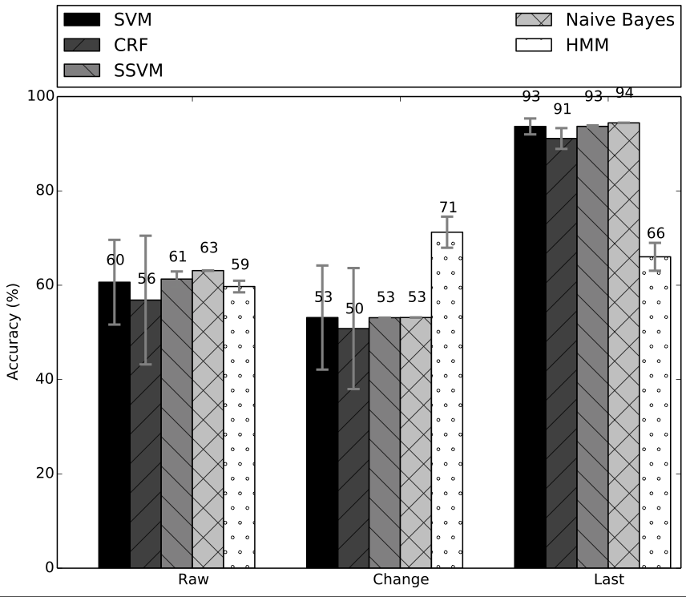
Comparison: House A

Slide 11
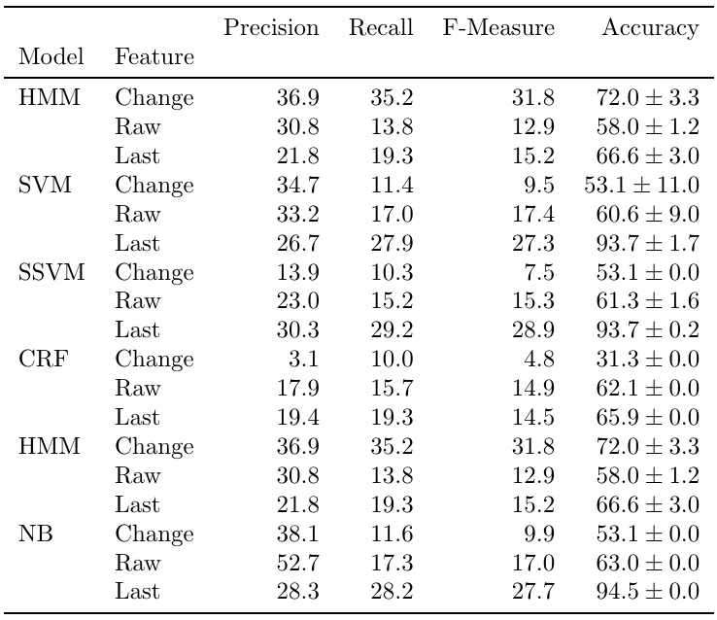
House A Metrics

Slide 12
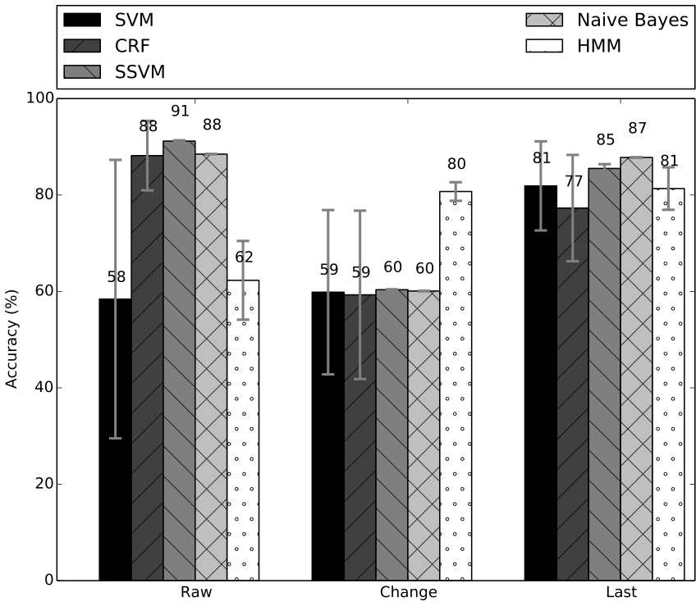
Comparison: House B

Slide 13
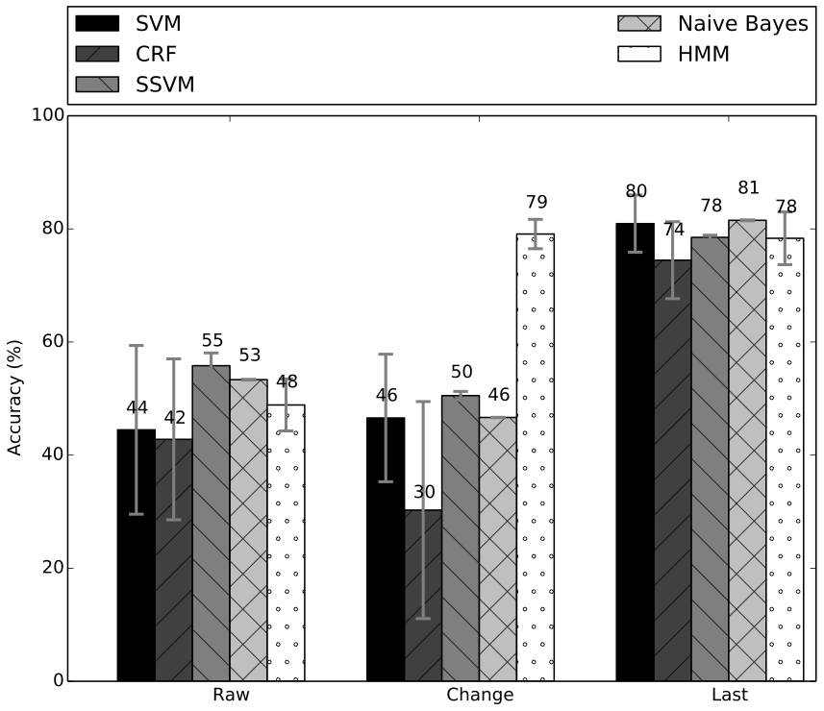
Comparison: House C

Slide 14
Summary
Naive Bayes consistently outperforms other methods
Structured SVM also performs well in sensors based activity recognition.

