Slide 1
Introduction to Cost Effectiveness Analysis
DARTH workgroup

Slide 2
Overview of Decision Analysis
Notes:
Part 1 = Showing code 3 state model
Part 2 = Exercise build Sick-Sicker model
Part 3 = Show answers of Sick-Sicker

Slide 3
What is Decision Analysis?
Explicit, quantitative and systematic approach to decision making under uncertainty
Identify, measure, and value the consequences of different alternatives as well as the uncertainty that exists when the decision needs to be made
Help structure the analyst’s thinking and facilitate the communication of assumptions
Provide a structural framework for synthesizing data from disparate sources and allows for extrapolation
Elements are incorporated into a mathematical model which is used to estimate the outcomes of different options or interventions

Slide 4


Decision Analysis
Option 1
Option 2
Option 3
Harms?
Benefits?
Cost?

Slide 5
Prevalence
of disease
Efficacy of treatment
or preventive measures
Risk of future events
Side effects / harms
Decision
model
Health-related
quality of life
Adherence /
compliance
Costs
Diagnostic accuracy
Health & economic
outcomes for
alternative strategies
Policy
Implications

Slide 6
Model Types
Decision trees
Schematic representation of uncertain events/consequences of different alternatives
Cohort state transition models
Dynamic model that captures disease progression and other events
Simulates a homogeneous cohort
Usually deterministic
Individual-based models / microsimulation
Stochastic dynamic model
Simulates individuals
Most flexible model type

Slide 7
Analysis Outcomes
Notes:
Part 1 = Showing code 3 state model
Part 2 = Exercise build Sick-Sicker model
Part 3 = Show answers of Sick-Sicker

Slide 8
Health Outcomes
Disease-specific
Intermediate clinical markers
Cases averted
Events averted
Generic
Lives saved / deaths averted
Life-years gained
Quality-adjusted life-years (QALYs) gained

Slide 9
Quality-Adjusted Life-Years
1.0
0.9
0.7
0.3
0
2
3.5
4.5
7
Time
(years)
← Life span →
QALYs =
(2)(1)
+(1.5)(.7)
+(1)(.3)
+(2.5)(.9)
= 5.6

Slide 10
Costs
Formal healthcare sector
Facilities and resources
Drugs and devices
Personnel time
Informal healthcare sector
Patient time
Unpaid caregiver time
Transportation costs
Non-healthcare sector
Legal or criminal justice
Education
Housing

Slide 11
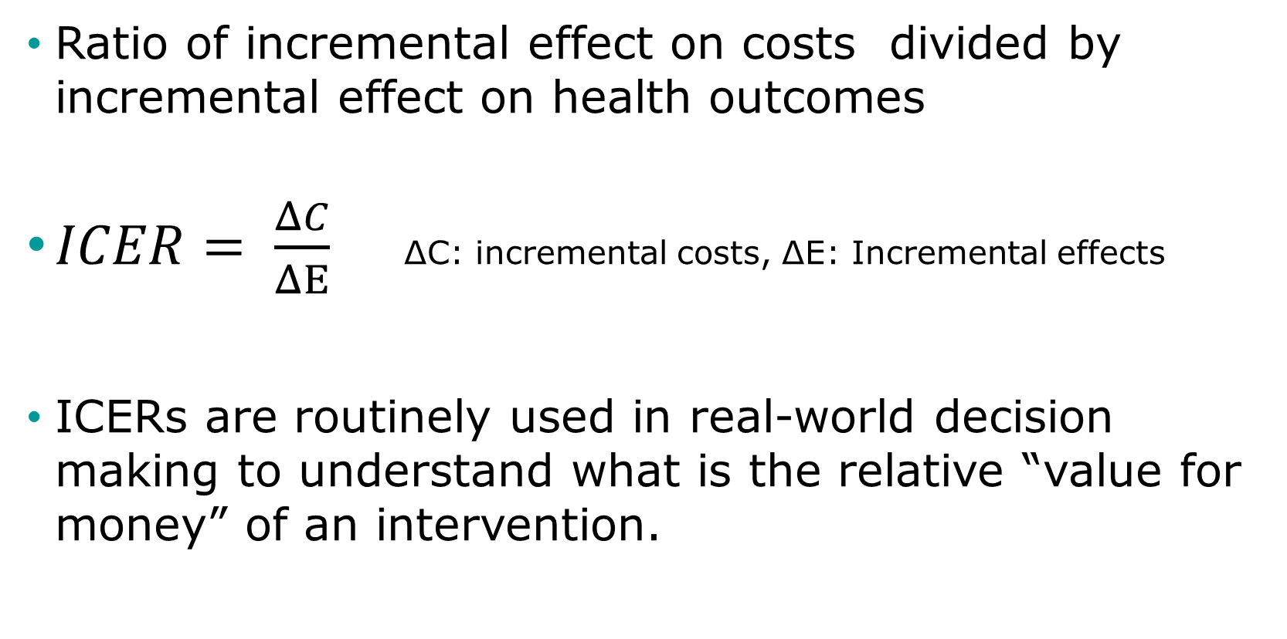
Incremental Cost Effectiveness Ratio
Ratio of incremental effect on costs divided by incremental effect on health outcomes
$ICER= \frac{ΔC}{ΔΕ}$ ΔC: incremental costs, ΔΕ: Incremental effects
ICERs are routinely used in real-world decision making to understand what is the relative “value for money” of an intervention.

Slide 12
Cost-Effectiveness Analysis
Subset of decision analytic questions where the objective is to balance costs and health benefits
Defined willingness-to-pay per unit of health benefit (also called cost-effectiveness threshold)
40,000
C
30,000
Cost ($)
$50,000/QALY
20,000
B
10,000
A
$20,000/QALY
0
8
8.5
9
Effectiveness (QALYs)

