Slide 1



The effect of health expenditures on quality of care:
Evidence from inpatients with acute myocardial infarction
HAD5744: Health Econometrics I
Final Project Presentation
Peiya Cao & Nan Chen

Slide 2
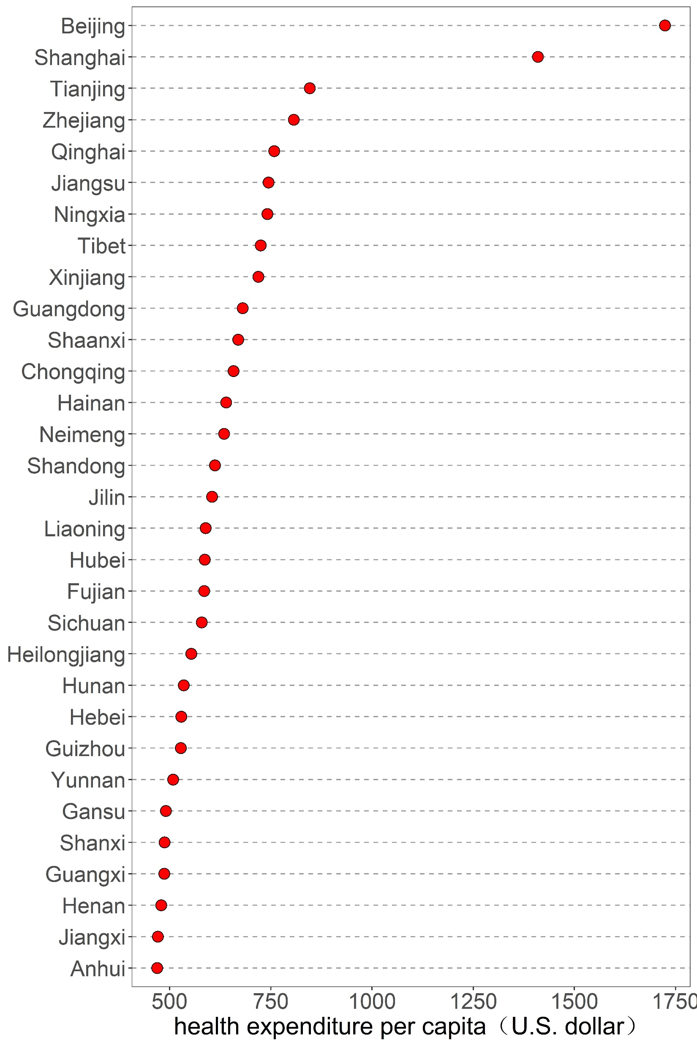
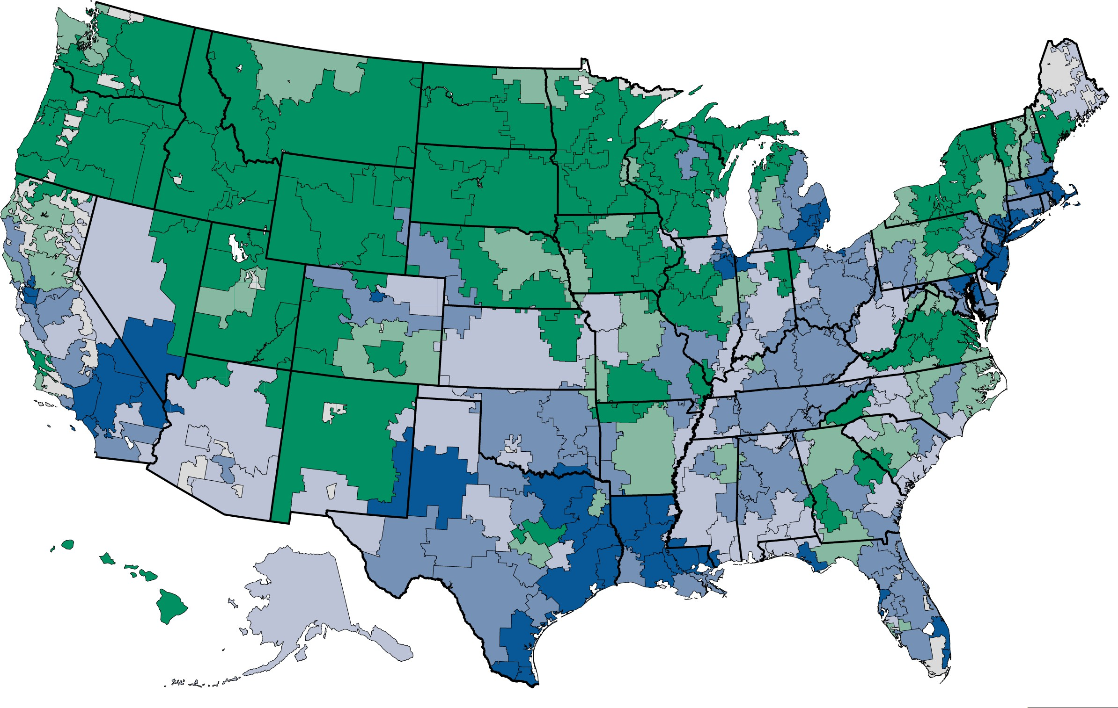
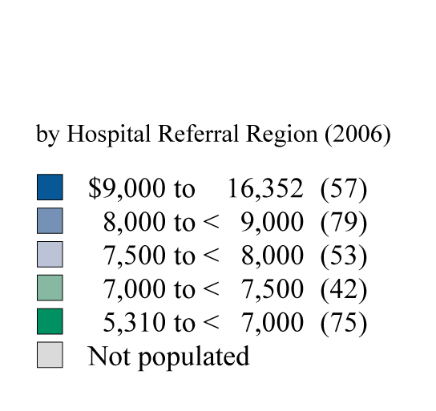
Introduction
Medicare spending varies dramatically
Medicare spending in 2006 varied more than threefold across U.S. hospital referrel regions
(Darmouth Atlas, 2009)
Source: China Health Statistical Yearbook 2020 (Exchange rate on 2019)

Slide 3
Introduction
Correlations (consistent results: higher expenditures is not correlated with a better quality of care)
Higher-Spending Regions V.S. Lower-Spending Ones
Adherence to evidence-based care guidelines worse (Fisher ES,et al.,2003; Baicker K, et al.,2004)
Mortality higher following acute myocardial infarction, hip fracture, and colorectal cancer diagnosis (Fisher ES, et al.,2003)
…
Causal effects (different results according to type of patient and health services)
Except for AMI patients, a 10 percent increase in inpatient spending was associated with a decrease of between 3.1 and 11.3 percent in thirty-day mortality (Kaestner R & Silber JH , 2010)
Higher returns to surgery, better outcomes among patients most appropriate for surgery, and worse outcomes among patients least appropriate for surgery(Chandra and Staiger DO , 2007)
…
Most of previous studies conducted in developed countries, little is know about such effect in the context of China
Research question: Higher-expenditure regions are less problematic if they can produce better health outcomes, what is the association between health expenditures and quality of care?

Slide 4
Study area and data source
Hospital discharge data
Discharge data in the fourth quarter from 2016 to 2019
(from September to December)
(2017-2019 for constructing units for analysis)
(2016 only for IV strategy)
AMI hospital discharge data from 2017 to 2019
Hospital-level administrative data
Hospitals' annual report
Sichuan province: ranks the fifth largest province (486,052 km²) in land size and had a resident population of 83.75 million in 2019

Slide 5

Methods
Choice of disease: acute myocardial infarction (AMI)
“Pickiness” of patients and their providers among hospitals has less chance of happening
AMI is highly prevalent, and it is the leading cause of mortality, resulting in a large number of hospital admissions for sample size guarantee
Hospitals that provide higher-quality services can achieve substantially lower mortality rates or cause fewer readmission cases
Hospitals have to treat AMI, and they treat a lot of it -- so we really care if the spending gradient affects quality here from a policy perspective; if it doesn't, we need to start talking about how to resign spending in

Slide 6
Methods
Main definitions
Quality measures: (1) 30 day all-cause unplanned readmission; (2) in-hospital mortality
Definition of health expenditure: total inpatient expenditures during the index hospitalization for treatment of AMI
Quality measure criterions: patients admitted in secondary or tertiary hospitals; whose urgency status when admission were critical urgent or urgent; excluded AMI patients who admitted after December 1, 2019
Health expenditure criterions: excluded AMI patients whose total inpatient expenditures are fewer than 100 Chinese yuan, after removing the extreme value of total inpatient expenditures (maximum and minimum expenditures), we included the AMI patients whose total inpatient expenditures were in the 95% cost range
Samples (final sample 19,031 for quality measure 1# and 20,917 for quality measure #2)

Slide 7
Methods
Unobserved confounders
physicians’ beliefs, medical uncertainty or clinical indications
Simultaneous problems
Total inpatient expenditure
X
Quality measures
Y

Slide 8
Methods
#1 average total inpatient expenditures of inpatients with non-specific diseases of a hospital in a previous period (year 2016)
#2 average total inpatient expenditures of AMI inpatients of a hospital in a previous period (year 2016)
#3 average length of stay of inpatients with non-specific diseases of a hospital in a previous period (year 2016)
#4 average length of stay of AMI inpatients of a hospital in a previous period (year 2016)
hospital-specific treatment level
Z
Total inpatient expenditure
X
Quality measures
Y

Slide 9
Methods
Relevance: previous evidence from the Dartmouth Atlas Project showing that the treatment intensity and resource use for patients in a hospital is significantly associated with the intensity of treatment and use of resources in that same hospital, even in different periods (Darmouth Atlas, 2009)
Validity: the patient doesn’t pick the hospital
Monotonicity: hospitals with intensive treatment and resource use leads to higher total expenditures of patients

Slide 10
Methods
Observed confounders
individual demographic features: age, gender, socioeconomic status, comorbidity, the severity of illness, whether covered by social health insurance
hospital-level characteristics: ownership, whether for profit and the capacity of hospitals
hospital service areas (HSAs) characteristics: supply of hospital resources, hospital market share, per capita GDP and urbanization rate
×
hospital-specific treatment level
Z
Total inpatient expenditure
X
Quality measures
Y
×

Slide 11
Methods
Two-stages least-squares (2SLS) method:
(Eq.1)
(Eq.2)
Robustness checks: make sure our results are not sensitive to the IV choice; we also did some robustness checks with different combinations of the IVs.
Statistical analysis

Slide 12
Results
Table 1 Demographic characteristics of AMI inpatients according to two measures of quality
Variables | 30-day all-cause unplanned readmission |  | P | In-hospital mortality |  | P
 | Yes | No |  | Yes | No
 | (n=407) | (n=18,624) |  | (n=1,045) | (n=19,872)
Total inpatient expenditures M(SD) | 16465.91 (12313.17) | 22.996.36 (14,115.82) | <0.001 | 17,088.24 (11,775.65) | 22,603.66 (14,137.68) | <0.001
Critical urgent N(%) | 2,212 (61.21) | 23,394 (22.15) | <0.001 | 672 (64.31) | 10,115 (50.90) | <0.001
Surgery N(%) | 294 (72.24) | 8,629 (46.33) | <0.001 | 687 (65.74) | 9,447 (47.54) | <0.001
Charlson comorbidity index M(SD) | 1.78 (1.51) | 1.66 (1.46) | 0.113 | 2.47 (1.82) | 1.66 (1.46) | <0.001
Age M(SD) | 69.72 (11.11) | 68.58 (12.69) | 0.073 | 77.40 (9.86) | 68.61 (12.68) | <0.001
Female N(%) | 139 (34.15) | 6,230 (33.45) | 0.767 | 441 (42.20) | 6,678 (33.61) | <0.001

Slide 13
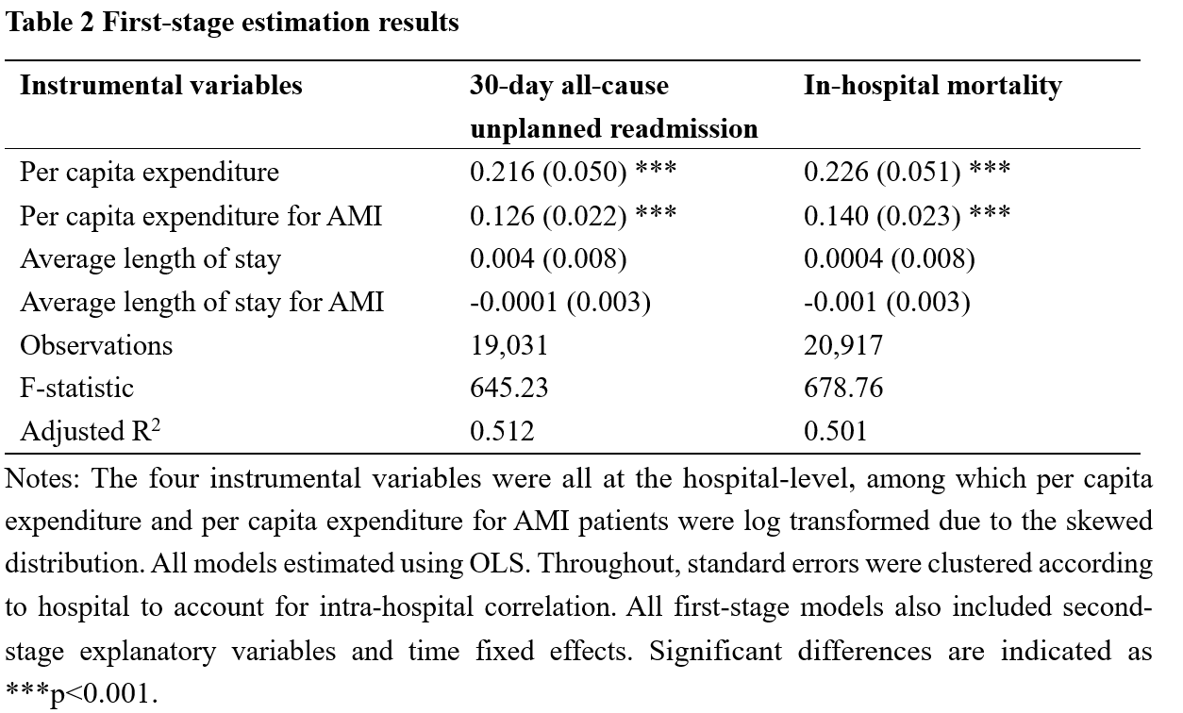
Results

Slide 14
Results
Table 3 Causal effect of expenditures by IV models
Variable | 30-day all-cause unplanned readmission |  |  | In-hospital mortality
 | Coefficient | OR (95% CI) |  | Coefficient | OR (95% CI)
Log (expenditures) | -0.222* | 0.801 (0.666, 0.962) |  | -0.353*** | 0.683 (0.586, 0.797)
IV1 | √ |  |  | √
IV2 | √ |  |  | √
IV3 | √ |  |  | √
IV4 | √ |  |  | √
Covariates | √ |  |  | √
Observations | 19,031 |  |  | 20,917

Slide 15
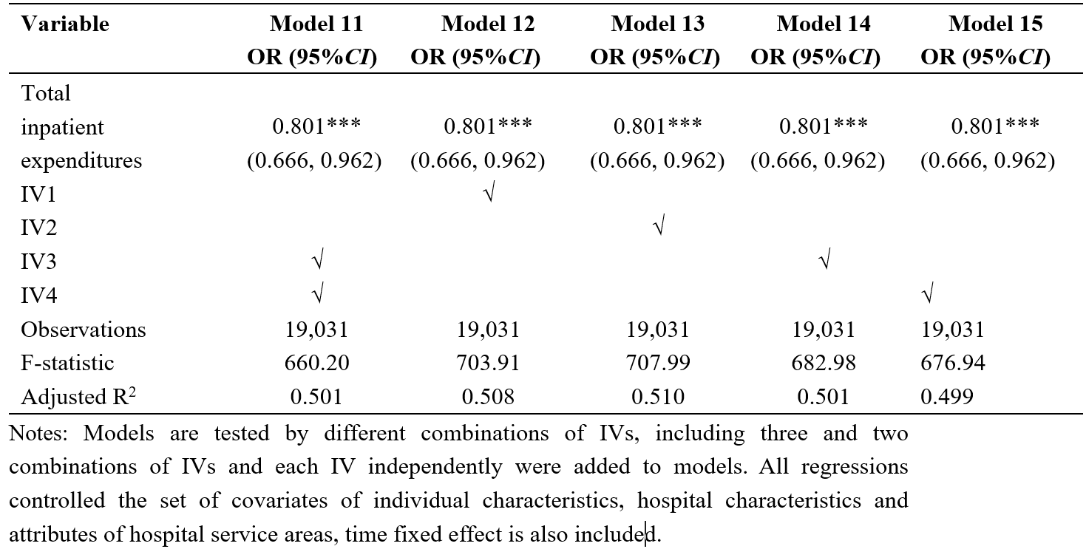
Continued

Slide 16
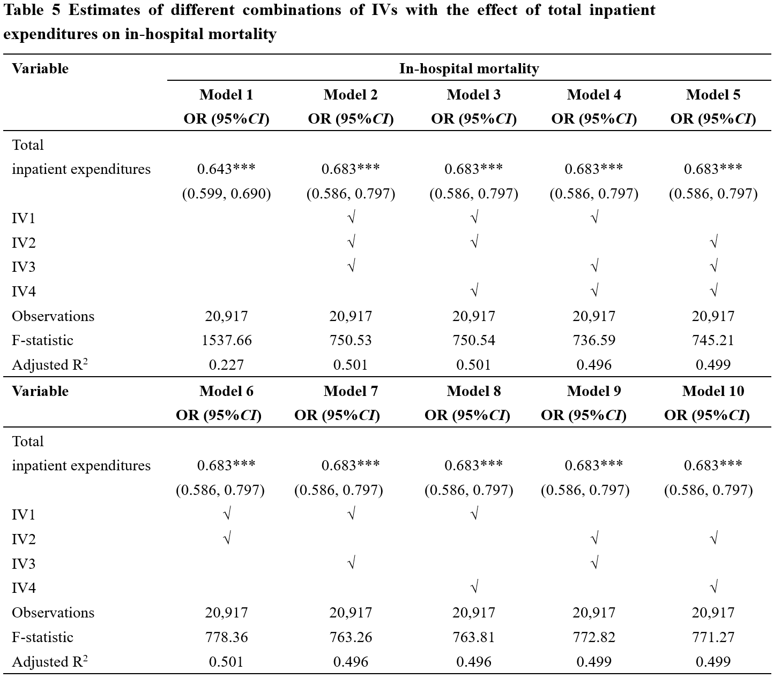
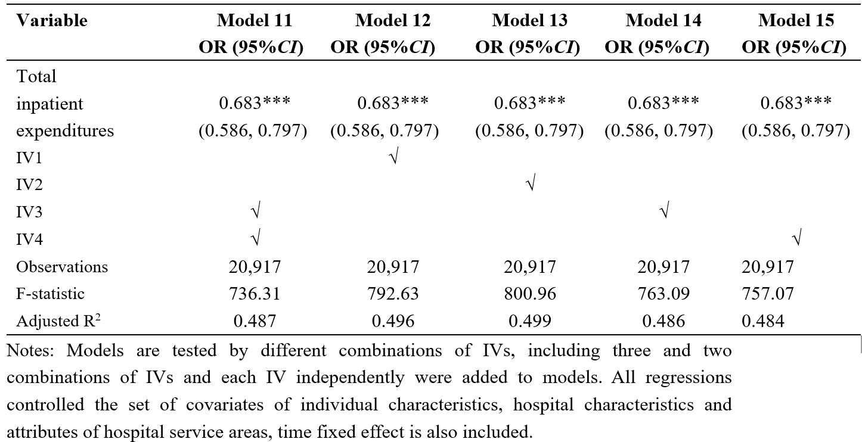
Continued

Slide 17
Thanks for listening!
Q&A

