Slide 1
MENTAL HEALTH COUNSELING & WORKPLACE ABSENTEEISM
USING AN INSTRUMENTAL VARIABLE APPROACH
Casey Chu
HAD5744 – Final Assignment

Slide 2
AGENDA
INTRODUCTION
RESULTS
01
03
02
METHODS
WORKPLACE ABSENTEEISM AND MENTAL HEALTH OVERVIEW, RATIONALE & RESEARCH QUESTION
DEMOGRAPHIC CHARACTERISTICS & EARLY ANALYSIS RESULTS
04
NEXT STEPS
NEXT STEPS IN ANALYSIS
SELECTED APPROACH, KEY VARIABLES, AND MAIN ANALYSIS

Slide 3
01
INTRODUCTION

Slide 4
MENTAL HEALTH & ABSENTEEISM
Absenteeism (absence from work for reasons beyond occasional illness, vacation, or
personal commitments) is a major indirect cost of productivity loss related to poor
mental health in the workplace
Workers with mental health conditions are more likely to be absent and will have longer absences than workers without mental health conditions
Substantial economic costs of loss of productivity – estimated at $6.3 billion in Canada¹
Key Factors Involved²
Workplace culture
Stigma
Private insurance coverage
Access to mental health services
1. Centre for Addiction and Mental Health. (2020). Workplace Mental Health—A Review and Recommendations. https://www.camh.ca/-/media/files/workplace-mental-health/workplacementalhealth-a-review-and-recommendations-pdf.pdf
2. Ruud, T., & Friis, S. (2022). Continuity of care and therapeutic relationships as critical elements in acute psychiatric care. World Psychiatry, 21(2), 241–242. https://doi.org/10.1002/wps.20966

Slide 5
MENTAL HEALTH & ABSENTEEISM & HEALTHCARE UTILIZATION
So far, most studies have found increased general healthcare utilization among workers who are absent from work; however:
Few of these studies attempt to derive a causal relationship
Look at healthcare utilization overall or all types of mental health care, not mental healthcare that is preventive and continuous (e.g., acute care vs. community-level)
Research Question: Is seeing a mental health professional (psychologist and/or social worker) for counseling services protective against absenteeism due to mental health?

Slide 6
02
METHODS
Design, Key Variables, and Analysis

Slide 7
DESIGN
X
Exogenous Variables/
Backdoors
Data Source (panel data):
Canadian Community Health Survey, 2002: Cycle 1.2, Mental Health and Well-being
Design-based method: Instrumental Variables (IV) Analysis with Bivariate Probit
Main variables:
Outcome Variable: missing work in last 14 days for a mental health reason
Treatment Variable: receiving counseling in last 12 months
Instrumental Variable: receiving counseling or therapy before age 19 (IV#1) and concentration of psychiatrists in area (IV#2)
note: this presentation will focus on IV#1
D
Receiving Counseling (past year)
Y
Absence (past 14 days)
Z
Early Counseling or Geographic Conc. Of Psychiatrists

Slide 8
SAMPLE AND CONTROLS
X
Exogenous Variables/
Backdoors
Sample
Inclusion: Individuals with anxiety or mood disorder
Exclusions:
Individuals with learning disabilities
Individuals who were unemployed in the last 12 months
Controls
Age
Sex
Education
Marital Status
Distress (for severity)
D
Receiving Counseling (past year)
Y
Absence (past 14 days)
Z
Early Counseling

Slide 9
IV ASSUMPTIONS (1)
X
Exogenous Variables/
Backdoors
Excludability – no relationship between instrument and outcome
Likely met (nothing found in literature)
Exogeneity – instrument is uncorrelated with confounders between treatment and outcome
Potentially early counseling could mean a long-lasting mental health condition that could influence job role (which can confound relationship between D→Y)
D
Receiving Counseling (past year)
Y
Absence (past 14 days)
Z
Early Counseling

Slide 10
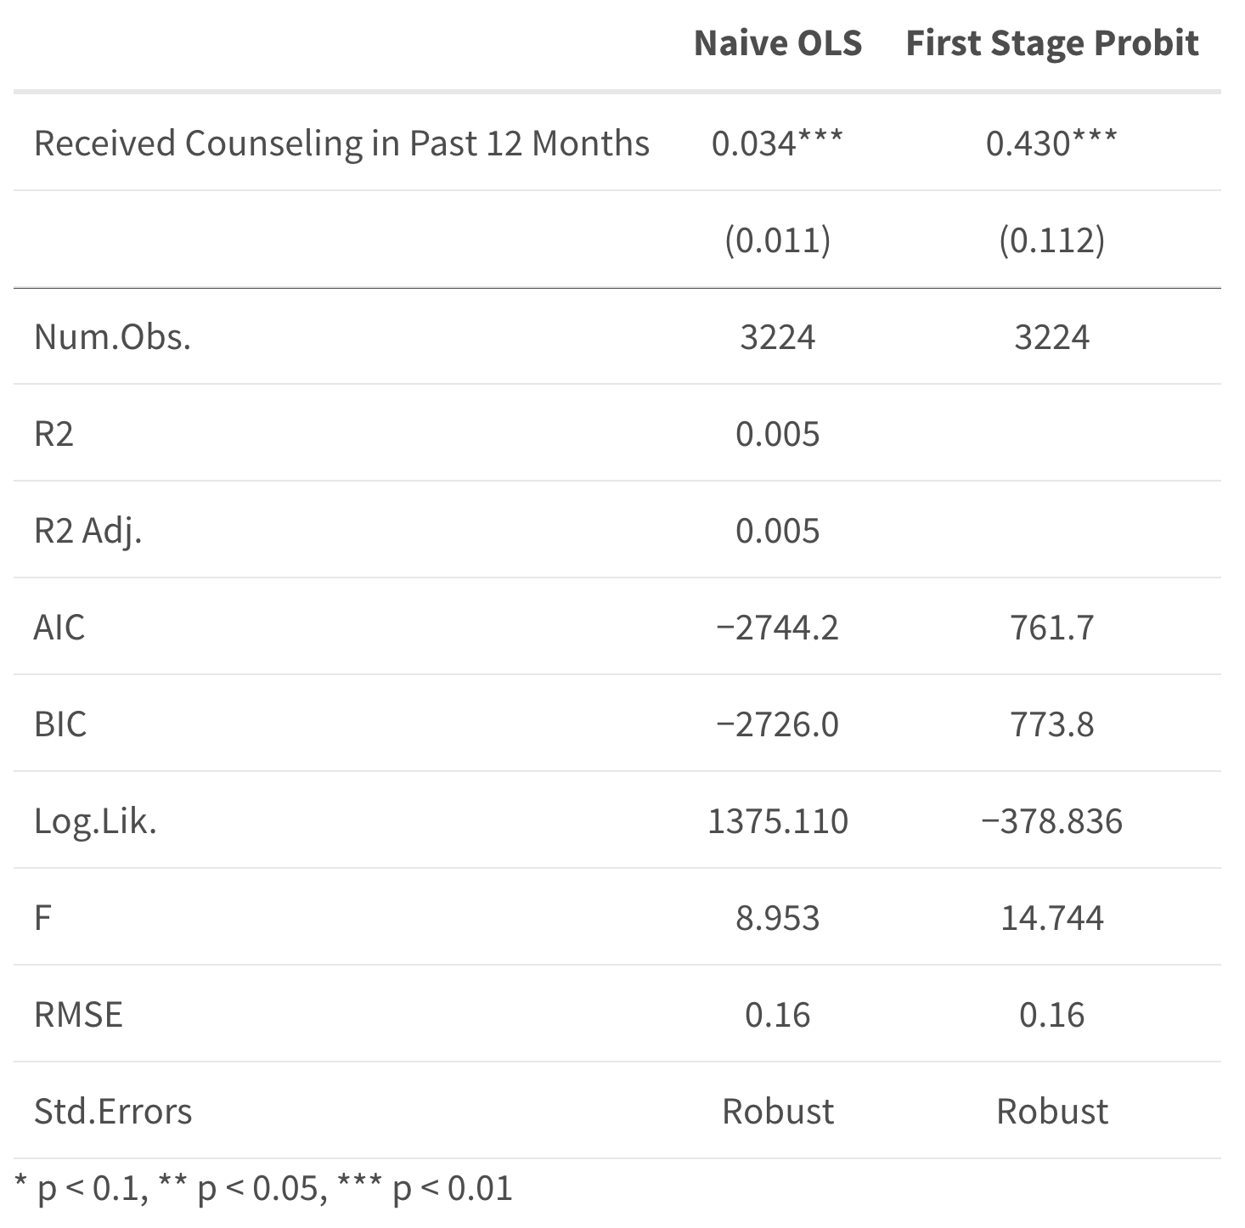
IV ASSUMPTIONS (2)
Relevance – strong correlation between instrument and treatment
Poorly met for this instrument (f-stat is low)
Monotonicity – there are no defiers, instrument induces people into treatment (not necessary to meet)
10.2% of the sample are defiers or never-takers
Z
 | No Early Counseling | Early Counseling
No Counseling Received in Past Year | 76.2% | 10.2%
Received Counseling in Past Year | 10.7% | 2.3%
D

Slide 11
03
RESULTS
For first instrument: receiving mental health counseling/therapy before age 19

Slide 12
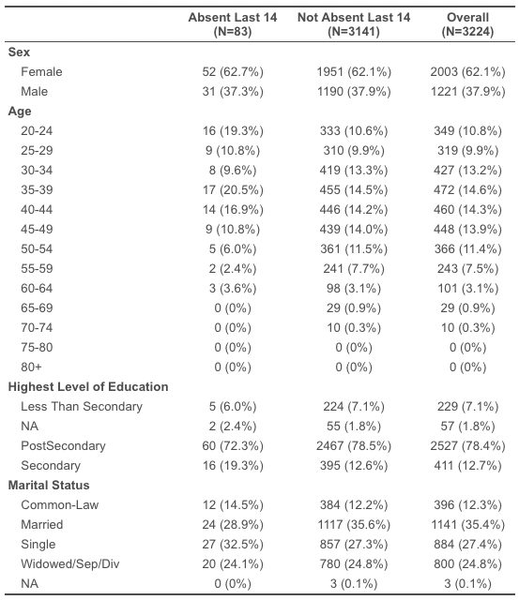
TABLE 1 – Demographic Characteristics

Slide 13
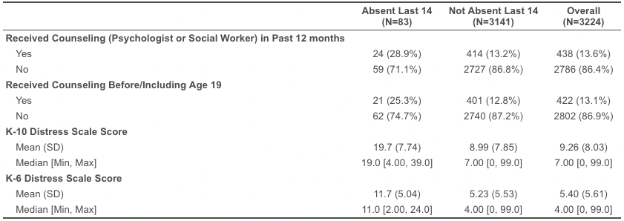
TABLE 2 – Key Variables

Slide 14
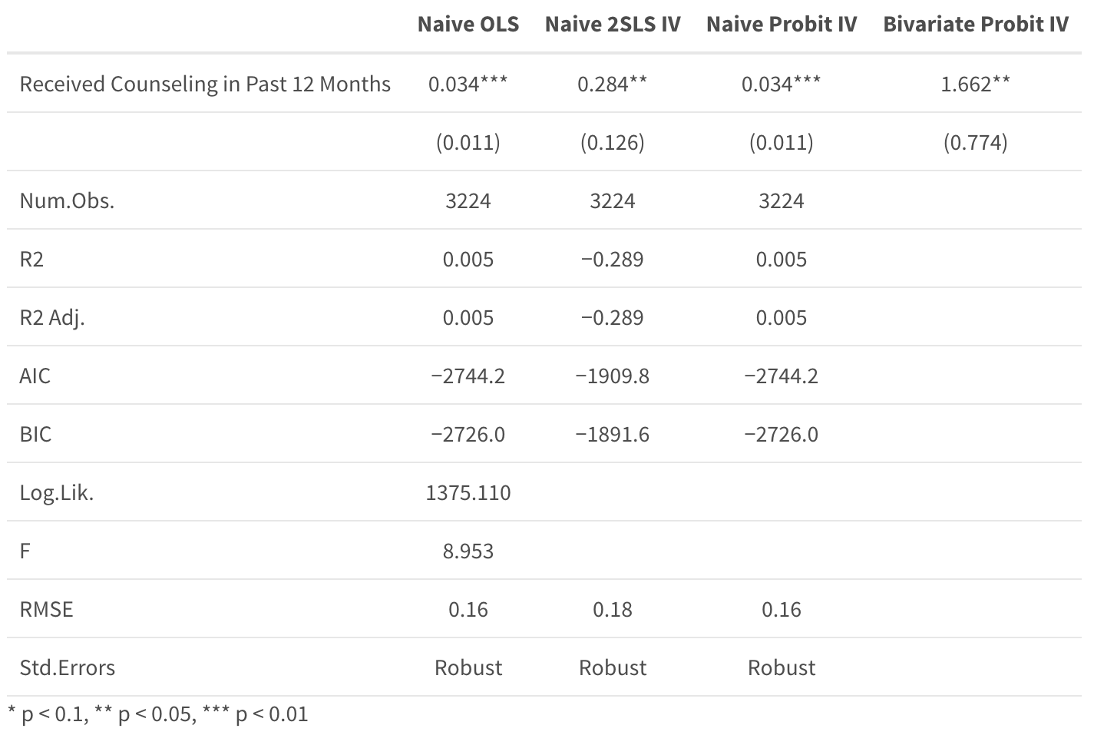
Two-Stage Bivariate Probit Results (no covariates yet)
treatment effect is 31.61 % (2.81, 89.75), meaning a 31.61% increase in likelihood of being absent in the last 14 days for individuals who receive counseling before age 19 and in the last 12 months

Slide 15
04
NEXT STEPS

Slide 16
NEXT STEPS
Apply survey weights
Try second analysis with psychiatrist concentration as the instrument (geographic variability)
Examine relationship with covariates (e.g., demographic variables, job type, severity measures)

Slide 17
THANK YOU FOR LISTENING!
QUESTIONS?

