Slide 1
Exploring the causal relationship between non-communicable disease multimorbidity, catastrophic health expenditure, and it’s impacts on quality of life in Ghana.
Jessica Morgan & Chantal Valiquette
December 2, 2022
Health Econometrics I
HAD 5744
Notes:
No COI

Slide 2
Outline
Introduction
Objectives
Data and Summary Statistics
Methods
Preliminary Results

Slide 3
Introduction
Background
Region of Analysis: Ghana
Notes:
1-2 Slides
Brief Literature Review

Slide 4
Background
Non-communicable diseases (NCDs) account for ~74% of all global deaths [1]
Low- and middle- income countries have high incidences of NCD-related “premature” deaths [1]
Multimorbidity with NCDs (NCD MM) are associated with increased health costs and catastrophic health expenditure (CHE)[2-6]
Financial burden from NCDs may negatively impact quality of life (QoL) [6]
Notes:
Additional:
“Premature” deaths are defined by death before age 70 [1]
Multimorbidity with NCDs (NCD MM) accrues even greater costs than single NCDs [2]
While NCD MM has been correlated with higher health expenditure, a casual relationship has not been well established [3-6]
Given this, in what context/country might it be best to examine this relationship?

Slide 5

Region of Analysis: Ghana
Low-middle income country [7]
Higher risk for NCD MM [1]
National Health Insurance Scheme (NHIS) adopted in 2003 [7]
68.6 % of the population has health coverage (between private and public insurance) [7]
Notes:
Interesting policy implications as impact on health expenditure may be mitigated given private insurance and NHIS

Slide 6
Objectives
Establish the causal relationship between NCD MM and CHE
Examine the relationship between CHE and QoL considering policy implications of this relationship in Ghana.
Notes:
Determine if there is a causal relationship between NCD MM and high health expenditure, and analyze how that may impact targeted policy initiatives to improve QoL for individuals in Ghana.

Slide 7
Data & Summary Statistics
Defining Covariates
Visualizing the Data
Notes:
1-2 Slides

Slide 8
Defining Covariates
Included:
poverty, age, sex, region (urban vs rural), household size, employment status (employed <2/past 7 days), insurance status (both voluntary and mandatory), social supports, disability, education, income
Unable to Include:
distance to health facility, Indigeneity, medication adherence
References: [4][6][8-19]
Notes:
Covariates identified from the literature
Poverty - Assumed poverty line similar to 2013 → report https://www.unicef.org/ghana/media/531/file/The%20Ghana%20Poverty%20and%20Inequality%20Report.pdf
1314 GHS is upper poverty line per adult per year for 2013 (calculate this into CAD)
They used Greer and Thorbecke (FGT) poverty indices. Took upper poverty line representing line “below which an individual is considered to be unable to meet all their food and non-food needs”
Did not look at “lower poverty line below which an individual is considered unable to even meet their food needs” → 792 GHS per adult per year
We calculated this by divide household income by household members (cannot differentiate between child and adult)
Created this as binary variable from adjusted income reported in dataset (poverty is </= 1314 GHS per year)
All participants were above the upper poverty threshold
Even if accounting for inflation, 2013 poverty line would be higher than 2010, and inclusion of children should make it lower. So can feel comfortable that data set includes individuals above poverty line.
Included: Age, gender, residence → urban/rural (coded urban 1, also somewhat proxy for distance to health facility as this was not clearly reported), household size, health insurance (proxy payment with spending on mandatory and/or voluntary insurance plans in the past year), social supports (do you have someone you can trust and confide in), income (past year), disability (as a result of injury in past year → this could technically qualify as NCD but will include for completeness) listed covariate from dataset
Education also listed covariate (measured as number of school years completed).
Not explicitly included:
Health literacy identified in the literature, however we will assume this is accounted for through education.
SES → multiple factors to determine this, many accounted for through other covariates (e.g. poverty, insurance, age, urban/rural, education, social supports, income) Inpatients vs outpatient events - likely serves as mediating effect so should be account for in NCD MM to CHE regression
Labour force has also been listed association, however we chose not to include this as different occupations may increase of decrease likelihood of NCD (effect of income should partially account for a more clear association of this). → e.g. Farming occupation inversely associated with NCD in one study: Abebe, S. M., Andargie, G., Shimeka, A., Alemu, K., Kebede, Y., Wubeshet, M., ... & Birku, M. (2017). The prevalence of non-communicable diseases in northwest Ethiopia: survey of Dabat Health and Demographic Surveillance System. BMJ open, 7(10), e015496.
Not included: No clear way to calculate Indigeneity without major assumptions
Medication adherence difficult to discern (reports on taking medication for specific diseases in past 2 weeks and past 12 months but cannot make good assumptions regarding adherance from these)
Not including environmental expenditure (this is on health system level)
Would be ref: Badulescu D, Simut R, Badulescu A, Badulescu AV. The Relative Effects of Economic Growth, Environmental Pollution and Non-Communicable Diseases on Health Expenditures in European Union Countries. Int J Environ Res Public Health. 2019;16(24):5115. doi:10.3390/ijerph16245115

Slide 9
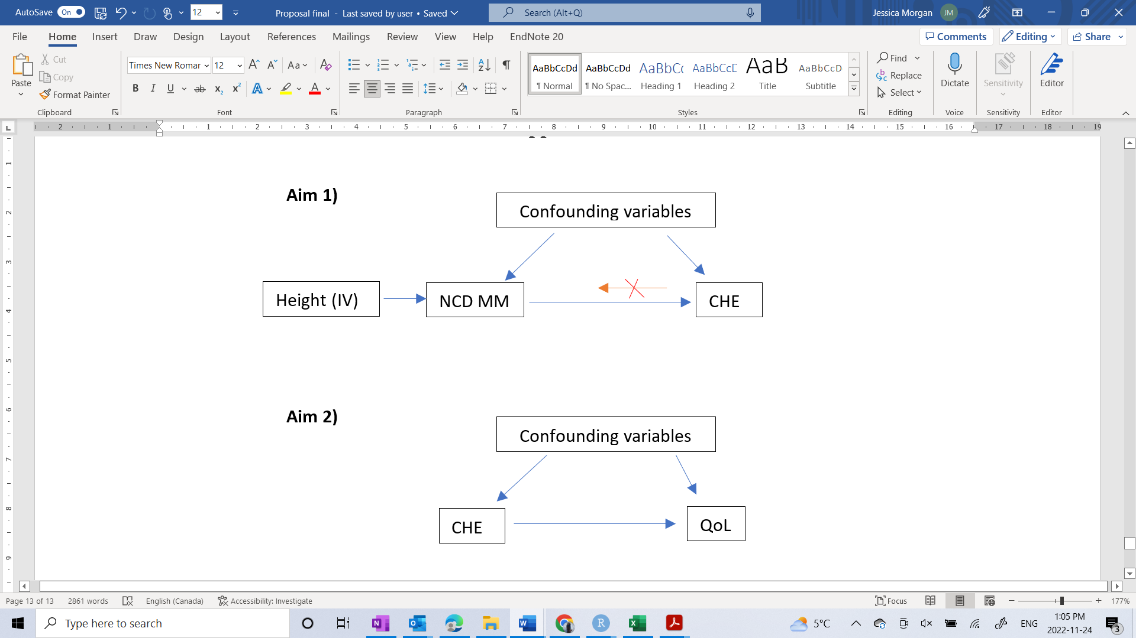
Visualizing the Data: DAG
References: [20-21]
Notes:
The data used for this study will be from Wave 1 of The World Health Organization’s (WHO) Study on global AGEing and adult health (SAGE).^{i} This was a single cross-sectional study conducted in Ghana and five other countries from across the world and consisted of a questionnaire administered to persons over 50 years of age.^{i} Data from a smaller sample of adults between 18 and 49 years of age is also included, with the original intention to be used as a comparison group for age-related studies.^{ii} Wave 1 was conducted between 2007 and 2010 and included 803 participants aged 18-49 and 4305 participants aged 50+, for a total of 5108 individual respondents from Ghana.^{ii} The questionnaire consists of four main sections, of which we will be using two: the household and individual data sections.^{i}
^{i} Biritwum R, Mensah G, Yawson A, Minicuci N. Study on Global AGEing and Adult Health (SAGE) Wave 1 - The Ghana National Report.; 2013.
^{ii} Kowal P, Chatterji S, Naidoo N, et al. Data Resource Profile: The World Health Organization Study on global AGEing and adult health (SAGE). Int J Epidemiol. 2012;41(6):1639-1649. doi:10.1093/ije/dys210

Slide 10
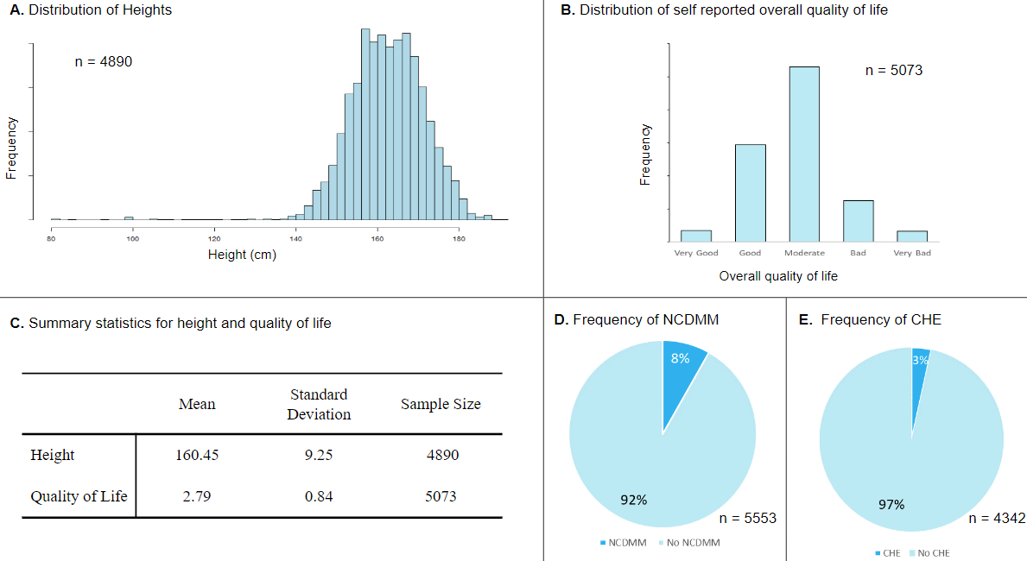
Visualizing the Data: Summary Statistics
References: [20-21]
Notes:
The data used for this study will be from Wave 1 of The World Health Organization’s (WHO) Study on global AGEing and adult health (SAGE).^{i} This was a single cross-sectional study conducted in Ghana and five other countries from across the world and consisted of a questionnaire administered to persons over 50 years of age.^{i} Data from a smaller sample of adults between 18 and 49 years of age is also included, with the original intention to be used as a comparison group for age-related studies.^{ii} Wave 1 was conducted between 2007 and 2010 and included 803 participants aged 18-49 and 4305 participants aged 50+, for a total of 5108 individual respondents from Ghana.^{ii} The questionnaire consists of four main sections, of which we will be using two: the household and individual data sections.^{i}
^{i} Biritwum R, Mensah G, Yawson A, Minicuci N. Study on Global AGEing and Adult Health (SAGE) Wave 1 - The Ghana National Report.; 2013.
^{ii} Kowal P, Chatterji S, Naidoo N, et al. Data Resource Profile: The World Health Organization Study on global AGEing and adult health (SAGE). Int J Epidemiol. 2012;41(6):1639-1649. doi:10.1093/ije/dys210

Slide 11
Methods
Incorporating Variables
Finding an Instrument Variable (IV)
Aim 1
Aim 2
Notes:
4-5 Slides
Majority of Presentation
Focus: Parameters recovering, identification of variables, assumptions made
LPM is heteroskedastic → need robust SE

Slide 12
Incorporating Variables: Calculating CHE
If 0.40 < $\frac{HE}{CTP}$ true, then CHE
If 0.40 < 𝐻𝐸/𝐶𝑇𝑃 true, then CHE
CTP = CE - SE
References: [22]
Notes:
Ref listed
To calculate CHE the following formula will be used:
[1] If 0.40 < $\frac{HE}{CTP}$ true, then CHE
Where HE is the total health expenditure of the household and CTP is the capacity to pay. A household’s capacity to pay is a household’s effective income after accounting for subsistence needs (SE).^{i} SE will be proxied using the average food expenditure of households whose food spending is in the 45th to 55th percentile of the study’s participants.^{i} Capacity to pay will be calculated using the following formula:
[2] CTP = CE - SE
Where CE is consumption expenditure, used to reflect effective income.^{i}
^{I} Xu K, Evans DB, Kawabata K, Zeramdini R, Klavus J, Murray CJ. Household catastrophic health expenditure: a multicountry analysis. The Lancet. 2003;362(9378):111-117. doi:10.1016/S0140-6736(03)13861-5
Already explained other covariates we will be using. In analysis including both income and unemployment status made SEs v small and unbelievable, so decided to only include income (assuming unemployment would be mediator of this).
For QoL

Slide 13


Incorporating Variables: Defining NCD MM and QoL
NCD MM: 2+ chronic diseases
diabetes, heart disease, asthma, hypertension, arthritis, depression, chronic lung disease, stroke, and cataracts
QoL: World Health Organization (WHO) definition
References: [20][23-24]
Notes:
NCDMM:
Lastly, having two or more of the following chronic diseases will be considered as having NCD MM: diabetes, heart disease, asthma, hypertension, arthritis, depression, chronic lung disease, stroke, and cataracts.^{ii,iii}
QoL:
This paper will use the WHO definition of QoL, which is an “individual's perception of their position in life in the context of the culture and value systems in which they live and in relation to their goals, expectations, standards and concerns”.^{i} To quantify this, WHO integrated an eight-item WHO Quality of Life (WHOQOL) assessment into the questionnaire.^{ii,i} This assessment tool includes an assessment of overall QoL which has values of “very good”, “good”, “moderate”, “bad”, and “very bad”, as well as “don’t know” and “not applicable”.^{ii,iii}
^{i} World Health Organization. WHOQOL: Measuring Quality of Life.
^{ii} Biritwum R, Mensah G, Yawson A, Minicuci N. Study on Global AGEing and Adult Health (SAGE) Wave 1 - The Ghana National Report.; 2013.
^{iii} World Health Organization. Study on Global Ageing and Adult Health Wave 1 - Individual Questionnaire - Set A. Published 2007.

Slide 14

Finding an IV
Endogeneity problem
Potential for a backflow effect from household CHE to individual NCD MM.
IV chosen must Satisfy 3 basic conditions:
Relevance
Exogeneity
Exclusion
Notes:
We will investigate this by using an instrumental variable (IV) to control for endogeneity in NCD MM and conduct a Two Stage Least Squares (2SLS) estimate.
For example, an individual whose household is already facing CHE incurred by a different family member may not be able to afford preventative measures which would otherwise decrease their personal risk of NCD MM. Therefore, an IV will be used to randomize NCD MM on CHE and reduce the bias of the causal estimate.

Slide 15
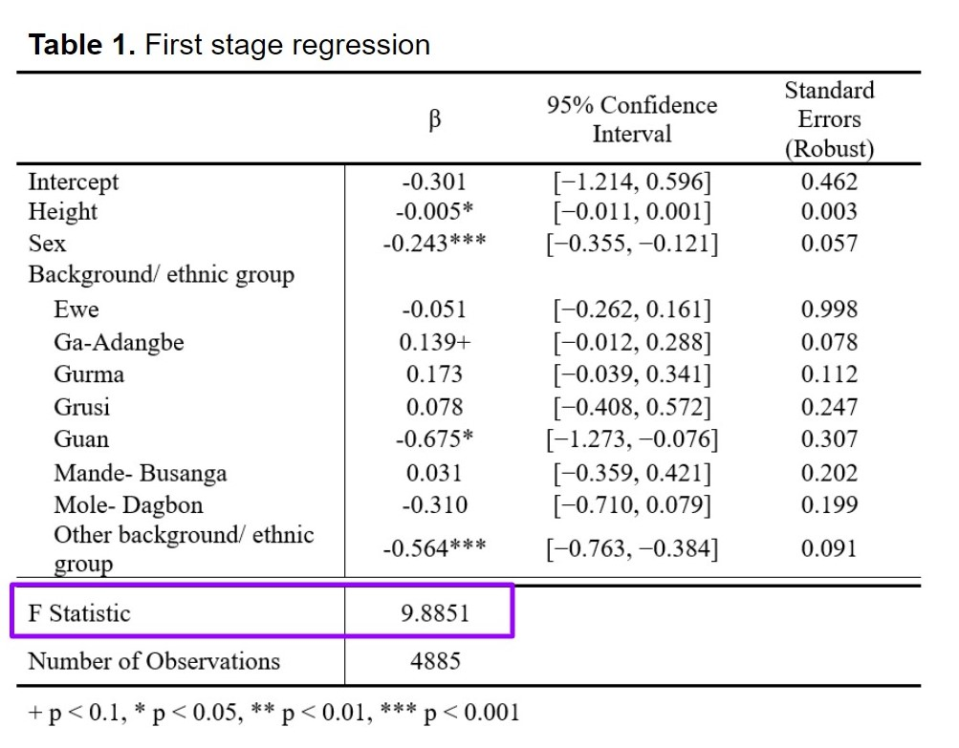
Finding an IV: Height
IV chosen must Satisfy 3 basic conditions:
Relevance
Evidence height may impact NCD [25][26]
Use variable for measured height [24]
F stat 9.8851 with regression of height on NCD MM
Exogeneity
Assume negligible backflow from NCD to height in the model
Exclusion
Height should only impact CHE through NCD
References: [24-25]
Notes:
Relevance:
More likely to develop diabetes and htn →Hoque, M. E., Khokan, M. R., & Bari, W. (2014). Impact of stature on non-communicable diseases: evidence based on Bangladesh Demographic and Health Survey, 2011 data. BMC Public Health, 14(1), 1-8.
Previous studies have used IV to establish casual relationship between height and CAD (IV Mendelian randomisation analyses in UK Biobank). Found “Mendelian randomisation results provided strong evidence for a protective causal effect of adult height on CAD risk, 1 standard deviation higher height (~6.5 cm) was causally associated with a 16% lower risk of CAD (OR = 0.84, 95% CI 0.80–0.87) using summary statistics data. Our results suggest that the effect of height on CAD is not mediated via socio-economic status variables.” → Gupta, V., Sachdeva, M. P., & Walia, G. K. (2019). "Mendelian Randomization" Approach in Economic Assessment of Health Conditions. Frontiers in public health, 7, 2. https://doi.org/10.3389/fpubh.2019.00002
Additional: Also link between short stature and coronary heart disease → (related to NCD MM): NCD includes stroke, heart disease, diabetes
Paajanen, T. A., Oksala, N. K., Kuukasjärvi, P., & Karhunen, P. J. (2010). Short stature is associated with coronary heart disease: a systematic review of the literature and a meta-analysis. European heart journal, 31(14), 1802-1809.
Relevance F Stat:
Use F statistic to confirm suitable strength of the IV
Weak IV BUT F statistic is above 5 → rejection threshold: Staiger, D. O., & Stock, J. H. (1994). Instrumental variables regression with weak instruments.
Likely smaller because heteroskedastic (although normal distribution), minimal height variation
Also habits developed in childhood can lead to NCD
UNICEF. (n.d.). Non-communicable diseases. Non-communicable diseases Behaviours that lead to disease often emerge during childhood and adolescence. Retrieved November 24, 2022, from https://www.unicef.org/health/non-communicable-diseases
Exogeneity:
Height maximum typically reached by adulthood → Stulp, G., & Barrett, L. (2016). Evolutionary perspectives on human height variation. Biological Reviews, 91(1), 206-234.
Therefore determined before when most NCD would have developed (exceptions: TMD1)
Exclusion:
Control for sex and ethnicity as these would relate to height (although population is within one country so likely low variation)
survey only done for adults >18 so didn’t use age,
Other variables are measured in past year or current so unlikely to have impact on height (e.g. childhood measures of these would impact → household income, household size, insurance status, region, social supports, disability)
Local Average Treatment Effects (LATE) in this case: compliers would be those who recorded height vs those who did not
Since recorded height was conducted by the survey conductor, data from those surveys is likely more reliable (more involved surveyer or more health conscious participant →? More accurate recordings). Identification relies on no defiers (monotonicity)
Survey [24]
“ANTHROPOMETRIC MEASUREMENTS: I would now like to measure how tall you are. To measure your height I need you to please take off your shoes. Put your feet and heels close together, stand straight and look forward standing with your back, head and heels touching the wall. Look straight ahead.
Height measure in centimeters”
Could have responses of refused or not able → coded to omit
Used this as more accurate than other variable → respondent self reported height
Bias: Height is a pre-instrument variable (largely genetic although can be impacted by environmental markers, e.g. nutritional development). Height maximum often reached in puberty (before CHE for most people) .

Slide 16
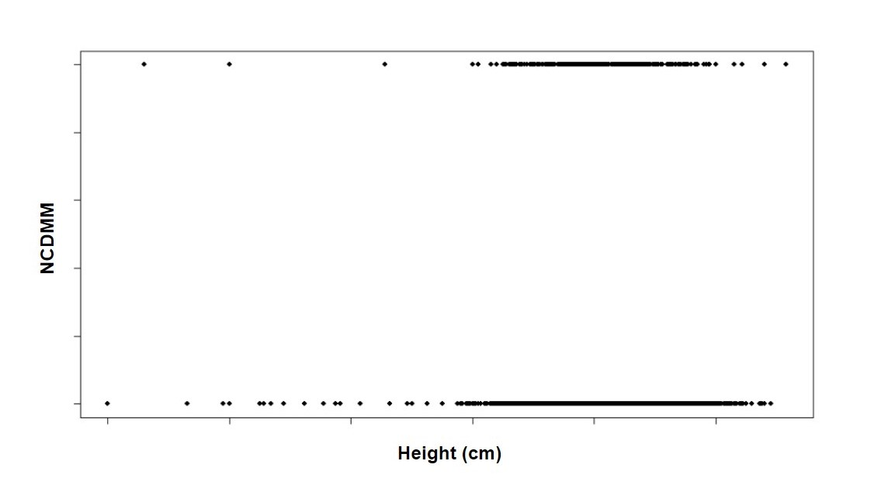

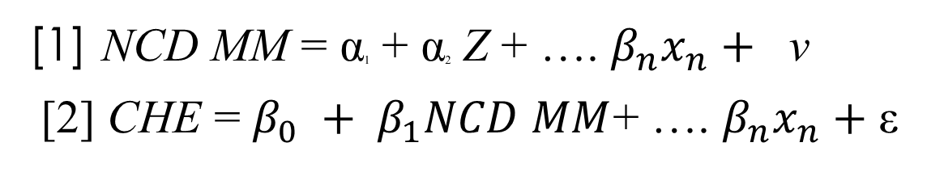
Aim 1: Bivariate Analysis
[1] $\text{NCD} \text{MM}\text{ = }\text{α}\text{1}\text{ + }\text{α}\text{2} \text{Z}\text{ + …. }β_{n}x_{n}+ \text{v}$
[2] CHE = $β_{0} + β_{1}NCD MM$+ …. $β_{n}x_{n}+$ε
Notes:
Need logit b/c between 0 & 1, need bivariate because NCD MM and CHE are binary
Can estimate this for 2 variables $i∈\left\{1,2\right\}$
Done using LPM probit → restricted between 0-1
Where p is the correlation parameter (correlation of binary outcomes)
β₀ is the intercept parameter
Is when y_{i} >0
y is CHE (1 above, 2 below)
X includes the covariates for each bivariate
P contains the IV variable which acts on binary NCD MM (this would also be probit)
https://drive.google.com/file/d/0BwogTI8d6EEiX19Ydnd2aEZCX1E/edit?resourcekey=0-lrW_U528aTluN9ipI2IMFA
https://www.sciencedirect.com/science/article/abs/pii/S0304407618302562
From 2sls: $β_{1}$ = $\frac{cov(z,y)}{cov(z,x)}$​​​​, where Cov() is the covariance of the variables. The impacts of other confounding variables will also be controlled for, $β_{n}x_{n}$.
This usually works if data is homoscedastic (tested by plotting the data on a scatter plot), the data was randomly sampled, and that there is no serial correlation between variables
Unfortunately we know our data is heteroskedastic so will need to correct with robust standard errors

Slide 17


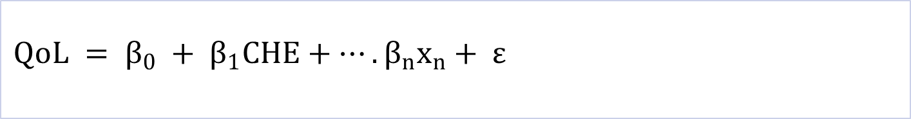
Aim 2: Regression on QoL OLS
$$QoL = β_{0} + β_{1}CHE+…. β_{n}x_{n}+ ε$$
Notes:
Where β₀ is the intercept parameter, β₁ is the OLS estimator, $β_{n}x_{n}$ represents the confounding variables and their associated regression coefficients, and ε is the error term. The assumptions needed to establish this causal relationship are: 1) that there is mean zero error, and 2) there is mean independence
To defend that there is mean independence, all open backdoor paths between CHE and QoL will be closed. To defend that there is mean zero error, and therefore that our model is unbiased, it will be argued that our directed acyclic graph

Slide 18
Preliminary Results
Bivariate Analysis
Regression on QoL
Notes:
1-2 slides
Should note: Ghana has also adopted a National Health Insurance Scheme (NHIS) in 2003, a potential factor that may reduce the CHE of its population. Between the NHIS and private health insurance system, 68.6 % of the population has health coverage, as of the 2021 Ghana census. [7]

Slide 19
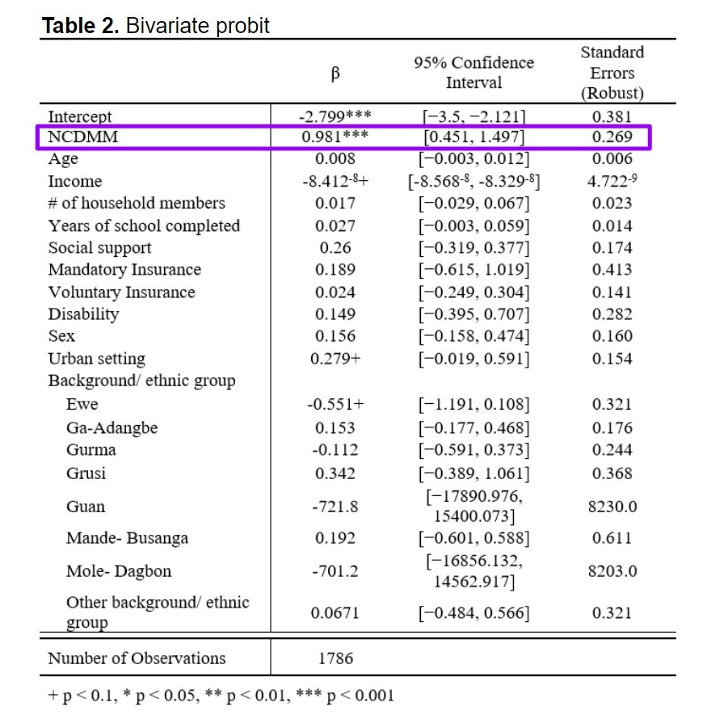
Aim 1: Bivariate Analysis
Notes:
Average treatment effect of NCD MM on CHE randomized by height is 12.65% (95% CI: 4.20 - 28.75).

Slide 20
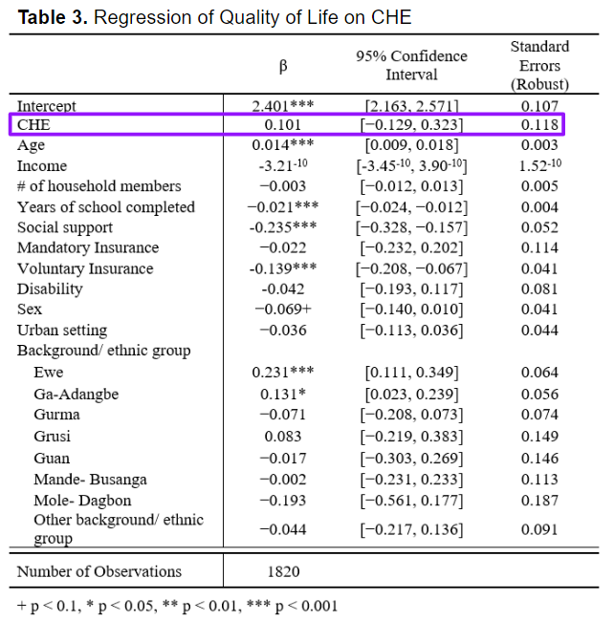
Aim 2: Regression on QoL

Slide 21

Questions?

Slide 22
References
[1] World Health Organization. Noncommunicable diseases. World Health Organization, September 11, 2012. Accessed October 27, 2022. https://www.who.int/news-room/fact-sheets/detail/noncommunicable-diseases
[2] Pan American Health Organization. Noncommunicable Diseases. Pan American Health Organization. Accessed October 27, 2022. https://www.paho.org/en/topics/noncommunicable-diseases#:~:text=These%20conditions%20include%20cancers%2C%20cardiovascular,inactivity%20and%20eating%20unhealthy%20diets.
[3] Marthias T, Anindya K, Ng N, et al. Impact of non-communicable disease multimorbidity on health service use, catastrophic health expenditure and productivity loss in Indonesia: a population-based panel data analysis study. BMJ Open. 2021;11(2):e041870. doi:10.1136/bmjopen-2020-041870
[4] Karan A, Farooqui HH, Hussain S, Hussain MA, Selvaraj S, Mathur MR. Multimorbidity, healthcare use and catastrophic health expenditure by households in India: a cross-section analysis of self-reported morbidity from national sample survey data 2017–18. BMC Health Serv Res. 2022;22(1):1151. doi:10.1186/s12913-022-08509-x
[5] Yadav J, Allarakha S, Menon GR, John D, Nair S. Socioeconomic Impact of Hospitalization Expenditure for Treatment of Noncommunicable Diseases in India: A Repeated Cross-Sectional Analysis of National Sample Survey Data, 2004 to 2018. Value Health Reg Issues. 2021;24:199-213. doi:10.1016/j.vhri.2020.12.010
[6] Anindya K, Ng N, Atun R, et al. Effect of multimorbidity on utilisation and out-of-pocket expenditure in Indonesia: quantile regression analysis. BMC Health Serv Res. 2021;21(1):427. doi:10.1186/s12913-021-06446-9

Slide 23
References
[7] International Trade Administration. Ghana - Country Commercial Guide. International Trade Administration. Accessed October 27, 2022. https://www.trade.gov/ghana-country-commercial-guide
[8] Cooke, E., Hague, S., & McKay, A. (2016). The Ghana poverty and inequality report: Using the 6th Ghana living standards survey. University of Sussex, 1-43.
[9] Zhang X, Miao W, Wu B, et al. Factors that dynamically affect provincial incidences of catastrophic health expenditure among middle-aged and elderly Chinese population-transition of disease financial risk protection from global to local. BMC Geriatr. 2022;22(1):759. doi:10.1186/s12877-022-03432-6
[10] Puri P, Pati S. Exploring the Linkages Between Non-Communicable Disease Multimorbidity, Health Care Utilization and Expenditure Among Aboriginal Older Adult Population in India. Int J Public Health. 2022;67. doi:10.3389/ijph.2022.1604333
[11] Al-Noumani H, Al-Harrasi M, al Zaabi O, Natarajan J. Predictors of health-related quality of life in patients with non-communicable diseases: A national cross-section study. Applied Nursing Research. 2022;64:151566. doi:10.1016/j.apnr.2022.151566
[12] van Wilder L, Clays E, Devleesschauwer B, et al. Health-related quality of life in patients with non-communicable disease: study protocol of a cross-sectional survey. BMJ Open. 2020;10(9):e037131. doi:10.1136/bmjopen-2020-037131
[13] Liu J, Yu W, Zhou J, Yang Y, Chen S, Wu S. Relationship between the Number of Noncommunicable Diseases and Health-Related Quality of Life in Chinese Older Adults: A Cross-Sectional Survey. Int J Environ Res Public Health. 2020;17(14):5150. doi:10.3390/ijerph17145150

Slide 24
References
[14] Shorey S, Ng ED. The Lived Experiences of Children and Adolescents with Non-Communicable Disease: A Systematic Review of Qualitative Studies. J Pediatr Nurs. 2020;51:75-84. doi:10.1016/j.pedn.2019.12.013
[15] Zhao Y, Atun R, Oldenburg B, et al. Physical multimorbidity, health service use, and catastrophic health expenditure by socioeconomic groups in China: an analysis of population-based panel data. Lancet Glob Health. 2020;8(6):e840-e849. doi:10.1016/S2214-109X(20)30127-3
[16] Sum G, Salisbury C, Koh GCH, et al. Implications of multimorbidity patterns on health care utilisation and quality of life in middle-income countries: cross-sectional analysis. J Glob Health. 2019;9(2). doi:10.7189/jogh.09.020413
[17] Dugee O, Sugar B, Dorjsuren B, Mahal A. Economic impacts of chronic conditions in a country with high levels of population health coverage: lessons from Mongolia. Tropical Medicine & International Health. 2019;24(6):715-726. doi:10.1111/tmi.13231
[18] Bose M, Banerjee S. Equity in distribution of public subsidy for noncommunicable diseases among the elderly in India: an application of benefit incidence analysis. BMC Public Health. 2019;19(1):1735. doi:10.1186/s12889-019-8089-y
[19]Rasul FB, Kalmus O, Sarker M, et al. Determinants of health seeking behavior for chronic non-communicable diseases and related out-of-pocket expenditure: results from a cross-sectional survey in northern Bangladesh. J Health Popul Nutr. 2019;38(1):48. doi:10.1186/s41043-019-0195-z

Slide 25
References
[20] Biritwum R, Mensah G, Yawson A, Minicuci N. Study on Global AGEing and Adult Health (SAGE) Wave 1 - The Ghana National Report.; 2013.
[21] Kowal P, Chatterji S, Naidoo N, et al. Data Resource Profile: The World Health Organization Study on global AGEing and adult health (SAGE). Int J Epidemiol. 2012;41(6):1639-1649. doi:10.1093/ije/dys210
[22] Xu K, Evans DB, Kawabata K, Zeramdini R, Klavus J, Murray CJ. Household catastrophic health expenditure: a multicountry analysis. The Lancet. 2003;362(9378):111-117. doi:10.1016/S0140-6736(03)13861-5
[23] World Health Organization. WHOQOL: Measuring Quality of Life.
[24] World Health Organization. Study on Global Ageing and Adult Health Wave 1 - Individual Questionnaire - Set A. Published 2007.
[25] Hoque, M. E., Khokan, M. R., & Bari, W. (2014). Impact of stature on non-communicable diseases: evidence based on Bangladesh Demographic and Health Survey, 2011 data. BMC Public Health, 14(1), 1-8.

