Slide 1

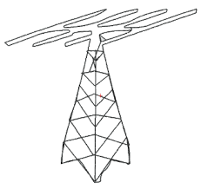

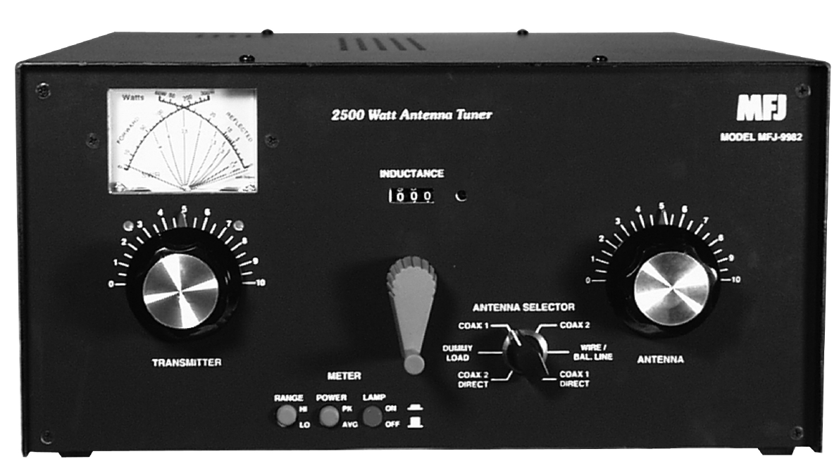
I N T E L L I T U N E
Applications
Antenna Tuning Unit (ATU) decreases tuning time allowing user to cycle through frequency spectrum effortlessly
Variable reactive component values mapped to frequency key in microcontroller for fast tuning
Provides user granular tuning ability by use of variable reactive components
Intellitune Antenna Tuning Unit (ATU)
Features
Automatic antenna tuning that improves output power transmission
Voltage Standing Wave Ratio (VSWR) measurement and correction to maximum transfer
Rapid and reliable tuning
Specifications
ATU capable of handling 2.5 kW
Weighs less than 10 lbs
Supports the frequency bands allocated for amatuer radio as defined by the Federal Communications Commision

