Slide 1

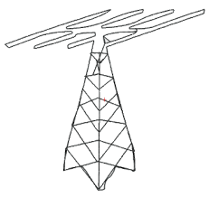

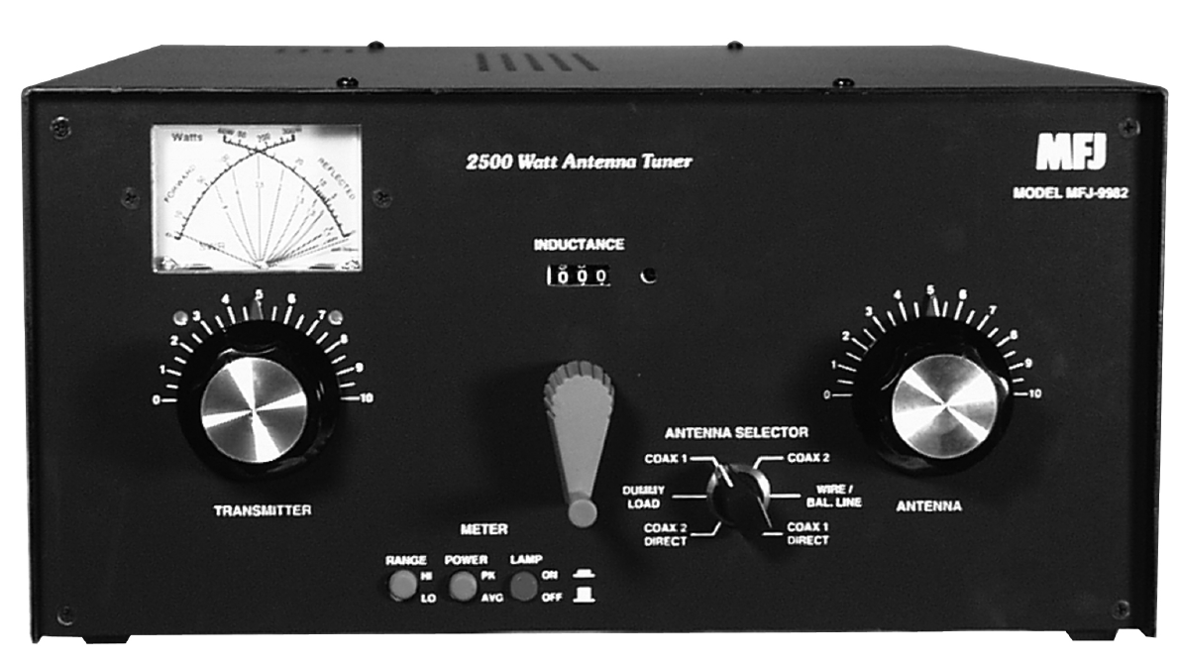
Intellitune
Applications:
ATU decreases tuning time allowing user to cycle through frequency spectrum effortlessly
Provides user granular tuning ability by use of variable reactive components
Features:
Automatic impedance matching network accomplished with variable capacitance and inductance
Voltage Standing Wave Ratio (VSWR) measurement and correction to maximum transfer
Variable reactive component values mapped to frequency key in microcontroller for fast tuning
Specification:
Two 12 volt, 0.26 N-m stepper motors that drive variable capacitance and inductance
PIC 24 microcontroller utilizing Digital to Analog Converter (DAC)
Antenna Tuning Unit (ATU) capable of handling 2.5 kW
Weighs less than 10 lbs.

