Slide 1
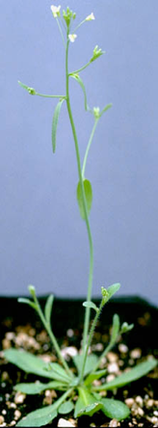
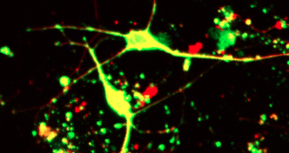

"Protective/Regenerative Activity of iron chelators DFP, DFO and DPD on neuritic degeneration of dopaminergic neurons in PD"
Patricio Pérez Henríquez
BCMN Program
Advisor: Dr. Marco Tulio Nuñez
Iron and Aging Biology Laboratory
Department of Biology
Faculty of Sciences
University of Chile

Slide 2
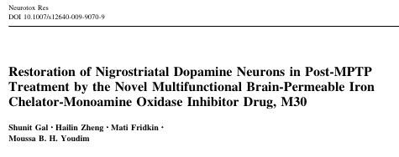
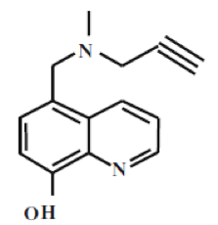
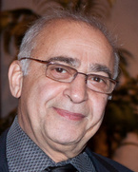
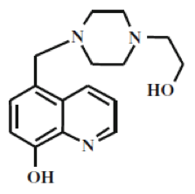

Parkinson's Treatments
- Levodopa
- Surgery
- Selegiline
- Amantadine
- Benzatropine
M30
- Rasagiline
VK28

Slide 3
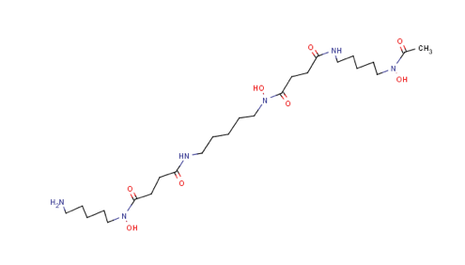
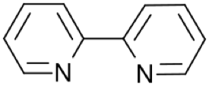
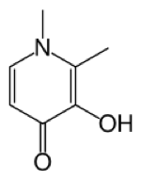
Iron Chelators
Desferioxamina
(DFO)
Dipiridilo
(DPD)
Deferiprona
(DFP)
Objective
1. Reproduce previous results of the lab on the protection and regeneration caused by compounds M30 and VK28
2. Evaluate the protective/regenerative capacity of iron chelators DFP, DFO, DPD.
3. Evaluate functional neurite regeneration.

Slide 4
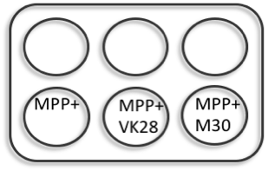
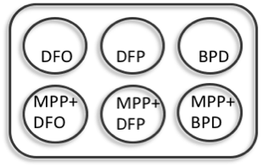
Methodology for neuroprotection
- Primary midbrain culture (PMC) of E14 rats
- Treatment with MPP+ (chemical model of Parkinson’s) at DIV7
- Add drugs to MPP+-damaged cells and maintain damage with MPP+
Experimental Design
MPP+
Drugs
Immunofluorescence
DIV0
DIV7
DIV8
DIV10
48 hrs with drugs
Ctrl
VK28
M30
72 hrs MPP+
48 hrs with drugs
0,1 µM
0,5 µM
0,25 µM
10 µM
100 µM
100 µM

Slide 5
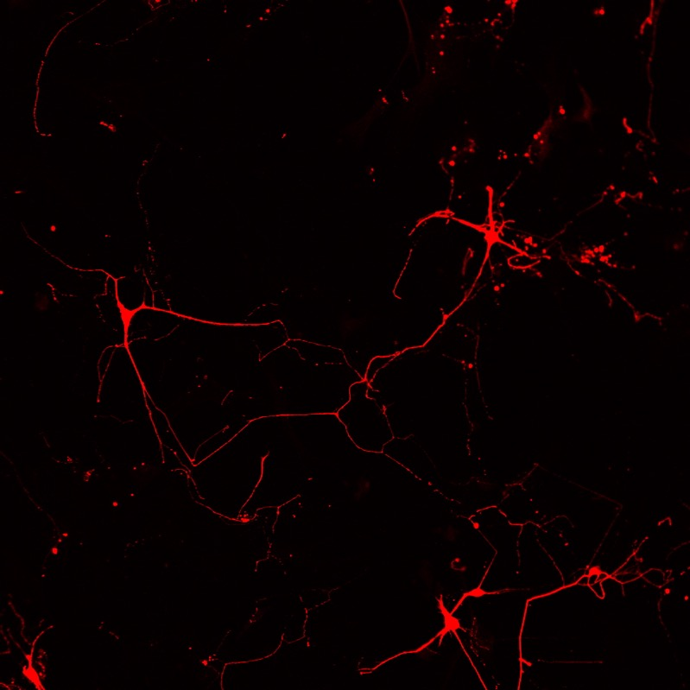
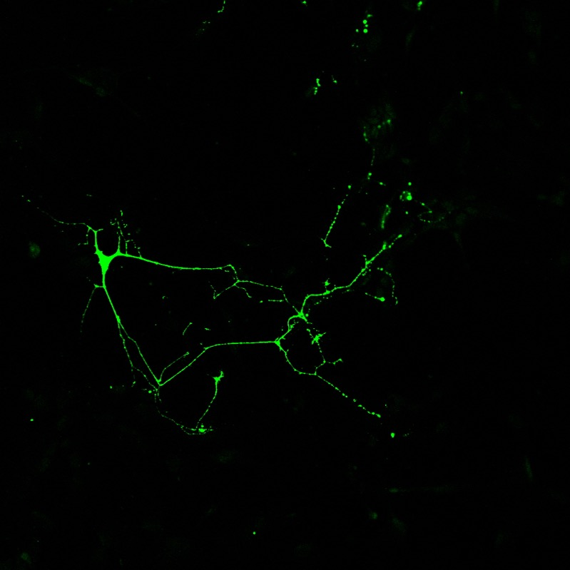
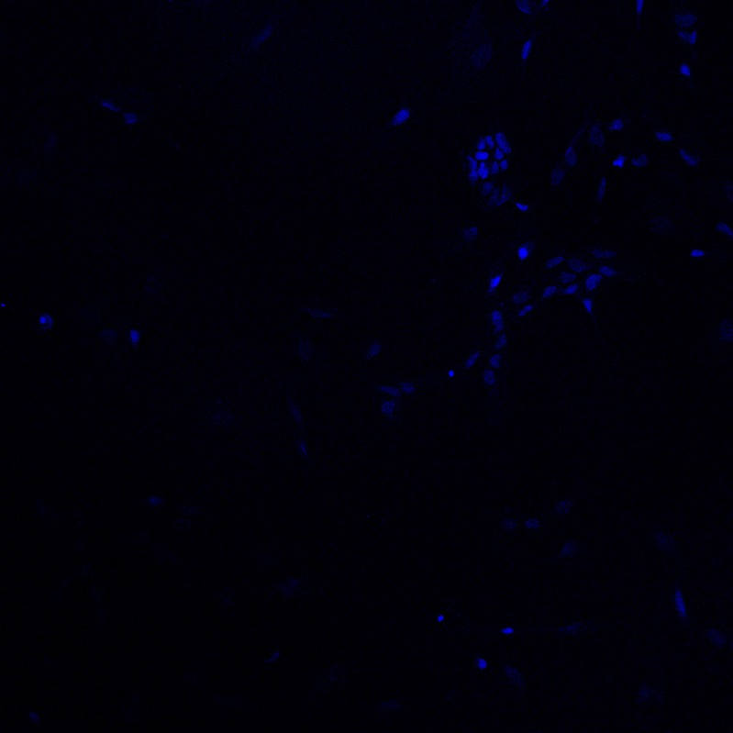
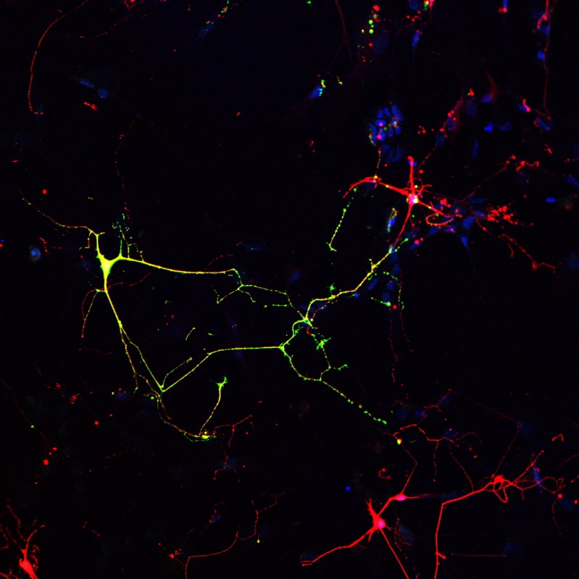
Dopaminergic neurons phenotype DIV10 (Th+)
- beta3
- th
- topro
- merged

Slide 6
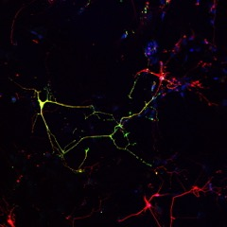
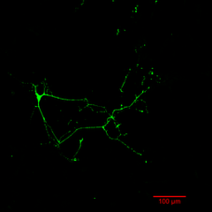
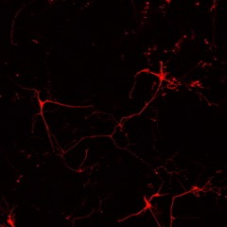
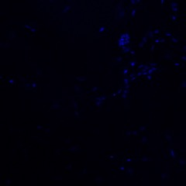
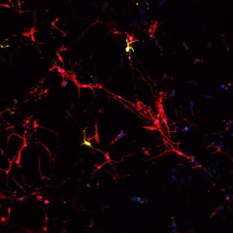
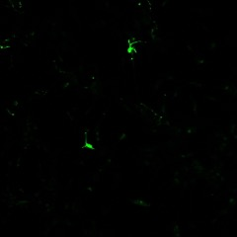
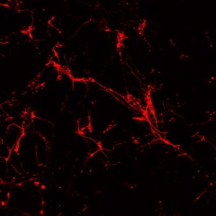
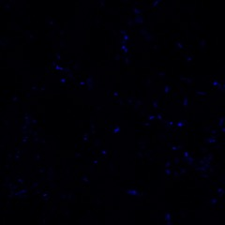
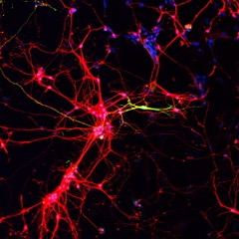
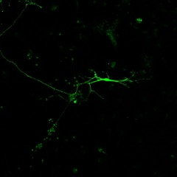
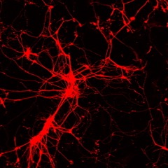
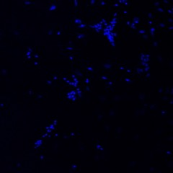
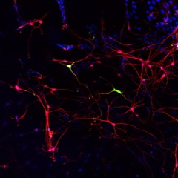
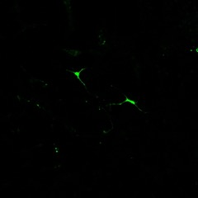
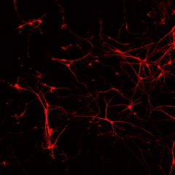
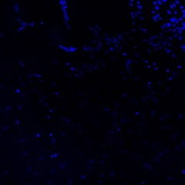
- merged
- th
- beta3
- topro
Control
MPP+
VK28
MPP+
and VK28

Slide 7
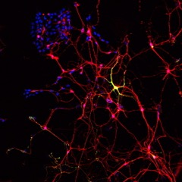
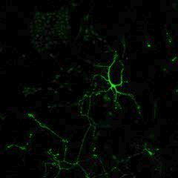
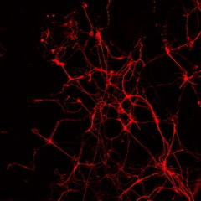
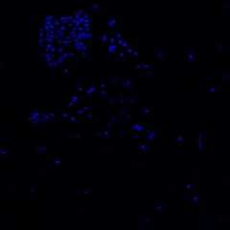
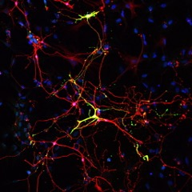
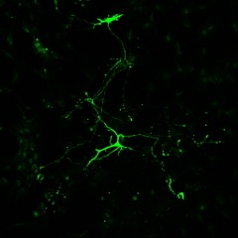
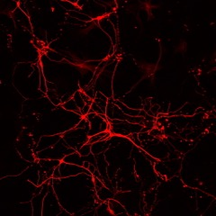
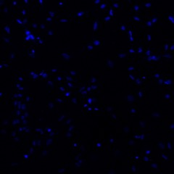
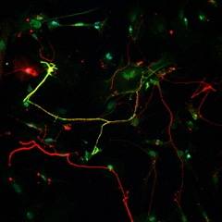
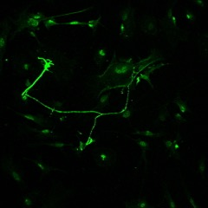
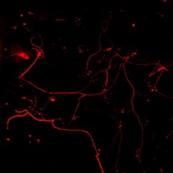
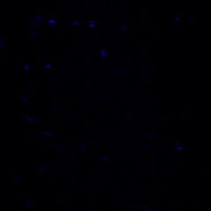
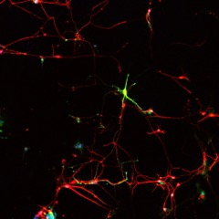
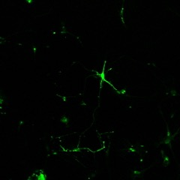
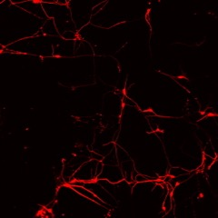
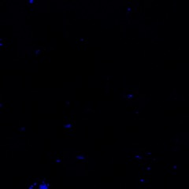
- merged
- th
- beta3
- topro
M30
MPP+
and M30
DFO
MPP+
and DFO

Slide 8
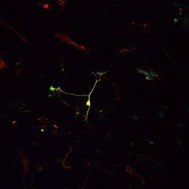
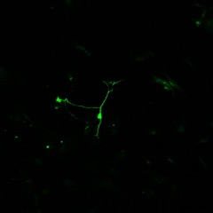
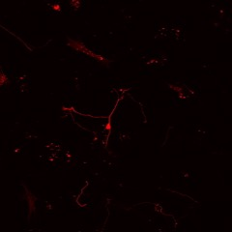













- merged
- th
- beta3
- topro
DFP
MPP+
and DFP
DPD
MPP+
and DPD

Slide 9

Tracing neurites in stitched image (with macnification)

Slide 10

Tracing neurites in stitched image (with macnification)

Slide 11

Tracing neurites in stitched image (with macnification)

Slide 12






Dopaminergic neurons phenotype DIV10 (Th+)
Control
VK28
M30
MPP+
and VK28
MPP+
and M30
MPP+

Slide 13

Control

Slide 14

M30

Slide 15






DFO
DFP
DPD
MPP+
and DFO
MPP+
and DFP
MPP+
and DPD

Slide 16

M30 protects better than VK28
- MPP+ reduces the tree (length)
- M30 and VK28 increase the tree (length)
- M30 protects/regenerates better than VK28
- DFO and DFP mask MPP+

Slide 17
Methodology for neuro-regeneration
- After initial success, we reduced the concentration for DFO, DFP and BPD (see below from red to black)
- We also started measuring neurites from stitched images using the software ‘macnification’.
Recovery Experiment
MPP+
- Remove MPP+
- Lower [cc] drugs
Drugs
Immunofluorescence
DIV0
DIV7
DIV8
DIV10
48 hrs con drogas
Ctrl
VK28
M30
24 hrs MPP+
48 hrs con drogas
0,1 µM
0,5 µM
0,25 µM
5 µM
50 µM
10 µM
10 µM
100 µM
100 µM

Slide 18

Control

Slide 19

MPP+

Slide 20

DFP

Slide 21

DFP & MPP

Slide 22

BPD & MPP

Slide 23

DFO & MPP

Slide 24
Functional assays
- Identify the nature of the tree generated in recovery experiments under iron chelator treatments
Recovery Experiment
- Remove MPP+
- Extend culture
- Identity of the tree
MPP+
Immunofluorescence
Drugs
DIV0
DIV10
DIV11
DIV13
Ctrl
- Th, tau1, MAP2
MPP y DFP
MPP y DPD
24 hrs MPP+
48 hrs con drogas
- Th, Syn, topro
MPP+
- Th, GAP43, topro
MPP y DFO
MPP y M30

Slide 25


Previously reported
Inagaki et al. Nat Neurosci (2001) vol. 4 (8) pp. 781-2

Slide 26


Previously reported
Virmani et al. Synaptotagmin 7 splice variants differentially regulate synaptic vesicle recycling.
EMBO Journal (2003) vol. 22 (20) pp. 5347-57
Sinaptofisina/Grb4
Segura et al. Grb4 and GIT1 transduce ephrinB reverse signals modulating spine morphogenesis and synapse formation. Nat Neurosci (2007) vol. 10 (3) pp. 301-10

Slide 27


Synaptophysin accumulates around TH+ neurites
- Th/Syn/topro
- Th/Syn

Slide 28








Synaptophysin accumulates around TH+ neurites
Th/Syn/topro
Syn
Th
topro

Slide 29





Synaptophysin accumulates around TH+ neurites
Th/Syn
Syn
Th

Slide 30




tau1 and MAP2 markers did not segregate in 10-day PMC
tau1
Th
MAP2
Th/tau1/MAP2

Slide 31




Synaptophysin accumulates around TH+ neurites
A
B
Th/Syn/topro
Th/Syn/topro
Syn
Syn
Th
Th
topro
topro

Slide 32
Conclusions

Slide 33






A
Th
B
GAP43
C
Th/GAP43/TOPRO

Slide 34



