Slide 1
Differential Equation Solutions of Transient Circuits
Dr. Holbert
March 3, 2008

Slide 2
1st Order Circuits
Any circuit with a single energy storage element, an arbitrary number of sources, and an arbitrary number of resistors is a circuit of order 1
Any voltage or current in such a circuit is the solution to a 1st order differential equation

Slide 3

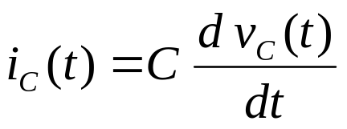
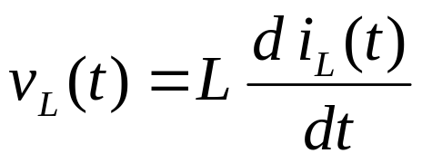
RLC Characteristics
Element | V/I Relation | DC Steady-State
Resistor |  | V = I R
Capacitor |  | I = 0; open
Inductor |  | V = 0; short
ELI and the ICE man

Slide 4
A First-Order RC Circuit
v_{r}(t)
+
–
R
+
+
–
v_{s}(t)
C
v_{c}(t)
–
One capacitor and one resistor in series
The source and resistor may be equivalent to a circuit with many resistors and sources

Slide 5
The Differential Equation
v_{r}(t)
+
–
R
+
+
–
v_{s}(t)
C
v_{c}(t)
–
KVL around the loop:
v_{r}(t) + v_{c}(t) = v_{s}(t)

Slide 6
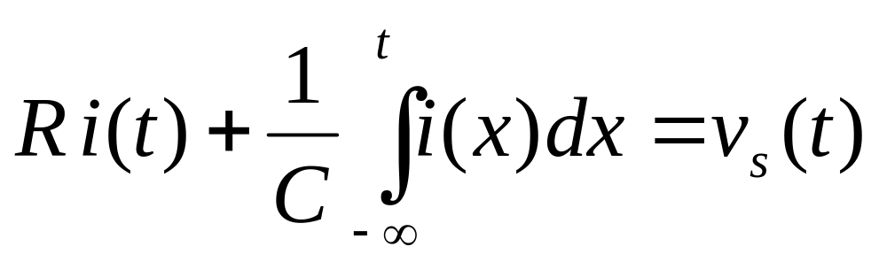
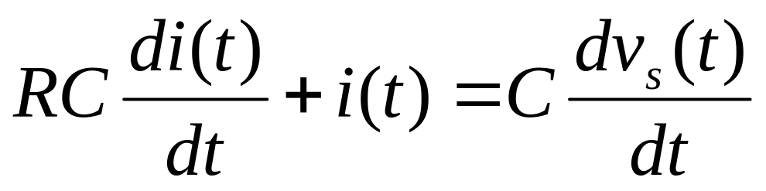
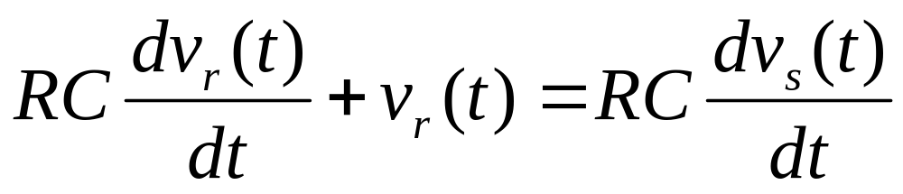
RC Differential Equation(s)
From KVL:
Multiply by C;
take derivative
Multiply by R;
note v_{r}=R·i

Slide 7
A First-Order RL Circuit
+
i_{s}(t)
R
L
v(t)
–
One inductor and one resistor in parallel
The current source and resistor may be equivalent to a circuit with many resistors and sources

Slide 8
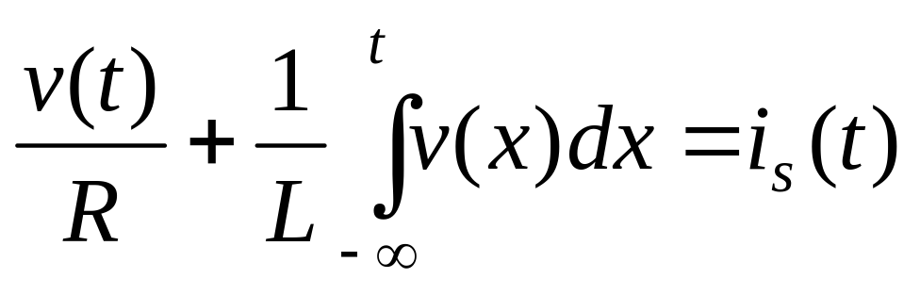
The Differential Equations
+
i_{s}(t)
R
L
v(t)
–
KCL at the top node:

Slide 9
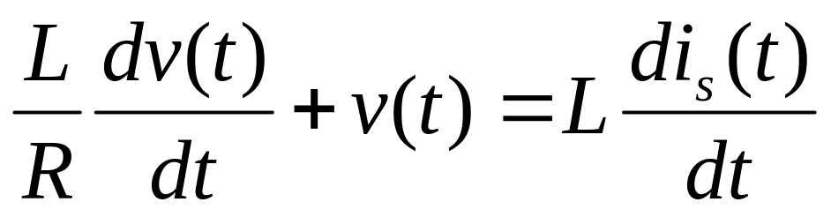
RL Differential Equation(s)
From KCL:
Multiply by L;
take derivative

Slide 10
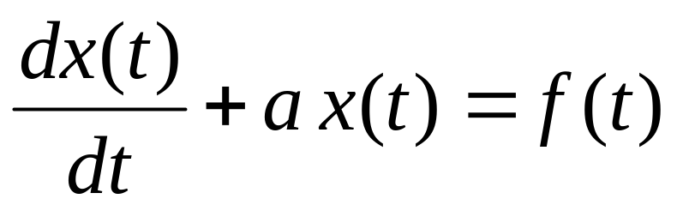
1st Order Differential Equation
Voltages and currents in a 1st order circuit satisfy a differential equation of the form
where f(t) is the forcing function (i.e., the independent sources driving the circuit)

Slide 11
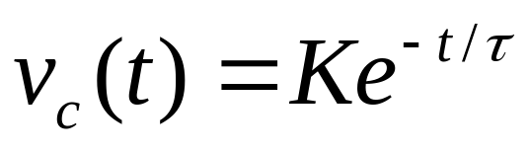
The Time Constant (τ)
The complementary solution for any first order circuit is
For an RC circuit, τ = RC
For an RL circuit, τ = L/R
Where R is the Thevenin equivalent resistance

Slide 12
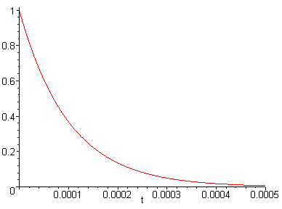
What Does v_{c}(t) Look Like?
τ = 10⁻⁴

Slide 13
Interpretation of τ
The time constant, τ, is the amount of time necessary for an exponential to decay to 36.7% of its initial value
-1/τ is the initial slope of an exponential with an initial value of 1

Slide 14
Applications Modeled by a 1st Order RC Circuit
The windings in an electric motor or generator
Computer RAM
  A dynamic RAM stores ones as charge on a capacitor
  The charge leaks out through transistors modeled by large resistances
  The charge must be periodically refreshed

Slide 15
Important Concepts
The differential equation for the circuit
Forced (particular) and natural (complementary) solutions
Transient and steady-state responses
1st order circuits: the time constant (τ)
2nd order circuits: natural frequency (ω₀) and the damping ratio (ζ)

Slide 16
The Differential Equation
Every voltage and current is the solution to a differential equation
In a circuit of order n, these differential equations have order n
The number and configuration of the energy storage elements determines the order of the circuit
n ≤ number of energy storage elements

Slide 17
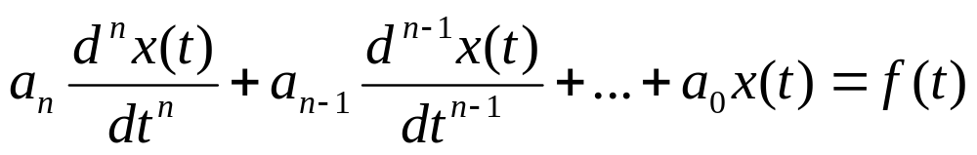
The Differential Equation
Equations are linear, constant coefficient:
The variable x(t) could be voltage or current
The coefficients a_{n} through a₀ depend on the component values of circuit elements
The function f(t) depends on the circuit elements and on the sources in the circuit

Slide 18
Building Intuition
Even though there are an infinite number of differential equations, they all share common characteristics that allow intuition to be developed:
  Particular and complementary solutions
  Effects of initial conditions

Slide 19
Differential Equation Solution
The total solution to any differential equation consists of two parts:
x(t) = x_{p}(t) + x_{c}(t)
Particular (forced) solution is x_{p}(t)
  Response particular to a given source
Complementary (natural) solution is x_{c}(t)
  Response common to all sources, that is, due to the “passive” circuit elements

Slide 20
Forced (or Particular) Solution
The forced (particular) solution is the solution to the non-homogeneous equation:
The particular solution usually has the form of a sum of f(t) and its derivatives
  That is, the particular solution looks like the forcing function
  If f(t) is constant, then x(t) is constant
  If f(t) is sinusoidal, then x(t) is sinusoidal

Slide 21
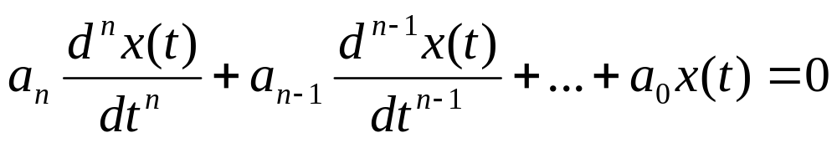
Natural/Complementary Solution
The natural (or complementary) solution is the solution to the homogeneous equation:
Different “look” for 1st and 2nd order ODEs

Slide 22
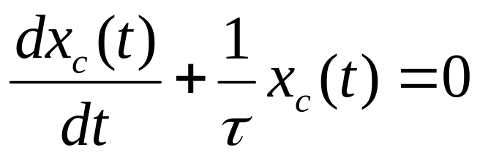

First-Order Natural Solution
The first-order ODE has a form of
The natural solution is
Tau (τ) is the time constant
    For an RC circuit, τ = RC
    For an RL circuit, τ = L/R

Slide 23
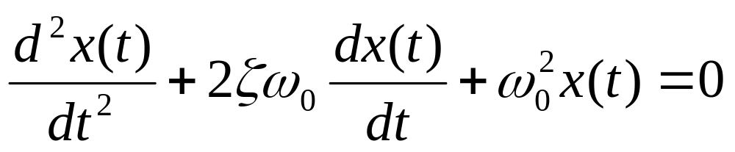
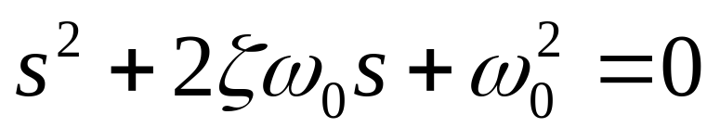
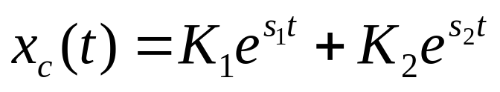
Second-Order Natural Solution
The second-order ODE has a form of
To find the natural solution, we solve the characteristic equation:
which has two roots: s₁ and s₂
The complementary solution is (if we’re lucky)

Slide 24
Initial Conditions
The particular and complementary solutions have constants that cannot be determined without knowledge of the initial conditions
The initial conditions are the initial value of the solution and the initial value of one or more of its derivatives
Initial conditions are determined by initial capacitor voltages, initial inductor currents, and initial source values

Slide 25
2nd Order Circuits
Any circuit with a single capacitor, a single inductor, an arbitrary number of sources, and an arbitrary number of resistors is a circuit of order 2
Any voltage or current in such a circuit is the solution to a 2nd order differential equation

Slide 26
A 2nd Order RLC Circuit
i (t)
R
+
–
v_{s}(t)
C
L
The source and resistor may be equivalent to a circuit with many resistors and sources

Slide 27
The Differential Equation
i(t)
v_{r}(t)
+
–
R
+
+
–
C
v_{c}(t)
v_{s}(t)
v_{l}(t)
–
–
+
L
KVL around the loop:
v_{r}(t) + v_{c}(t) + v_{l}(t) = v_{s}(t)

Slide 28
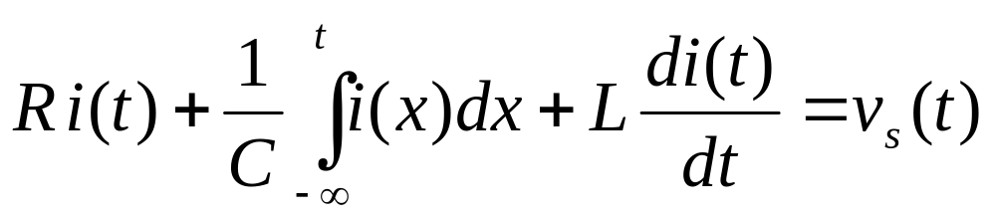
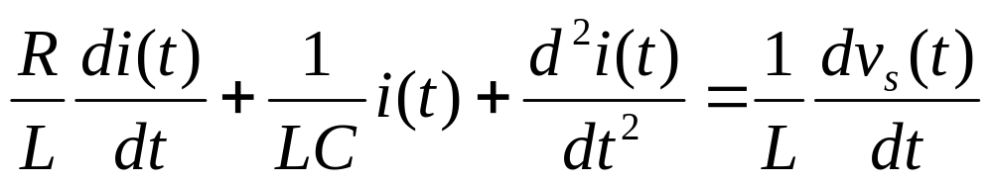
RLC Differential Equation(s)
From KVL:
Divide by L, and take the derivative

Slide 29
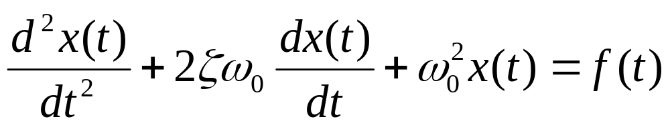
The Differential Equation
Most circuits with one capacitor and inductor are not as easy to analyze as the previous circuit. However, every voltage and current in such a circuit is the solution to a differential equation of the following form:

Slide 30
Class Examples
Drill Problems P6-1, P6-2
Suggestion: print out the two-page “First and Second Order Differential Equations” handout from the class webpage

