Slide 1
Tech Symposium 2016
Workshop on elasticsearch
(Vipul Ranjan and ICRD team)

Slide 2
What we will do in the workshop (1) – 15 minutes
Elasticsearch basics – 101 for elasticsearch

Slide 3
What we will do in the workshop (2) – 15 minutes
Workshop setup
Start elastic engine
Use elastic head to see the status of elastic engine

Slide 4
What we will do in the workshop (3) – 15 minutes
Index sample data into elastic
View the added data through elastichead

Slide 5
What we will do in the workshop (4) – 30 minutes
Access the data programmatically
Write more sophisticated queries

Slide 6
What data are we going to use in the workshop
We have generated fake data for few companies, their employees and their stock prices

Slide 7
Elasticsearch basics

Slide 8

Search is cool
Why do we need search?
Users get relevant data faster. Life gets easier and happier ☺

Slide 9
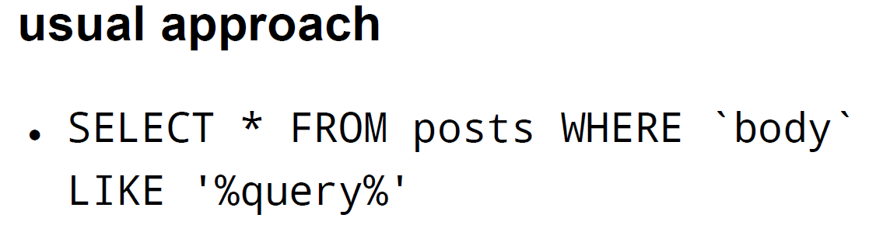
Search in traditional applications
Databases are great to store data. However, when it comes to search, retrieving data in traditional manner falls short of expectations.
Delink storage engine with search engine

Slide 10
Needs of our users
Users want to quickly search the data
Users want to get similar sounding results in search
Users want analytics on the fly
Users want google like autosuggest
Add a layer of search engine to our applications

Slide 11
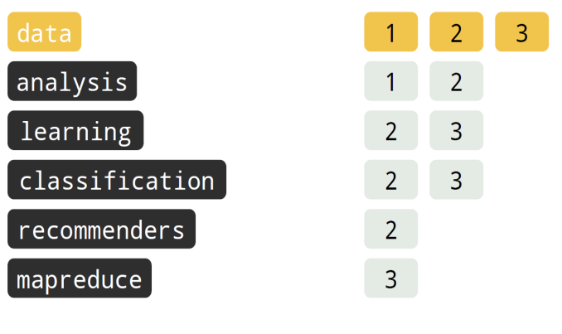
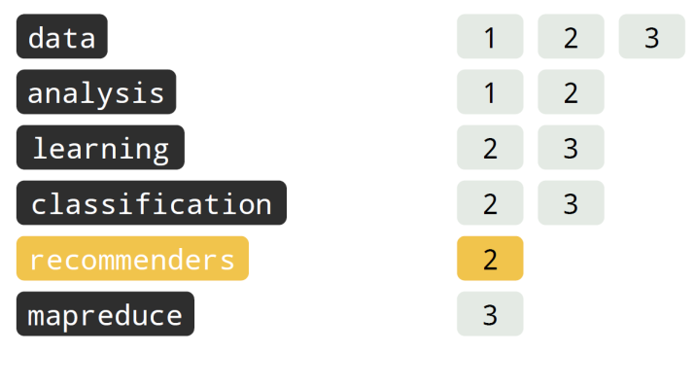
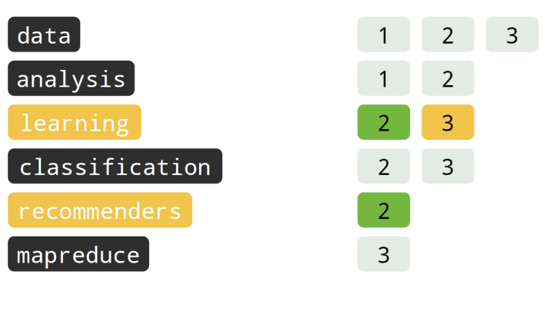
How do search engines work
document 1: flexible and powerful open source, distributed realtime data search and analytics engine for the cloud help in analysis...
document 2: Apache Mahout has implementations of a wide range of machine learning and data analysis, classification, recommenders...
document 3: Our core data learning algorithms for clustering, classification and batch based collaborative filtering are implemented on top of Apache Hadoop using the MapReduce...
Inverted indexes are key to search engines. Essential for ranking algorithms.

Slide 12
What is elasticsearch
Document oriented search engine
JSON based, Apache Lucene
Schema Free
Yet enables control of it when needed
Distributed
Scales Up+Out, Highly Available
Multi-tenancy
Dynamically create/delete indices
API centric & RESTful
Most functionality is exposed through an API
elasticsearch enables our traditional applications to be search ready in an easy, quick and cost effective manner

Slide 13
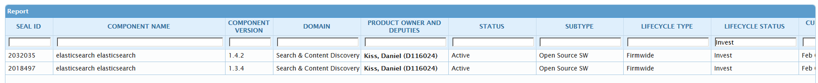
Why elasticsearch
Easy to deploy (minimum configuration)
Scales vertically and horizontally
Easy to use API
Modules for most programming/scripting languages
Provides various features auto-suggest, fuzzy logic search, analytics support out of the box
Short learning curve considering all the complexities are managed behind the scene
Actively developed with good online documentation
It’s free
Used by github, mozilla, soundcloud, stack overflow, foursquare, stumbleupon
Invest mode in SEAL
Elastic search is proven technology that can be leveraged by JPMorgan applications

Slide 14
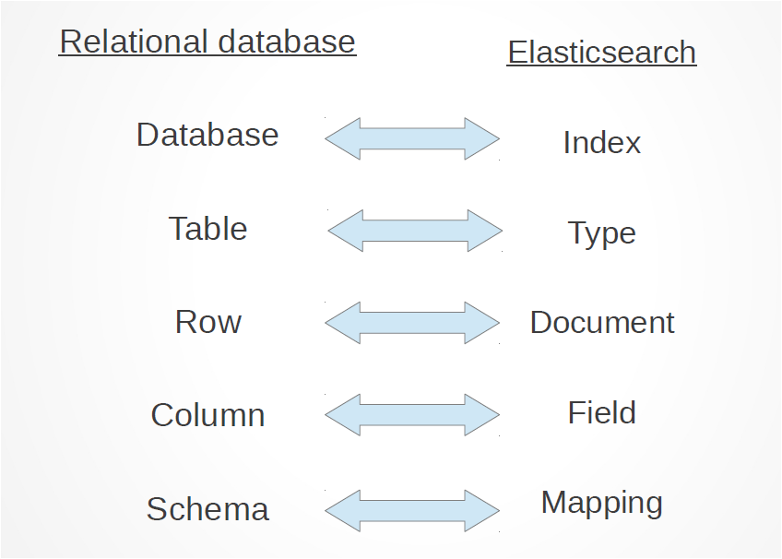
Bird’s eye view
Elastic search itself is built on top of Lucene. Lucene is
High performance, scalable, full-text search library
Focus: Indexing + Searching Documents
100% Java, no dependencies, no config files
No crawlers or document parsing
Users: Wikipedia, Technorati, Monster.com, Nabble, TheServerSide, Akamai, SourceForge
Applications: Eclipse, JIRA, Roller, OpenGrok, Nutch, Solr, many commercial products
Node
Shard
Index
Type
Doc
Field
Mapping
Elastic search is lots of lucene instances at your disposal at the same time

Slide 15
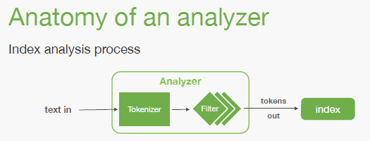
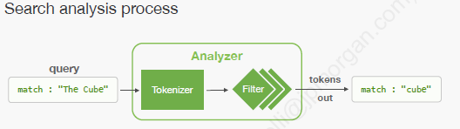
What are analyzers
Analysis is a process that consists of the following:
Tokenizers are used to break a string down into a stream of terms or tokens. A simple tokenizer might split the string up into terms wherever it encounters whitespace or punctuation.. Ex:- keyword,lowercase,ngram,edge ngram,pattern etc.
Last, Token filters accept a stream of tokens from a tokenizer and can modify tokens (eg lowercasing), delete tokens (eg remove stopwords) or add tokens (eg synonyms), ngram,edgeNgram.
Elastic provides a bunch of analyzers we can define our own custom analyzers as per the need.

Slide 16
Workshop setup

Slide 17
Download the package
https://github.com/ppesd-2016/es-demo/archive/master.zip
Download the zip from given link
Extract the zip at any location

Slide 18

Look at the package structure
Package will have contents as shown in the image
Directories of the interest are project and softwares
project – contains demo application source code that can be imported in IDE
softwares – contains all the building blocks required for local setup of elasticsearch cluster

Slide 19
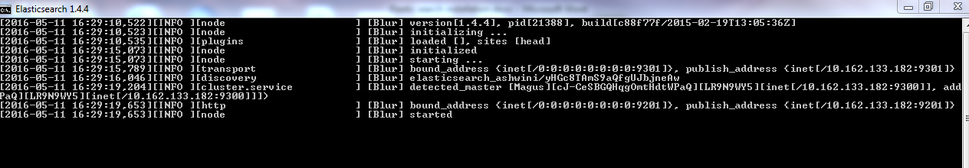
Start elastic
Elasticsearch is already downloaded as part of the package.
Go to the folder location <es-demo-master> \softwares
Unzip the elasticsearch-1.4.4.zip folder
Go inside config\elasticsearch.yml file. Change the following property at line no 32,321 respectively and un comment that line.
cluster.name: Your name or SID
discovery.zen.ping.multicast.enabled:false
Go inside bin folder and run the elasticsearch.bat file twice to start two instances of elasticsearch. Since we will be working on two nodes, we have to start two instances of elastic.

Slide 20

Cluster health
Let’s start with a basic health check, which we can use to see how our cluster is doing. To check the cluster health, we will be using the _cat API. Our node HTTP endpoint is available at port 9200
localhost:9200/_cat/health?v
We can also get a list of nodes in our cluster as follows:
localhost:9200/_cat/nodes?v
we can see our two nodes named “Blur” and “Magnus" that is currently in our cluster.

Slide 21
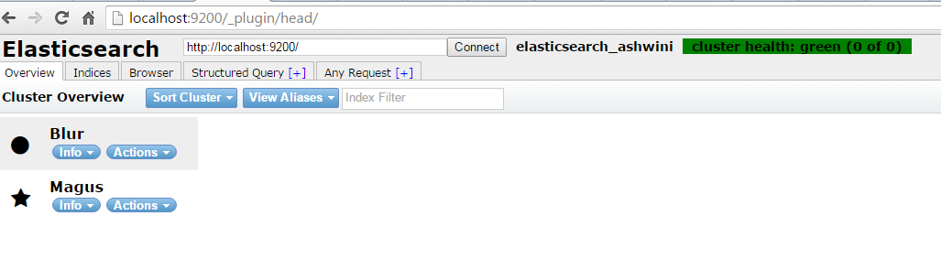
Start elasticsearch head
Run following command to setup elasticsearch head
elasticsearch-1.4.4\bin>plugin --url file:///<es-demo-master> / softwares / elasticsearch-head-master.zip --install head
You can access the elastic head using the url : http://localhost:9200/_plugin/head/

Slide 22
Load data

Slide 23
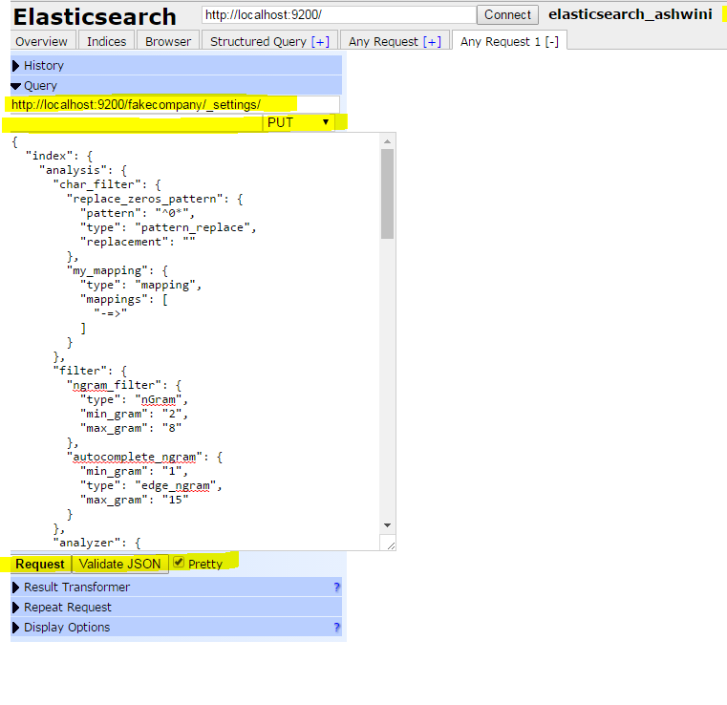
Create index called “fake_company”
1.Go to elastichead : http://localhost:9200/_plugin/head/
2.Go to Indices tab. Click on New Index. Enter the Index name as “fake_company”
3. To update the index settings, make sure to close the index first. On the Overview page, Under fake_company , Click on actions -> Close
4. Go to Any Request tab .
In the query field enter : http://localhost:9200/fake_company/_settings/
Delete the text “_search” in the text below if it is pre-populated.
Select PUT request.
Copy and paste the contents of indexSettings.json (<es-demo-master>\softwares \MappingsAndData \Mappings)
In the text box.
See following screen shot.
Click on Request.
You will see acknowledge : true in the right screen if the request was successful.
5. Once the above steps are completed, open the index. On the Overview page, Under fake_company , Click on actions -> Open

Slide 24
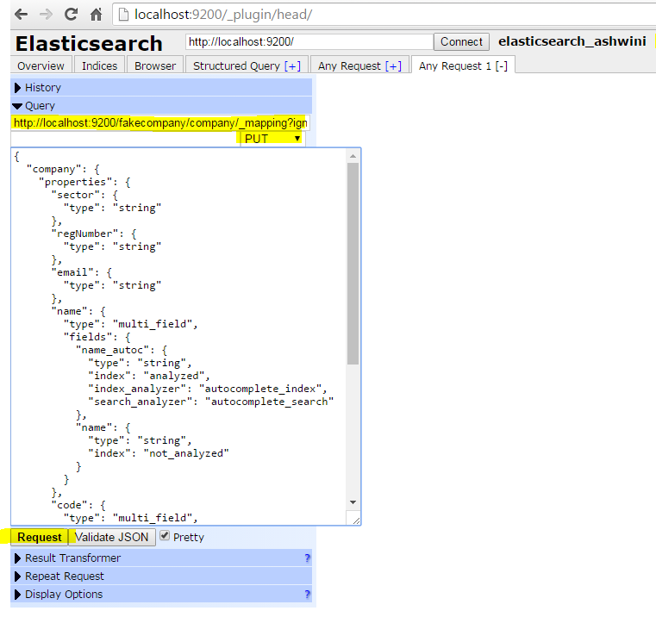
Create mappings for company, employee and stockprice data
Go to elastichead -> any request tab
In the query field enter : http://localhost:9200/fake_company/company/_mapping?ignore_conflicts=true
Select PUT request.
For mappings, go to folder location
"<es-demo-master>\softwares\MappingsAndData\Mappings
And copy the contents of companyMappingsOnly.json and enter in the text box below .
3. Click on Request.
It will create a doc type called company and updates the mapping of it.
Similarly create mappings for other types as well (employee, stockprice).
http://localhost:9200/fake_company/employee/_mapping?ignore_conflicts=true (use employee_mappings.json)
http://localhost:9200/fake_company/stock/_mapping?ignore_conflicts=true (use stock_mappings.json)

Slide 25
Load data using logstash
Data can be populated through logstash. The data to be populated is stored in a csv file. Logstash reads the csv file and populates it to elasticsearch.
Following is the configuration used by logstash. It is saved in testCompany.conf file
input {
file {
path => "<es-demo-master>\softwares\MappingsAndData\ es_demo_data\test_company.csv"
start_position => "beginning"
}
}
filter {
csv {
columns => ["code","name","url","email","sector","regNumber"] //define the columns
separator => ","
}
}
output {
elasticsearch {
protocol => http
index => "fake_company" //index name
document_type => "company" //document type
host => "localhost:9200" //populates data to your local elastic instance
}
stdout { codec => rubydebug }
}

Slide 26
Steps to populate data by logstash
1. Go to command prompt.
2. Go to logstash bin location
<es-demo-master>\softwares\logstash-1.5.0\bin
Ex:- to verify for logstash is working as expected:
logstash -e 'input { stdin { } } output { stdout {} }'
3. Type the below cmd to start populating data.
logstash –f <es-demo-master>\softwares\MappingsAndData\es_demo_data\testCompany.conf
4. The command will read the contents of conf file. In this conf file, logstash looks for input { } where we have specified the csv file that it has to read.
5. So the logstash reads the contents of csv file and starts populating elastic.
6. The data that is being populated can be seen on the command prompt.
7. Once all the data is populated, press Ctrl+C to terminate the process, so that we can run other commands to populate employee and stockprice data in the same window.
Similarly to populate data for employee and stockprice run the following cmd.
logstash –f <es-demo-master>\softwares\MappingsAndData\es_demo_data\testEmployee.conf
logstash –f <es-demo-master>\softwares\MappingsAndData\es_demo_data\testStockPrice.conf

Slide 27
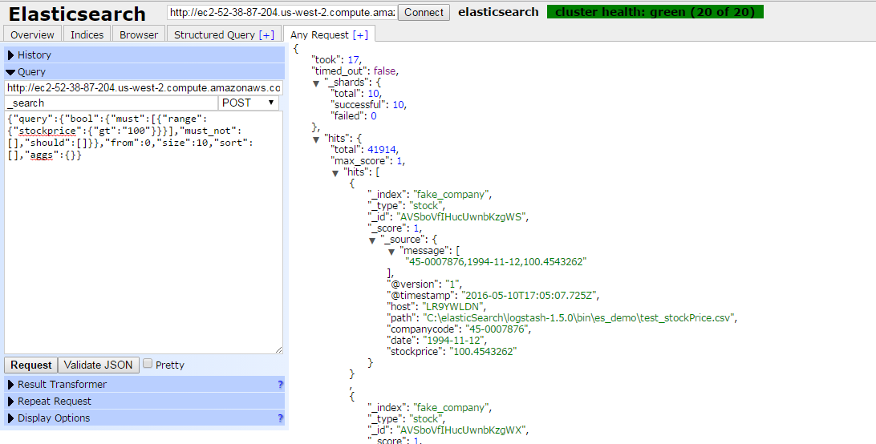
Search the data using elastic head
1. Select Any Request
2. Enter query
3. Click on Request
Query to get company
{"query":{"bool":{"must":[{"query_string":{"default_field":"company.code.code_autoc","query":"74-0002552"}}],"must_not":[],"should":[]}},"from":0,"size":10,"sort":[],"aggs":{}}
Query to get employee
{"query":{"bool":{"must":[{"query_string":{"default_field":"employee.fullname.fullname_autoc","query":"Jam"}}],"must_not":[],"should":[]}},"from":0,"size":10,"sort":[],"aggs":{}}
Query to get stock price
{"query":{"bool":{"must":[{"range":{"stockprice":{"gt":"100"}}}],"must_not":[],"should":[]}},"from":0,"size":10,"sort":[],"aggs":{}}

Slide 28
Accessing elasticsearch through java

Slide 29
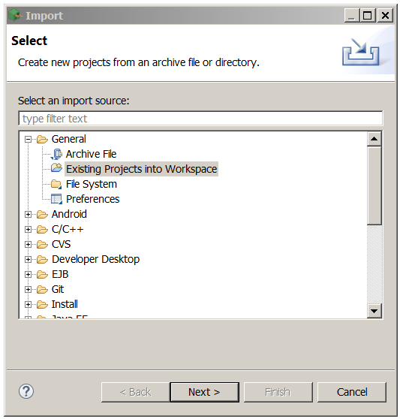
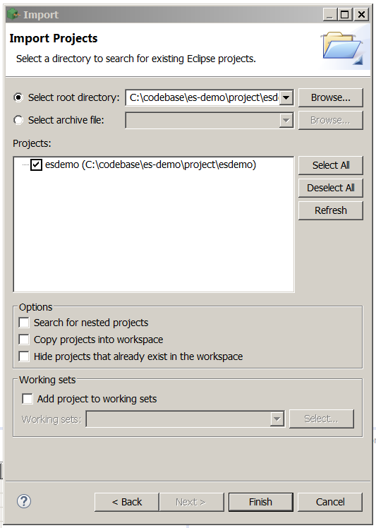
Java code structure
Import demo project into eclipse, project can be found under /es-demo/project/esdemo
Select the directory where project resides on the machine
Import existing project

Slide 30
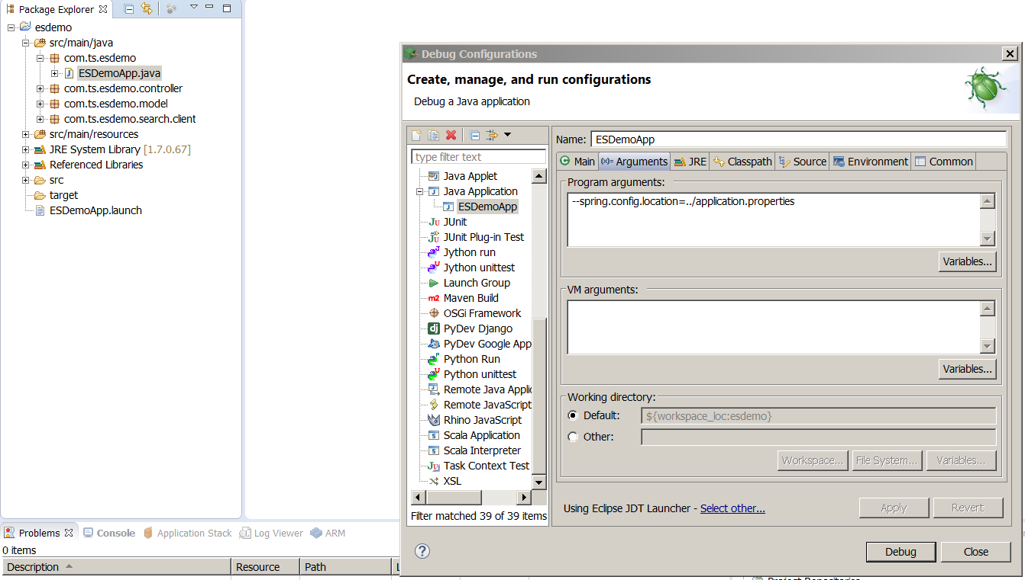
Running the application
Application stack - spring boot, freemarker template engine, HTML5 and bootstrap
Project comes with most of the well-defined settings
Libraries and application.properties required by the application are one level up @ /es-demo/project, update elasticsearch.cluster.name property with the cluster name you have given during elastic setup
Application entry point
Launch configuration automatically loaded
Hit the button

Slide 31
Running the application
On successful startup, application can be accessed @
http://localhost:8888/es/welcome
Embedded tomcat is used as container, app logs (esdemo_app.log) can be found at
Windows - %TEMP%
Unix - /tmp
Alternatively,
Application has been deployed over amazon cloud @
http://ec2-52-38-87-204.us-west-2.compute.amazonaws.com:8888/es/welcome

Slide 32
Transport client
Two ways to interact with ES
1) HTTP REST API
- best suited for inter-operability
2) Native binary protocol
- Java based API shipped with ES library
- Two ways to establish connection to ES cluster, as node client or transport client
In ES demo app, we are going with transport client approach
Transport client doesn’t join cluster (utilizes resources of application JVM which interacts with ES) unlike node client which joins the cluster as non data node, establishes channel to the data nodes and data nodes establishes the channels back to client node. Hence transport client is ideal in situations where we perform short lived frequent operations, where as node client can be used when we need long lived persistent connections.
Joining/leaving of transport client has minimal impact on cluster states or data nodes, whereas in case of client node it has to be kept updated with cluster states and when it leaves the cluster all the data nodes and cluster state gets impacted due to two way channel establishment.

Slide 33
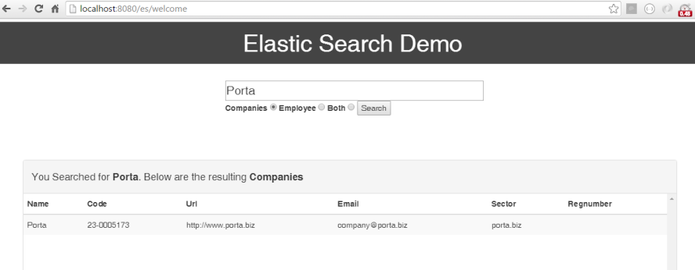
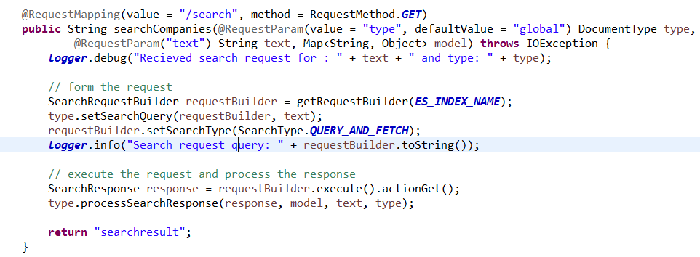
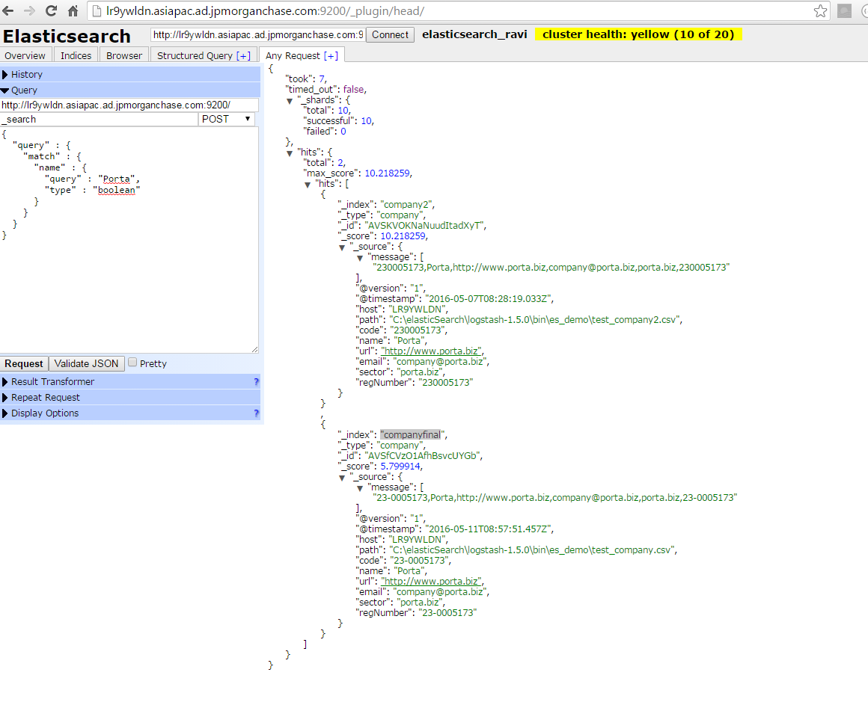
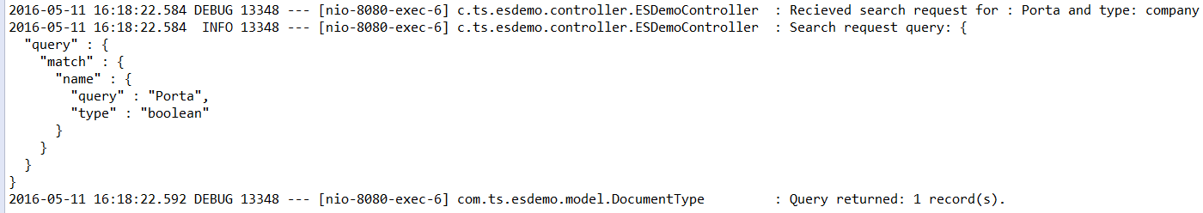
Use case 1 - Company search
Select Companies radio button and search for Porta
Java service- type company
Search in elastic head – same index fake_company
{
"query" : {
"match" : {
"name" : {
"query" : "Porta",
"type" : "boolean"
}
}
}
}
Search Query and Number of records returned from search- Java Logs

Slide 34
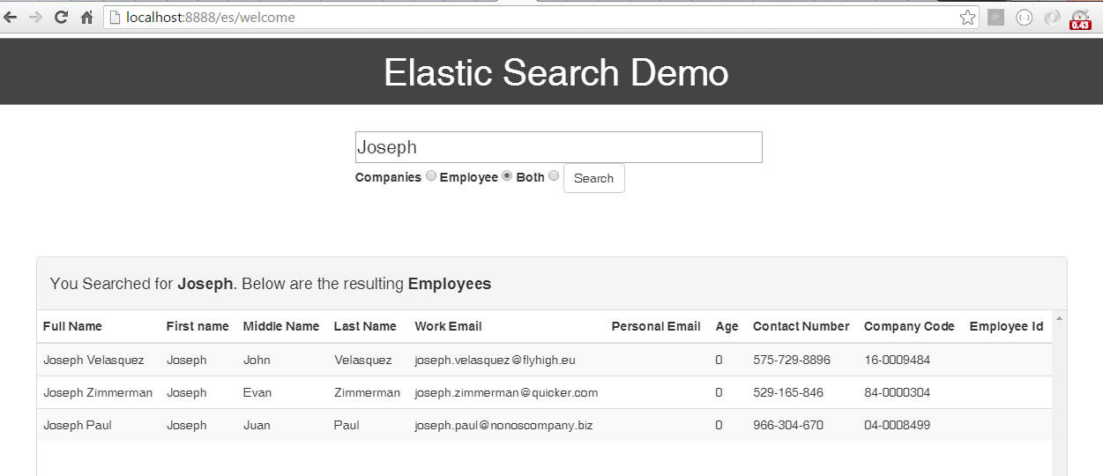
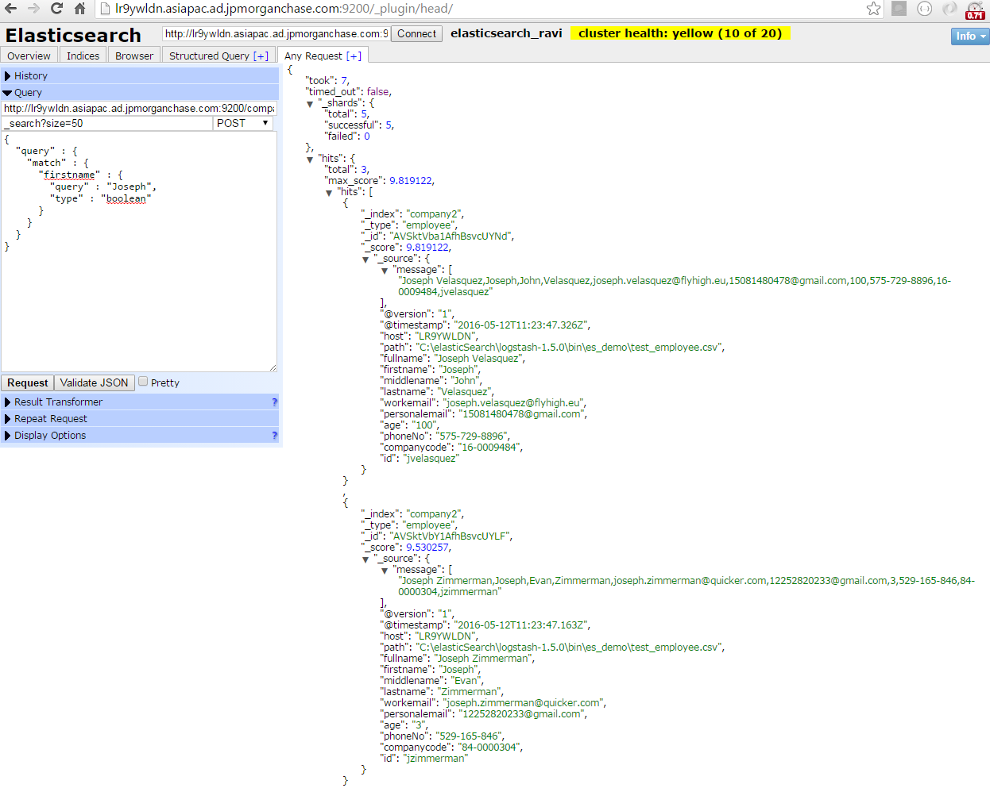
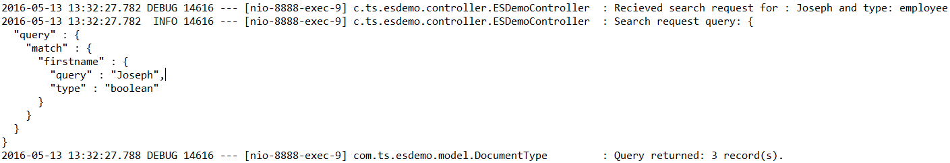
Use case 2 - Employee search
Select Employee radio button and search for Joseph
Java service- type employee
Search in elastic head – same index fake_company
{
"query" : {
"match" : {
"firstname" : {
"query" : "Joseph",
"type" : "boolean"
}
}
}
}
Search Query and Number of records returned from search- Java Logs

Slide 35
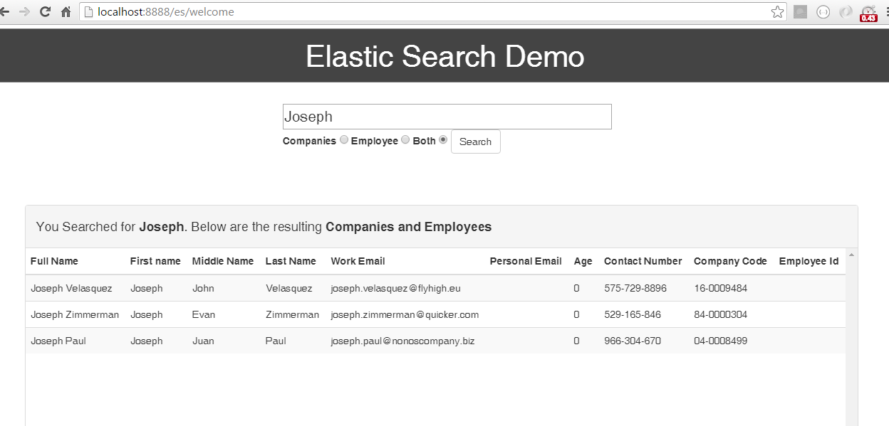
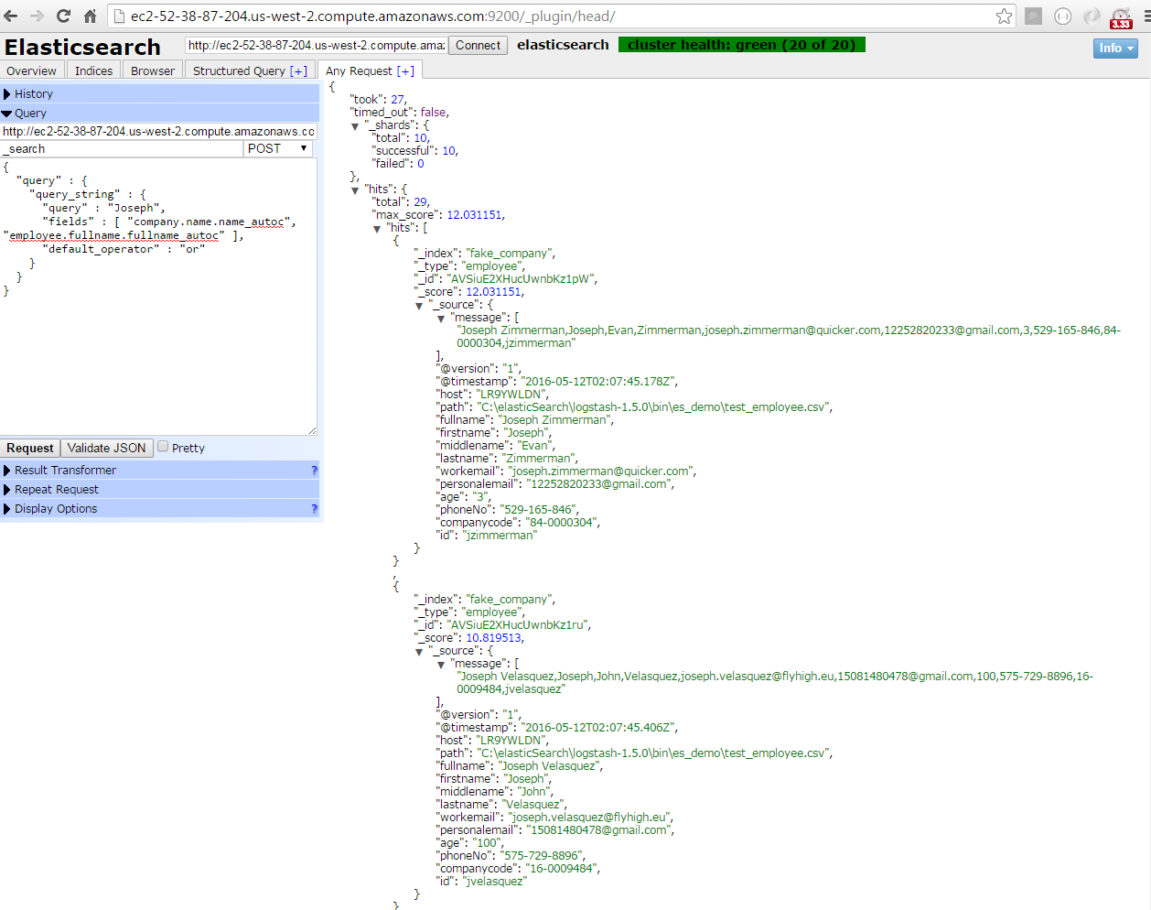
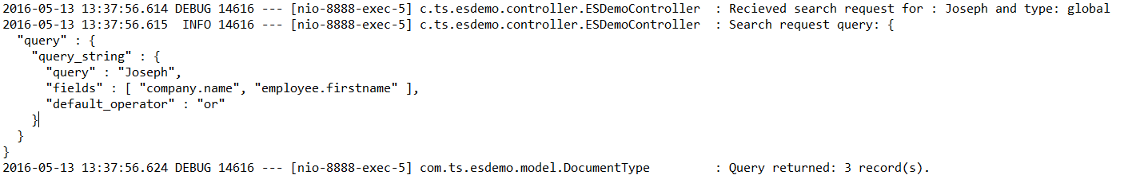
Use case 3 - Global search
Select Both radio button and search for Joseph
Java service- type is global
Search in elastic head – same index fake_company
{
"query" : {
"query_string" : {
"query" : "Joseph",
"fields" : [ "company.name", "employee.firstname" ],
"default_operator" : "or"
}
}
}
Search Query and Number of records returned from search- Java Logs

Slide 36
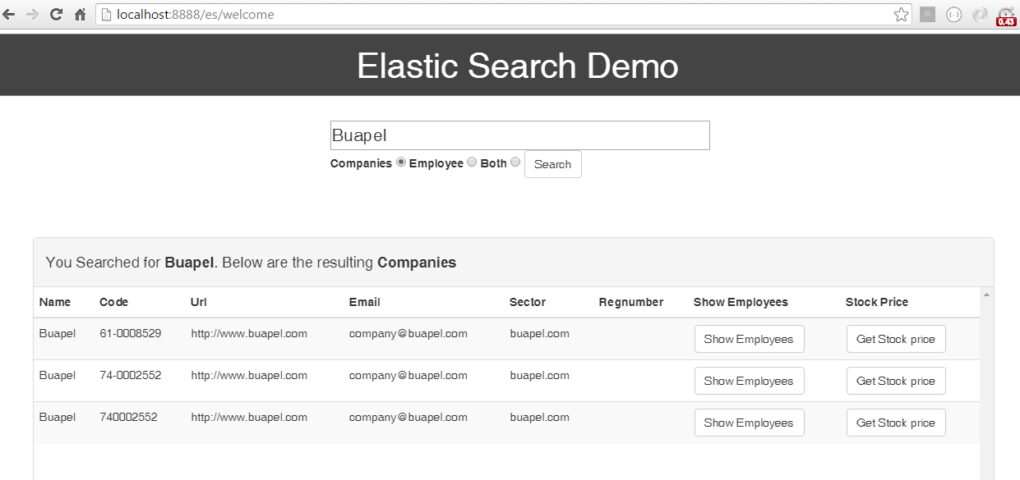
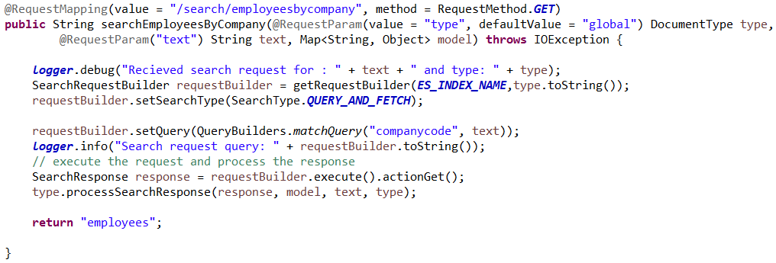
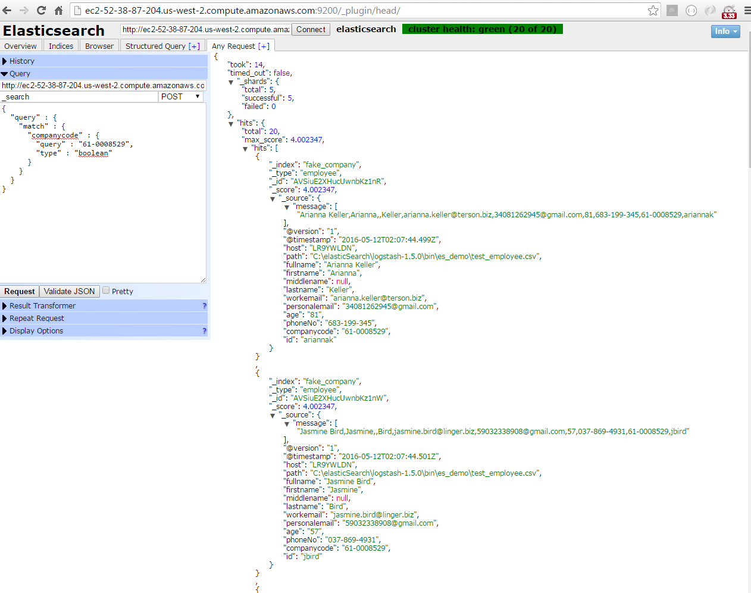
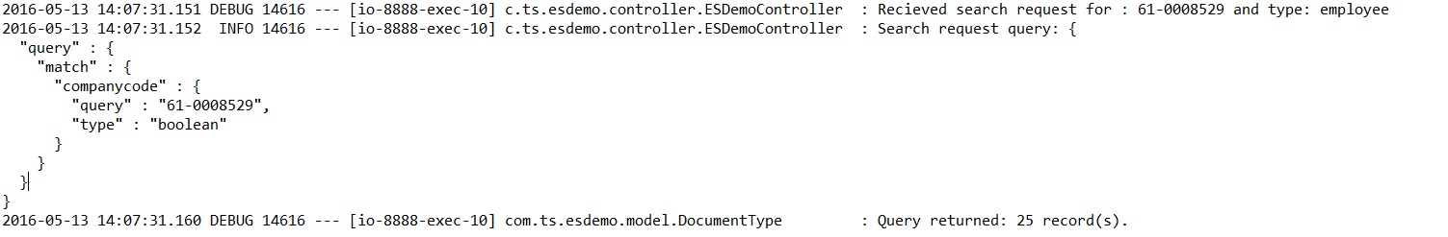
Use case 4- Search All Employees
Search for company Buapel and
click on show Employees
Java service- type is employee
Search in elastic head – same index fake_company
{
"query" : {
"match" : {
"companycode" : {
"query" : "61-0008529",
"type" : "boolean"
}
}
}
}}
Search Query and Number of records returned from search- Java Logs

Slide 37
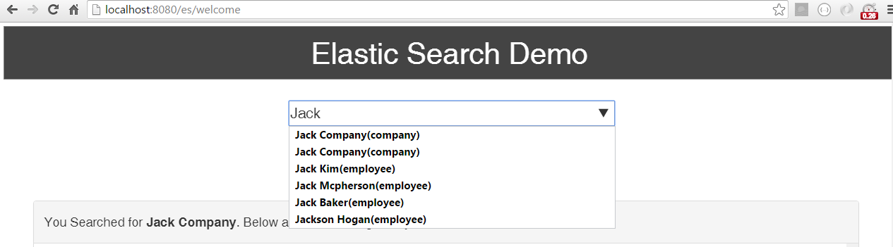
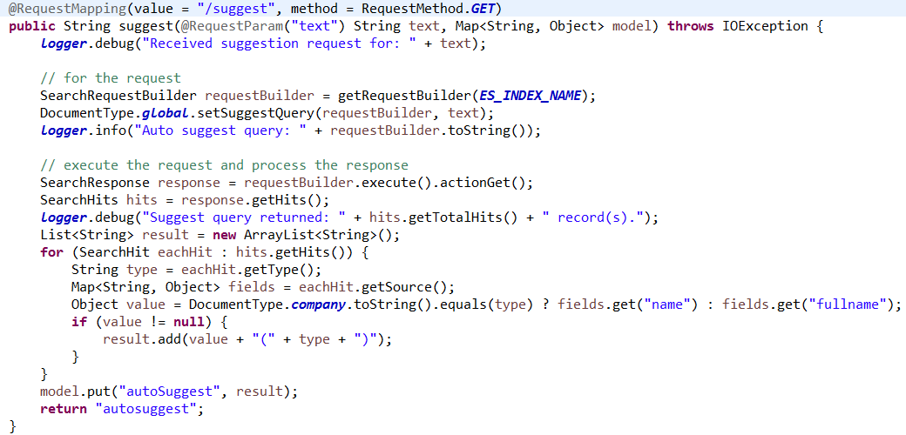
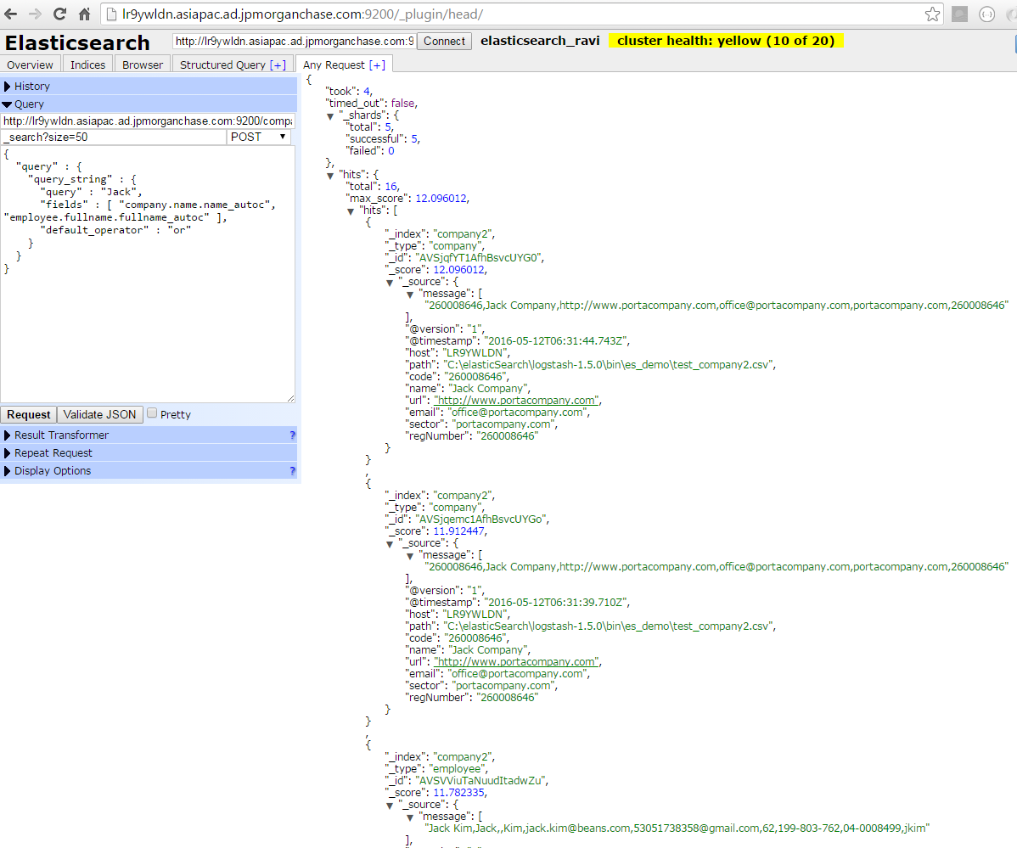
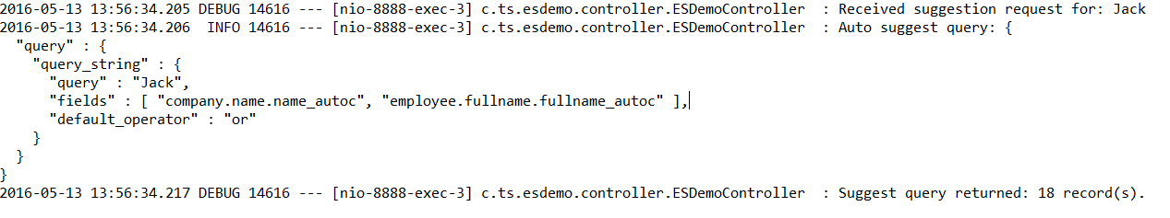
Use case 5 - Autosuggest search
In global search type Jack
Java controller for suggest
Search in elastic head – same index fake_company
{
"query" : {
"query_string" : {
"query" : "Jack",
"fields" : [ "company.name.name_autoc", "employee.fullname.fullname_autoc" ],
"default_operator" : "or"
}
}
}
Search Query and Number of records returned from search- Java Logs

Slide 38
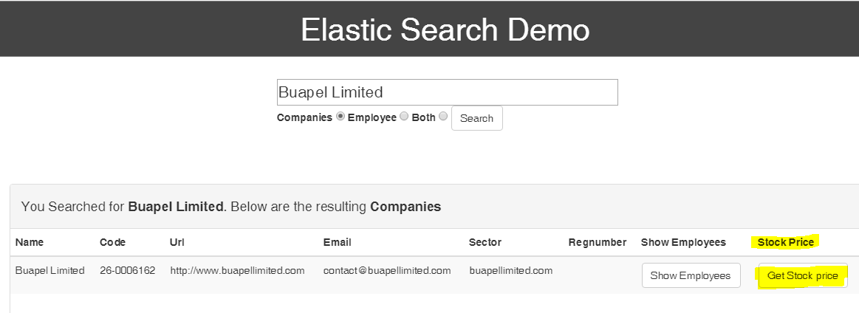
Use case 6 : Stock price search
The elastic query used to perform stock price search by company is :
{
"from": 0,
"size": 5000,
"query": {
"match": {
"companycode": {
"query": "26-0006162",
"type": "boolean"
}
}
}
}.
The Java method : searchStockpriceByCompany() in EsDemoController.java

Slide 39
Use case 7 : Fuzzy Search
Fuzzy matching treats two words that are “fuzzily” similar as if they were the same word.
For eg, if the company “Quickr Ltd” is misspelled as “Qickrr Ltd”, then elasticsearch has the capability to return the docs that matches the company with a maximum edit distance of 2. So in this case,
User enters text : Qickrr Ltd
1st edit : Qickr Ltd – removes r
2nd edit: Quickr Ltd - inserts the character u
So the new text is Quickr Ltd
It can also edit as follows,
1st edit : Qicker Ltd – replaces r with e
2nd edit: Quicker Ltd - inserts the character u
So the new text is Quicker Ltd
So two companies “Quicker Ltd “ and “Quickr Ltd“ that matches the search will be returned.

Slide 40
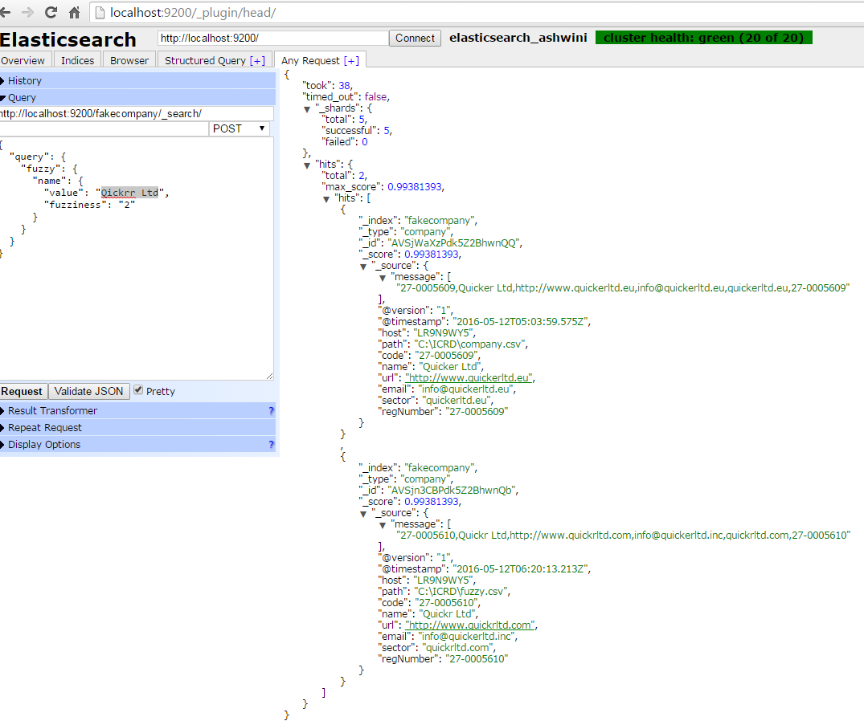
Fuzzy Query :
Request url : http://localhost:9200/fakecompany/company/_search/
Elasticsearch query :
{
"query": {
"fuzzy": {
"name": {
"value": "Qickrr Ltd",
"fuzziness": "2"
}
}
}
}

Slide 41


